Slide 1





Data weighting, and dealing with earthquakes and other non-linear motions
M. Floyd K. Palamartchouk
Massachusetts Institute of Technology Newcastle University
GAMIT-GLOBK course
University of Bristol, UK
12–16 January 2015
Material from R. King, T. Herring, M. Floyd (MIT) and S. McClusky (now ANU)

Slide 2
Outline
Previous lecture showed simple time series models
  Linear rate
  Seasonal terms
  Temporally correlated noise
Perturbations to such model include
  Discontinuities due to equipment or environment changes
  Discontinuities due to earthquakes
  Non-linear motions due to earthquakes
  Non-linear motions due to transient events (e.g. volcanic inflation episodes)
Recommended implementation

Slide 3
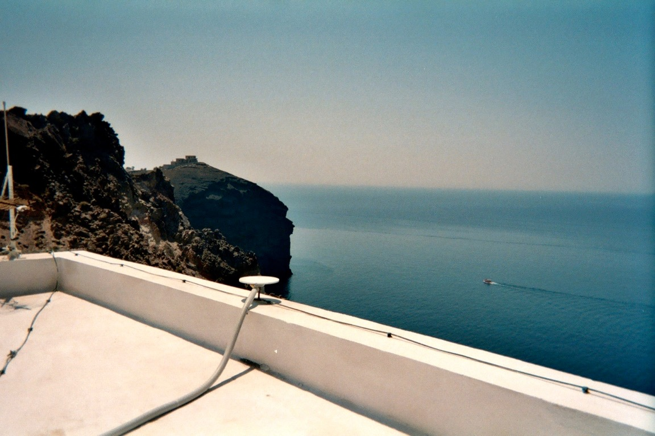
Changes to equipment
Antenna is main concern, although receiver may also affect continuity of calculated position
  Even antennas of the same model type may not be manufactured within acceptable geodetic tolerance
stinf_to_rename useful for creating automatic list

Slide 4
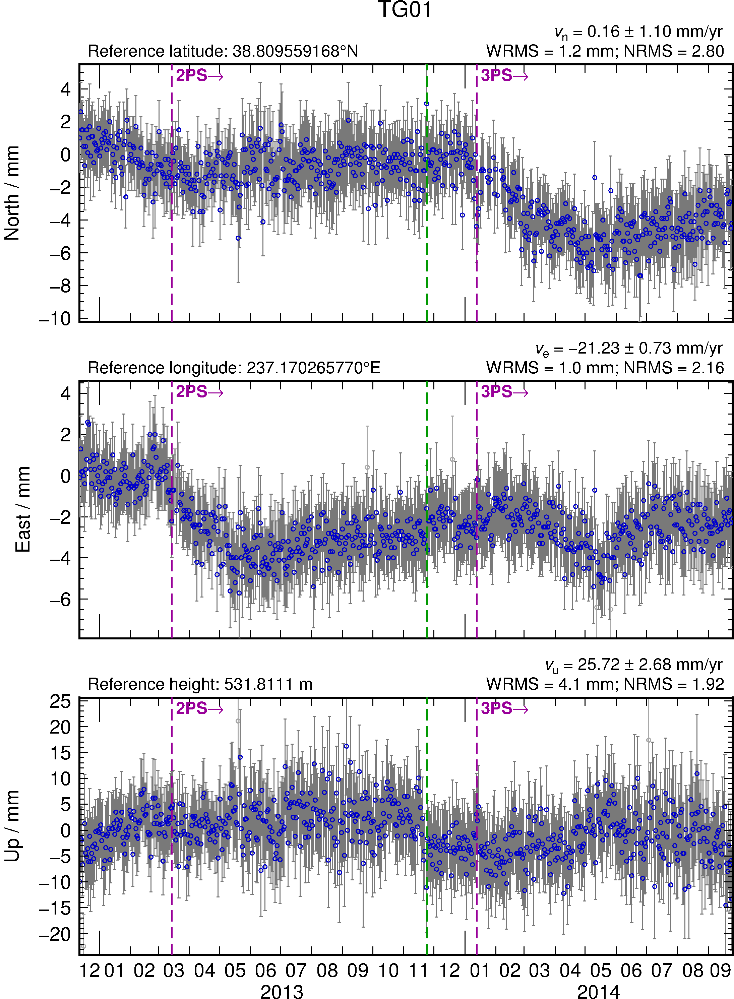
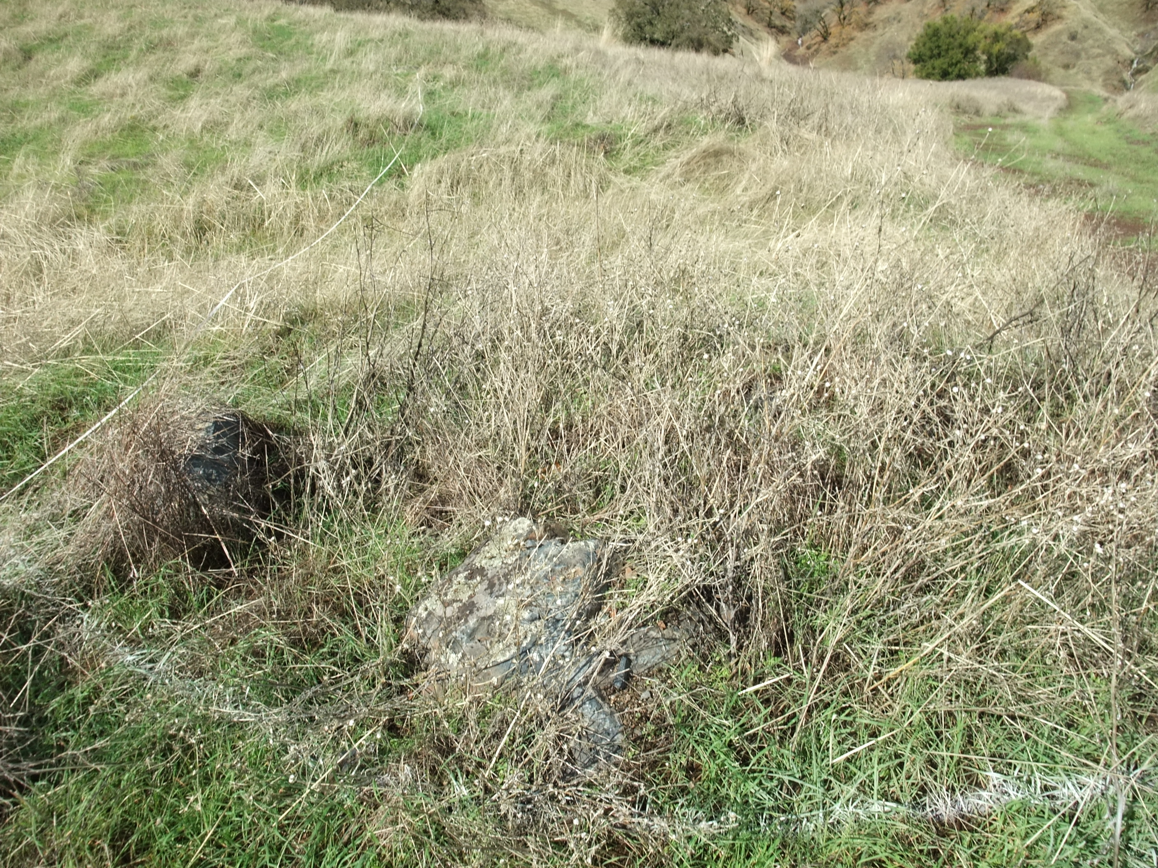
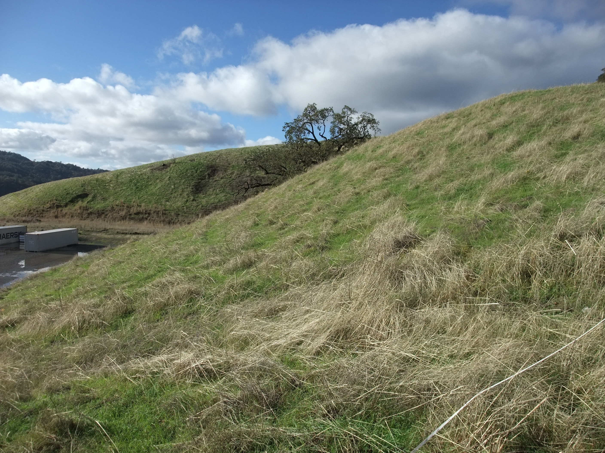
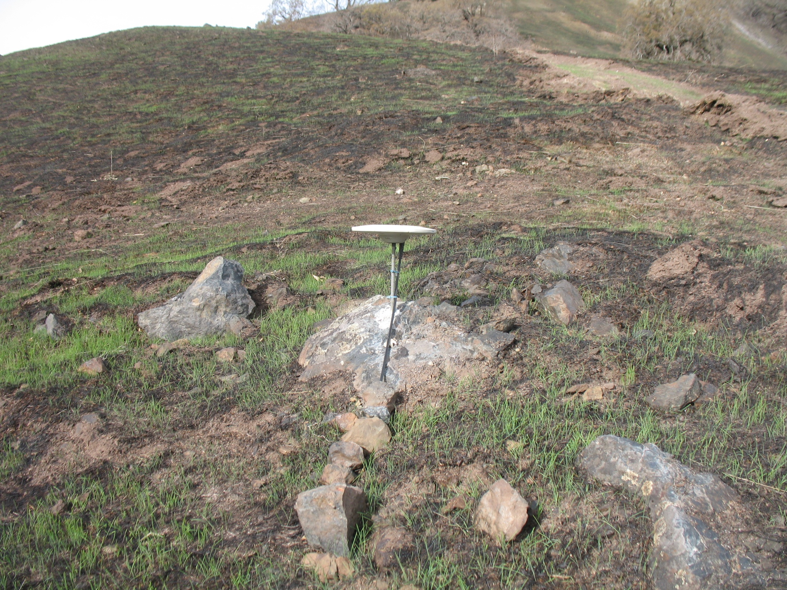
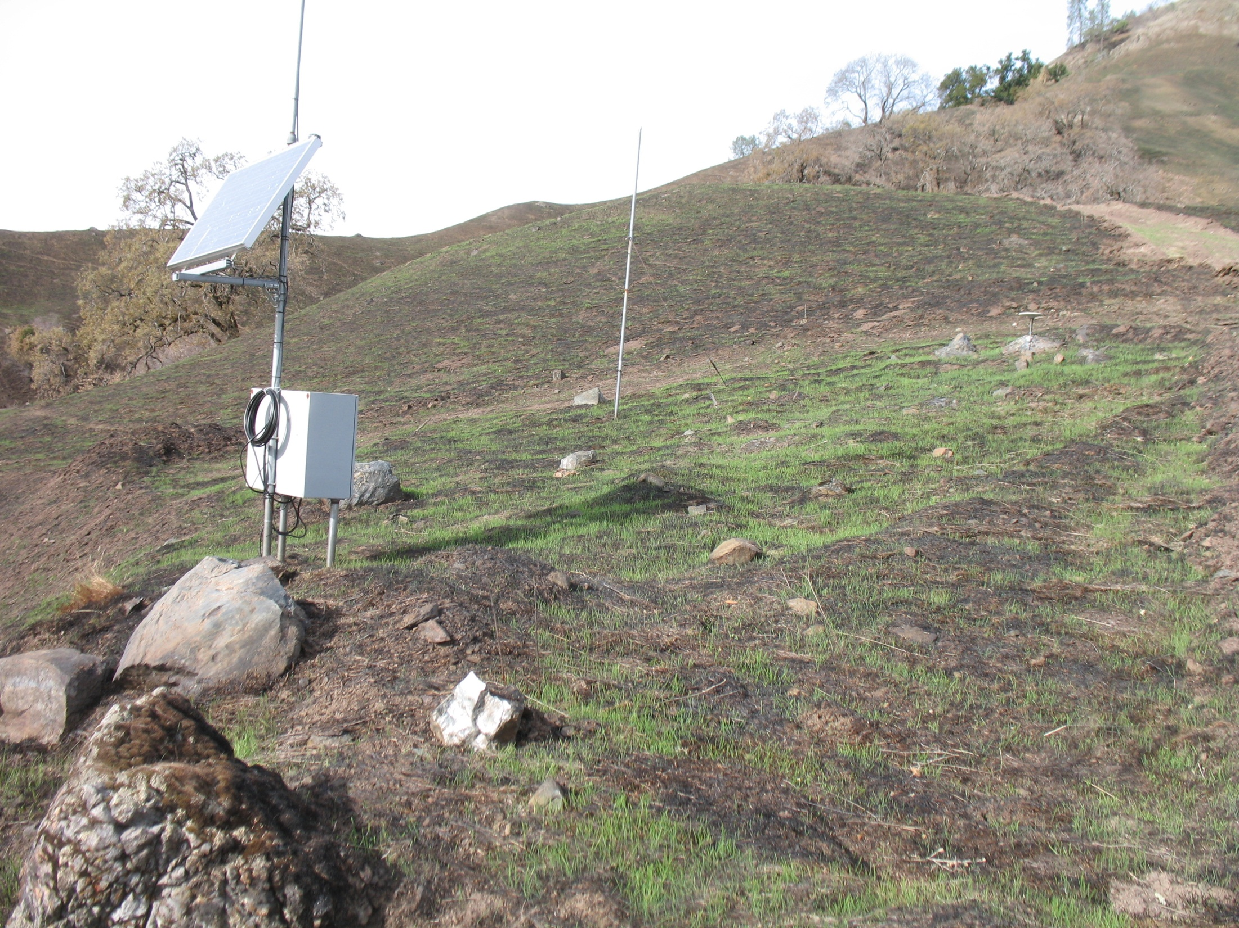
Changes in multipath environment
Photograph by M. Floyd
Photograph by M. Floyd
Photograph by R. Haught
Photograph by R. Haught
Notes:
SB4 showing November 2013 fire (http://cdfdata.fire.ca.gov/incidents/incidents_details_info?incident_id=932). GPS antenna (TG01) in upper right.

Slide 5
Rename scheme
Rename scheme uses first character of suffix
  XXXX_GPS → XXXX_2PS → XXXX_3PS → … etc.
Beyond “9PS”, convert to 10th letter of alphabet (“JPS”) and beyond
  … → XXXX_9PS → XXXX_JPS → XXXX_KPS → … etc.
  But remember “XPS” is a special case for excluding sites from globk runs
For manual renames (e.g. due to manual inspection rather than known events), use letters in alphabet before “J”
  XXXX_APS, XXXX_BPS, etc.
  But remember “GPS” is a special case (the default)

Slide 6
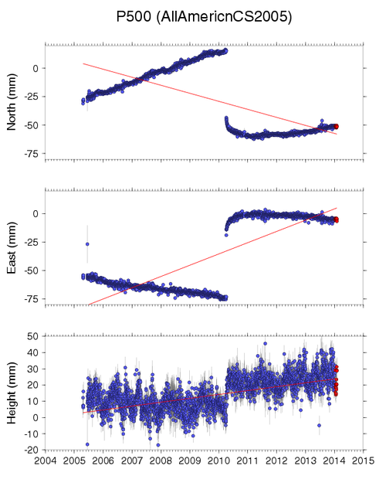
Earthquakes
Earthquakes occur at known times
May exhibit more than just discontinuity
Take care when earthquake occurs in the middle of processing day
  Some data will fall before and some after ground displacement
  Time series point on day of earthquake may appear between pre-earthquake and post-earthquake position

Slide 7
Radius of influence
eq_def line in eq-file contains earthquake ID (two characters), location, etc.
  ID is used to substitute last two characters of 8-character site name, e.g. XXXX_GPS → XXXX_GSN
sh_makeeqdef will search archives (ANSS ComCat or ISC) to generate eq_def records

Slide 8
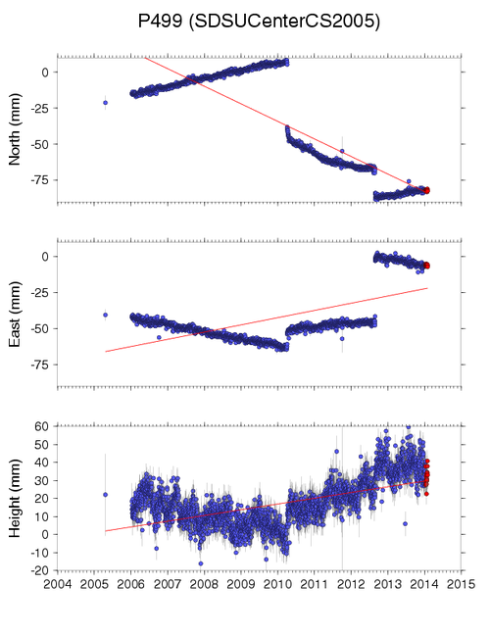
Many earthquakes…
Complications arise in a tectonically active area with multiple events
Sites may be renamed several times and therefore have various two-character suffixes
Non-linear motions may be included in apr-file with “EXTENDED” records (see globk help)

Slide 9
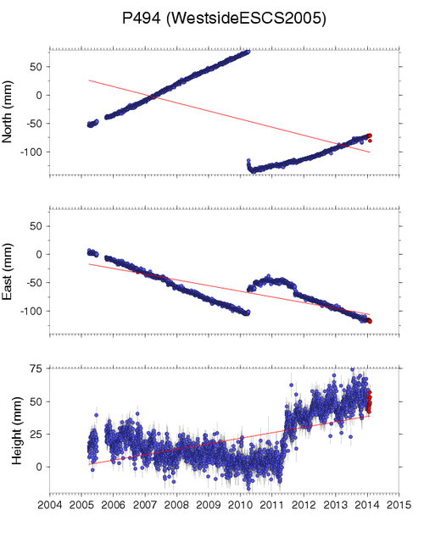
Undocumented effects
2010-04-04 M_{w}7.2
Time series inspection is very important to catch undocumented effects
Insert manually-determined discontinuities using letter for first character of suffix
?

Slide 10
tsfit
Time series fitting tool
Works on “.pos”-files
As requested, outputs
  files of residuals to fit (“.res”-files)
  “.vel”-file
  “.apr”-file
  Edits (“rename”s) file
Can perform
  Editing based on maximum sigma (max_sigma)
  Editing based on misfit as a function of sigma (nsigma)
  Estimation of periodic terms
  Estimation of discontinuities
  Estimation of post-seismic decays
eq_file my_eq_file.eq
periodic 365.2425
periodic 182.62125
max_sigma 0.01 0.01 0.03
nsigma 3
velfile my_vels.vel
out_aprf my_apr.apr
rep_edits my_edits.xcl
resroot my_prefix

