Slide 1
Extraction of atmospheric parameters
M. Floyd K. Palamartchouk
Massachusetts Institute of Technology Newcastle University
GAMIT-GLOBK course University of Bristol, UK 12–16 January 2015
Material from R. King, T. Herring, M. Floyd (MIT) and S. McClusky (now ANU)

Slide 2
Severe meteorological conditions
Other factors to consider:
Rapid change in atmospheric pressure affects (dry) hydrostatic delay (mostly function of pressure and temperature)
Low pressure reduces ZHD, possibly making site appear higher (consider position constraint)
BUT, also reduces atmospheric loading, which physically raises site position (~ 0.5 mm/hPa)
BUT, additional loading due to raised sea-level (“inverted barometer”) physically lowers site position proportionally near coasts
Heavy rainfall creates short-term, unmodelled surface loading
Storm surge creates short-term, unmodelled ocean loading
Additional loading physically lowers site position
How to deconvolve competing physical and apparent effects?

Slide 3
Impacts of extreme weather on GPS
Rainfall load (negligible unless extreme: 4 inches equivalent to 10 millibar, or 5 mm vertical displacement)
PWV
Notes:
Density of water under International Standard Atmosphere surface conditions (101325 Pa at 15°C) is 999.1026 kg/m³. Therefore 1 inch of additional surface water due to rainfall is equivalent to a change in atmospheric pressure of 2.49 millibar (using the SI value of g = 9.80665 m/s²), which may induce ~ 1.25 mm of surface displacement (~ 0.5 mm/hPa).

Slide 4
GPS for surface hydrology
Possible to use direct surface multipath signal to infer local vegetation growth and decay, soil moisture and snow depth.
http://xenon.colorado.edu/portal/

Slide 5
Challenges and Opportunities in GPS Vertical Measurements
“One-sided” geometry increases vertical uncertainties relative to horizontal and makes the vertical more sensitive to session length
For geophysical measurements the atmospheric delay and signal scattering are unwanted sources of noise
For meteorological applications, the atmospheric delay due to water vapor is an important signal; the hydrostatic delay and signal scattering are sources of noise
Loading of the crust by the oceans, atmosphere, and water can be either signal or noise
Local hydrological uplift or subsidence can be either signal or noise
Changes in instrumentation are to be avoided
Notes:
Signal prop affects show up in phase residuals – motions do not.
Any of these CAN be dominant in height estimates; also can be negligible
all also show up in horizontal
Scattering and monument instability influence site selection
Atm and loading influence modeling approach.

Slide 6
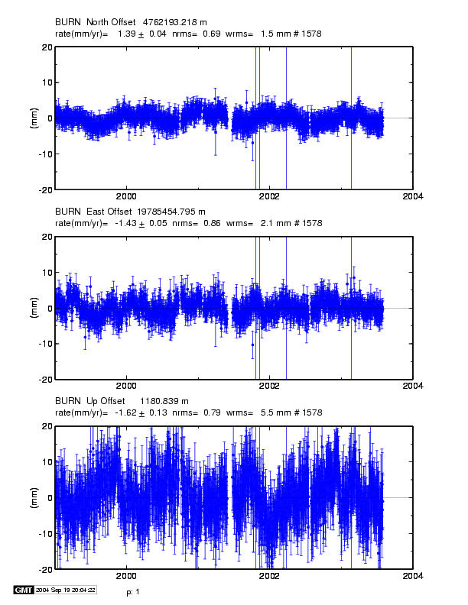
Time series for continuous station in (dry) eastern Oregon
Vertical wrms 5.5 mm, higher than the best stations. Systematics may be atmospheric or
hydrological loading,
Local hydrolology, or Instrumental effects
Notes:
Typical time series for a moderately well-behaved continuous site: eastern Oregon (low rainfaill)
2 mm horz (best are < 1 mm) 5.5 mm vertical (best are < 3 mm).
Height noise could be any combination of the four effects we’re considering .
Ignore here:
Nearly full continuous time series for BURN (4.5 yrs). Note the formal (white noise) rate uncertainties are less than 0.1 mm/yr, but the residuals are not random. We’ll compare these rates with those estimated from a 2-yr subset of the data in the next slide.

Slide 7
Effect of the Neutral Atmosphere on GPS Measurements
Slant delay = (Zenith Hydrostatic Delay) * (“Dry” Mapping Function) +
(Zenith Wet Delay) * (Wet Mapping Function)
• To recover the water vapor (ZWD) for meteorological studies, you must have a very accurate measure of the hydrostatic delay (ZHD) from a barometer at the site.
• For height studies, a less accurate model for the ZHD is acceptable, but still important because the wet and dry mapping functions are different (see next slides)
• The mapping functions used can also be important for low elevation angles
• For both a priori ZHD and mapping functions, you have a choice in GAMIT of using values computed at 6-hr intervals from numerical weather models (VMF1 grids) or an analytical fit to 20-years of VMF1 values, GPT and GMF (defaults)

Slide 8
Percent difference (red) between hydrostatic and wet mapping functions for a high latitude (dav1) and mid-latitude site (nlib). Blue shows percentage of observations at each elevation angle. From Tregoning and Herring [2006].
Notes:
Problem is that the distribution of satellites on sky for different latitudes creates a bias in H
Difference between hydrostatic and wet mapping functions (expressed as a percentage of the hydrostatic mapping function) for the Niell Mapping Functions (red) at high latitude site (Davis, 67±S) and mid-latitude site (North Liberty, 41±N). The percentage of observations at each elevation angle for a typical 24 hour period is shown in blue.

Slide 9
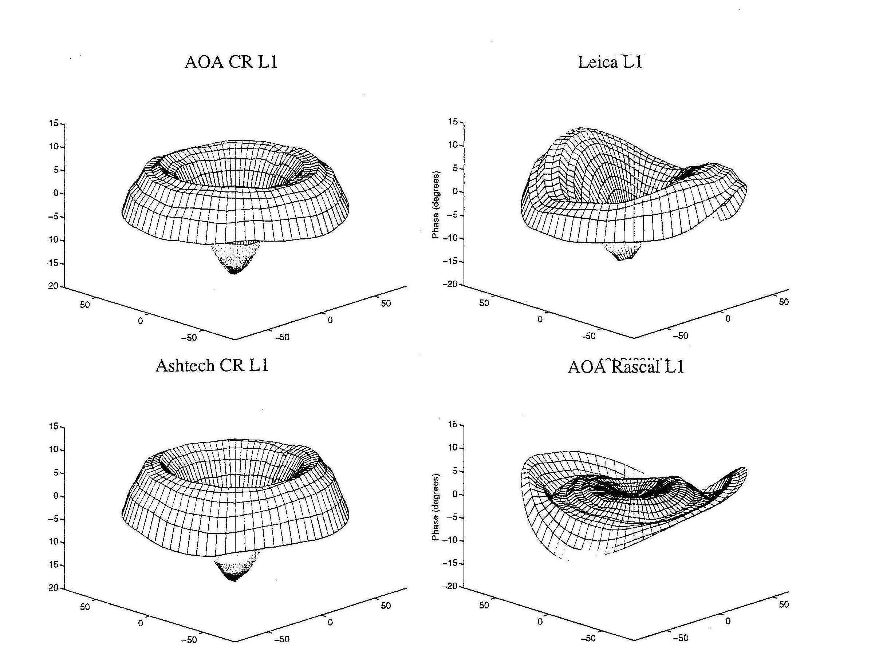
Antenna Phase Patterns
Notes:
The first problem we have is that the phase-response pattern of any physical antenna is not spherical. So the effective phase center ---the point to which you want to refer the location of the ground monument---varies as a function of elevation angle, and hence changes if you use a different minimum cutoff—which can happen when you change receivers or cables because of the change in SNR. Sometimes, the patterns also vary with azimuth, as with the Leica and Rascal antennas here, but most of the antennas used for high precision work have symmetric patterns. L1 phase variations for antennas tested by UNAVCO. Zenith values at the center and values for 10 degrees elevation at the edges. 10 deg L1 phase = 5 mm. From Rocken et a. ????

Slide 10
Modeling Antenna Phase-center Variations (PCVs)
Ground antennas
Relative calibrations by comparison with a ‘standard’ antenna (NGS, used by the IGS prior to November 2006)
Absolute calibrations with mechanical arm (GEO++) or anechoic chamber
May depend on elevation angle only or elevation and azimuth
Current models are radome-dependent
Errors for some antennas can be several cm in height estimates
Satellite antennas (absolute)
Estimated from global observations (T U Munich)
Differences with evolution of SV constellation mimic scale change
Recommendation for GAMIT: Use latest IGS absolute ANTEX file (absolute) with AZ/EL for ground antennas and ELEV (nadir angle) for SV antennas
(MIT file augmented with NGS values for antennas missing from IGS)

Slide 11
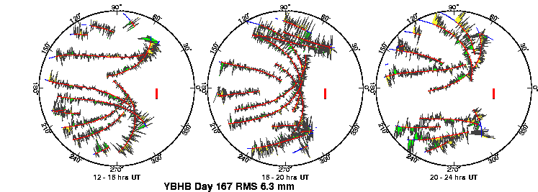
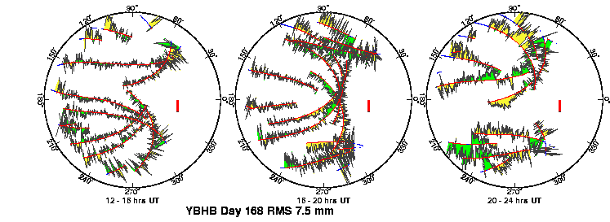
Multipath and Water Vapor Can be Seen in the Phase Residuals
Notes:
Review of sky plots: North to the right; red lines are satellite paths in the sky; green and yellow for positive and negative residuals (sign not important, visual aid); red bar is scale (10 mm). Plots are for the same 12-hour period on two successive days. Repeating high-frequency patterns are multipath; patterns that do not repeat are water vapor.

Slide 12
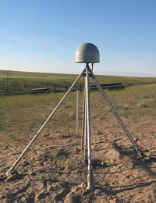
Top: PBO station near Lind, Washington.
Bottom: BARD station CMBB at Columbia College, California
Notes:
Review of phase vs elevation plots: black dots are the residuals (as in last slide) with all satellites lumped together and plotted versus height above the horizon. Red line is the mean; green lines are GAMIT’s model for weighting the observations. Mutlipath and lower-frequency signal scattering (reflections within the antenna + mount) are a function of the type of mount, height above the ground, and the reflective environment around the antenna. We now routinely create phase vs elevation plots in all of our processing. Here are two examples from continuous stations from the west US, The top one is a new PBO station in Eastern Washington. Except for the thin rods supporting the antenna, the support and the area around the antenna is “clean”, and the phase pattern quite flat. An older continuous station, mounted on a pillar. Note the low-frequency reflections at low elevation angles, indicative of higher multipath and/or an inadequate model for the antenna (+ mount) phase center variations.

Slide 13
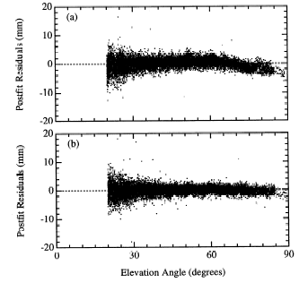
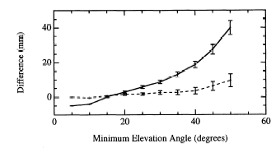
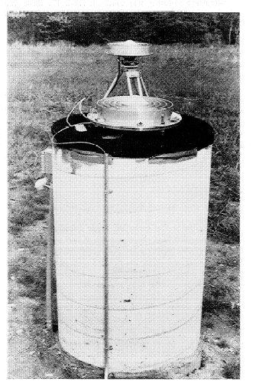
Left: Phase residuals versus elevation for Westford pillar, without (top) and with (bottom) microwave absorber.
Right: Change in height estimate as a function of minimum elevation angle of observations; solid line is with the unmodified pillar, dashed with microwave absorber added.
[From Elosequi et al.,1995]
Notes:
The GPS research group at Harvard noticed that the height they estimated for the pillar at the Haystack Observatory (near Boston) was sensitive to the cutoff angle they used in their processing (upper right). The phase vs elevation plot (upper left) show swhy: notice the bend in the curve, indicative of a poor model for the antenna phase center variations. They related the pattern not the antenna itself but to the metal plate imbedded in the top of the concrete pillar. When they put microwave absorbing material beneath the antenna, the pattern flattened and the sensitivity to cutoff angle went away.

Slide 14
Effect of error in a priori ZHD
Difference between:
Surface pressure derived from “standard” sea level pressure and the mean surface pressure derived from the GPT model
Station heights using the two sources of a priori pressure
Relation between a priori pressure differences and height differences. Elevation-dependent weighting was used in the GPS analysis with a minimum elevation angle of 7°

Slide 15
Differences in GPS estimates of ZTD at Algonquin, Ny Alessund, Wettzell and Westford computed using static or observed surface pressure to derive the a priori. Height differences will be about twice as large. (Elevation-dependent weighting used).
Short-period Variations in Surface Pressure not Modeled by GPT
Notes:
10-day span of ZD estimates from GAMIT at 4 stations, showing…
DIFFERENCES in ZTD (red) vs differences (ERROR) in pressure (black)
NOTE high correlation.

Slide 16
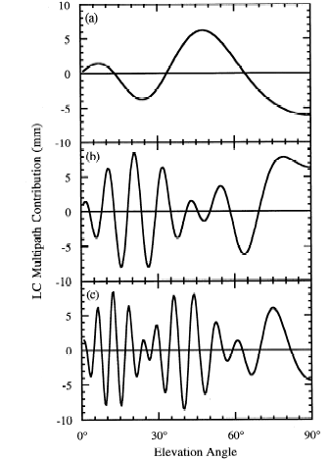
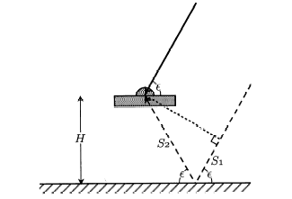
Antenna Ht
0.15 m
0.6 m
Simple geometry for incidence of a direct and reflected signal
1 m
Multipath contributions to observed phase for three different antenna heights [From Elosegui et al, 1995]
Notes:
This model for the period of reflections as a function of height of the antenna illustrates the problem when an antenna is mounted within about a wavelength of a reflective surface. For an antenna mounted 1-2 m above the surface, the variations will be of the order of minutes, and tend to have low, though still significant correlatations with the signature of the station’s coordinates and the atmospheric delay. Once you get within a half-meter, though, the longer period variations are a real problem. And this is even without taking into account the interaction with the antenna structure.

Slide 17
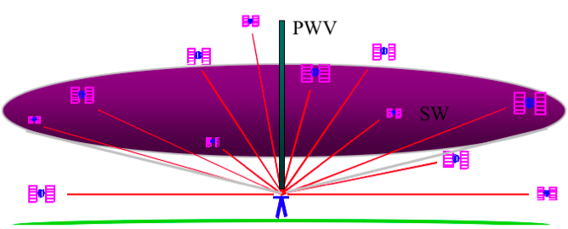
Sensing Atmospheric Delay the
The signal from each GPS satellite is delayed by an amount dependent on the pressure and humidity and its elevation above the horizon. We invert the measurements to estimate the average delay at the zenith (green bar).
( Figure courtesy of COSMIC Program )

Slide 18
Zenith delay from wet and dry components of the atmosphere
Total delay is ~2.5 m Variability mostly caused by wet component
Hydrostatic delay is ~2.2 m
Little variability between satellites or over time
Well calibrated by surface pressure.
Wet delay is ~0.2 meters
Obtained by subtracting the hydrostatic (dry) delay.
Courtesy of J. Braun (UCAR)
Colors are for different satellites
Notes:
The three figures on the left show time series of ZHD (bottom), ZWD (middle), and ZTD (top) simulated from a MM5 3-km model simulation of a squall line. The

Slide 19
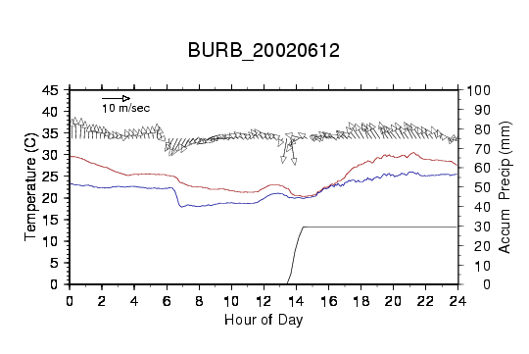
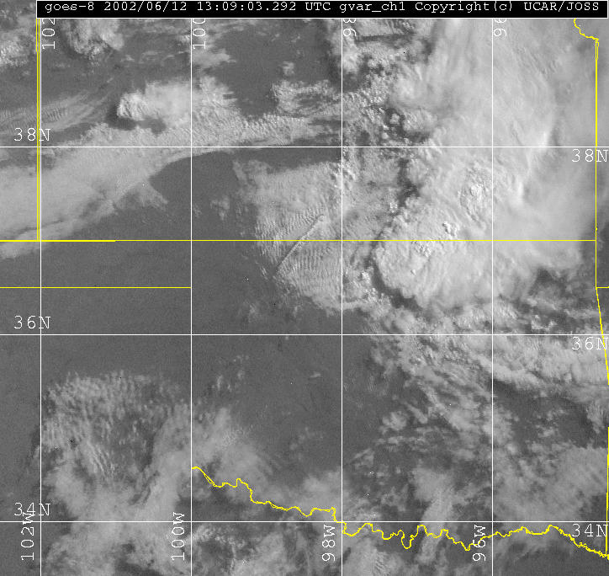
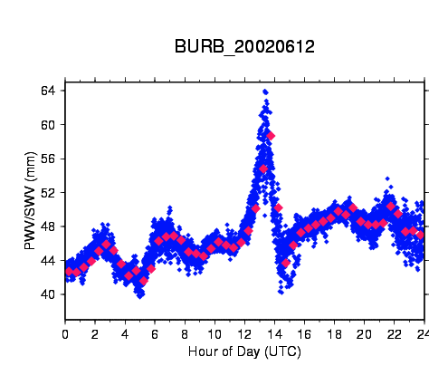
Example of GPS water vapor time series
GOES IR satellite image of central US on left with location of GPS station shown as red star.
Time series of temperature, dew point, wind speed, and accumulated rain shown in top right. GPS PW is shown in bottom right. Increase in PW of more than 20mm due to convective system shown in satellite image.
Notes:
GOES 8 image at 1309 UTC and GPS PW/SW for station BURB

Slide 20
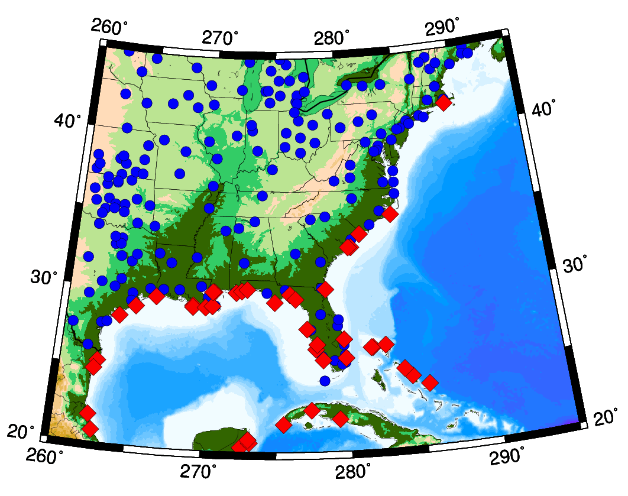
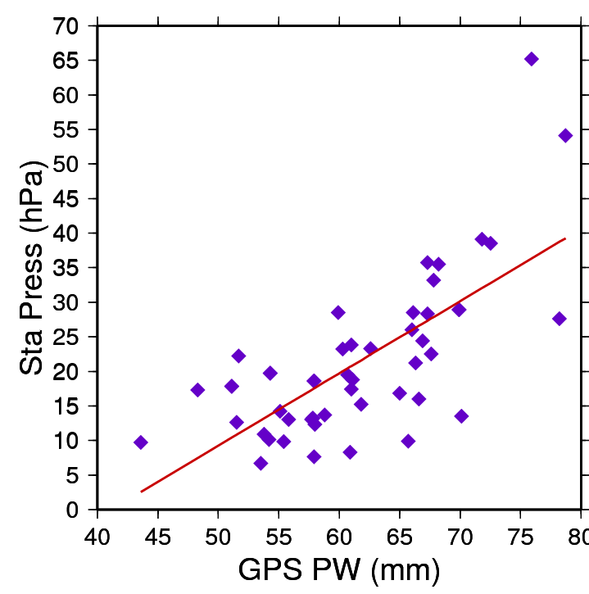
Water vapor as a proxy for pressure in storm prediction
GPS stations (blue) and locations of hurricane landfalls
Correlation (75%) between GPS-measured precipitable water and drop in surface pressure for stations within 200 km of landfall.
J.Braun, UCAR
Notes:
20
The map on the lower left shows Suominet GPS stations (in blue), and locations of hurricane landfall from 2003-2005. The scatterplot on the upper right shows the correlation between GPS PW and drop in surface pressure (1013 - Surf_Press) for stations within 200km of hurricane landfall. The correlation between PW and surface pressure is -0.71. This high correlation is a positive sign that GPS PW can be used to improve intensity forecasts.

Slide 21
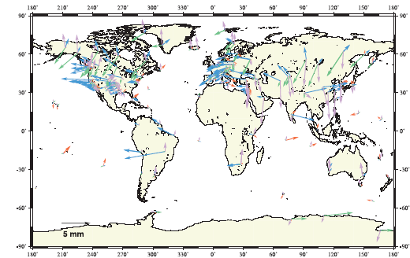
Annual Component of Vertical Loading
Atmosphere (purple)
2-5 mm
Snow/water (blue)
2-10 mm
Nontidal ocean (red)
2-3 mm
From Dong et al. J. Geophys. Res., 107, 2075, 2002
Notes:
The only loading effect we currently account for in our processing are those from ocean tides. For these the current models are quite good for most parts of the world, but probably inadequate for high latitudes (above the TOPEX altimeter coverage) and around some complicated shorelines. (High local tides do not mean large errors, however, because it’s the total mass of the water that matters.)
This map is taken from a paper by Danan Dong (former MIT student) and his colleagues at JPL, Scripps, and GSI in Japan. They estimated annual and semi-annual terms in vertical GPS station position and attempted to match these with predicted motions derived from a variety of sources. They could not obtain sufficient correlation overall to validate the models, but they’ve given us rough estimates of the amplitudes and geographical distribution of the induced displacements.
Tom Herring, with Tonie VanDam first detected atmospheric loading effects in VLBI data 10 years ago but neither the global pressure fields nor the data coverage were sufficient to develop and test good models. There’s now an operational program to use the NCEP and European Center analyses to compute loading corrections on a global grid and we’re planning to test these in our GPS analyses over the next few months.

Slide 22
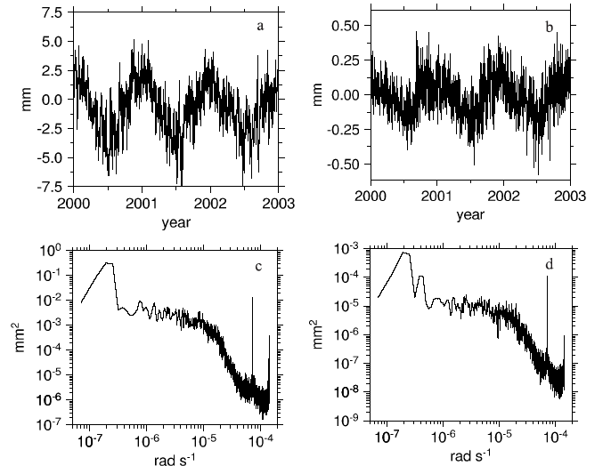
Atmospheric pressure loading near equator
Vertical (a) and north (b) displacements from pressure loading at a site in South Africa. Bottom is power spectrum. Dominant signal is annual. From Petrov and Boy (2004)
Notes:
The next three slides are from a study by Leonid Petrov and Jean-Paul Boy at Goddard to repeat the Herring and VanDam study with current pressure fields and VLBI data. This slide shows a 3-year time series and spectra for vertical and horizontal loading at low latitudes The horizontal signal is quite small, the vertical is quite detectable with GPS or VLBI measurements. The dominant signals are diurnal and semi-diurnal (narrow spikes to right), and wide-band annual and semiannual. There is relatively little power at periods below 10 days.

Slide 23
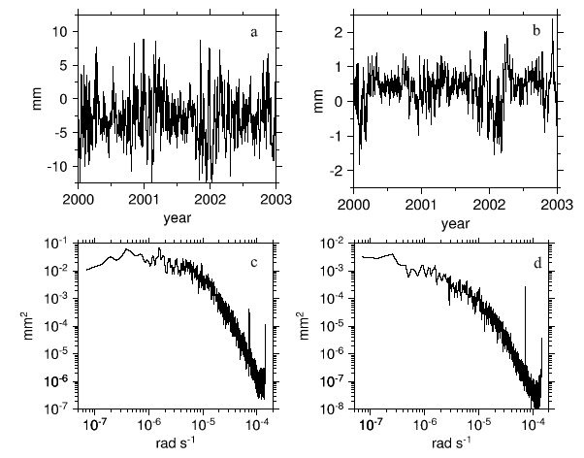
Atmospheric pressure loading at mid-latitudes
Vertical (a) and north (b) displacements from pressure loading at a site in Germany. Bottom is power spectrum. Dominant signal is short-period.
Notes:
At mid-latitudes, the circulation of low and high pressure systems with periods of 5-10 days is typical, and the annual and semiannual signal is relatively weak. (The inverted barometer assumption for the oceanic response may not be valid at these short periods.) Effect larger and the horizontal signal can be significant.

Slide 24
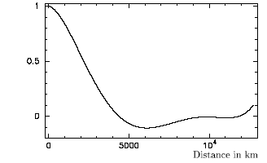
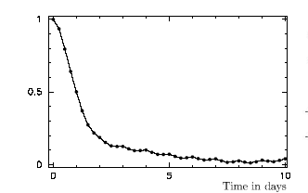
Spatial and temporal autocorrelation of atmospheric pressure loading
From Petrov and Boy, J. Geophys. Res., 109, B03405, 2004
Notes:
The autocorrelation functions tell us a lot about what we should see in the data and how to design our measurements. We expect to get a lot of cancellation when we’re measuring regional networks of less than 1000 km. And we will expect to average out a lot of the temporal variation (at mid-latitudes) if we separate measurements of a given station by more than two days.
LAST SLIDE

Slide 25
References
Larson, K. M., E. Gutmann, V. Zavorotny, J. Braun, M. Williams, and F. G. Nievinski (2009), Can We Measure Snow Depth with GPS Receivers?, Geophys. Res. Lett., 36, L17502, doi:10.1029/2009GL039430.
Larson, K. M., E. E. Small, E. Gutmann, A. Bilich, P. Axelrad, and J. Braun (2008), Using GPS multipath to measure soil moisture fluctuations: initial results, GPS Solut., 12, doi:10.1007/s10291-007-0076-6.
Larson, K. M., E. E. Small, E. Gutmann, A. Bilich, J. Braun, and V. Zavorotny (2008), Use of GPS receivers as a soil moisture network for water cycle studies, Geophys. Res. Lett., 35, L24405, doi:10.1029/2008GL036013.
Tregoning, P., and T. A. Herring (2006), Impact of a priori zenith hydrostatic delay errors on GPS estimates of station heights and zenith total delays, J. Geophys. Res., 33, L23303, doi:10.1029/2006GL027706.
Wolfe, D. E., and S. I. Gutman (2000), Developing an Operational, Surface-Based, GPS, Water Vapor Observing System for NOAA: Network Design and Results, J. Atmos. Ocean. Technol., 17, 426–440, doi:10.1175/1520-0426(2000)017%3C0426:DAOSBG%3E2.0.CO;2.

