Slide 1


Verticals: atmosphere, loading, and reference frames
T. A. Herring R. W. King M. A. Floyd
Massachusetts Institute of Technology
GPS Data Processing and Analysis with GAMIT/GLOBK/TRACK
UNAVCO Headquarters, Boulder, Colorado
10–14 August 2015
Material from T. A. Herring, R. W. King, M. A. Floyd (MIT) and S. C. McClusky (now ANU)

Slide 2
OVERVIEW
Atmospheric delay treatment and issues
  GAMIT setup for different approaches
  Impacts of atmospheric modeling
Loading
  GAMIT setup and some results
Reference frame realization: Vertical effects
  Basic approaches
  Treatment of scale estimates and impact on height estimates

Slide 3
Atmospheric model
The apriori models used in GAMIT for the atmospheric delays are controlled by the sestbl. entries:
  Met obs source = UFL GPT 50 ; hierarchical list with humidity value at the end; e.g. RNX UFL GPT 50 ; default GPT 50
  DMap = VMF1 ; GMF(default)/VMF1/NMFH; GMF now invokes GPT2 if gpt.grid is available (default)
  WMap = VMF1 ; GMF(default)/VMF1/NMFW
  Use map.list = N ; VMF1 list file with mapping functions, ZHD, ZWD, P, Pw, T, Ht
  Use map.grid = Y ; VMF1 grid file with mapping functions and ZHD
Above would used Vienna mapping functions and met data (surface pressure) from these files. Recommended but not default because of need for grid files.

Slide 4
Setup to use VMF1
To use VMF1: Met and mapping functions
  you need to download vmf1grd.YYYY from everest.mit.edu
  Create links in ~/gg/tables between map.grid.YYYY and the vmf1 files (due to size we assume they may stored in some other location)
  sh_gamit will automatically link day directory files to your gg/tables files.
The met source is hierarchical but the mapping functions must specified.

Slide 5
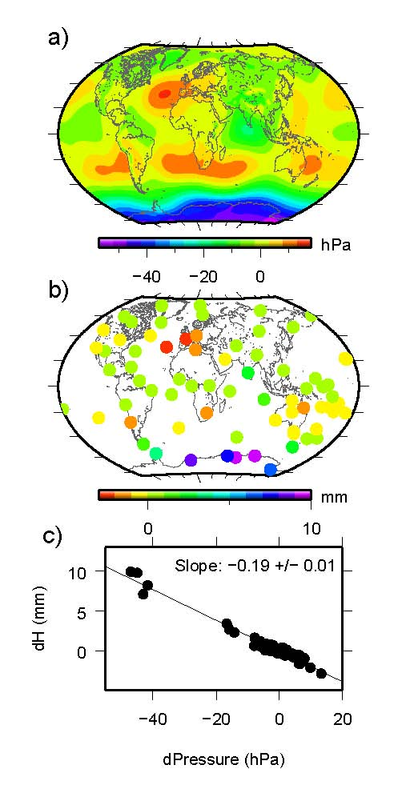
Impact of met source
Difference between
a) surface pressure derived from “standard” sea level pressure and the mean surface pressure derived from the GPT model.
b) station heights differences using the two sources of a priori pressure.
c) Relation between a priori pressure differences
and height differences. Elevation-dependent weighting was used in the GPS analysis with a minimum elevation angle of 7 deg.

Slide 6
Loading Effects
Invoking in GAMIT; sestbl. Entries
  Tides applied = 31 ; Binary coded: 1 earth 2 freq-dep 4 pole 8 ocean 16 remove mean for pole tide
  ; 32 atmosphere ; default = 31
  Use otl.list = N ; Ocean tidal loading list file from OSO
  Use otl.grid = Y ; Ocean tidal loading grid file, GAMIT-format converted from OSO
  Apply atm loading = N ; Y/N for atmospheric loading
  Use atml.list = N ; Atmospheric (non-tidal) loading list file from LU
  Use atml.grid = N ; Atmospheric (non-tidal) loading grid file from LU, converted to GAMIT format
  Use atl.list = N ; Atmospheric tides, list file, not yet available
  Use atl.grid = N ; Atmospheric tides, grid file
Default settings. Consistent with IGS ITRF2014 contribution (i.e., no non-tidal loading applied).

Slide 7
To apply “Tidal” loading
Ocean tidal loading is needed. Link otl.grid in gg/tables to otl_FES2004.grid (download from everest.mit.edu; not included in standard tar files due to size). Close to the coast in complicated regions, list values specific to a location might be better. Be careful that nearby sites don’t from different sources.
“Tidal” atmospheric pressure loading atl.grid has diurnal and semidiurnal S1 and S2 load. Nominally removed from 6hr tabular atmospheric loading values before interpolation (usefulness of this model is not clear --- mostly harmless).

Slide 8
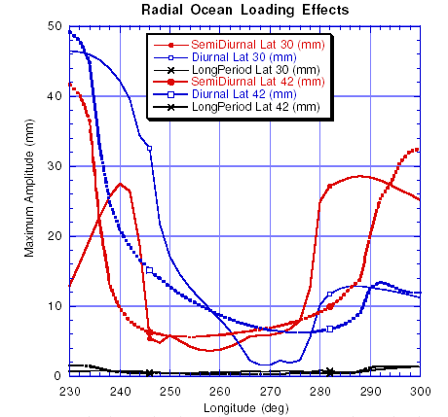
Ocean loading magnitudes
Locations at “corners”
WES2 288.5 42.6
ALBH 236.5 48.4
RICH 279.6 25.6
SIO 242.8 32.8

Slide 9
To apply non-tidal loading
Set sestbl. for atml.grid and link atml.grid.YYYY in gg/tables to the appropriate grid files. (atml.list option currently not used).
When linking atml.grid, there are choices of loading types (files available in GRIDS on everest.mit.edu)
  atmdisp_cm.YYYY: Center of mass, 6hr raw data
  atmfilt_cm.YYYY: Center of mass, filtered to remove periods less than~1.2 day. Should be used with S1/S2 atl.grid file.
  Center of figure (cf) and center of earth (ce) frames are available also (these frames are almost identical).
When working in current year, near realtime, updated files from everest need to be downloaded regularly.
Atml Loading applied in GAMIT can be removed in GLOBK with the appl_mod command.
Hydrology loading is supported in the file formats but is currently not implemented in GAMIT.

Slide 10
Example: Atmospheric load
AB27 in central Alaska

Slide 11
Example: Atmospheric load
AC52 in Southern coastal Alaska

Slide 12
Example: Atmospheric load
AC52 in Southern coastal Alaska: North
Horizontals do not normally look this good
High frequency in center of mass is S1/S2 “tide”

Slide 13
Basic issues in reference frame realization
Concept is to align the estimated site positions and possibly velocity to a set of well defined locations that have physical significance for the analysis being performed (e.g., PBO we align to a realization of the North America plate based on ITRF2008.
GLORG is the module which does this and computes the covariance matrix of the aligned solution in the reference frame chosen.
Transformation is often called an N-parameter Helmert transformation:
  N=3 translation only (could also be just rotation)
  N=6 translation and rotation
  N=7 translation, rotation and scale
In GLOBK analyses, you need to decide
  How many parameters (3/6/7)
  Sites to use to determine the parameters (sh_gen_stats)
  Values of the positions/velocities of the reference frame sites
  Weight to be given to heights in computing the transformation parameters (CND_HGTV command; first two arguments for position and velocity).
Notes:
Dong D., T. A. Herring, and R. W. King, Estimating Regional Deformation from a Combination of Space and Terrestrial Geodetic Data, J. Geodesy, 72, 200–214, 1998.

Slide 14
Choices of reference frame
Choose your reference frame based on your geophysical objectives
  Velocities in ITRF are difficult to interpret visually from a geophysical perspective
    Local surroundings of a volcano
    One side of a fault
    Upper plate of a subduction zone
Major plate reference frame
  Major plates are often chosen to conform with conventional perspectives of velocity solutions
  Relative to Eurasia, Nubia, North America, South America, etc.
  But don’t feel restricted by this. Sometimes your geophysical discussion is best visualized relative to any stable boundary of a deforming region
Regional reference frame
  Central Valley of California, non-deforming part of Anatolia, smaller coherent regions, etc
Local reference frame
  Sites near but outside the influence of a volcano, geothermal field, etc.

Slide 15
Ways to define a reference frame
Create an apr-file for use by glorg
  Apply known rotation rate to apr-file (e.g. itrf08_comb.apr → itrf08_comb_eura.apr)
  Zero velocity apr-file records (and iterate using sh_exglk to create updated apr-file)
Define set of sites (must be included in GAMIT processing or other H-file input to GLOBK) which define stable region
  plate in globk command file

Slide 16
Reference frame implementation
Any vector may be mapped from one co-ordinate system to another by the application of
  Translation (affects position of co-ordinate origin)
  Rotation (affects orientation of co-ordinate axes)
  Scale (affects length of co-ordinate axes)

Slide 17
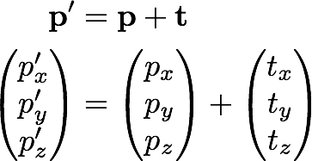
1: Translation

Slide 18
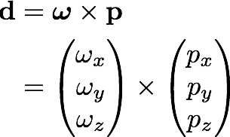
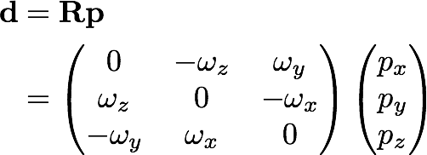
2: Rotation
Rotation vector, ω, is defined as in the direction of the rotation axis with length equal to the magnitude of angular rotation
Displacement (or velocity) vector then makes a right-handed triplet with the rotation vector, ω, and radial vector, p.

Slide 19
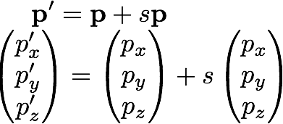
3: Scale

Slide 20
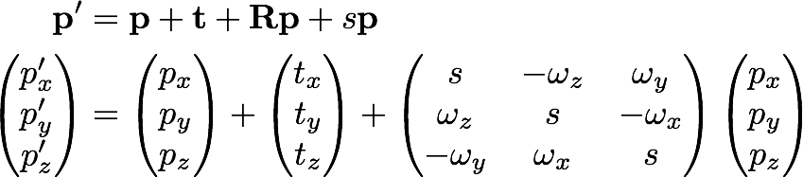
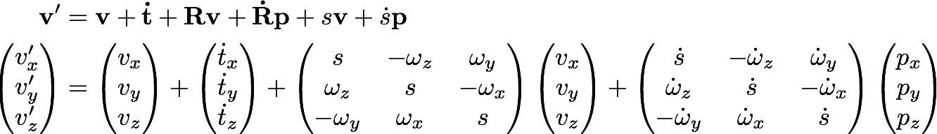
Helmert transformation
Position
Velocity
Usually, the terms Rv and sv are very small and can be neglected (< 10⁻⁶ rad × < 0.1 m/yr and < 0.1 ppb × < 0.1 m/yr, respectively)

Slide 21
Examples
Expressing velocities in ITRF is not very meaningful or useful when we want to look at the deformation at a plate boundary, e.g. the San Andreas Fault system
Better to look at velocities with one side “fixed” so we can see what the other side is doing relative to it
NA
PA
NA
PA

Slide 22
What does “with respect to” mean?
Horizontal motions are restricted to the surface of the Earth, therefore the Helmert transformation may not contain translation or scaling of position terms
Set v’ to zero for all sites that you wish to estimate all other velocities with respect to
Estimate the best-fit transformation parameters, e.g. by least squares estimation, to achieve this minimization of velocities in a region
Apply the estimated transformation to all velocities
All velocities are now “with respect to” the chosen subset
The subset could be, for instance, all on one tectonic plate, or any given region from which you wish to see the deformation

Slide 23
Reference frames in Geodetic Analyses
Output from GAMIT
  Loosely constrained solutions
  Relative position well determined, “Absolute position” weakly defined
  Need a procedure to expressed coordinates in a well defined reference frame
Two aspects
  Theoretical (e.g., rigid block, mantle-fixed, no-net-rotation of plates)
  Realization through a set of coordinates and velocities
    “finite constraints” : a priori sigmas on site coordinates
    “generalized constraints” : minimize coordinate residuals while adjusting translation, rotation, and scale parameters
Three considerations in data processing and analysis
  Consistent with GPS orbits and EOP (NNR)
    not an issue if network small or if orbits and EOP estimated
  Physically meaningful frame in which to visualize site motions
  Robust realization for velocities and/or time series
Notes:
The key point here is that maintaining a consistent frame in your velocity solution but particularly in your time series, is important for getting a geodetic robust result, the manner by which this done and the frame in which it is realized need not be the frame of primary physical interest. The maintenance of a consistent frame is what we accomplish through “stabilization” in glorg. Relating this frame to a plate or block can be done afterward with a different set of sites.

Slide 24
Frame definition with finite constraints
Applied in globk (glorg not called): We do not recommend this approach since it is sensitive to over-constraints that can distort velocities and positions
Example:
  apr_file itrf08.apr
  apr_neu all 10 10 10 1 1 1
  apr_neu algo .005 005 .010 .001 .001 .003
  apr_neu pie1 .002 005 .010 .001 .001 .003
  apr_neu drao .005 005 .010 .002 .002 .005
  …
Most useful when only one or two reference sites or very local area.
Disadvantage for large networks is that bad a priori coordinates or bad data from a reference site can distort the network

Slide 25
Frame definition with generalized constraints
Applied in glorg: minimize residuals of reference sites while estimating translation, rotation, and/or scale (3 -7 parameters)
  apr_file itrf08.apr
  pos_org xtran ytran ztran xrot yrot zrot
  stab_site algo pie1 drao …
  cnd_hgtv 10 10 0.8 3.
  stab_it 4 0.5 2.5
All reference coordinates free to adjust (anomalies more apparent); outliers are iteratively removed by glorg
Network can translate and rotate but not distort
Works best with strong redundancy (number and [if rotation] geometry of coordinates exceeds number of parameters iloading effects
Notes:
This is the preferred method. Must be careful due to glorg’s iterative removal or poorly fitting sites that the ultimate solution still has enough redundancy and stabilization power. Look through first hundred lines or so of . Can change statistics in cnd_hgtv and stab_it to control .

Slide 26
Stabilization using a Global Set of Sites
Use 40 or more sites with good velocities determined in the ITRF2008 frame
The itrf08_comb.apr file, when used together with itrf08_comb.eq to account consistently for instrumental changes over time, provides the widest choice of sites, 1992-2013.
Combining your solution with the MIT or SOPAC global h-files offer access to over 100 sites without having to include them in your GAMIT processing.
  You need just 4-6 common sites, which should be of high quality but need not be well know in ITRF2008 since these “tie” sites do not need to be in your frame-realization list.
For global ITRF stabilization, you can use the hierarchical list igb08_heirarchy.stab_site in gg/tables
Although a global frame may be a convenient way to do the stabilization, it is usually not necessary for regional studies.
Notes:
The “hierarchy” feature of the stab_site list allows you to specify alternative sites in each geography region, depending on which sites are available.

Slide 27
Stabilization using Regional or Local Sites
If your area of study has a robust cGPS network (10 or more well-distributed sites) with accurate a priori velocities, then glorg stablization is robust and little thought is involved (glorg will automatically discard the one or two sites which may be weak or inconsistent)
If your region is short on cGPS stations with well-known coordinates, you will need to think carefully about the choice of sites to include in your solution and use the initial stabilization. A stabilization site should have
  high quality data over the full span of your study
  coordinates well-known in ITRF2008
  Provide symmetric coverage around your study area (except that if the region is small enough, a translation-only stabilization may be possible and distribution is less important)

Slide 28
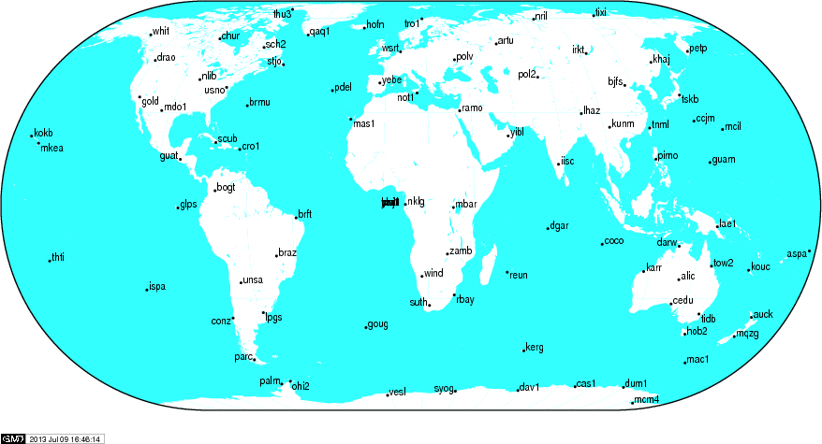
IGS (IGb08) reference frame core network
http://igscb.jpl.nasa.gov/network/refframe_core.html
Notes:
When selecting sites to process with your local data of interest, look first to include sites from the IGS core network.

Slide 29
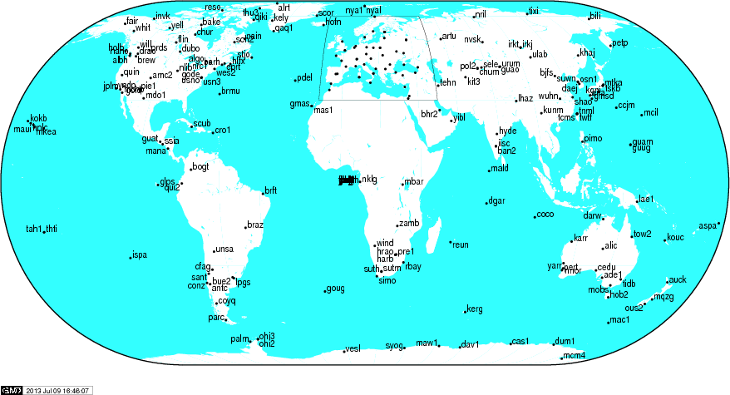
IGS (IGb08) reference frame network
http://igscb.jpl.nasa.gov/network/refframe.html
Notes:
If the IGS core network sites are not available, too sparse or do not exist at the epoch of your measurements, try densifying your stabilizing network with all the IGS reference frame sites (the IGS core network is a sub-set of this).

Slide 30
Frame realization sites for PBO
PBO used an hierarchical list based on 500km site spacing (sh_gen_stat stabrad option). (Blue dots)

Slide 31
Issues with Estimating Scale
Many GPS analyses, automatically include scale when aligning reference frames. Since the Earth is almost spherical, scale changes are directly proportional to the average height difference between the reference site coordinates and their apriori values.
When comparing and analyzing height changes, how scale is treated directly effects the results. Aspects of this issue are discussed in a white paper that should be available shortly from the GAGE analysis documentation at UNAVCO.
Scale estimates are related the mean height differences over the reference sites. Should this be removed or not is an open question.
Scale estimates on next slide show magnitude of effect for the PBO network.

Slide 32
PBO network scale estimates
PBO network estimates compared to global estimates converted to average height differences (6317 km Earth). Spikes in winter are often due to Alaskan sites.
Notes:
Red and Blue lines merge to make purple. Apr_scale in global command file and scale in pos_org command. Results generated with tscon.

Slide 33
Use of Global binary H-files
Include global h-files … or not ? For post-2000 data not needed for orbits
Advantages
  Access to a large number of sites for frame definition
  Can (should) allow adjustment to orbits and EOP
  Eases computational burden
Disadvantages
  Must use (mostly) the same models as the global processing
  Orbits implied by the global data worse than IGSF. Once-per-revolution radiation model parameters (loose in global h-files) should be treated carefully.
  Some bad data may be included in global h-files (can remove)
  Greater data storage burden
MIT hfiles available at ftp://everest.mit.edu/pub/MIT_GLL/HYY
When using MIT files, add apr_svant all F F F to globk command file to fix the satellite antenna offsets

Slide 34
Velocities and Time Series
The criteria for stabilization are different for velocity solutions and time series
Velocity solutions:
  Physical reference is important
  Not so sensitive to station dropout (solution holds the frame together)
Time series:
  Physical reference is not important
  Sensitive to station dropout
  Best representation of the statistics of the velocity solution is stabilization using ALL the well-determined sites from the velocity solution, now in a common frame
Notes:
When defining the frame in the velocity solution, the important thing is usually to visualize motion a way most useful for interpretation. Even if there is little or no redundancy in the stabilization site set, you’ve still got a consistent frame because you are estimating only one set of frame parameters. There will be no distortion of internal strain.
When defining the frame for a time series, you have to work to be sure that it’s being done consistently for each epoch.
In the next few slides, we’lll look at examples, first for velocity, then for time series.

Slide 35
a priori coordinate files
We now distribute, and encourage GAMITeers to use, a set of apr-files that are a concatenated set of coordinates for all sites that are, in some present or past version, formally defined in the ITRF (531 sites or 891 including those in IGS cumulative solution)
Found in ~/gg/tables/ and use in apr_file command or glorg command file
These are also rotated to major plates using the Euler poles of ITRF2008-PMM (Altamimi et al., 2012)
  itrf08_comb_amur.apr (relative to Amurian plate)
  itrf08_comb_anta.apr (Antarctica)
  itrf08_comb_arab.apr (Arabia)
  itrf08_comb_aust.apr (Australia)
  itrf08_comb_carb.apr (Caribbean)
  itrf08_comb_eura.apr (Eurasia)
  itrf08_comb_indi.apr (India)
  Itrf08_comb_na12.apr (North America, after Blewitt et al., 2013)
  itrf08_comb_nazc.apr (Nazca)
  itrf08_comb_noam.apr (North America)
  itrf08_comb_nubi.apr (Nubia)
  Itrf08_comb_nu13.apr (Nubia, after Saria et al., 2013)
  itrf08_comb_pcfc.apr (Pacific)
  itrf08_comb_soam.apr (South America)
  itrf08_comb_soma.apr (Somalia)
  itrf08_comb_sund.apr (Sunda)
Notes:
This is a way of expressing your solution relative to a major plate by specifying these apr-file in the apr_file commands of glorg. But still be sure globk run is consistent with GAMIT processing, i.e. orbits and EOPs defined in ITRF2008-NNR.

Slide 36
Referencing to a horizontal block (‘plate’)
Applied in glorg: first stabilize in the usual way with respect to a reference set of coordinates and velocities (e.g. ITRF-NNR), then define one or more ‘rigid’ blocks
apr_file itrf08.apr
pos_org xtran ytran ztran xrot yrot zrot
stab_site algo pie1 nlib drao gold sni1 mkea chat
cnd_hgtv 10 10 0.8 3.
plate noam algo pie1 nlib
plate pcfc sni1 mkea chat
After stabilization, glorg will estimate a rotation
vector (‘Euler pole’) for each plate with respect
to the frame of the full stabilization set and print
the relative poles between each set of plates
Use sh_org2vel to extract the velocities of all sites with respect to each plate
Notes:
Assign_plate assigns sites to plate but they are not used in estimation.

Slide 37
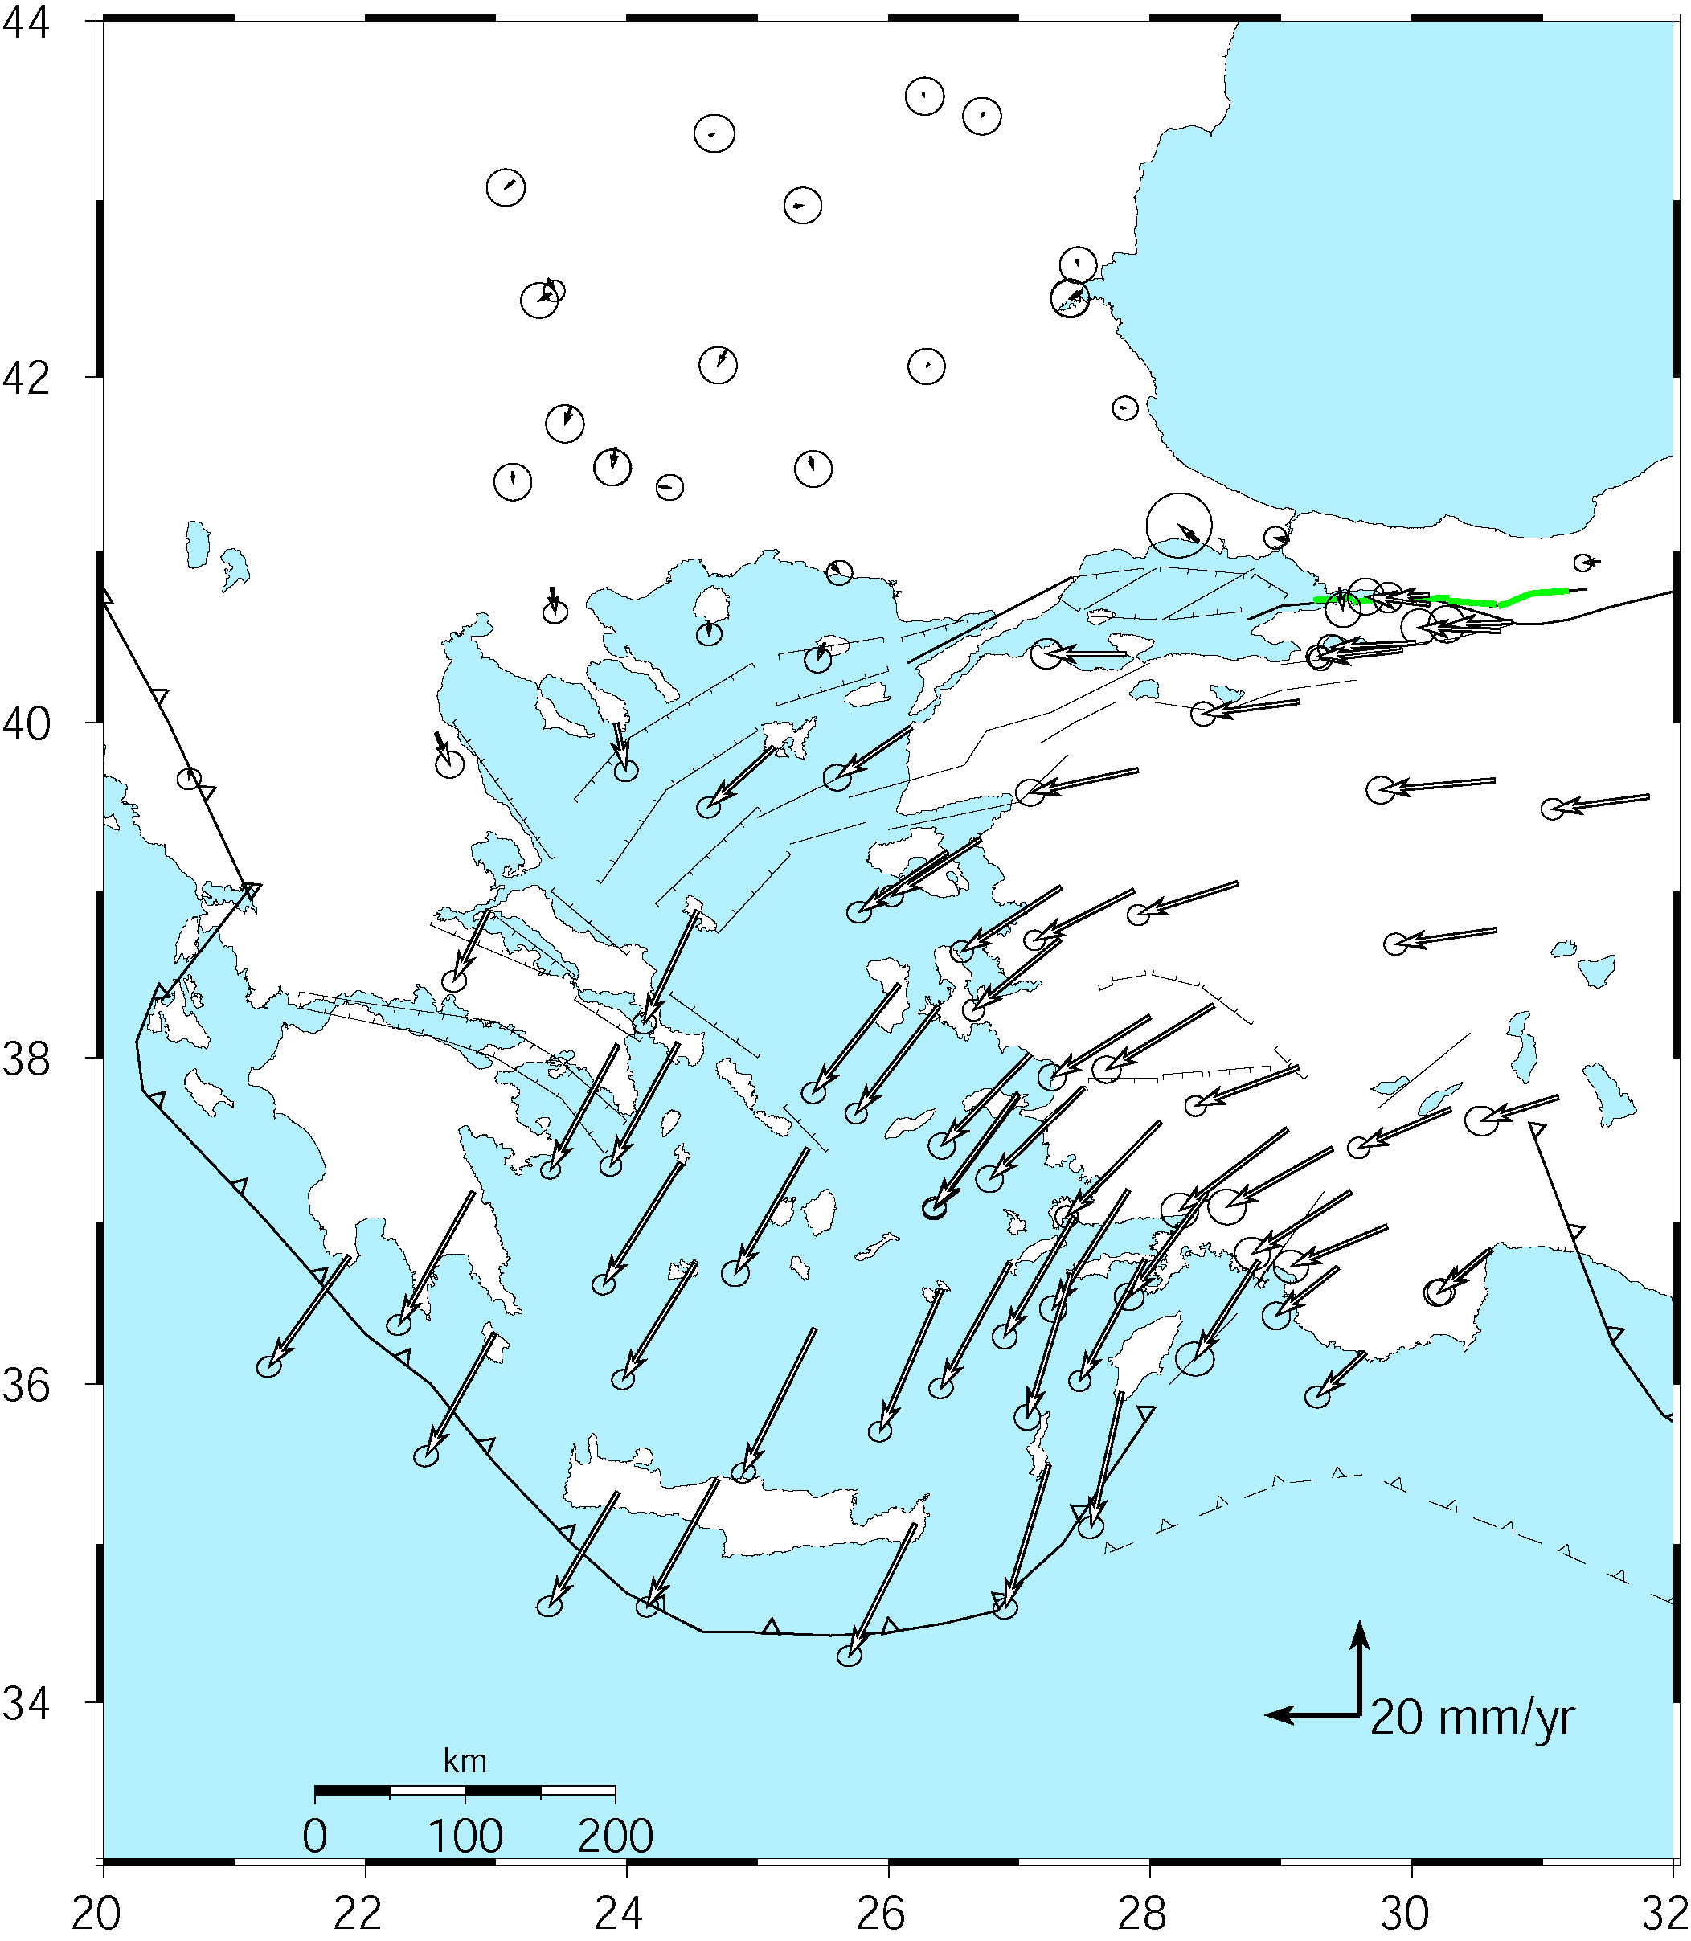
Velocities of Anatolia and the Aegean in a Eurasian frame
Realized by minimizing the velocities of 12 sites over the whole of Eurasia
McClusky et al. [2000]
Notes:
First let’s look at an example of representation of velocity-solution stabilization for visualization and interpretation.

Slide 38
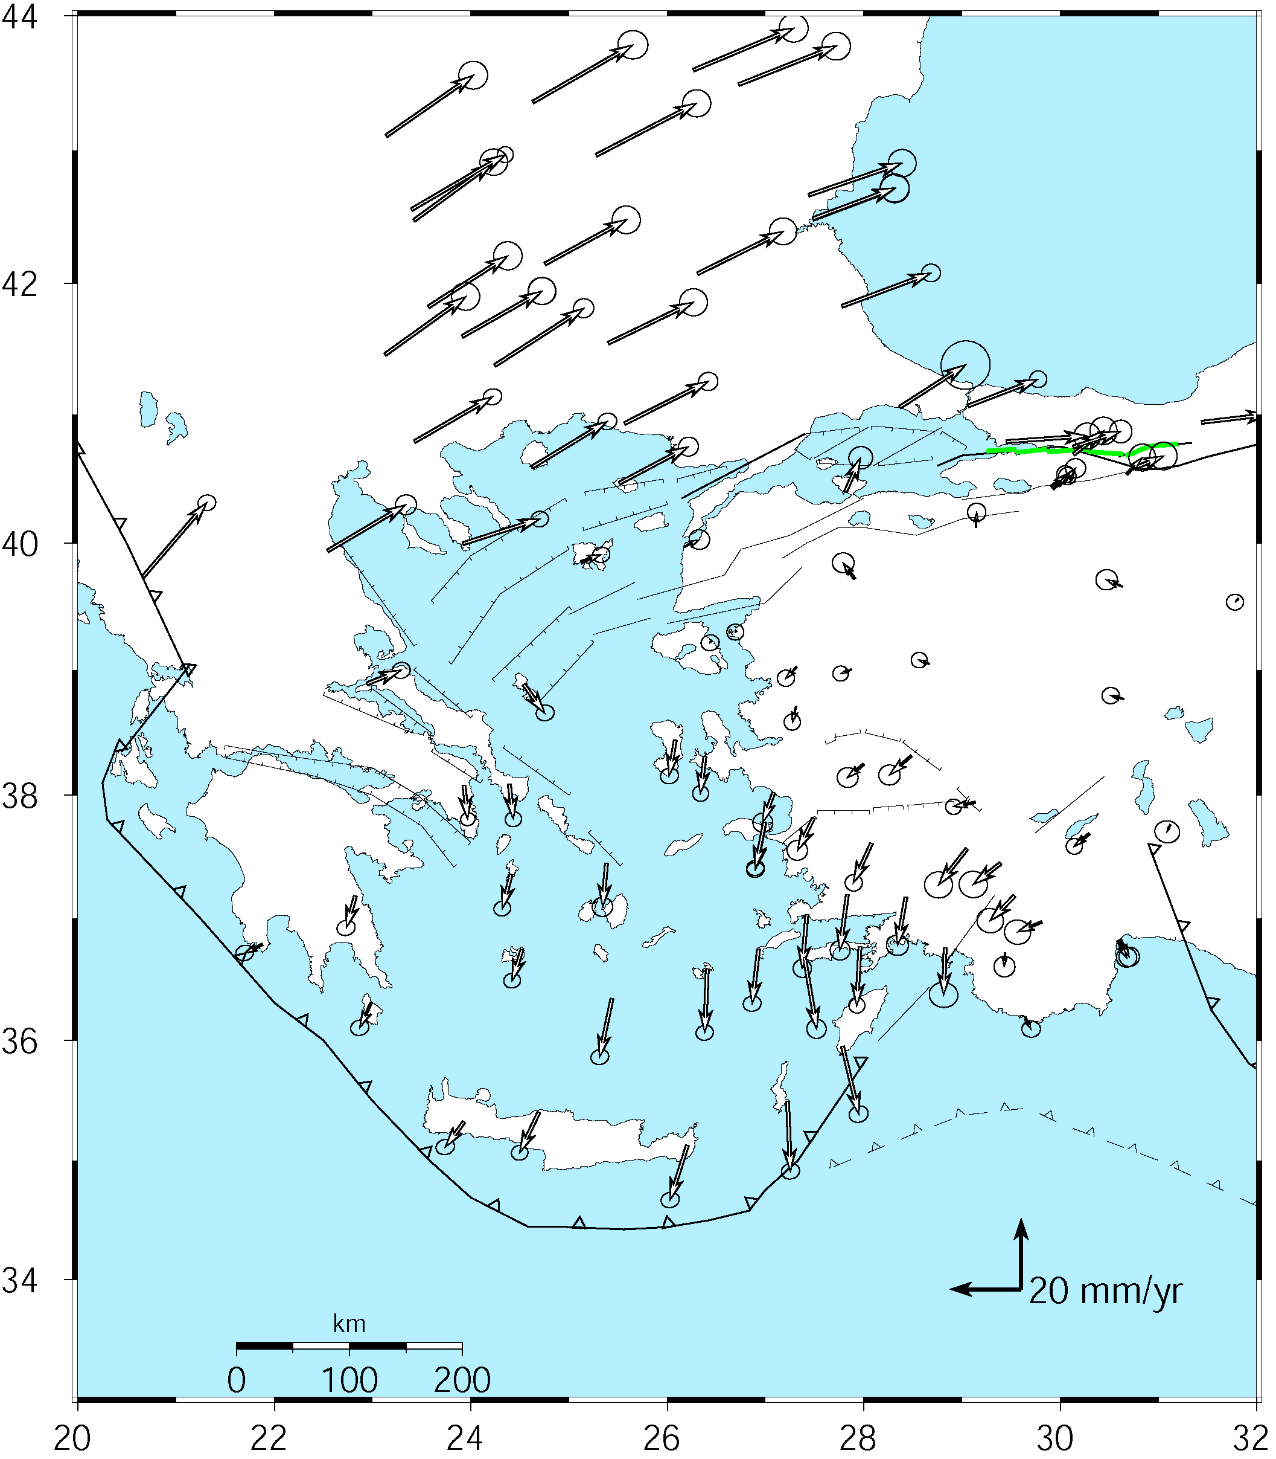
Velocities in an Anatolian frame
Better visualization of Anatolian and Aegean deformation
Here stations in Western/Central are used to align the reference frame (apriori velocity set to zero).
McClusky et al. [2000]
Notes:
Note that the major velocity gradients are still present: right-lateral shear across the North Anatolia fault and extension into the Aegean Sea, left-lateral shear and dilation around Rhodes.

Slide 39
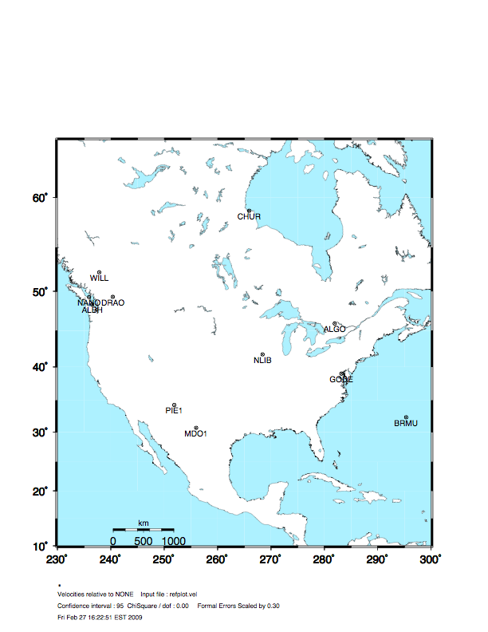
Stabilization Challenges for Time Series
Network too wide to estimate translation-only
(but reference sites too few or poorly distributed to estimate rotation robustly )
Notes:
Now an example of potential problems with time series stabilization. The picture shows the full network. We’ll look at what happens when you use various subsets of these stations for stabilization.

Slide 40
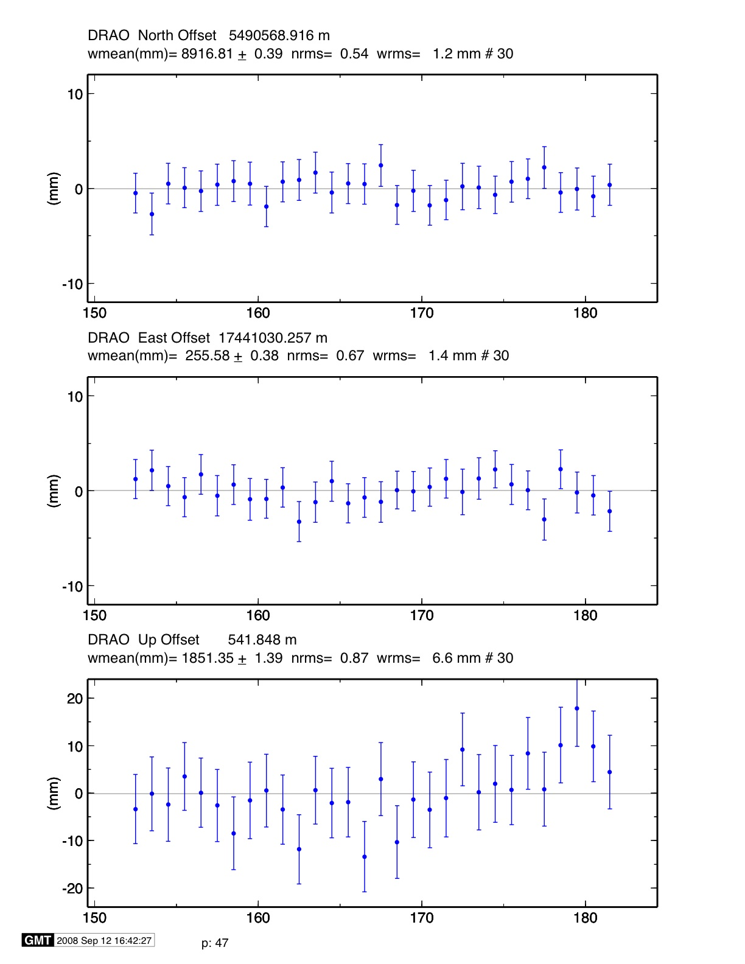
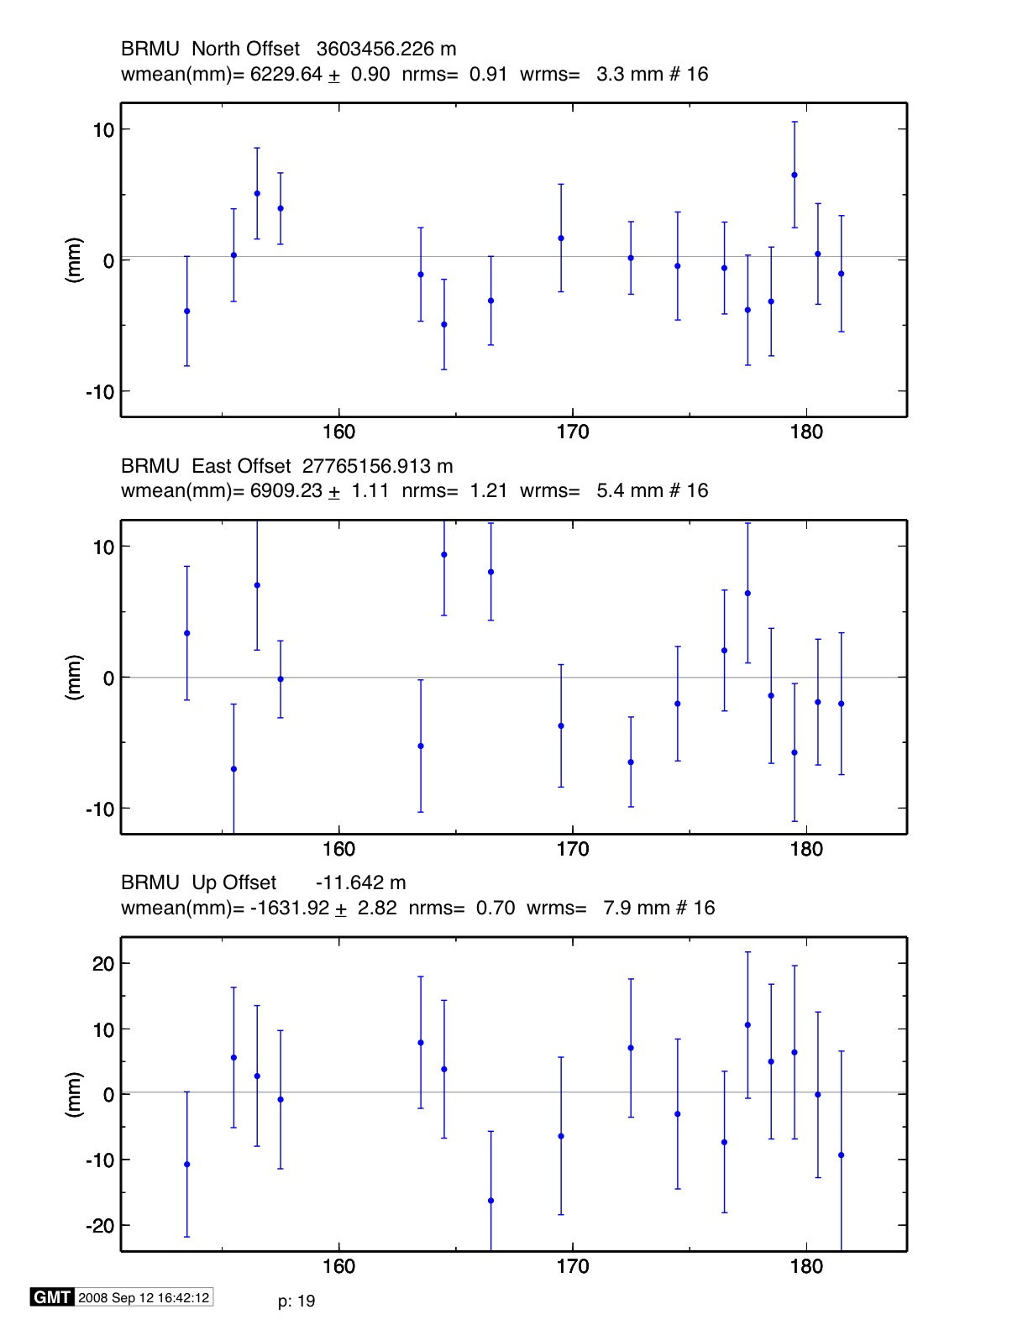
Stable reference frame
Stabilization Challenges for Time Series
*
Example of time series for which the available reference sites changes day-to-day but is robust (6 or more sites, well distributed, with translation and rotation estimated)
Day 176 ALGO PIE1 DRAO WILL ALBH NANO rms 1.5 mm
Day 177 ALGO NLIB CHUR PIE1 YELL DRAO WILL ALBH NANO
rms 2.3 mm
*
**
**
**
**
**
*
**
^ ^
^ ^
Notes:
The time series plots show the repeatability over 40 days for two sites, DRAO and BRMU., for the case where we have 9 stabilization sites on most days, but only 6 on day 176. In this case, even the 6 sites are well enough distributed and well enough behaved that day 176 is sill well stabilized.

Slide 41
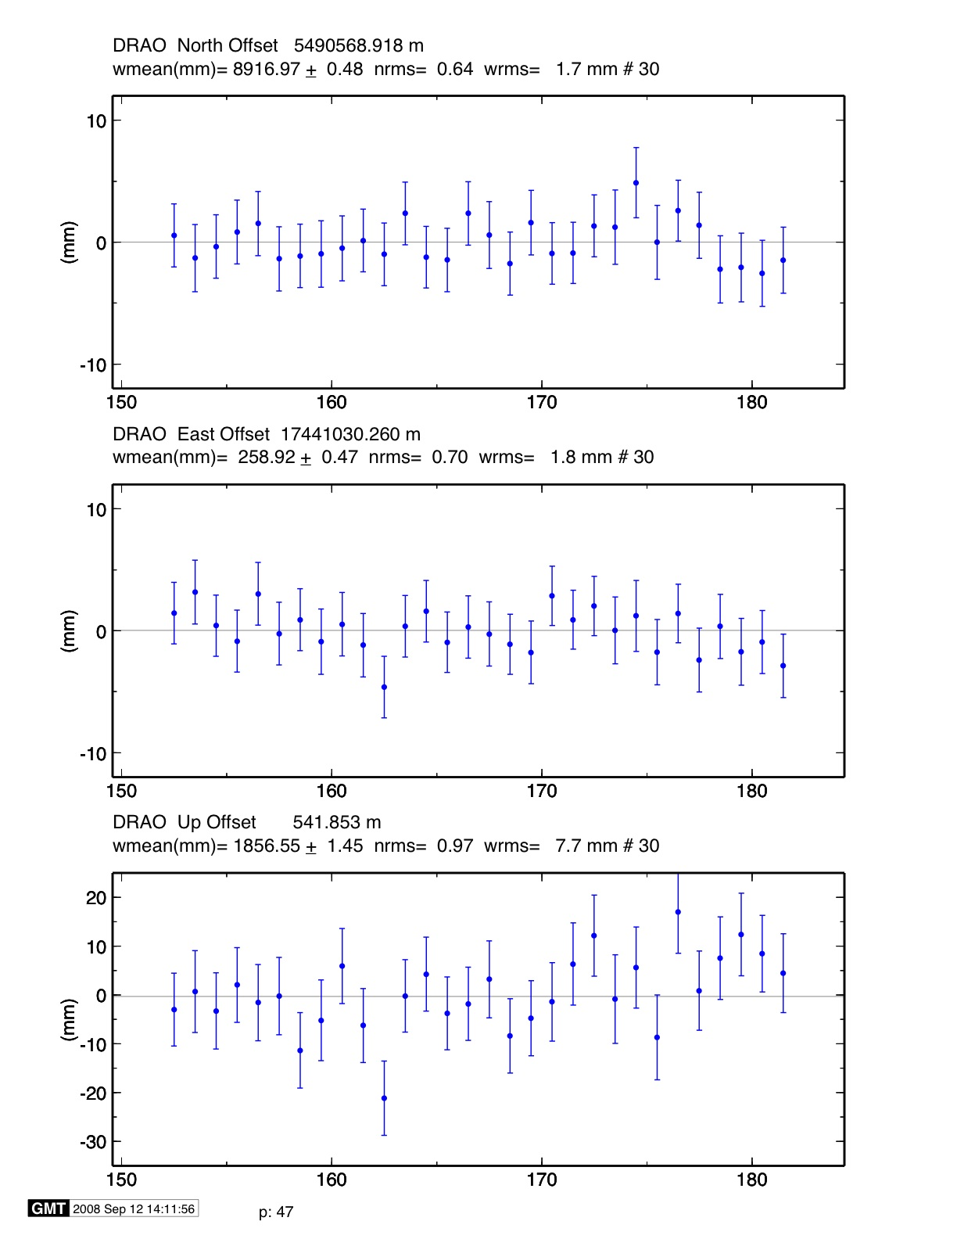
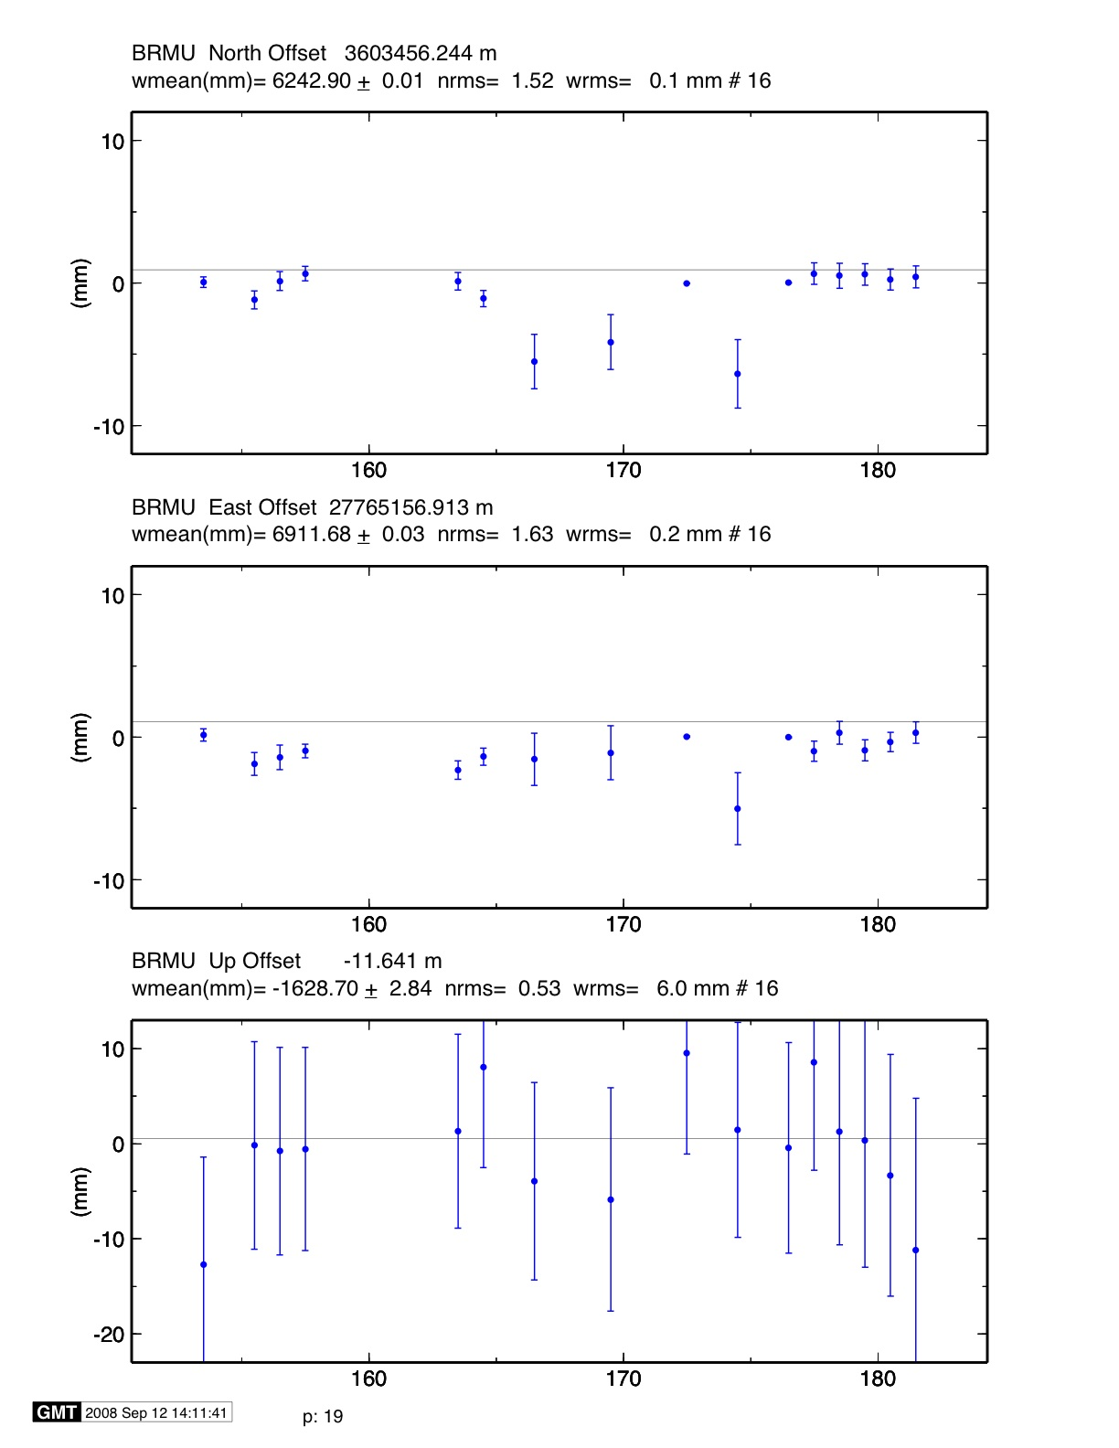
Unstable case
Stabilization Challenges for Time Series
*
Example of time series for which the available reference sites changes day-to-day and is not robust (only 3 sites on one day)
NOTE: Distant frame definition sites can have very small error bars when used and large error bars when not used.
Day 176 BRMU PIE1 WILL
rms 0.4 mm
Day 177 BRMU ALGO NLIB PIE1
YELL WILL
rms 2.0 mm
**
*
*
**
**
^ ^
^ ^
^ ^
^ ^
Notes:
In this case, however, the 6-site network is adequate for the core of the network (DRAO, but not for the edge (BRMU). On days when BRMU is in the stabilization, it aborbs all the rotatioin and have a tiny gimas, and on other days, it gets removed and has outliers with large sigmas.

Slide 42
Rules for Stabilization of Time Series
Small-extent network: translation-only in glorg, must constrain EOP in globk
Large-extent network: translation+rotation, must keep EOP loose in globk;
if scale estimated in glorg, it must estimate scale in globk
1st pass for editing:
  “Adequate” stab_site list of stations with accurate a priori coordinates and velocities and available most days
  Keep in mind deficiencies in the list
Final pass for presentation / assessment / statistics
  Robust stab_site list of all/most stations in network, with coordinates and velocities determined from the final velocity solution
System is often iterated (velocity field solution, generate time series, editing and statistics of time series; re-generate velocity field).
Notes:
Here’s a summary guide to maintaining a robust stabilization.

Slide 43
GLOBK Reporting of models
When binary h-files from GAMIT h-files are used (as opposed to SINEX files), GLOBK and GLIST can report models used. Can be critical when combining with MIT h-files.
GPS System Information : Time GPST Frame J2000 Precession IAU76 Radiation model BERNE Nutation IAU00 Gravity EGR08 EarthRad NCLE1 AntThrust ANTBK
MODELS Used in Analysis: SD-WOB | SD-UT1 | IERS10 | E-Tide | K1-Tide | PoleTide| OC-Load | MPT2010 | OceanPT |
LOAD Models Used : NCEP CM USED |
ATM Delay Models Used : UFL | GP25 | VMF1 | VMF1 | 2nd Order Ion | GMAP | IGRF11 |
These lines are wrapped.

Slide 44
Summary
Atmospheric delay treatment and issues
  VMF1 approach (used gridded assimilation meteorological data) is probably best but does required large and regularly updated (if near real-time) grid files
Loading
  Not standard yet in IGS processing. Again needs large grid files. Models used in GAMIT can be removed in GLOBK.
Reference frame realization: Vertical effects
  Treatment of scale estimates and impact on height estimates should be carefully considered when heights are on interest.

