Slide 1


Survey-mode measurements and analysis
T. A. Herring R.W. King M. A. Floyd
Massachusetts Institute of Technology
GPS Data Processing and Analysis with GAMIT/GLOBK/TRACK
UNAVCO Headquarters, Boulder, Colorado
10–14 August 2015
Material from R. W. King, T. A. Herring, M. A. Floyd (MIT) and S. C. McClusky (now ANU)

Slide 2
Measurement Strategies I: Occupation Time
Given time and personnel constraints, what are the trade-offs between between spatial and temporal density?
Ideally, you would like for the white-noise position uncertainty for an occupation to contribute to the velocity uncertainty at a level less than the usually dominant long-period correlated noise.
Typical white-noise uncertainties (Horizotnal and Vertical) as a function of occupation time:
6-8 hrs: 2-2.5 mm H, 5-10 mm V
12-24 hrs: 1.0-1.5 mm H, 3-5 mm V
36-48-hrs: 0.7-1.0 mm H, 2-4 mm V
Observations over 3 or more days will give you more redundancy
Observations of 5 or more days will be necessary for mm-level vertical uncertainties
If your region has few continuous stations, you should consider running one or two survey-mode stations for the entire time of the survey to provide continuity
Notes:
If your scientific\ goals require a spatially dense network , then you may chose to rely on having two or more sites whose motions are expected to be the same and use this spatial redundancy as s substitute for temporal redundancy in identifying outliers. The spatial redundancy would be more important than the temporal if the error in a position determination is correlated over the occupation time (e.g. a single flawed setup continued for several days).

Slide 3
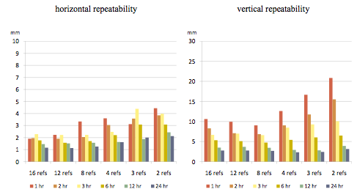
Precision v session length for network processing
Notes:
This slide shows repeatability in position over 31 days as a function session length of a test site in central Italy when processed with 2 to 16 continuous reference sites spanning 180-600 km. See Firuzabadi and King, GPS Solutions, doi:10/1007/s10291-0110218-8, 2011, for details of the study.

Slide 4
Measurement Strategies II: Monuments and Instrumentation
Issues in site and antenna selection :
Monument stability
Accessibility
Ease of setup
Multipath
Vandalism
  • There is no clear prescription for all cases; let’s look at some examples

Slide 5
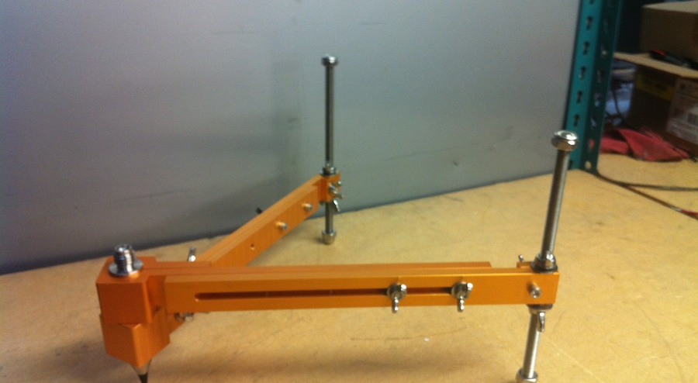
Three primary mounting options
Spike mount
Tripod with optical or physical plummet
Mast
Courtesy UNAVO web page
Notes:
Spike mount: Light-weight, fixed height, low profile and easy to set, but vulnerable to low-ground reflections and long-period multipath.
Tripod: Avoids low-ground obstructions and long-period multipath, but heavy, high-profile, and vulnerable to setup errors.
Tech 2000 mast: medium weight, fixed height, avoids low-ground obstructions and long-period multipath, but 1st-time setup time-consuming.

Slide 6
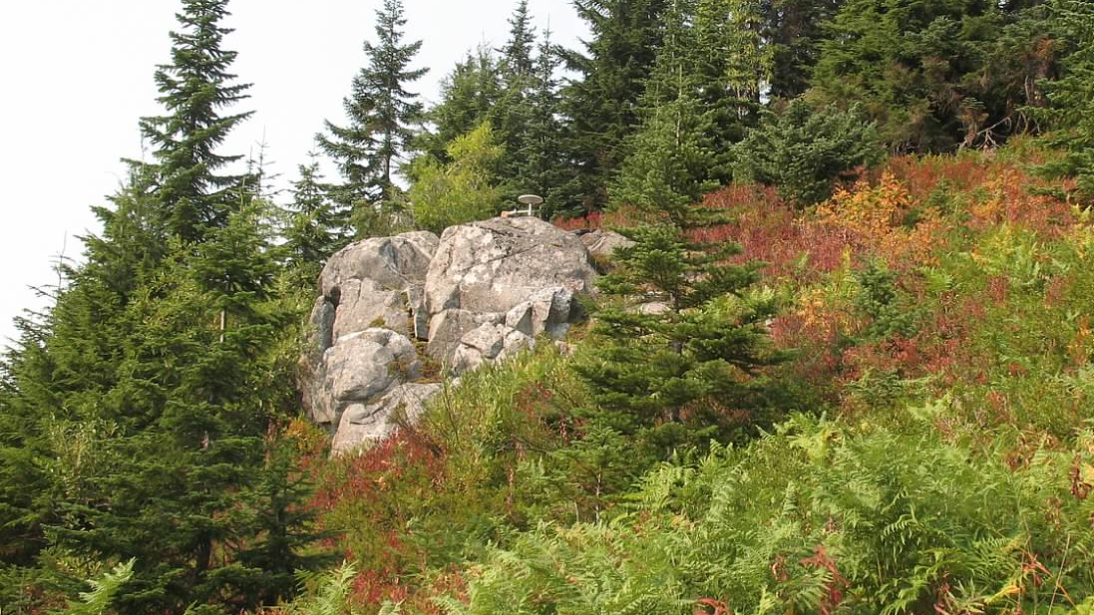
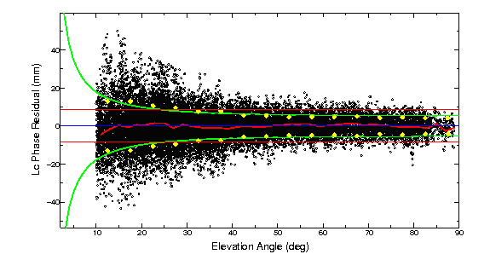
Low mount in a good enviroment
STVP
Steven’s Pass, Cascades Range in western Washington
18-cm spike mount
No long-term repeatability yet, but 44 hrs
of observations in 2012 give formal
uncertainties 0.5 mm horizontal, 3 mm
vertical. Note minimal long-period signal
Scattering.
Notes:
This is an example of a good sGPS site observed with a low-mounted antenna. The ground drops off in a 270-degree arc, trees block the view and generate reflections in a 90-degree arc, mostly in the north-polar “hole” of SV visibility. This site has two occupations, 11 years apart, one with a 1-m tripod, the second one with the spike mount as shown. The velocity uncertainty and residual from a block model are each ~0.6 mm/yr.

Slide 7
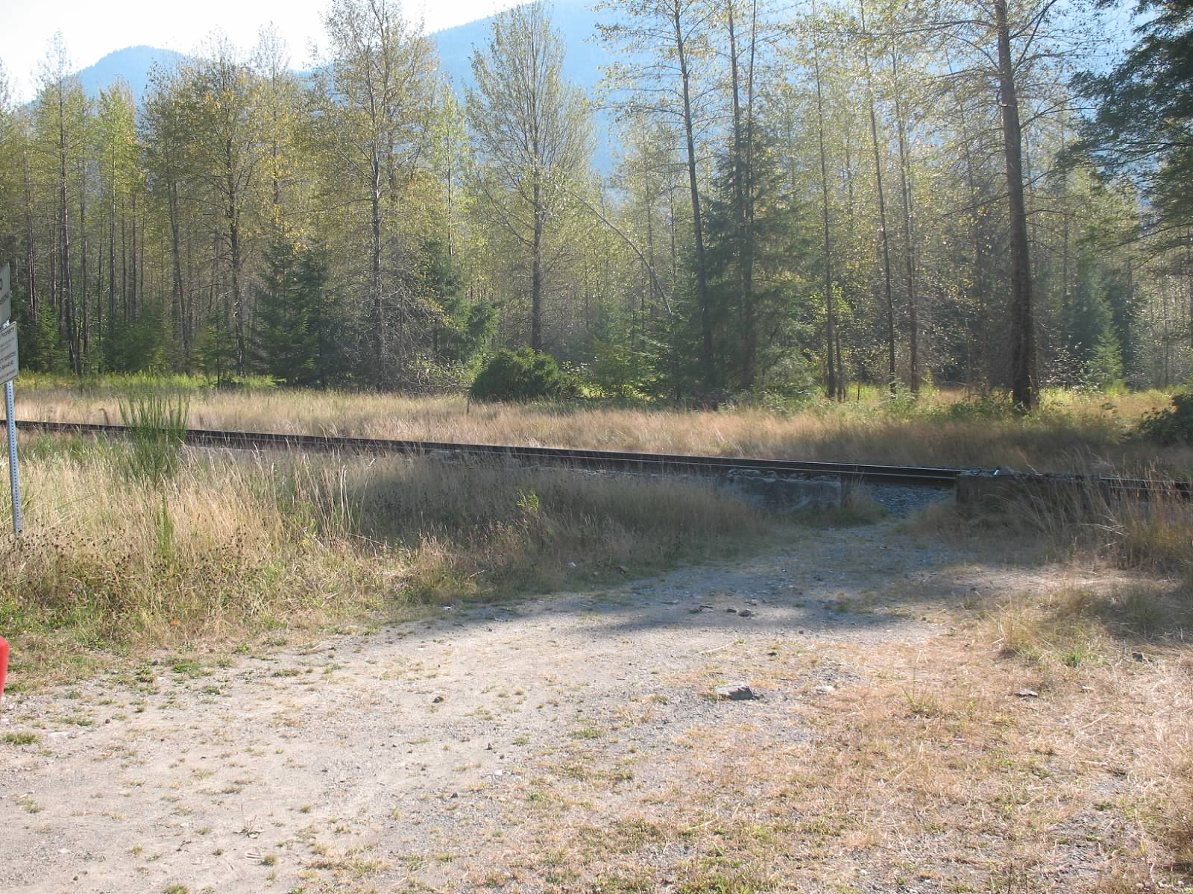
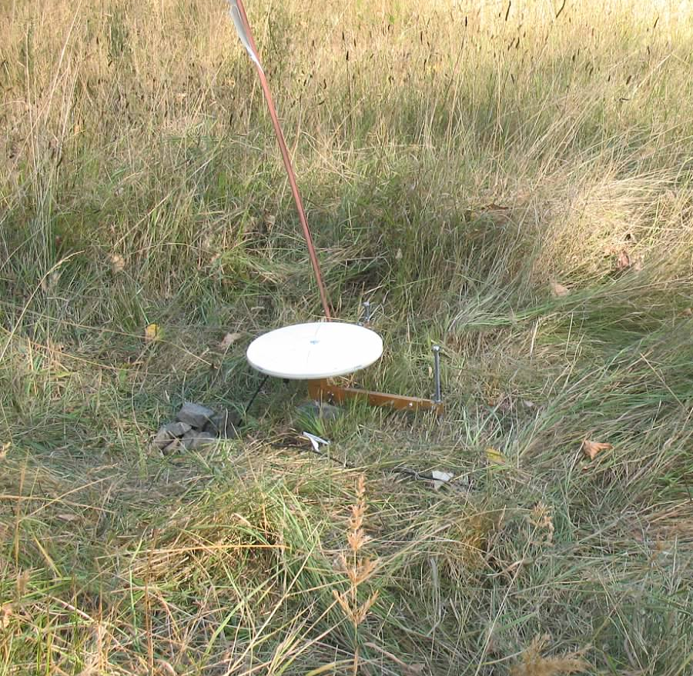
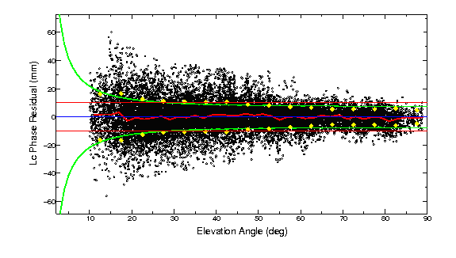
Low mount in a dirty environment
B059
Roadside meadow in western Washington
12.5-cm spike mount
Two 24-hr measurements in 2012 agree at 1 mm horizontal, 4 mm vertical though the formal uncertainties are 2 mm, 10mm due to high random noise (diffuse multipath or water vapor?) Note minimal long-period signal scattering. Long-term scatter is 3 mm horizontal, 5 mm vertical (monument instablity?)

Slide 8
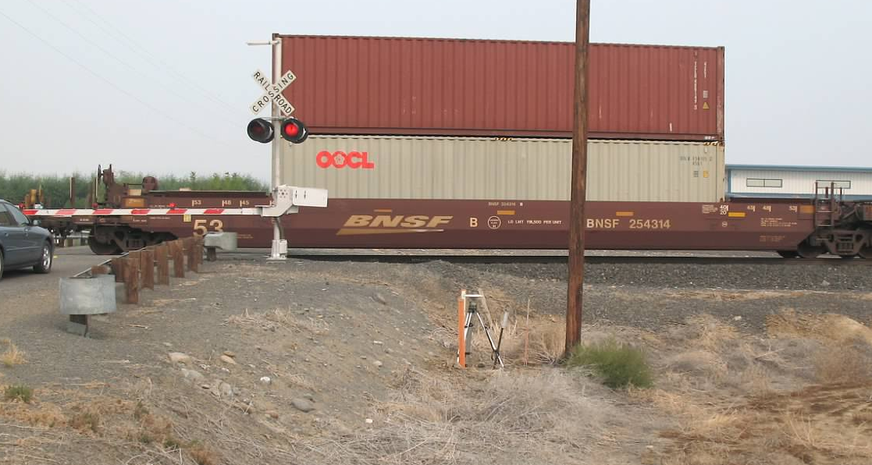
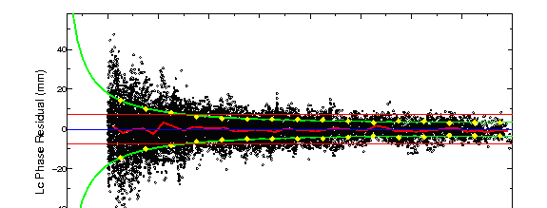
High mount in a dirty environment
C033
Old survey mark in dirt in central Washington.
Tripod mount. (Train blockage was short-lived)
2012 19-hr session and 5-hr session agree at 1.5 mm horizontal, 3 mm vertiical. Long-term repeatability 2 mm horizontal, 12 mm vertical.
Surprisingly little short-period multipath (dry dirt?)

Slide 9
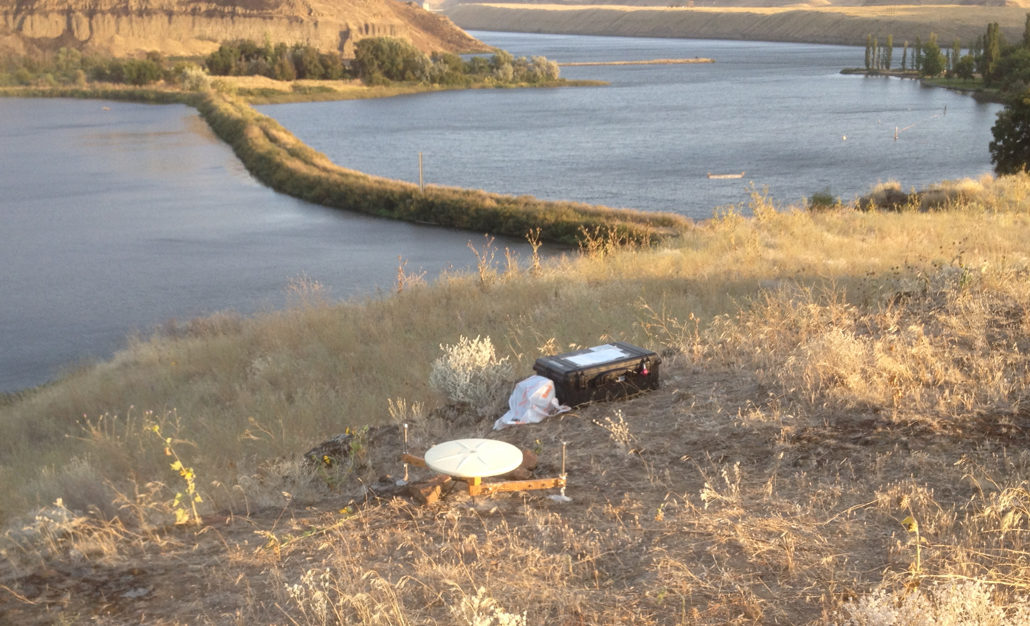
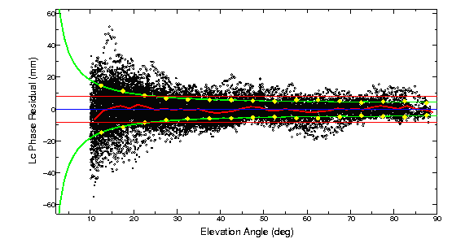
Low mount on a slope
LYFR
Rocky river bank in eastern Oregon
12.5-cm spike mount
Single 14-hr session . Long-period multipath due to slope and/or reflective rocks ?
Notes:
We have yet to determined the relationship between the height of the spike mount and the effect on long-period multipath. Is there a critically bad resonance height (remember that L1 has a wavelength of 19 cm, and L2 24 cm)? We’ve seen some evidence of this with pillars. Is there an optimal height that minimizes the long-period multipath? Possibly, but the curve may be shallow.

Slide 10
Special Characteristics of Survey-mode Data
Editing is critical: every point counts
Usually combined with cGPS data to provide continuity and a tie to the ITRF
Appropriate relative weighting needed in combining with cGPS data
Antenna meta-data may be more complicated
Heights may be problematic if different antennas used
Seasonal errors behave differently than in cGPS data: best strategy is to observe at the same time of the year (unlike cGPS, which has minimal seasonal sensitivity at 1.5, 2.5, 3.5 ….years total span)

Slide 11
Analysis Strategy
Generate time series and aggregated h-files for each survey
  Use spans less than ~ 30 days to avoid biasing the position estimate from an in correct velocity
  Include cGPS data only on days when sGPS data are available to maintain common-mode cancellation
  Strenghens the sGPS positions estimates within each survey and allows better assessment of the long-term statistics
  Edit carefully the daily values within each span
Generate time series and a velocity using the aggregated h-files from a span of 3 or more years
  Edit carefully the long-term time series
  Add 0.5 of white noise (sig_neu) to the cGPS estimates from each span to avoid overweighting the cGPS position estimates
  Use a separate (ie.g PBO) analysis of the daily cGPS time series to get the appropriate RW (mar_neu) values for each cGPS site; use the median RW for the sGPS sites.
See sGPS_recipe.txt for detailed commands
Notes:
The aggregation time should be short enough that errors in the a priori velocity will not cause changes in the a priori position sufficient to bias the adjustments, but long enough to average the short-term noise so that the time series represent the long-term statistics. A practical consideration is how you want to perform the daily editing---only many 5- to 30-day spans where the slope should be nearly zero and the epoch of the point clear, or a few longer spans where daily values may be harder to identify.
The short-course folder also includes the GLOBK command files to be used in the recipe.

Slide 12
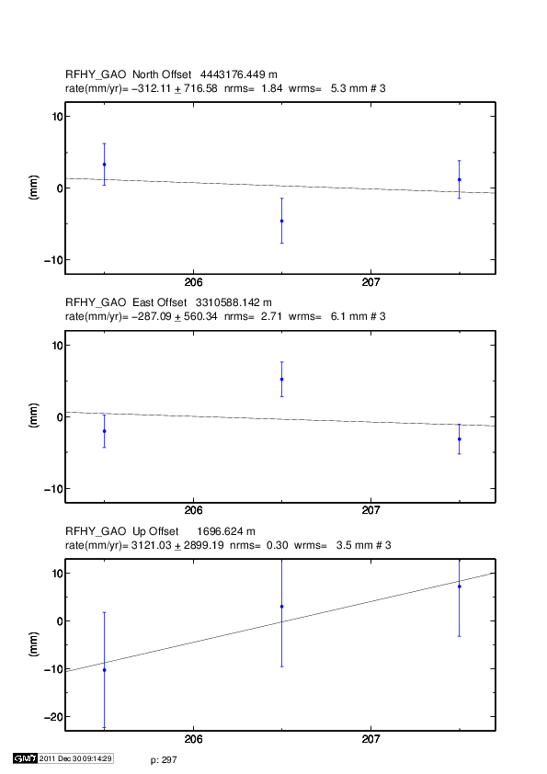
Editing example
Notes:
Both the N and E components here have apparent outliers. If we accept that an nrms of 0.7 is statistically normal for the GAMIT weighting, then the scatter in the N is 2 sigma (95 %,) and the E, 4-sigma. Since the 1st and 3rd pts agree within their uncertainties, it’s probably that the middle point is the outlier. The first thing to do is to examine the log sheets, sky plots, and the time series of other sites occupied on the same day to see if you can confirm that the middle point is indeed the outlier. With this assumption, we would remove ( rename rphy rphy_xps 2008 7 24 0 0 2008 7 24 24 0, in eq_file) or downweight it (e.g. sig_neu rphy .01 .01 0 2008 7 24 0 0 2008 7 24 24 0, in globk_comb.cmd ). Alternatively, and especially if you had only two discordant points and cannot determine which one is bad, you can downweight all of the points (e.g. sig_neu rphy .007 .007 0 2008 7 23 0 0 2008 7 25 24 0). You can also make a note to reexamine these days after you’ve gotten a multi-year time series and can identify whether the N and E estimate for this 2008 survey are too high or two low.

