Slide 1


Utility programs and scripts
M. A. Floyd T. A. Herring
Massachusetts Institute of Technology
GAMIT/GLOBK/TRACK Short Course for GPS Data Analysis
Korea Institute of Geoscience and Mineral Resources (KIGAM)
Daejeon, Republic of Korea
23–27 May 2016
Material from T. A. Herring, R. W. King, M. A. Floyd (MIT) and S. C. McClusky (now ANU)

Slide 2
Outline
Organizing/pre-processing
Part of sh_gamit
Evaluating results
Visualization

Slide 3
Guide to scripts
There are many scripts in the ~/gg/com directory and you should with time look at all these scripts because they often contain useful guides as to how to do certain tasks.
  Look at the programs used in the scripts because these show you the sequences and inputs needed for different tasks
  Scripting methods are useful when you want to automate tasks or allow easy re-generation of results.
  Look for templates that show how different tasks can be accomplished.
~/gg/kf/utils and ~/gg/gamit/utils contain programs invoked by the scripts in /com or run directly from a command-line.
Both the shell-scripts and the utility programs are self-documenting, invoked by typing the name without any arguments.

Slide 4
GAMIT/GLOBK utilities
Organizating/Pre-processing
sh_get_times: List start/stop times for all RINEX files
sh_upd_stnfo: Add entries to station.info from RINEX headers
doy: Convert to/from DOY, YYMMDD, JD, MJD, GPSW
convertc: Transform coodinates (cartesian/geodetic/spherical)
glist: List sites for h-files in gdl; check coordinates, models
cortran/convertc: Translate coordinate types and file formats
corcom: Rotate an apr file to a different plate frame
unify_apr: Set equal velocities/coordinates for glorg equates
glist2cmd: Create a use_site list from a glist file
vel2stab: Create a stab_site list from a velocity org file
sh_dos2unix: Remove the extra CR from each line of a file

Slide 5
GAMIT/GLOBK Utilities (cont)
Scripts used by sh_gamit but useful stand-alone
sh_get_rinex: ftp a RINEX o file from remote archives (ftp_info)
sh_crx2rnx: convert to/from RINEX/Hatanaka
sh_get_nav: ftp a RINEX n file from remote archives
sh_get_met: ftp a RINEX m file from remote archives
sh_get_hfiles: ftp h-files from MIT/SOPAC
sh_update_eop: ftp an EOP file from IERS, create pmu, ut1., wob.
sh_get_orbits: ftp a g-file or sp3 file from remote archives, call -->
sh_sp3fit: create a g- or t-file from an sp3 file (1-3 days)

Slide 6
GAMIT/GLOBK Utilities (cont)
Evaluating results
sh_oneway: Plot phase residuals (sky map; vs elevation) [GMT]
sh_plotelmean: Elevation angles average residuals plots [GMT]
cview: Display and manipulate phase residuals [X-windows]
sh_plot_pos: Plot coordinate times series [GMT]
sh_tshist: Plot histogram of time-series statistics [GMT]
tsview: Display and manipulate coordinate time series [MATLAB]
sh_plotvel: Plot velocity maps [GMT]
sh_map_elements, sh_map_calif, sh_map_balkans, etc.
velview: Display and manipulate velocity maps [MATLAB]
sh_velhist: Plot histogram of velocity statistics
sh_org2vel: Extract plate-referenced velocities from glorg print file
velrot: Combine velocity fields from different analyses

Slide 7
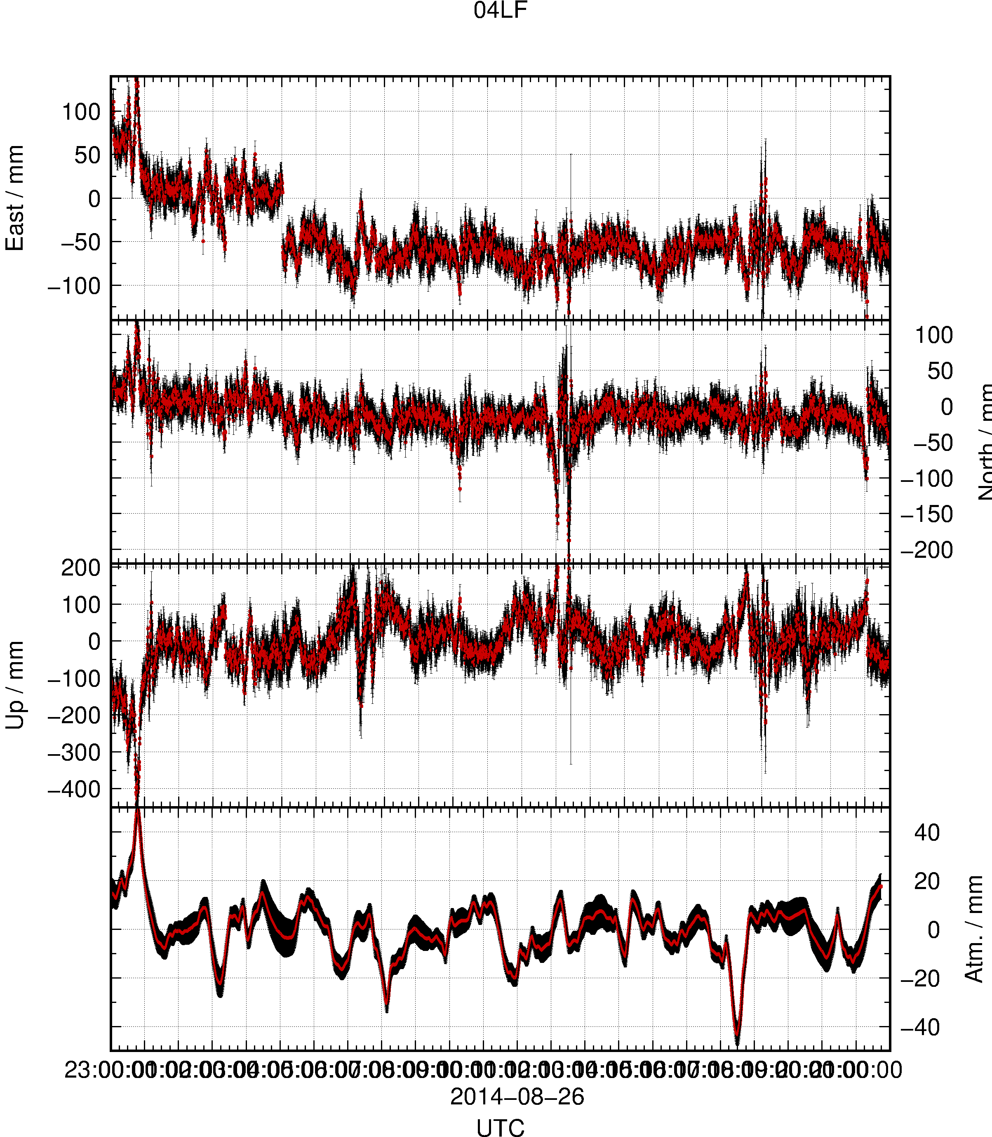
sh_plot_track
Reads track “NEU”, “DHU” or “XYZ” output file
May add subplot to view evolution of atmospheric delay

Slide 8
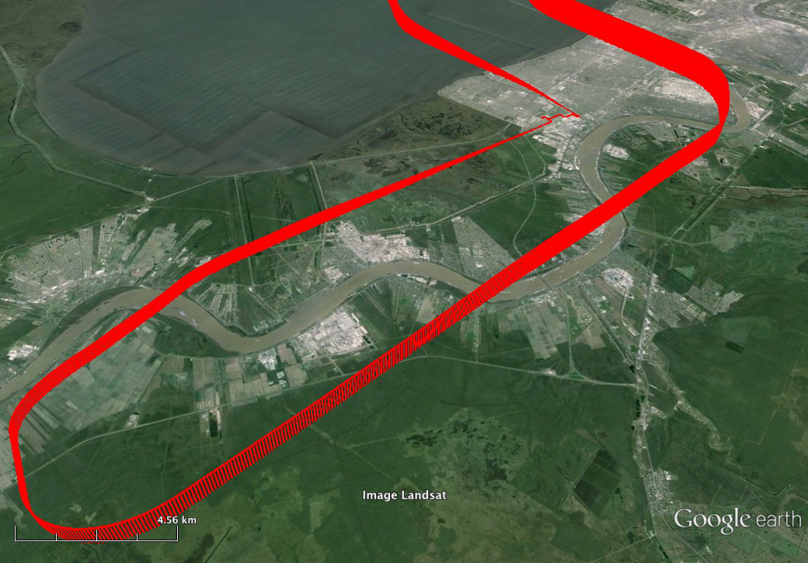
sh_kml
Script for converting several formats of result into KML format for viewing in Google Earth
  glist (may also be used with time slider)
  “.org”-file / “.vel”-file
  track “GEOD”-format output file

