Slide 1



GPS measurements in the field
M. A. Floyd
Massachusetts Institute of Technology, Cambridge, MA, USA
School of Earth Sciences, University of Bristol
United Kingdom
2–5 May 2017
Material from T. A. Herring, R. W. King, M. A. Floyd (MIT) and S. C. McClusky (now ANU)
http://web.mit.edu/mfloyd/www/courses/gg/201705_Bristol/

Slide 2
Outline
Survey setups
Potential errors
  Human error
  Monument error
  Seasonal error
  System error
Hands-on equipment

Slide 3
Survey setups
May be done with:
  Tripod
  Spike mount
  Pole
Intentions:
  Set antenna horizontal
  Ensure antenna is centered above survey mark (necessarily requires that the antenna mount is set horizontal)
  Align antenna conventional mark to true north

Slide 4
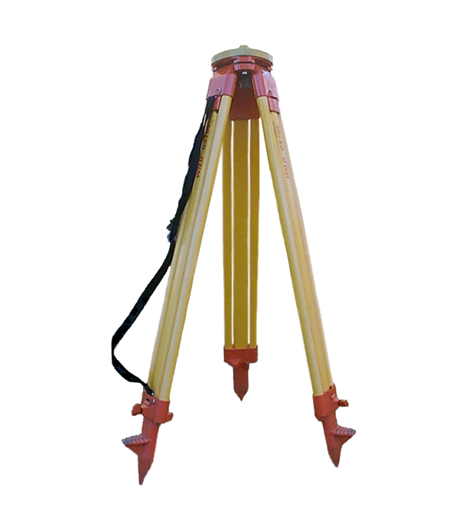
Surveyor’s tripod
Advantages:
  Easily portable
  Stable on flat ground
Disadvantages:
  Inconsistent height setup (variable multipath)
  Easily disturbed
http://facility.unavco.org

Slide 5
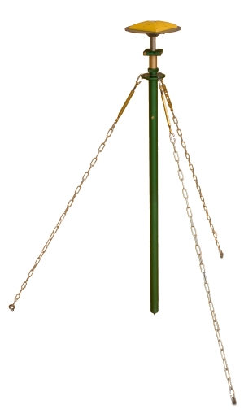
Fixed-height mast (e.g. Tech2000)
Advantages:
  Automatically centered
  Fixed height (reduces human error)
  Stable
  Identical multipath environment each setup
Disadvantages:
  Difficult first-time placement due to anchor installation (also requires large, hard surface)
http://facility.unavco.org
Notes:
http://facility.unavco.org/kb/questions/202/Tech2000+GNSS+Antenna+Mast

Slide 6
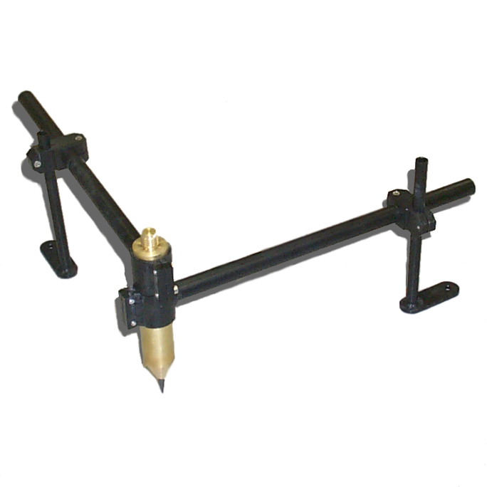
Spike mounts
Advantages:
  Fixed height (reduces human error)
Disadvantages:
  Awkward to level precisely and orientate antenna
  Proximity to ground may increase direct multipath signal
http://facility.unavco.org

Slide 7
Basic rules for any setup
Know how well your equipment is calibrated, and how to calibrate or verify its accuracy if necessary
  A 1-D level is a very useful tool to have!
Iterate using finer and finer adjustments
  It’s a rare day that the best of us find an acceptably accurate setup the first time
Always work upward from the base of a tripod setup
  Fix the legs once an approximate (within a few cm) position is achieved
  Work exclusively with the tribrach on the platform thereafter
Always level the (optical) plummet before assessing the centering, especially after making adjustments

Slide 8
Human error

Slide 9
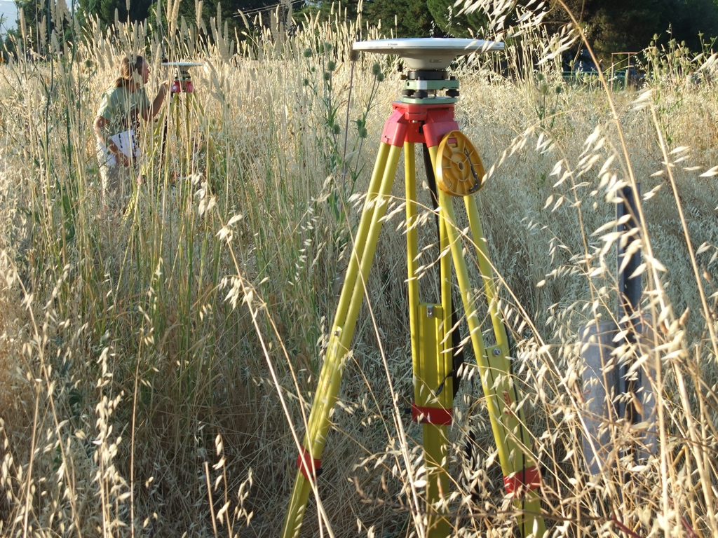
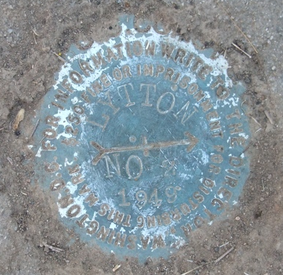
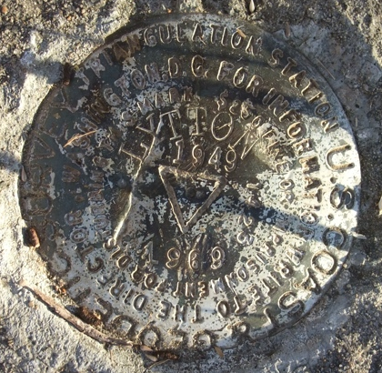
Location errors
Photograph by M. Floyd
Photograph by M. Floyd
Photograph by M. Floyd
Notes:
Made especially difficult by the head-high grass!

Slide 10
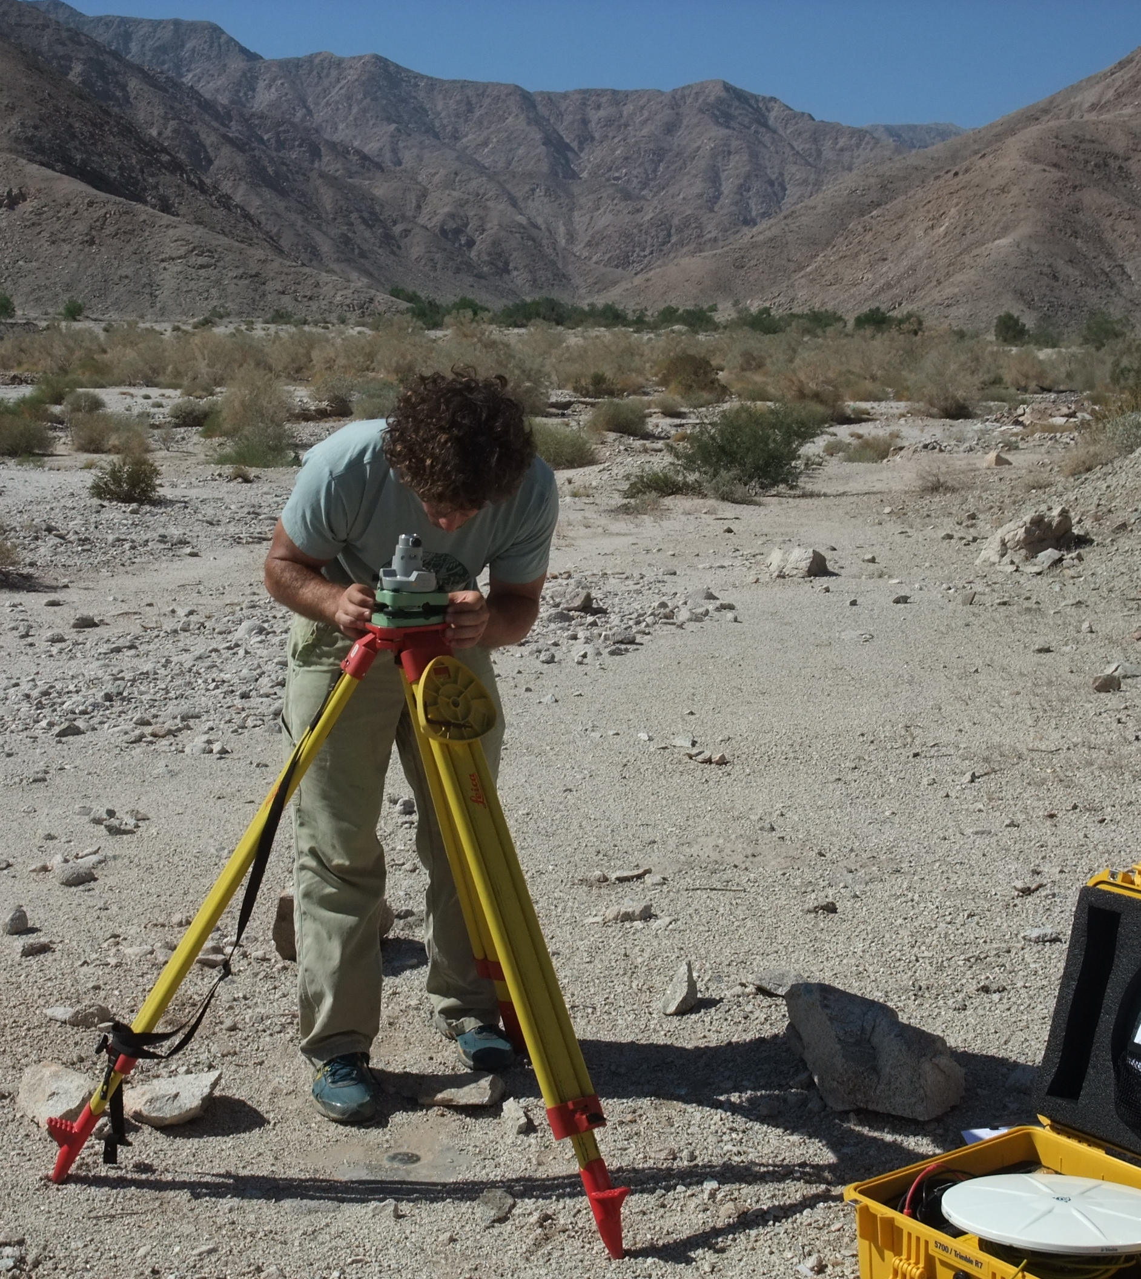
Setup errors
Episodic survey setups can mean that measurements are not centered perfectly over a mark or the antenna height not measured accurately
These measurements tend to exhibit an independent and random nature
Photograph by M. Floyd

Slide 11
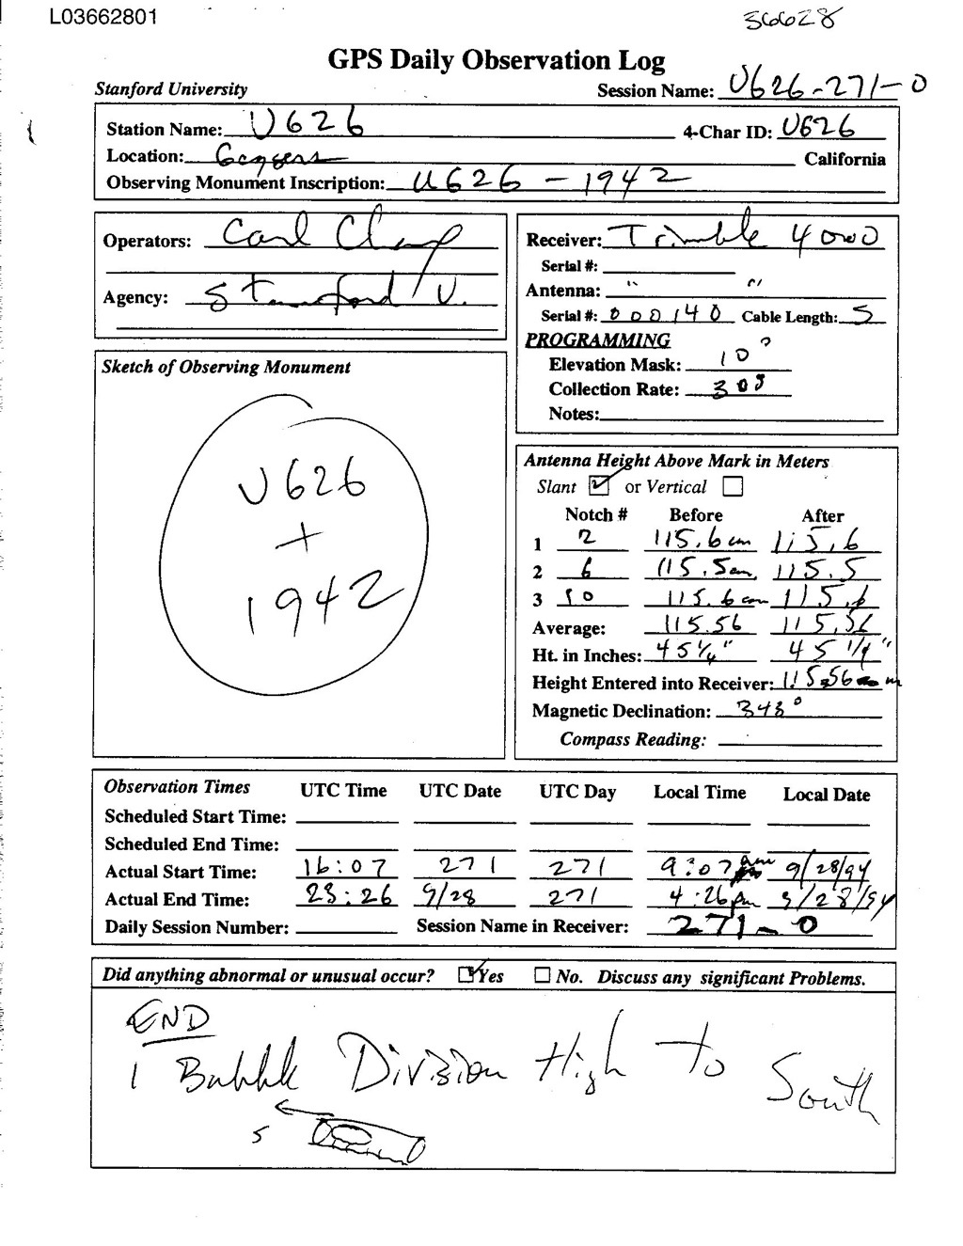
Archive errors
2.10 OBSERVATION DATA G (GPS) RINEX VERSION / TYPE
teqc 2006Jul20 UNAVCO Archive Ops 20060725 16:48:29UTCPGM / RUN BY / DATE
Solaris 5.9|UltraSparc IIi|cc -xarch=v9 SC5.5|=+-|*Sparc COMMENT
BIT 2 OF LLI FLAGS DATA COLLECTED UNDER A/S CONDITION COMMENT
U626 MARKER NAME
U626 MARKER NUMBER
UNKNOWN Stanford University OBSERVER / AGENCY
3414A05687 TRIMBLE 4000SSE NP 5.71 / SP 1.26 REC # / TYPE / VERS
3015A00136 TRM14532.00 ANT # / TYPE
-2683218.3014 -4185018.7102 3983204.9361 APPROX POSITION XYZ
1.4755 0.0000 0.0000 ANTENNA: DELTA H/E/N
1 1 WAVELENGTH FACT L1/2
5 L1 L2 C1 P1 P2 # / TYPES OF OBSERV
30.0000 INTERVAL
1994 9 28 16 7 30.0000000 GPS TIME OF FIRST OBS
END OF HEADER
94 9 28 16 7 30.0000000 0 5G 5G 6G17G20G24
2437477.48856 1792564.39355 22428902.4774 22428904.8324
-548226.77657 -402556.82256 20834866.1484 20834867.2274
-567509.56556 -371824.37155 22860949.9614 22860952.7034
1203057.74657 883752.12057 20612879.2734 20612882.3204
793138.12755 501650.82355 22928979.6334 22928982.6914

Slide 12
Monument error

Slide 13
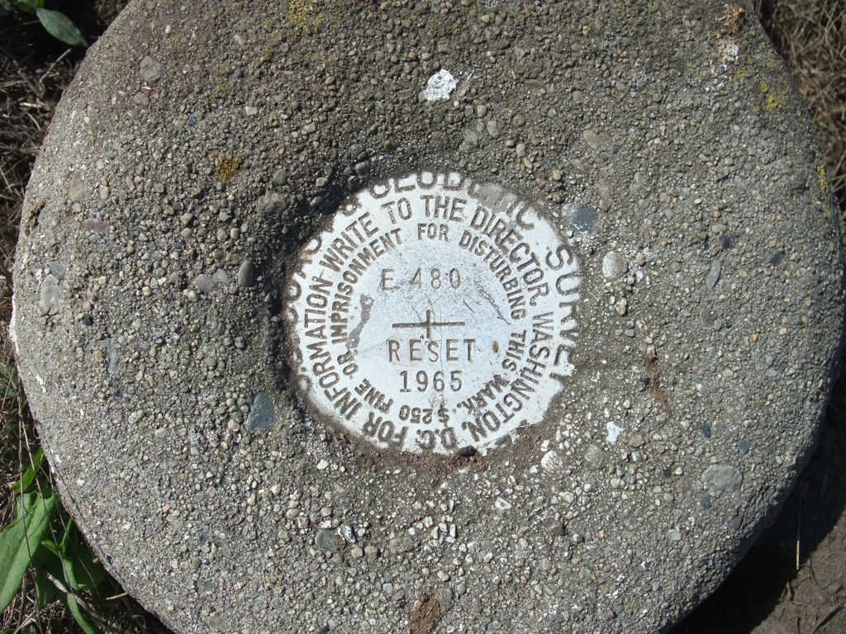
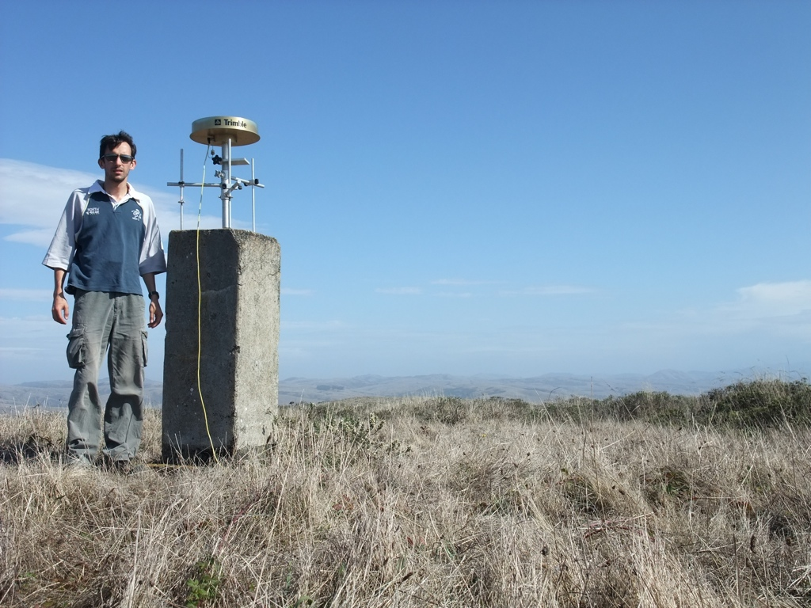
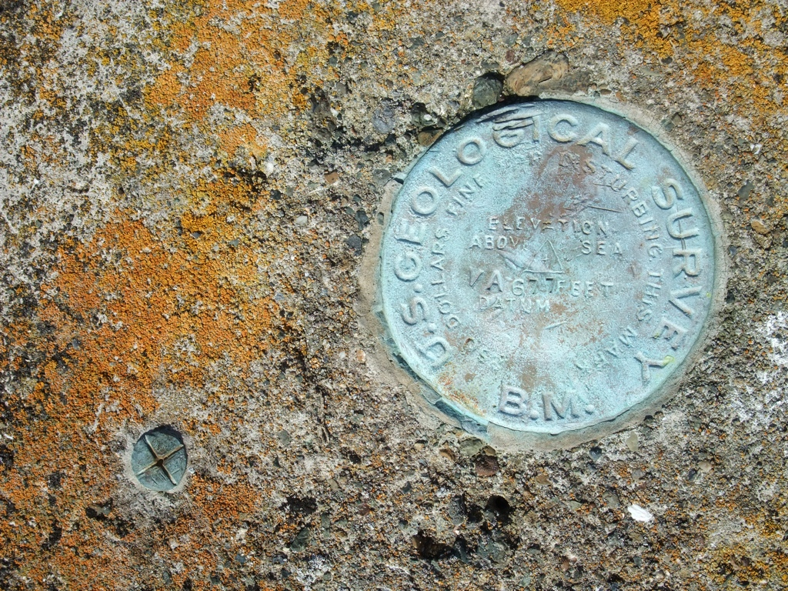
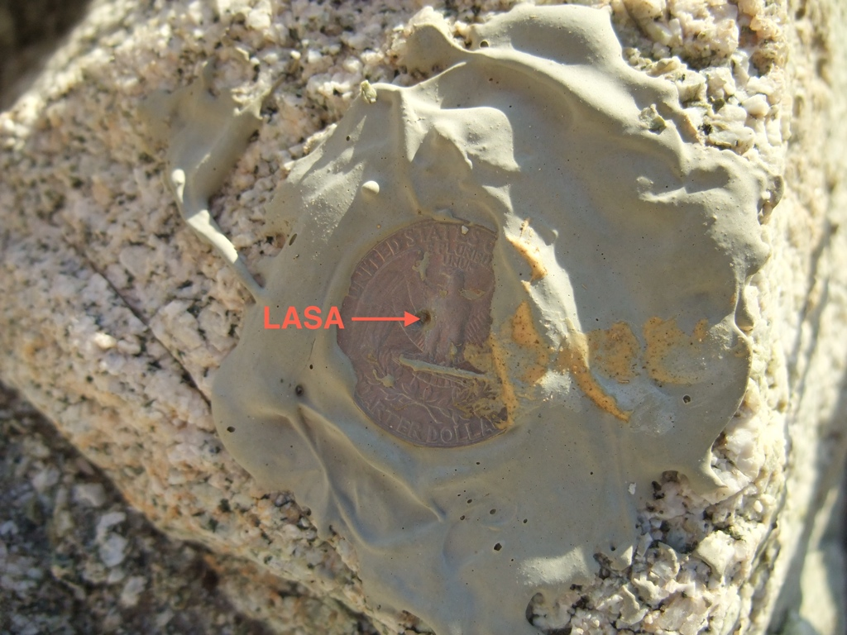
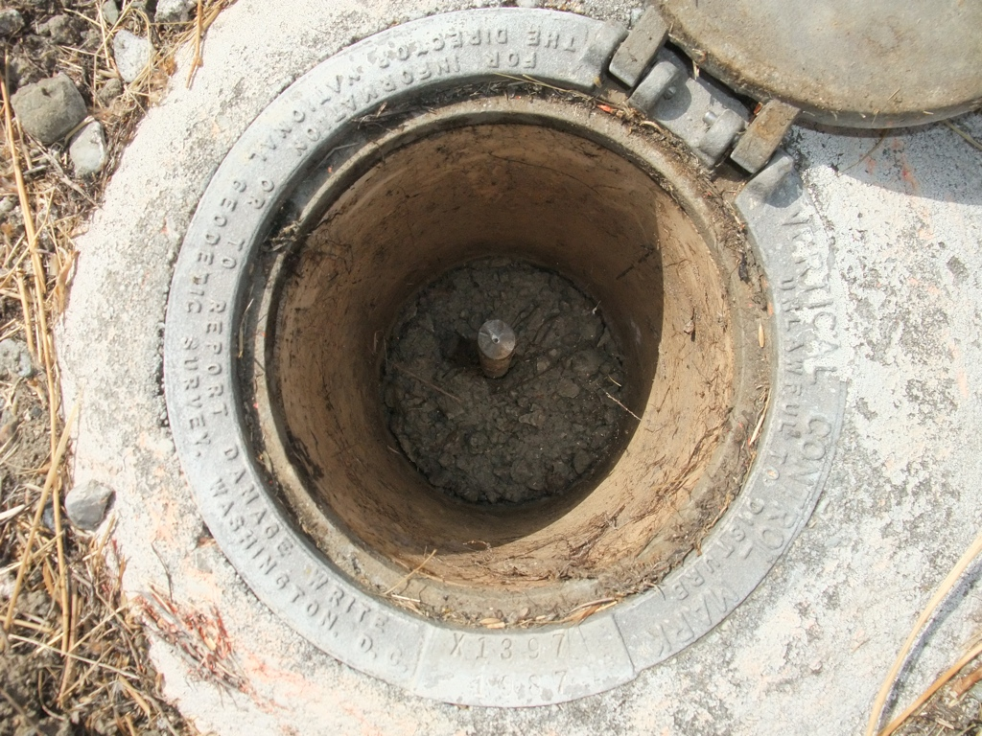
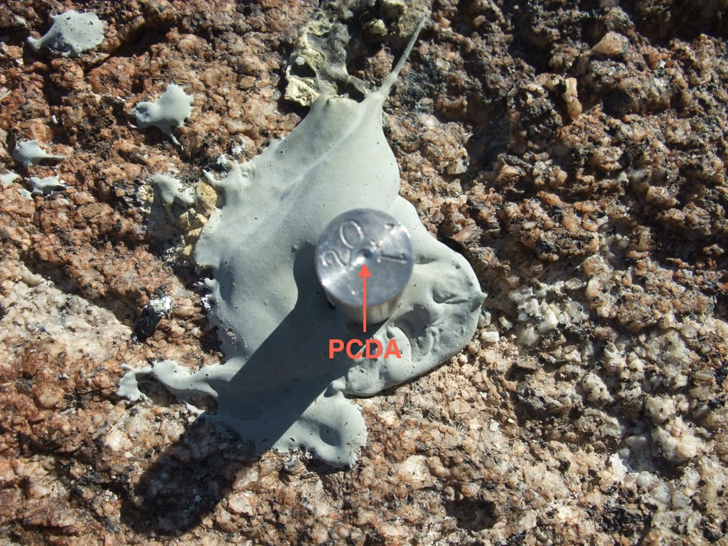
Survey marks
Cast plates
Concrete pillars
Glued punched coin
Driven rods
Drilled pin

Slide 14
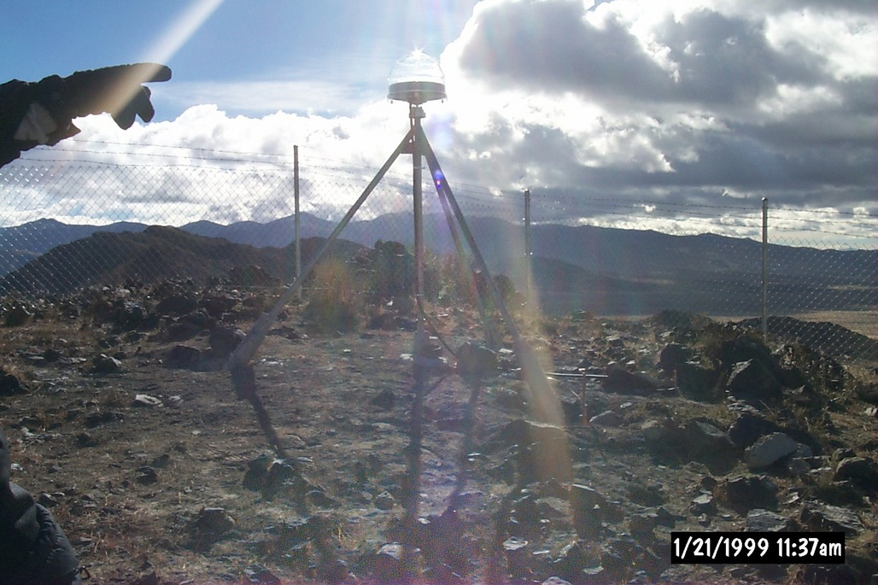
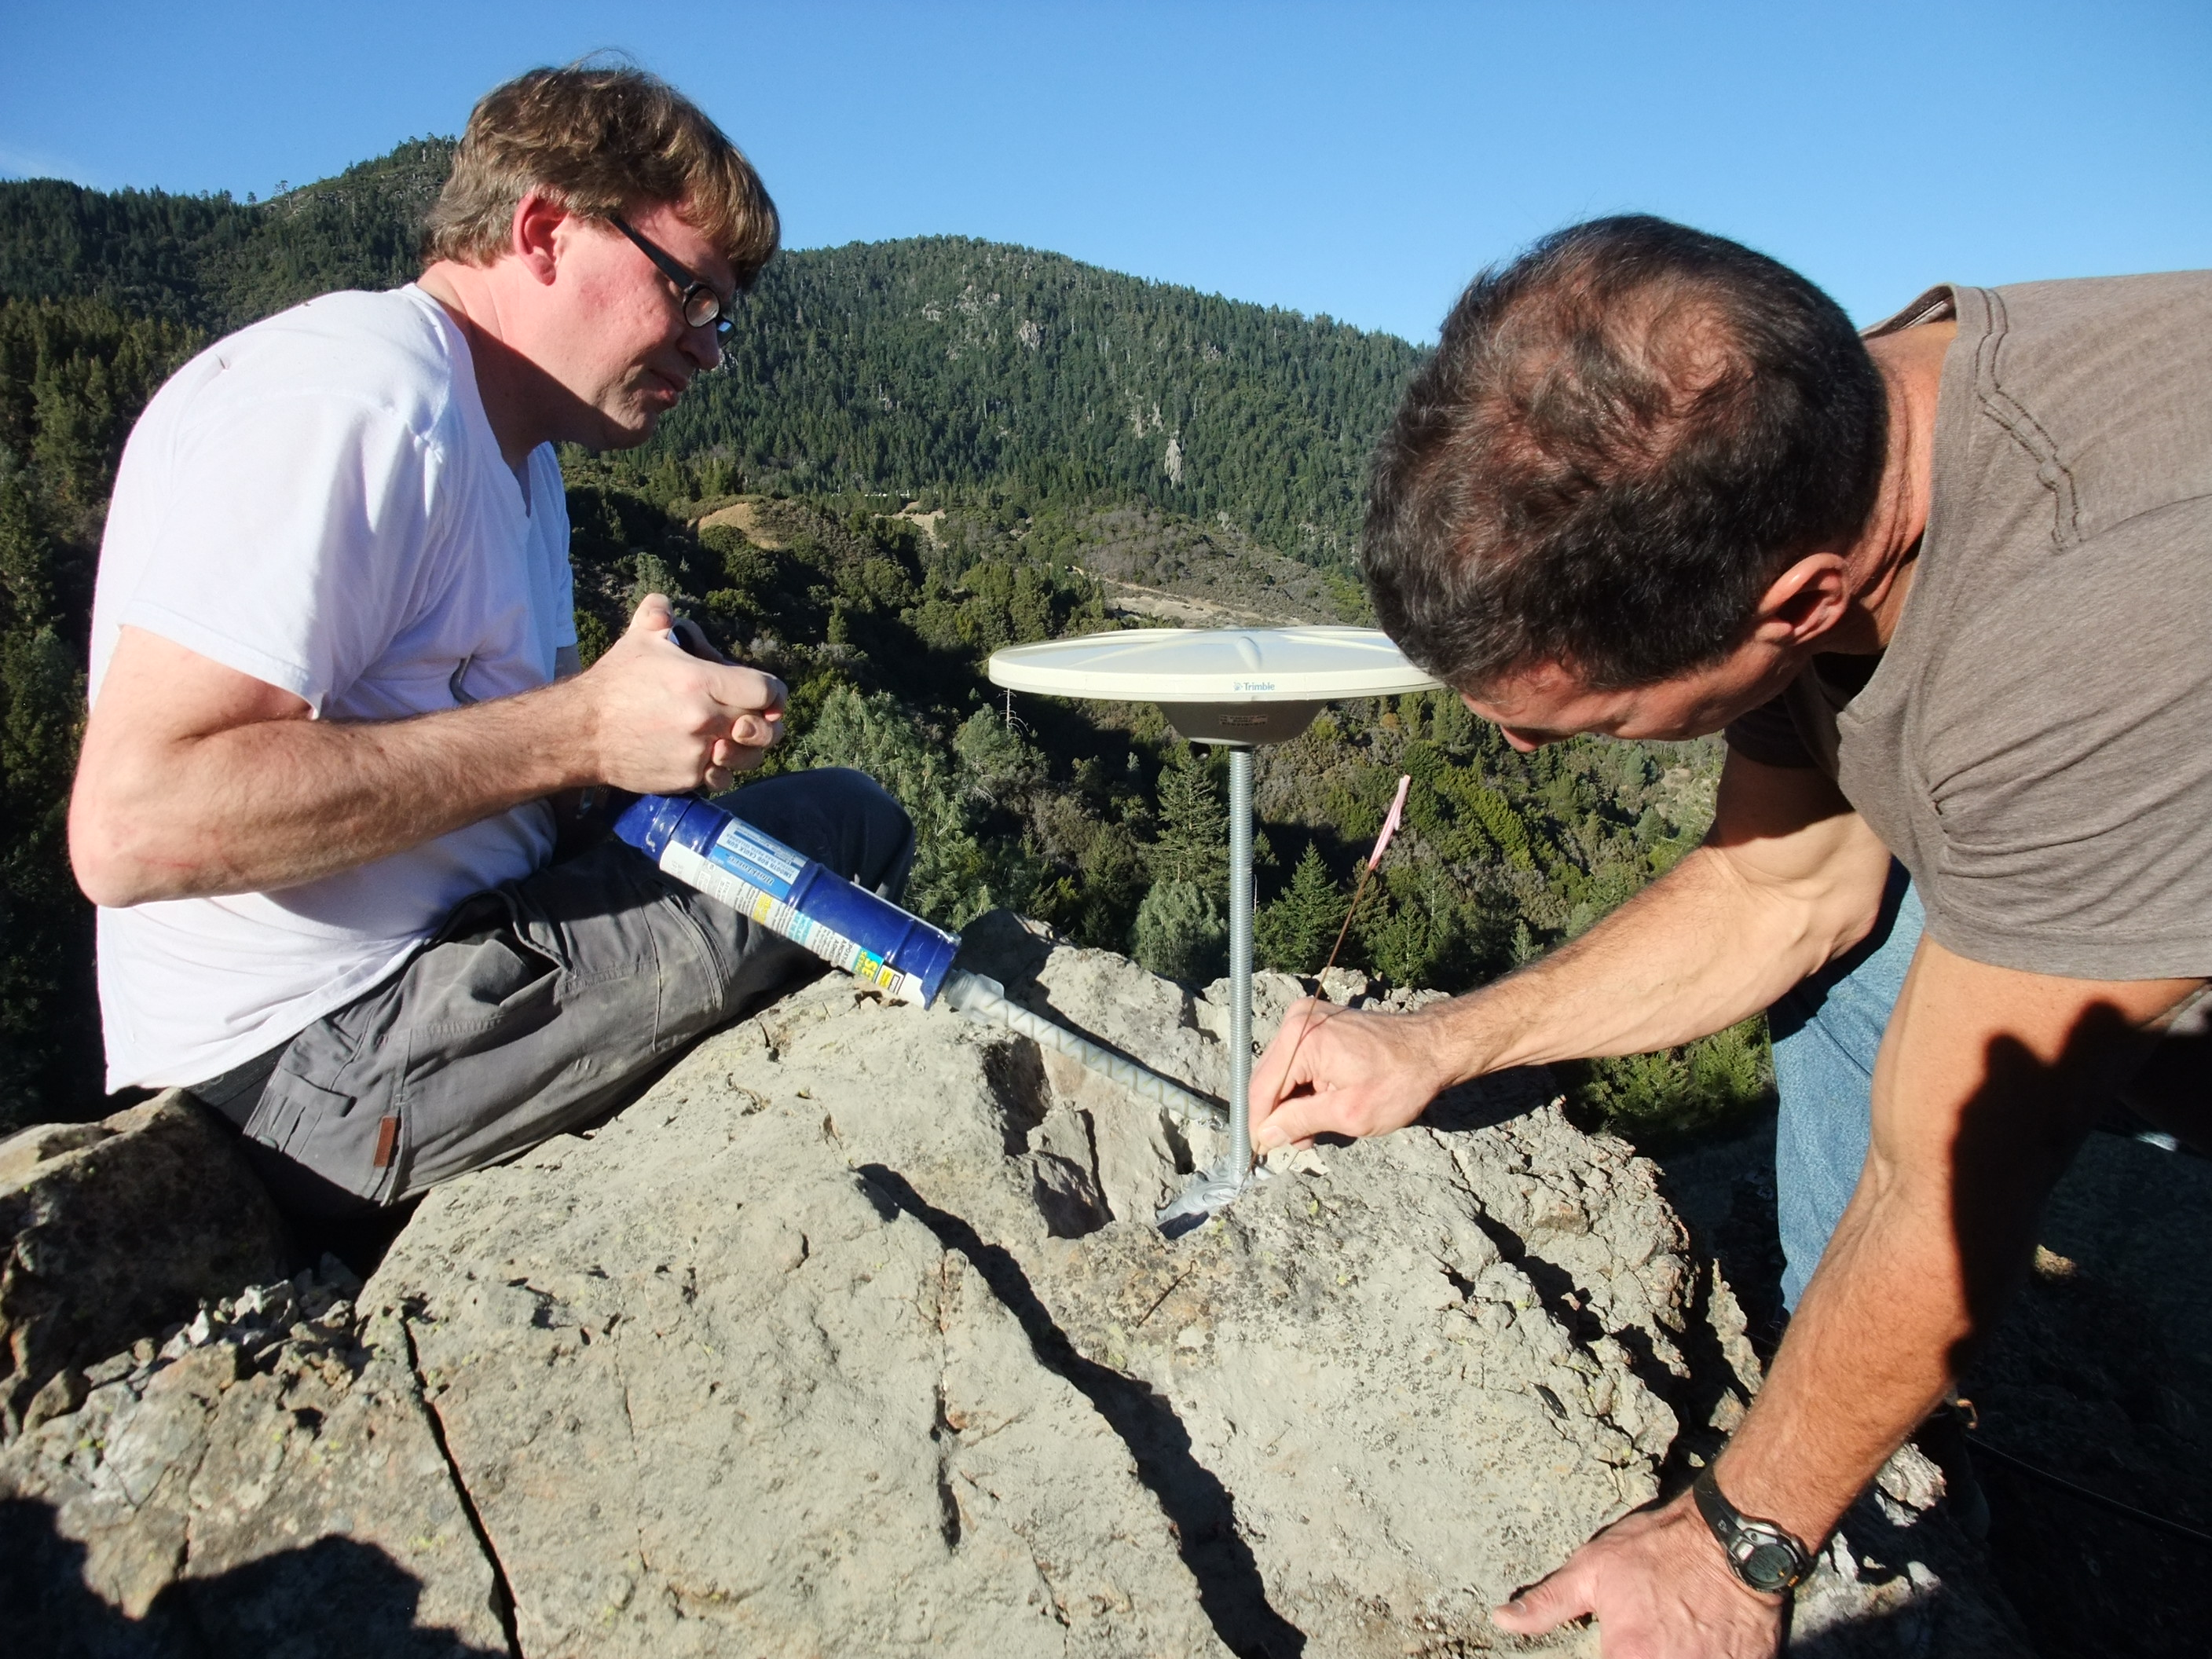
Monuments for tectonics (best)
Drilled monuments
Shallow rod in bedrock
Attached to solid bedrock
Very stable
Must be secured somehow
Attached to solid bedrock
Cheap and easy to install
Must be secured somehow

Slide 15
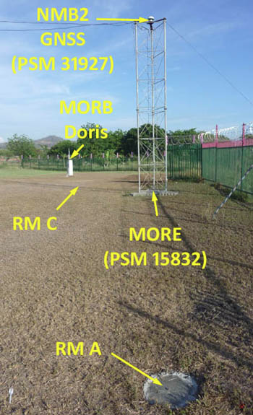
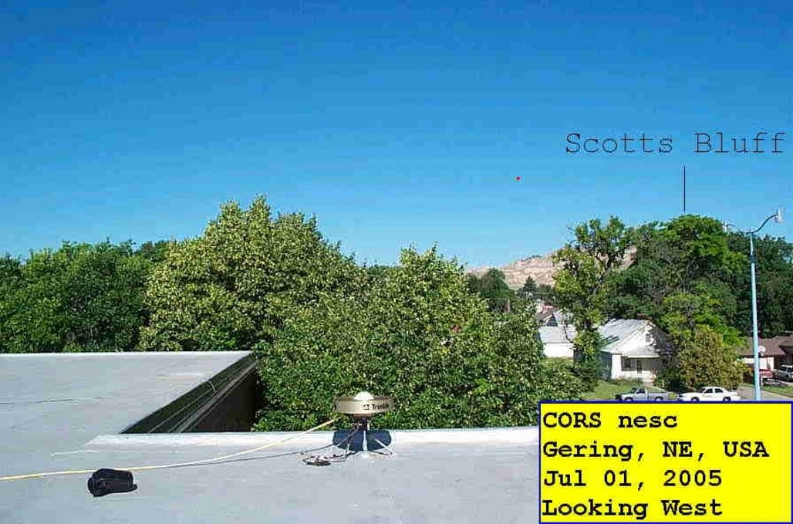
Monuments for tectonics (other)
High metal masts
Roofs of buildings
Generally secure
Suffer from heat expansion and contraction
May suffer from unstable foundation
Easily accessible
Generally secure
No knowledge of building foundation stability

Slide 16
Seasonal error

Slide 17
Groundwater variations
Wet ground may
expand and uplift but
additional load also
produces subsidence
Dry ground may
contract and subside
but reduced load also
produces uplift
Spring
Winter
Summer
Fall

Slide 18
System error

Slide 19
Propagation effects
Ionosphere
  Frequency-dispersive layer causes differential delay of L1 and L2 as a function of (unknown) total electron content (TEC)
Troposhere
  Delay through medium, especially water in atmosphere
Clock errors
  Offsets and drift of receiver and satellite clocks affects time, and therefore phase/distance, measurement
Multipath
  Back-scattering of signal interferes with direct signals
  Random: no good method for mitigation or modeling

Slide 20
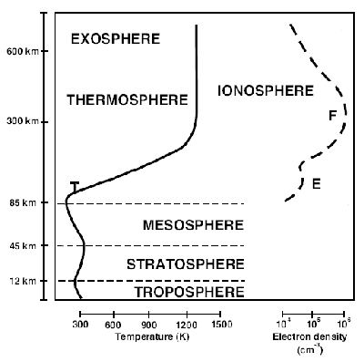
Atmospheric effects
Ionosphere
  delay ∝ 1/f²
Troposphere
  “Dry” delay
  “Wet” delay

Slide 21
Time series noise characteristics

Slide 22
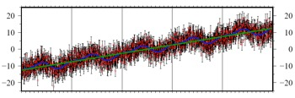
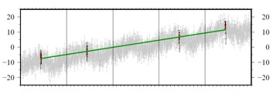
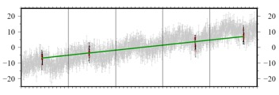
Survey timing
“Survey” 1
Continuous
“Survey” 2
 | x₀ | v | A₀ | τ₀ | A₁ | τ₁ | ε
Input | −12.5 mm | 5 mm/yr | 2 mm | 1.88 (0.3 yr) | 1 mm | 5.65 (0.45 yr) | 3 mm
Continuous * | −12.41 mm | 4.93 mm/yr | 1.82 mm | 1.93 (0.31 yr) | 0.91 mm | 5.48 (0.44 yr) | 3.07 mm
“Survey” 1 | −9.55 mm | 4.72 mm/yr | - | - | - | - | -
“Survey” 2 | −8.21 mm | 3.21 mm/yr | - | - | - | - | -
* Maximum likelihood estimation of velocity and periodic terms, given a noise model

Slide 23
“Unknown” error?
A potential error is anything that is not accounted for by a modeled or estimated parameter

