Slide 1


Time series and error analysis
M. A. Floyd
Massachusetts Institute of Technology, Cambridge, MA, USA
GPS Data Processing and Analysis with GAMIT/GLOBK
Earth Observatory of Singapore
17–21 July 2017
http://geoweb.mit.edu/~floyd/courses/gg/201707_EOS/
Material from R. W. King, T. A. Herring, M. A. Floyd (MIT) and S. C. McClusky (now at ANU)

Slide 2
Issues in GNSS error analysis
What are the sources of the errors ?
How much of the error can we remove by better modeling ?
Do we have enough information to infer the uncertainties from the data ?
What mathematical tools can we use to represent the errors and uncertainties ?
Notes:
Sources tell us: maximum sizes, frequency content and correlation times..
Modeling: always want to remove or whiten if possible: add parameters
Data span long enough and density great enough to “see” the behavior of the time series
Tools: spectral analysis to infer characteristics; program models and controls to implement

Slide 3
Determining the uncertainties of GNSS parameter estimates
Rigorous estimate of uncertainties requires full knowledge of the error spectrum, both temporal and spatial correlations (never possible)
Sufficient approximations are often available by examining time series (phase and/or position) and reweighting data
Whatever the assumed error model and tools used to implement it, external validation is important
Notes:
Fulll knowledge of the errors would require knowing the magnitude and correlations of every error at every epoch and place.
Implication of Points 1 and 2 may be that we shouldn’t try to be rigorous; rather, we need to understand and account for the dominant errors at the frequencies we’re most interested in.

Slide 4
Tools for error analysis in GAMIT/GLOBK
GAMIT
“AUTCLN reweight = Y” (default in sestbl.) uses phase rms from postfit edit to reweight data with constant + elevation-dependent terms
GLOBK
Rename (eq_file) to “_XPS” or “_XCL” to remove outliers
“sig_neu” adds white noise by station and span
  Best way to “rescale” the random noise component
  A large value can also substitute for “_XPS”/“_XCL” renames for removing outliers
“mar_neu” adds random-walk noise
  Principal method for controlling velocity uncertainties
In the gdl-files, rescale variances of an entire h-file
  Useful when combining solutions from with different sampling rates or from different programs (Bernese, GIPSY)
Utilities
tsview and tsfit can generate “_XPS” commands graphically or automatically
grw and vrw can generate “sig_neu” commands with a few key strokes
FOGMEx (“realistic sigma”) algorithm implemented in tsview (MATLAB) and tsfit/ensum
  sh_gen_stats generates “mar_neu” commands for globk based on the noise estimates
sh_plotvel (GMT) allows setting of confidence level of error ellipses
sh_tshist and sh_velhist (GMT) can be used to generate histograms of time series and velocities

Slide 5
Sources of error
Signal propagation effects
  Receiver noise
  Ionospheric effects
  Signal scattering (antenna phase center / multipath)
  Atmospheric delay (mainly water vapor)
Unmodeled motions of the station
  Monument instability
  Loading of the crust by atmosphere, oceans, and surface water
Unmodeled motions of the satellites
Notes:
The three categories listed here provide a useful way to think about errors in GPS measurements. For studying global phenomena they are all potentially important, but we’ll concentrate on measurements at continental and regional scales. For these inter-site distances, we now know the orbits of the satellites well enough that their contribution is usually small. So we’ll look at effects in signal propagation and uninteresting motions of the receiving antenna. In signal propagation, first order ionospheric effects are removed in all high precision work by combining signals at the two GPS frequencies. And for modern observations, receiver noise is nearly negligible. So we’re left with scattering effects and the atmosphere. These two sources of error are examined in more detail in the ‘Concept in GPS Analysis lecture from Monday.

Slide 6
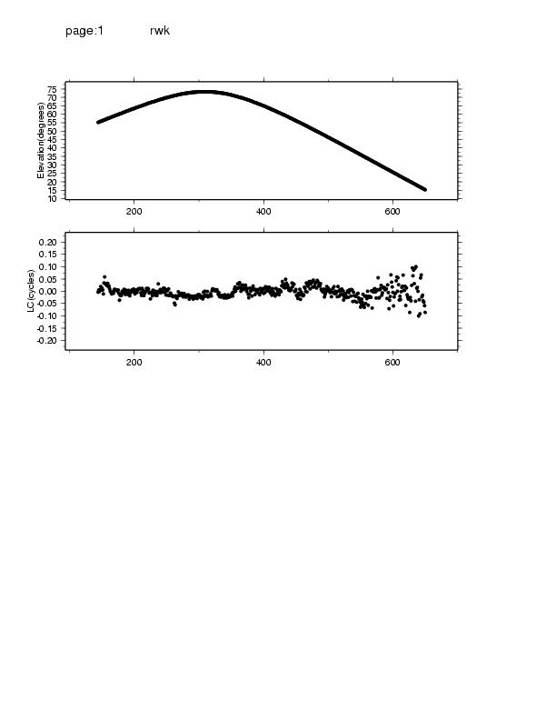
Characterizing phase noise
Epochs
20
0 mm
-20
1 2 3 4 5
Hours
Elevation angle and phase residuals for single satellite
Notes:
This slide, produced from a cview display, will give us a feel for the phase noise of a “typically good” antenna environment.
Shows 30s samples of the one-way LC phase residuals after removing clock drift and the best-fit geometric model and clock. Also shown is the elevation angle of the observations. The overall rms is 8 mm (0.04 cycles), but the scatter increases from 2 mm at the zenith to 15 mm at low elevations, due both to increased multipath and atmospheric effects. For this reason, GAMIT weights the phases by an elevation-dependent model derived (by AUTCLN) for each station. At high elevations the dominant errors have correlation times of about 25 minutes. If we use the default sampling of SOLVE (2 minutes) and scale by the nrms (the usual procedure to make chi2=1) these “formal” uncertainties will be too small by a factor of about sqrt(25/2), 3.5, because we have treated every (2-minute) sample as independent though only about every 12th point is independent. Because of this, GAMIT does not rescale by the nrms, typically 0.2, and we get q-file uncertainties that are only about 30% too small (3.5/5) if our eye-ball estimate of temporal correlations is representative of the full error spectrum. As we shall see, the median value of short-term scatter in daily positions is typically ~0.7, confirming our “eyeball” estimate of correlation times. Note that the formal solve sigma (but not the real sigma!) depends on the sampling. These values apply with 2-minute sampling and elevation-dependent weighting. if you use, for example, 30s sampling in SOLVE (Decimation factor = 1), then you’ve oversampled by another factor of 4 and your formal errors will be too small by another factor of 2.

Slide 7
Characterizing phase noise
Notes:
This slide, produced from a cview display, will give us a feel for the phase noise of a “typically good” antenna environment.
Shows 30s samples of the one-way LC phase residuals after removing clock drift and the best-fit geometric model and clock. Also shown is the elevation angle of the observations. The overall rms is 8 mm (0.04 cycles), but the scatter increases from 2 mm at the zenith to 15 mm at low elevations, due both to increased multipath and atmospheric effects. For this reason, GAMIT weights the phases by an elevation-dependent model derived (by AUTCLN) for each station. At high elevations the dominant errors have correlation times of about 25 minutes. If we use the default sampling of SOLVE (2 minutes) and scale by the nrms (the usual procedure to make chi2=1) these “formal” uncertainties will be too small by a factor of about sqrt(25/2), 3.5, because we have treated every (2-minute) sample as independent though only about every 12th point is independent. Because of this, GAMIT does not rescale by the nrms, typically 0.2, and we get q-file uncertainties that are only about 30% too small (3.5/5) if our eye-ball estimate of temporal correlations is representative of the full error spectrum. As we shall see, the median value of short-term scatter in daily positions is typically ~0.7, confirming our “eyeball” estimate of correlation times. Note that the formal solve sigma (but not the real sigma!) depends on the sampling. These values apply with 2-minute sampling and elevation-dependent weighting. if you use, for example, 30s sampling in SOLVE (Decimation factor = 1), then you’ve oversampled by another factor of 4 and your formal errors will be too small by another factor of 2.

Slide 8
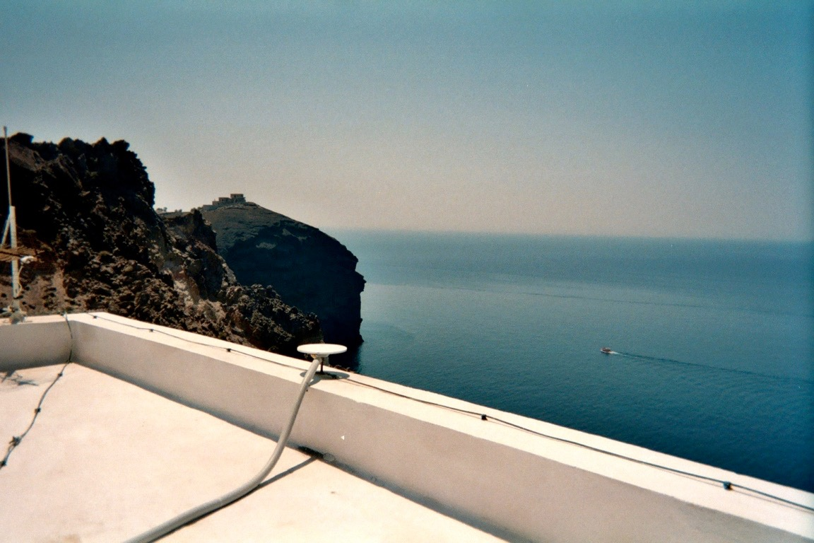
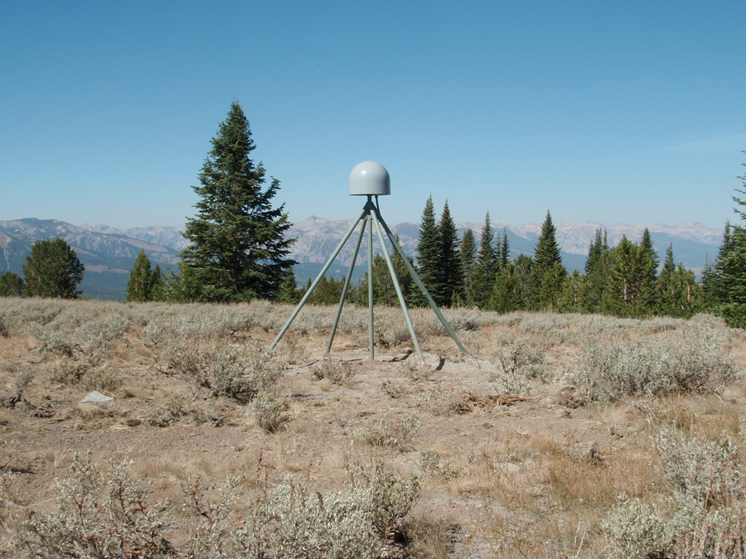
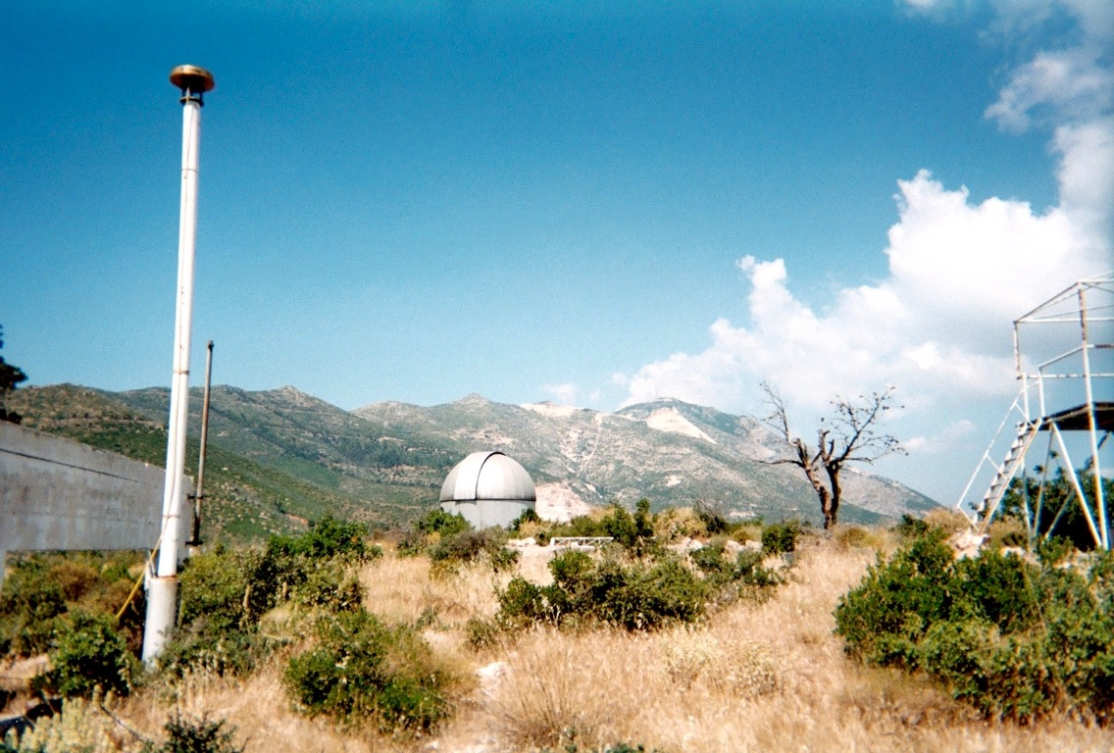
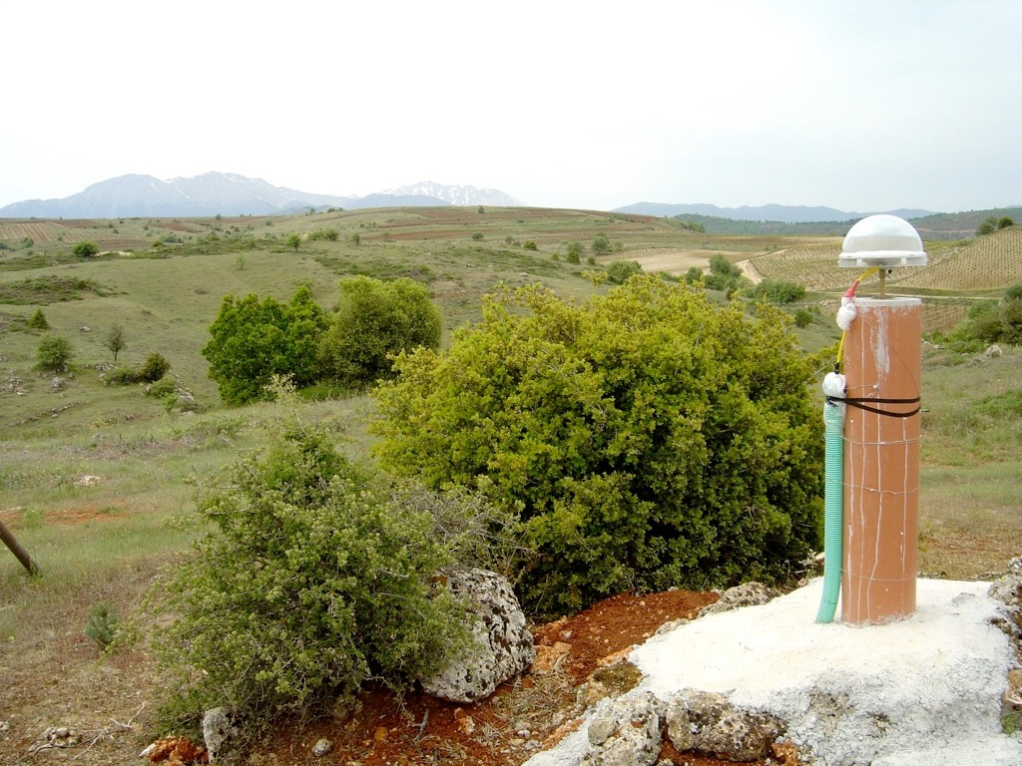
Monument types
http://pbo.unavco.org/instruments/gps/monumentation
Walls
Deep-bracing
Reinforced concrete pillars
Poles
Notes:
Each has their own relation to wind, water, heat, etc. This can be manifested in time series.

Slide 9
Time series characteristics

Slide 10
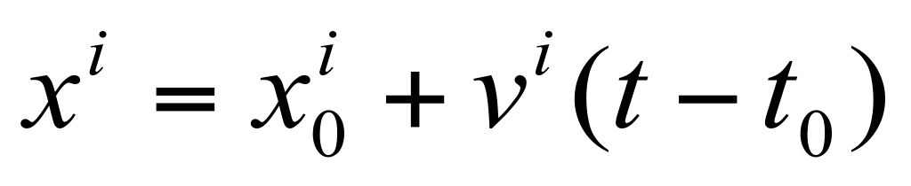
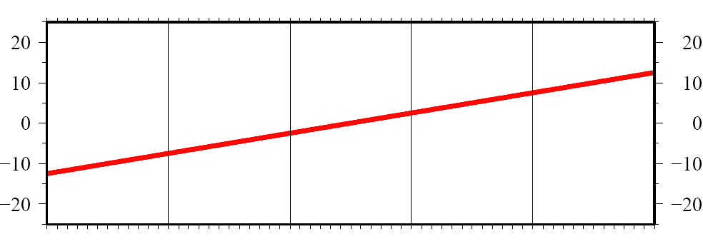
Time series components
observed
position
(linear)
velocity term
initial
position

Slide 11
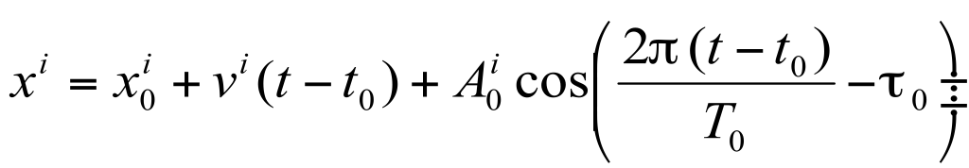
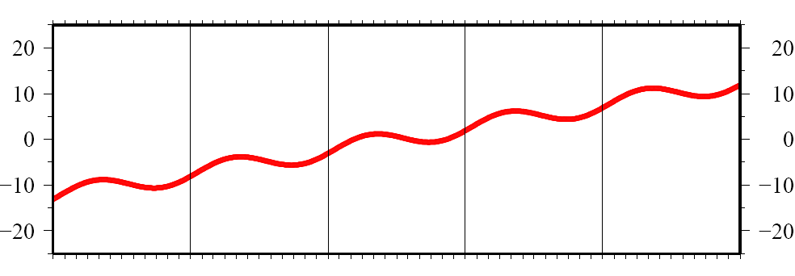
Time series components
observed
position
(linear)
velocity term
initial
position
annual period
sinusoid
Notes:
tau0 = 0.3 yr

Slide 12
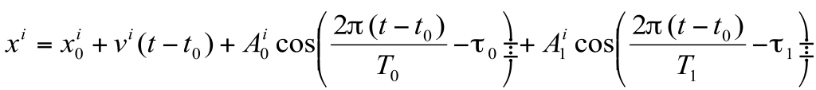
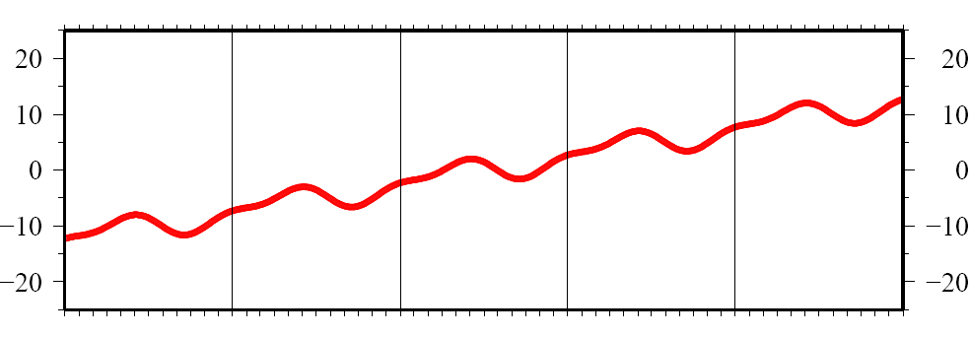
Time series components
observed
position
(linear)
velocity term
initial
position
annual period
sinusoid
semi-annual
period sinusoid
seasonal term

Slide 13
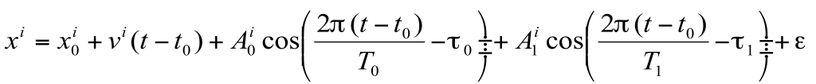
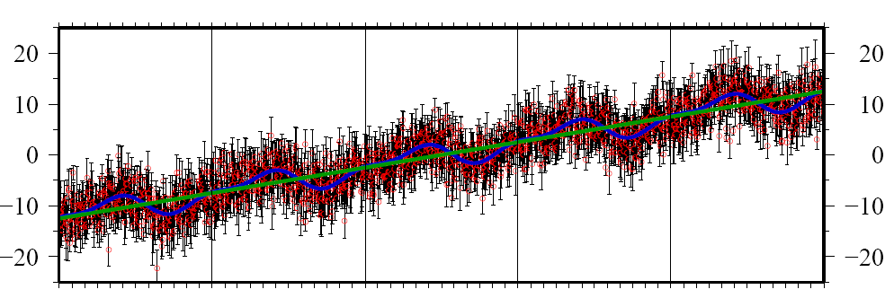
Time series components
observed
position
(linear)
velocity term
initial
position
annual period
sinusoid
semi-annual
period sinusoid
seasonal term
ε = 3 mm white noise

Slide 14
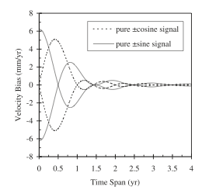
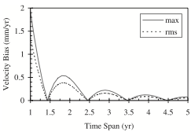
Velocity errors due to seasonal signals in continuous time series
Annual signals from atmospheric and hydrological loading, monument translation and tilt, and antenna temperature sensitivity are common in GPS time series
Theoretical analysis of a continuous time series by Blewitt and Lavallee (2002,2003)
Top: Bias in velocity from a 1mm sinusoidal signal in-phase and with a 90-degree lag with respect to the start of the data span
Bottom: Maximum and rms velocity bias over all phase angles
  The minimum bias is NOT obtained with continuous data spanning an even number of years
  The bias becomes small after 3.5 years of observation
Notes:
Seasonal, primarily annual. errors due to atmospheric conditions (propagation and loading), changing ground water, and temperature effects on the monuments or antenna elements can be important in GPS measurements. Its pretty obvious that for survey-mode measurements made once a year, the best strategy is to observe at the same time each year, and if the errors are truly annual or semi-annual, they will be nullified. For continuous measurements, however, there is the somewhat non-intuitive result that truncating the time series at an even number of years does not null the veloicity error (sketch a cosine on the back of an envelope to convince yourself of this). Geoff Blewit and David Lavallee did a study of the effect of these errors as a function of span length, and found that the optimal truncation length is on the half-year. Further, as for errors with other shapes, longer time spans reduce the effects. Keep in mind that if seasonal errors are not dominant, extending a time series, e.g. to 4 years instead of truncating it at 3.5 years, would usually produce a smaller bias.

Slide 15
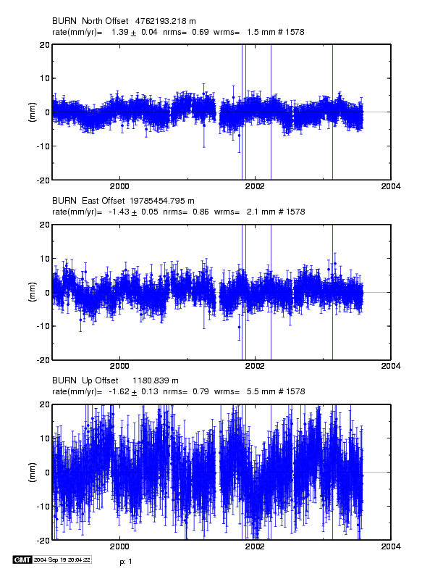
Characterizing the noise in daily position estimates
Note temporal correlations of 60-200 days and seasonal terms
Notes:
Now let’s move to time series of daily observations. 4-yr from CGPS station in eastern Oregon (dry climate).
Note wrms ~2 mm horizontal 6 mm vertical. Nrms ~0.7. The formal error under a white noise assumption after scaling by the nrms is 0.03 mm/yr horizontal, 0.1 mm/yr vertical. But the correlation time for independent observations is ~100 days, so if we again apply our rule-of-thumb, and take only every 100th point as independent, we would scale the velocity uncertainties by a factor of 10, to get 0.3 mm/yr horizontal and 1 mm/yr vertical tuncertainties for the velocity estimates. . This “eye-balling” of correlation times will usually get you within a factor of two of a more rigorous estimate of the true uncertainty, as we will see shortly. Let’s look at three ways of doing this a bit more rigorously. One uses a formal spectral analysis, another relates empirically the white-noise and correlated noise components, and a the third performs a more rigorous estimate the correlation times.

Slide 16
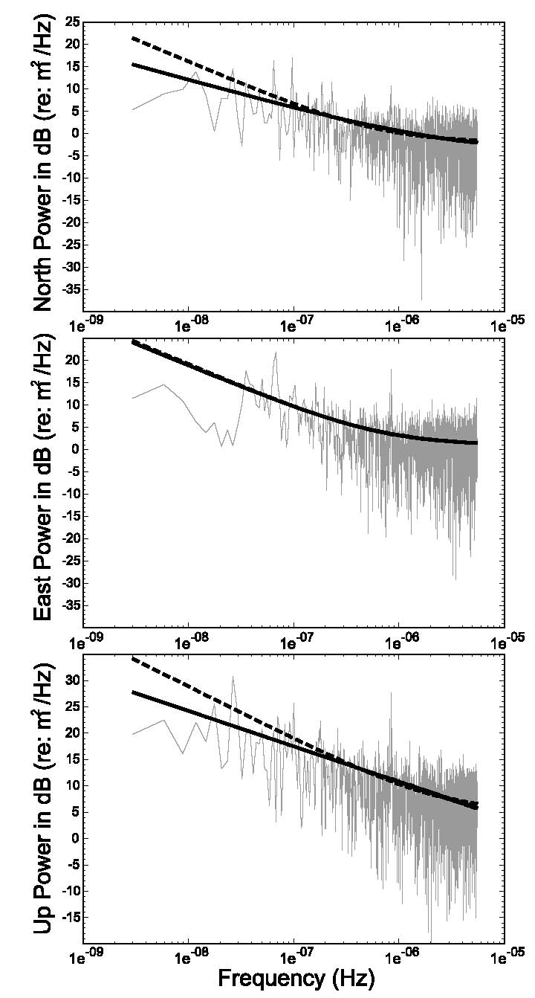
Spectral analysis of the time series to estimate an error model
Figure 5 from Williams et al. (2004): Power spectrum for common-mode error in the SOPAC regional SCIGN analysis. Lines are best-fit white noise plus flicker noise (solid = mean amplitude; dashed = maximum likelihood estimation)
Note lack of taper and misfit for periods > 1 yr (frequencies < π × 10⁻⁸)
Notes:
This figure from the 2004 paper by Simon Williams and colleagues shows a power spectrum of a 10-year time series (1991-2001) , N, E, and U, for a continuous station in southern California. The high-frequency (short-period) noise on the right-hand side has nearly constant amplitude for periods up to about 10.days (1.e-6), implying that it can be characterized by a white-noise error model. The most important feature for the purpose of getting realistic velocity estimates is the increase in amplitude for periods longer than 10 days. This increase implies temporally correlated noise. If we can represent the spectrum as a power law—that is, plot this on a log-log scale (which we’ve done), then a slope of -2 implies that the noise is a random walk. The slopes from GPS time series spectra at periods greater than 10 days are typically between -0.5 and -1.5, leading analysis to conclude that the noise is most like “flicker” noise, which has a slope (“spectral index”) of -1. See Mao et al. (1998) and Williams et al (2004) to read more about this. Note that for periods greater than 100 days (1.e-7), the spectral amplitudes are quite variable, reflecting our inability to estimate them reliably a small number of samples. This is critical since long-period noise is most correlated with an estimate of the slope of the time series: if there is a anomalously large long-period noise signal, proper characterization of the high-frequency noise in the time series will not be very useful for getting a reliable estimate of the velocity uncertainty.

Slide 17
Summary of spectral analysis approach
Power law: slope of line fit to spectrum
  0 = white noise
  −1 = flicker noise
  −2 = random walk
Non-integer spectral index (e.g. “fraction white noise” → 1 > k > −1 )
Good discussion in Williams (2003)
Problems:
  Computationally intensive
  No model captures reliably the lowest-frequency part of the spectrum
Notes:
Summary of spectral characterization of noise.
There is also the possibility of noise that is not stationary, that is, it changes in character as function of time. In this case, all of the techninques we mention here will be invalid.
.

Slide 18
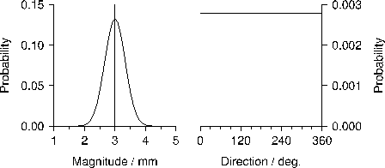

“White” noise
Time-independent (uncorrelated)
Magnitude has continuous probability function, e.g. Gaussian distribution
Direction is uniformly random
“True” displacement per time step
Independent (“white”) noise error
Observed displacement after time step t (v = d/t)

Slide 19
“Color” noise
Time-dependent (correlated): power-law, first-order Gauss-Markov, etc.
Convergence to “true” velocity is slower than with white noise, i.e. velocity uncertainty is larger
Must be taken into account to produce more “realistic” velocities
This is statistical and still does not account for all other (unmodeled) errors elsewhere in the GPS system
* example is “random walk” (time-integrated white noise)
“True” displacement per time step
Correlated (“colored”) noise error*
Observed displacement after time step t (v = d/t)

Slide 20
CATS (Williams, 2008)
Create and Analyze Time Series
Maximum likelihood estimator for chosen model solves for
  Initial position and velocity
  Seasonal cycles (sum of periodic terms) [optional]
  Exponent of power law noise model
Requires some linear algebra libraries (BLAS and LAPACK) to be installed on computer (common nowadays, but check!)
  Information on M. Floyd’s experience of compiling CATS at http://web.mit.edu/mfloyd/www/computing/cats/
Formerly at http://www.pol.ac.uk/home/staff/?user=WillSimoCats
  However, above web page and source code no longer seem to available
  Possibly a sign that CATS is superseded by Hector?

Slide 21
Hector (Bos et al., 2013)
Much the same as CATS but faster algorithm
Maximum likelihood estimator for chosen model solves for
  Initial position and velocity
  Seasonal cycles (sum of periodic terms) [optional]
  Exponent of power law noise model
  Also, as of Hector version 1.6:
  Changes in linear velocity
  Non-linear motions (logarithmic and/or exponential decays)
Requires ATLAS linear algebra libraries to be installed on computer
Linux package available but tricky to install from source due to ATLAS requirement
http://segal.ubi.pt/hector/

Slide 22
sh_cats/sh_hector
Scripts to aid batch processing of time series with CATS or Hector
Requires CATS and/or Hector to be pre-installed
Outputs
  Velocities in “.vel”-file format
  Equivalent random walk magnitudes in “mar_neu” commands for sourcing in globk command file
Can take a long time!
Reads GAMIT/GLOBK formats
  pos-file(s) as input
  eq-file(s) to define discontinuities for estimation of offsets
  tsfit command file containing “eq_file”, “max_sigma”, “n_sigma” and/or “periodic” options instead of specifying as sh_cats/sh_hector options
Writes files for GLOBK
  apr-file(s), including “EXTENDED” terms where periodic and/or non-linear (logrithmic and/or exponential decay) terms have been estimated
  “mar_neu” commands for equivalent random walk process noise

Slide 23
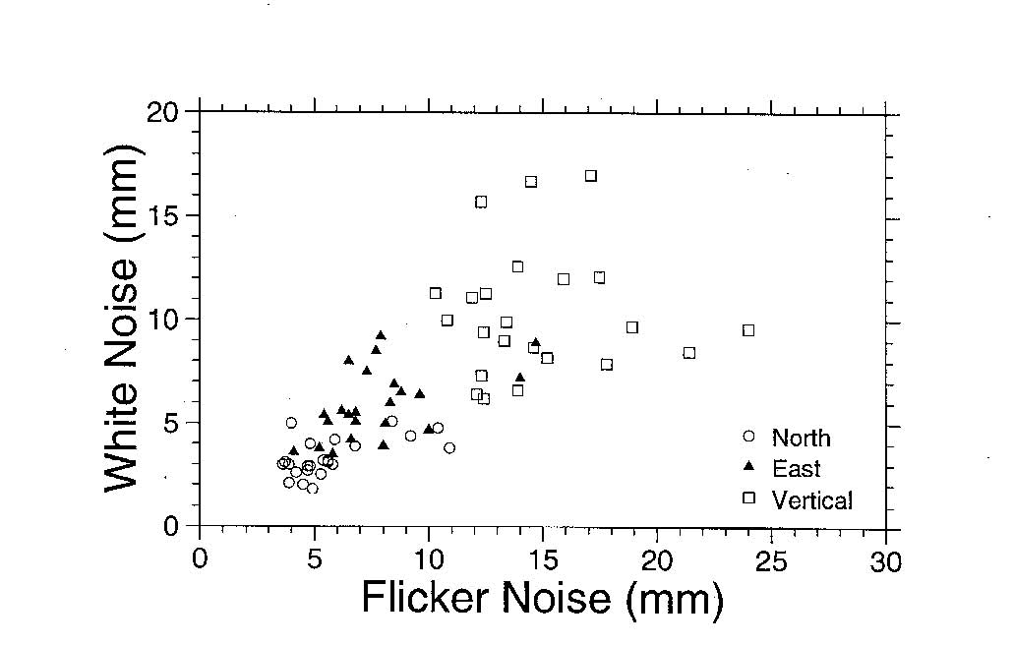
Approximations (Mao et al., 1999)
Use white noise statistics (wrms) to predict the flicker noise
White noise vs flicker noise from Mao et al. (1999)
spectral analysis of 23 global stations
Notes:
A second approximation to getting realistic uncertainties makes the assumption that the amplitude of the long-period sources of noise is proportional to the white noise. Since white noise can be easily computed from time series, and flicker noise (or RW noise) not, Mao et al.performed a spectral analysis of times series(2 years only) for 24 IGS stations and looked for correlations between the WN and FN components. The figure shows their results, with N, E, an U plotted on the same As you can see, there is a correlation, and a straight-line fit to the points will get you within about 50% of the appropriate flicker noise component to apply for a given wrms. See Equation 20 in their paper..

Slide 24
“Realistic sigma” algorithm for velocity uncertainties
Motivation
Computational efficiency
Handle time series with varying lengths and data gaps
Obtain a model that can be used in globk
Concept
The departure from a white-noise (√n) reduction in noise with averaging provides a measure of correlated noise.
Implementation
Fit the values of χ² versus averaging time to the exponential function expected for a first-order Gauss-Markov (FOGM) process (amplitude, correlation time)
Use the χ² value for infinite averaging time predicted from this model to scale the white noise sigma estimates from the original (least-squares) fit
and/or
Fit the values to a FOGM with infinite averaging time (i.e., random walk) and use these estimates as input to globk (“mar_neu” command)
Notes:
The third approach is the one we’ve taken in GLOBK. It assume that the the noise can be represented by a Gauss-Markov process. Loosely speaking, a Gaussian process is a random process that can be described by its mean and variiance; both the Poisson and normal distributions are Gaussian. A Markov process is one in which the expected value of the next random variable depends on only on its present state and not on its history. Although no single instantaneous source of GPS error is necessarily Gaussian, the central limit theorem allows us to hypothesize, at least, that the ensemble of errors will have a Guassian distribuiton. Viewed another way, our best hope of being to characterize ithe likelihood that the estimated parameter will fall within certain range, e.g. 95% of the time, is to assume that it has a Gaussian distribution, for which the probability distribution can be represented analytically by an exponential equation. We use a first-order Markov process, specifically a random walk, in GLOBK to model stochastic variations because it can be directly implemented in a Kalman fiilter, whereas flicker noise, which is not a Markov process cannot. As we’ll show, these assumptions can be tested by the distribution of velocity residuals from an appropriately modeled GPS solution.

Slide 25
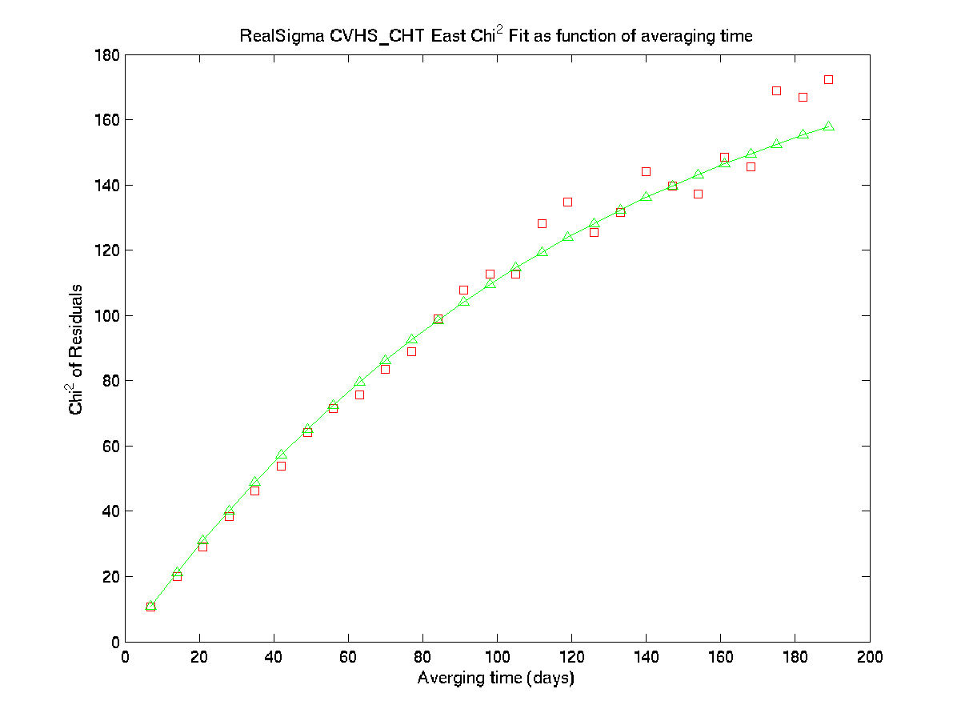
Extrapolated variance (FOGMEx)
For independent noise,
variance ∝ 1/√N_{data}
For temporally correlated noise, variance (or 𝜒²/d.o.f.) of data increases with increasing window size
Extrapolation to “infinite time” can be achieved by fitting an asymptotic function to RMS as a function of time window
  𝜒²/d.o.f. ∝ e^{−𝜎𝜏}
Asymptotic value is good estimate of long-term variance factor
Use “real_sigma” option in tsfit
Notes:
Strang, G. and K. Borre (1997), Linear Algebra, Geodesy, and GPS, Wellesley-Cambridge Press, 624 pp.

Slide 26
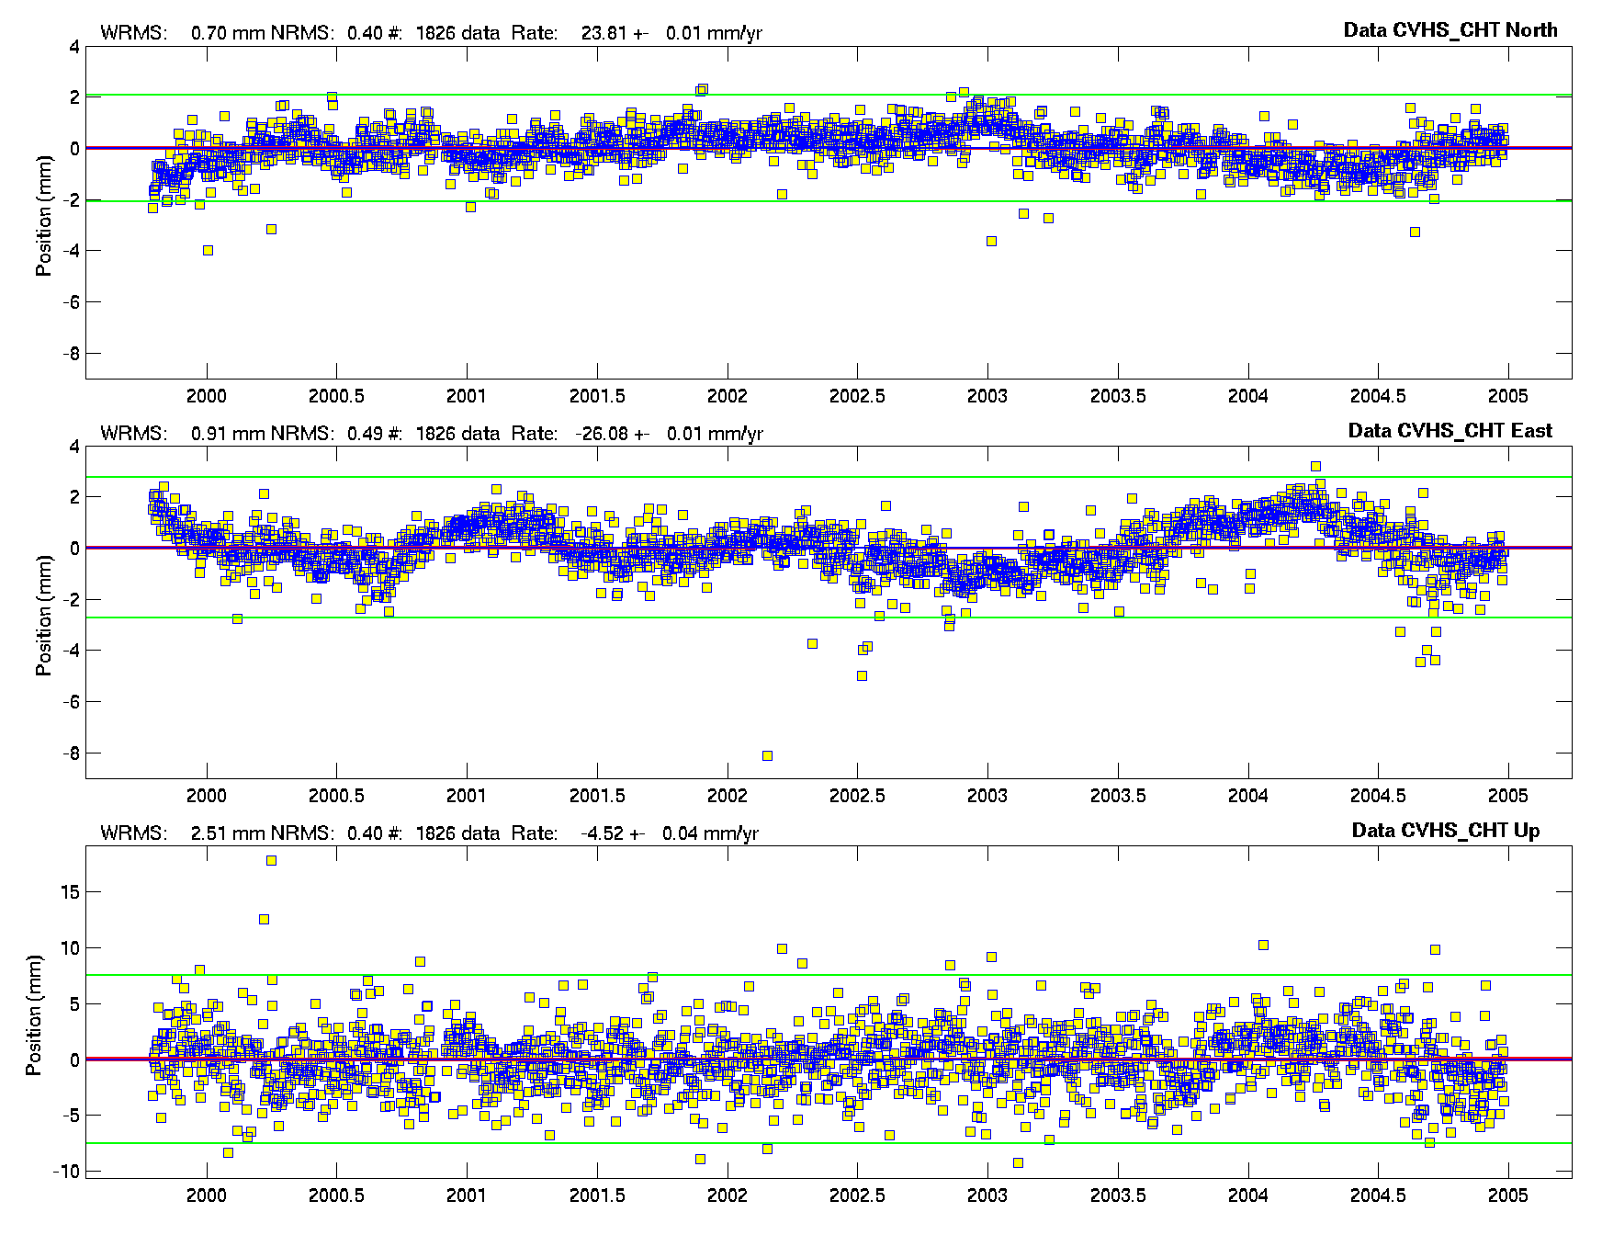
Understanding the FOGMEx algorithm: Effect of averaging on time-series noise
Note the dominance of correlated errors and unrealistic rate uncertainties with a white noise assumption:
.01 mm/yr N,E
.04 mm/yr U
Yellow: Daily (raw) Blue: 7-day averages
Notes:
Five-year time series for a southern California site. . The WRMS is < 1 mm in horizontal, 2.5 mm in vertical. Yellow squares are daily values, with NRMS of ~0.5 (better than a typical site). Blue points are 7-day averages, which you can see reduces the short-term noise considerably (as we expect, since it’s white, but not much the long-term. Suppose we keep averaging for longer and longer periods and observe what happens to the scatter. If the noise were white, we’d expect the WRMS to go down by the square root of the number of points in the average and the NRMS remain the same. However, if the dominant frequencies of the noise are long-period, the WRMS will not decrease as rapidly and the NRMS will riise since the formal uncertainties are getting smaller by sqrt(n). Let’s see how this works on the E component of this time series. (While we’re here, though I’ll note that the “eye-ball” correlation time of this series is again about 100 days, implying a factor of 10 inflation of the WN uncertainty (.01 mm/yr here).

Slide 27
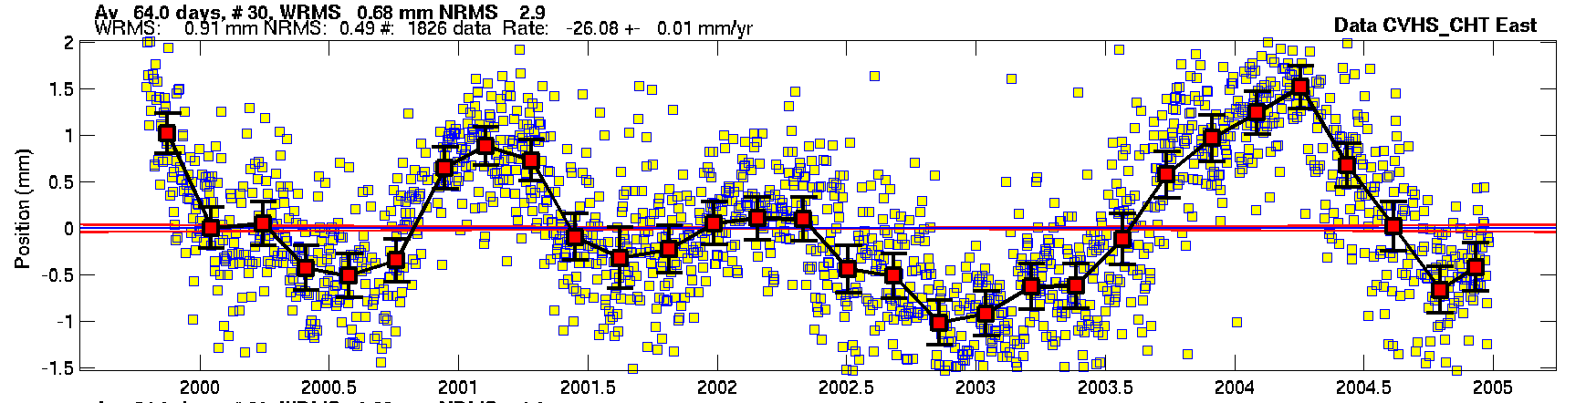
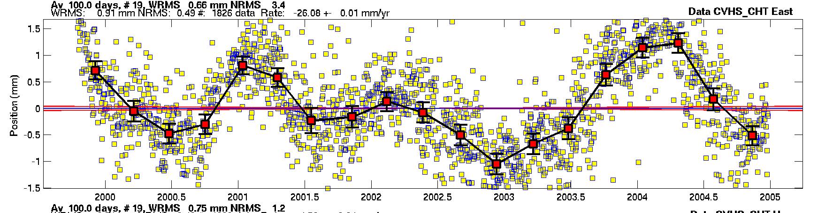
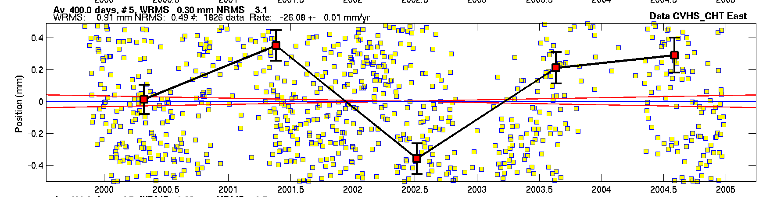
Same site, East component ( daily wrms 0.9 mm nrms 0.5 )
64-d avg
wrms 0.7 mm
nrms 2.0
100-d avg
wrms 0.6 mm
nrms 3.4
400-d avg
wrms 0.3 mm
nrms 3.1
Notes:
This plot shows the time series in East with 1-d averaging (yellow, all panels), 64d (top), 100d (middle), and 400d (bottom). The original wrms is 0.91 mm; with white noise, we would predict the 100d wrms to be 0.1 mm, but in fact it’s 0.66 mm, only a 30% reduction. At 400d, it’s decreased to 0.30 mm, a factor of three, much less than the factor of 20 predicted by WN. Turned around, we see that the nrms has gone from 0.5 (1d) to about 3 for averaging of 64d or more. And you can see this visually from the behavior of the curves: that is, the dominant (only relevant) noise here has a characteristic correlation time of 100-400+ days.
The red lines here show the range of rates allowed by the WN model.

Slide 28
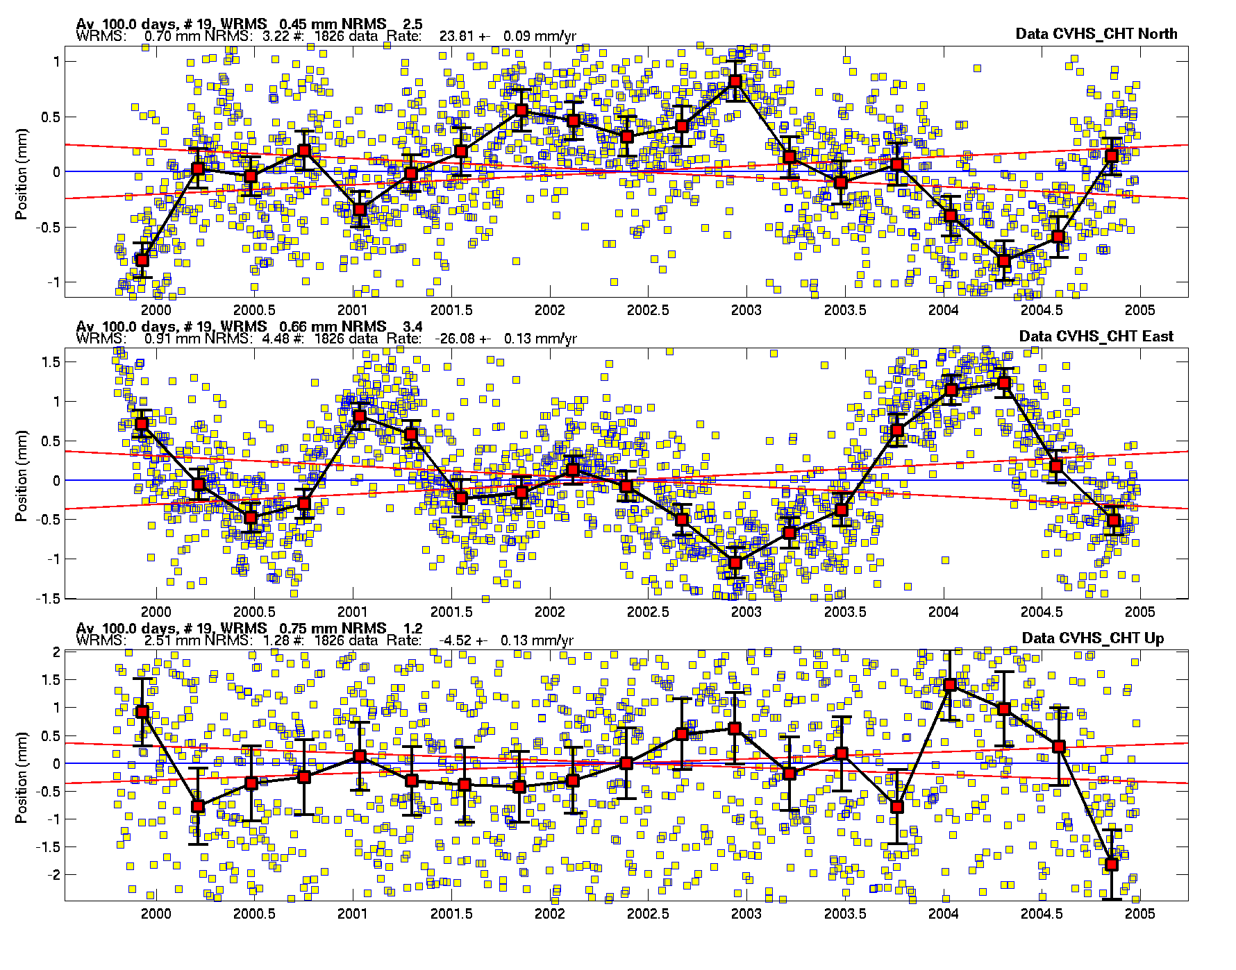
Using TSVIEW to compute and display the “realistic-sigma” results
Note rate uncertainties with the “realistic-sigma” algorithm :
0.09 mm/yr N
0.13 mm/yr E
0.13 mm/yr U
Red lines show the 68% probability bounds of the velocity based on the results of applying the algorithm.
Notes:
TSVIEW example: Here are now the N, E, and U time series, with 1d and 100d averaging. In this plot we have turned on the “realistic sigma” option of tsview, so the red lines now show the range of rates allowed by the more realistic sigmas estimated with the algorithm: 0.09 mm/yr N 0.13 E, 0.13U. (not too far from our “eyeball” estimate based on visually inspection of the original series !)

Slide 29
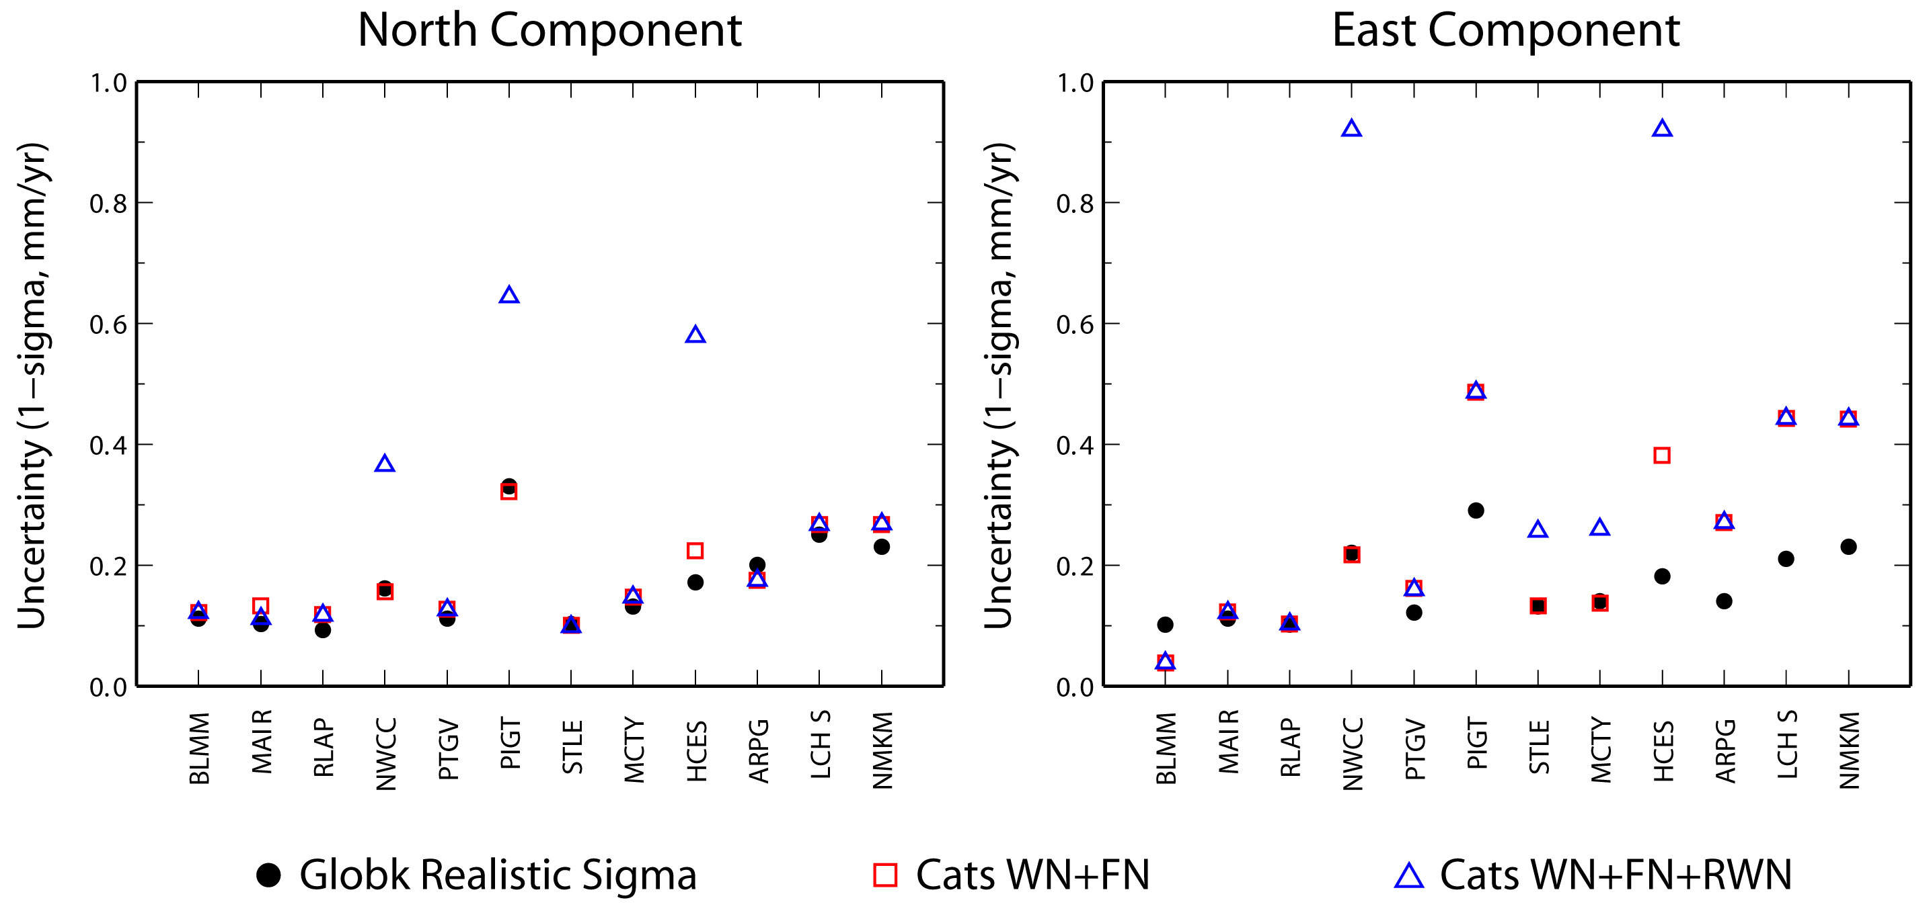
Comparison of estimated velocity uncertainties using spectral analysis (CATS) and Gauss-Markov fitting of averages (FOGMEx)
Plot courtesy E. Calais
Notes:
Several people have compared velocity uncertainties estimated using a spectral analysis with the CATS program developed by Simon Williams, with those estimated using Tom’s Realistic Sigma algorithm. The plot shows uncertainties for 12 sites in east Africa, with GLOBK sigmas shown with black dots and two CATS estimates in blue and red, one in which only white noise and flicker noise are estimated, the other in which a random walk is also included. What’s evident here, and verified by other comparisons I’ve seen is that when the time series is long and well-behaved, as for the first three sites, the two approaches agree very well; when the time series is unusually systematic, there are differences of up to a factor of two between GLOBK and CATS, ,and differences even larger between the CATS estimates with and without a random-walk estimated.

Slide 30
Summary of practical approaches
White noise + flicker noise (+ random walk) to model the spectrum (Williams et al., 2004)
White noise as a proxy for flicker noise (Mao et al., 1999)
Random walk to model to model an exponential spectrum (Herring “FOGMEx” algorithm for velocities)
“Eyeball” white noise + random walk for non-continuous data
All approaches require common sense and verification
Notes:
We’ll next look at a method to validate the error model you’ve applied to the data.

Slide 31
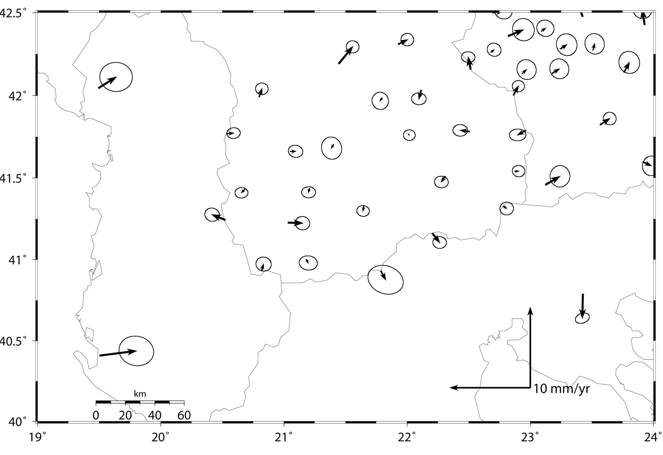
External validation of velocity uncertainties by comparing with a geophysical model
Simple case: assume no strain within a geologically rigid region
17 sites in central Macedonia: 4–5 velocities pierce error ellipses
GMT plot at 70% confidence
If geologically rigid model is valid, 70% of sites should show no statistically significant motion, i.e. velocity lies within error ellipse
Notes:
Once you’ve made your best estimate of the appropriate weighting of the daily solutions, you should validate these by examining the scatter in the velocities. To do this you need to have a region that is non-deforming or well-modeled at the level of the velocity uncertainties. A relatively simple application of this approach is possible with the network shown in this slide, where the velocities of the sites in central Macedonia are small and appear to be randomly distributed. If we plot these with GMT (sh_plotvel) with 70% error ellipses, we find that the residuals for 6 of the 20 stations in the stable region fall outside the error ellipses, approximately what we would expect if a Gaussian distribution applies. We’ll have more to say about this in the next example, where there is a large enough data set to infer its statistical properties.

Slide 32
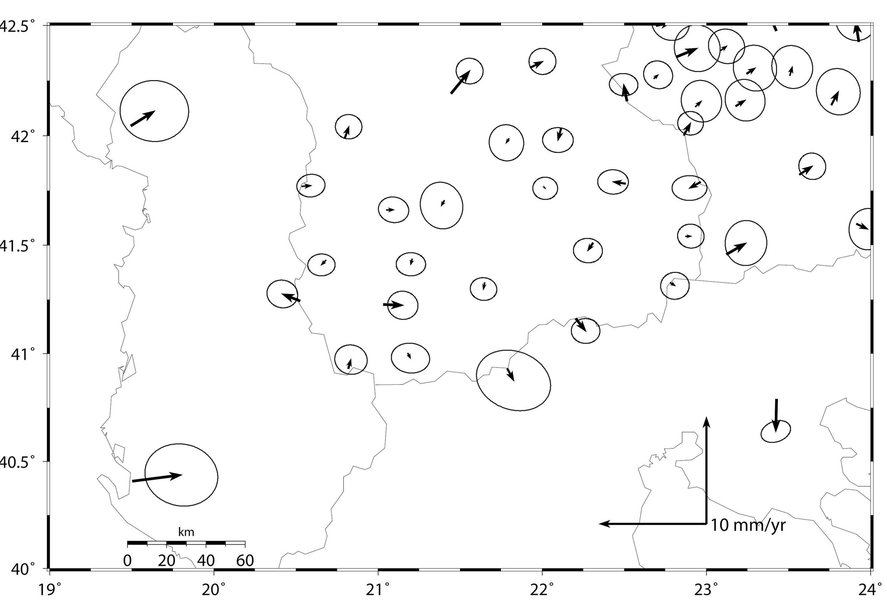
External validation of velocity uncertainties by comparing with a geophysical model
Same solution plotted with 95% confidence ellipses
Now 1–2 of 17 velocities pierce error ellipses
Notes:
This slide shows the same solution but with the GMT error ellipses drawn at the 95% confidence level. In this plotting, only 1 or 2 of the arrows pierce their confidence ellipses, again what we would expect if the GLOBK one-sigma, single-component uncertainties are derived with the correct white and random noise in GLOBK and the distribution of errors is Gaussian. Note that this network was measured only twice (three times for a few sites), four years apart, so time series analysis was not possible. Rather, we tuned the uncertainties by applying scaiing, until we got the residual distribution correct. In general, scaling is not the best way to do this, but works here since there are only two epochs.

Slide 33
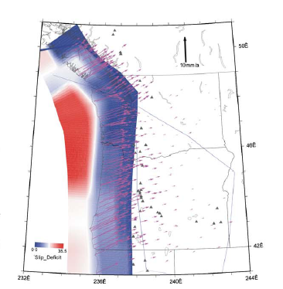
External validation of velocity uncertainties by comparing with a geophysical model
A more complex case of a large network in the Cascadia subduction zone
Colors show slipping and locked portions of the subducting slab where the surface velocities are highly sensitive to the model; area to the east is slowly deforming and insensitive to the details of the model
McCaffrey et al. 2007
Notes:
With a larger data set we can formalize this procedure—that is, we can see if the distribution of normalized velocity residuals matches a probability distribution. We’ll use an example from the Pacific Northwest, for which there are over 300 stations with accurate velocities determined from survey-mode and continuous observations (next slide) over 3 to 13 years.
Here’s a tectonic model of the region, generated by the DEFNODE elastic block-model program developed by Rob McCaffrey,, color coded by the level of strain and with velocities shown relative to North America (red is freely slipping at depth, blue is locked near the surface). In the best model for this region, the Oregon block, SW of the diagonal line, is rotating clockwise relative to NA. Note that the model effects are small and smooth for E OR and WA, which can be fit easily with a two-block model and small elastic strain from the slab, to calibrate the uncertainties in the velocity estimates.

Slide 34
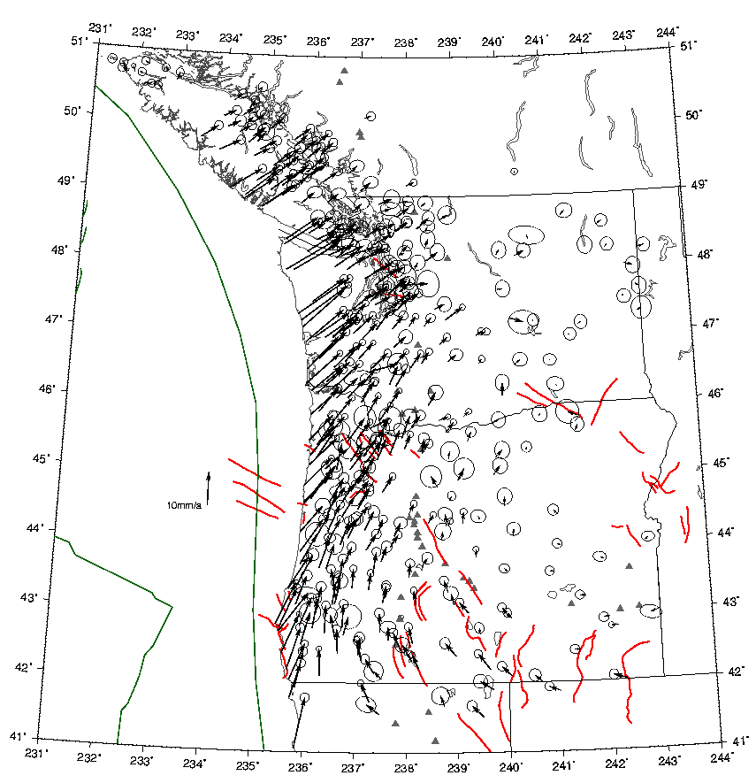
Velocities and 70% error ellipses for 300 sites observed by continuous and survey-mode GPS 1991-2004
Validation area (next slide) is east of 238°E
Notes:
These are the observed velocities with their error 70% error ellipses. Near the coast, where the fault is locked in a complicated manner, we cannot model the velocities without making some assumptions about the compllexity of the locking; that is, the problem of assessing errors gets mixed up with the geophysical modeling, something we’re try to avoid. However, east of about 238E, the residual velocities are insensitive to the details of the subduction model and we can use a deformation model in which we have as much confidence as the no-deformation assumption we used for central Macedonia.

Slide 35
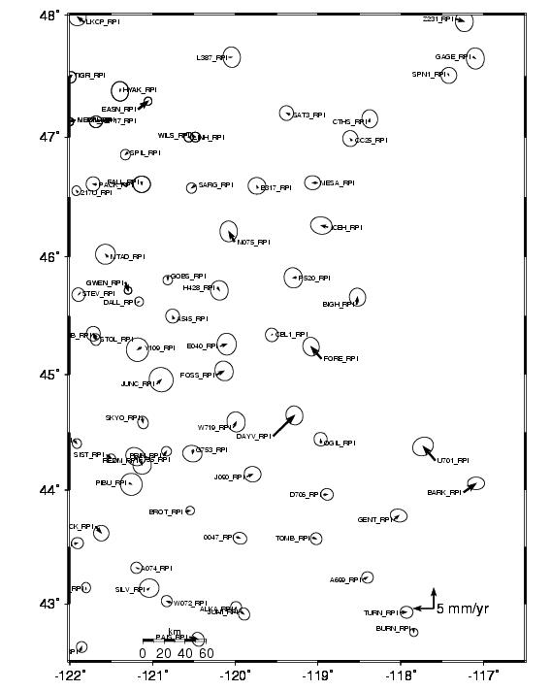
Residuals to elastic block model for 73 sites in slowly deforming region
Error ellipses are for 70% confidence:
13-17 velocities pierce their ellipse
Notes:
This plot shows just the slowly deforming test area of eastern Oregon There are about 73 stations in this area. The error ellipses are plotted for 70% confidence, so if we have applied the correct weighting to the data, we should expect about 23 of the arrows to exceed the error ellipses. If we count these visually, there are 16 clearly outside and another 7 too close to call. This approach works best when you have a region which you are sure strain is negligible compared to the data errors, but even when there is significant strain, it’s a useful calibration if you think you can model the strain in most regions to within 10-20% of the errors. If you’ve designed your network to provide sufficient spatial redundancy, you usually distinguish by patterns what is station noise and what is model noise. The most troublesome problems arise when an area seems to move coherently but the source of the motion is from spatially coherent errors—for example, if you observe all stations in a small region at the same time and they are all affected by a weather pattern or orbital error during that period. Note the one or two large outliers, which value well outside a normal distribution and can be omitted from the sample.

Slide 36
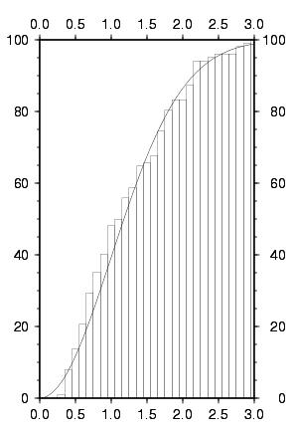
Statistics of velocity residuals
Cumulative histogram of normalized velocity residuals for eastern Oregon and Washington
  70 sites
Noise added to position for each survey:
  0.5 mm random (“sig_neu”)
  1.0 mm/sqrt(yr) random walk (“mar_neu”)
Solid line is theoretical for a χ-distribution
Percent within ratio
Ratio (velocity magnitude/uncertainty)
Notes:
We can formalize the probability analysis by plotting the cumulative normalized residuals against a theoretical curve for a chi distribution (sh_velhist). The horizontal access is the normalized residual, that is, the residual velocity divided by the uncertainty obtained from the GLOBK solution; the vertical axis is the percent of these residuals that are less than or equal to the given ratio. So, for example, about 40% of the residuals are less than their 1-sigma uncertainty and 95% are less than 2.5 times their uncertainty. You can see that for the error model adopted, the cumulative histogram follows the theoretical distribution at most levels of probability within about 15%. We established the error model by adding to the position estimates at each epoch a white noise (WN) (sig_neu) and random-walk noise (RW) (mar_neu) component., in this case 0.5 mm of WN and 1.0 mm/sqrt(yr) RW. We got these values by trial and error, using the cumulative velocity histogram as a guide.

Slide 37
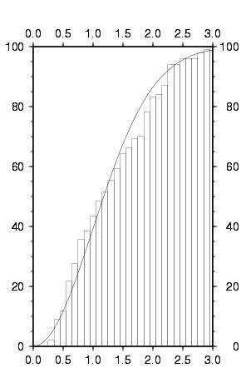
Statistics of velocity residuals
Same as last slide but with a smaller random-walk noise added:
  0.5 mm random
  0.5 mm/yr random walk
  cf. 1.0 mm/sqrt(yr) RW for “best” noise model
Note greater number of residuals in range of 1.5–2.0 sigma
Percent within ratio
Ratio (velocity magnitude/uncertainty)
Notes:
If we decrease the RW from 1.0 mm/sqrt(yr) to 0.5 mm/sqrt(yr), then we get a greater misfit to the theoretical chi distribution; the gap between 70% and 90% indicates that the normalized residual was too large in this range, suggesting that the a subset of the velocity uncertainties was too small due to the decrease in the RW noise applied.

Slide 38
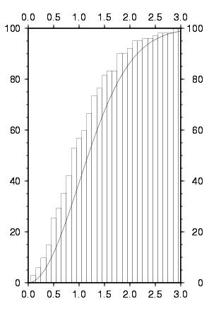
Statistics of velocity residuals
Same as last slide but with larger random and random-walk noise added :
  2.0 mm white noise
  1.5 mm/sqrt(yr)) random walk
  cf. 0.5 mm WN and 1.0 mm/sqrt(yr) RW for “best” noise model
Note smaller number of residuals in all ranges above 0.1-sigma
Percent within ratio
Ratio (velocity magnitude/uncertainty)
Notes:
Conversely if we increase the RW to 1.5 mm/sqrt(yr) and also the WN to 2 mm at each epoch there is a misfit in the other direction, indicating that the velocity uncertainties are too large for the actual scatter. Put another way, if this were our noise model and we published results suggesting that a pattern of deformation was too small to be detected by the data at, e.g. 90% confidence, we would be doing a disservice to our measurements.

Slide 39
Summary
All algorithms for computing estimates of standard deviations have various problems
  Fundamentally, rate standard deviations are dependent on low frequency part of noise spectrum, which is poorly determined without very long time series (decades)
Assumptions of stationarity (constant noise characteristics over time) are often (usually?) not valid
FOGMEx (“realistic sigma”) algorithm is a convenient and reliable approach to getting velocity uncertainties in globk
  We are testing how reliable, in comparison to other methods, given good and bad time series
Velocity residuals from a physical model, together with their uncertainties, can be used to validate the error model

Slide 40
References
Spectral Analysis
Langbein and Johnson (1997), J. Geophys. Res., 102, 591–603, doi:10.1029/96JB02945.
Zhang et al. (1997), J. Geophys. Res., 102, 18035–18055, doi:10.1029/97JB01380.
Mao et al. (1999), J. Geophys. Res., 104, 2797–2816, doi:10.1029/1998JB900033.
Dixon et al. (2000), Tectonics, 19, 1–24, doi:10.1029/1998TC001088.
Williams (2003), J. Geod., 76, 483–494, doi:10.1007/s00190-002-0283-4.
Williams et al. (2004), J. Geophys. Res., 109, B03412, doi:10.1029/2003JB002741.
Langbein (2008), J. Geophys. Res., 113, B05405, doi:10.1029/2007JB005247.
Williams (2008), GPS Solut., 12, 147–153, doi:10.1007/s10291-007-0086-4.
Bos et al. (2013), J. Geod., 87, 351–360, doi:10.1007/s00190-012-0605-0.
Effect of seasonal terms on velocity estimates
Blewitt and Lavallée (2002), J. Geophys. Res., 107, 2145, doi:10.1029/2001JB000570.
Blewitt and Lavallée (2003), J. Geophys. Res., 108, 2010, doi:10.1029/2002JB002297.
Realistic Sigma Algorithm
Herring (2003), GPS Solut., 7, 194–199, doi:10. 1007/s10291-003-0068-0.
Reilinger et al. (2006), J. Geophys. Res., 111, B05411, doi:10.1029/2005JB004051.
Validation in velocity fields
McClusky et al. (2000), J. Geophys. Res., 105, 5695–5719, doi:10.1029/1999JB900351.
McClusky et al. (2001), Geophys. Res. Lett., 28, 3369–3372, doi:10.1029/2001GL013091.
Davis et al. (2003), Geophys. Res. Lett., 30, 1411, doi:10.1029/2003GL016961.
McCaffrey et al. (2007), Geophys J. Int., 169, 1315–1340, doi:10.1111/j.1365-246X.2007.03371.x.

