Slide 1


Survey-mode measurements and analysis
M. A. Floyd
Massachusetts Institute of Technology, Cambridge, MA, USA
GPS Data Processing and Analysis with GAMIT/GLOBK
Earth Observatory of Singapore
17–21 July 2017
http://geoweb.mit.edu/~floyd/courses/gg/201707_EOS/
Material from R. W. King, T. A. Herring, M. A. Floyd (MIT) and S. C. McClusky (now at ANU)

Slide 2
Measurement strategies I
Occupation time
Given time and personnel constraints, what are the trade-offs between between spatial and temporal density?
Ideally, you would like for the white noise position uncertainty for an occupation to contribute to the velocity uncertainty at a level less than the usually dominant long-period correlated noise
Typical white noise uncertainties (horizontal and vertical) as a function of occupation time are:
  6–8 hrs: 2–2.5 mm (H), 5–10 mm (V)
  12–24 hrs: 1.0–1.5 mm (H), 3–5 mm (V)
  36–48-hrs: 0.7–1.0 mm (H), 2–4 mm (V)
Observations over 3 or more days will give you more redundancy
Observations of 5 or more days will be necessary for mm-level vertical uncertainties
If your region has few continuous stations, you should consider running one or two survey-mode stations for the entire time of the survey to provide continuity
Notes:
If your scientific goals require a spatially dense network , then you may chose to rely on having two or more sites whose motions are expected to be the same and use this spatial redundancy as s substitute for temporal redundancy in identifying outliers. The spatial redundancy would be more important than the temporal if the error in a position determination is correlated over the occupation time (e.g. a single flawed setup continued for several days).

Slide 3
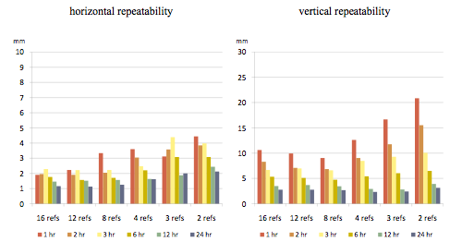
Precision v session length for network processing
Notes:
This slide shows repeatability in position over 31 days as a function session length of a test site in central Italy when processed with 2 to 16 continuous reference sites spanning 180-600 km. See Firuzabadi and King, GPS Solutions, doi:10/1007/s10291-0110218-8, 2011, for details of the study.

Slide 4
Measurement strategies II
Monuments and instrumentation
Issues in site and antenna selection:
  Monument identification
  Monument stability
  Accessibility
  Ease of setup
  Multipath
  Log (metadata) errors
  Vandalism
There is no clear prescription for all cases
Let’s look at some examples…

Slide 5
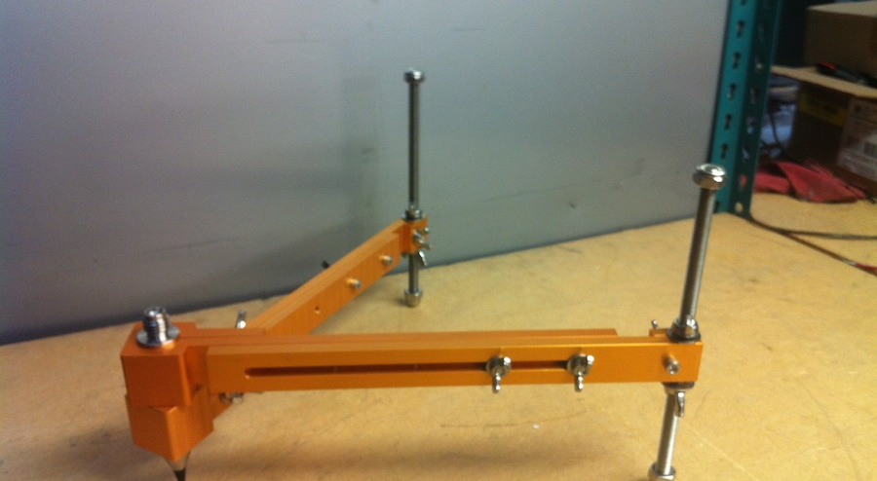
Three primary mounting options
Spike mount
Tripod with optical or physical plummet
Mast
Courtesy UNAVO web page
Notes:
Spike mount: Light-weight, fixed height, low profile and easy to set, but vulnerable to low-ground reflections and long-period multipath.
Tripod: Avoids low-ground obstructions and long-period multipath, but heavy, high-profile, and vulnerable to setup errors.
Tech 2000 mast: medium weight, fixed height, avoids low-ground obstructions and long-period multipath, but 1st-time setup time-consuming.

Slide 6
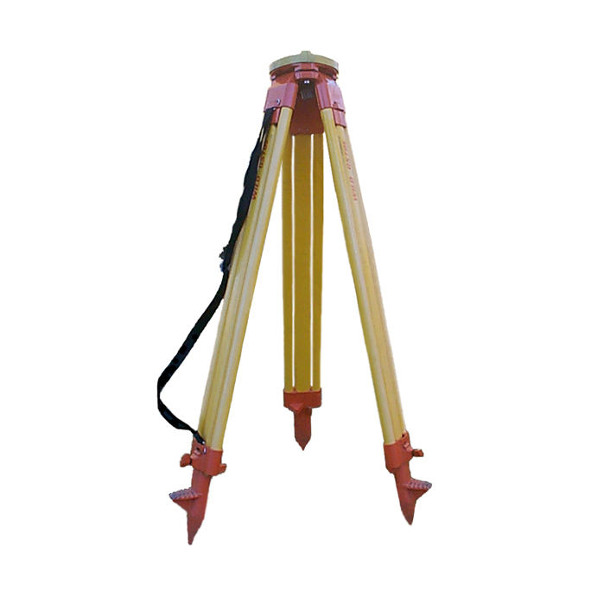
Surveyor’s tripod
Advantages:
  Easily portable
  Stable on flat ground
Disadvantages:
  Inconsistent height setup (variable multipath)
  Easily disturbed
http://facility.unavco.org
Notes:
Tripod setup instructions may be found at:
http://kb.unavco.org/kb/article/how-to-set-up-a-tripod-and-tribrach-60.html#attachments

Slide 7
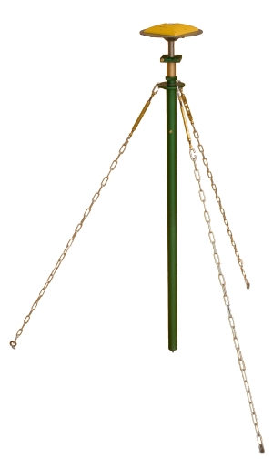
Fixed-height mast (e.g. Tech2000)
Advantages:
  Automatically centered
  Fixed height (reduces human error)
  Stable
  Identical multipath environment each setup
Disadvantages:
  Difficult first-time placement due to anchor installation (also requires large, hard surface)
http://facility.unavco.org
Notes:
http://facility.unavco.org/kb/questions/202/Tech2000+GNSS+Antenna+Mast
http://kb.unavco.org/kb/article/unavco-resources-gnss-antenna-mounts-394.html

Slide 8
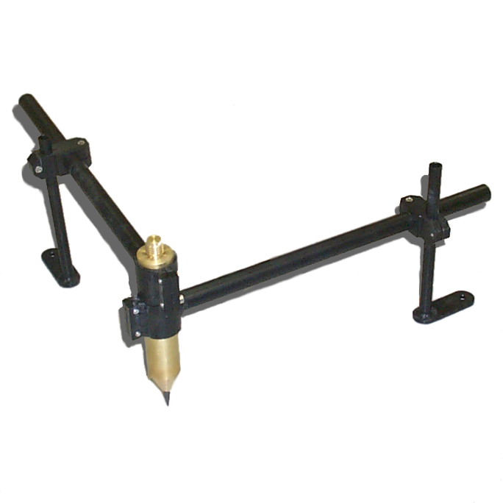
Spike mounts
Advantages:
  Fixed height
  Low height reduces horizontal centering inaccuracy if slightly off level
  Easily hidden from vandals
Disadvantages:
  Awkward to level precisely and orientate antenna
  Proximity to ground may increase direct multipath signal
http://facility.unavco.org
Notes:
http://kb.unavco.org/kb/article.php?id=199

Slide 9
Basic rules for any setup
Know how well your equipment is calibrated, and how to calibrate or verify its accuracy if necessary
  A 1-D level is a very useful tool to have!
Iterate using finer and finer adjustments
  It’s a rare day that the best of us find an acceptably accurate setup the first time
Always work upward from the base of a tripod setup
  Fix the legs once an approximate (within a few cm) position is achieved
  Work exclusively with the tribrach on the platform thereafter
Always level the (optical) plummet before assessing the centering, especially after making adjustments

Slide 10
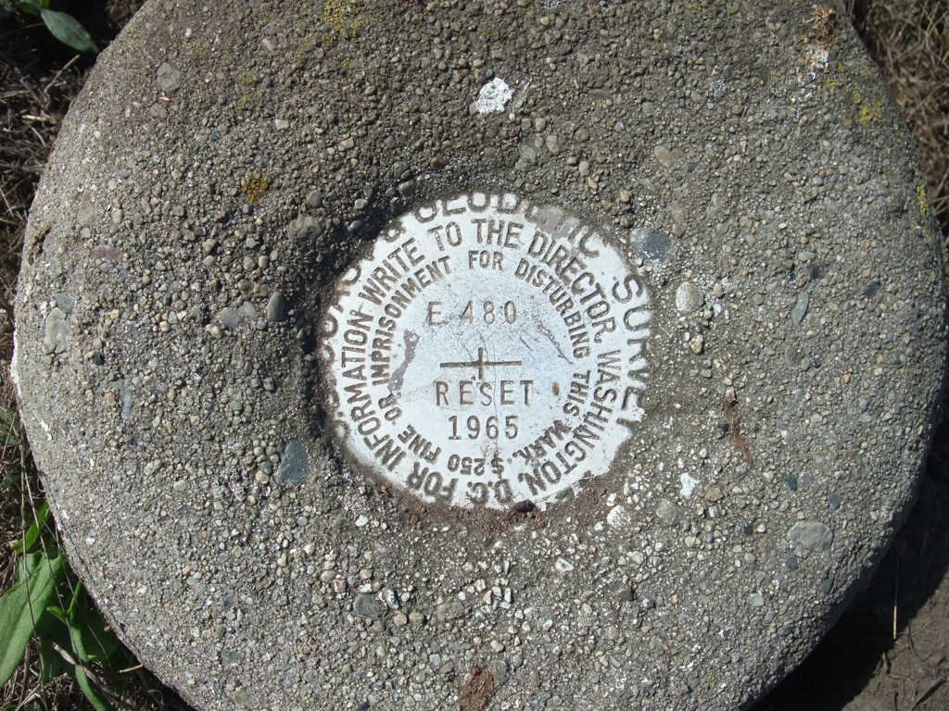
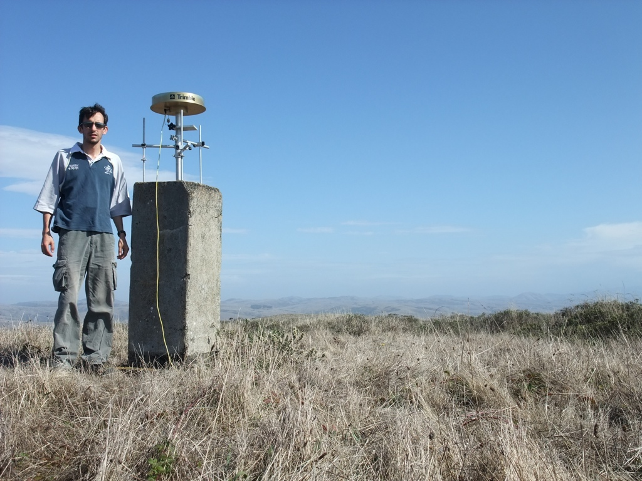
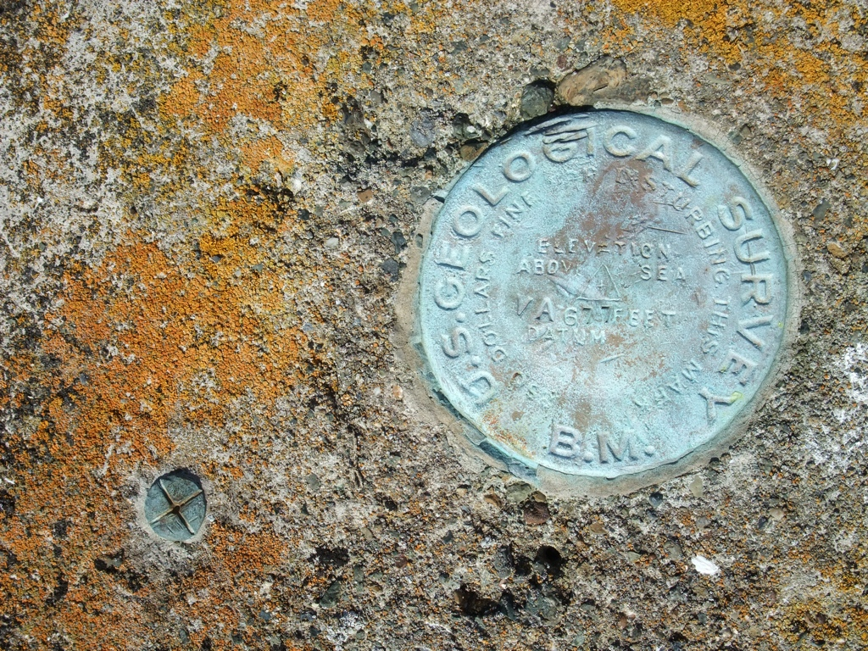
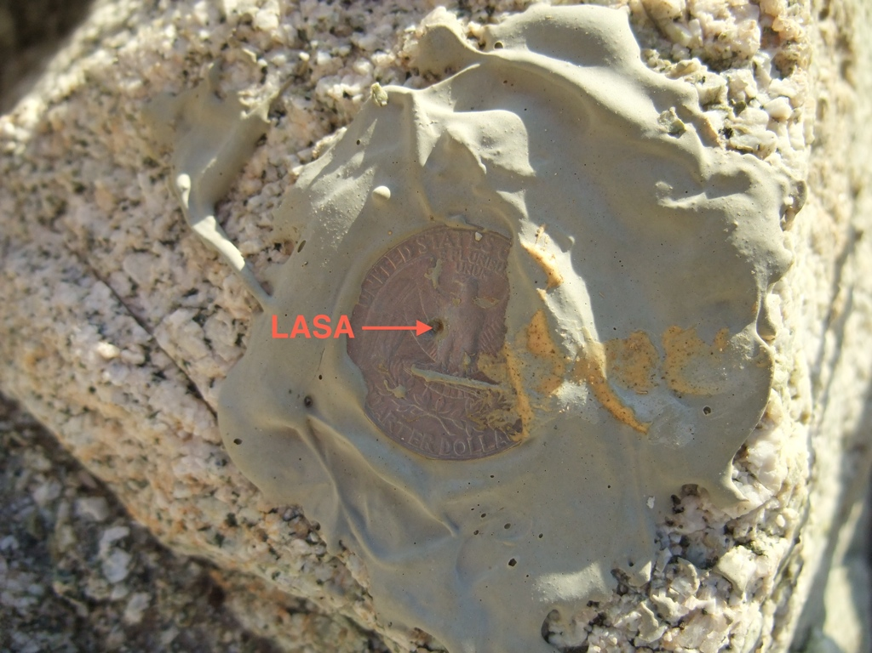
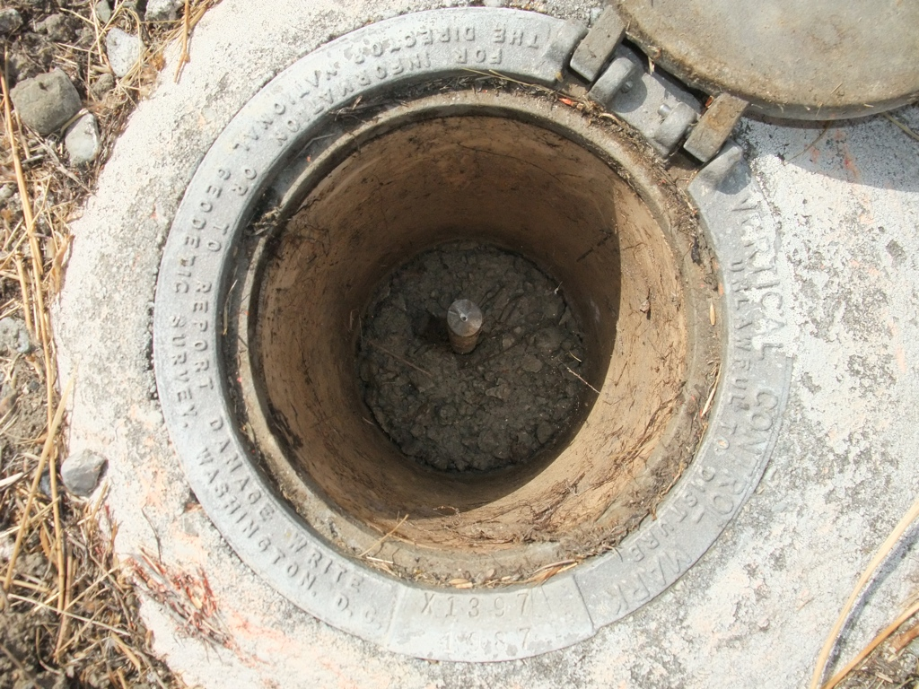
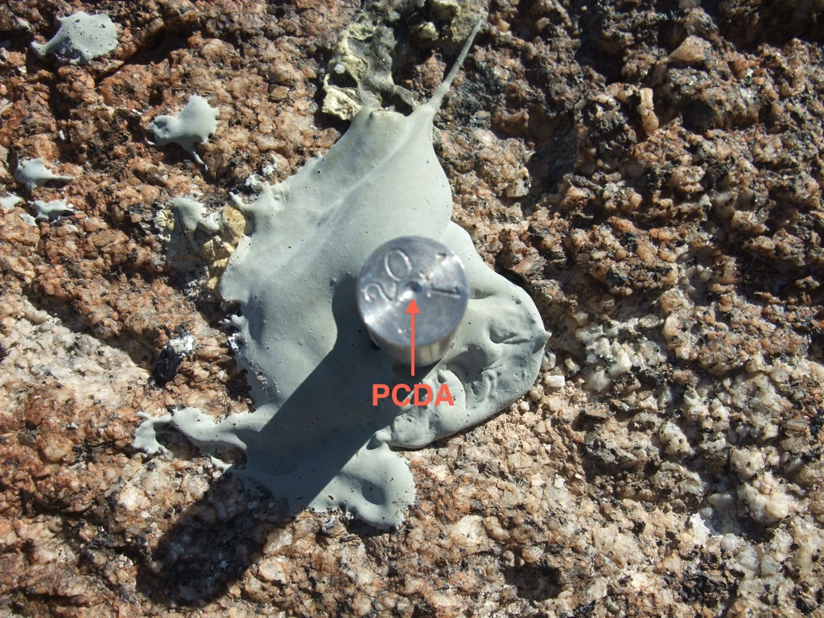
Examples of survey marks
Cast plates
Concrete pillars
Glued punched coin
Driven rods
Drilled pin
Notes:
Note that depressed or raised monuments may not be suitable for spike mounts, so be prepared with alternatives.

Slide 11
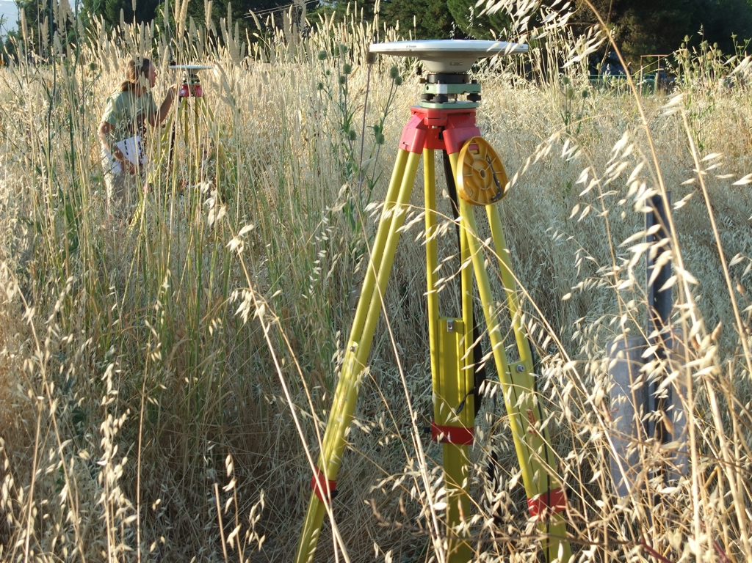
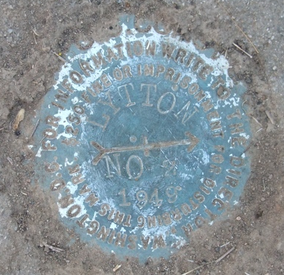
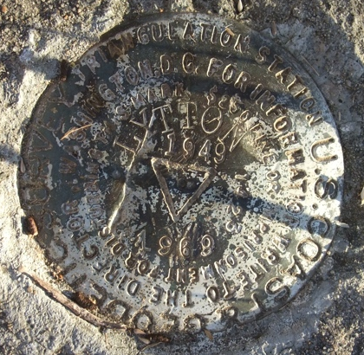
Site identification errors
Photograph by M. Floyd
Photograph by M. Floyd
Photograph by M. Floyd
Notes:
The similarity of the stamp of the central mark at one of its witness marks combined with a lack of photographs or sketches on log sheets from previous occupations meant that the incorrect mark was occupied when measured by a new group. This was made especially difficult by the head-high grass! Once the data from the incorrect mark was processed and identified as such, proceeding occupations measured both marks simultaneously, with better log sheet records!, and the velocities were equated.

Slide 12
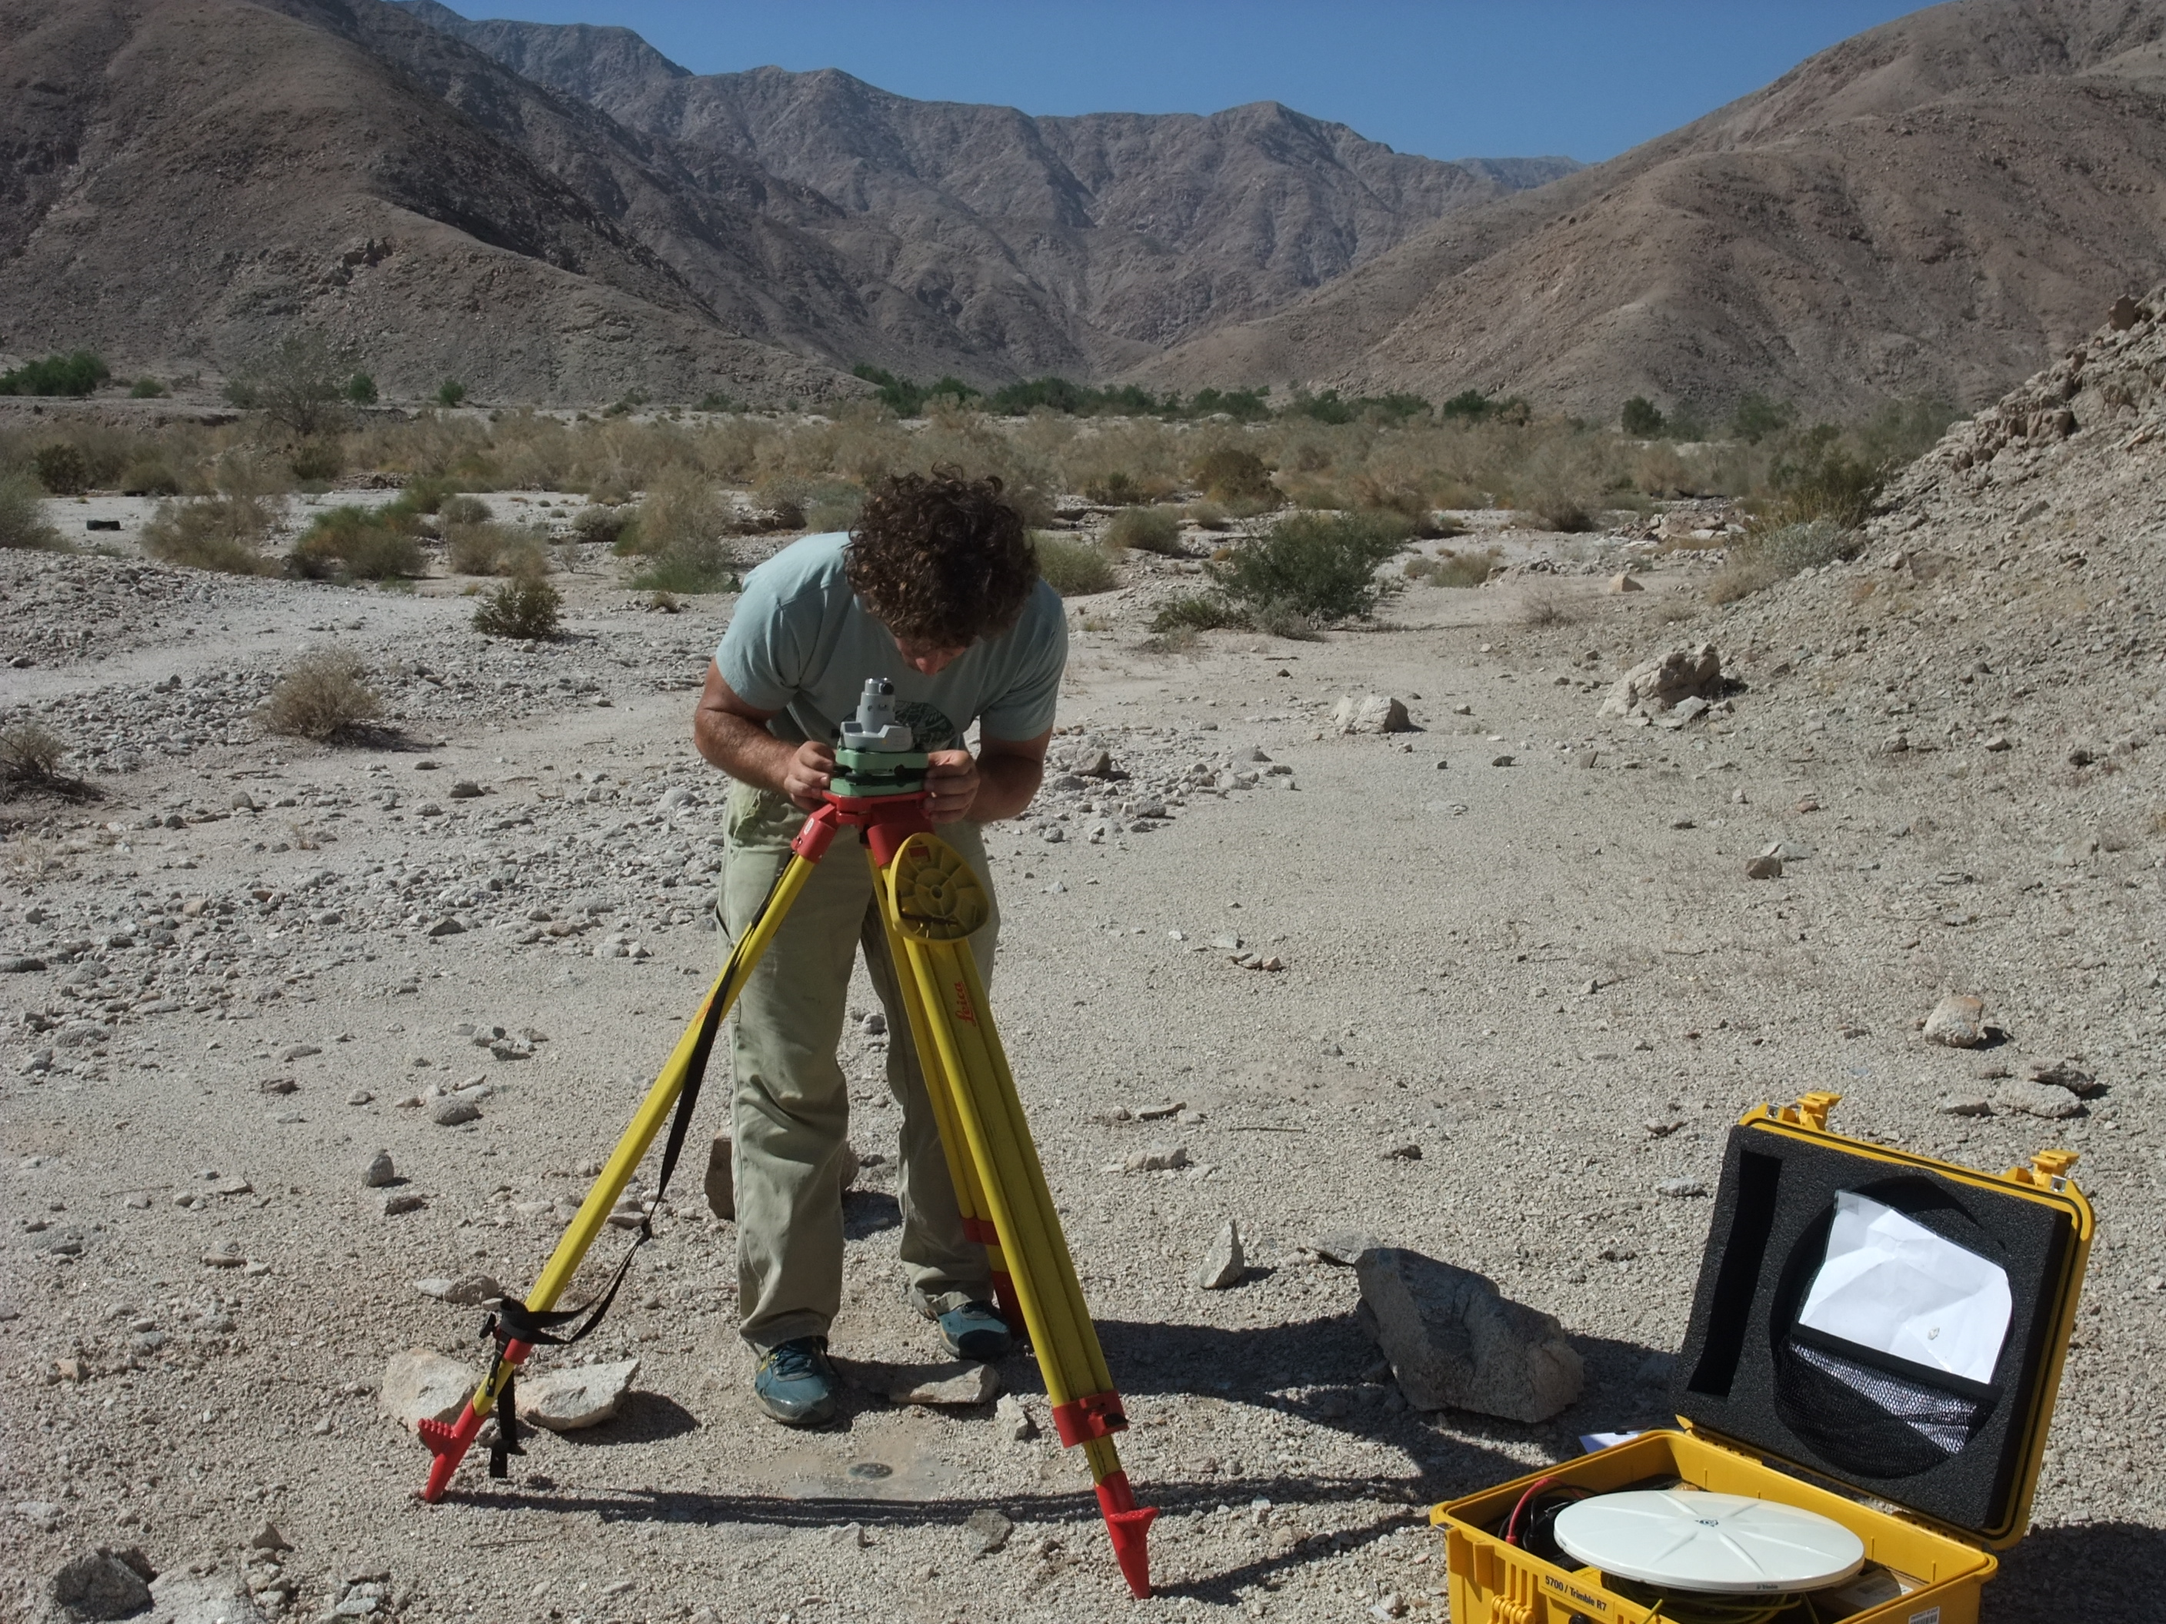
Antenna setup errors
Episodic survey setups can mean that measurements are not centered perfectly over a mark or the antenna height not measured accurately
These measurements tend to exhibit an independent and random nature
Photograph by M. Floyd

Slide 13
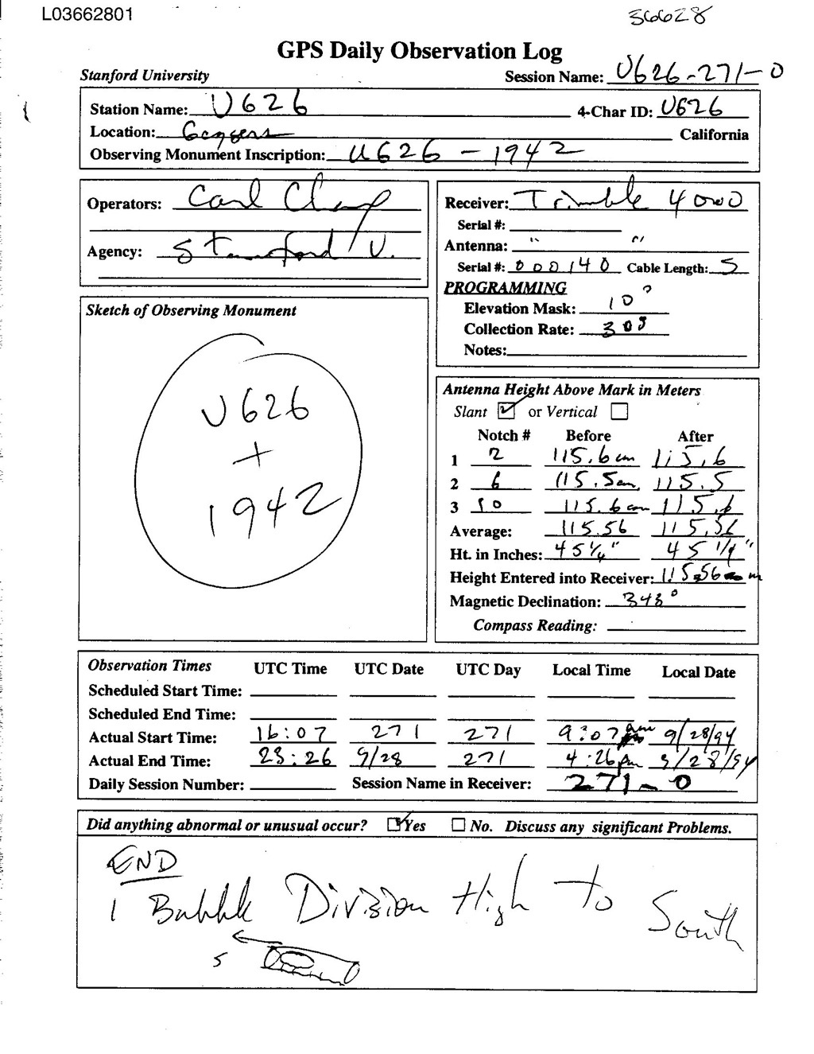
Log (metadata) and archive errors
Critical: antenna type (serial #); height and type; monument id
2.10 OBSERVATION DATA G (GPS) RINEX VERSION / TYPE
teqc 2006Jul20 UNAVCO Archive Ops 20060725 16:48:29UTCPGM / RUN BY / DATE
Solaris 5.9|UltraSparc IIi|cc -xarch=v9 SC5.5|=+-|*Sparc COMMENT
BIT 2 OF LLI FLAGS DATA COLLECTED UNDER A/S CONDITION COMMENT
U626 MARKER NAME
U626 MARKER NUMBER
UNKNOWN Stanford University OBSERVER / AGENCY
3414A05687 TRIMBLE 4000SSE NP 5.71 / SP 1.26 REC # / TYPE / VERS
3015A00136 TRM14532.00 ANT # / TYPE
-2683218.3014 -4185018.7102 3983204.9361 APPROX POSITION XYZ
1.4755 0.0000 0.0000 ANTENNA: DELTA H/E/N
1 1 WAVELENGTH FACT L1/2
5 L1 L2 C1 P1 P2 # / TYPES OF OBSERV
30.0000 INTERVAL
1994 9 28 16 7 30.0000000 GPS TIME OF FIRST OBS
END OF HEADER
94 9 28 16 7 30.0000000 0 5G 5G 6G17G20G24
2437477.48856 1792564.39355 22428902.4774 22428904.8324
-548226.77657 -402556.82256 20834866.1484 20834867.2274
-567509.56556 -371824.37155 22860949.9614 22860952.7034
1203057.74657 883752.12057 20612879.2734 20612882.3204
793138.12755 501650.82355 22928979.6334 22928982.6914
Notes:
Be very clear in the log what antenna was used (type, serial number), how the height was measured, and what is the inscription on the monument.

Slide 14
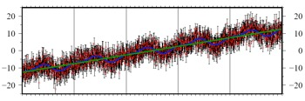
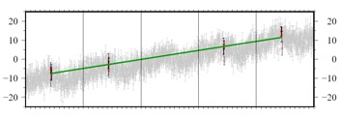
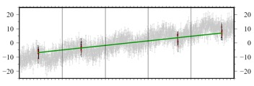
Potential impact of survey timing
“Survey” 1
Continuous
“Survey” 2
 | x₀ | v | A₀ | τ₀ | A₁ | τ₁ | ε
Input | −12.5 mm | 5 mm/yr | 2 mm | 1.88 (0.3 yr) | 1 mm | 5.65 (0.45 yr) | 3 mm
Continuous * | −12.41 mm | 4.93 mm/yr | 1.82 mm | 1.93 (0.31 yr) | 0.91 mm | 5.48 (0.44 yr) | 3.07 mm
“Survey” 1 | −9.55 mm | 4.72 mm/yr | - | - | - | - | -
“Survey” 2 | −8.21 mm | 3.21 mm/yr | - | - | - | - | -
* Maximum likelihood estimation of velocity and periodic terms, given a noise model
Notes:
Synthetic time series showing continuous data with linear trend, periodic signals and (3 mm) white noise error. “Survey” 1 picks only data points from continuous time series in June in four of the five years of synthetic data. “Survey” 2 picks data points from continuous time series in June for first two years and September for second two years. Table shows the results of time series analysis compared to the synthetic input values. “Survey” 1 recovers the input (and continuous) velocity within reasonable associated uncertainty whereas “survey” 2 has a significant velocity bias due to the influence of survey timing relative to the seasonal signal’s peaks and troughs.

Slide 15
Propagation effects
Ionosphere
  Frequency-dispersive layer causes differential delay of L1 and L2 as a function of (unknown) total electron content (TEC)
Troposhere
  Delay through medium, especially water in atmosphere
Clock errors
  Offsets and drift of receiver and satellite clocks affects time, and therefore phase/distance, measurement
Multipath
  Back-scattering of signal interferes with direct signals
  Random: no good method for mitigation or modeling

Slide 16
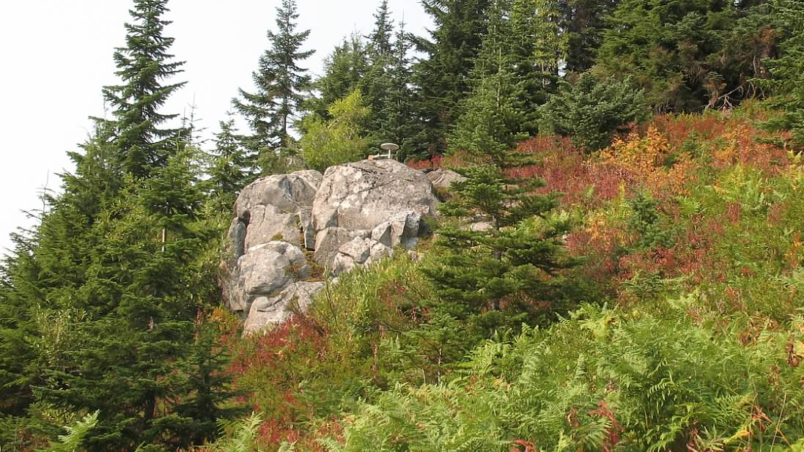
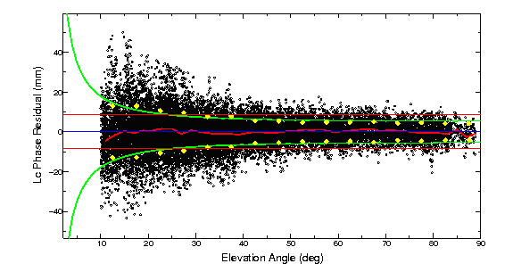
Low mount in a good environment
STVP
Steven’s Pass, Cascades Range in western Washington
18-cm spike mount
No long-term repeatability yet, but 44 hrs
of observations in 2012 give formal
uncertainties 0.5 mm horizontal, 3 mm
vertical. Note minimal long-period signal
Scattering.
Notes:
This is an example of a good sGPS site observed with a low-mounted antenna. The ground drops off in a 270-degree arc, trees block the view and generate reflections in a 90-degree arc, mostly in the north-polar “hole” of SV visibility. This site has two occupations, 11 years apart, one with a 1-m tripod, the second one with the spike mount as shown. The velocity uncertainty and residual from a block model are each ~0.6 mm/yr.

Slide 17
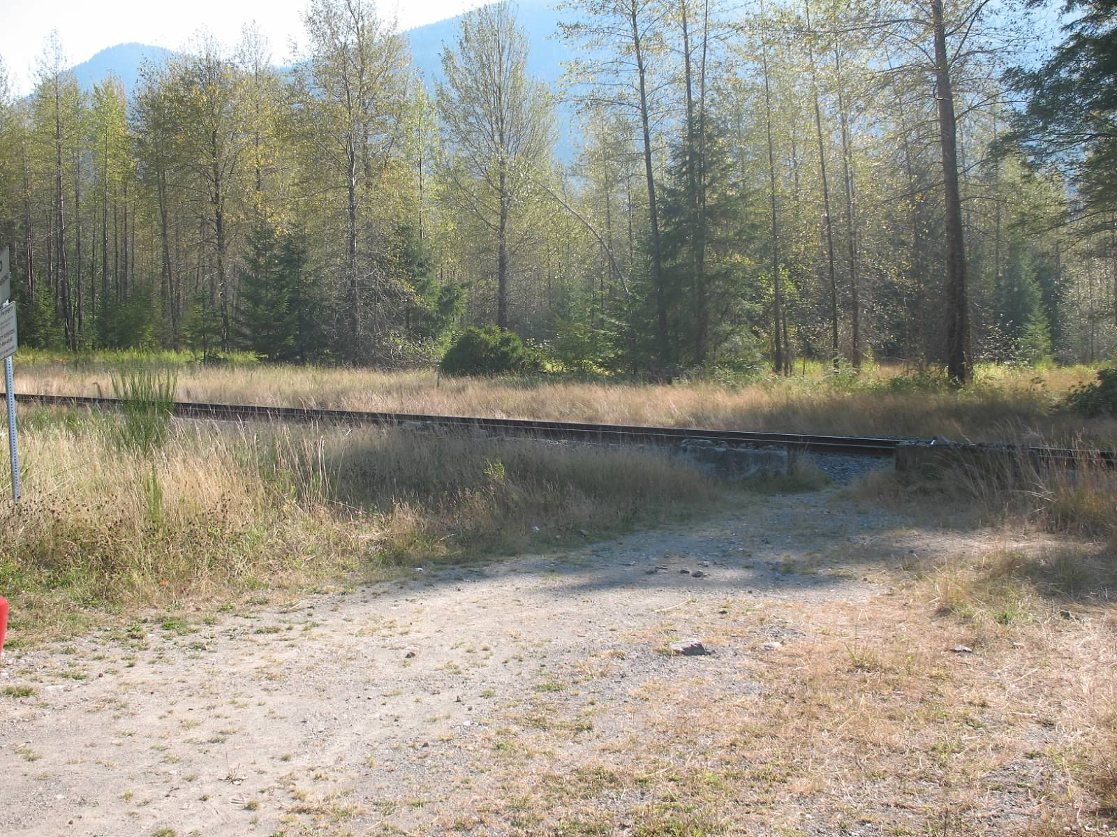
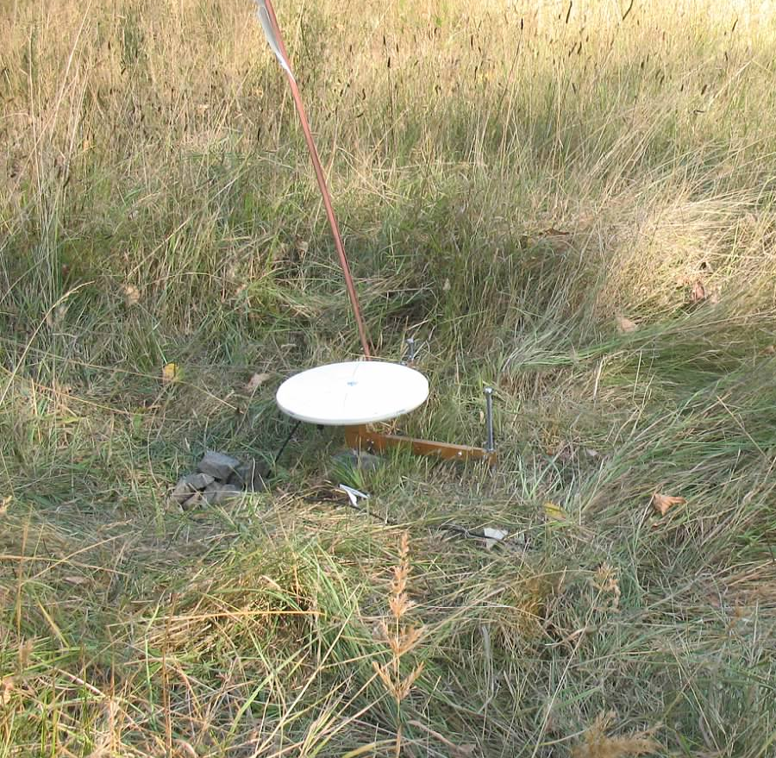
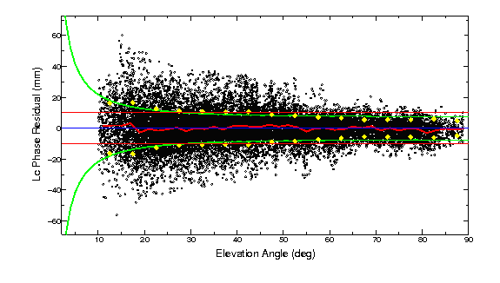
Low mount in a dirty environment
B059
Roadside meadow in western Washington
12.5-cm spike mount
Two 24-hr measurements in 2012 agree at 1 mm horizontal, 4 mm vertical though the formal uncertainties are 2 mm, 10mm due to high random noise (diffuse multipath or water vapor?) Note minimal long-period signal scattering. Long-term scatter is 3 mm horizontal, 5 mm vertical (monument instablity?)

Slide 18
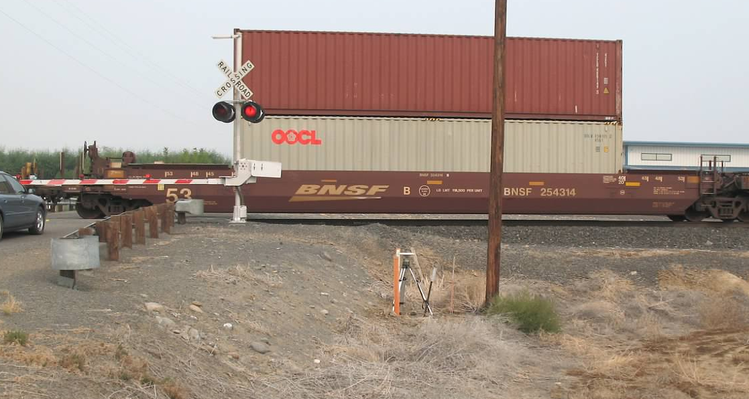
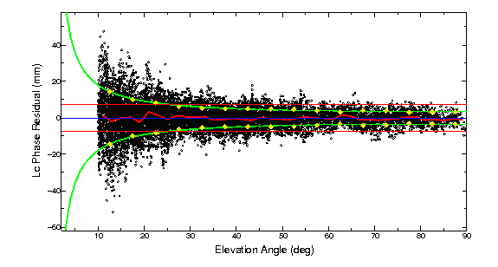
High mount in a dirty environment
C033
Old survey mark in dirt in central Washington.
Tripod mount. (Train blockage was short-lived)
2012 19-hr session and 5-hr session agree at 1.5 mm horizontal, 3 mm vertiical. Long-term repeatability 2 mm horizontal, 12 mm vertical.
Surprisingly little short-period multipath (dry dirt?)

Slide 19
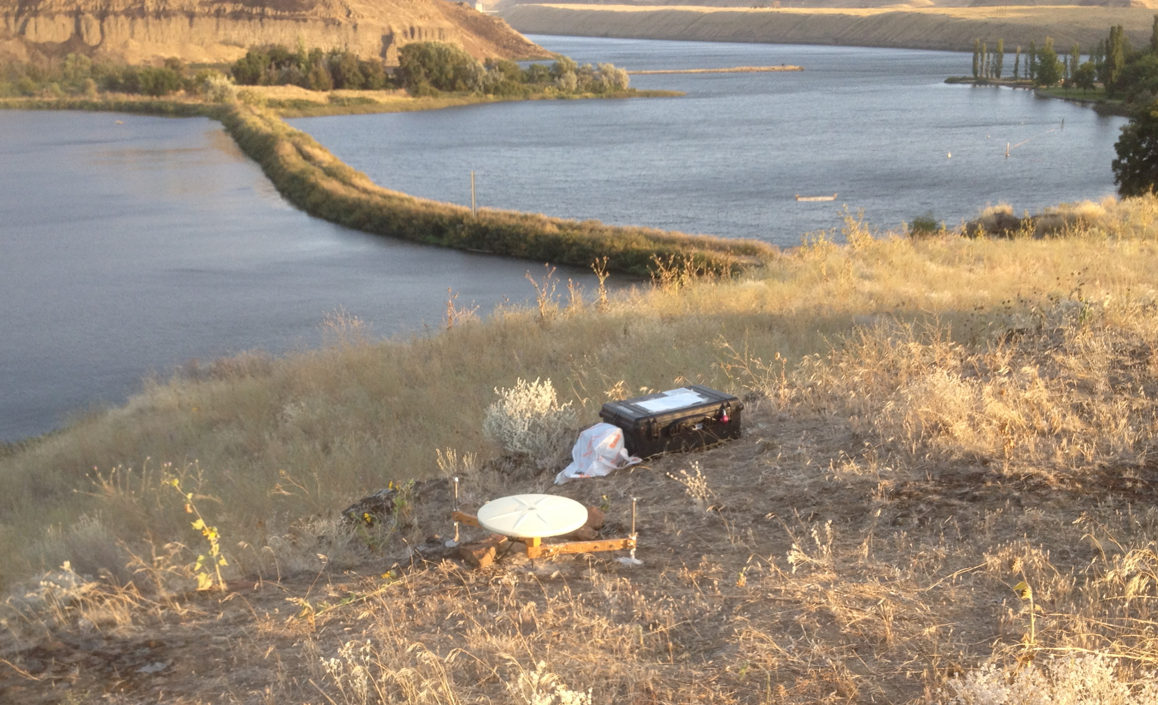
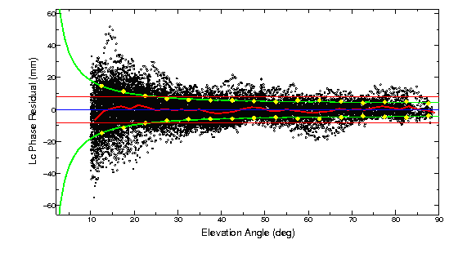
Low mount on a slope
LYFR
Rocky river bank in eastern Oregon
12.5-cm spike mount
Single 14-hr session . Long-period multipath due to slope and/or reflective rocks ?
Notes:
We have yet to determined the relationship between the height of the spike mount and the effect on long-period multipath. Is there a critically bad resonance height (remember that L1 has a wavelength of 19 cm, and L2 24 cm)? We’ve seen some evidence of this with pillars. Is there an optimal height that minimizes the long-period multipath? Possibly, but the curve may be shallow.

Slide 20
Special characteristics of survey-mode data
Editing is critical: every point counts
Usually combined with cGNSS data to provide continuity and a tie to the ITRF
Appropriate relative weighting needed in combining with cGNSS data
Antenna meta-data may be more complicated
Heights may be problematic if different antennas used
Seasonal errors behave differently than in cGNSS data: best strategy is to observe at the same time of the year (unlike cGNSS, which has minimal seasonal sensitivity at 1.5, 2.5, 3.5 ….years total span)
Notes:
For the effects of annual and semi-annual errors on velocity estimates, see Blewitt and Lavallee, J. Geophys. Res., 107, 10.1029/2001JB000570, 2002.

Slide 21
Analysis strategy
Generate time series and aggregated h-files for each survey
  Use spans less than ~ 20 days to avoid biasing the position estimate from an in correct a priori velocity
  Include cGNSS data only on days when sGNSS data are available to maintain common-mode cancellation
  Aggregration of sGNSS positions estimate within each survey to allow better assessment of the long-term statistics
  Edit carefully the daily values within each span
Generate time series and a velocity using the aggregated h-files from a span of 3 or more years
  Edit carefully the long-term time series
  Add 0.5 of white noise (“sig_neu”) to the cGNSS estimates from each span to avoid overweighting the cGPS position estimates
  Use a separate (e.g. PBO) analysis of the daily cGNSS time series to get the appropriate RW (“mar_neu”) values for each cGNSS site, then use the median RW for the sGNSS sites
See sGPS_recipe.txt for detailed commands
Notes:
The aggregation time should be short enough that errors in the a priori velocity will not cause changes in the a priori position sufficient to bias the adjustments, but long enough to average the short-term noise so that the time series represent the long-term statistics. A practical consideration is how you want to perform the daily editing---only many 5- to 20-day spans where the slope should be nearly zero and the epoch of the point clear, or a few longer spans where daily values may be harder to identify.
The short-course folder also includes the GLOBK command files to be used in the recipe.

Slide 22
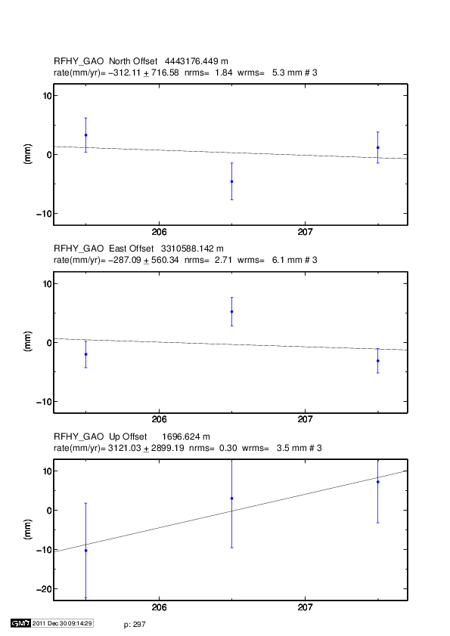
Editing example
Notes:
Both the N and E components here have apparent outliers. If we accept that an nrms of 0.7 is statistically normal for the GAMIT weighting, then the scatter in the N is 2 sigma (95 %,) and the E, 4-sigma. Since the 1st and 3rd pts agree within their uncertainties, it’s probable that the middle point is the outlier. The first thing to do is to examine the log sheets, sky plots, and the time series of other sites occupied on the same day to see if you can confirm that the middle point is indeed the outlier. With this assumption, we would remove ( rename rphy rphy_xps 2008 7 24 0 0 2008 7 24 24 0, in eq_file) or downweight it (e.g. sig_neu rphy .01 .01 0 2008 7 24 0 0 2008 7 24 24 0, in globk_comb.cmd ). Alternatively, and especially if you had only two discordant points and cannot determine which one is bad, you can downweight all of the points (e.g. sig_neu rphy .007 .007 0 2008 7 23 0 0 2008 7 25 24 0). You can also make a note to reexamine these days after you’ve gotten a multi-year time series and can identify whether the N and E estimate for this 2008 survey are too high or two low.

