Slide 1


Dealing with earthquakes and other non-linear motions
M. A. Floyd
Massachusetts Institute of Technology, Cambridge, MA, USA
GPS Data Processing and Analysis with GAMIT/GLOBK
Earth Observatory of Singapore
17–21 July 2017
http://geoweb.mit.edu/~floyd/courses/gg/201707_EOS/
Material from R. W. King, T. A. Herring, M. A. Floyd (MIT) and S. C. McClusky (now at ANU)

Slide 2
Outline
Previous lecture showed common time series models
  Linear rate
  Seasonal terms
  Temporally correlated noise
Irregular perturbations to such models include
  Discontinuities due to equipment or environment changes
  Discontinuities due to earthquakes
  Non-linear motions due to earthquakes
  Non-linear motions due to transient events (e.g. volcanic inflation episodes)
Recommended implementation

Slide 3
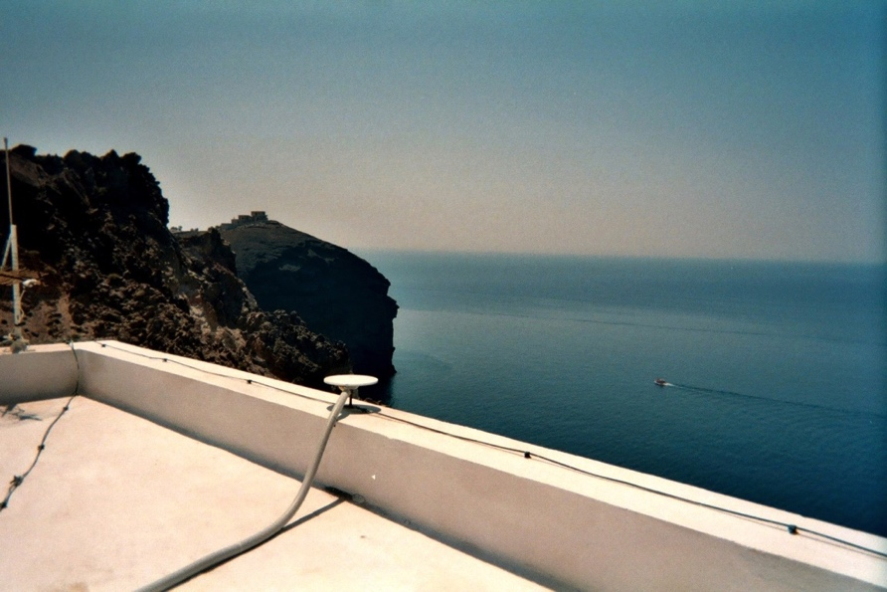
Changes to equipment
Antenna is main concern, although receiver may also affect continuity of calculated position
  Even antennas of the same model type may not be manufactured within acceptable geodetic tolerance
stinf_to_rename useful for creating automatic list

Slide 4
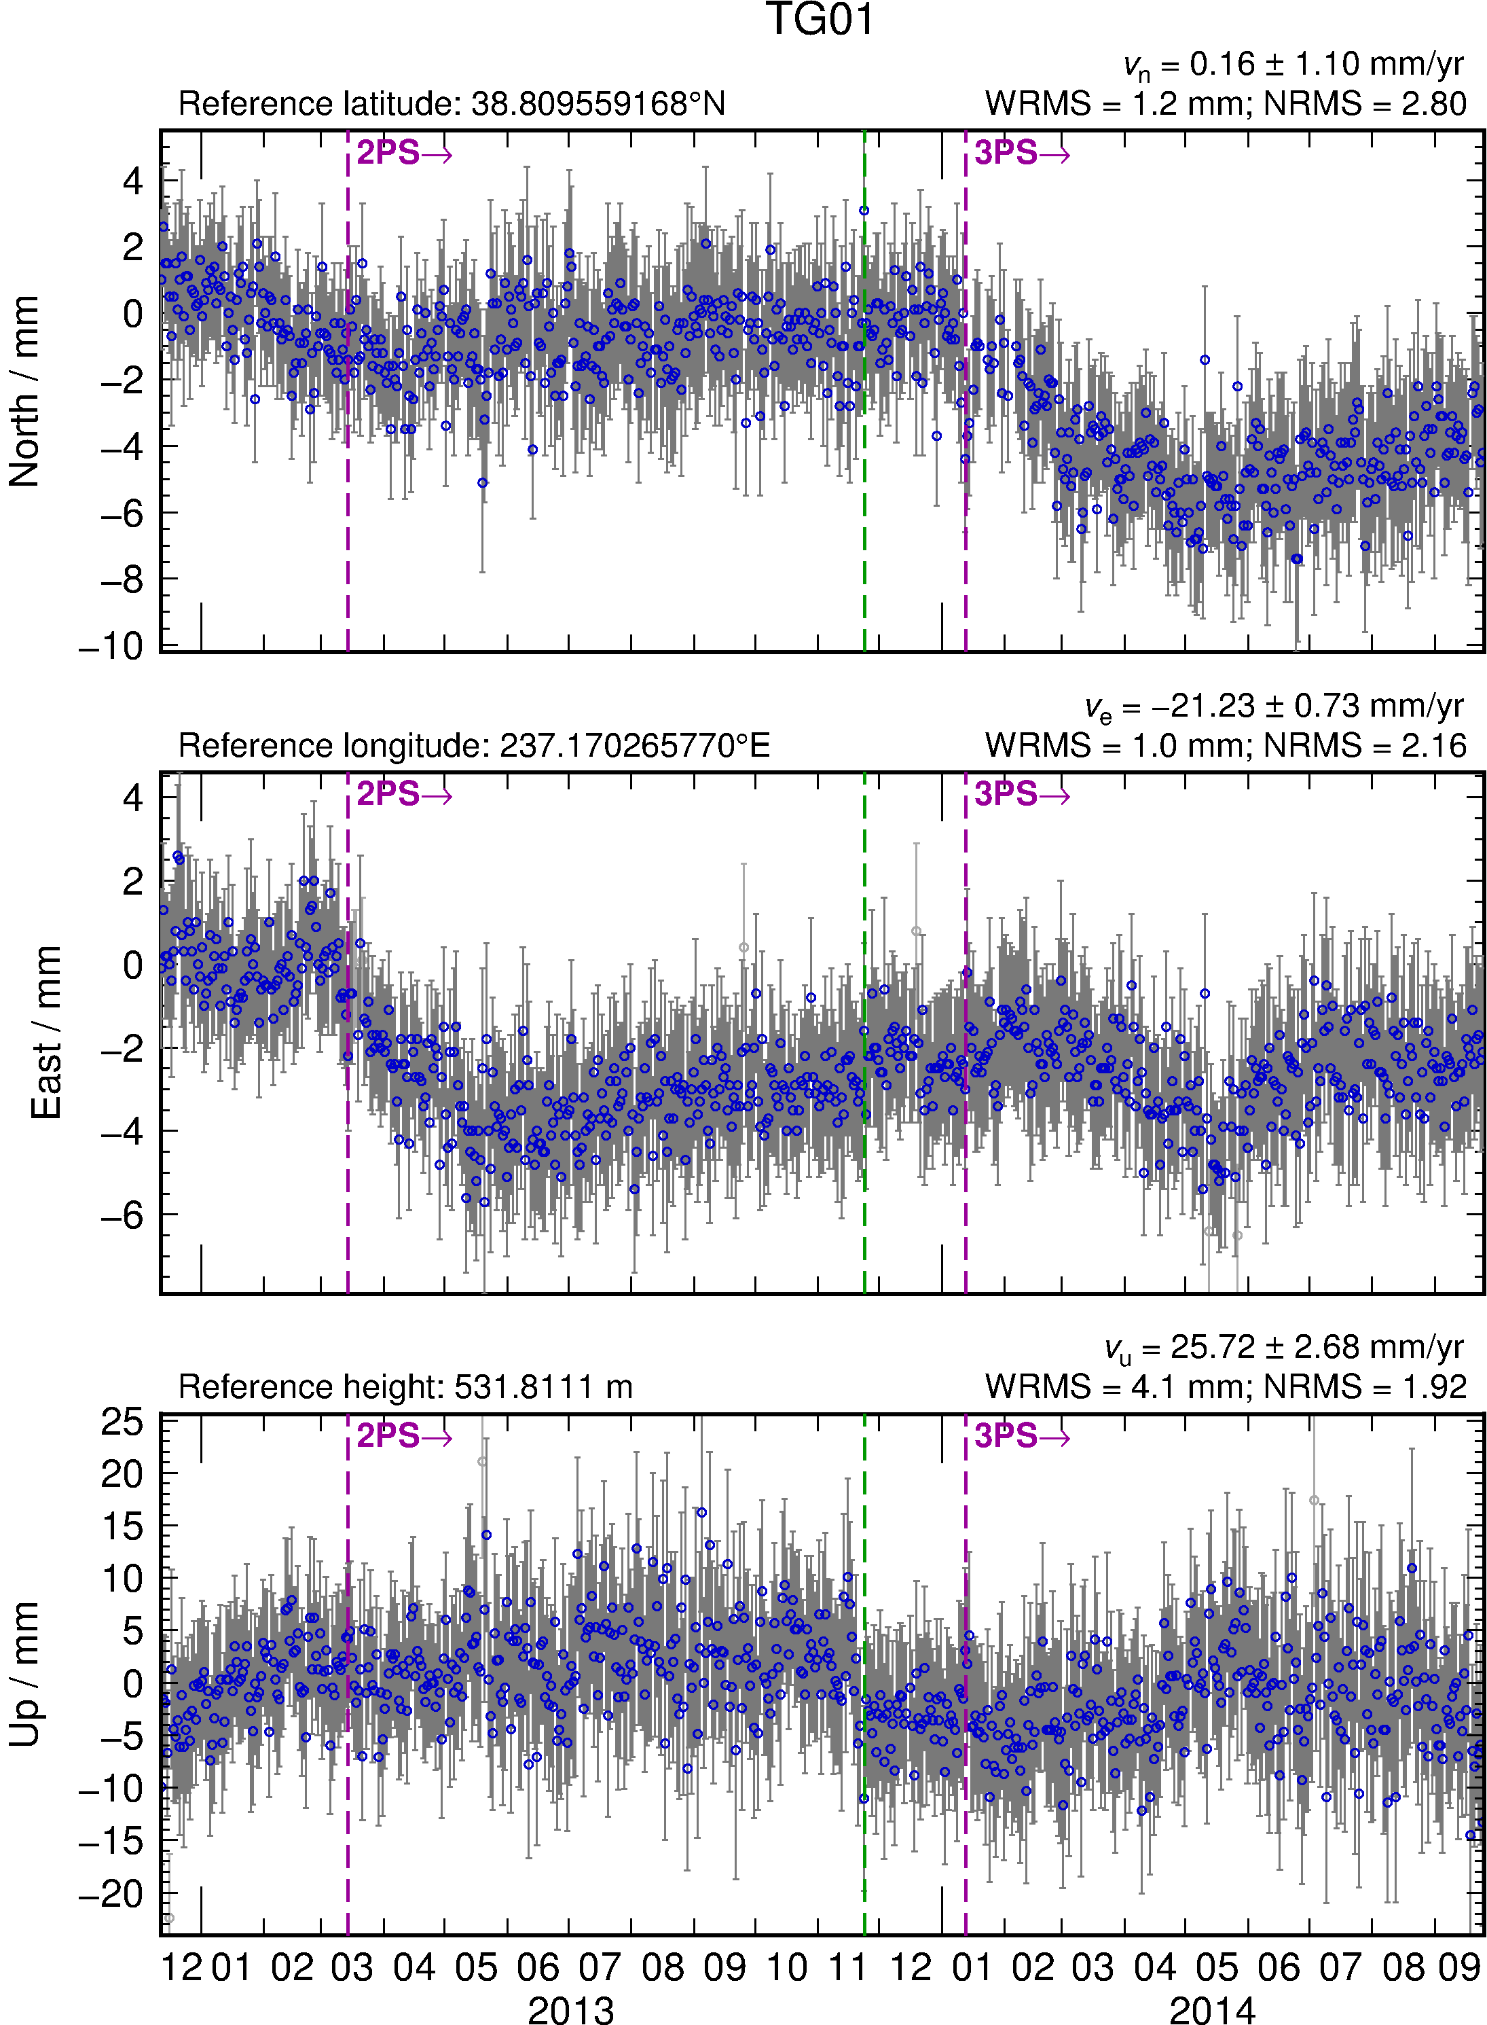
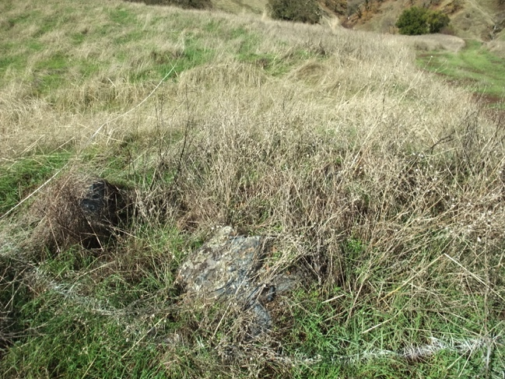
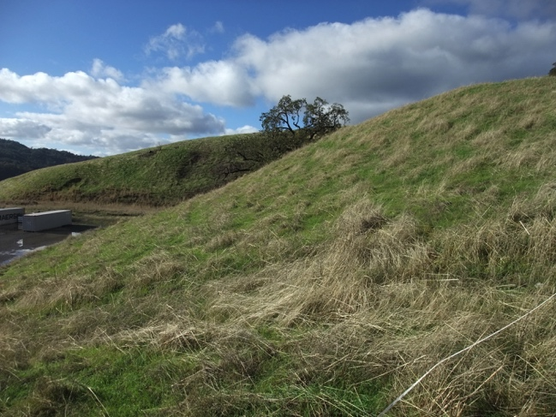
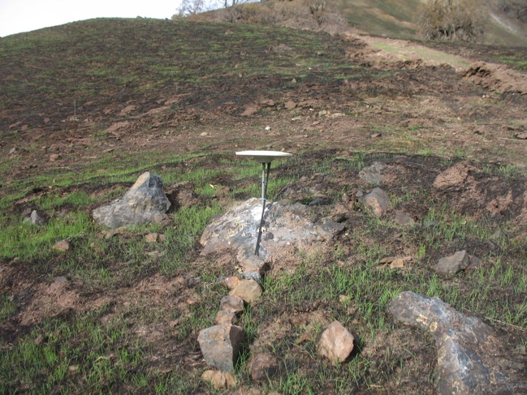
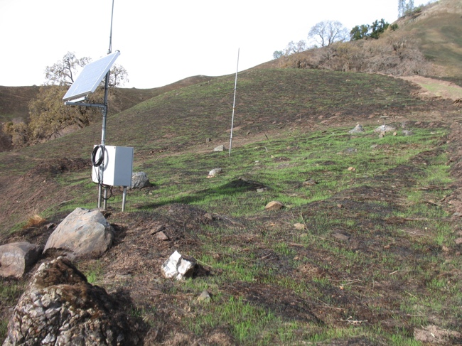
Changes in multipath environment
Photograph by M. Floyd
Photograph by M. Floyd
Photograph by R. Haught
Photograph by R. Haught
Notes:
SB4 showing November 2013 fire (http://cdfdata.fire.ca.gov/incidents/incidents_details_info?incident_id=932). GPS antenna (TG01) in upper right.

Slide 5
Rename scheme
Rename scheme uses first character of suffix
  XXXX_GPS → XXXX_2PS → XXXX_3PS → … etc.
Beyond “9PS”, convert to 10th letter of alphabet (“JPS”) and beyond
  … → XXXX_9PS → XXXX_JPS → XXXX_KPS → … etc.
  But remember “XPS” is a special case for excluding sites from globk runs
For manual renames (e.g. due to manual inspection rather than known events), use 8 available letters in alphabet before “J”
  XXXX_APS, XXXX_BPS, etc.
  But remember “GPS” is a special case (the default)

Slide 6
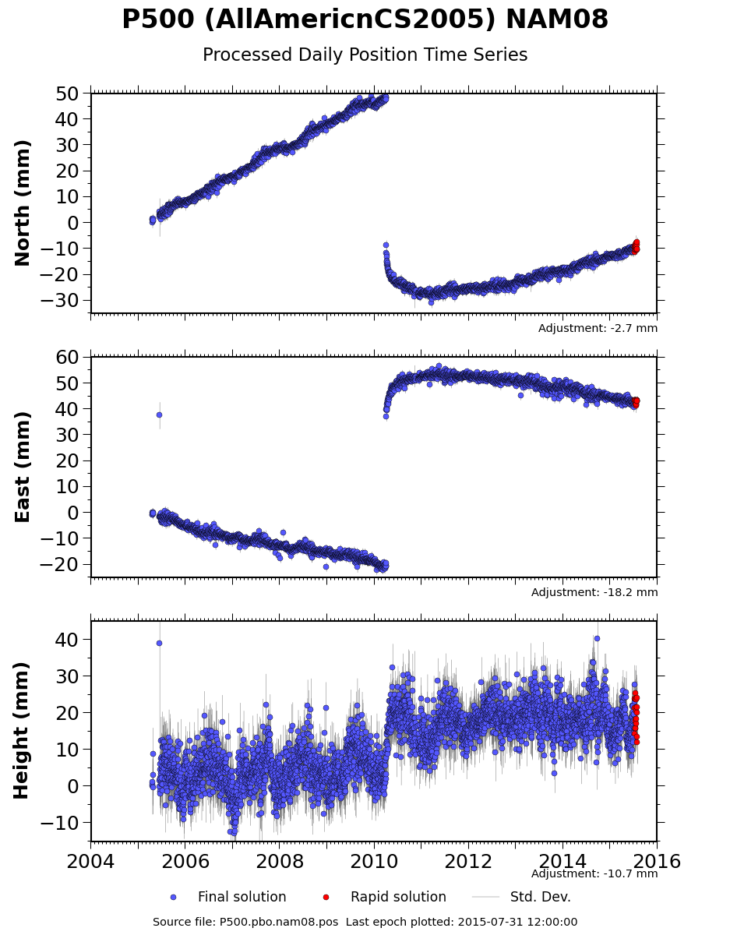
Earthquakes
Earthquakes occur at known times
May exhibit more than just a discontinuity
Take care when earthquake occurs in the middle of processing day
  Some data will fall before and some after ground displacement
  Time series point on day of earthquake may appear between pre-earthquake and post-earthquake position

Slide 7
Radius of influence
“eq_def” line in eq-file contains earthquake ID (two characters), location, etc.
  ID is used to substitute last two characters of 8-character site name, e.g. XXXX_GPS → XXXX_GSN
sh_makeeqdef will search archives (ANSS ComCat or ISC) to generate “eq_def” records

Slide 8
Non-linear motions
Logarithmic decay
Exponential decay
Derives from afterslip on fault plane controlled by rate-and-state friction (e.g. Marone et al., 1991)
Velocity perturbation reduces with ¹/_{t}
Derives from assumption of viscoelastic relaxation in stressed medium, e.g. after an earthquake

Slide 9
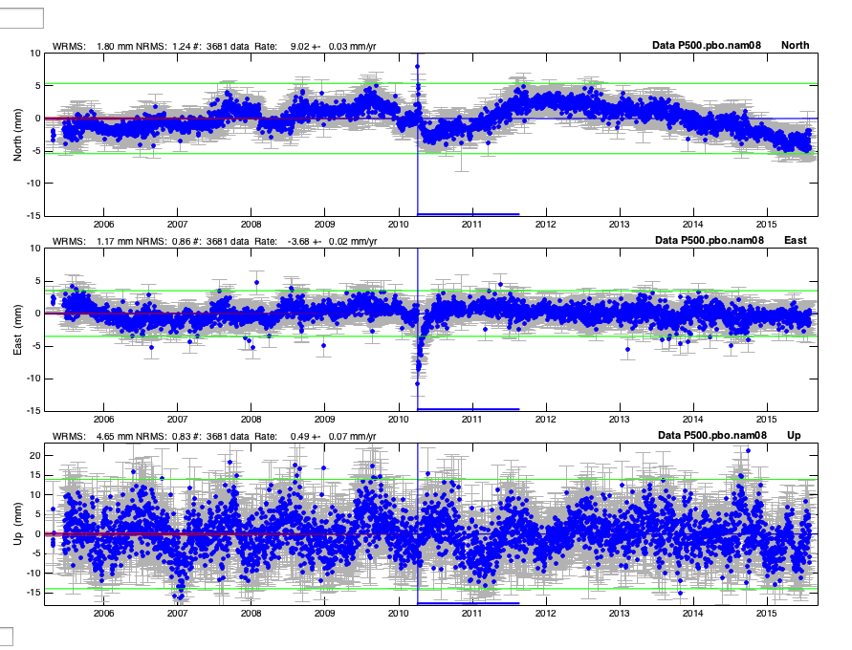
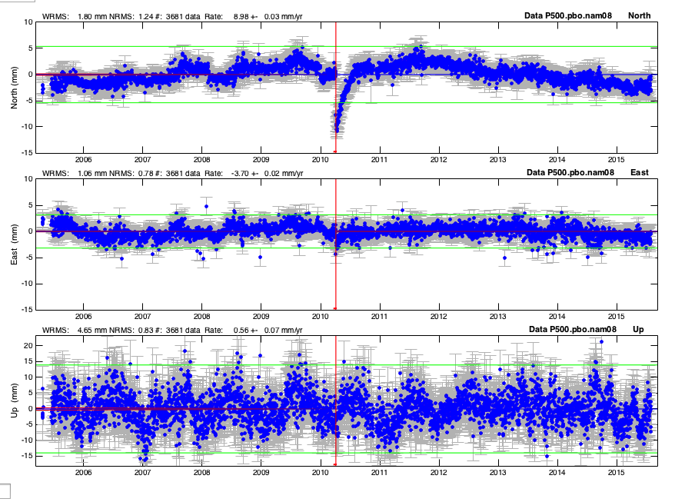
Non-linear motions
Logarithmic decay
Exponential decay
Logarithmic looks good in east; Exponential looks good in north; Height doesn’t care

Slide 10
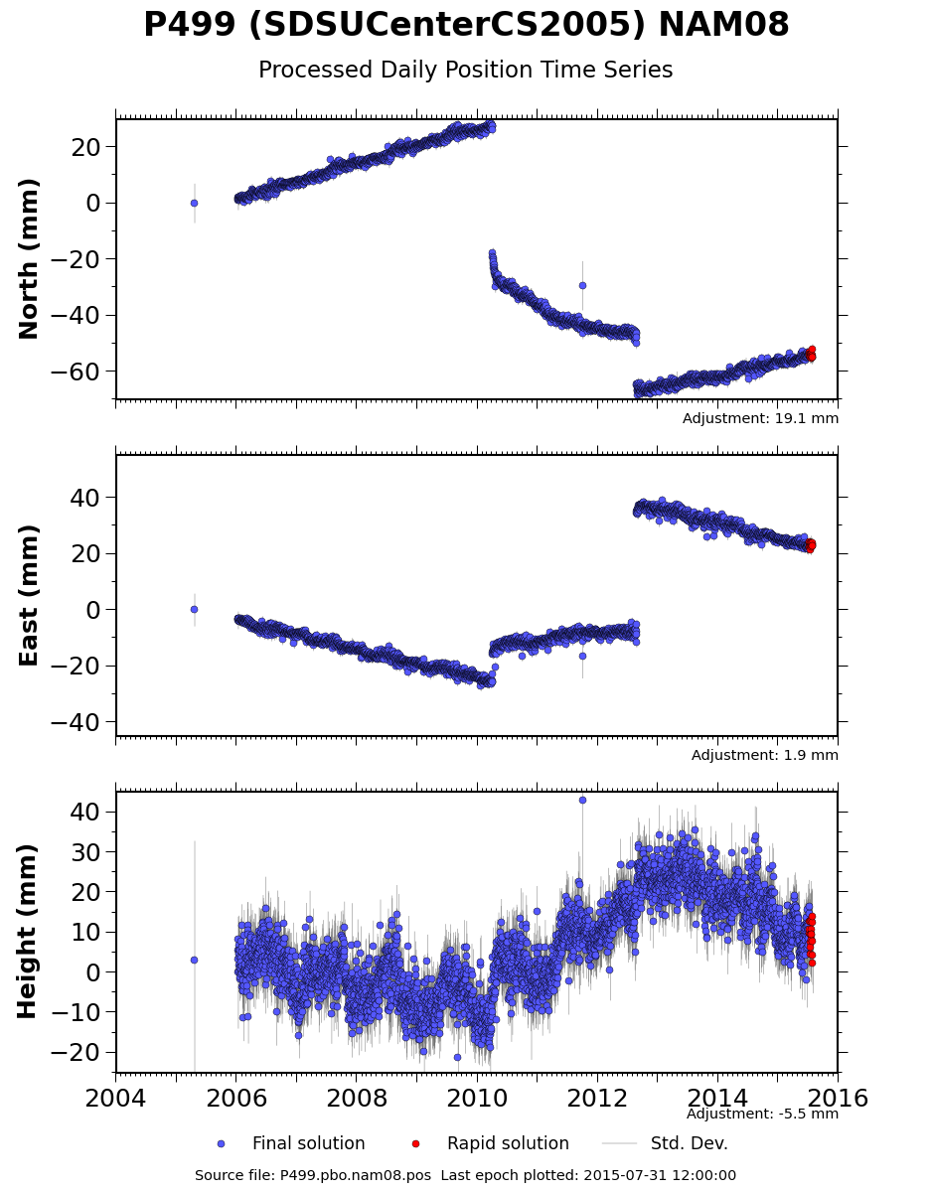
Many earthquakes…
Complications arise in a tectonically active area with multiple events
Sites may be renamed several times and therefore have various two-character suffixes
Non-linear motions may be included in apr-file with “EXTENDED” records (see globk help)

Slide 11
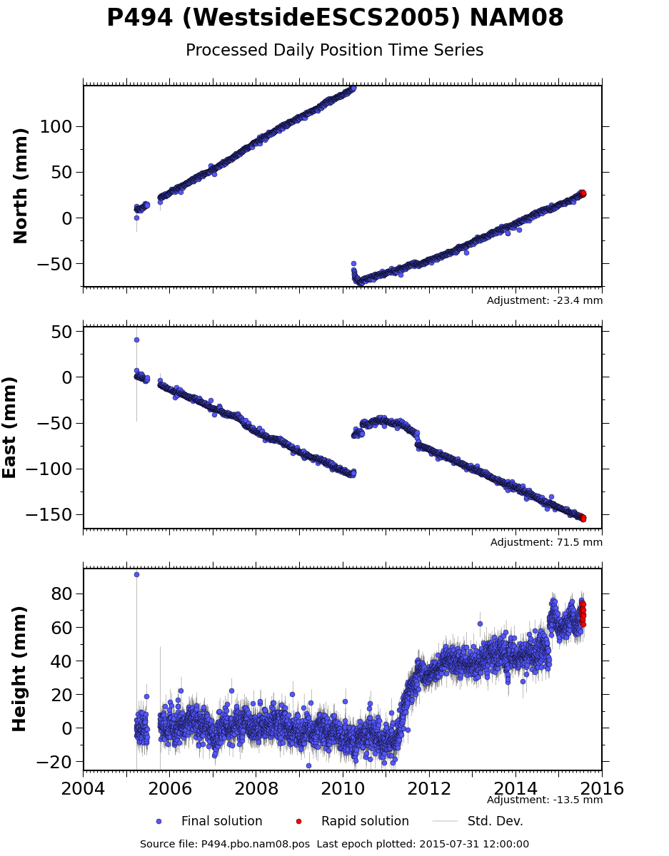
Undocumented effects
2010-04-04 M_{w}7.2
Time series inspection is very important to catch undocumented effects
Insert manually-determined discontinuities using letter for first character of suffix
? Jump is due to washer removal from top of the antenna.
?

Slide 12
Other phenomena
Several examples of other phenomena some of which are likely to be motions of the monuments (often not tectonic), propagation medium effects, or failed equipment.
With continuous data these types of effects can often be diagnosed from the data.
For artifact effects, multipath and SNR measures are often useful for diagnostics.

Slide 13
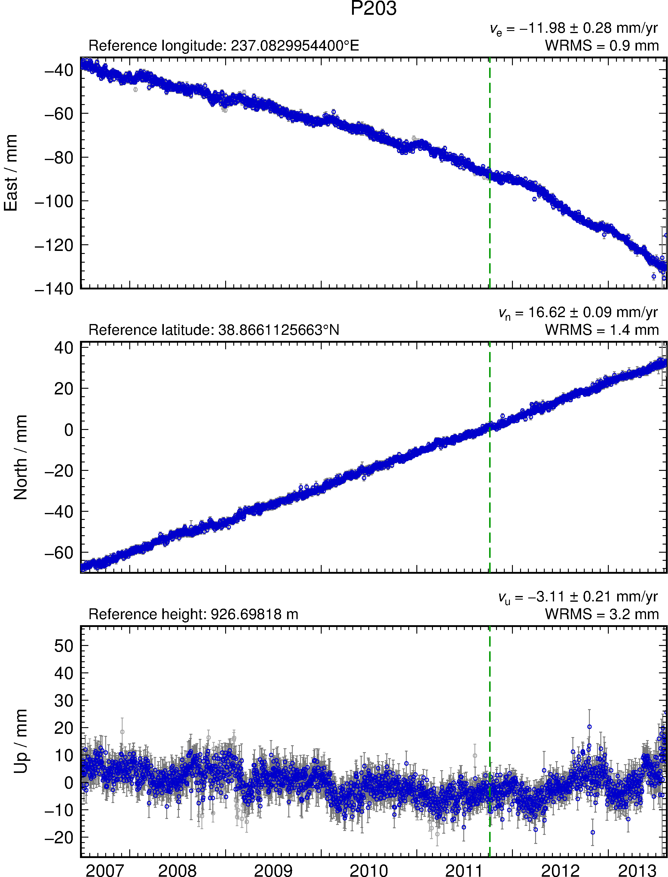
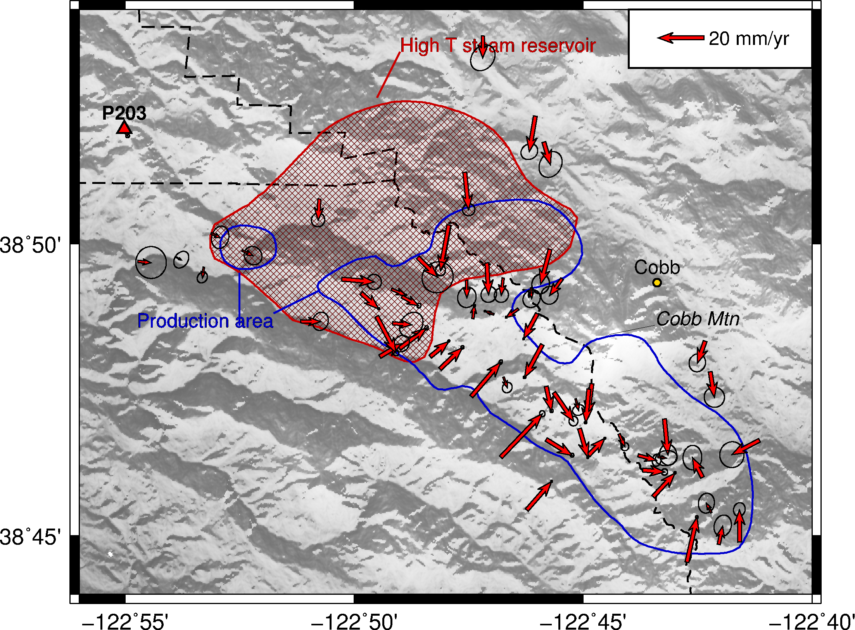
Start of EGS
demo injection
Plate Boundary Observatory (PBO)
continuous GPS site P203
North-westward
motion relative to
North America
Minor subsidence

Slide 14
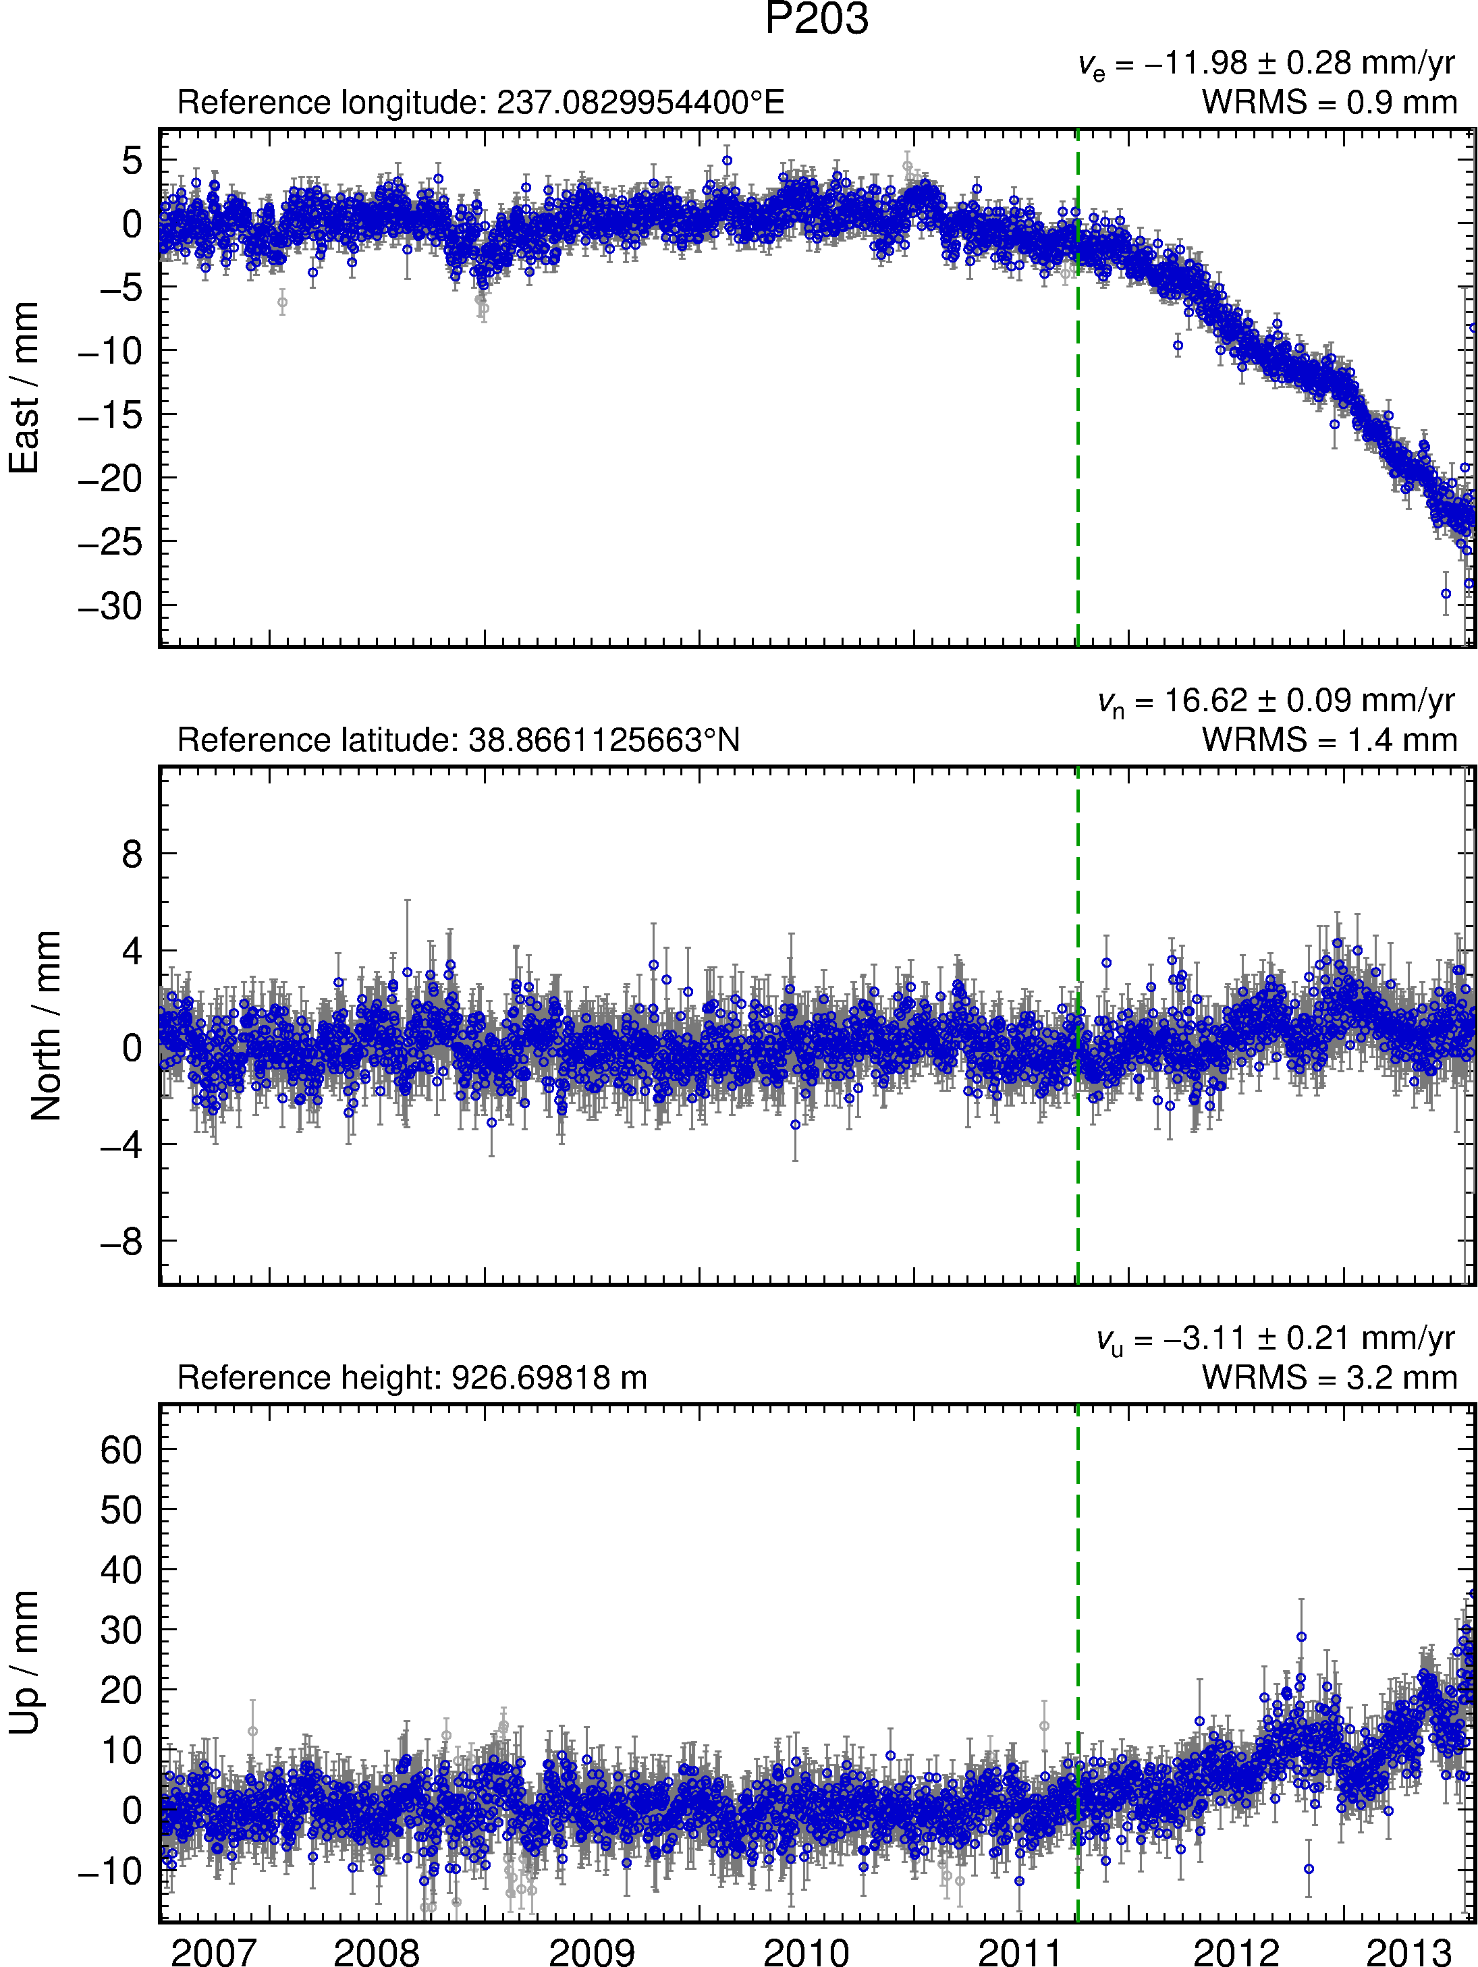
Start of EGS
demo injection
Increased
westward
motion
Plate Boundary Observatory (PBO)
continuous GPS site P203
Uplift
Notes:
Increase in horizontal motion ~ 1 cm/yr westward
Uplift ~ 1 cm/yr

Slide 15
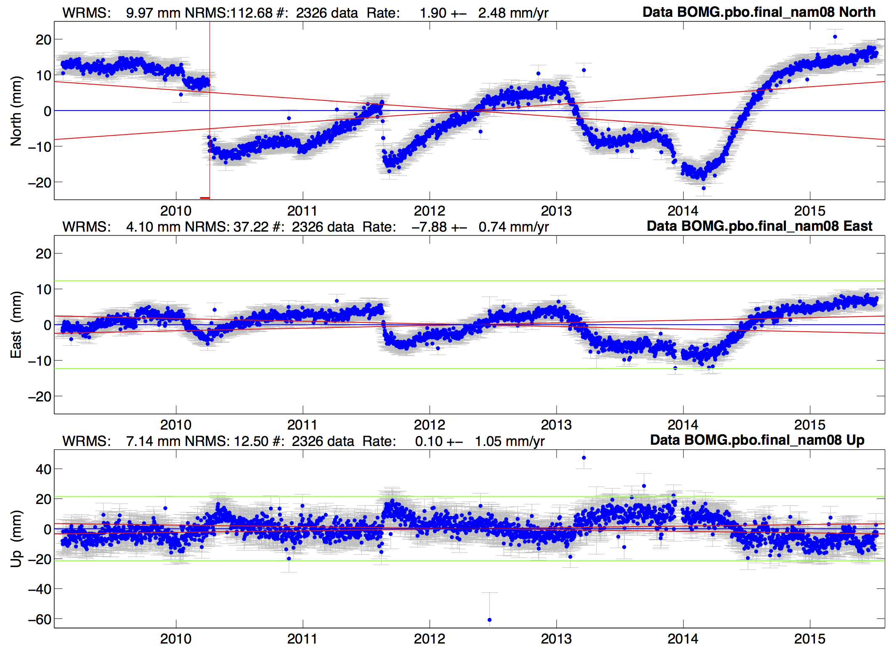
Bombay Beach Creep?
Notes:
High light FOGMEX rate sigma (red sloped lines). Vertical rate of El Major Cucapah (2010/04/04)

Slide 16
Episodic events: Yellowstone
Profile of velocity estimates across region. Large error bars (FOGMEx) show systematic sites
List of
noisy sites

Slide 17
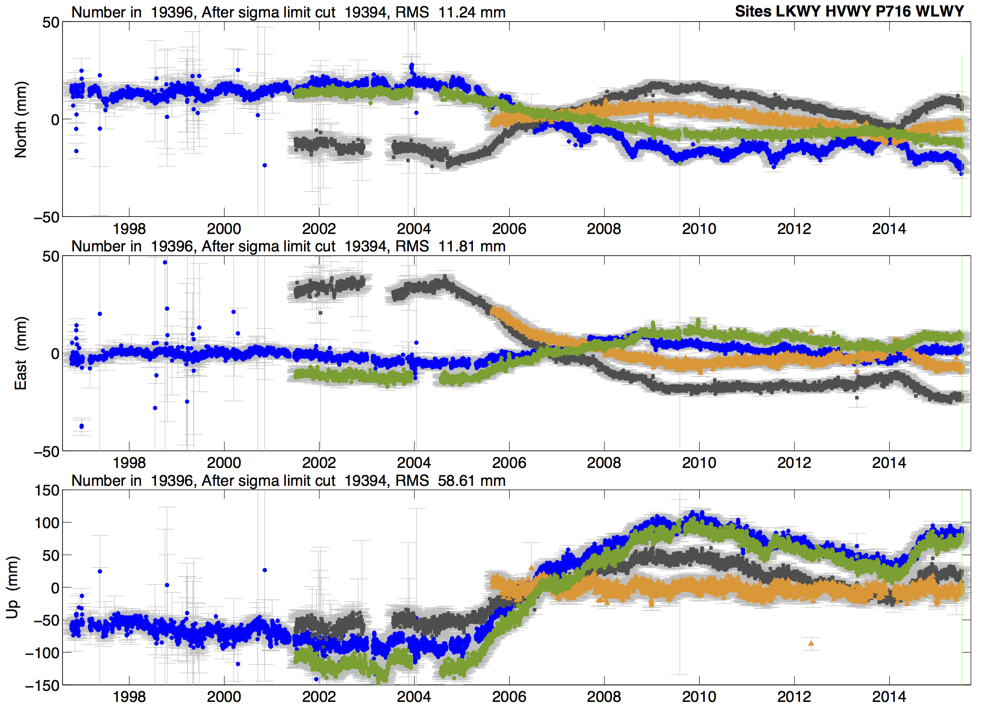
Selected Yellowstone time series

Slide 18
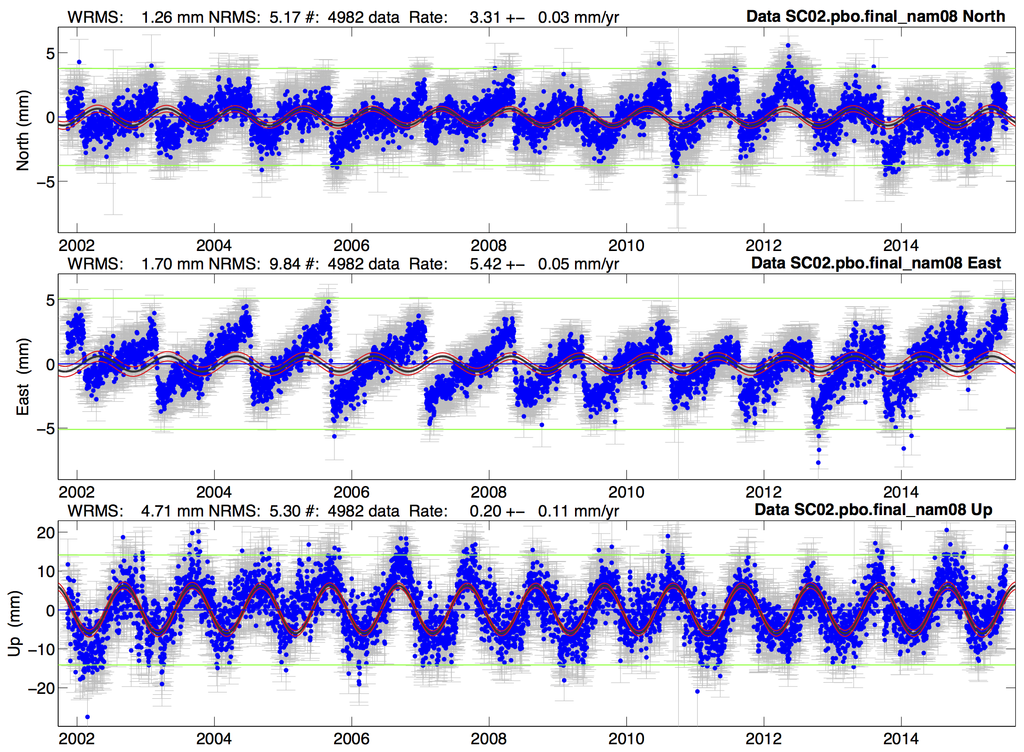
Episodic tremor and slip (ETS): Cascadia
Notes:
Annual in height but east is ~14 months (notice offsets move relative to sinusoidal wave).

Slide 19
Other examples
The following examples are from the UNACVO GAGE Data technical news:
http://plus.google.com/u/0/communities/112834235701900858710
Reports here on various anomalies that have been detected and investigated. Useful place to look for site issues.
GAGE ACC quarterly reports also contain information on anomalies

Slide 20
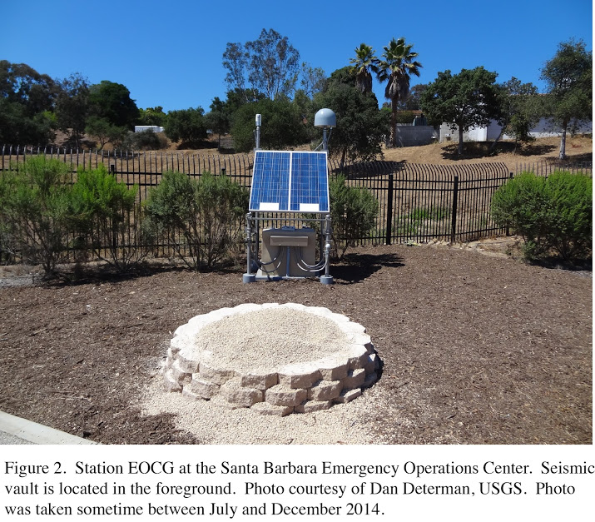
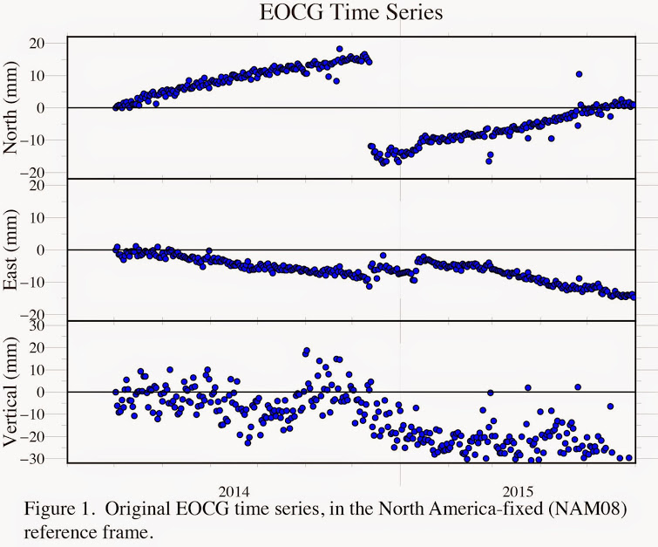
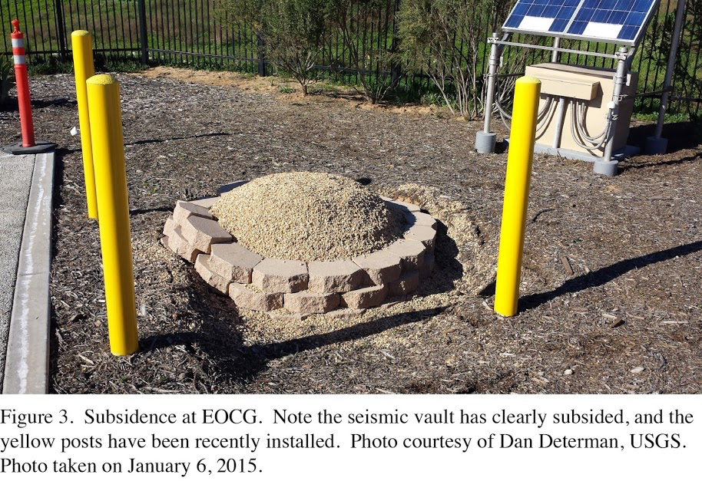
Local collapse
Site EOCG
http://plus.google.com/u/0/communities/112834235701900858710

Slide 21
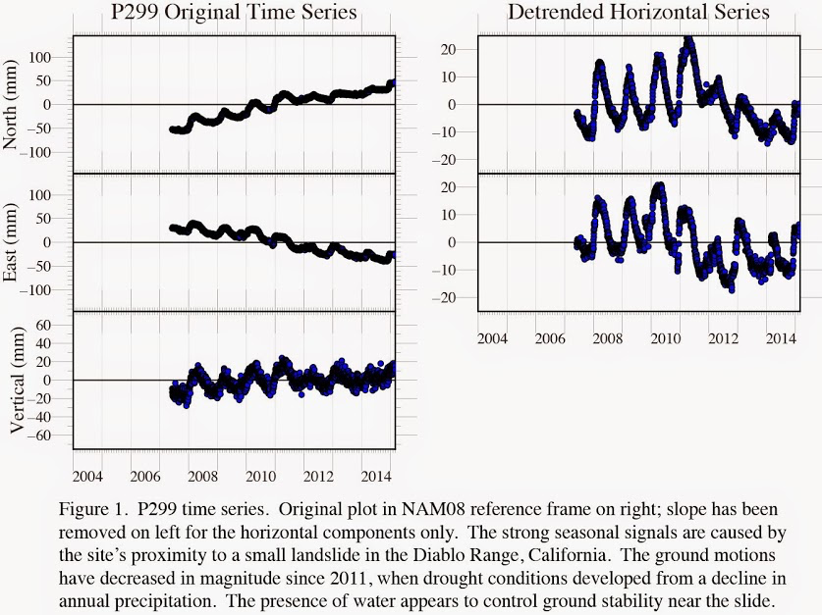
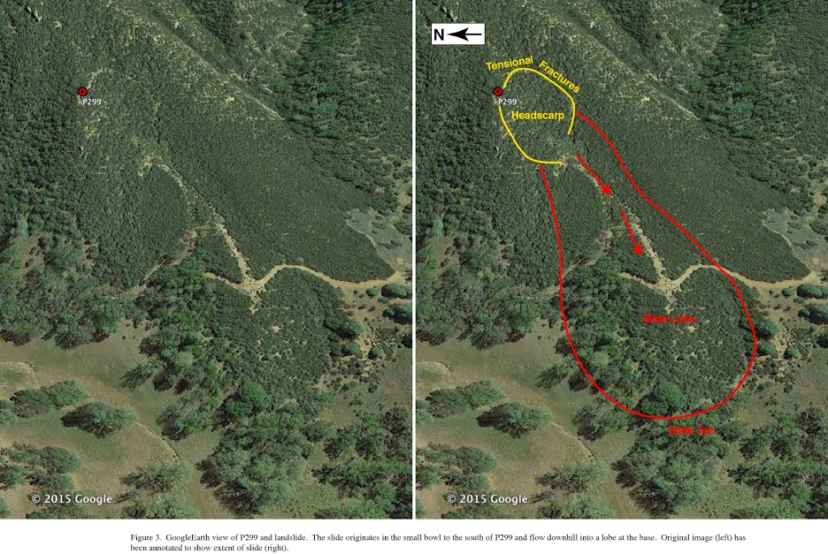
Landslide prone site
Location of earlier landslide showing strong seasonal

Slide 22
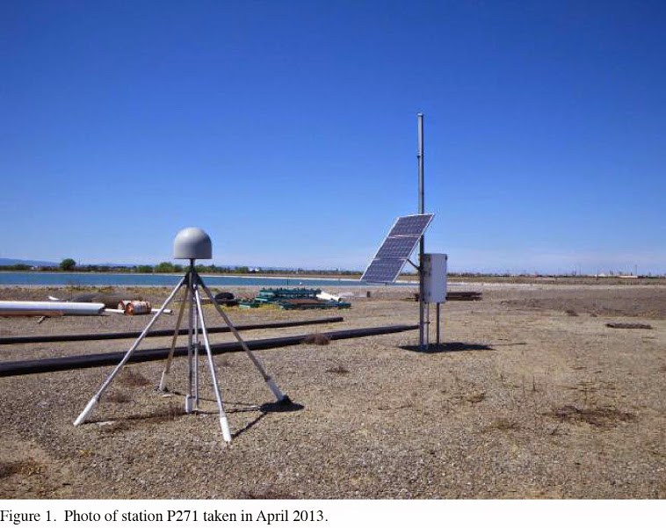
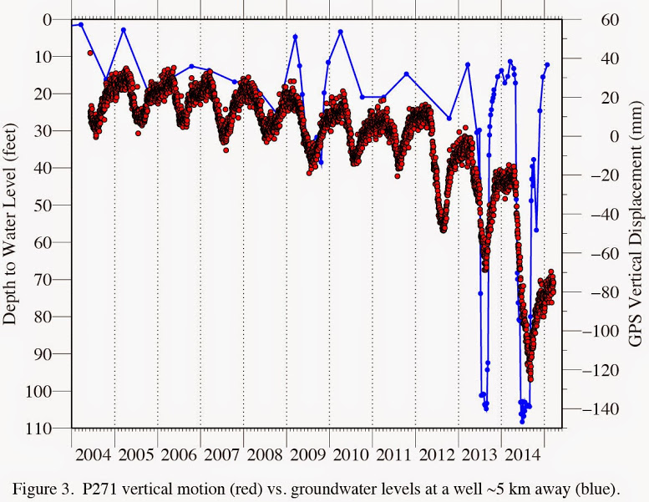
Ground water P271
Site P271 is strongly affected by ground water withdrawal
There are also horizontal periodic signals as well

Slide 23
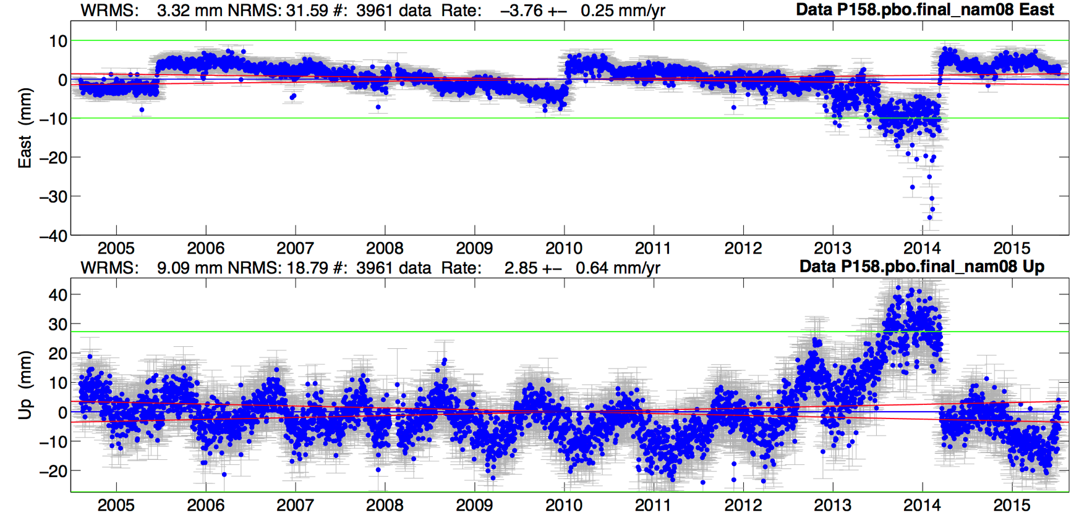
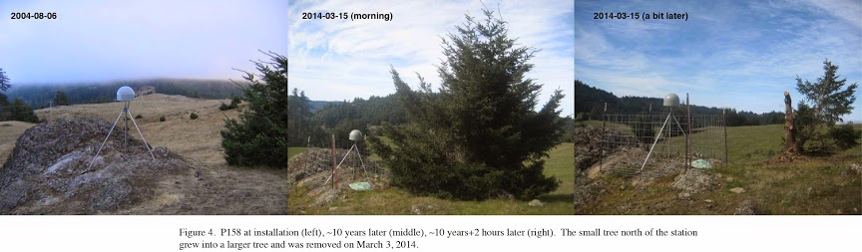
Vegetation Growth P158
North (not shown) is less affected.

Slide 24
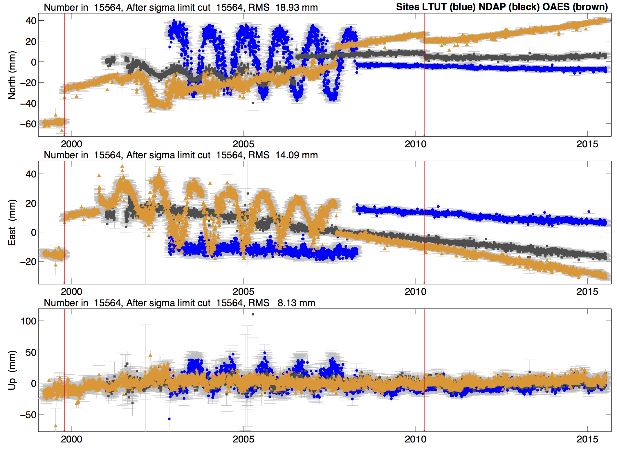
Bad antennas
Notes:
Red lines are Hector Mine and El Mayor Cucapah.

Slide 25
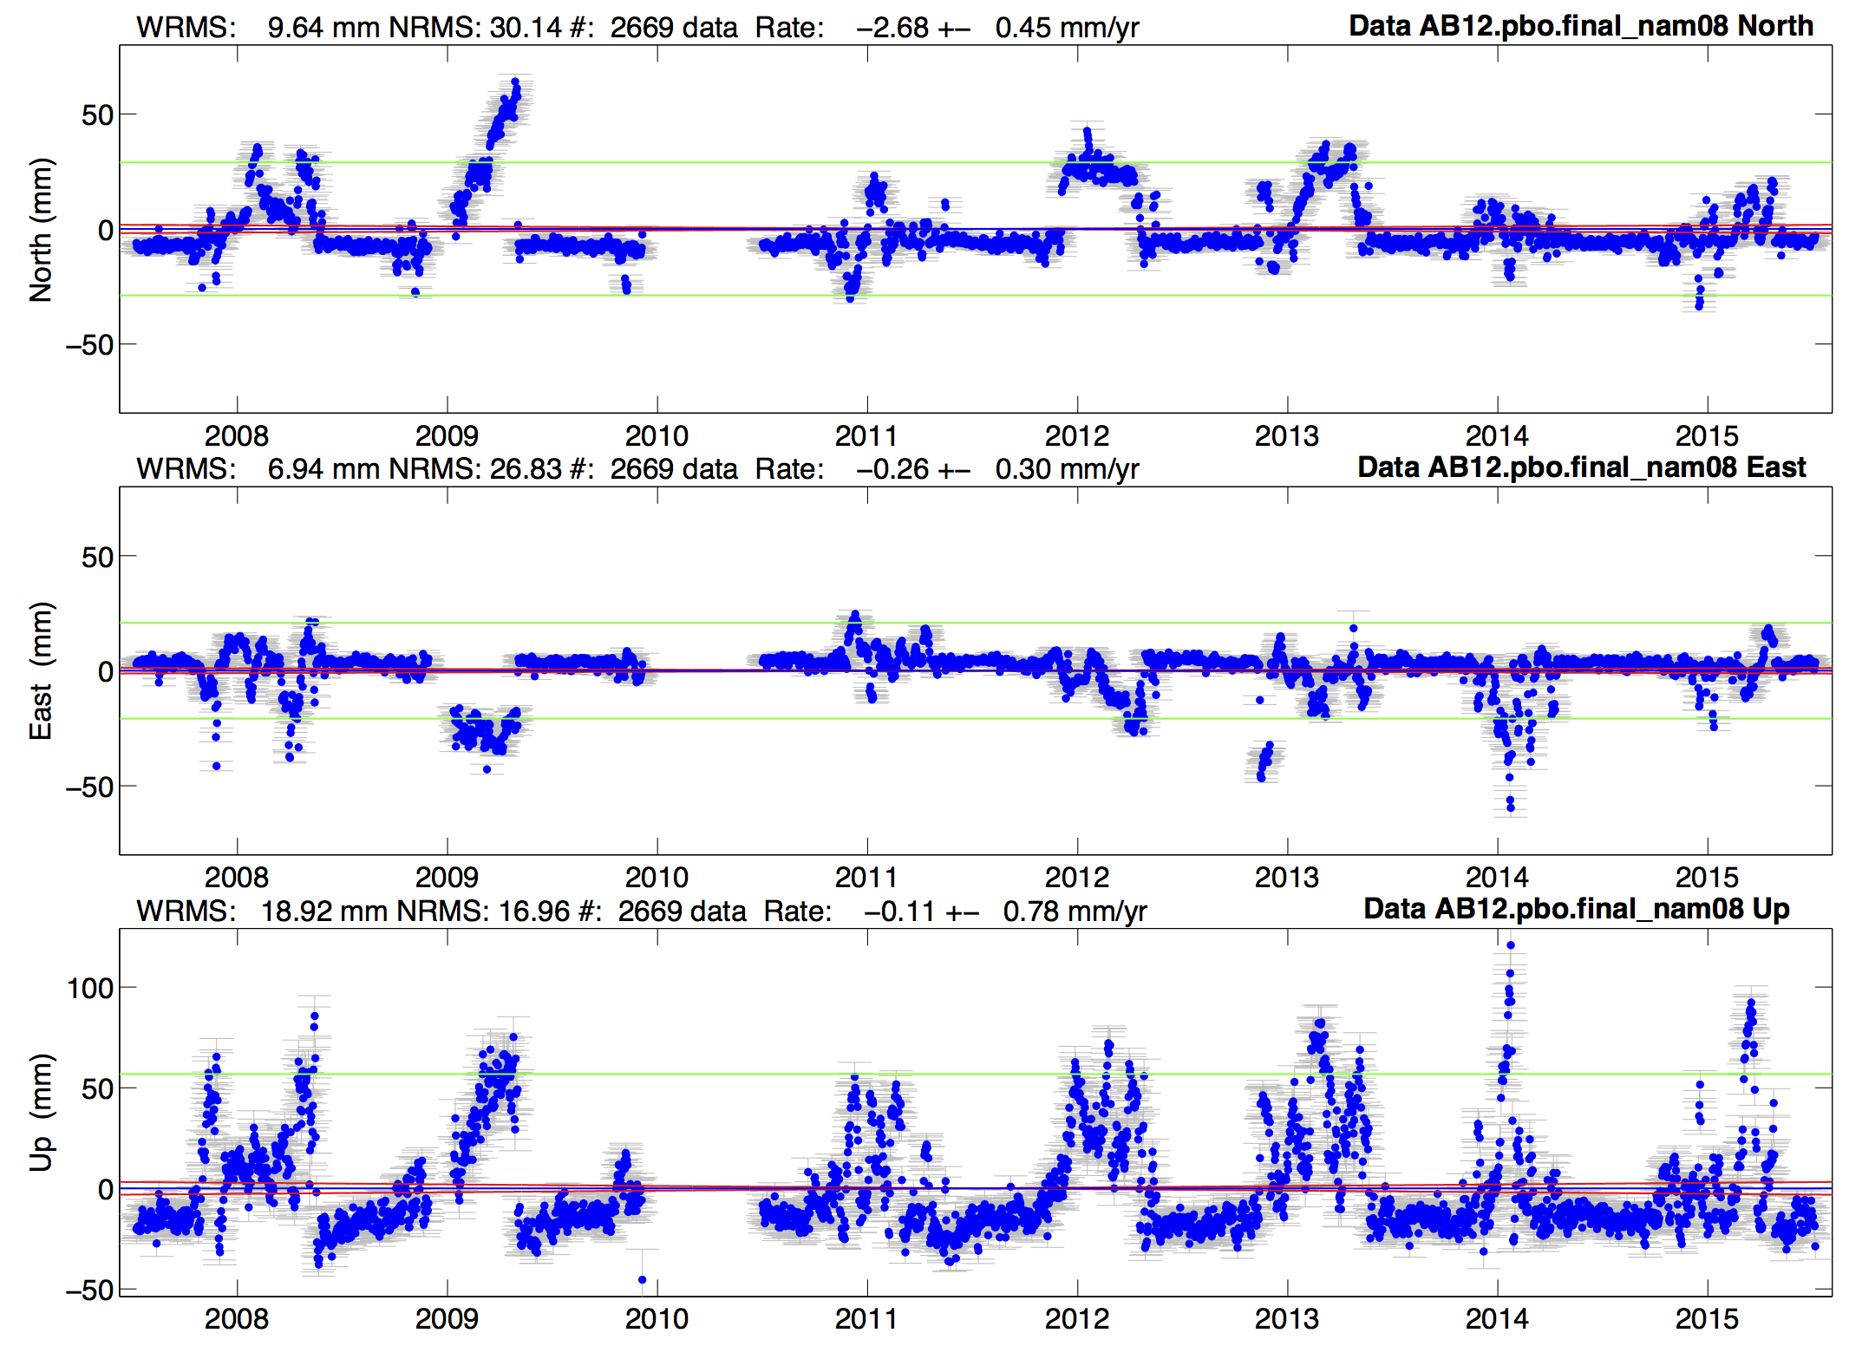
Snow on antenna

Slide 26
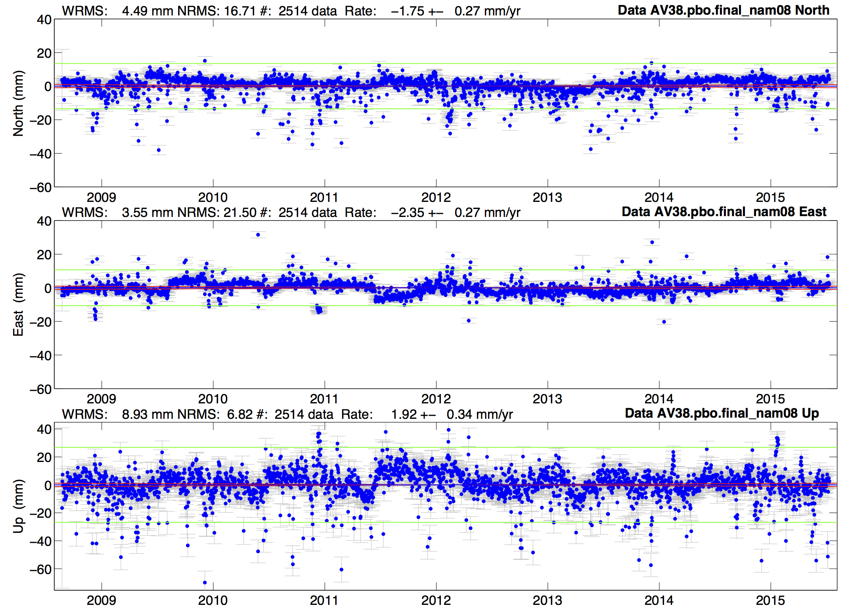
Skewed position residuals: Atmosphere delays?
Notes:
Site sits near two high volcanoes with a NS valley between the volcanoes.

Slide 27
Recommendations
Know your goals
  Only fit “nuisance” terms
  It is usually best not to try to fit signals that you are interested in, e.g. seasonal terms if you are studying these.
Depending on your goal (e.g. linear tectonic velocities), sometimes you just have to abandon data as it is likely to do more harm than good (rename to xxxx_XPS or xxxx_XCL)
  Adding large process noise in globk is one approach but be careful not to make too large
  GLOBK “sig_neu” command can be used for small duration “bad” events

