Slide 1


Utility programs and scripts
M. A. Floyd
Massachusetts Institute of Technology, Cambridge, MA, USA
GPS Data Processing and Analysis with GAMIT/GLOBK
Earth Observatory of Singapore
17–21 July 2017
http://geoweb.mit.edu/~floyd/courses/gg/201707_EOS/
Material from R. W. King, T. A. Herring, M. A. Floyd (MIT) and S. C. McClusky (now at ANU)

Slide 2
Outline
Organizing/pre-processing
Part of sh_gamit
Evaluating results
Visualization

Slide 3
Guide to scripts
There are many scripts in the ~/gg/com directory and we recommend you look at all these scripts over time because they often contain useful guides as to how to do certain tasks
  Look at the programs used in the scripts because these show you the sequences and inputs needed for different tasks
  Scripting methods are useful when you want to automate tasks or allow easy re-generation of results to your own specifications
  Look for templates that show how different tasks can be accomplished
~/gg/kf/utils/ and ~/gg/gamit/utils/ contain programs invoked by the scripts in ~/gg/com/ or run directly from a command line.
Both the shell scripts and the utility programs are self-documenting, invoked by typing the name without any arguments

Slide 4
GAMIT/GLOBK utilities
Organization/Pre-processing
sh_get_times: List start/stop times for all RINEX files
sh_upd_stnfo: Add entries to station.info from RINEX headers
doy: Convert between DOY, YYMMDD, JD, MJD, GPSW
convertc: Transform coordinates (Cartesian/geodetic/spherical)
glist: List sites for h-files in gdl-file, check coordinates and models
cortran/convertc: Translate coordinate types and file formats
corcom: Rotate an apr-file to a different plate frame
unify_apr: Set equal velocities/coordinates for glorg equates
glist2cmd: Create a “use_site” list from a glist summary file
vel2stab: Create a “stab_site” list from a velocity org-file
sh_dos2unix: Remove the extra CR from each line of a file

Slide 5
GAMIT/GLOBK utilities
Scripts used by sh_gamit but also useful as stand-alone
sh_get_rinex: ftp a RINEX “o” file from remote archives (see ftp_info)
sh_crx2rnx: convert to/from RINEX/Hatanaka
sh_get_nav: ftp a RINEX “n” file from remote archives
sh_get_met: ftp a RINEX “m” file from remote archives
sh_get_ionex: ftp a RINEX “i” (IONEX) file
sh_get_hfiles: ftp h-files from MIT/SOPAC
sh_update_eop: ftp an EOP file from IERS, create pmu, ut1., wob.
sh_get_orbits: ftp a g-file or SP3 file from remote archives
sh_sp3fit: create a g- or t-file from an SP3 file (1–3 days)
  Called by sh_get_orbits

Slide 6
GAMIT/GLOBK utilities
Evaluating results
sh_oneway: Plot phase residuals (sky map; vs elevation) [GMT]
sh_plotelmean: Elevation angles average residuals plots [GMT]
cview: Display and manipulate phase residuals [X-windows]
sh_plot_pos: Plot coordinate times series [GMT]
sh_tshist: Plot histogram of time-series statistics [GMT]
tsview: Display and manipulate coordinate time series [MATLAB]
sh_plotvel: Plot velocity maps [GMT]
sh_map_elements, sh_map_calif, sh_map_balkans, etc. [GMT]
velview: Display and manipulate velocity maps [MATLAB]
sh_velhist: Plot histogram of velocity statistics
sh_org2vel: Extract plate-referenced velocities from glorg print file
tscon: Rotate “.pos”-files into new reference frame rather than rerun glred/glorg
velrot: Combine velocity fields from different analyses

Slide 7
tscon to redefine reference frame
apr-file for your chosen reference frame may be specified in glorg command file
But if we want to put time series in different reference frames without rerunning glred, we can use tscon
tscon works in much the same way as glorg and has a command file that uses a few globk/glorg options
  tscon will not be able to use the full covariance matrix (with inter-site spatial correlations) that is available to glorg
  Remember to read in as many pos-files as possible so that as many stabilization sites as possible are available! You cannot rotate only one time series because the (network) stabilization is done in the same way as glorg

Slide 8
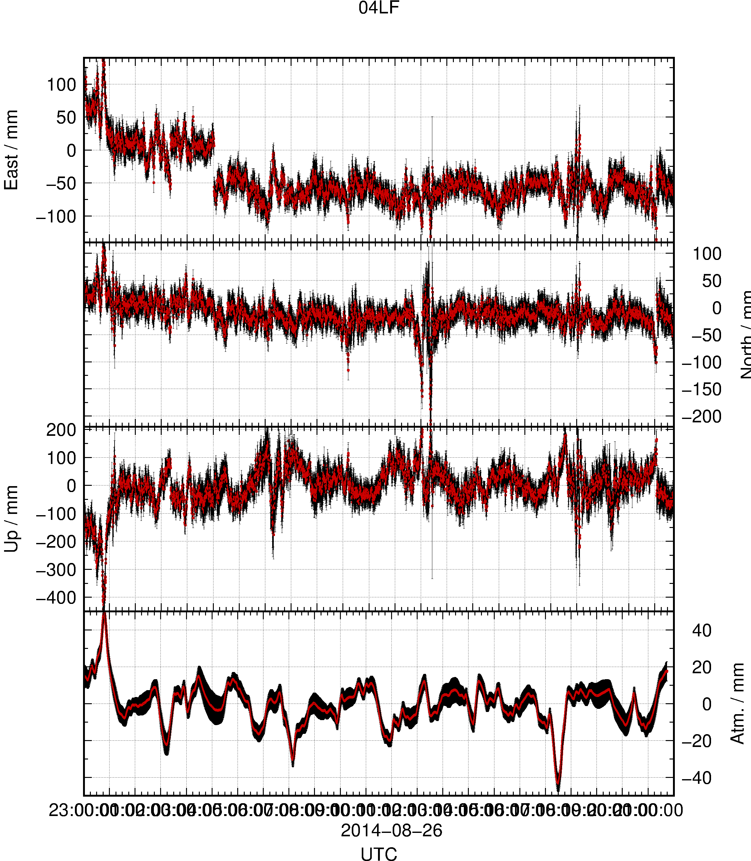
sh_plot_track
Reads track “NEU”, “DHU” or “XYZ” output file
May add subplot to view evolution of atmospheric delay

Slide 9
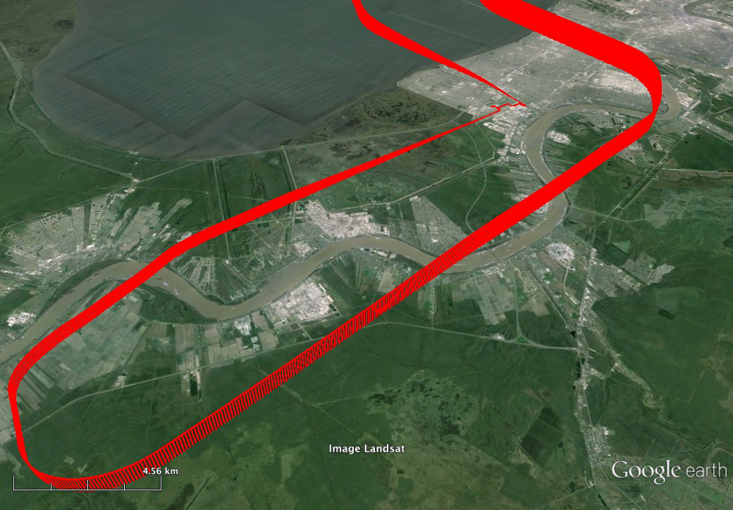
sh_kml
Script for converting several formats of result into KML format for viewing in Google Earth
  glist (may also be used with time slider)
  “.org”-file / “.vel”-file
  track “GEOD”-format output file

