Slide 1





GAMIT/GLOBK for GNSS
M. A. Floyd
Massachusetts Institute of Technology, Cambridge, MA, USA
GPS Data Processing and Analysis with GAMIT/GLOBK and track
Addis Ababa University, Ethiopia
24–25 & 27–29 November 2017
http://geoweb.mit.edu/~floyd/courses/gg/201711_AAU/
Material from R. W. King, T. A. Herring, M. A. Floyd (MIT) and S. C. McClusky (now at ANU)

Slide 2
The promise …
When GPS, Glonass, Beidou, and Galileo are deployed and modernized, there will be > 100 satellites and 12 distinct frequencies available for tracking
Obvious advantages for kinematic positioning and atmospheric studies, but also a means to separate periodic signals due to aliasing in the GPS orbits
Full deployment expected by 2020, but constellations > 20 SVs by mid-2018 should provide highly useful results

Slide 3
Outline
New Global Navigation Satellite System (GNSS) processing capabilities in GAMIT/GLOBK 10.61
Overview and brief description of current GNSS
Basics of how to process GNSS data in GAMIT/GLOBK
  New script options (e.g. sh_gamit)
  Importance of not mixing code releases and updating tables to latest versions
Results of initial tests
Some thoughts on GNSS implementation

Slide 4
GNSS available in GAMIT/GLOBK
As of GAMIT/GLOBK release 10.61 (2017-04-01), the following Global Navigation Satellite Systems (GNSSs) may be processed
  GPS (USA), BeiDou (China), Galileo (Europe), IRNSS (India)
  GLONASS (Russia), QZSS (Japan)
GNSS code is in trial and we need testers
  Bug-fixed and alpha-tested code is in the updates/source directory as gnss_170616.tar.gz, to be untarred at the gg level after the current incremental_updates.
  GNSS data must be processed separately for each system in GAMIT, i.e. one cannot process GPS data and Galileo data simultaneously

Slide 5
Why process separately?
  Dual-frequency observations are fundamental for GNSS to remove the ionosphere and are easily implemented under the current structure of GAMIT, but processing different systems across more than two frequencies simultaneously requires a different algorithmic approach and will take some time to implement
  Solution (h-) files from multiple systems (as with multiple sub-nets) can be rigorously combined in GLOBK to estimate site coordinates and velocities for static observations
  Based on research thus far, it is not clear that joint processing will Improve results for the long-sessions used for mm-level measurements, though that may change as the systems mature (improved orbits and knowledge of inter-system signal biases )

Slide 6
Summary of GNSSs

Slide 7
What is GPS?
The Global Positioning System is the U.S. global navigation satellite system
Orbital design is medium Earth orbit (approximately 20,200 km) inclined at 55° to equatorial plane
Dual L-band frequencies of 1575.42 MHz (L1) and 1227.60 MHz (L2)
  Modernization has introduced a third L-band frequency of 1176.45 MHz (L5) as well as “civilian” implementations of the original frequencies (L1C and L2C)
http://www.gps.gov/

Slide 8
What is GLONASS?
GLONASS is the Russian global navigation satellite system
Global constellation launched from 1982 and nominally but never realistically operational from 1993; revamped with new satellites from 2003
Similar to GPS (and Galileo and BeiDou-2) in orbit geometry
  Main orbital design is 3 medium Earth orbital planes (approximately 19,100 km) inclined at 64.8° to equatorial plane (24 satellites)
Differs primarily in using different frequencies rather than different codes to distinguish satellites – complicating the observation equations and making ambiguity resolution more difficult
https://www.glonass-iac.ru/en/
Currently not coded

Slide 9
What is Galileo?
Galileo is the European navigation satellite system
Global constellation launched from 2007, currently operational and due to be fully completed by 2020
Mostly similar to GPS (and GLONASS and BeiDou-2)
  Orbital design is 3 medium Earth orbital planes (approximately 23,222 km) inclined at 56° to equatorial plane
  Triple frequencies of 1575.42 MHz (E1), 1191.795 MHz (E5) and 1287.75 MHz (E6) (cf. 1575.42 MHz and 1227.60 MHz for GPS)
http://www.esa.int/Our_Activities/Navigation/Galileo

Slide 10
What is BeiDou?
BeiDou (BDS) is the Chinese navigation satellite system
Global constellation (BeiDou-2 or COMPASS) launched from 2007, currently operational and due to be fully completed by 2020
Mostly similar to GPS (and GLONASS and Galileo)
  Main orbital design is medium Earth orbit (approximately 21,528 km) inclined at 55° to equatorial plane (27 satellites)
  Other satellites in geostationary (5) and inclined geosynchronous (3) orbits (approximately 35,786 km)
  Dual frequencies of 1561.098 MHz (C2) and 1207.140 MHz (C7) (cf. 1575.42 MHz and 1227.60 MHz for GPS)
http://en.beidou.gov.cn/

Slide 11
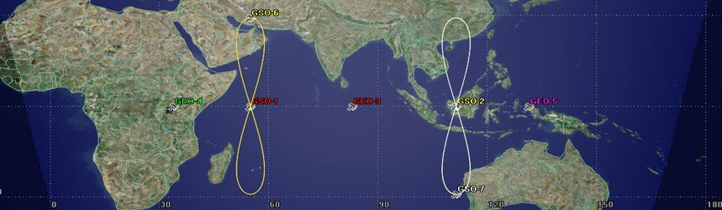
What is IRNSS (or NavIC)?
The Indian Regional Navigation Satellite System (or Navigation with Indian Constellation) is a hybrid navigation satellite system
Currently seven satellites (3 geostationary plus 4 geosynchronous)
  However, all three rubidium atomic clocks on satellite IRNSS-1A were announced to have failed in the latter half of 2016
Probably only useful over surroundings of Indian Ocean
From http://www.isro.gov.in/irnss-programme

Slide 12
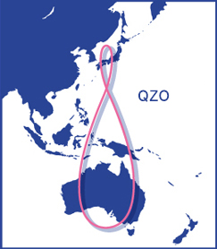
What is QZSS?
The Quasi-Zenith Satellite System is Japan’s high-altitude navigation satellite system
  Designed to augment GPS, not replace it
Currently only one operational satellite
  Planned to become four by end of 2018 and ultimately seven
Probably only useful for western equatorial Pacific
http://gzss.go.jp/en/
Currently not coded
From http://qzss.go.jp/en/overview/services/sv02_why.html

Slide 13
Processing GNSS in GAMIT/GLOBK

Slide 14
Version awareness and warnings
A major change between GAMIT/GLOBK 10.5 and 10.6 was the format of many tables (e.g. dcb.dat, svnav.dat, etc.) to accommodate code changes for GNSS
GAMIT/GLOBK 10.61 now builds upon the new file structures to deliver the data processing capability
Given these major changes, many tables used in GAMIT/GLOBK 10.6 and 10.61 are not backwards compatible with GAMIT/GLOBK 10.5 and prior releases
You cannot use many tables that came with GAMIT/GLOBK 10.5 and prior to process (GPS-only or GNSS) data using GAMIT/GLOBK 10.6 and later
Notes:
Instead of the old scheme in which satellite names were based on the PRN number, with the SV number carried along, with the new files, the satellites are ordered by SV number (generally the launch order) and identified for modeling by their spacecraft body names (see svnav.dat0

Slide 15
Suggestions for processing strategies
If you wish to combine data from different GNSS, process each system in a separate experiment directory, e.g. /2017g and /2017e for GPS and Galileo
Download the RINEX files in advance to check for availability of GNSS signals
For sh_gamit use the “-gnss” option to specify the GNSS; and COM1 for “-orbit” (IGSF ok for GPS)
Check the orbit-fit rms files in the /igs directory to assess the orbit quality
Combine the resulting h-files in GLOBK to produce a single result (time series or velocities)

Slide 16
RINEX files
RINEX 2, which is still by far the most common format of RINEX file, was designed in an era when only GPS was viable for observation
Since the redesign of GPS to broadcast a second code on L2 (“L2C”) specifically for civilian use, the restoration of GLONASS and the introduction of other navigation satellite systems, RINEX 2 no longer suffices to track all available observations
Be very careful with how you translate and use other people’s RINEX 2 files with L2C (see Berglund et al., 2010; Blume et al., 2012; and http://kb.unavco.org/kb/article/the-effects-of-l2c-signal-tracking-on-high-precision-carrier-phase-gps-postioning-689.html)

Slide 17
GAMIT
Several scripts now have an additional option
(“-gnss”) that sets the type of GNSS
  Most likely to use directly: sh_gamit, sh_get_orbits, sh_sp3fit
  Less likely to use directly: sh_preproc, sh_bcfit, sh_rxscan, sh_get_times, sh_makexp
Valid arguments are (only one of)
  G (GPS)
  R (GLONASS; not yet coded or available to use)
  C (BeiDou-2/COMPASS)
  E (Galileo)
  J (QZSS; not yet coded or available to use)
  I (IRNSS)
The default is still “G” (GPS)

Slide 18
GLOBK
GLOBK should work in the normal manner except that you cannot include orbits in the h-file (use BASELINE in GAMIT sestbl.)
See GLOBK lectures, including those on creating time series using glred and combination or velocity solutions using globk

Slide 19
track
track, the kinematic processing module, is not yet capable of reading RINEX 3 files or using GNSS data other than GPS
Development to incorporate
  However, the same inter-system bias, memory and computing time limitations exist for track as for GAMIT, so be aware of this one the capabilities are coded and released

Slide 20
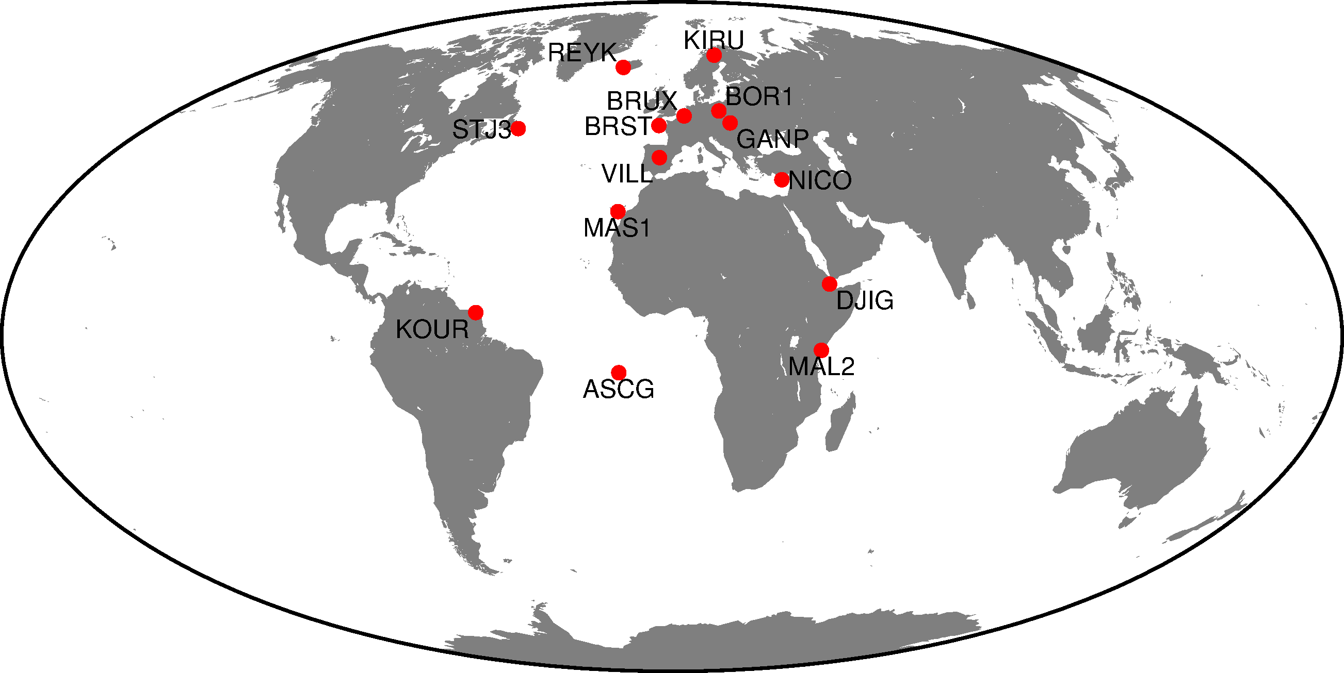
Results of initial tests
Systems processed:
GPS (L1 and L2)
Galileo (E1 and E5)
BeiDou (C2 and C7)
5 days processed
(2017-121 to 2017-125)
Notes:
To test that the current code runs smoothly and produces results comparable to the quaility of existing orbits, we processed GPS, Galileo, and Beidou observations over 5 days from 15 stations that are producting RINEX 3 files containing the two primary frequencies from each of these systems. We assessed the orbit quality from the agreement among IGS Acs submitting solutions and the satellite later ranging residuals for Galileo and BeiDou. Roughly speaking the Galileo and Beidou orbits are factors of 2-4 worse than GPS and at the level of 2-3 ppb. The effect of orbit errors on site coordinates depends on the number of satellites (next slide)

Slide 21
Sky tracks Day 121 at Spanish site VILL
Each circle covers a 4-hr window
GPS
Galileo
Beidou
Notes:
GPS has 32 SVs tracked; Galileo 18; Beidou 8 (3 MEO and 5 geostationary)

Slide 22
Phase RMS (for 2017-121)
From sh_gamit_121[gec].summary (mm):
Site | GPS | Galileo | BeiDou
ASCG | 7.8 | 9.1 | 4.8
BOR1 | 5.6 | 5.9 | 6.7
BRST | 8.5 | 9.7 | 7.0
BRUX | 4.4 | 5.0 | 4.7
DJIG | 5.9 | 8.0 | 17.1
GANP | 5.9 | 6.6 | 8.4
KIRU | 6.8 | 8.0 | 10.7
KOUR | 10.6 | 12.6 | 5.5
Site | GPS | Galileo | BeiDou
LAMP | 4.5 | 6.2 | 6.2
MAL2 | 7.7 | 10.0 | 12.7
MAS1 | 7.1 | 8.1 | 3.1
NICO | 6.1 | 9.1 | 22.1
REYK | 8.4 | 11.1 | 8.3
STJ3 | 5.3 | 6.0 | 2.3
VILL | 8.1 | 9.6 | 5.1
ALL | 7.1 | 8.6 | 11.3
Notes:
The Galileo phase noise is slightly larger than GPS at each station, possibly due to antenna mistuning for E5 or poorer orbits. Beidou shows a much larger variation because only three MEOs were tracked.

Slide 23
Ambiguity resolution
Best from sh_gamit_<DDD>[gec].summary:
System | Wide lane (WL) | Narrow lane (NL)
GPS | 98% | 91%
Galileo | 99% | 78%
BeiDou | 80% | 50%
Notes:
The same factors that contributed to the larger phase noise likely also cause the degradation of ambiguity resolution for Galileo and Beidou

Slide 24
Time series stabilization
From “POS STAT” lines in .org-file(s) (mm:
System | Sites | E | N | U
GPS | 10 | 1-2 | 1–2 | 6–10
Galileo | 9-10 | 2-3 | 2–4 | 11-16
BeiDou | 6–9 | 1–7 | 3–9 | 6–18

Slide 25
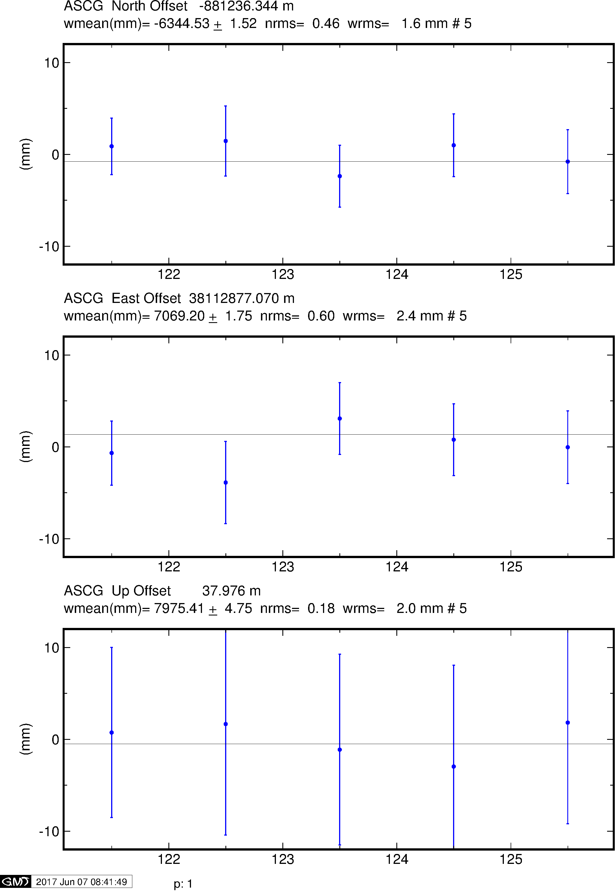
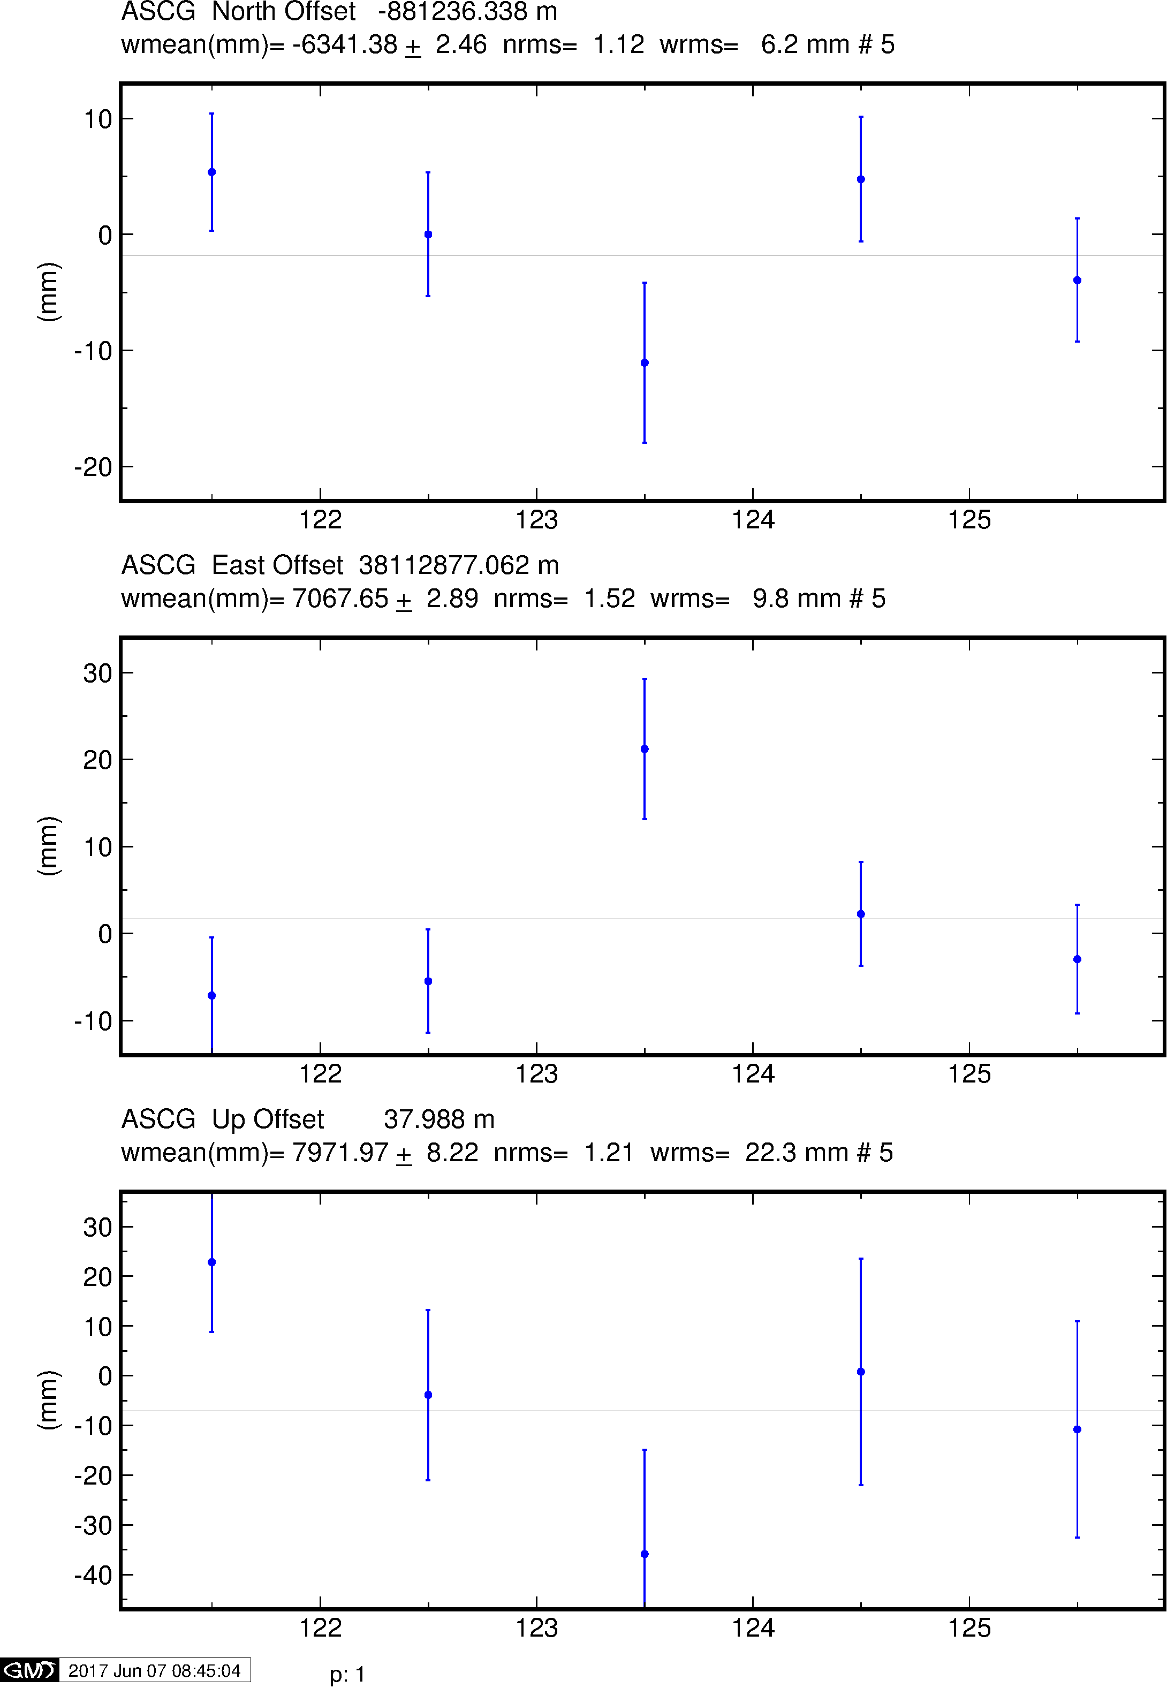
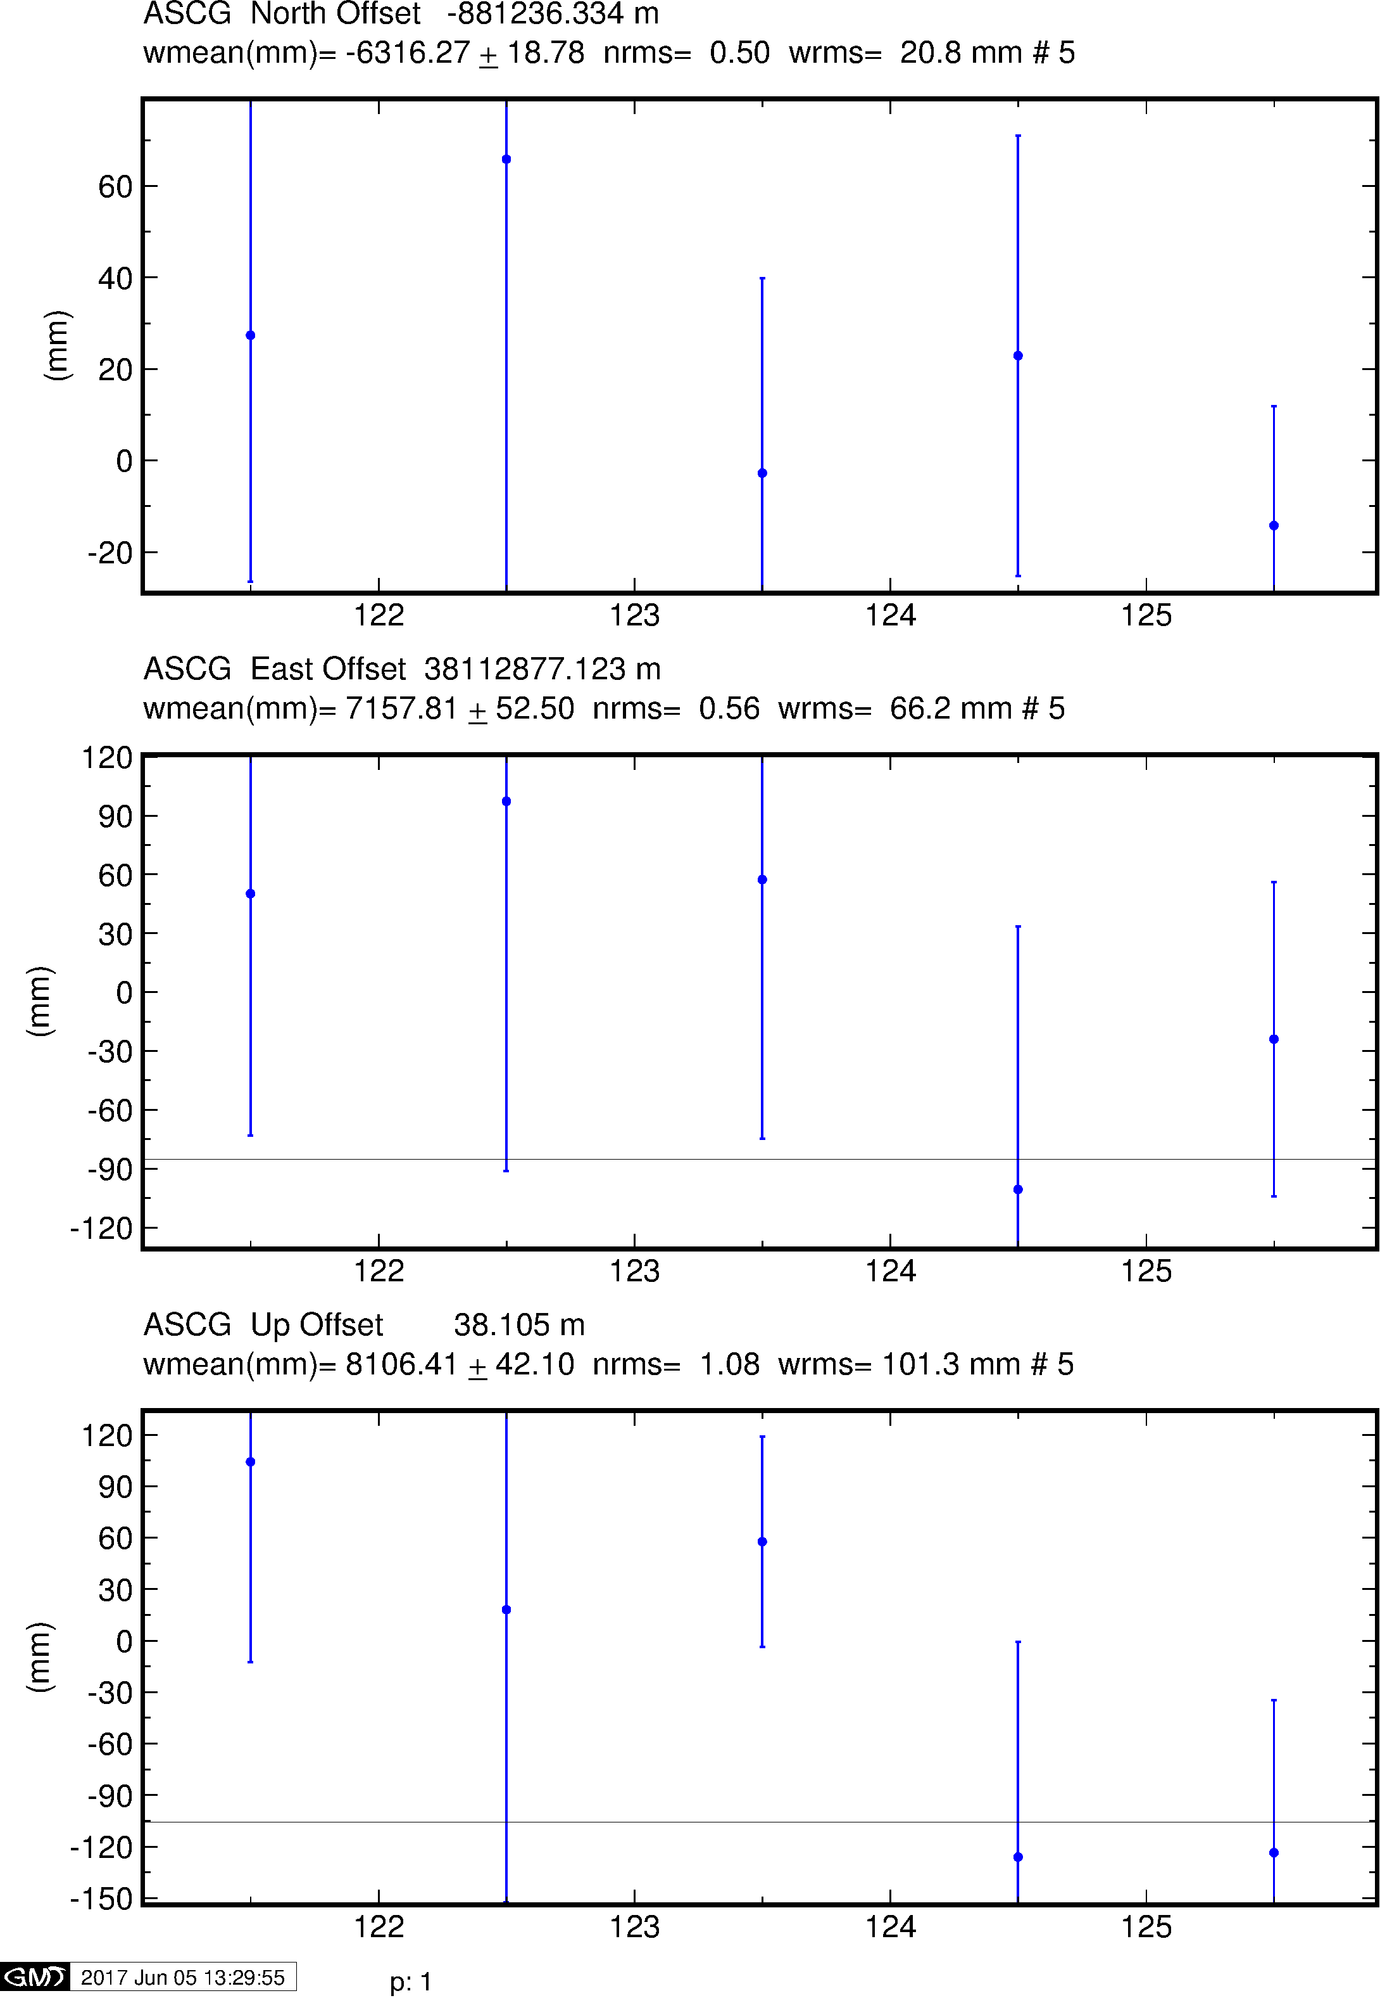
Example time series
GPS
Galileo
BeiDou

Slide 26
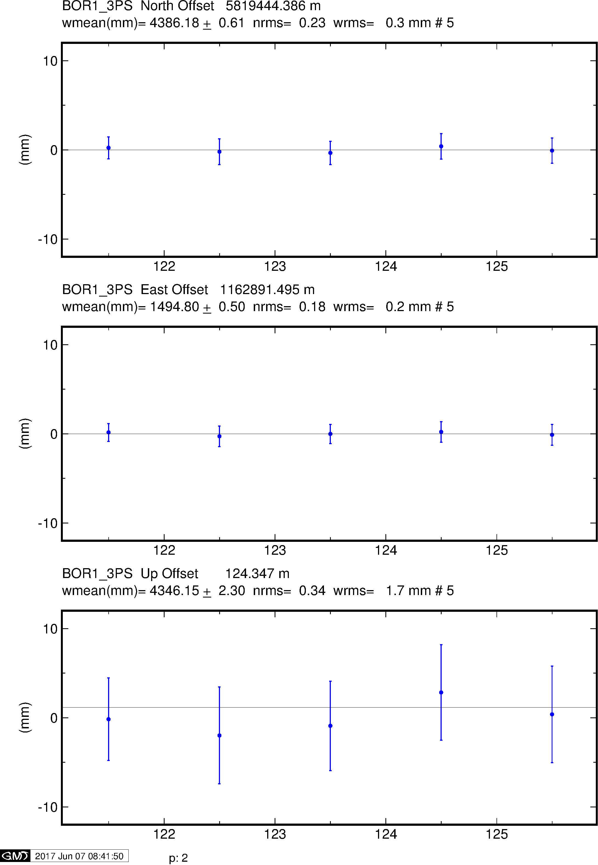
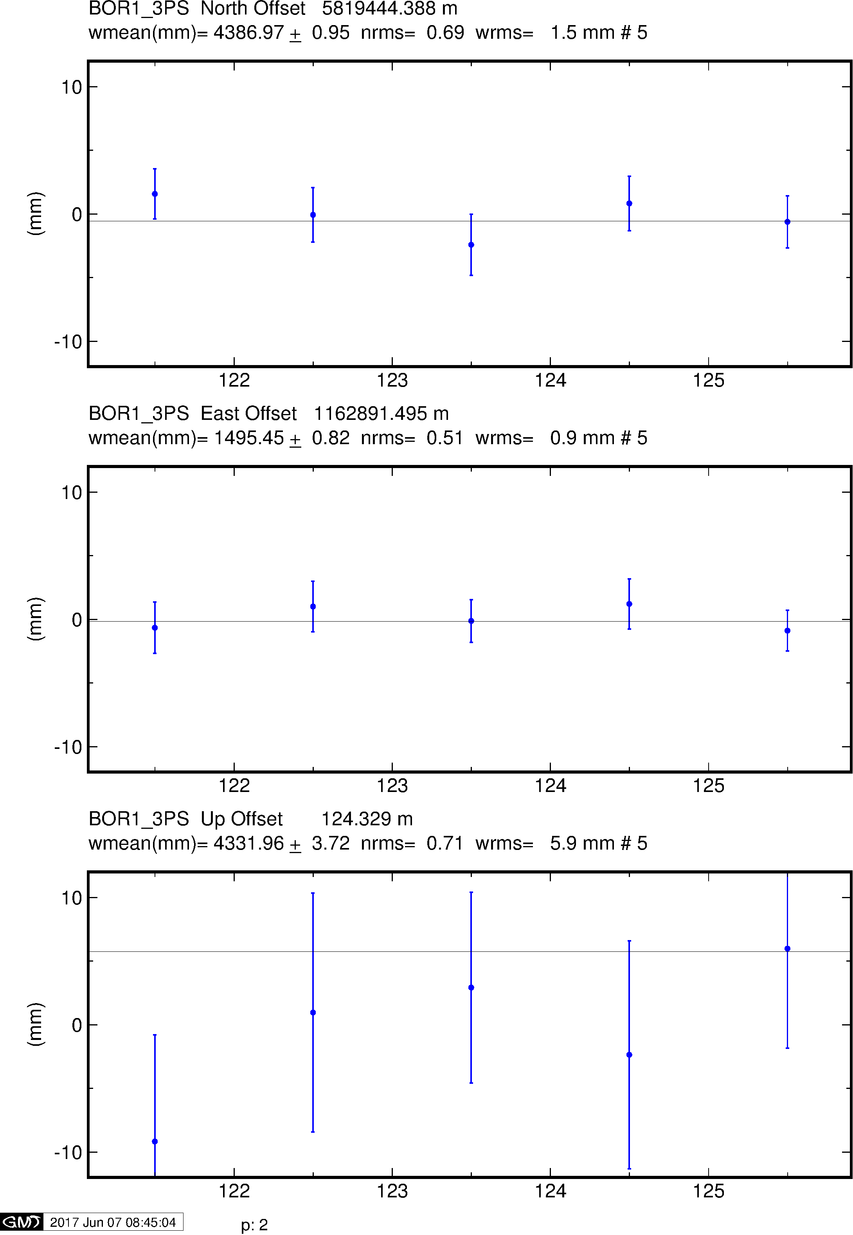
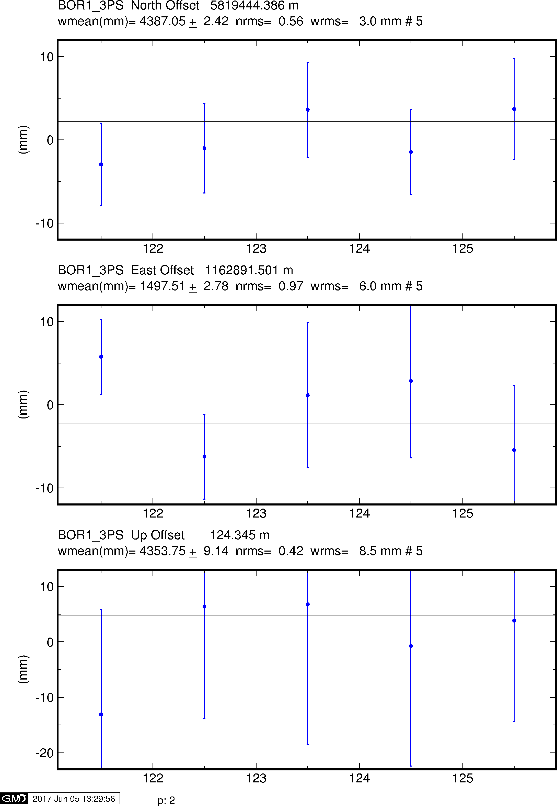
Example time series
GPS
Galileo
BeiDou
Notes:
5-day scatter for station BOR1 in centrl Europe. For the full set of 15 stations, the wrms N, E, U was
0.3-2.9, 0.2-2.4, 2-10 mm for GPS, 0.3-2.8, 0.3-2.4, 6-20 mm for Galileo, and 3-72, 5-66, 6-120 mm for Beidou.

Slide 27
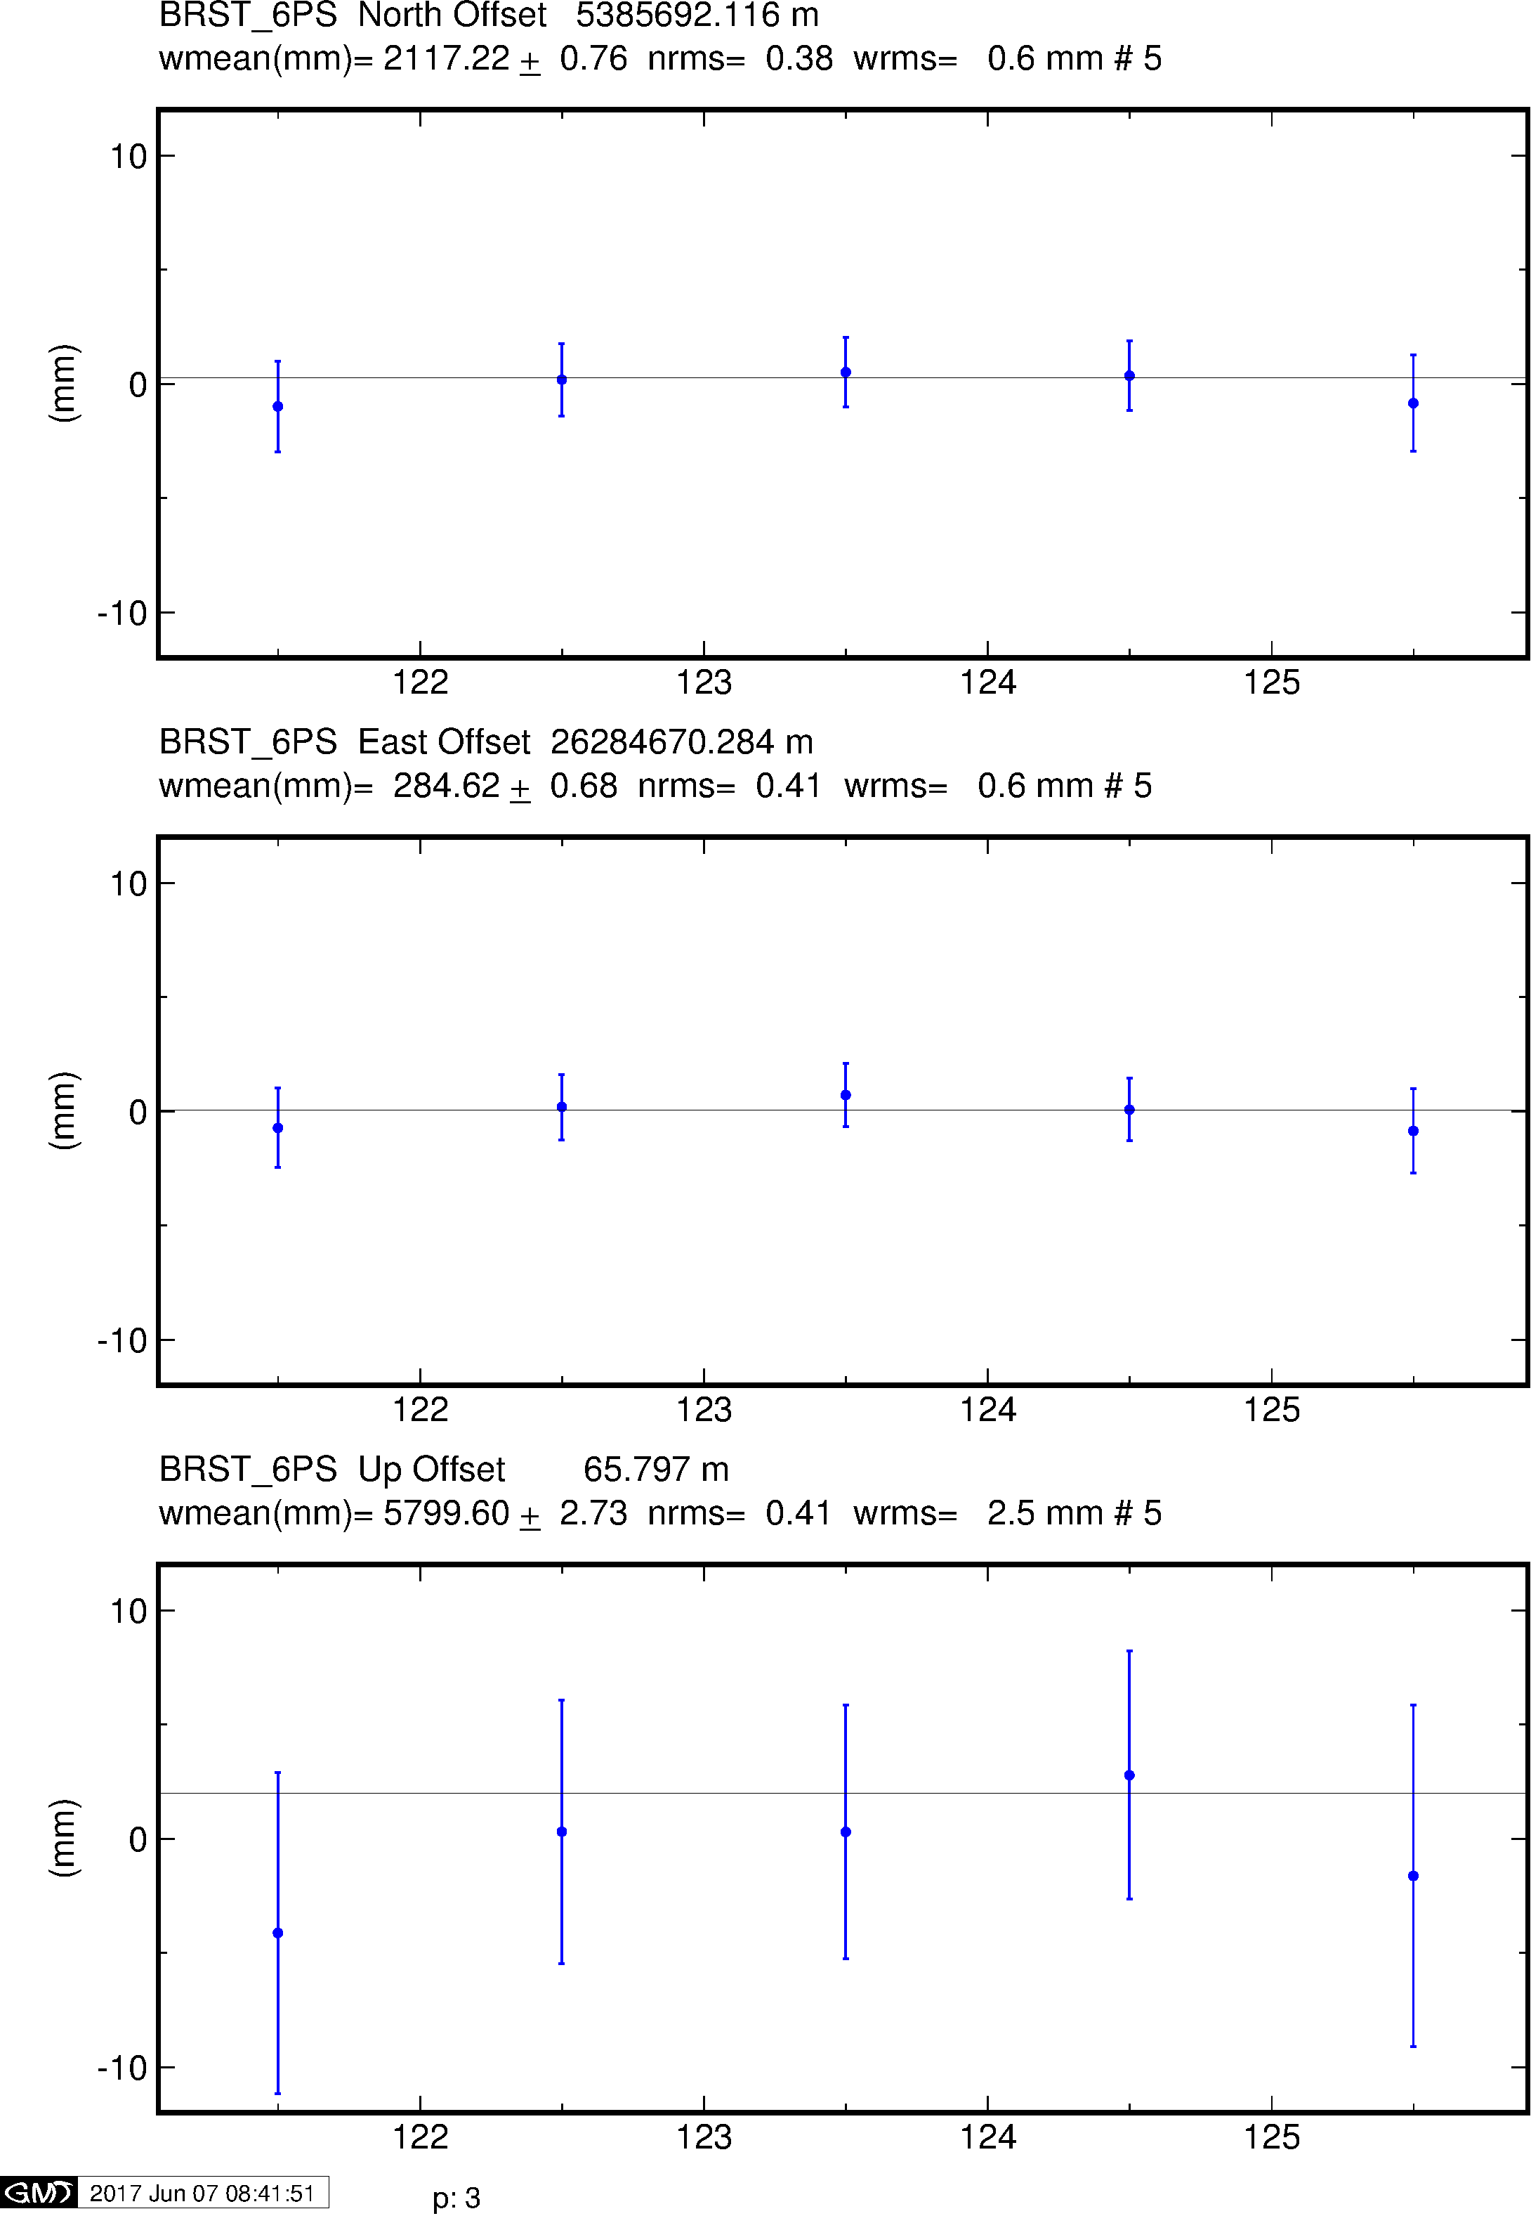
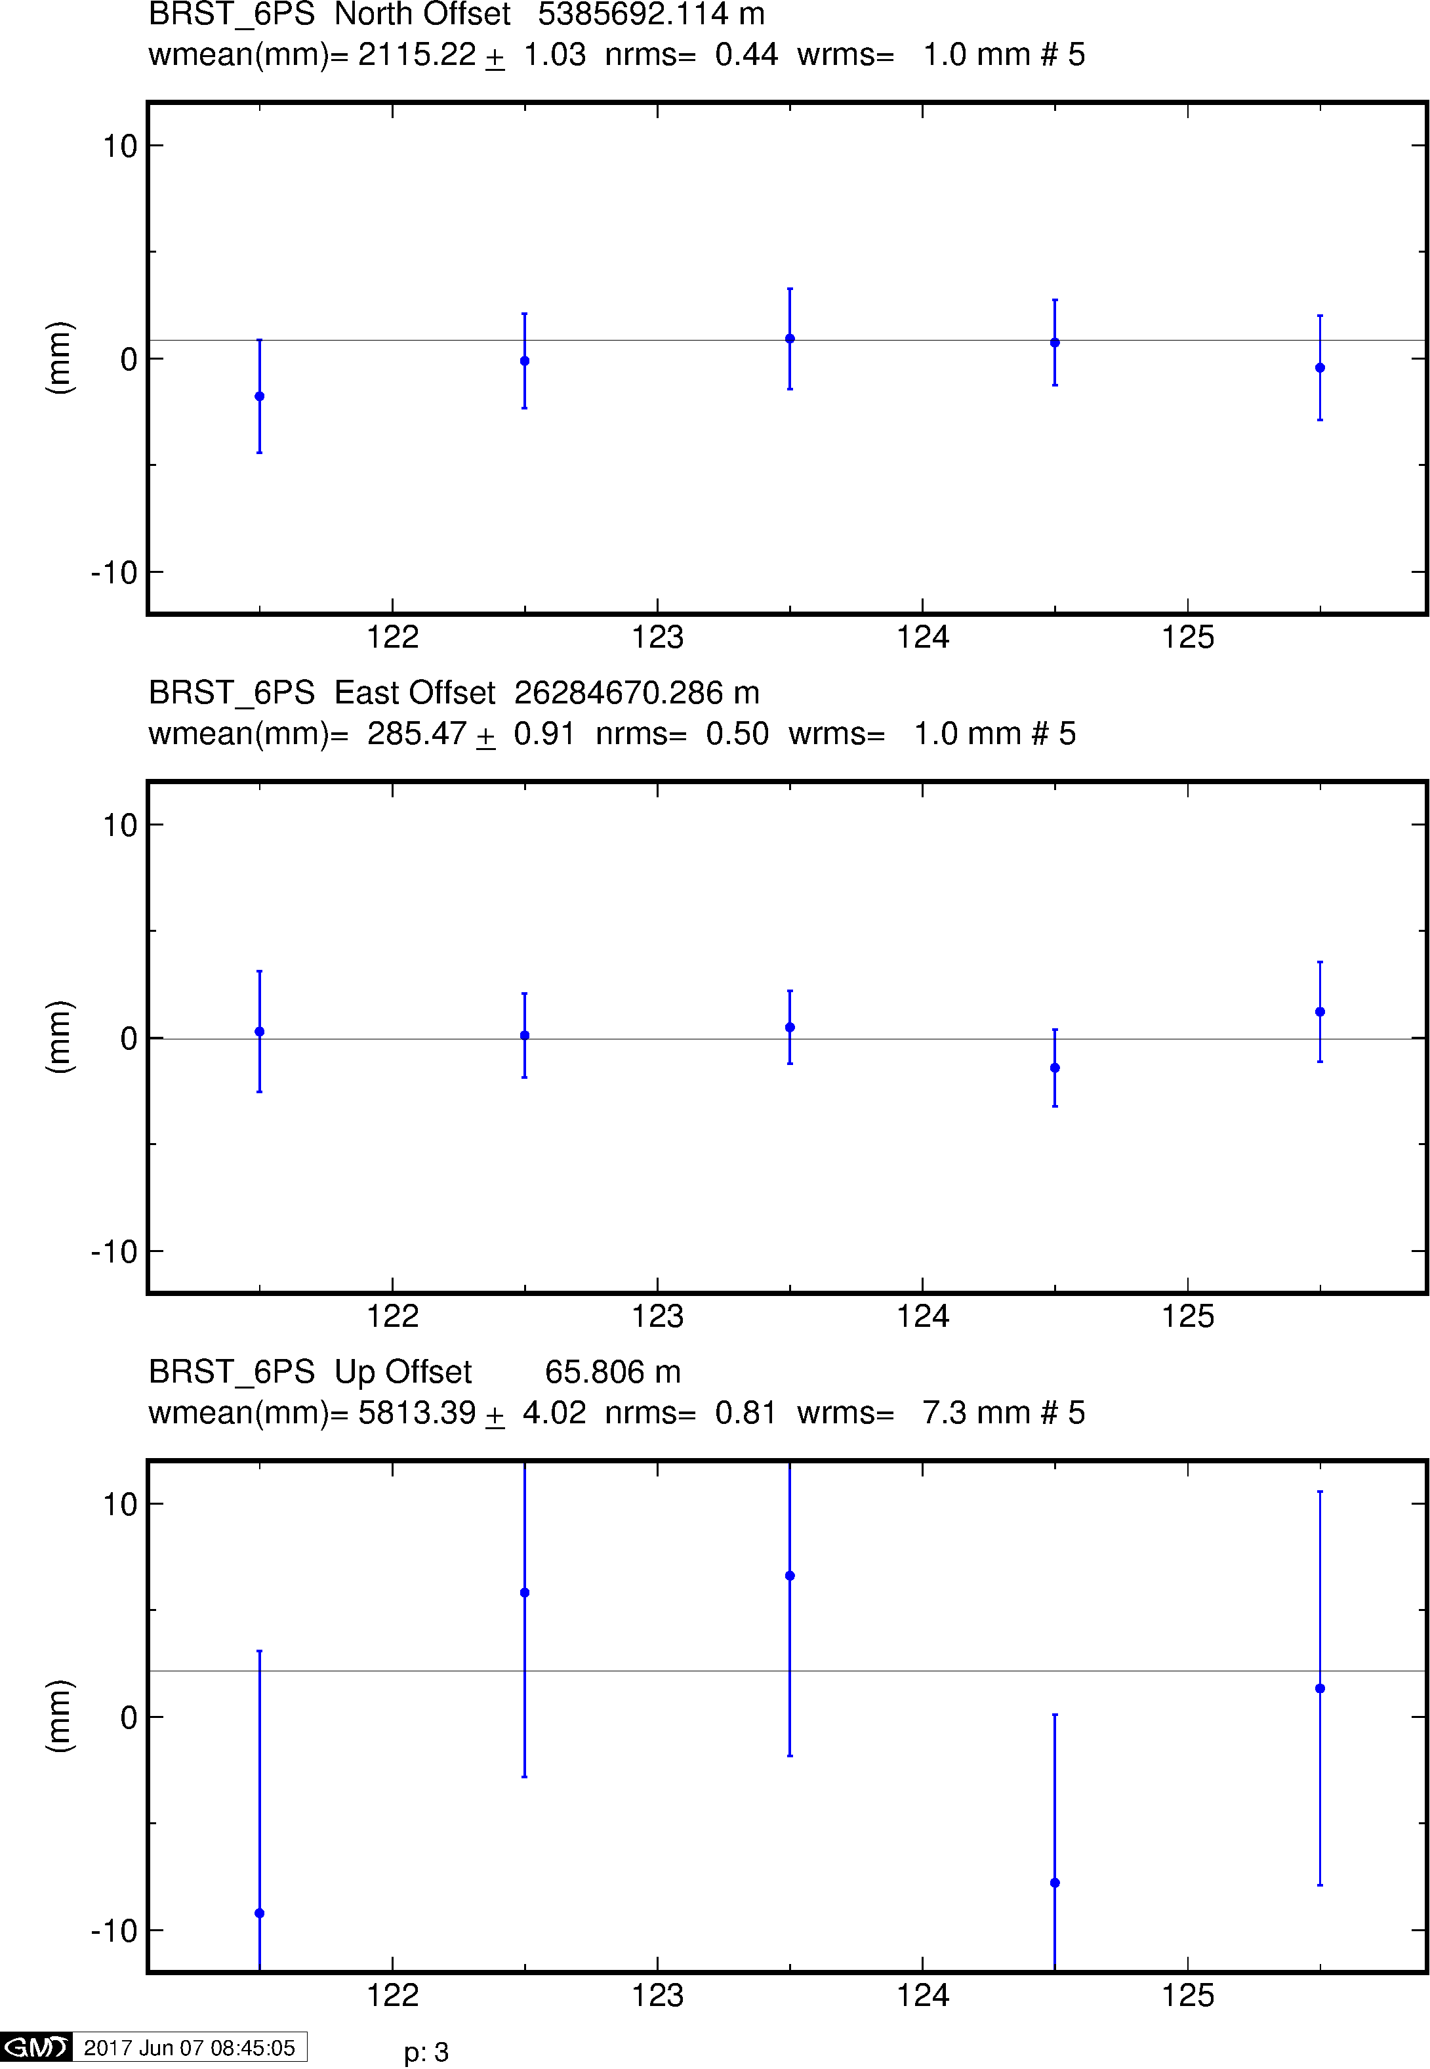
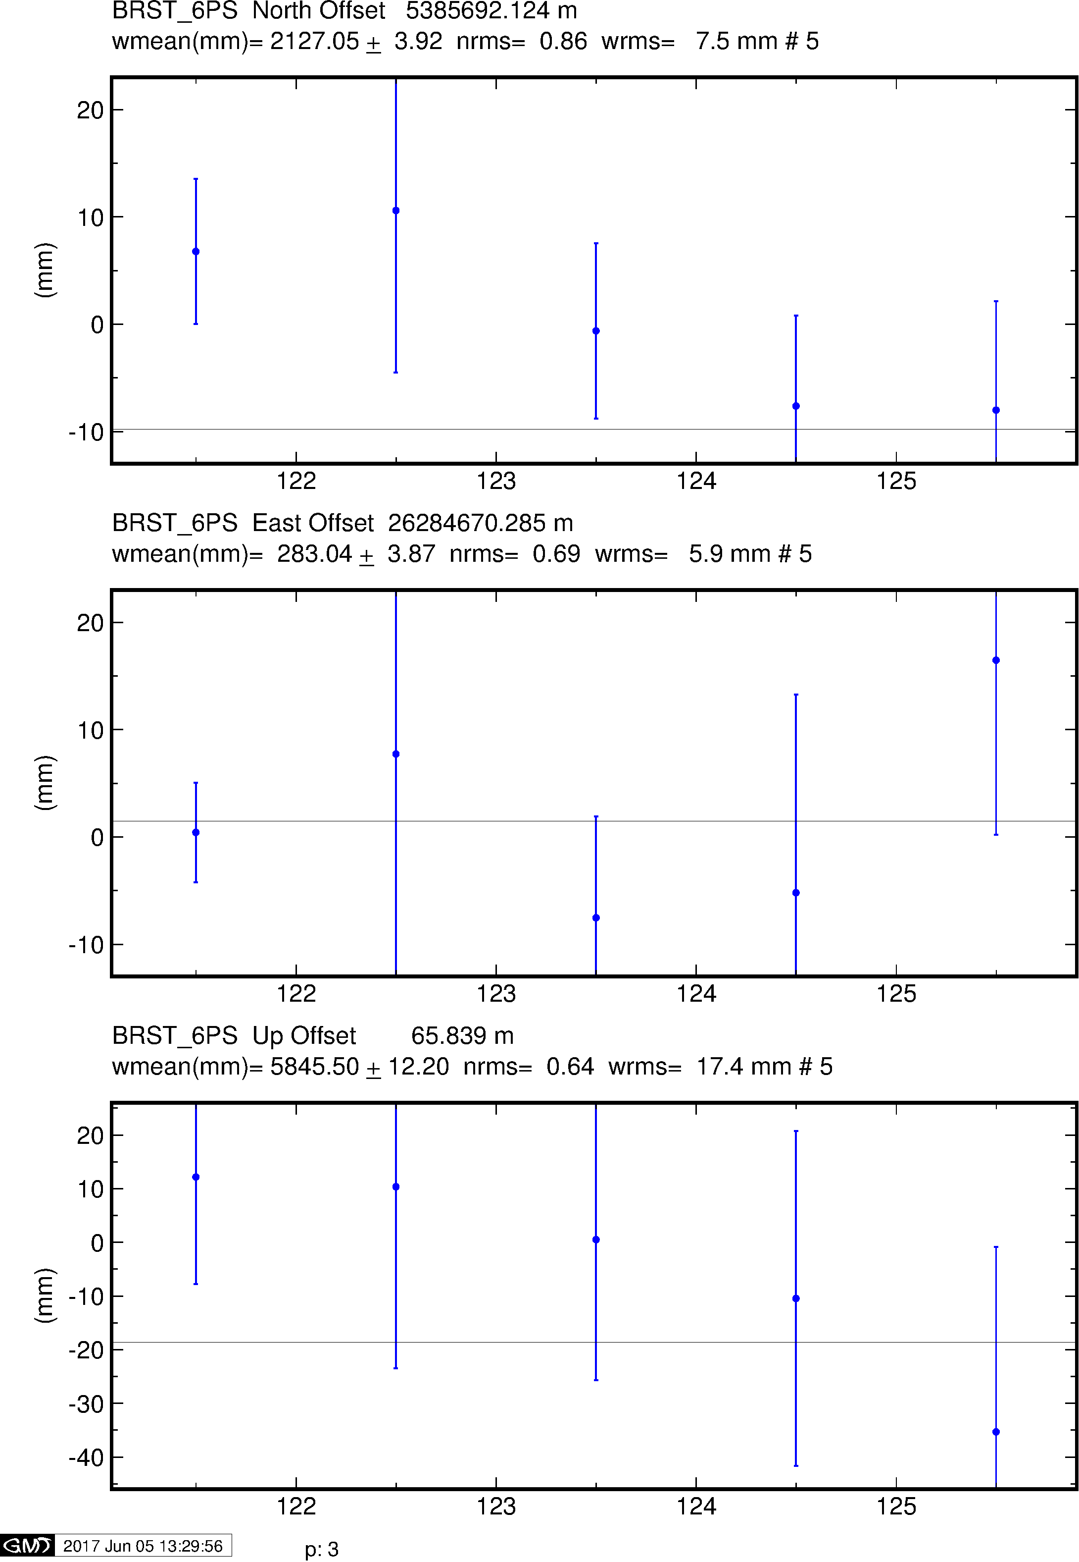
Example time series
GPS
Galileo
BeiDou

Slide 28
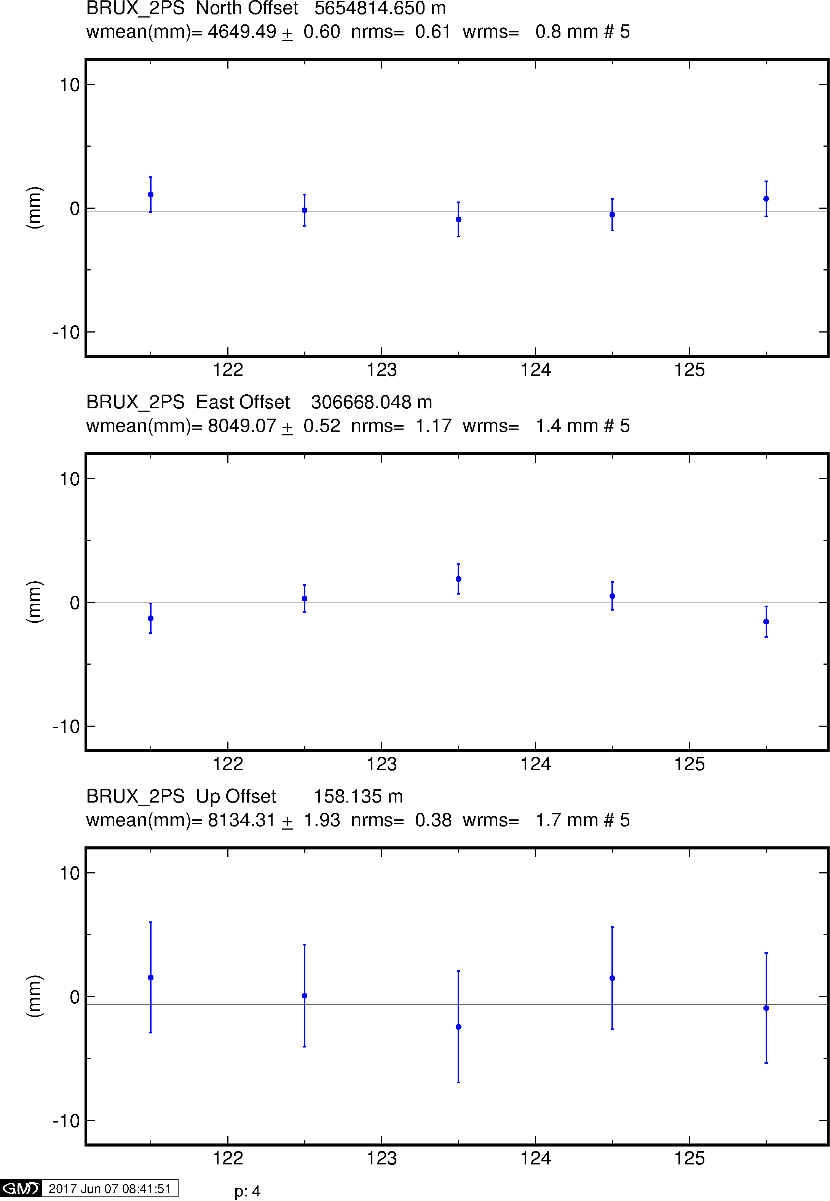
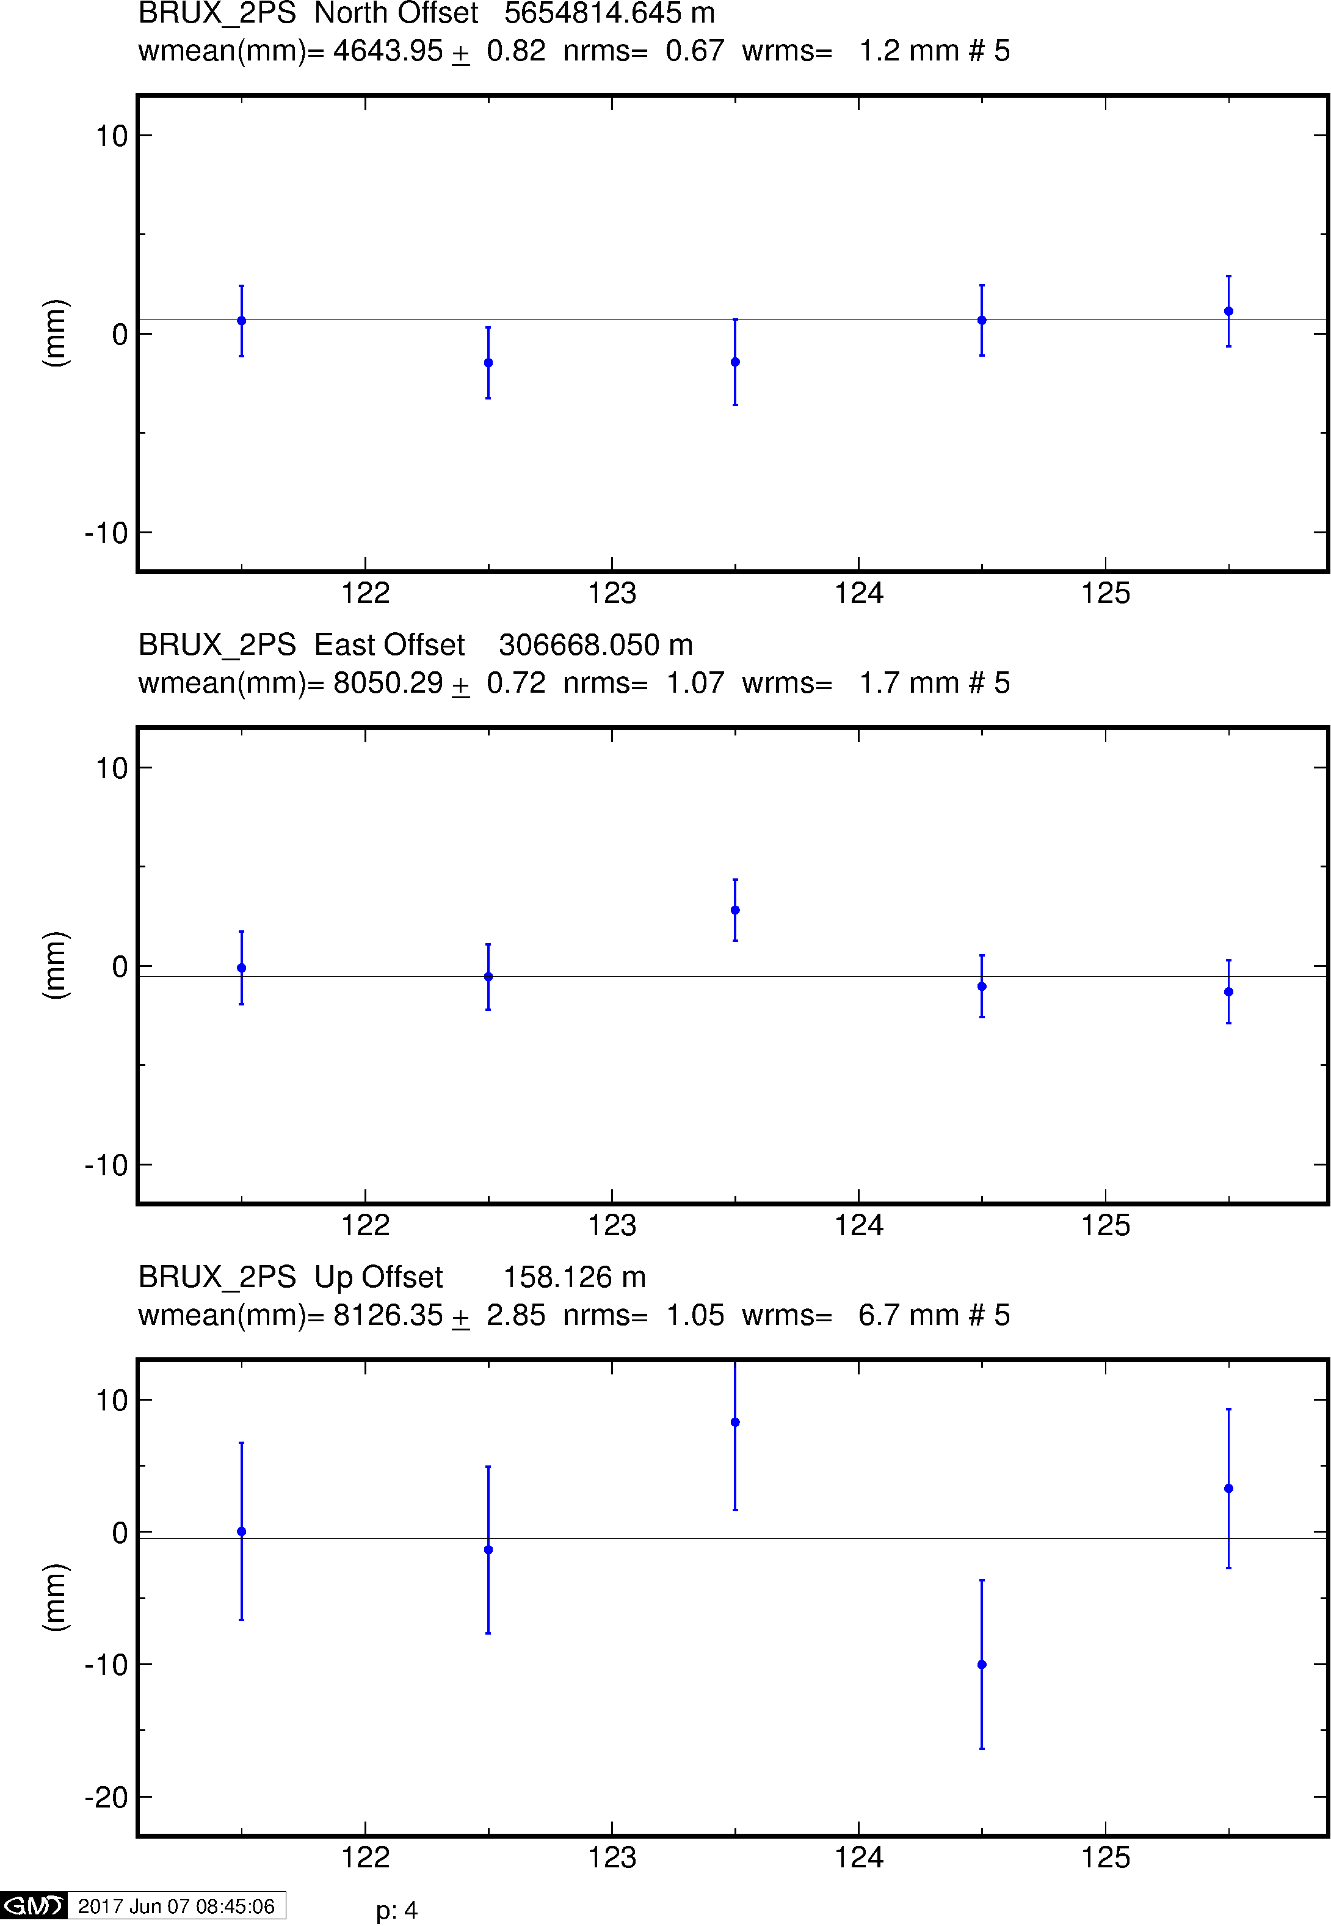
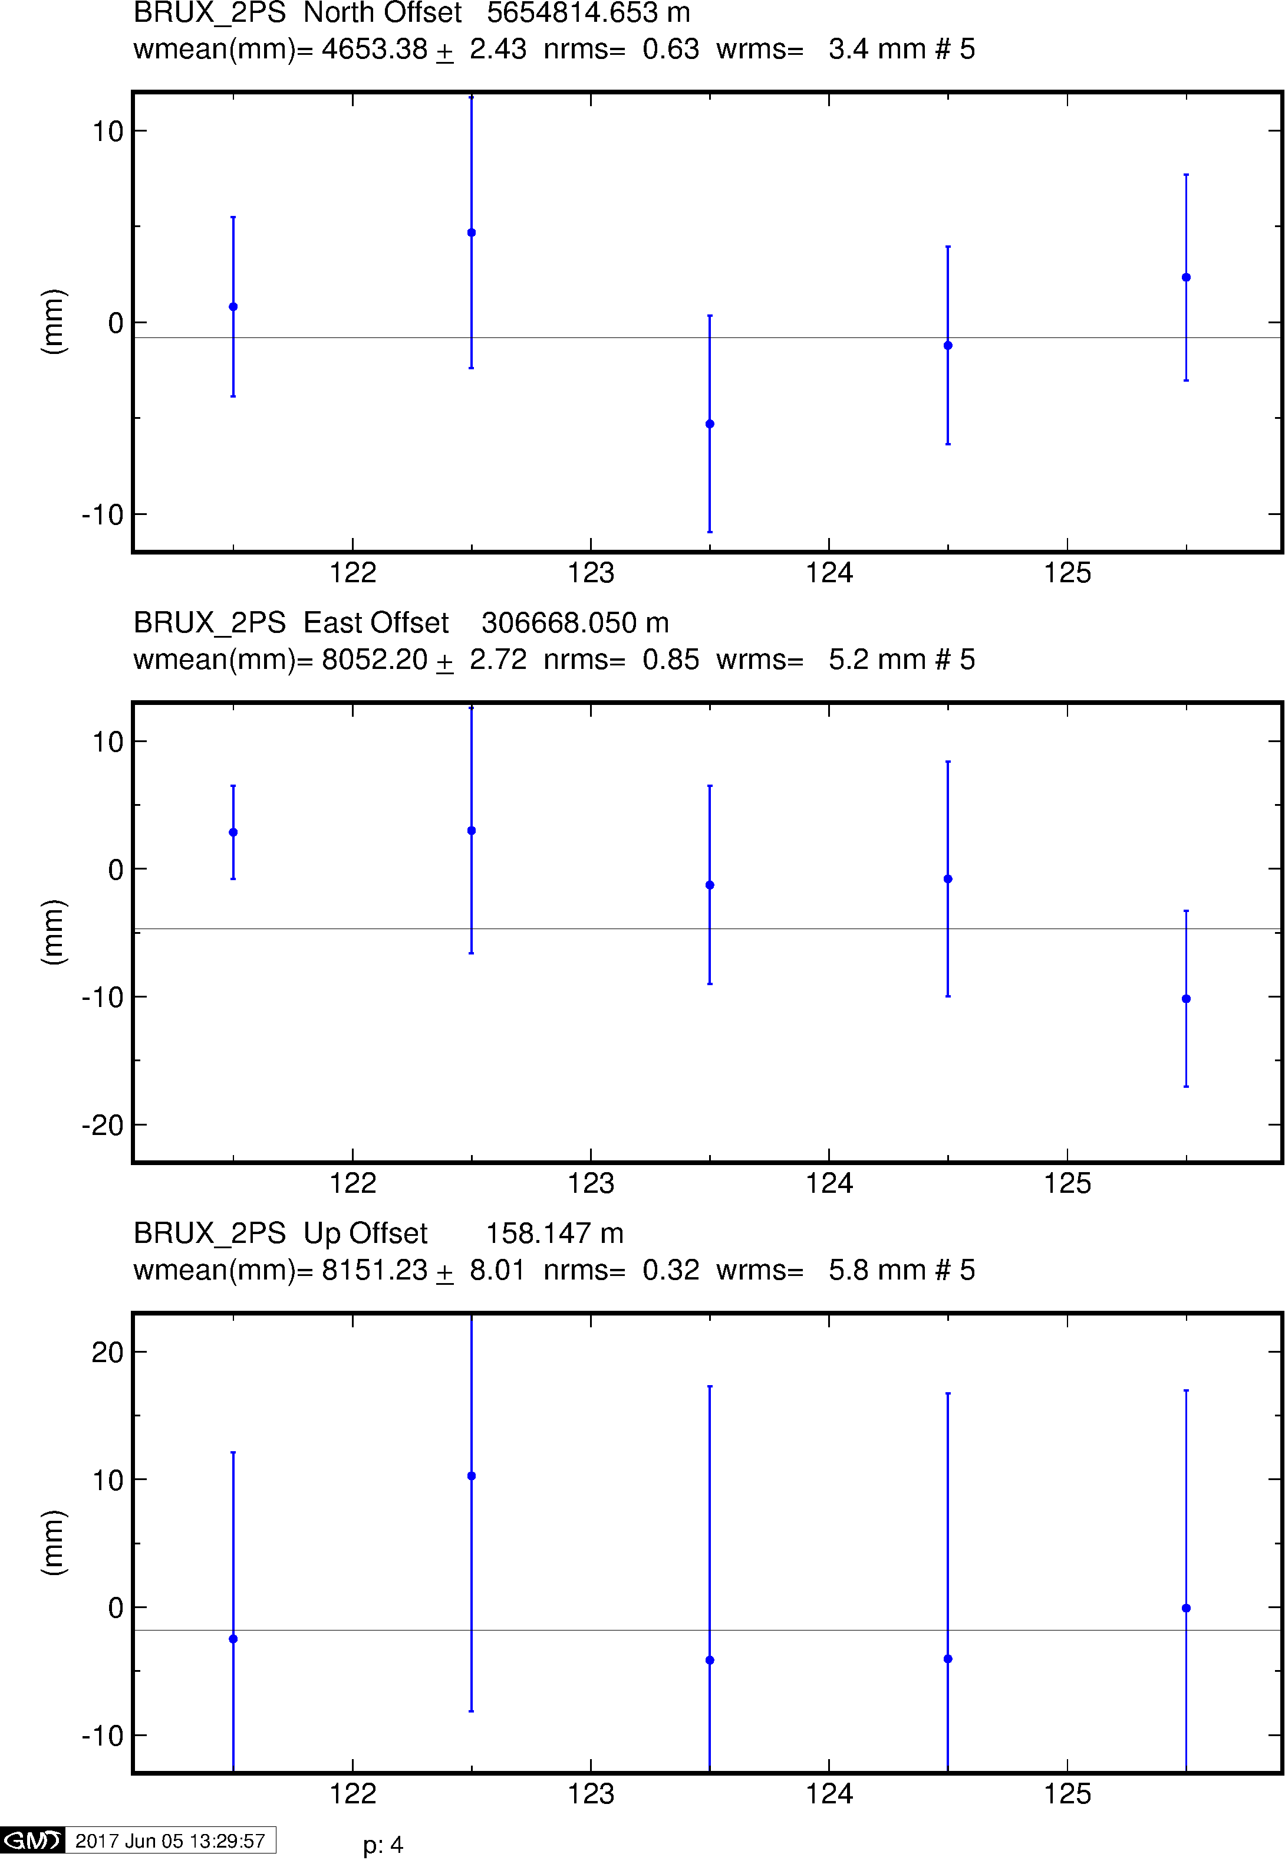
Example time series
GPS
Galileo
BeiDou

Slide 29
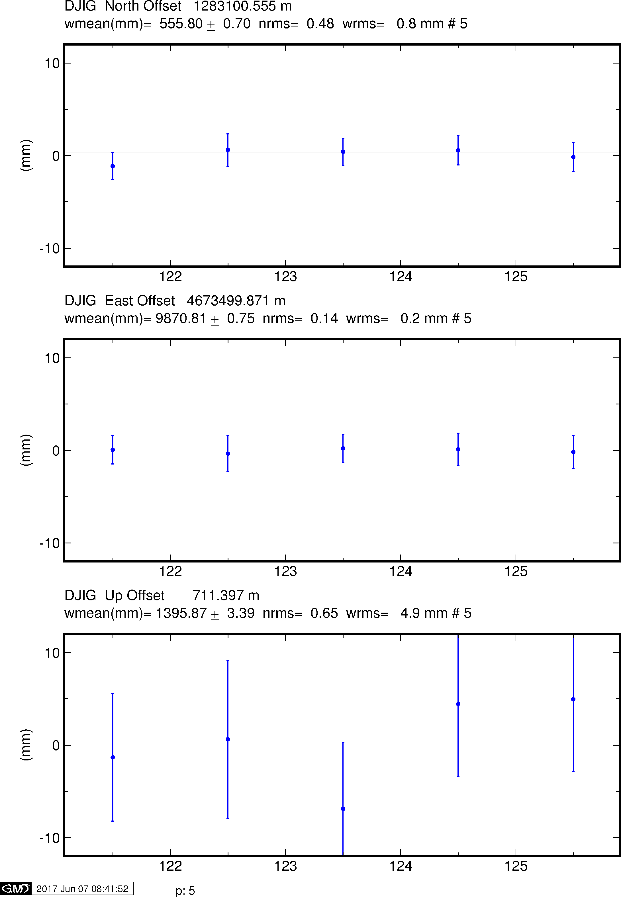
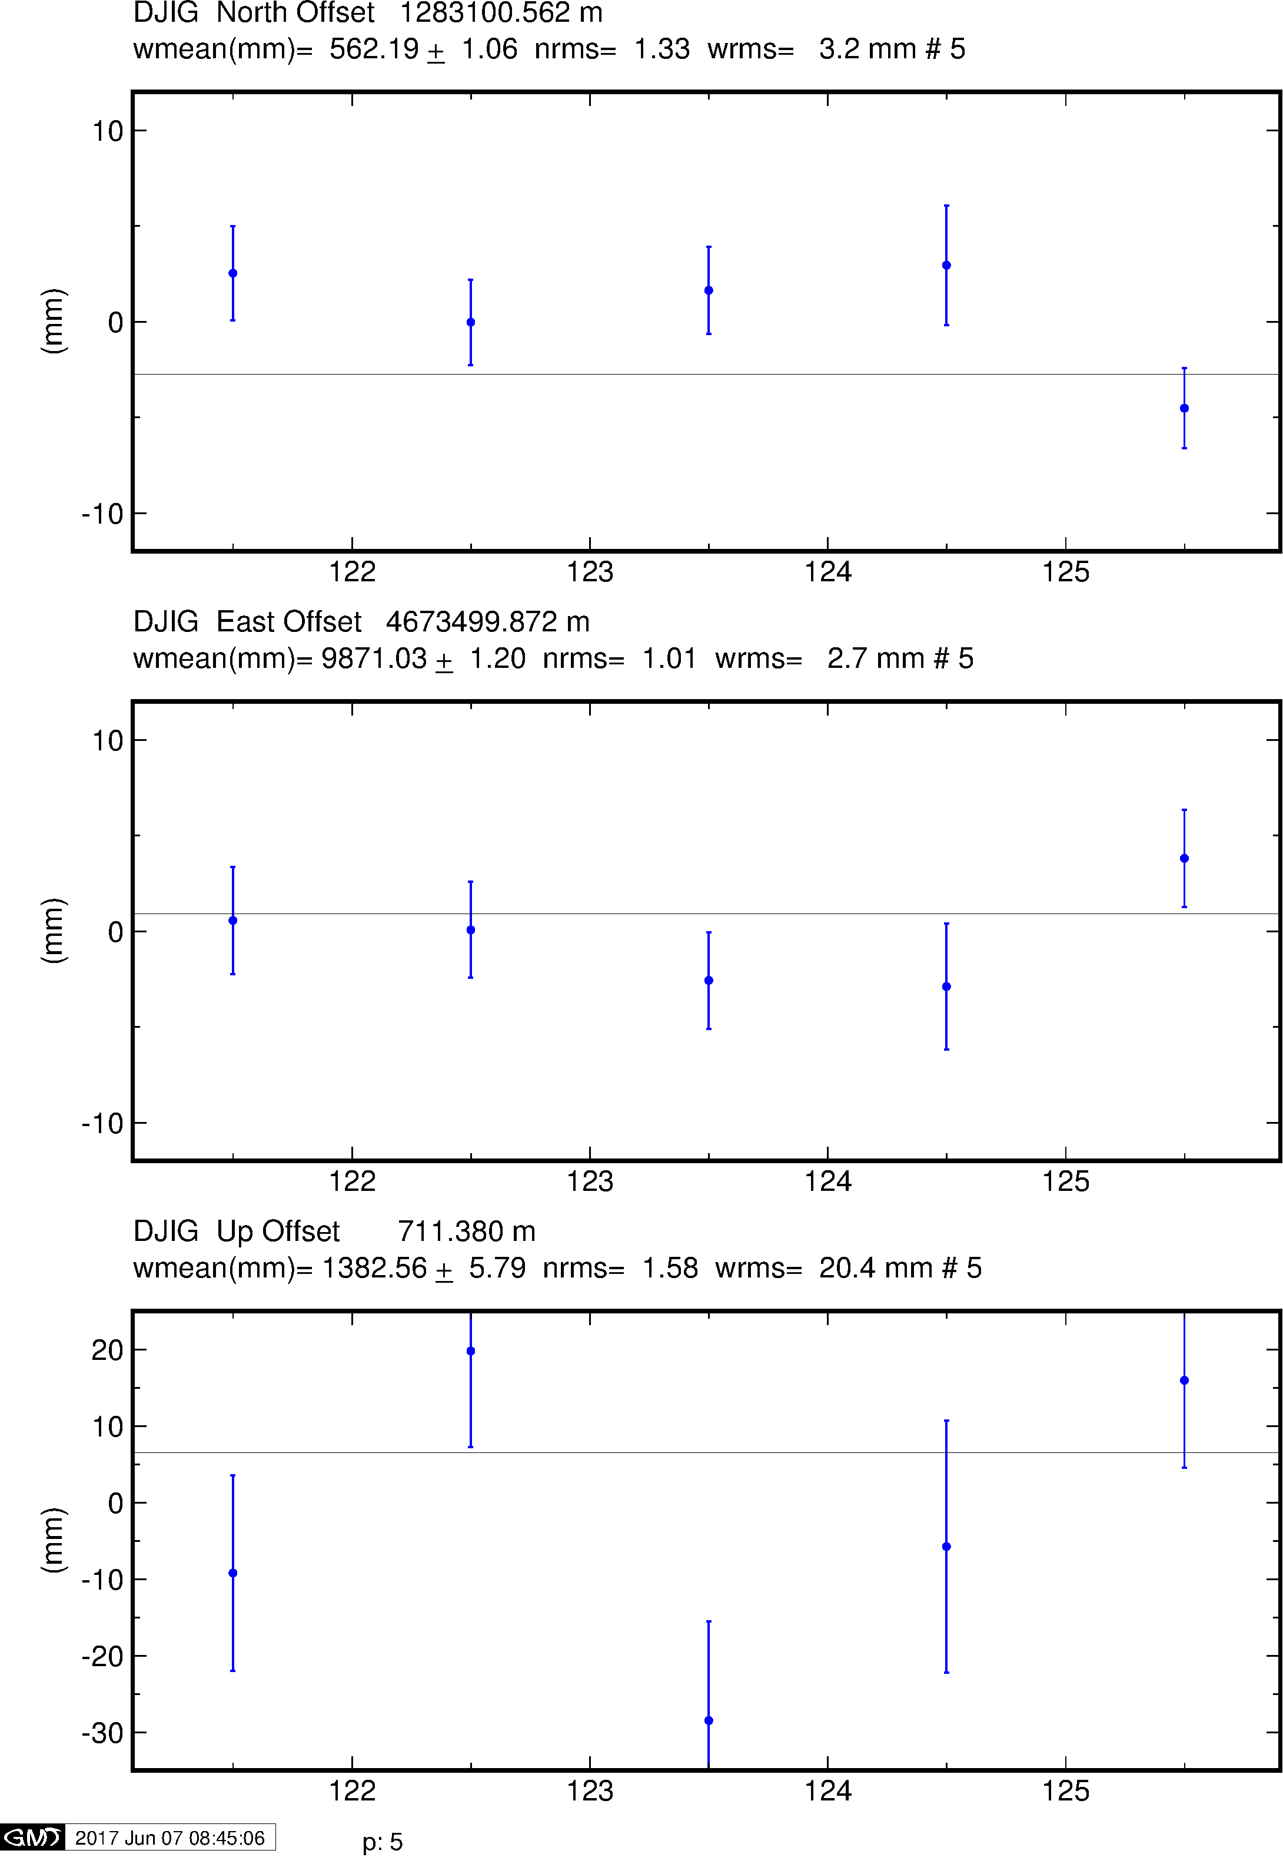
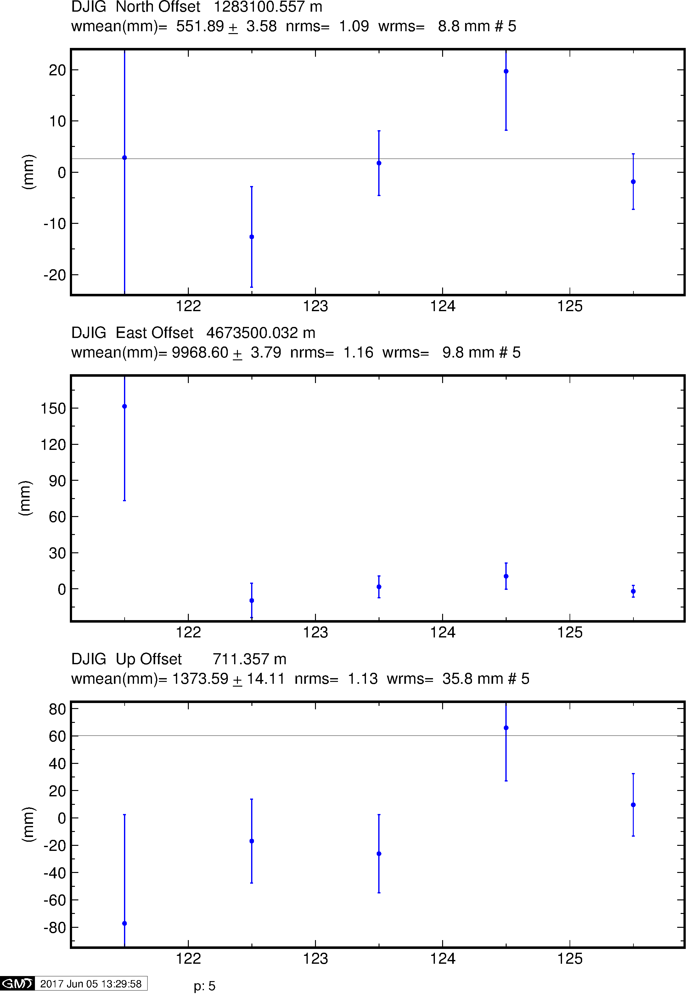
Example time series
GPS
Galileo
BeiDou

Slide 30
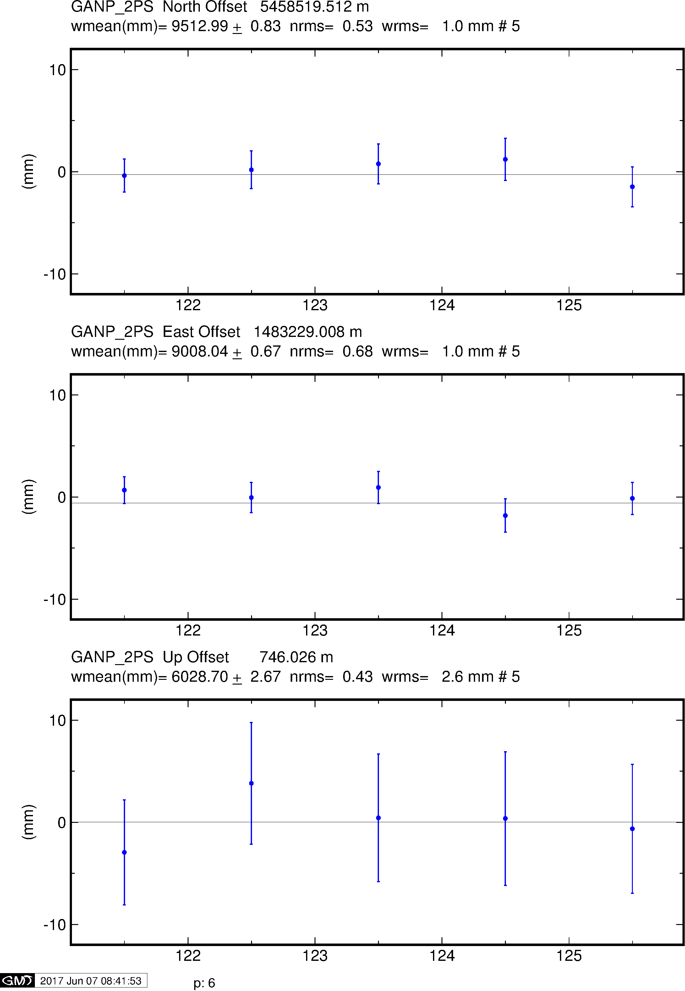
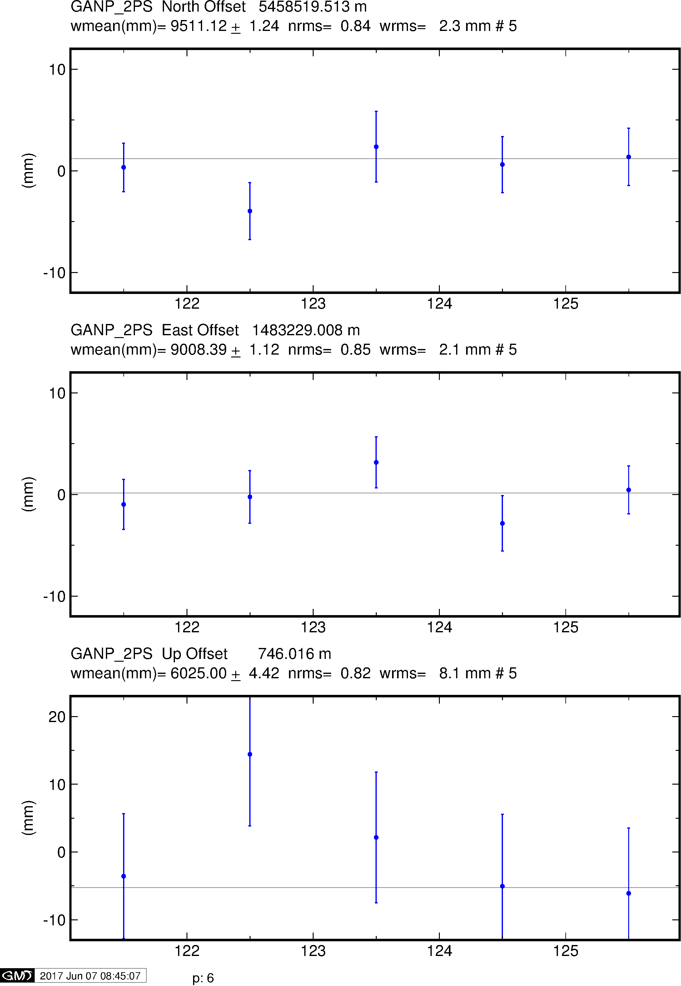
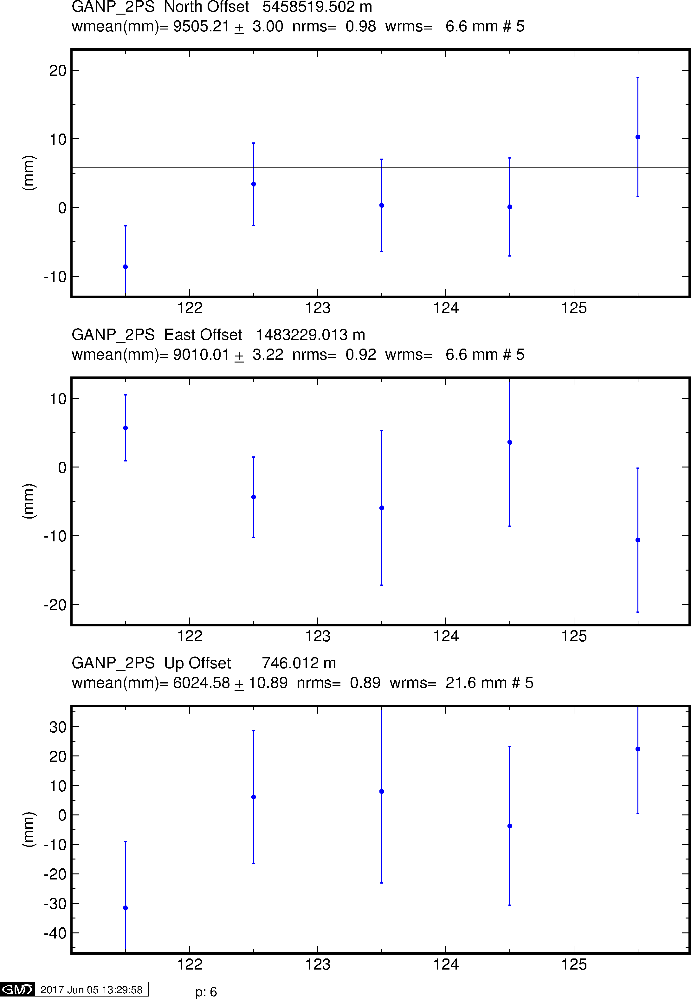
Example time series
GPS
Galileo
BeiDou

Slide 31
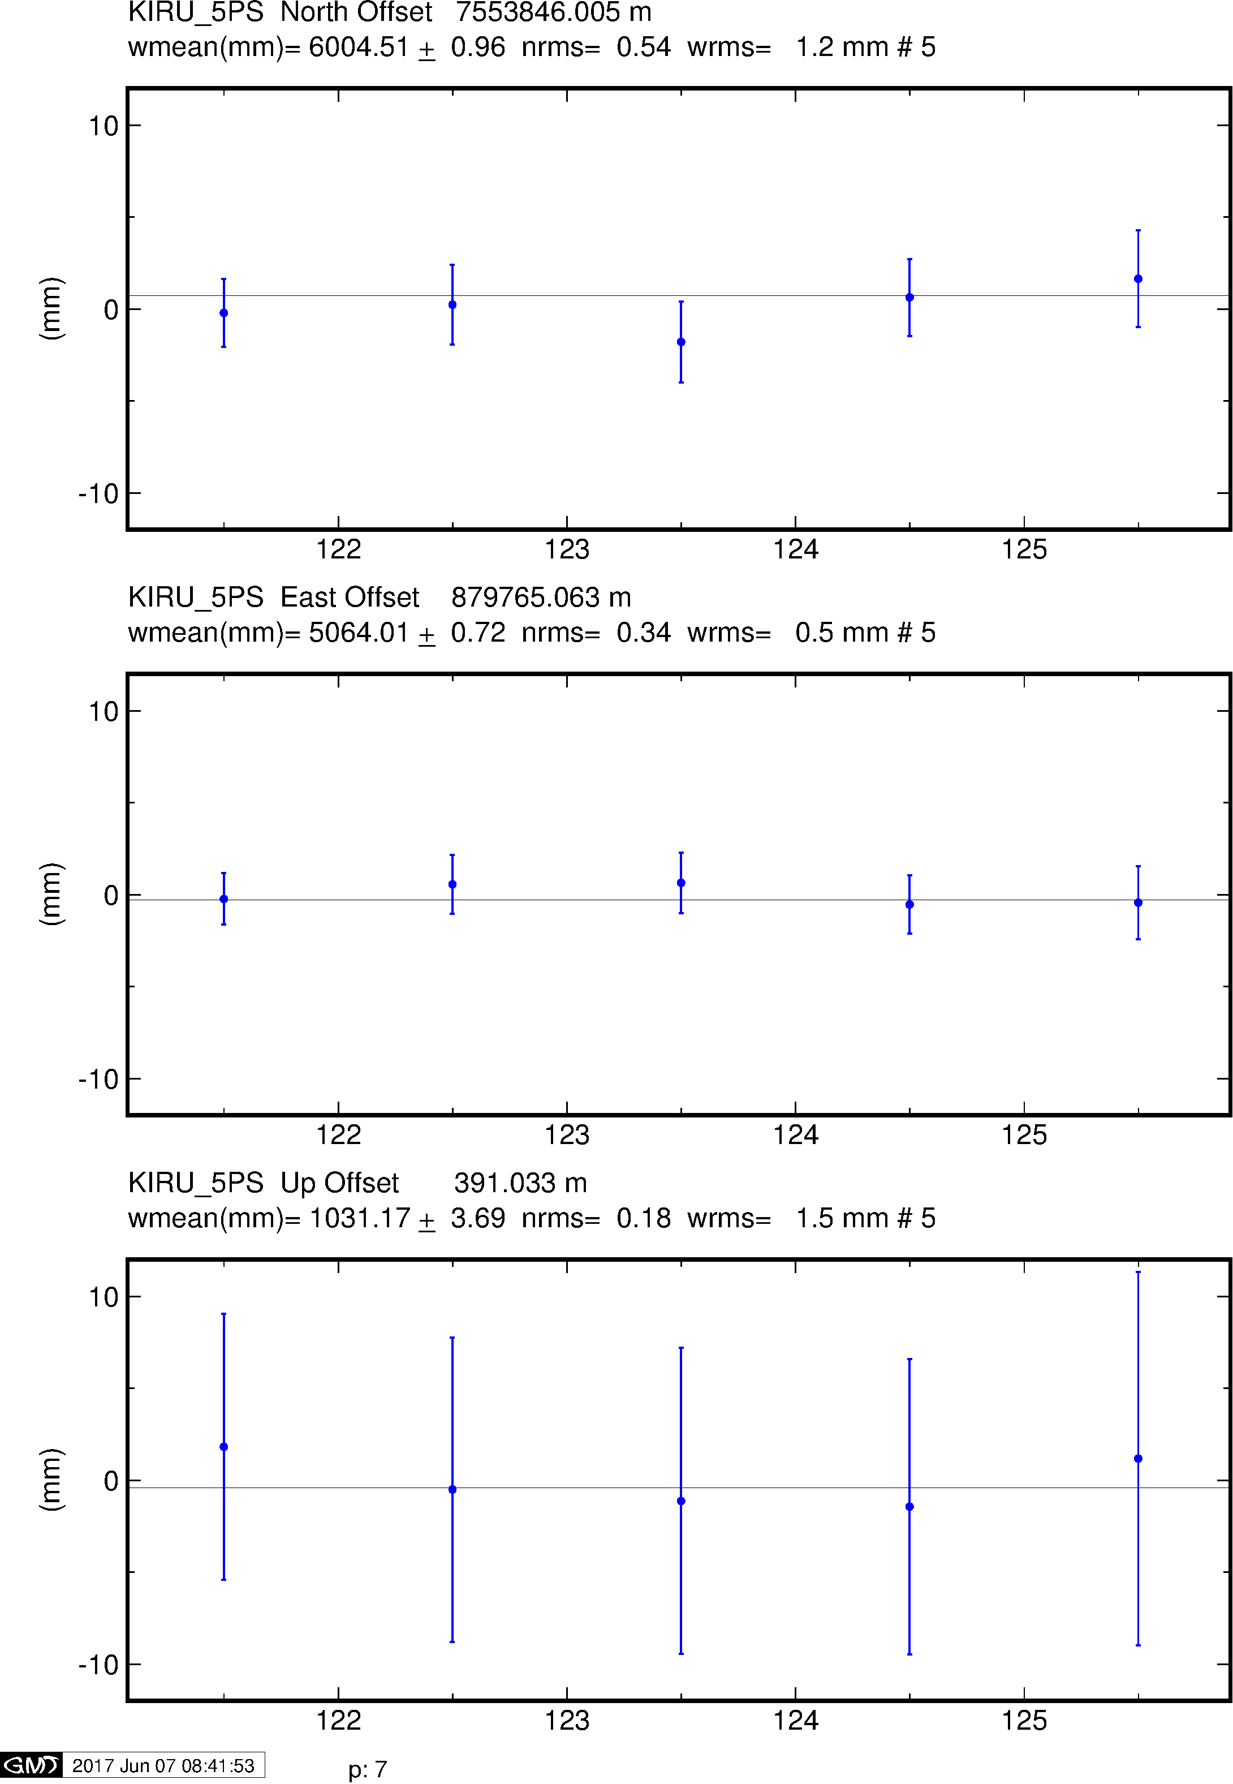
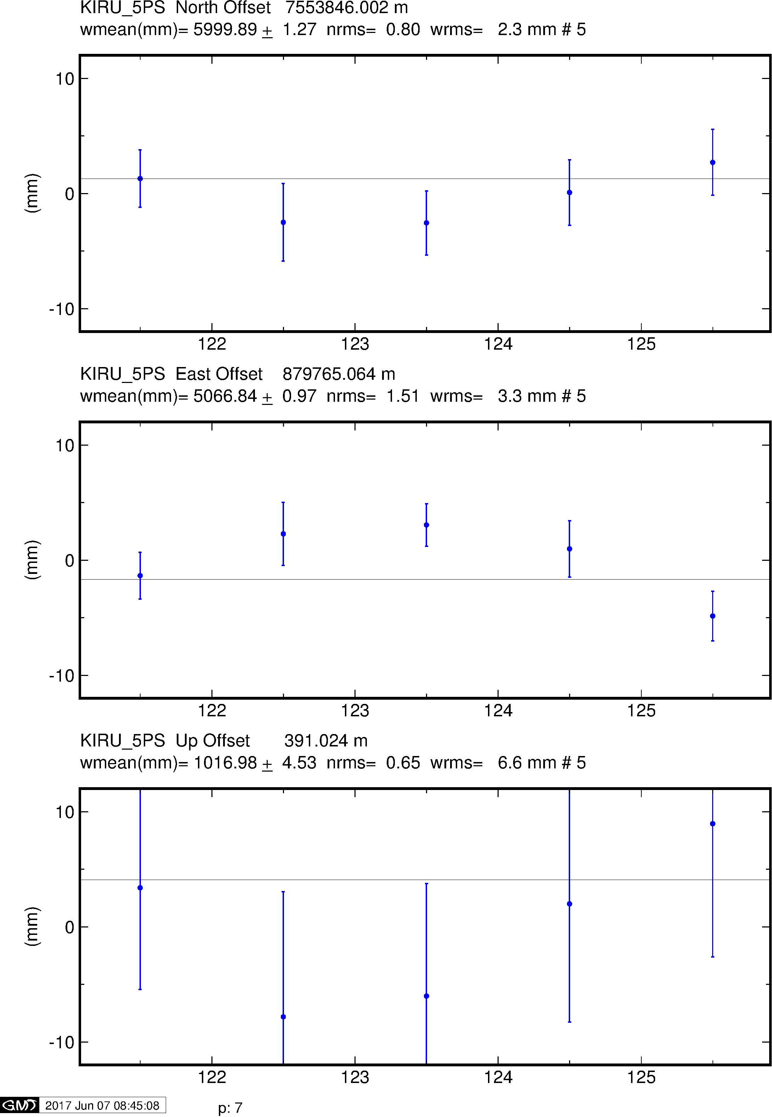
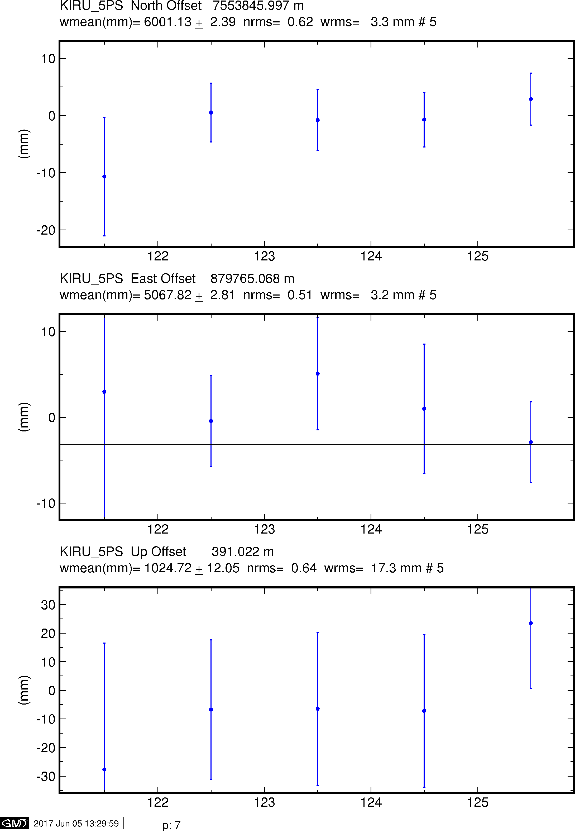
Example time series
GPS
Galileo
BeiDou

Slide 32
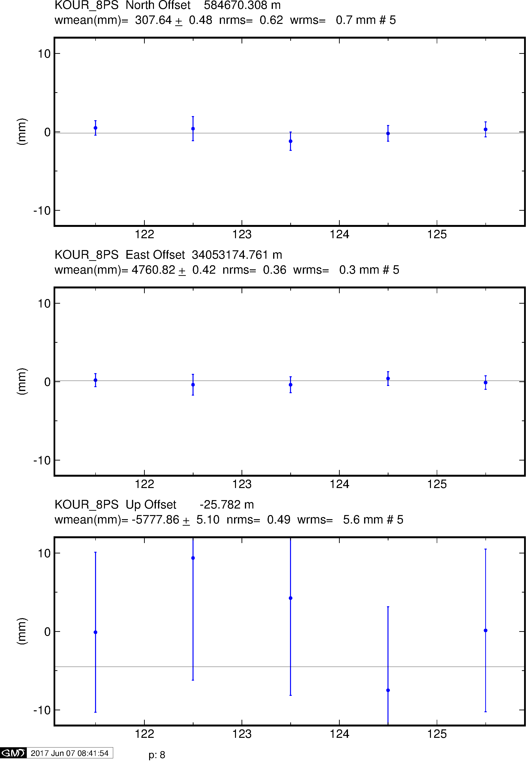
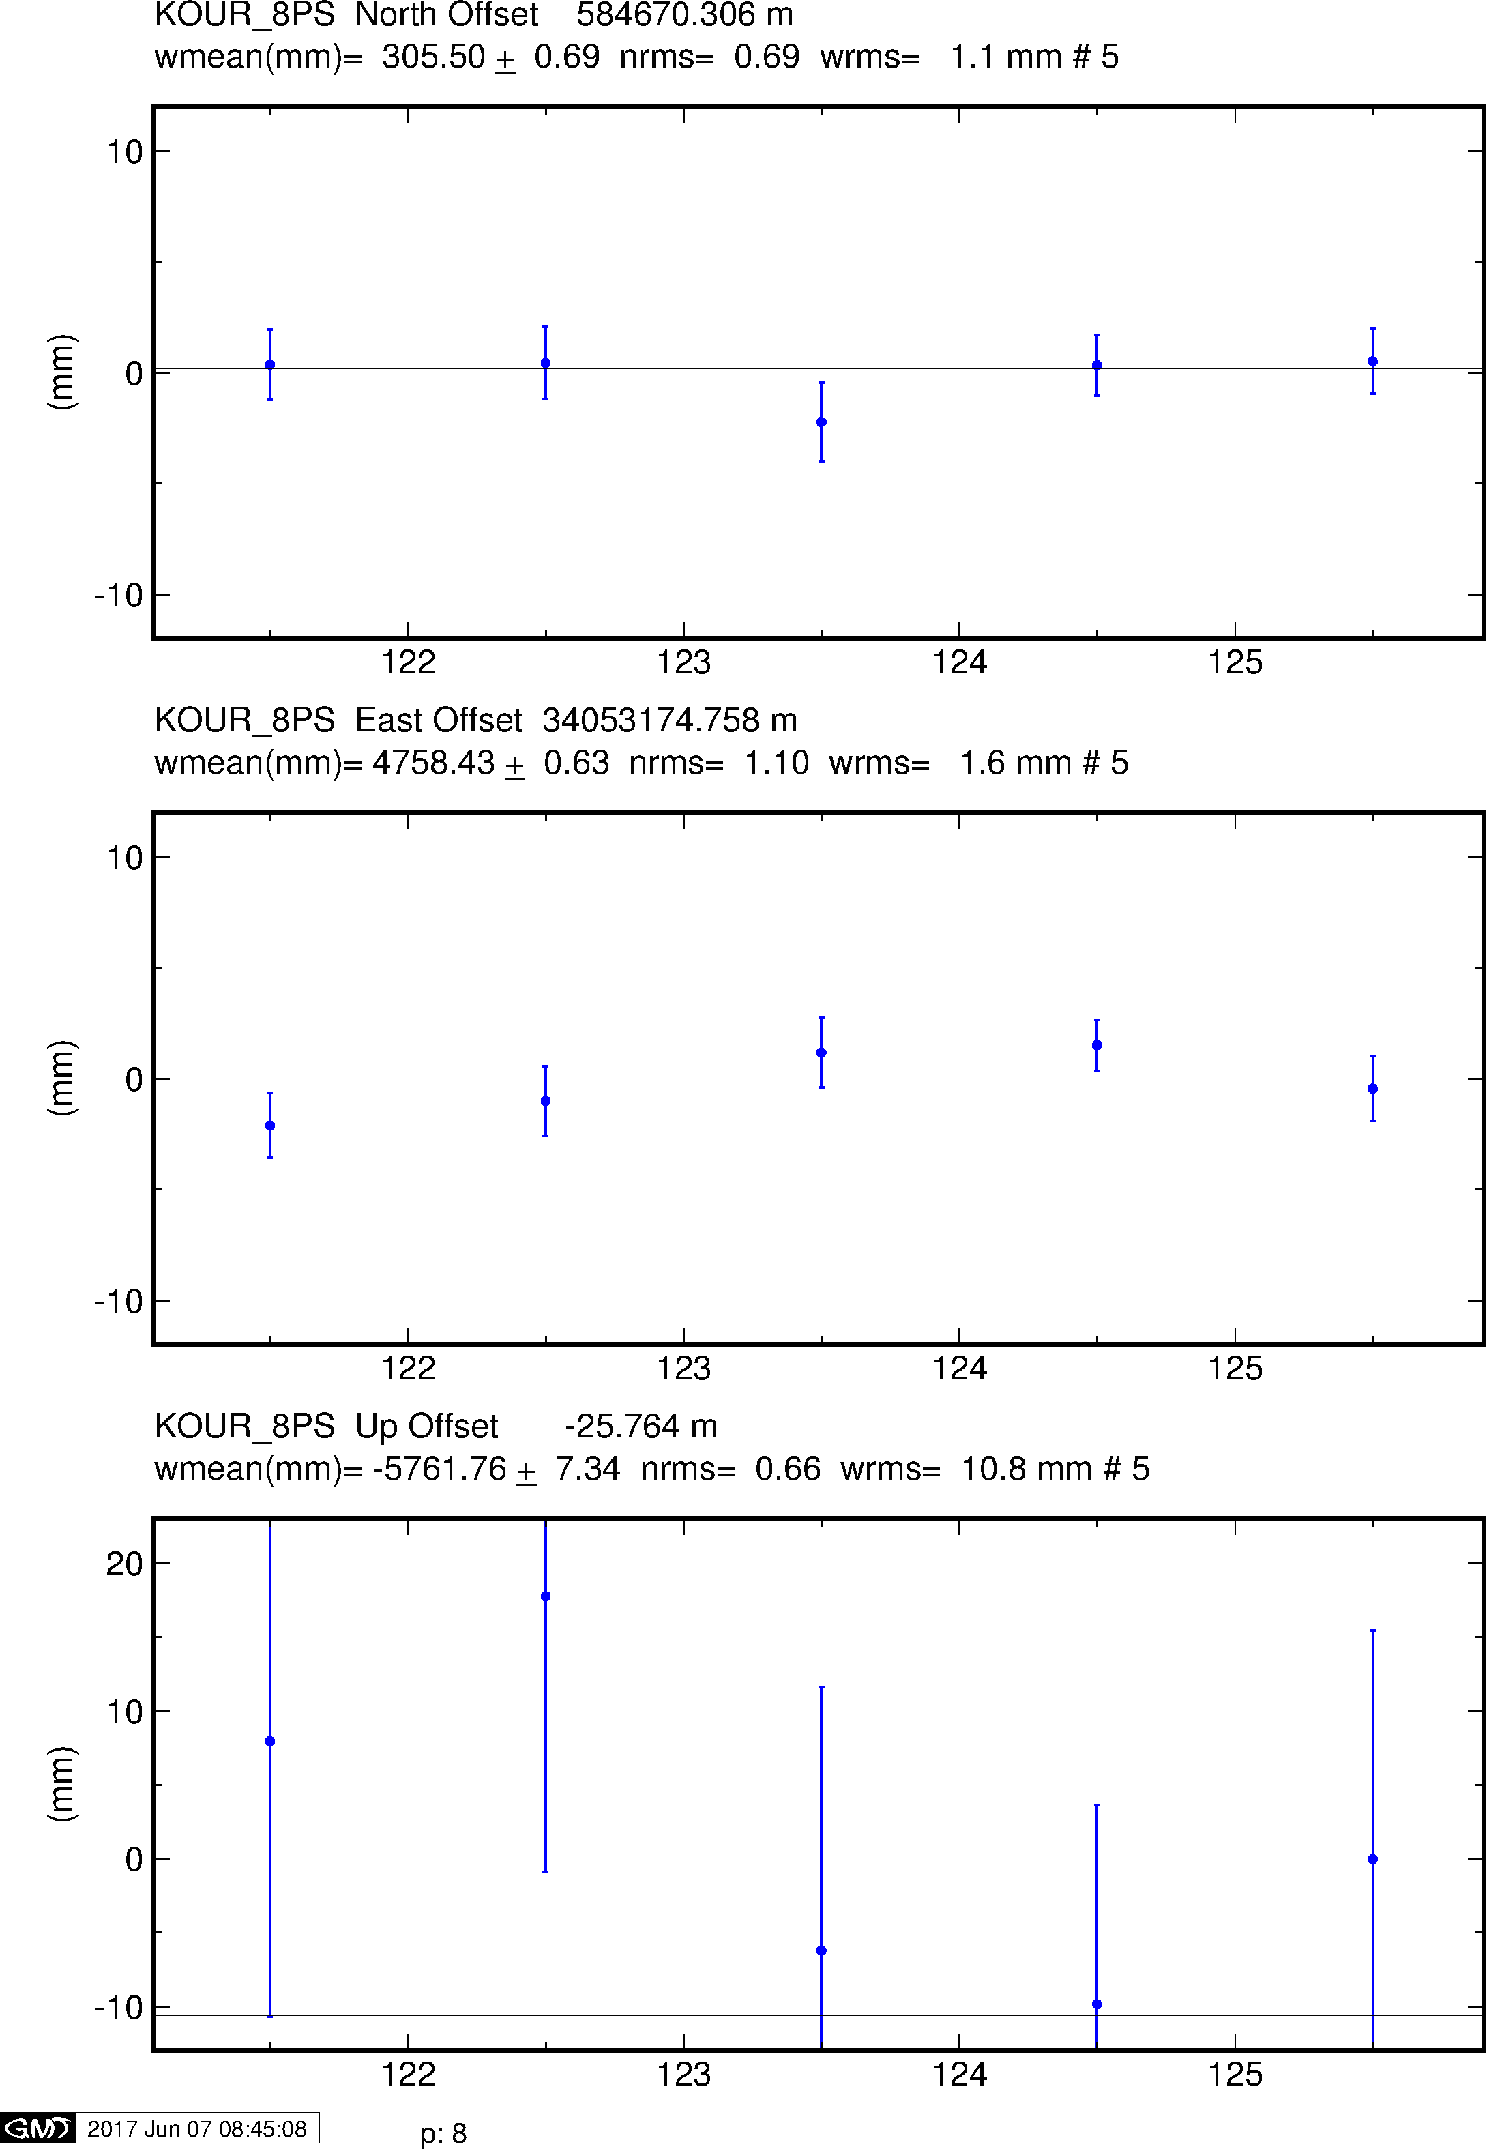
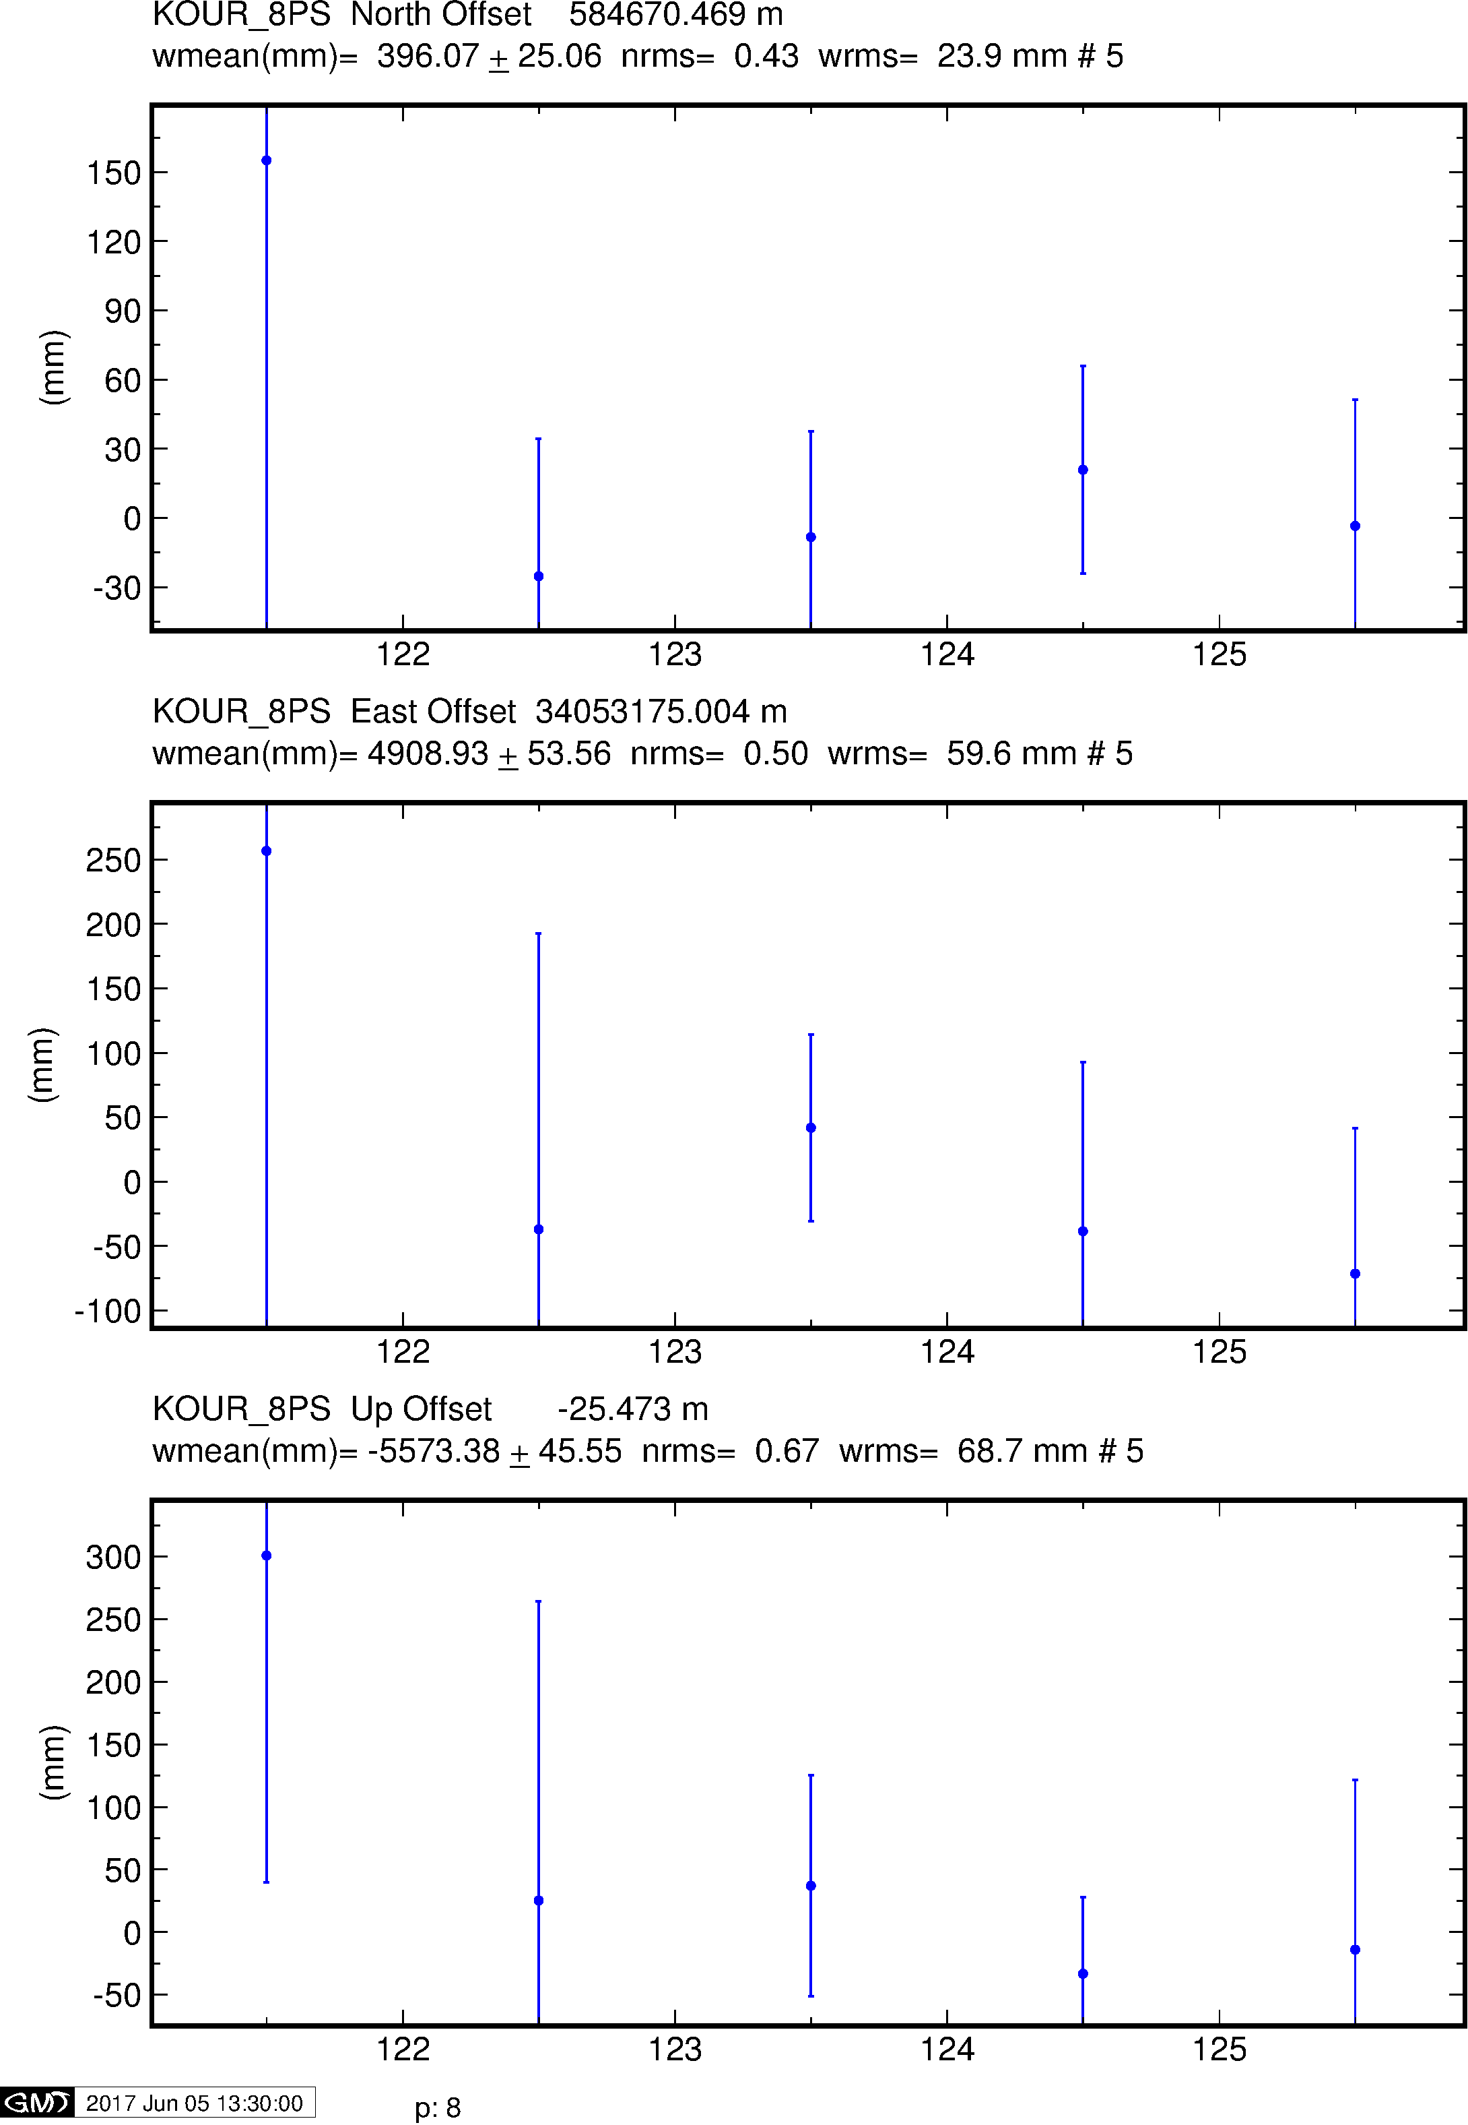
Example time series
GPS
Galileo
BeiDou

Slide 33
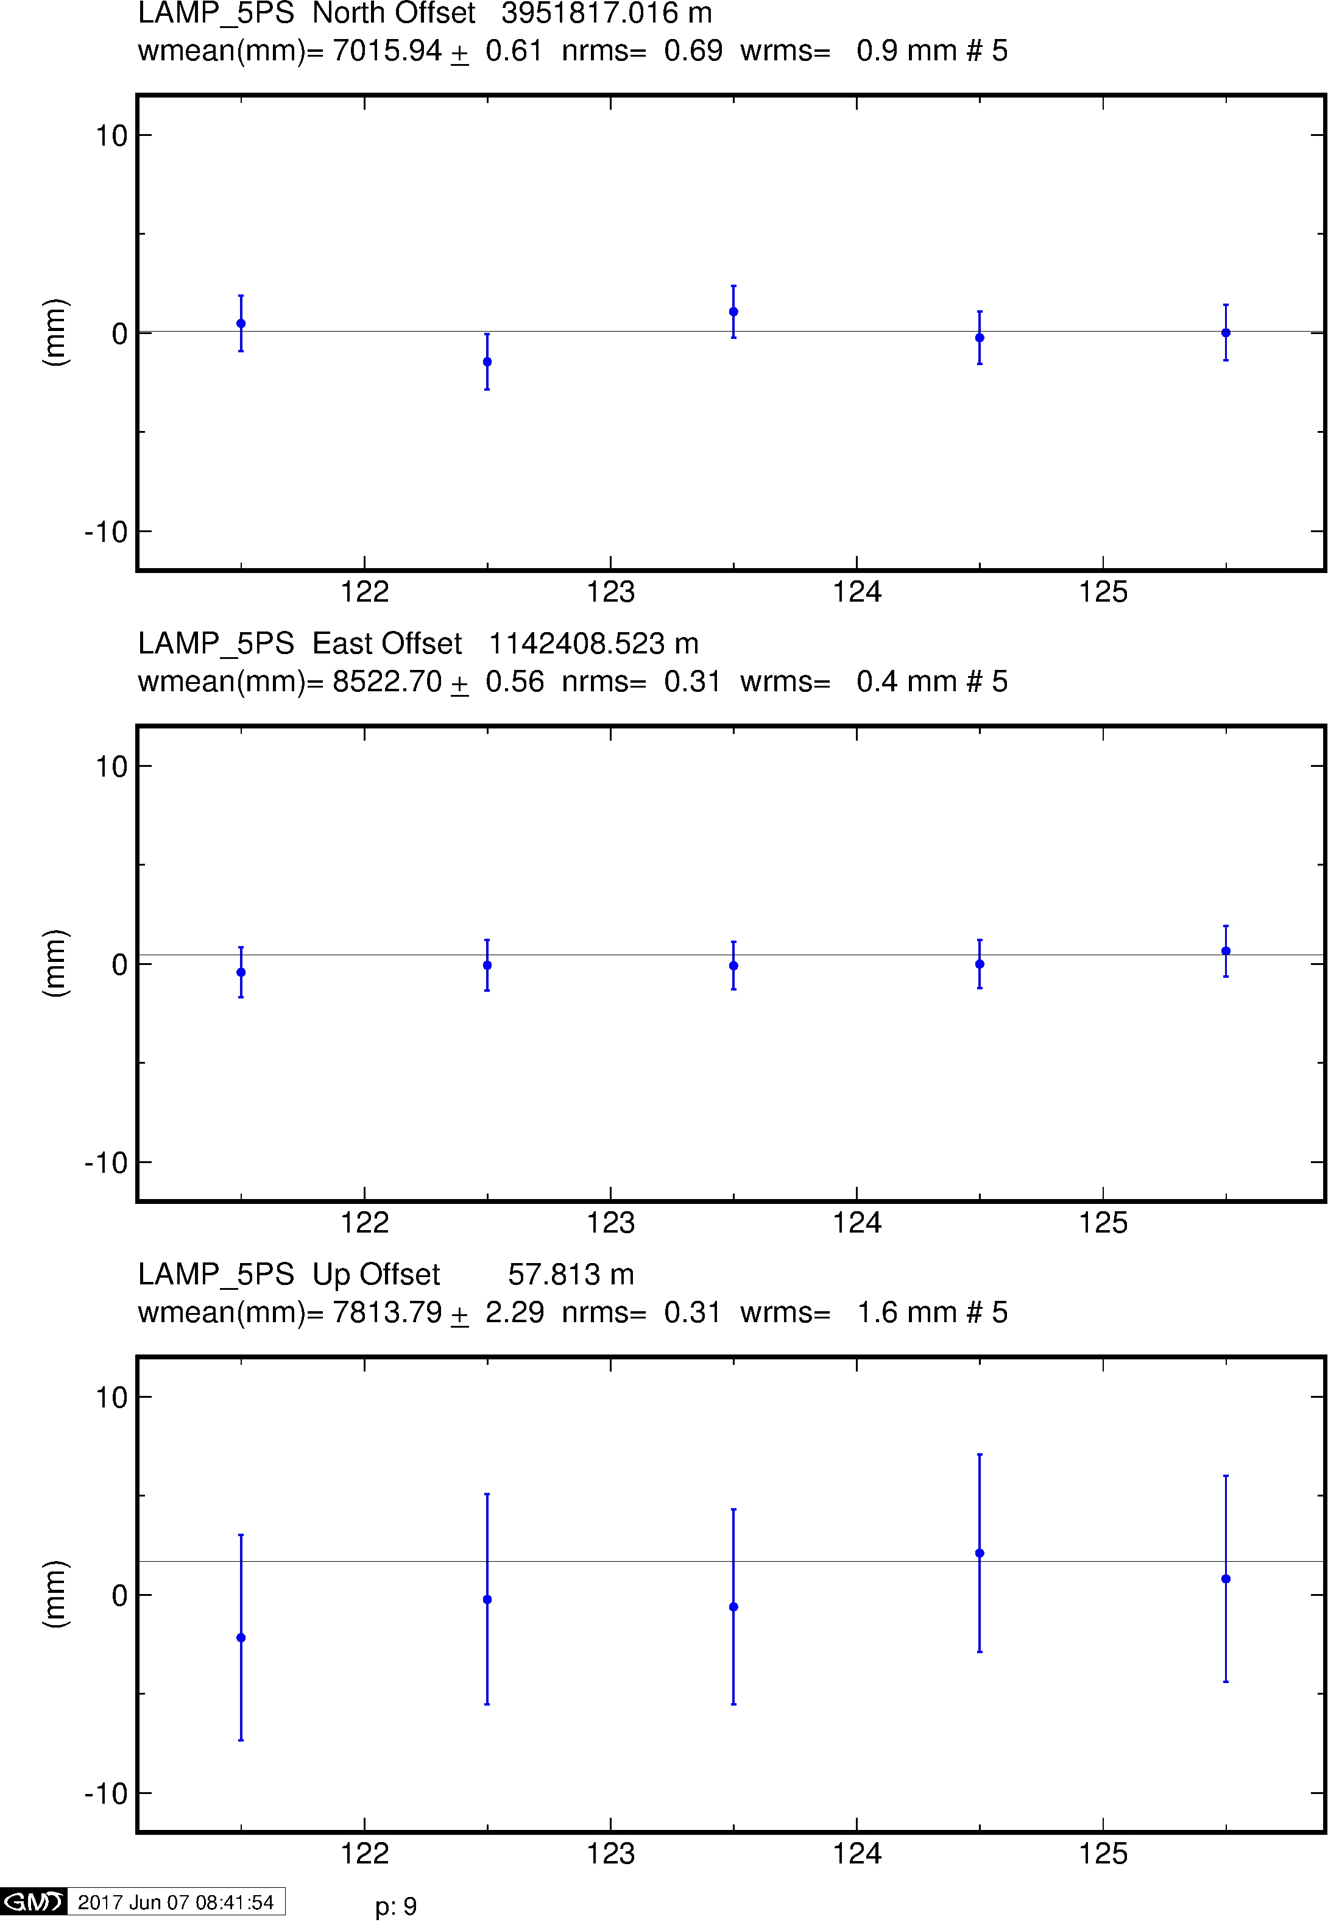
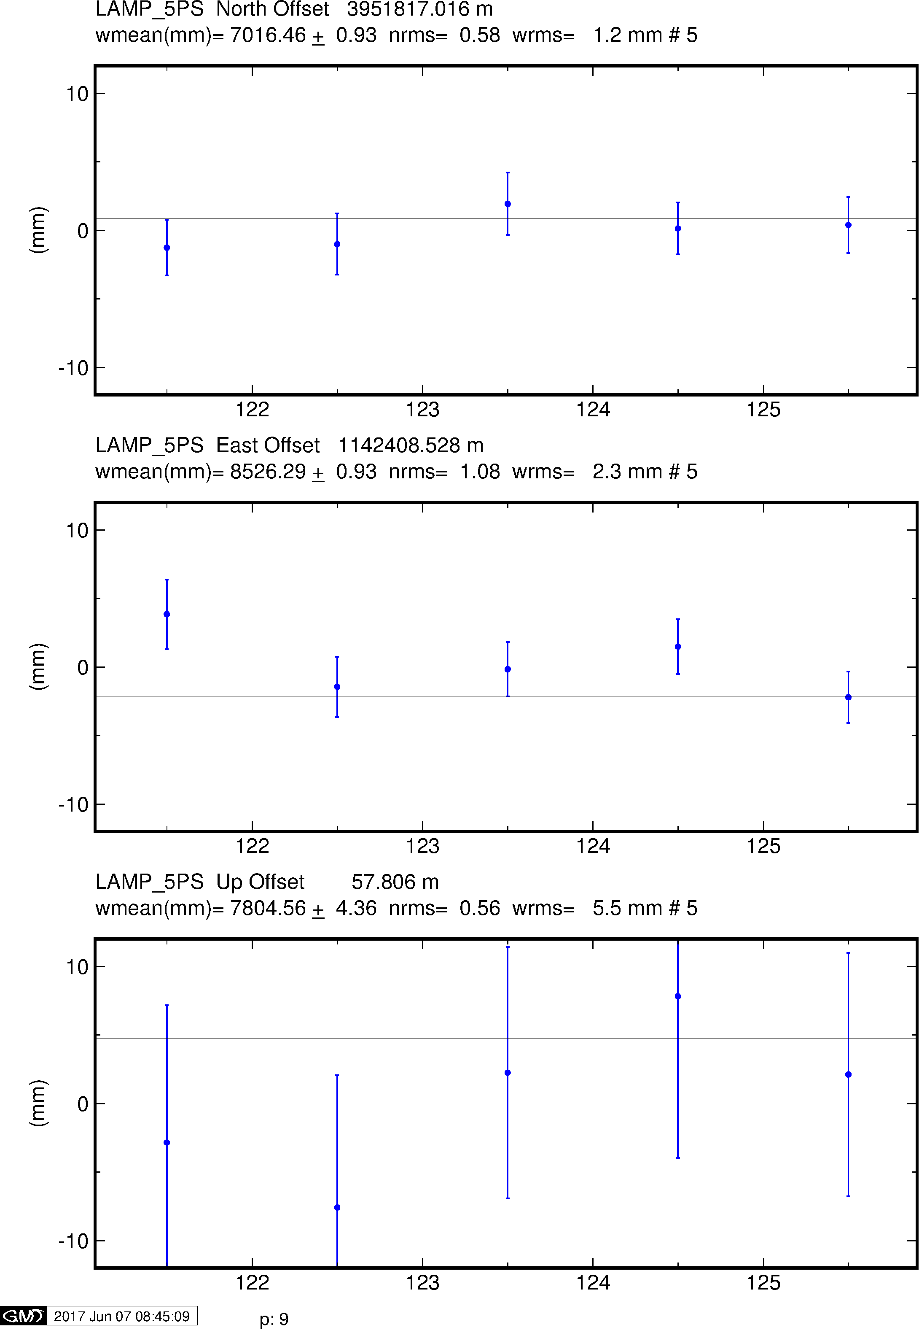
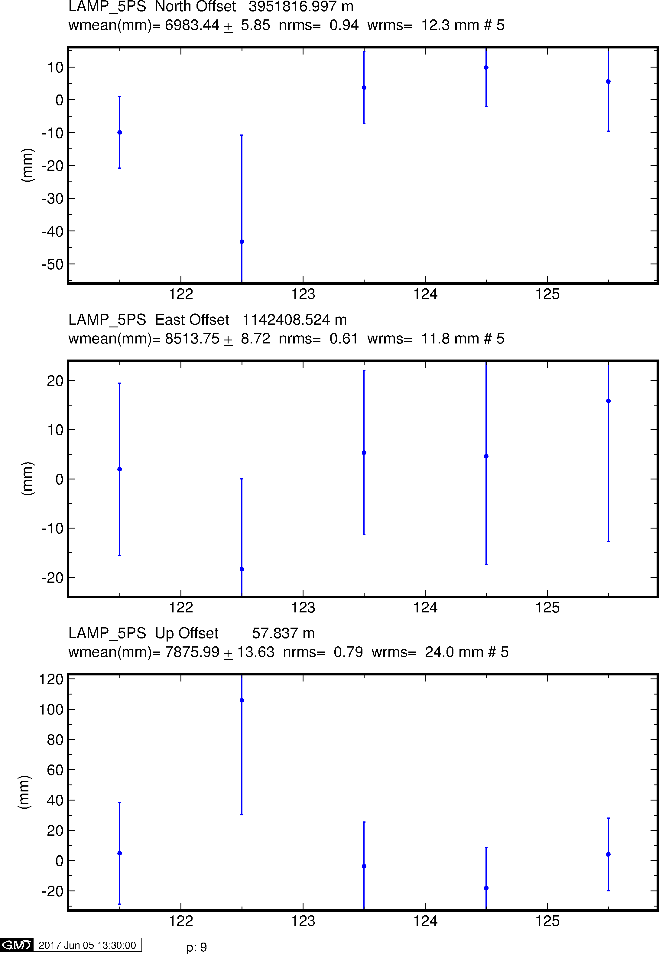
Example time series
GPS
Galileo
BeiDou

Slide 34
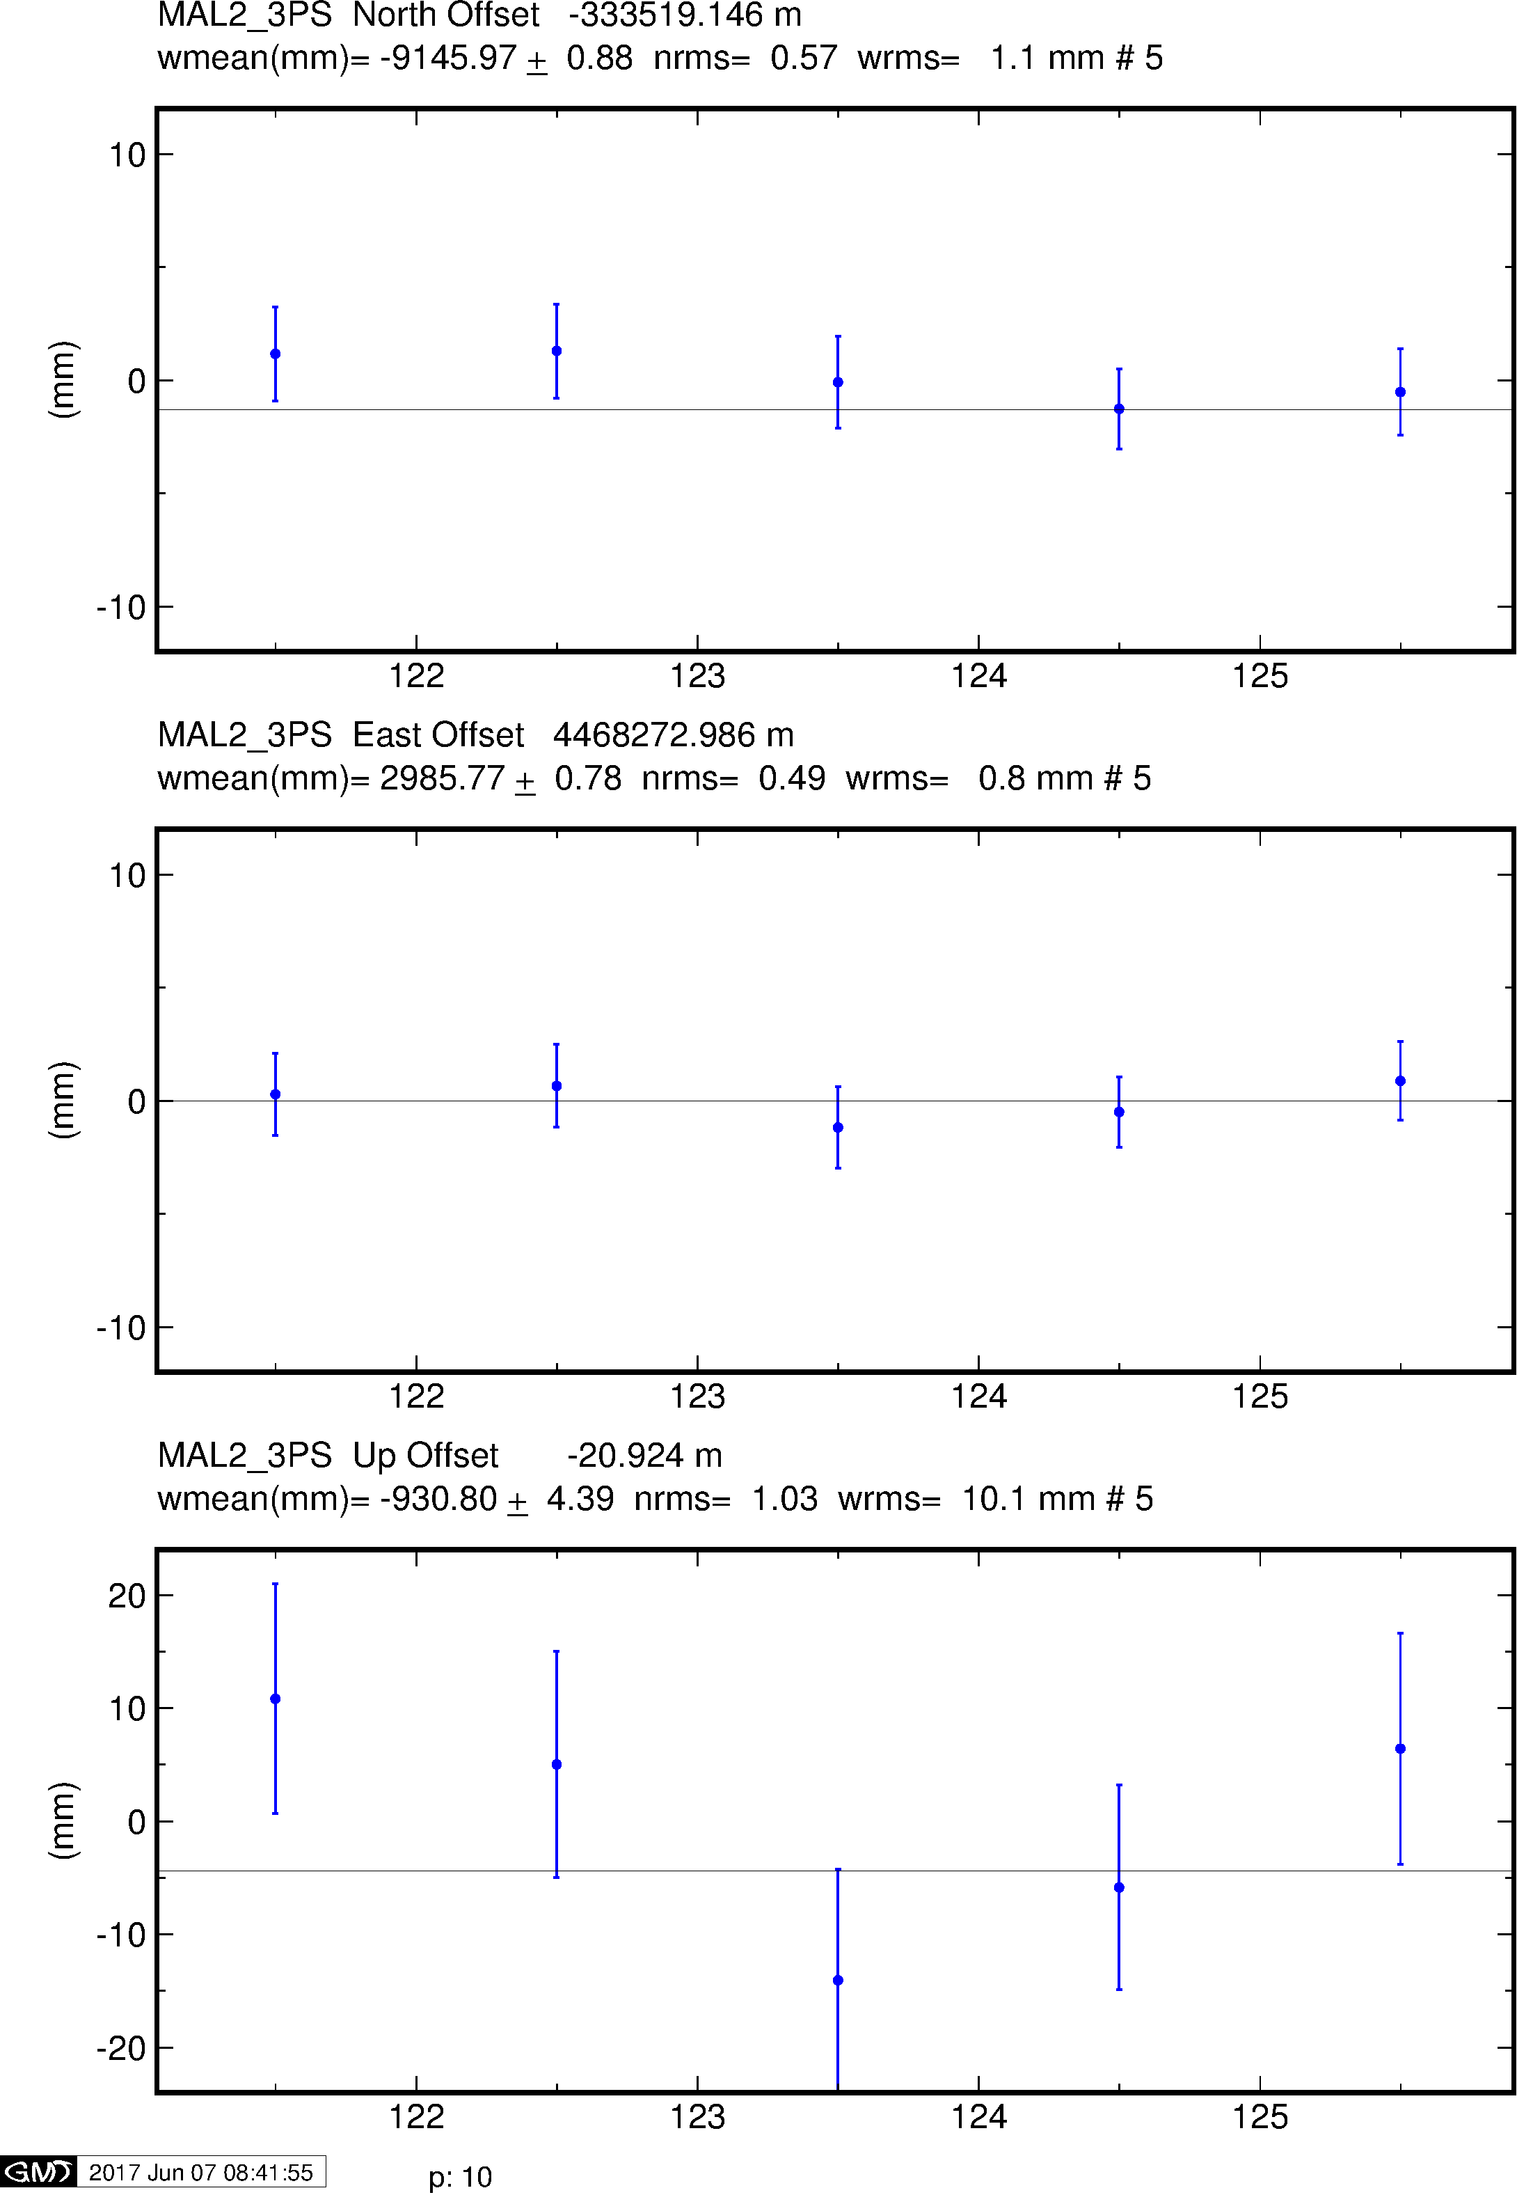
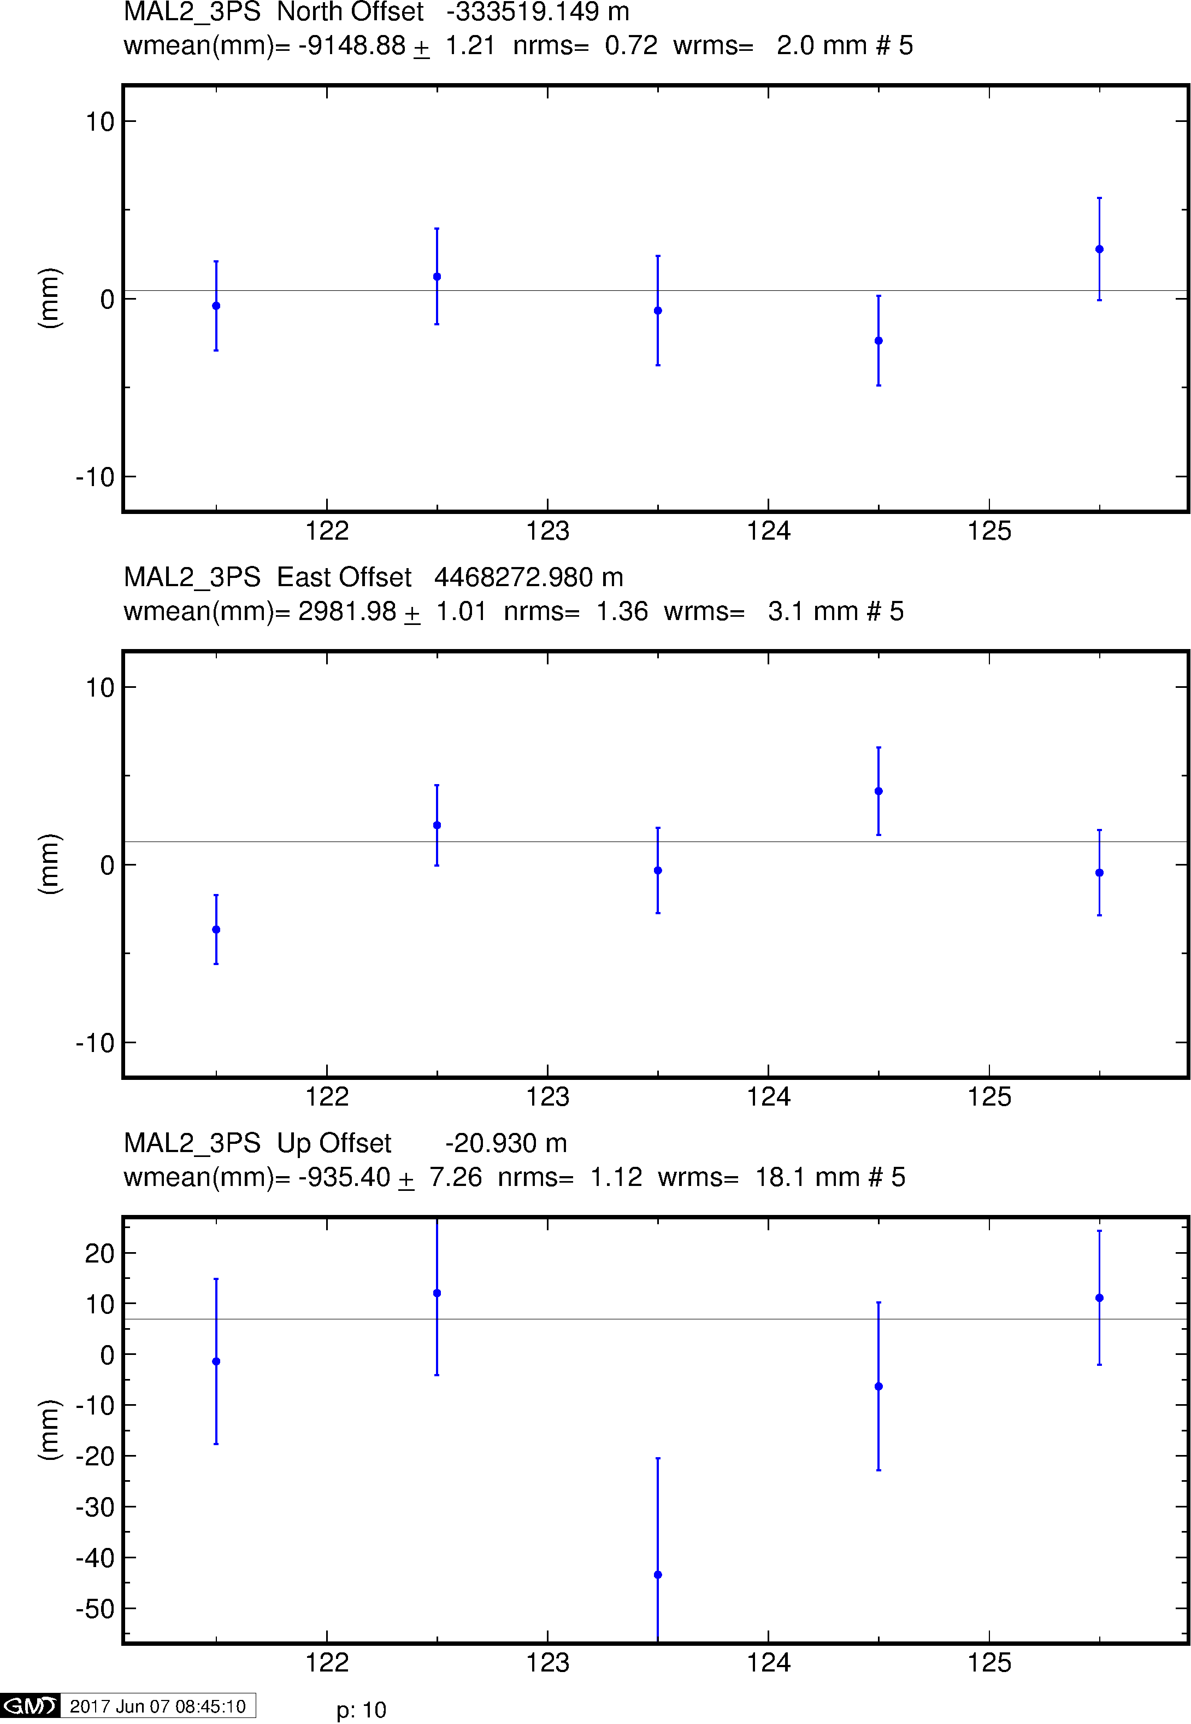
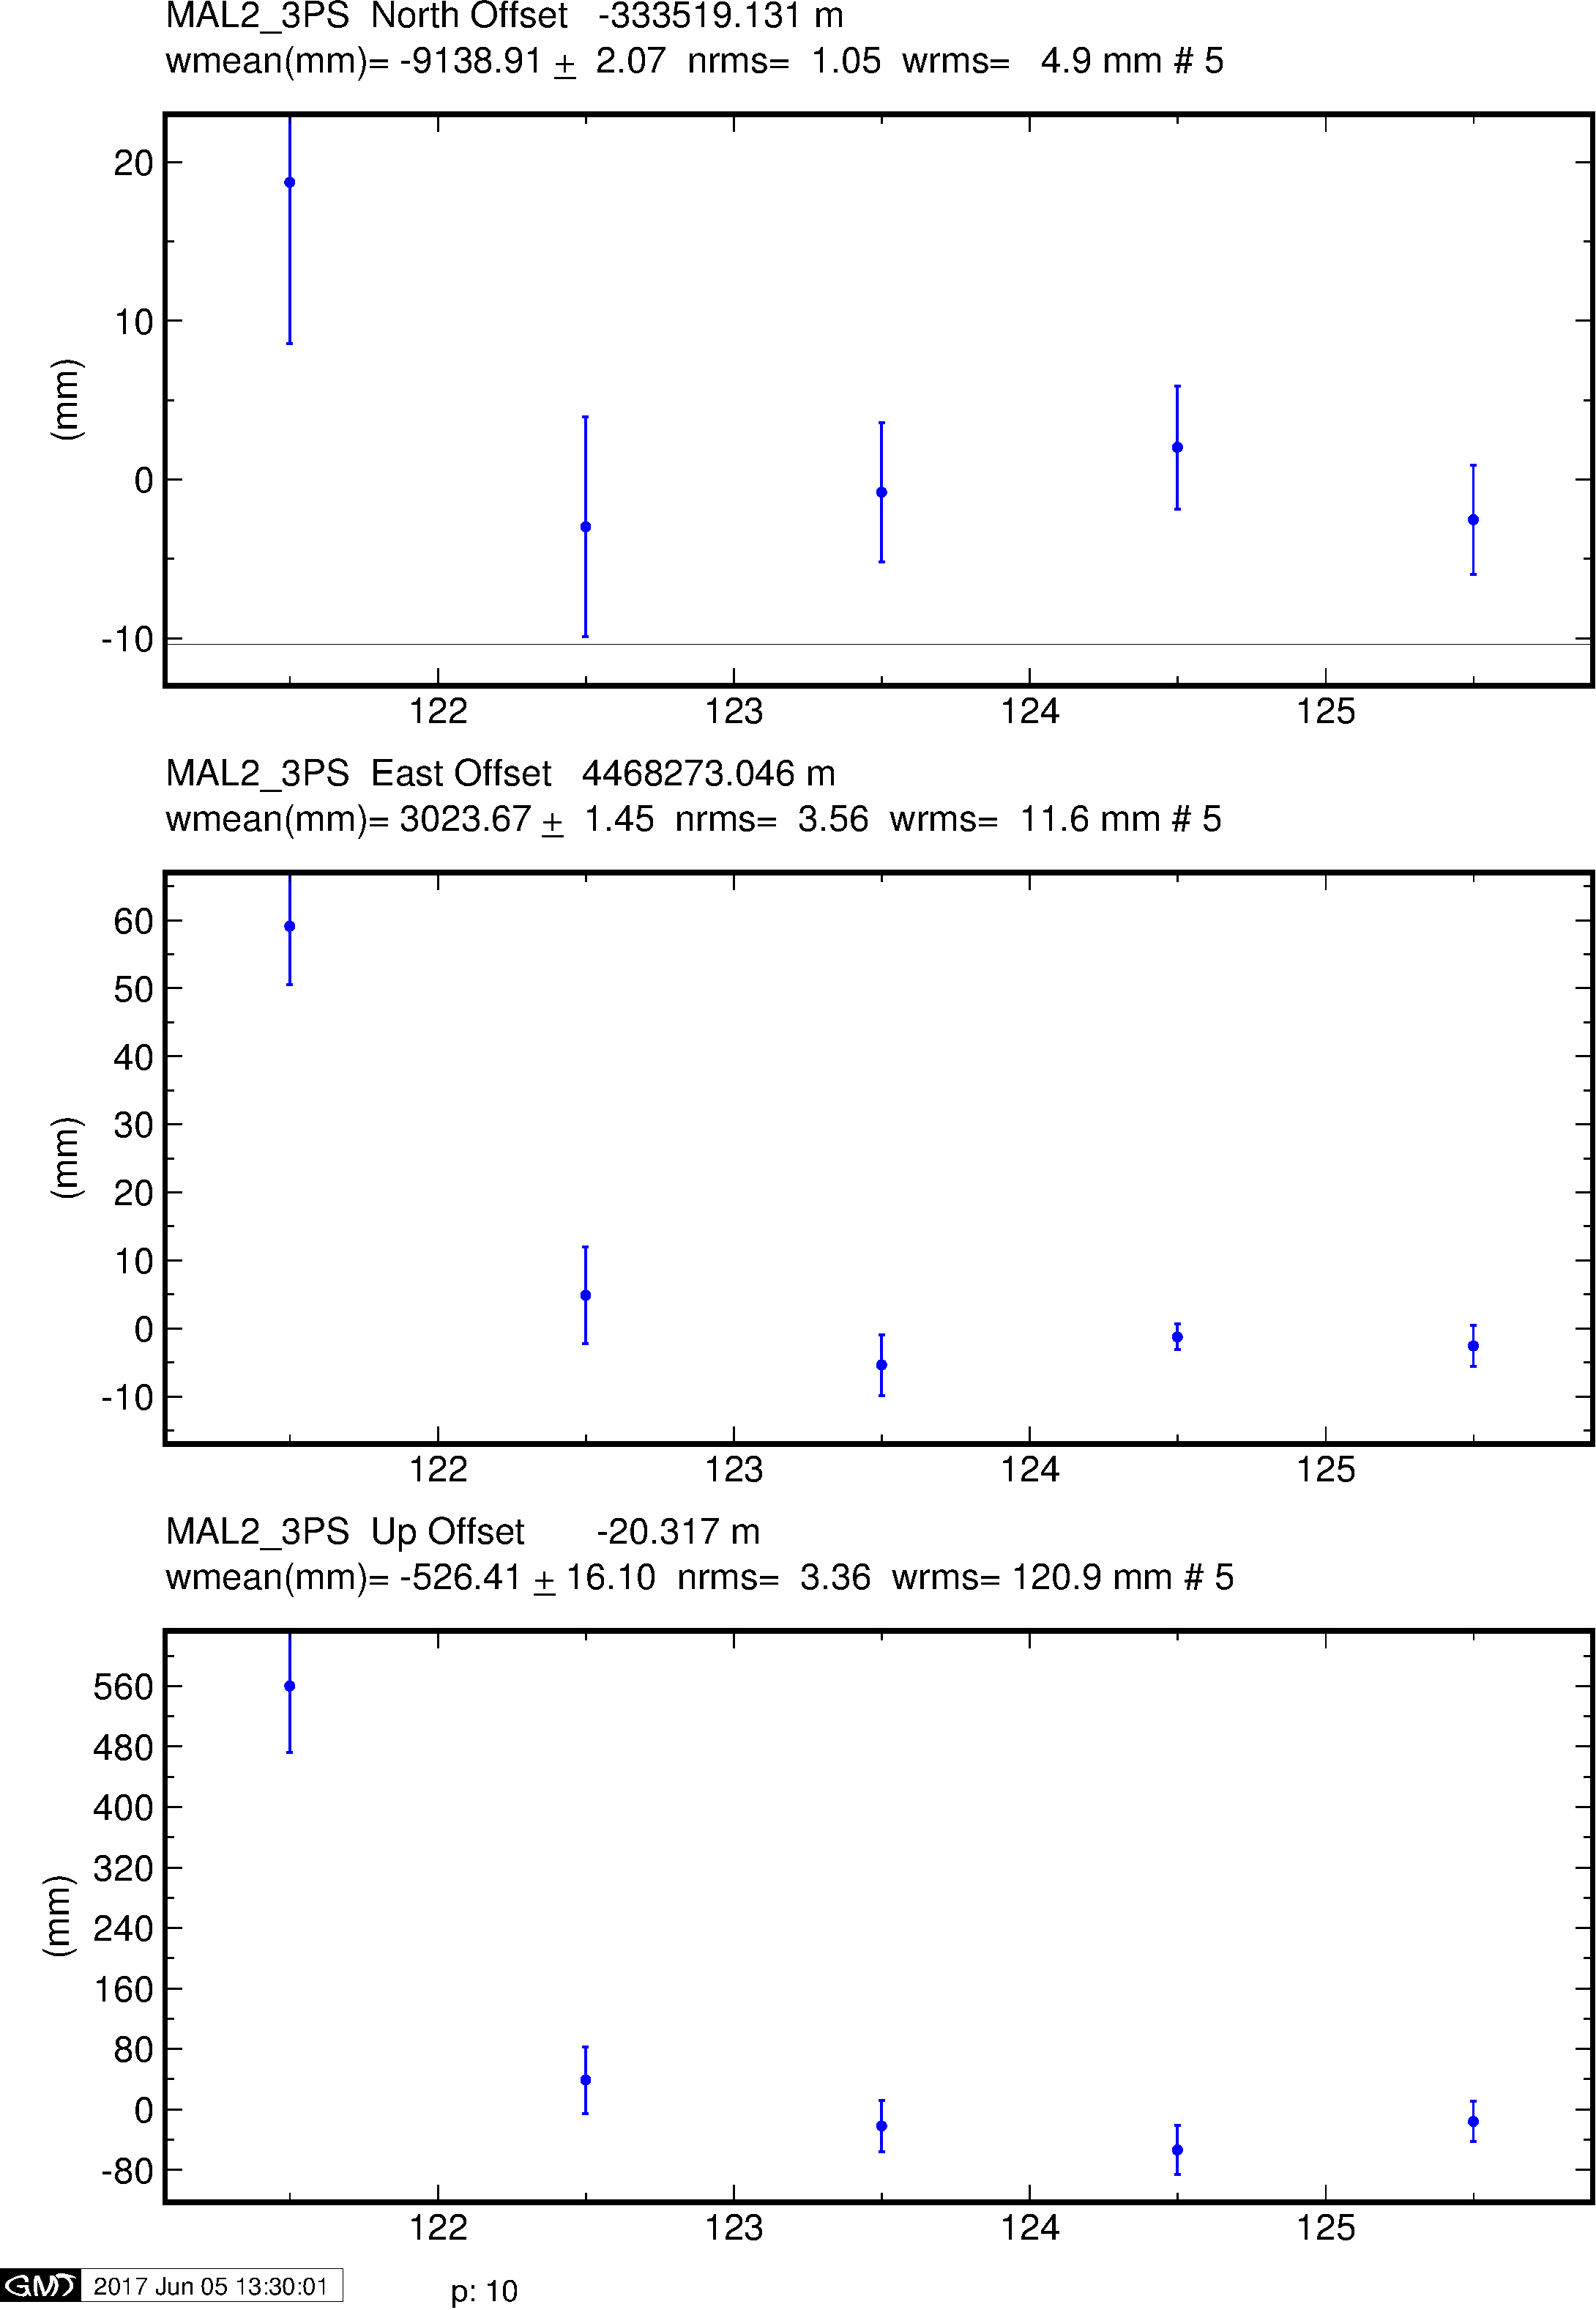
Example time series
GPS
Galileo
BeiDou

Slide 35
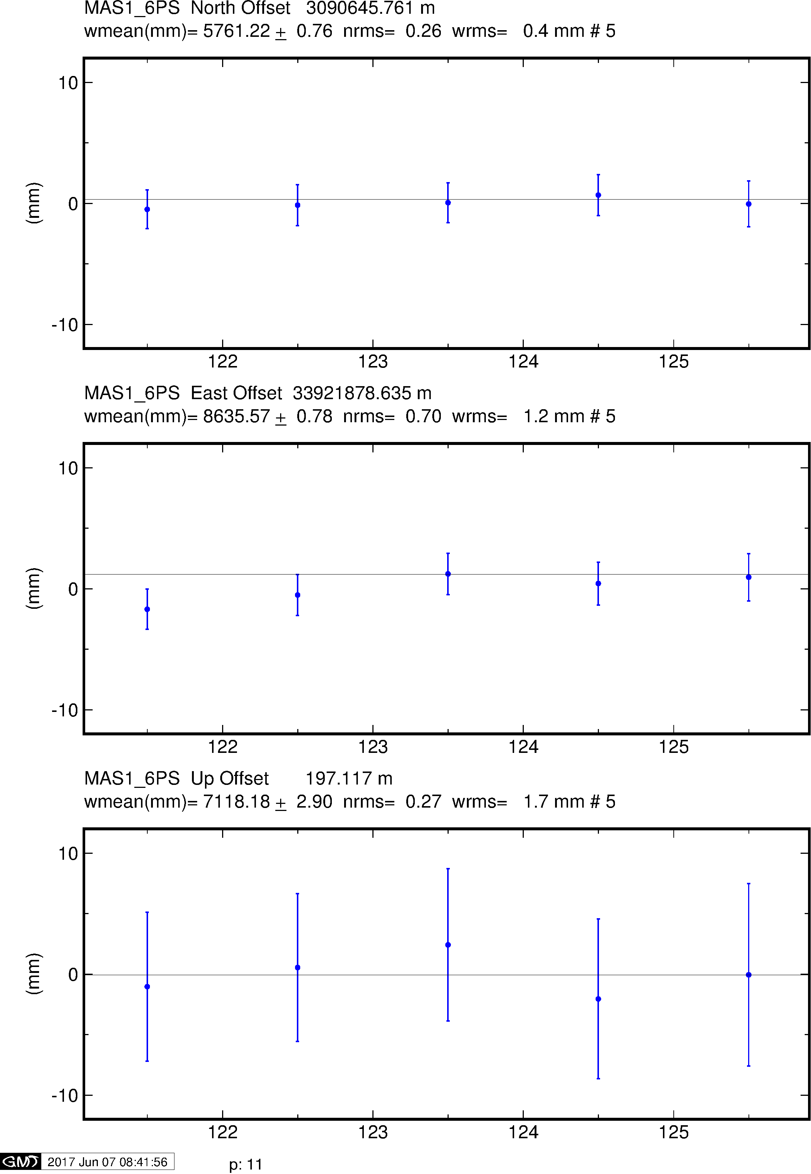
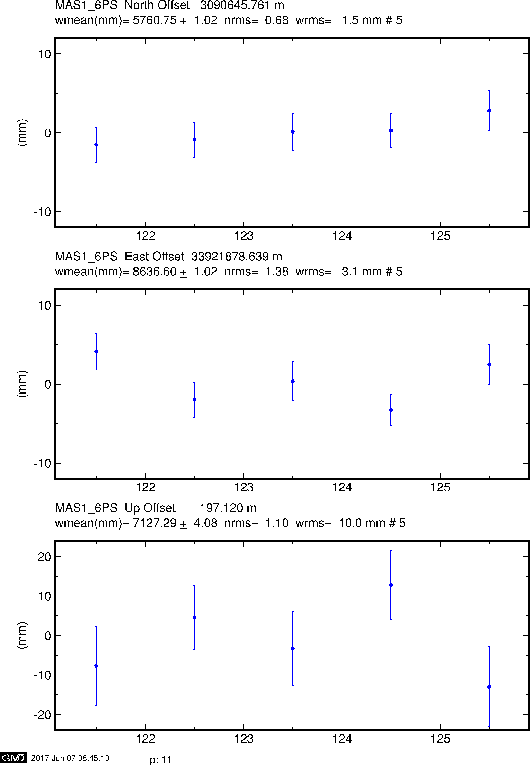
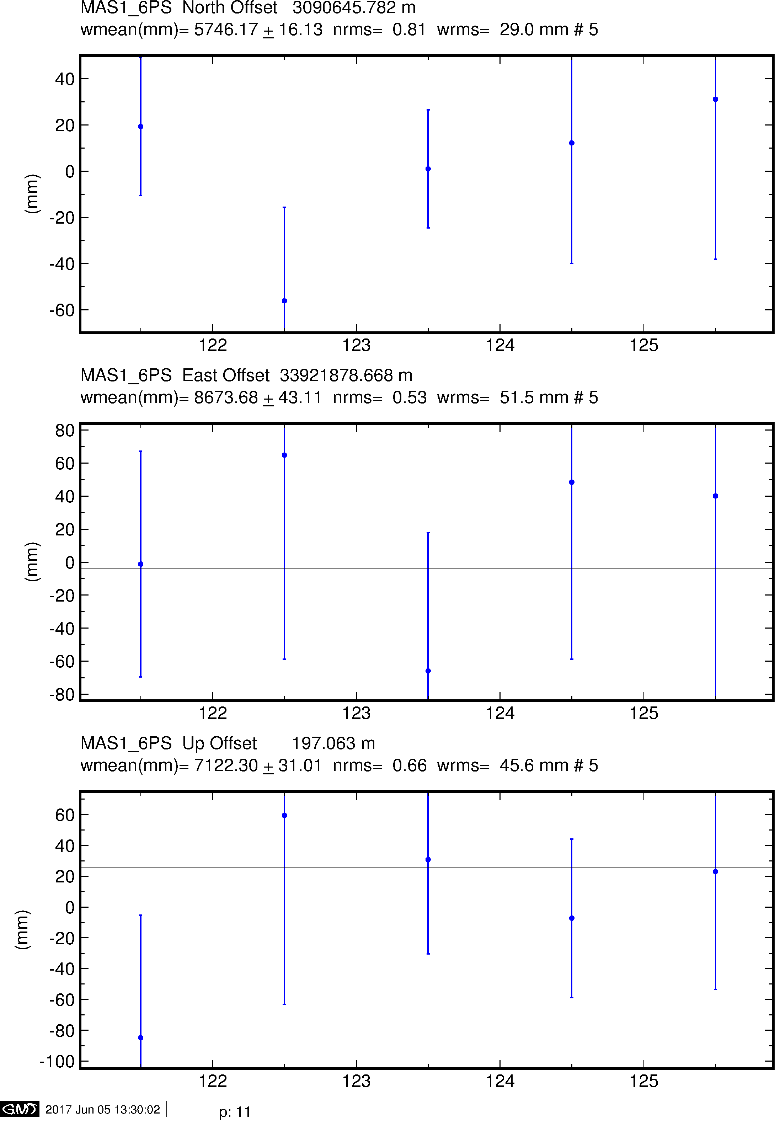
Example time series
GPS
Galileo
BeiDou

Slide 36
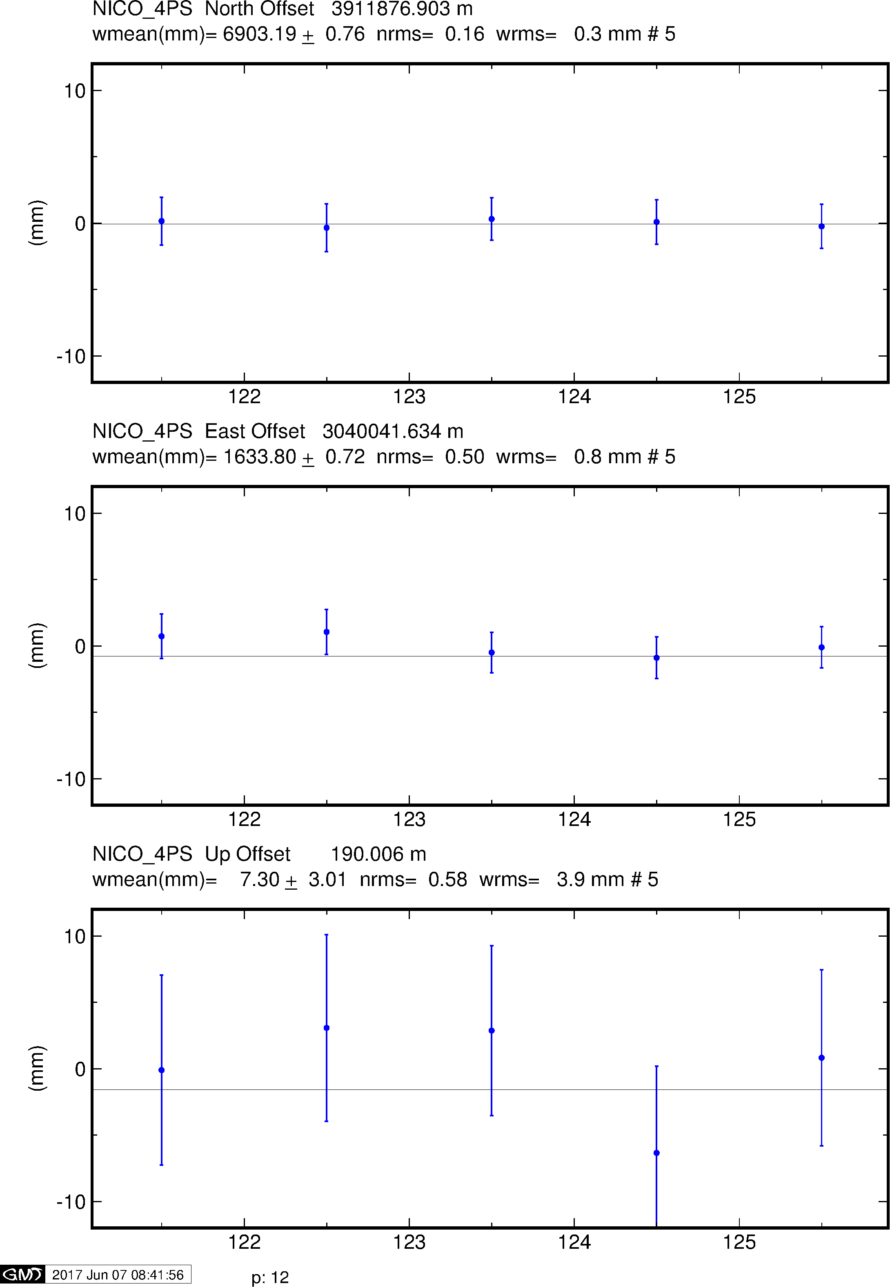
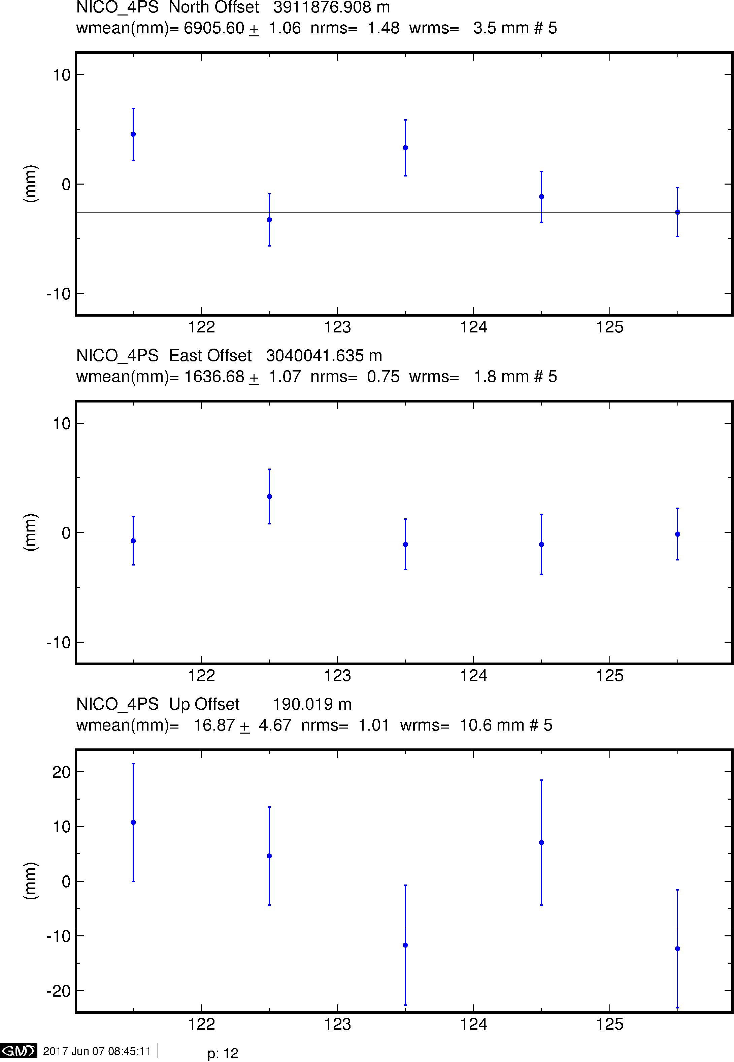
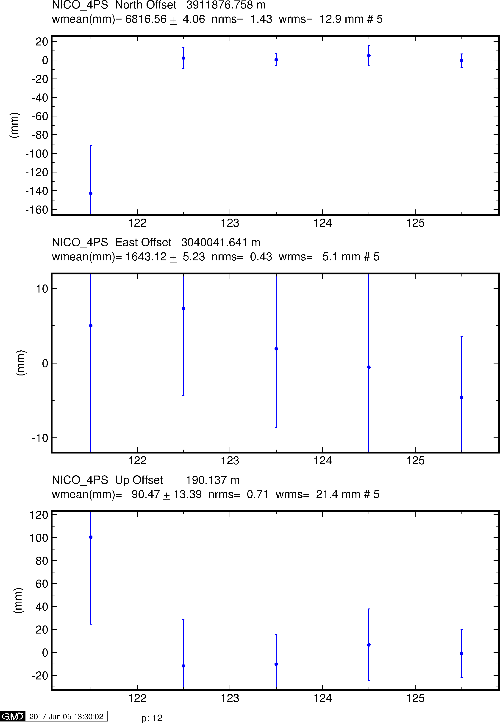
Example time series
GPS
Galileo
BeiDou

Slide 37
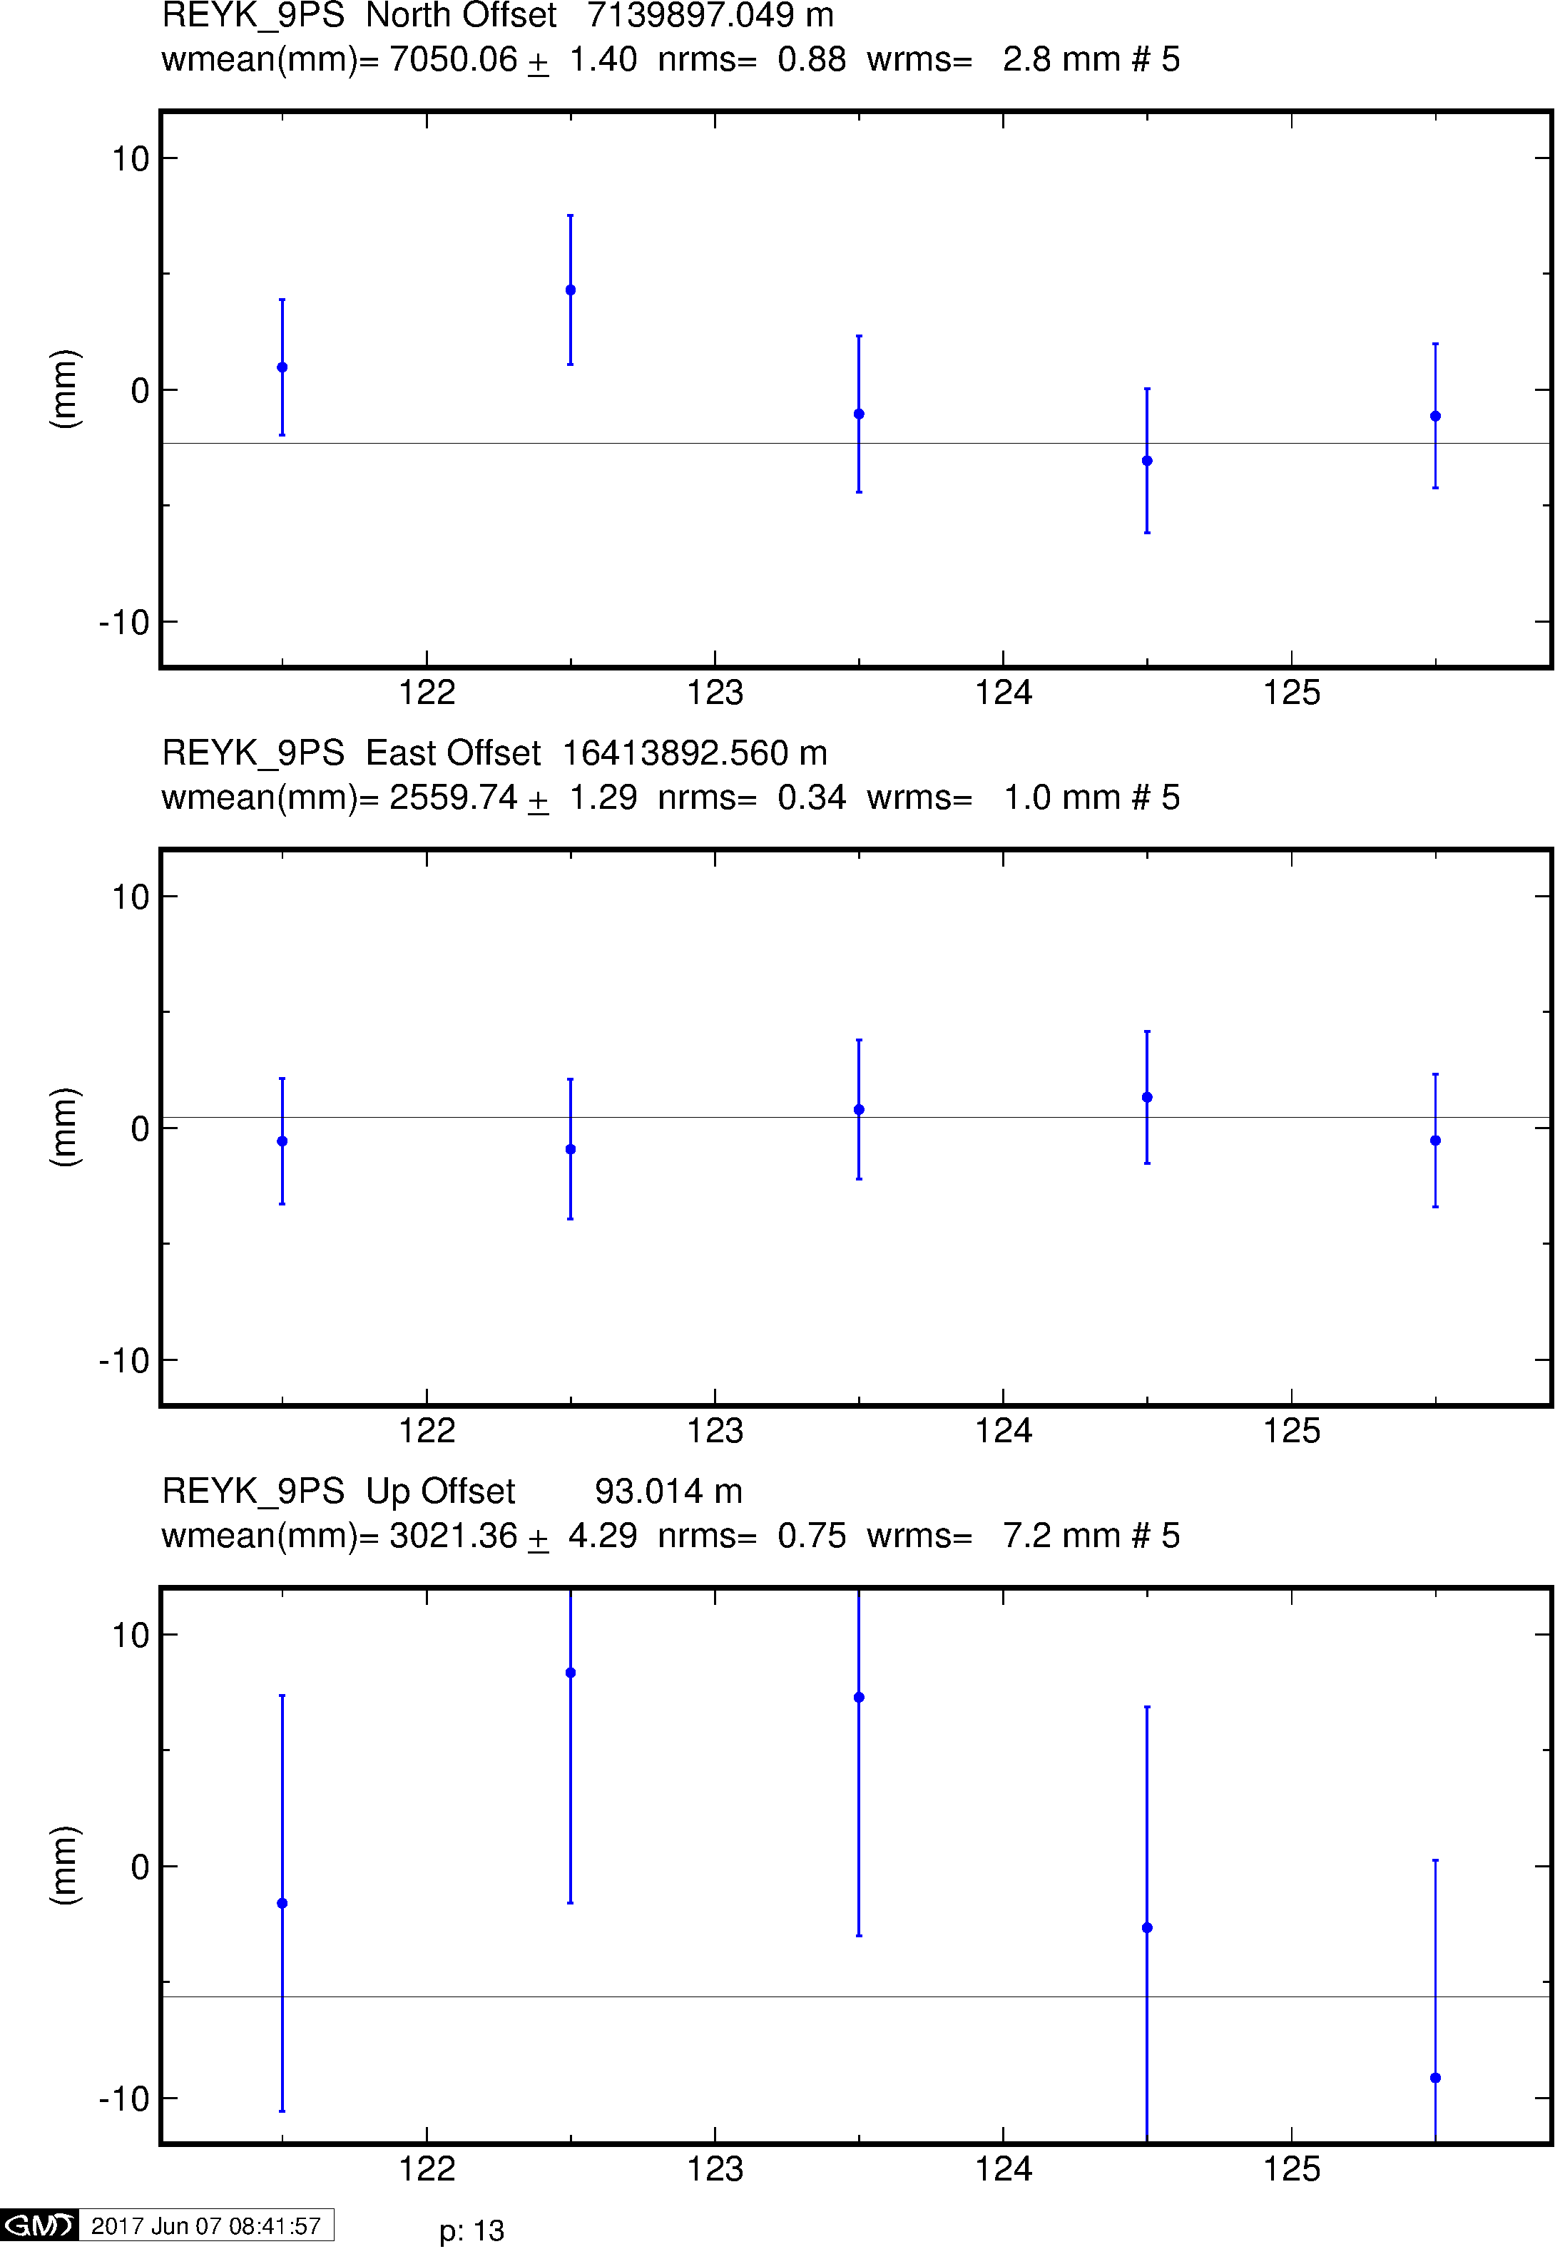
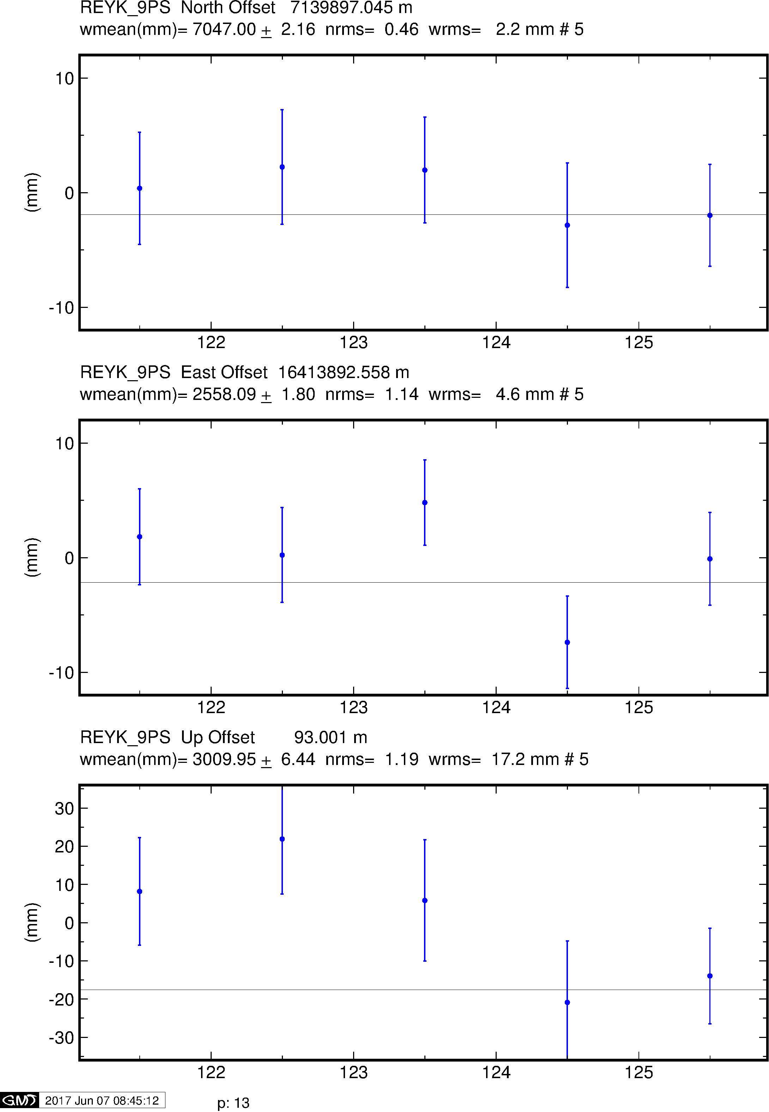
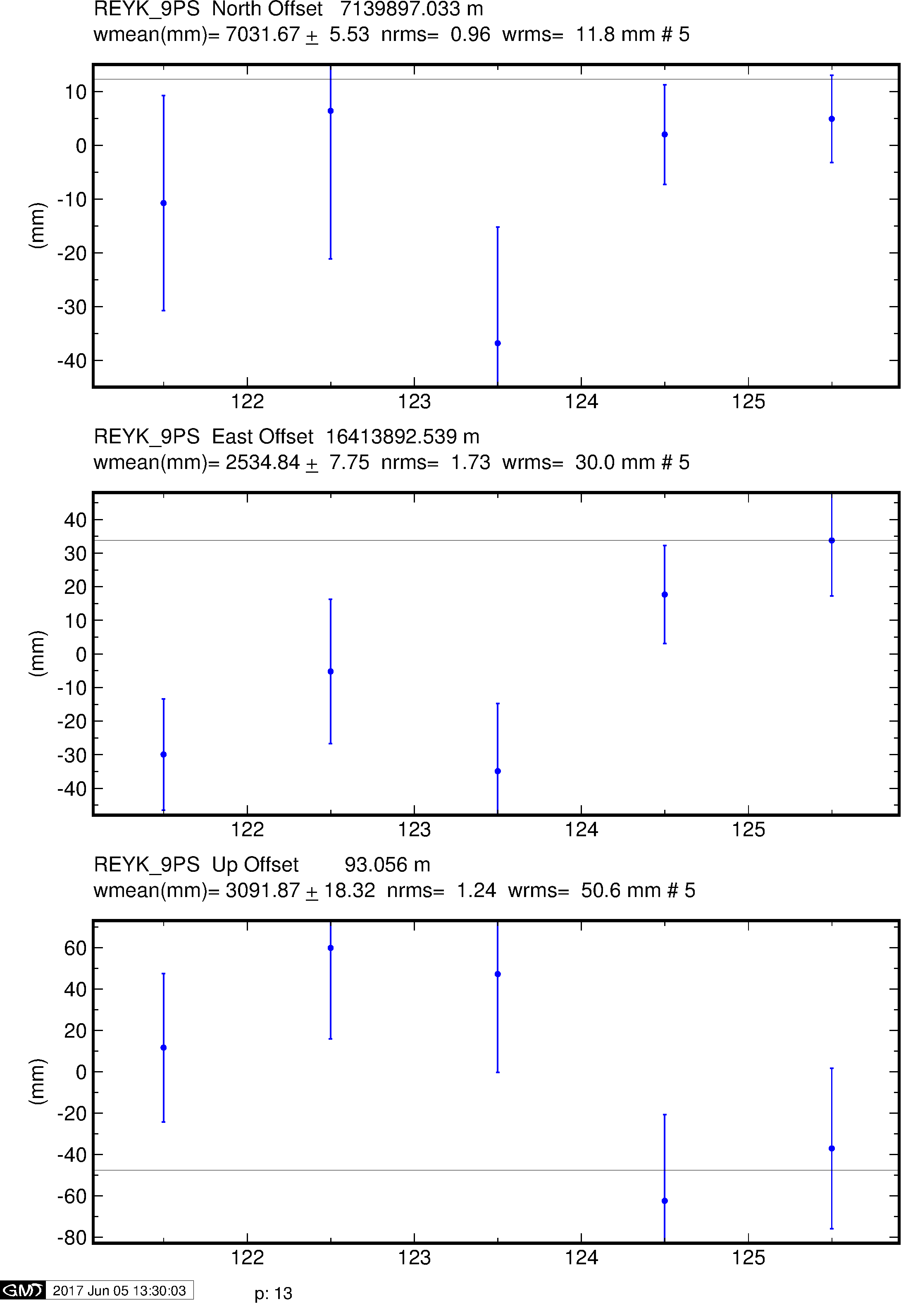
Example time series
GPS
Galileo
BeiDou

Slide 38
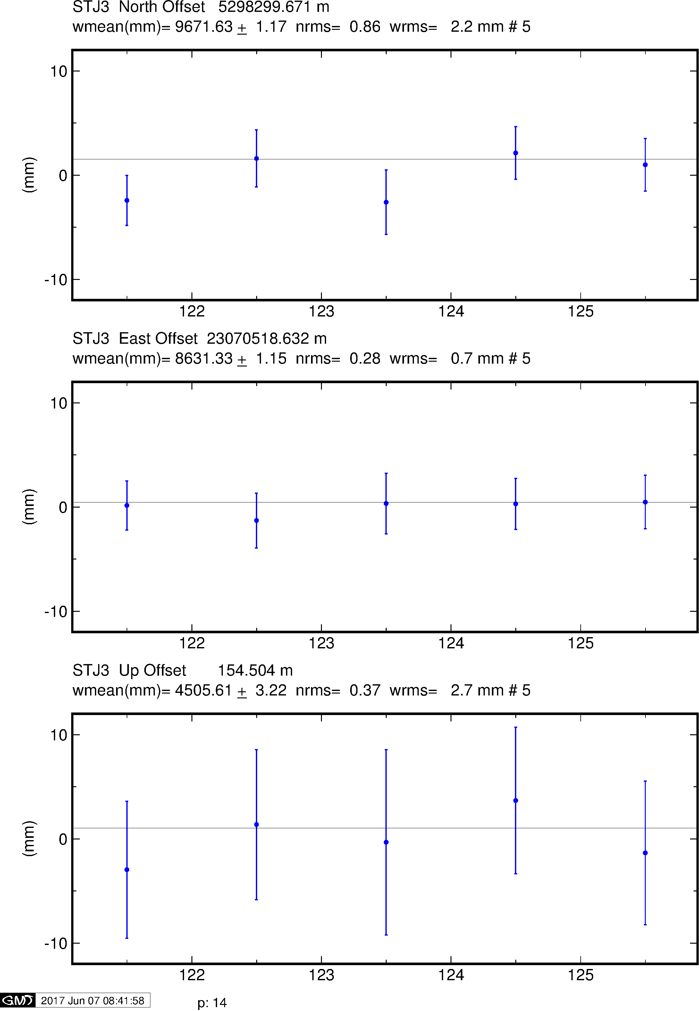
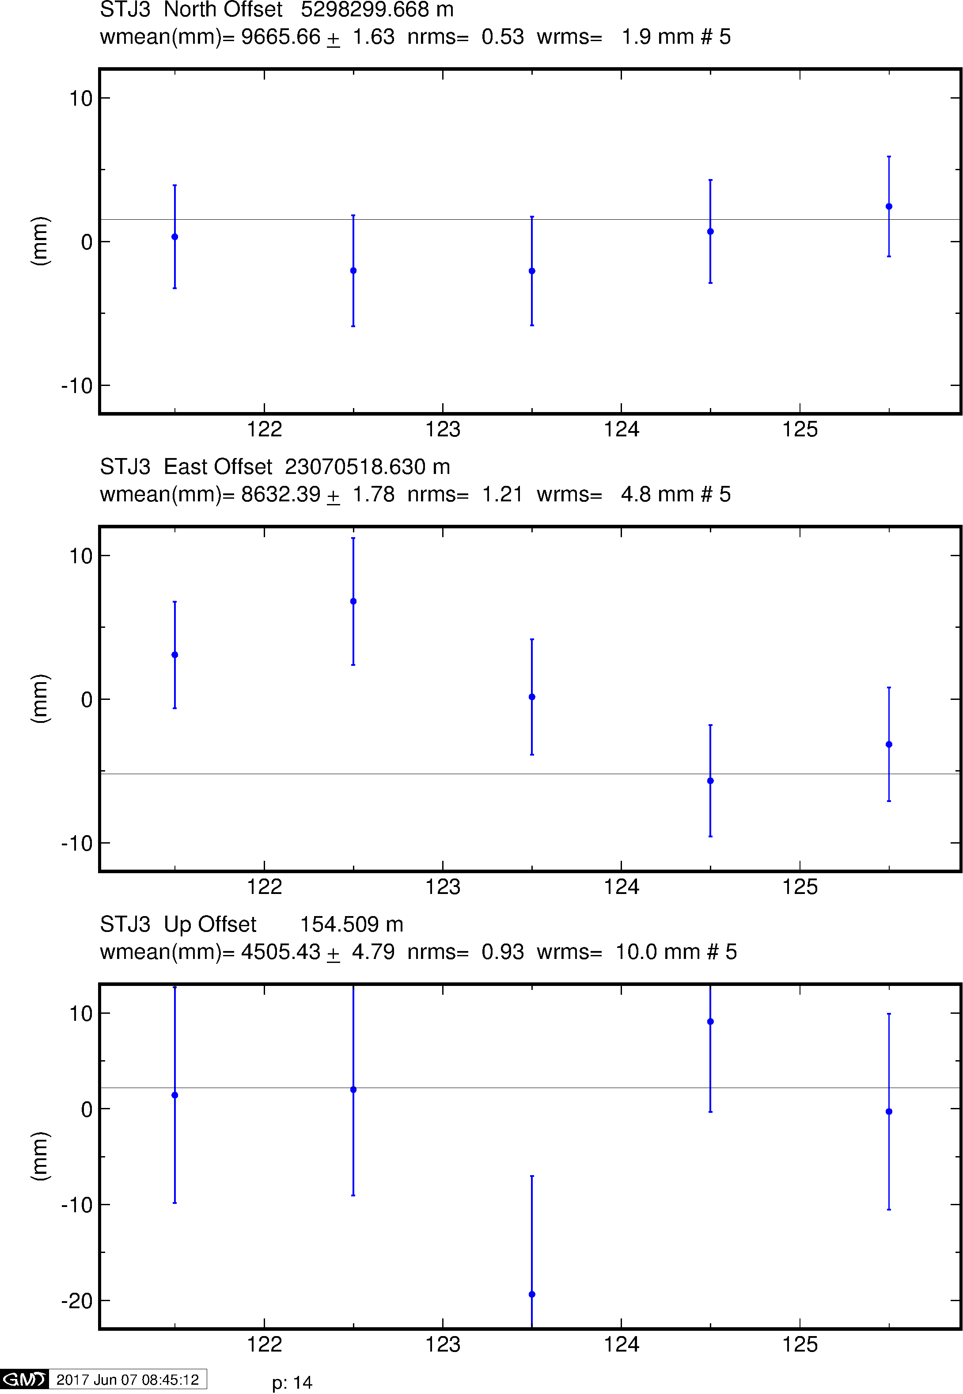
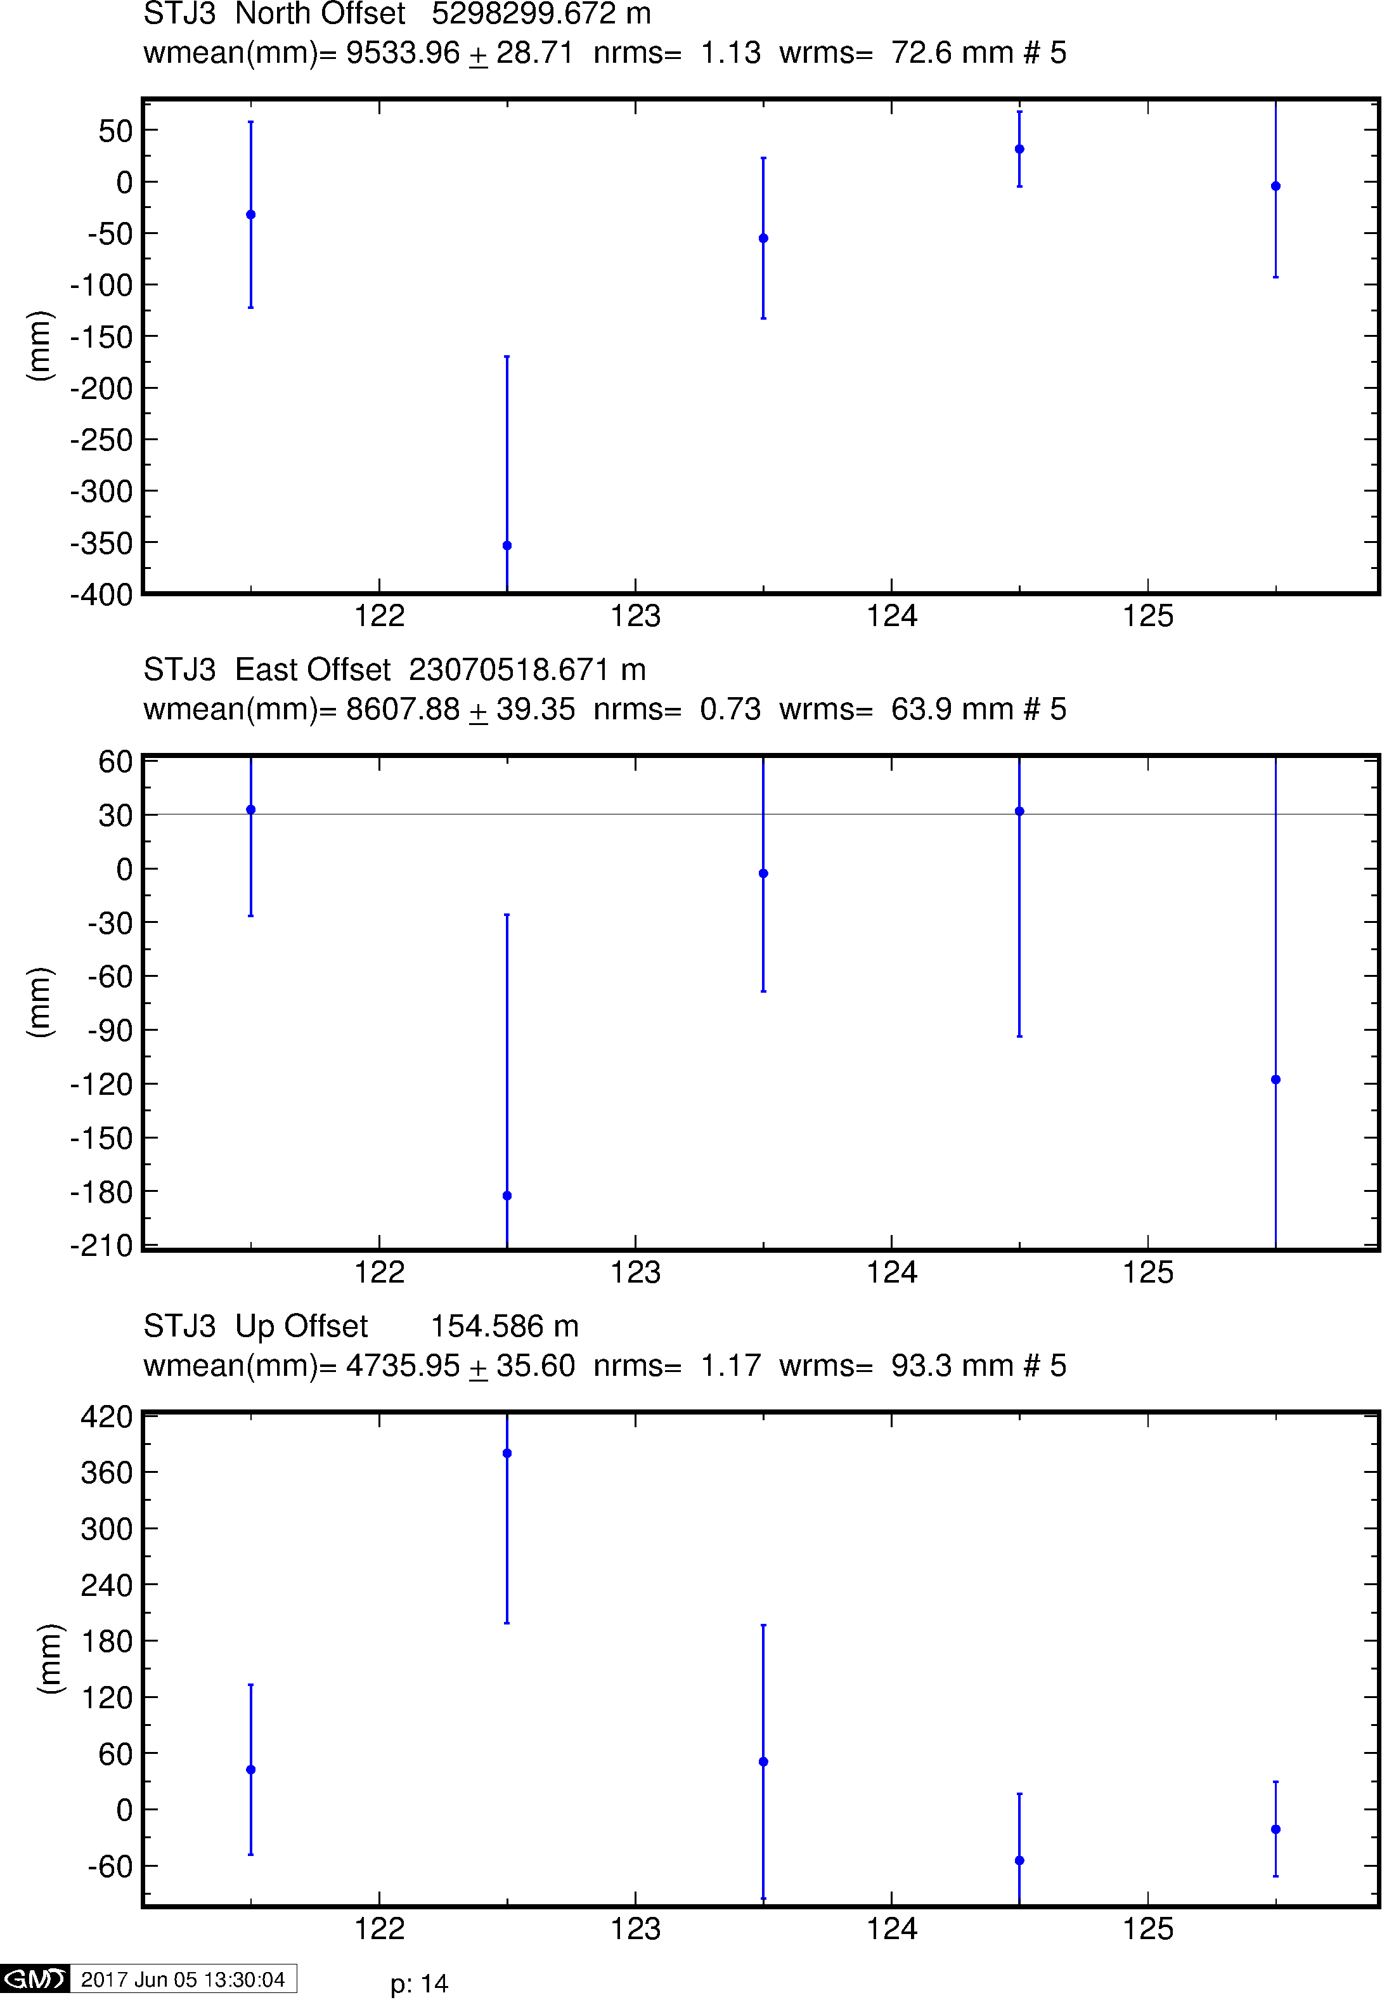
Example time series
GPS
Galileo
BeiDou

Slide 39
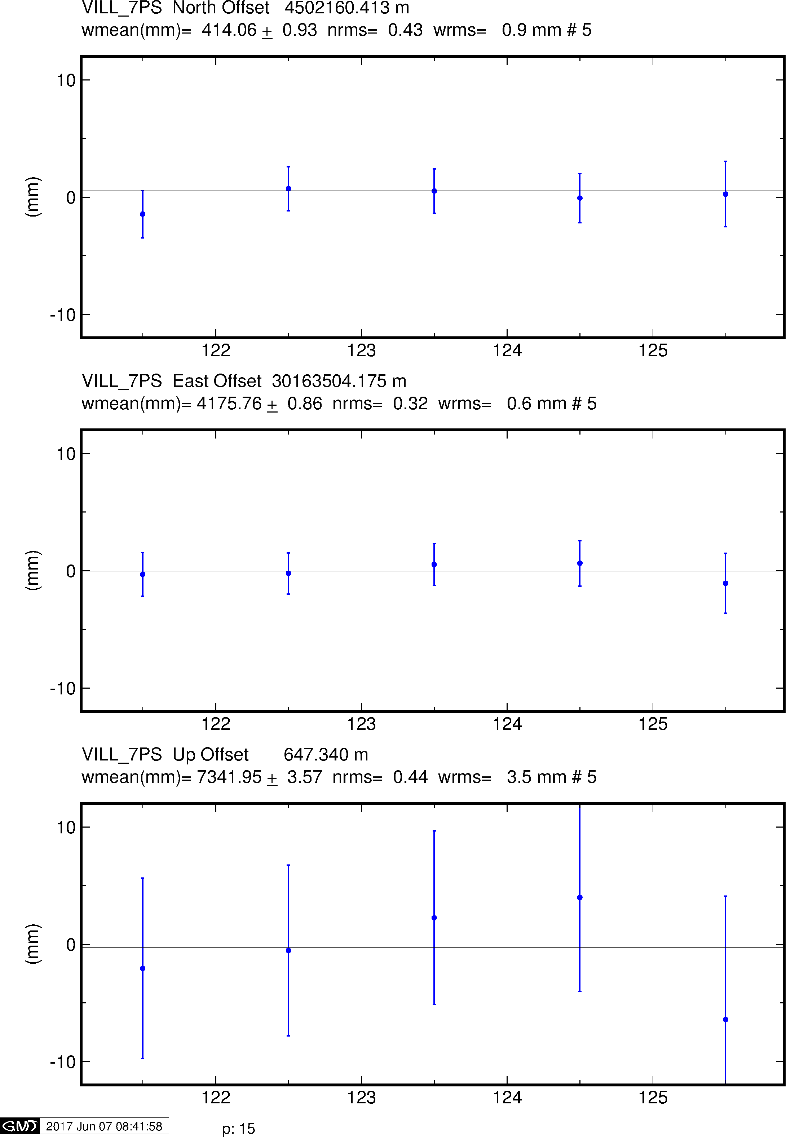
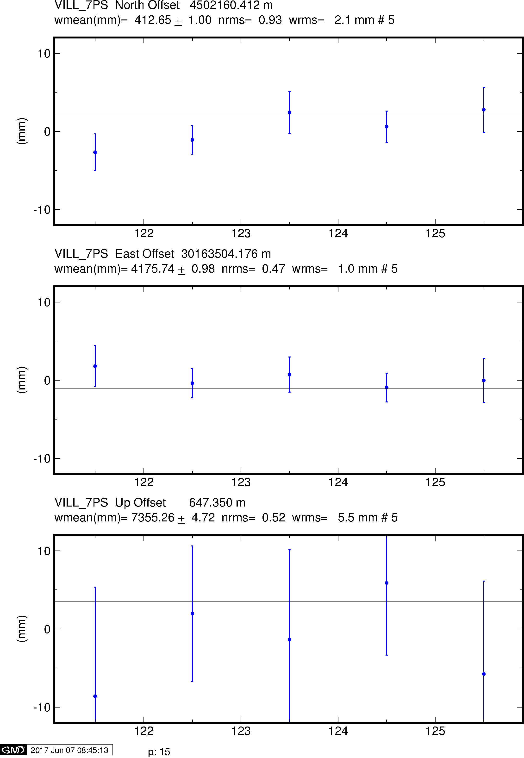
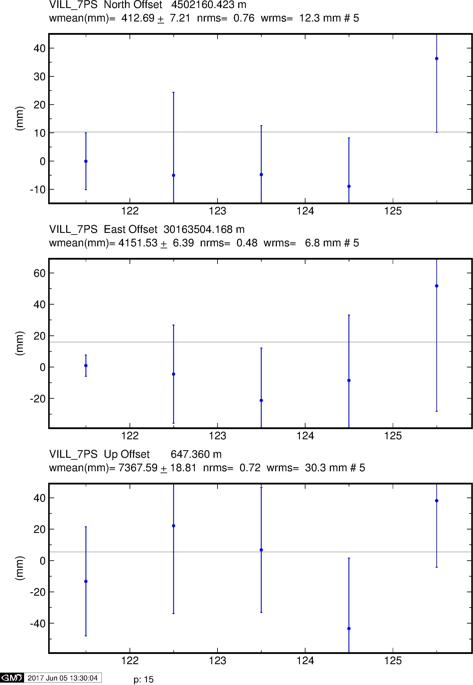
Example time series
GPS
Galileo
BeiDou

Slide 40
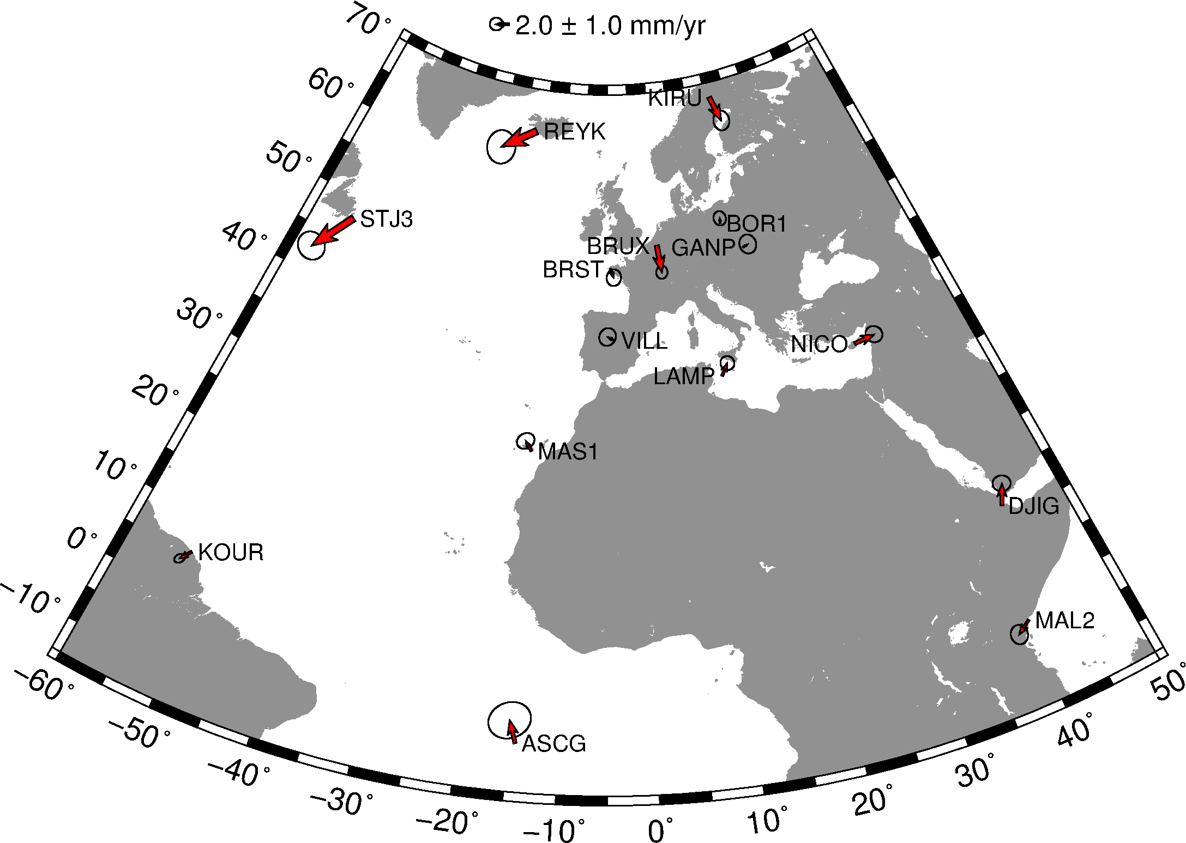
Position differences
(GPS versus Galileo)
Notes:
The wrms differences are 2.0 mm in N and 1.2 mm in E, with the stations near the centroid of the network generally (but not uniformly) better than those on the periphery, presumably reflecting orbital errors.

Slide 41
Initial impressions
Galileo has robust phase tracking and could, for small regional networks with good satellite coverage, now produce nearly GPS-quality results
The Beidou constelletion will need to be filled out significantly, expected by mid-2018
BeiDou also appears to be prone to single cycle slips, resulting in poor detection and cleaning of tracked phase
  This may be improved by tuning autcln.cmd

Slide 42
Other current limitations to GNSS
Antenna phase center offsets (PCOs) and variations (PCVs) for frequencies other than GPS’s L1 and L2 do not have calibrations yet and are not well known
  Affects accuracy of position and may increase phase misfit as a function of elevation and azimuth

Slide 43
Future developments
In addition to multi-GNSS data, the GPS system (and Galileo) now has many satellites that broadcast on three frequencies (L1, L2 and L5)
This creates the possibility of forming two additional types of linear combination (L1/L5 and L2/L5) beyond the usual LC (L1/L2)
Since the formation of the linear combination is a way to minimize the effect of the ionosphere,

Slide 44
Current limitations of GAMIT
Although GAMIT does have the ability to read RINEX 3 files, they must be named according to the RINEX 2 file naming convention in the rinex/ directory to be included in processing (see sh_rename_rinex3)
  i.e. ssssdddi.yyo where “ssss” is four-character site ID, “ddd” is ordinal date (day-of-year), “i” is session index and “yy” is two-digit year
Only dual (constant) frequency observations may be processed at any one time
track does not yet have the ability to read non-GPS data or RINEX 3 format files

Slide 45
Summary
GAMIT/GLOBK is now (as of 10.61) capable of processing almost all GNSS data, except
  GLONASS, which has variable frequencies and, as such, requires a redesign of the software’s structure and flow
  QZSS, which is a small, regional, high-altitude system of little use beyond the narrow design region or on a global scale (same is true of IRNSS, although this is coded)
GNSS data are available but few users are actually collecting or processing such data
As a result, global orbits are poorly constrained by ground stations with accurate coordinates in the terrestrial reference frame
  Satellite orbital models and antenna designs are less well known than GPS
  Many GNSSs other than GPS are in a similar “weak” state to where GPS was in the early 1990s before the advent of the IGS
It is difficult to predict at what time the other systems will enhance rather than degrade GPS results but we should see rapid improvement with the launch of more satellites and the expansion of the tracking network in the next 18 months
Notes:
Examination of the differences between analysis centers and comparison with SLR range residuals suggests that Glonass, Beidou, and Galileo orbits are about a factor of 2-4 worse than those for GPS.

Slide 46
Some suggested reading
Montenbruck, O., R. Schmid, F. Mercier, P. Steigenberger, C. Noll, R. Fatkulin, S. Kogure, and A. S. Ganeshan (2015), Adv. Space Res., 56, 1015–1029, doi:10.1016/j.asr.2015.06.019.

Slide 47
References
  Berglund, H., F. Blume, L. H. Estey, and A. A. Borsa (2010), The Effects of L2C Signal Tracking on High-Precision Carrier Phase GPS Positioning, Abstract G11B-0640 presented at 2010 Fall Meeting, AGU, San Francisco, Calif., 13-17 Dec.
  Blume, F., H. Berglund, and L. Estey (2012), The Effects of L2C Signal Tracking on High-Precision Carrier Phase GPS Positioning: Implications for the Next Generation of GNSS Systems, Abstract G52B-07 presented at 2012 Fall Meeting, AGU, San Francisco, Calif., 3-7 Dec. [http://acc.igs.org/trf/agu12_blume_l2c.pdf]
  http://kb.unavco.org/kb/article/the-effects-of-l2c-signal-tracking-on-high-precision-carrier-phase-gps-postioning-689.html
  Montenbruck, O., R. Schmid, F. Mercier, P. Steigenberger, C. Noll, R. Fatkulin, S. Kogure, and A. S. Ganeshan (2015), Adv. Space Res., 56, 1015–1029, doi:10.1016/j.asr.2015.06.019.

