Slide 1
Example 4:
Quick continuous station processing
This is an example of processing continuous stations by decimation to use only a single day per year to find an approximate rate of subsidence for an aquifer in the Central Valley of California
We will be considering the area south of Visalia, California, as described at https://www.nasa.gov/jpl/news/california-drought-20140225/
We will use specifically GPS observations only

Slide 2
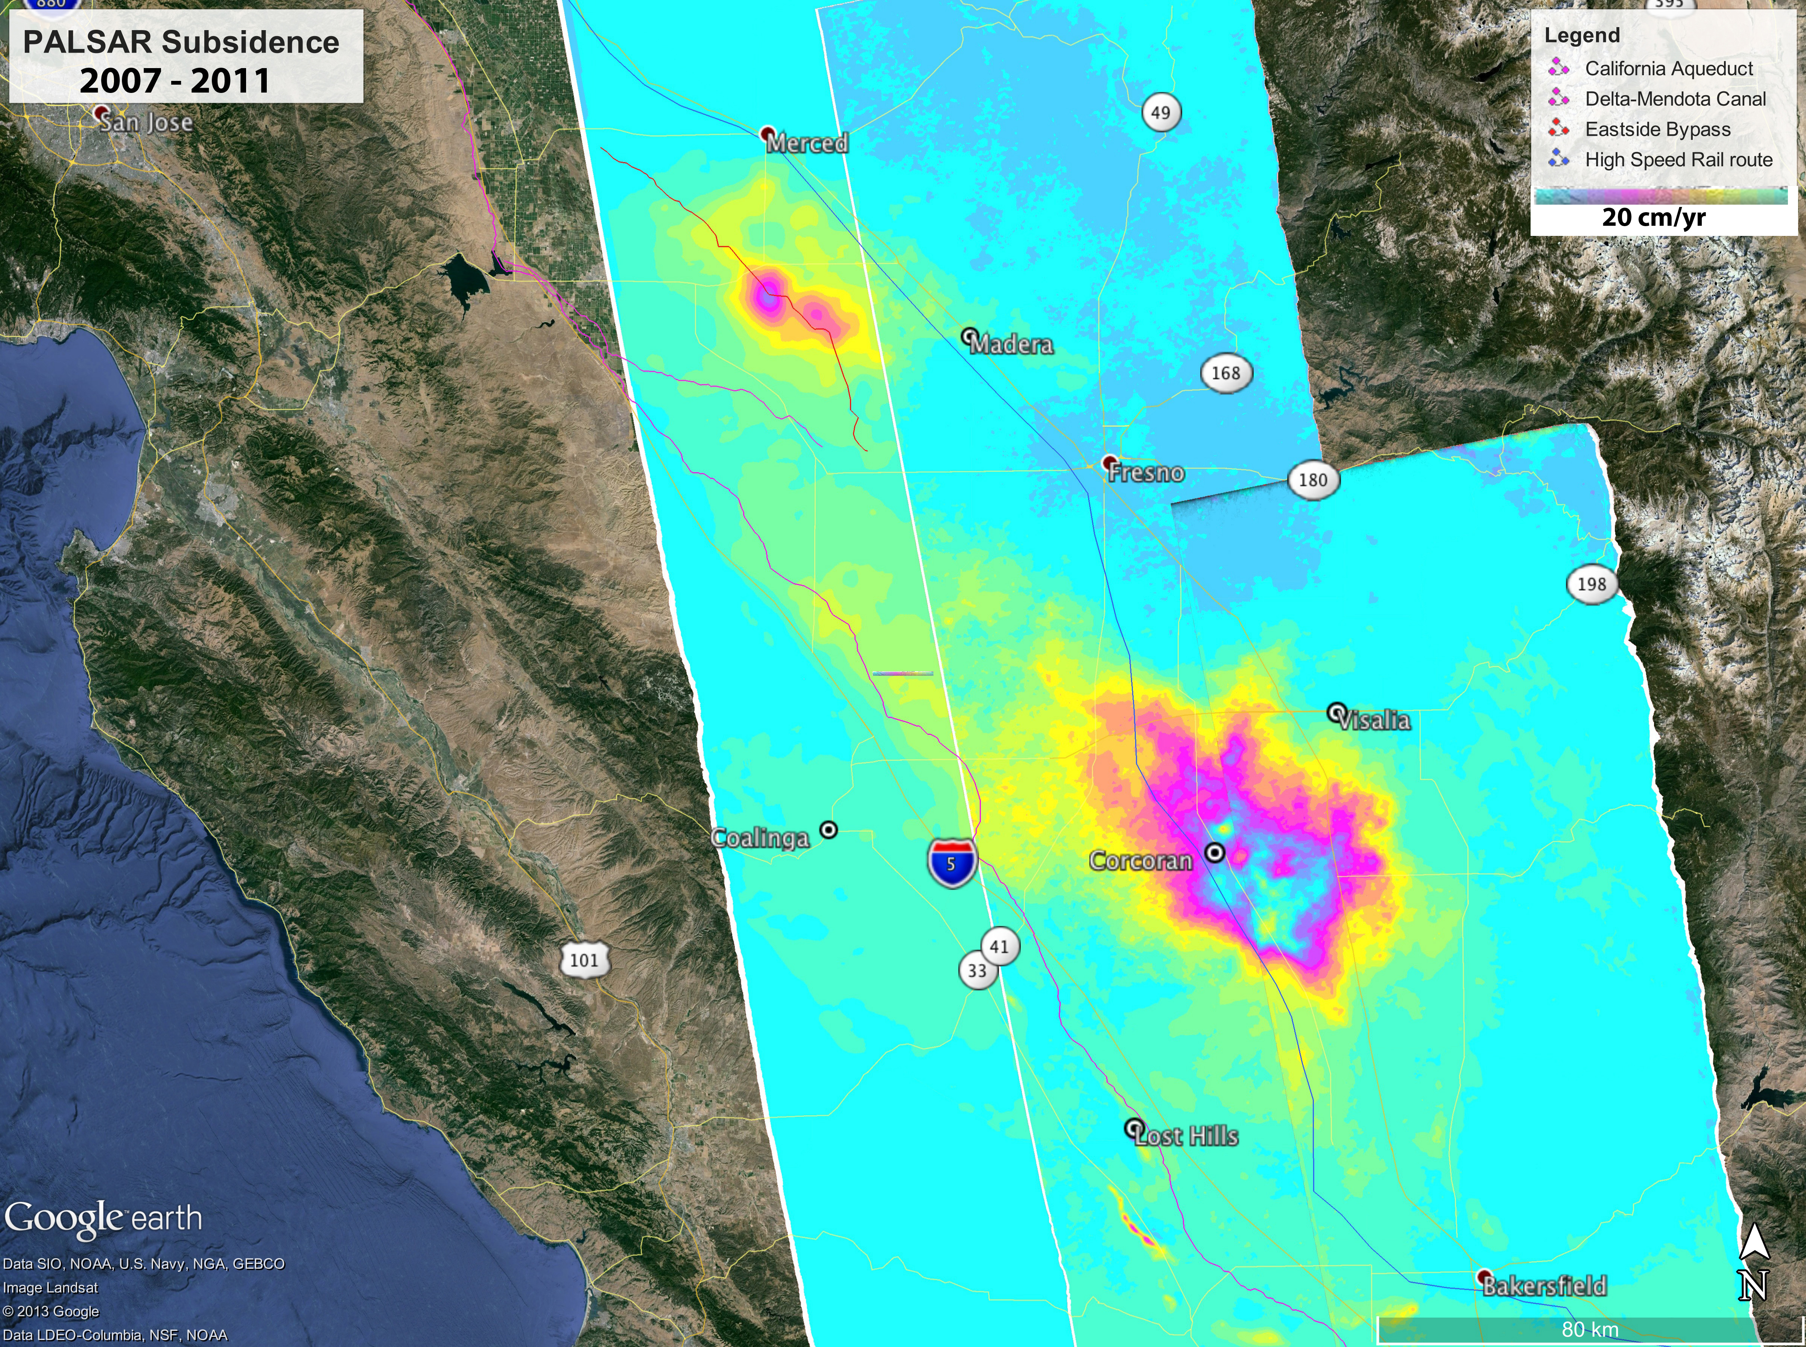
We will find and process local continuous GNSS sites, one day per year over the five-year period 2007 to 2011, as noted in the web article
Region of interest
https://www.nasa.gov/jpl/news/california-drought-20140225/

Slide 3
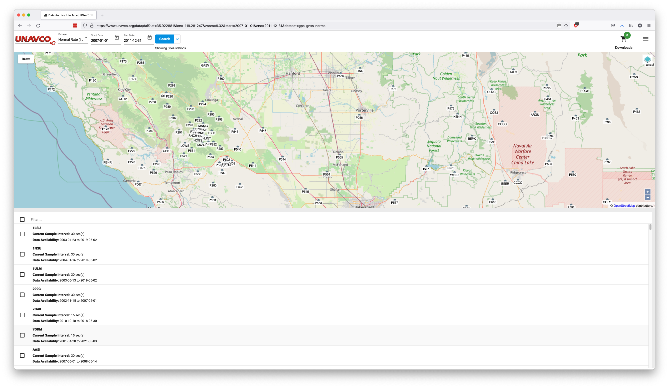
https://www.unavco.org/data/dai
Region of interest
Note local sites to process:
LIND
P056
P544
P545
P547
P564
P565
P566

Slide 4
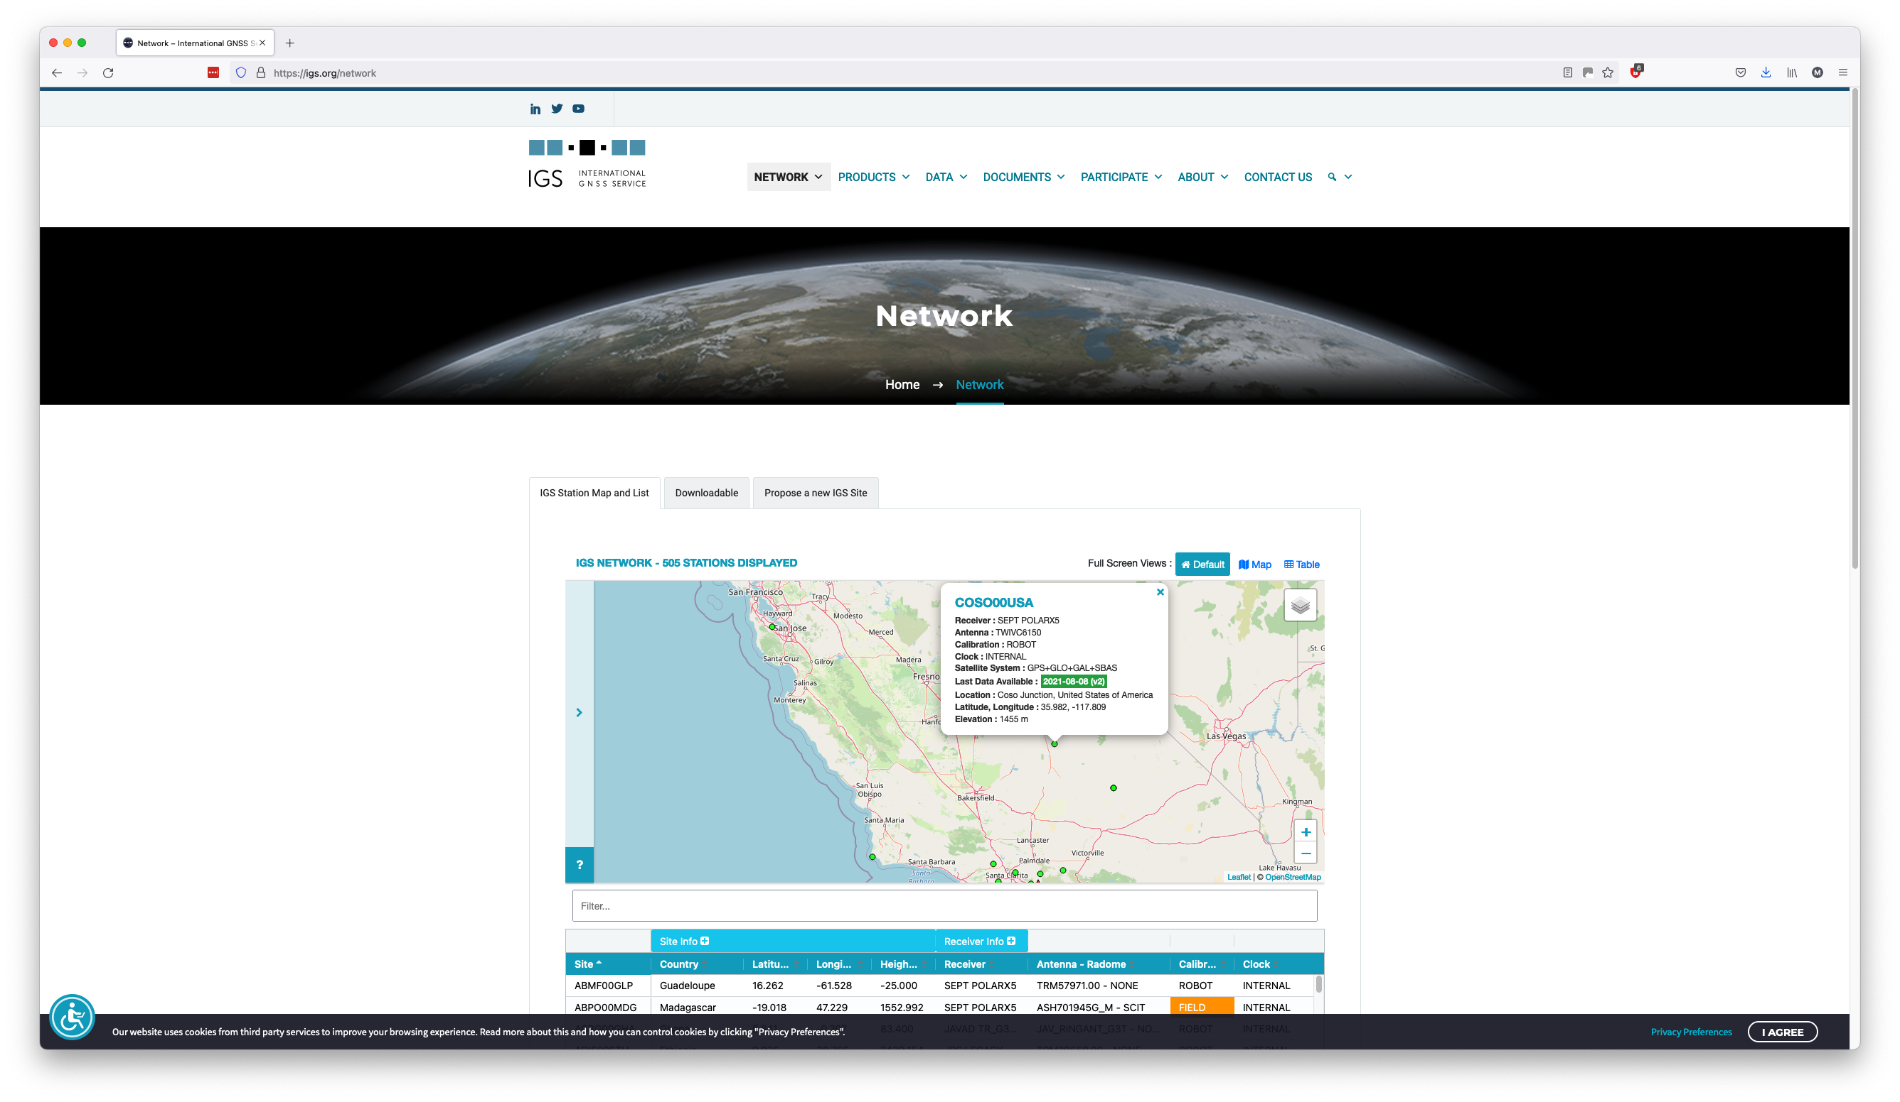
https://igs.org/network
Note regional IGS sites to process (to help define reference frame):
COSO
GOLD
SFDM
STFU
VNDP

Slide 5
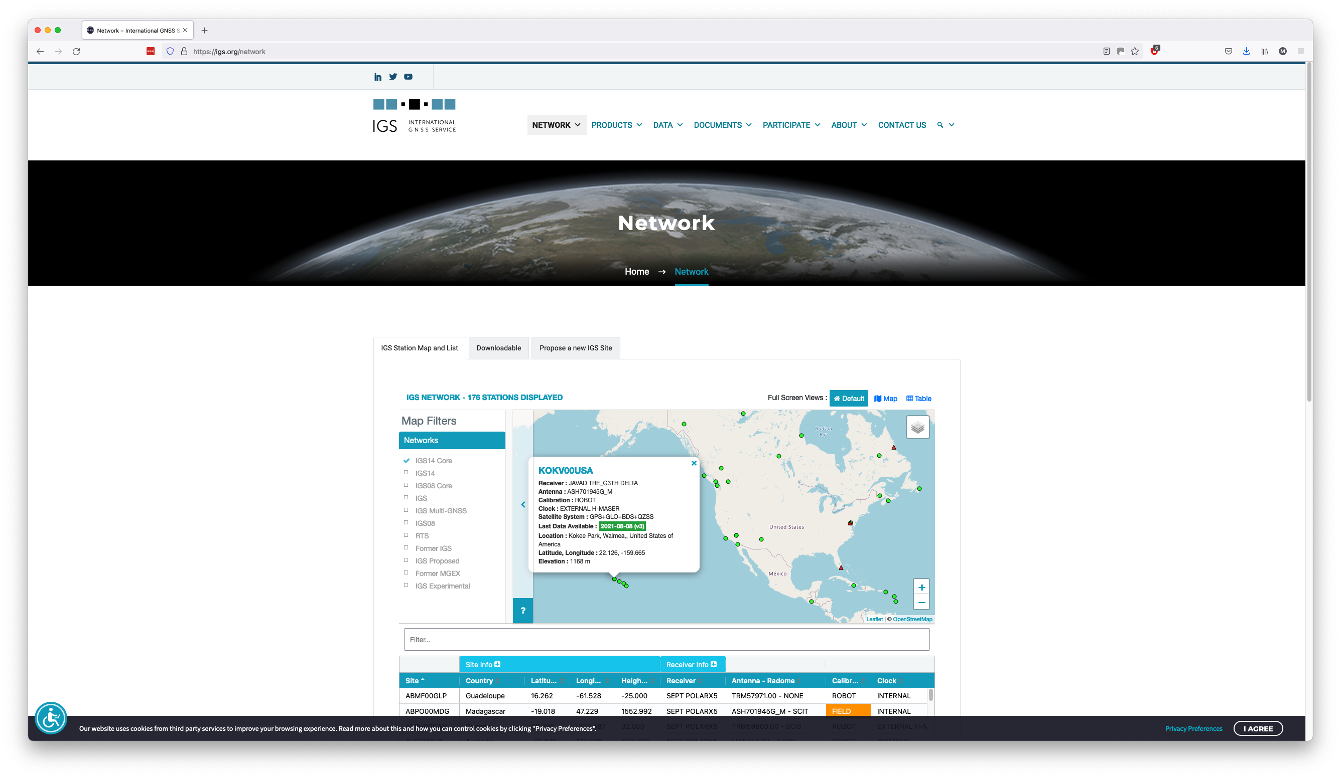
https://igs.org/network
Note global IGS sites to process (to help define reference frame):
ALBH
DRAO
FLIN
GODZ
HNLC
KOKV
MAUI
MKEA
MONP
PIE1

Slide 6
Prepare the main processing directory
Choose where to process and make a top-level directory, e.g.
mkdir ~/Desktop/subsidence/
We are going to be processing multiple years, each of which requires a separate sub-directory for GAMIT to process, e.g.
mkdir ~/Desktop/subsidence/{2007,2008,2009,2010,2011}
Also make a top-level tables directory where tables that are common across all years can be created and kept, e.g.
mkdir ~/Desktop/subsidence/tables/

Slide 7
Prepare the metadata files (sites.defaults)
Start by defining the sites, chosen to process in the previous step, in sites.defaults using the default file as a template, e.g.
cd ~/Desktop/subsidence/tables/
cp -p ~/gg/tables/sites.defaults .
Now edit the file accordingly for the sites to include, using any four-character experiment name (I choose “subs” for subsidence)
  All sites are available from public archives, so we will set the “ftprnx” flag to instruct sh_gamit to download them automatically
sites.defaults will look like the right-hand side:
  Note the first character of instruction lines must be a whitespace character otherwise the line is considered a comment
all_sites subs xstinfo
# Local sites
lind subs ftprnx
p056 subs ftprnx
p544 subs ftprnx
p545 subs ftprnx
p547 subs ftprnx
p564 subs ftprnx
p565 subs ftprnx
p566 subs ftprnx
# Regional IGS sites
coso subs ftprnx
gold subs ftprnx
sfdm subs ftprnx
stfu subs ftprnx
vndp subs ftprnx
# IGS14 sites
albh subs ftprnx
drao subs ftprnx
flin subs ftprnx
godz subs ftprnx
hnlc subs ftprnx
kokv subs ftprnx
maui subs ftprnx
mkea subs ftprnx
monp subs ftprnx
pie1 subs ftprnx

Slide 8
Prepare the metadata (station.info)
All sites are available from public archives, so there’s a good chance GAMIT/GLOBK already distributes the necessary station information
cd ~/Desktop/subsidence/tables/
sh_upd_stnfo -ref ~/gg/tables/station.info -l sd
Now verify that all sites are present, e.g. visually or using grep
If everything is present, move the “.new” file to the standard name
mv station.info.new station.info

Slide 9
Prepare the metadata (“.apr”-file)
Again, all sites are available from public archives, so there’s a good chance GAMIT/GLOBK already distributes the necessary station information
So verify that all sites are present in the default a priori coordinate file (~/gg/tables/igb14_comb.apr)
A few NOTA stations (P056, P544, P547, P564, P565 and P566) are missing, so we could either:
  Leave their a priori coordinates to be calculated by sh_gamit
  Download GAGE’s products, in which they are present, from https://www.unavco.org/data/gps-gnss/derived-products/derived-products.html (under “Direct File Access”, “File Server”, “GPS Site Coordinates”), then write coordinates for these sites to a file (e.g. subs.apr) and edit tables/process.defaults to define our own “.apr”-file (e.g. with “set aprf = subs.apr”) so that sh_gamit merges it with tables/lfile. before processing

Slide 10
Process using sh_gamit
For one day each year, say day 100, process the data
cd ~/Desktop/subsidence/2007/
sh_setup -yr 2007
cp -p ../tables/sites.defaults tables/
cp -p ../tables/station.info tables/
cp -p ../tables/subs.apr tables/
cp -p ../tables/process.defaults tables/
sh_gamit -d 2007 100 -expt subs -orbit igsf
Then do the same for 2008, 2009, 2010 and 2011 in their respective sub-directories of the main processing directory
  This can be done simultaneously to shorten the time taken to process everything
You will see a lot of output to the screen showing what GAMIT is doing, which can be saved to a file using redirection, e.g. “>& sh_gamit.log”, at the end of the sh_gamit command

Slide 11
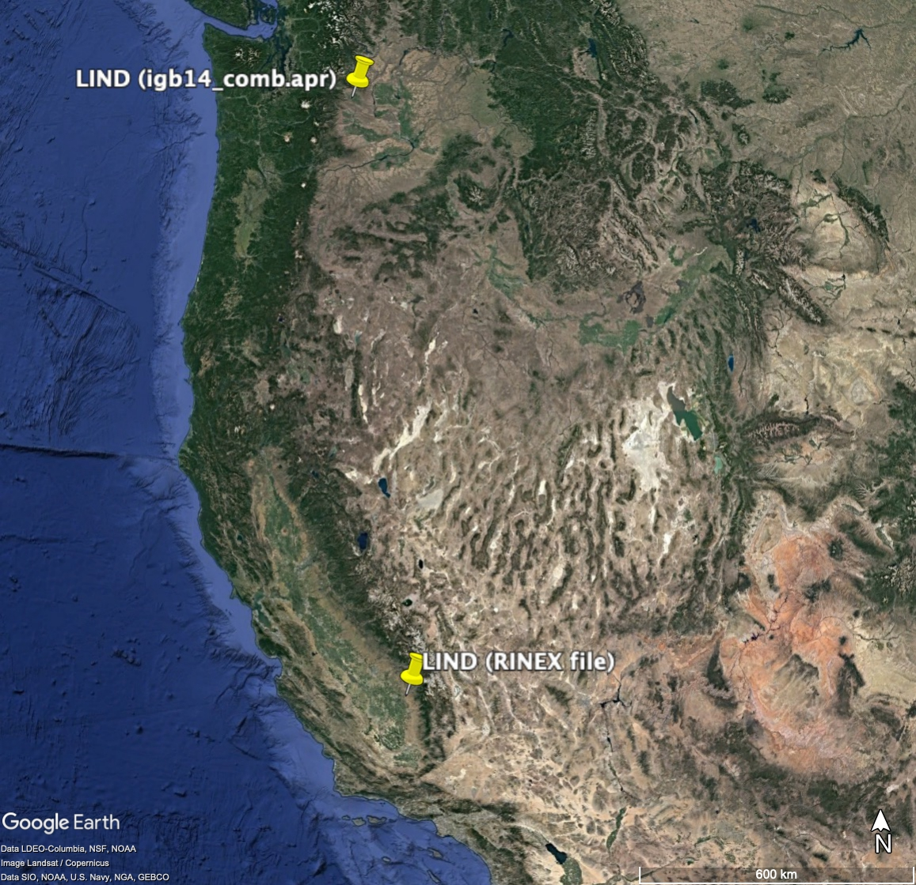
Any warnings or errors so far?
You will notice many “RCLOCK” messages when model is calculating synthetic observations for site LIND, which is listed as excluded in the sh_gamit summary files:
List of sites without Prefit coordinate solutions:
LIND NoPrefit
List of sites without Postfit coordinate solutions:
LIND NoPostfit
This is usually a sign of poor a priori coordinates, which manifest as clock errors (because time is distance with ranging measurements)
Double-checking back over the “.apr”-file, we see that the a priori coordinates from LIND come from the NGS17P03 solution but appear to be for a site nearer Ellensburg, Washington, not Visalia, California

Slide 12
Iterate with corrected a priori coordinates
We need to be careful to remove the bad LIND coordinates from the lfile. because this is a site ID clash, e.g. remove or comment LIND from 2007/tables/lfile., 2008/tables/lfile., etc.
We also need to be careful that the other LIND does not appear in any file defining discontinuities and which version of site coordinates to use for given periods, that relate to the other LIND
  It does, so we need to make a local copy of the accompanying “.eq”-file and link it to the generic file name used by GAMIT (tables/eq_rename)
cp -p ~/gg/tables/igb14_comb.eq tables/
ln -s -f tables/igb14_comb.eq tables/eq_rename
then edit tables/igb14_comb.eq to remove or comment out any records for LIND, e.g. “#rename LIND LIND_2PS 1998 07 27 00 00 2100 01 01 00 00”
We already have RINEX files and broadcast navigation files downloaded from the first attempt, so calculate a priori coordinates using those and a nearby site with accurate known coordinates for reference, e.g.
cd ~/Desktop/subsidence/2007/
sh_crx2rnx -f rinex/lind1000.07o.gz rinex/gold1000.07o.gz
sh_rx2apr -site rinex/lind1000.07o -nav brdc/brdc1000.07n -ref rinex/gold1000.07o -apr ~/gg/tables/igb14_comb.apr
cat lind.apr >> ../tables/subs.apr
Then repeat partially the steps in slide 10 for 2007, 2008 and 2009 (LIND is not available in 2010 and 2011), after moving or removing the first run’s output directory, e.g.
cd ~/Desktop/subsidence/2007/
cp -p ../tables/subs.apr tables/
mv 100 100.old
sh_gamit -d 2007 100 -expt subs -orbit igsf

Slide 13
Prepare h-files for GLOBK
We need to convert plain text (ASCII) h-files output from GAMIT to binary h-files for input to GLOBK
The h-files are written by GAMIT to each day sub-directory in the year directories, so we could be explicit for the one day we processed, e.g.
htoglb 2007/glbf /dev/null -a 2007/100/hsubsa.07100
or we could use a more generic command if many days were processed, e.g.
htoglb 2007/glbf /dev/null -a 2007/???/hsubsa.07???
Repeat one of these commands for each year

Slide 14
Prepare GLOBK command files
Create local copies of the globk and glorg command files in a solution directory
mkdir ~/Desktop/subsidence/gsoln/
cd ~/Desktop/subsidence/gsoln/
cp -p ~/gg/tables/globk.cmd ~/gg/tables/glorg.cmd .
Add our local All_CWU_igs14.apr file after the default ~/gg/tables/igb14_comb.apr, in both the newly copied gsoln/globk.cmd and gsoln/glorg.cmd files, so the correct LIND coordinates in the former do not get overwritten by the wrong ones in the latter, e.g.
# Optionally add additional apr files for other sites
apr_file ../tables/subs.apr
We also need to be sure that the other LIND does not appear in any file defining discontinuities (“eq_file” option in globk.cmd)
  It does, so we need to edit globk.cmd to use the local copy instead and increase tolerance for preliminary coordinates
eq_file ../tables/igb14_comb.eq
We are processing some NOTA stations and GAMIT/GLOBK also distributes GAGE control files in tables/, so let’s add some appropriate files defining known discontinuities, e.g.
# Optionally add a second eq_file for analysis-specific renames
eq_file ~/gg/tables/All_PBO_ants.eq
eq_file ~/gg/tables/All_PBO_unkn.eq
eq_file ~/gg/tables/All_PBO_eqs.eq

Slide 15
Create time series from GAMIT results
We will generate time series for the whole period of processing with one glred command, which runs globk once per session to create individual data points at each time
We do this in the top-level multi-year solution directory by listing the files we wish to include in a “.gdl”-file (global directory listing) and running glred with that list, e.g.
cd ~/Desktop/subsidence/goln/
ls ../20??/glbf/h*_subs.glx > subs.glx.gdl
glred 6 glred_20210810.prt glred_20210810.log subs.glx.gdl globk.cmd
The output file names (glred_20210810.prt, which will become glred_20210810.org after glorg is run by glred to define the reference frame, and glred_20210810.log) are arbitrary but we recommend some type (“glred” or “rep” for repeatability, i.e. time series) and date identifier

Slide 16
Create some plots for viewing (GMT)
We would like to view the results, so let’s plot the time series and ask the plotting script, sh_plot_pos, to do some basic analysis for us, like determine the rates, using the same discontinuities files that we included in globk.cmd, e.g. (note the line wrap)
sh_plot_pos -f glred_20210810.org -k -t -r -u -b ~/gg/tables/igb14_comb.eq ~/gg/tables/All_PBO_ants.eq ~/gg/tables/All_PBO_unkn.eq -e ~/gg/tables/All_PBO_eqs.eq -d _20210810
This will generate a series of “.pos”-files from the “.org”-file output by glred in a pos_20210810/ directory and a series of plots of those “.pos”-files, with velocities estimated, in a plots_20210810/ directory
  The plots are PostScript

Slide 17
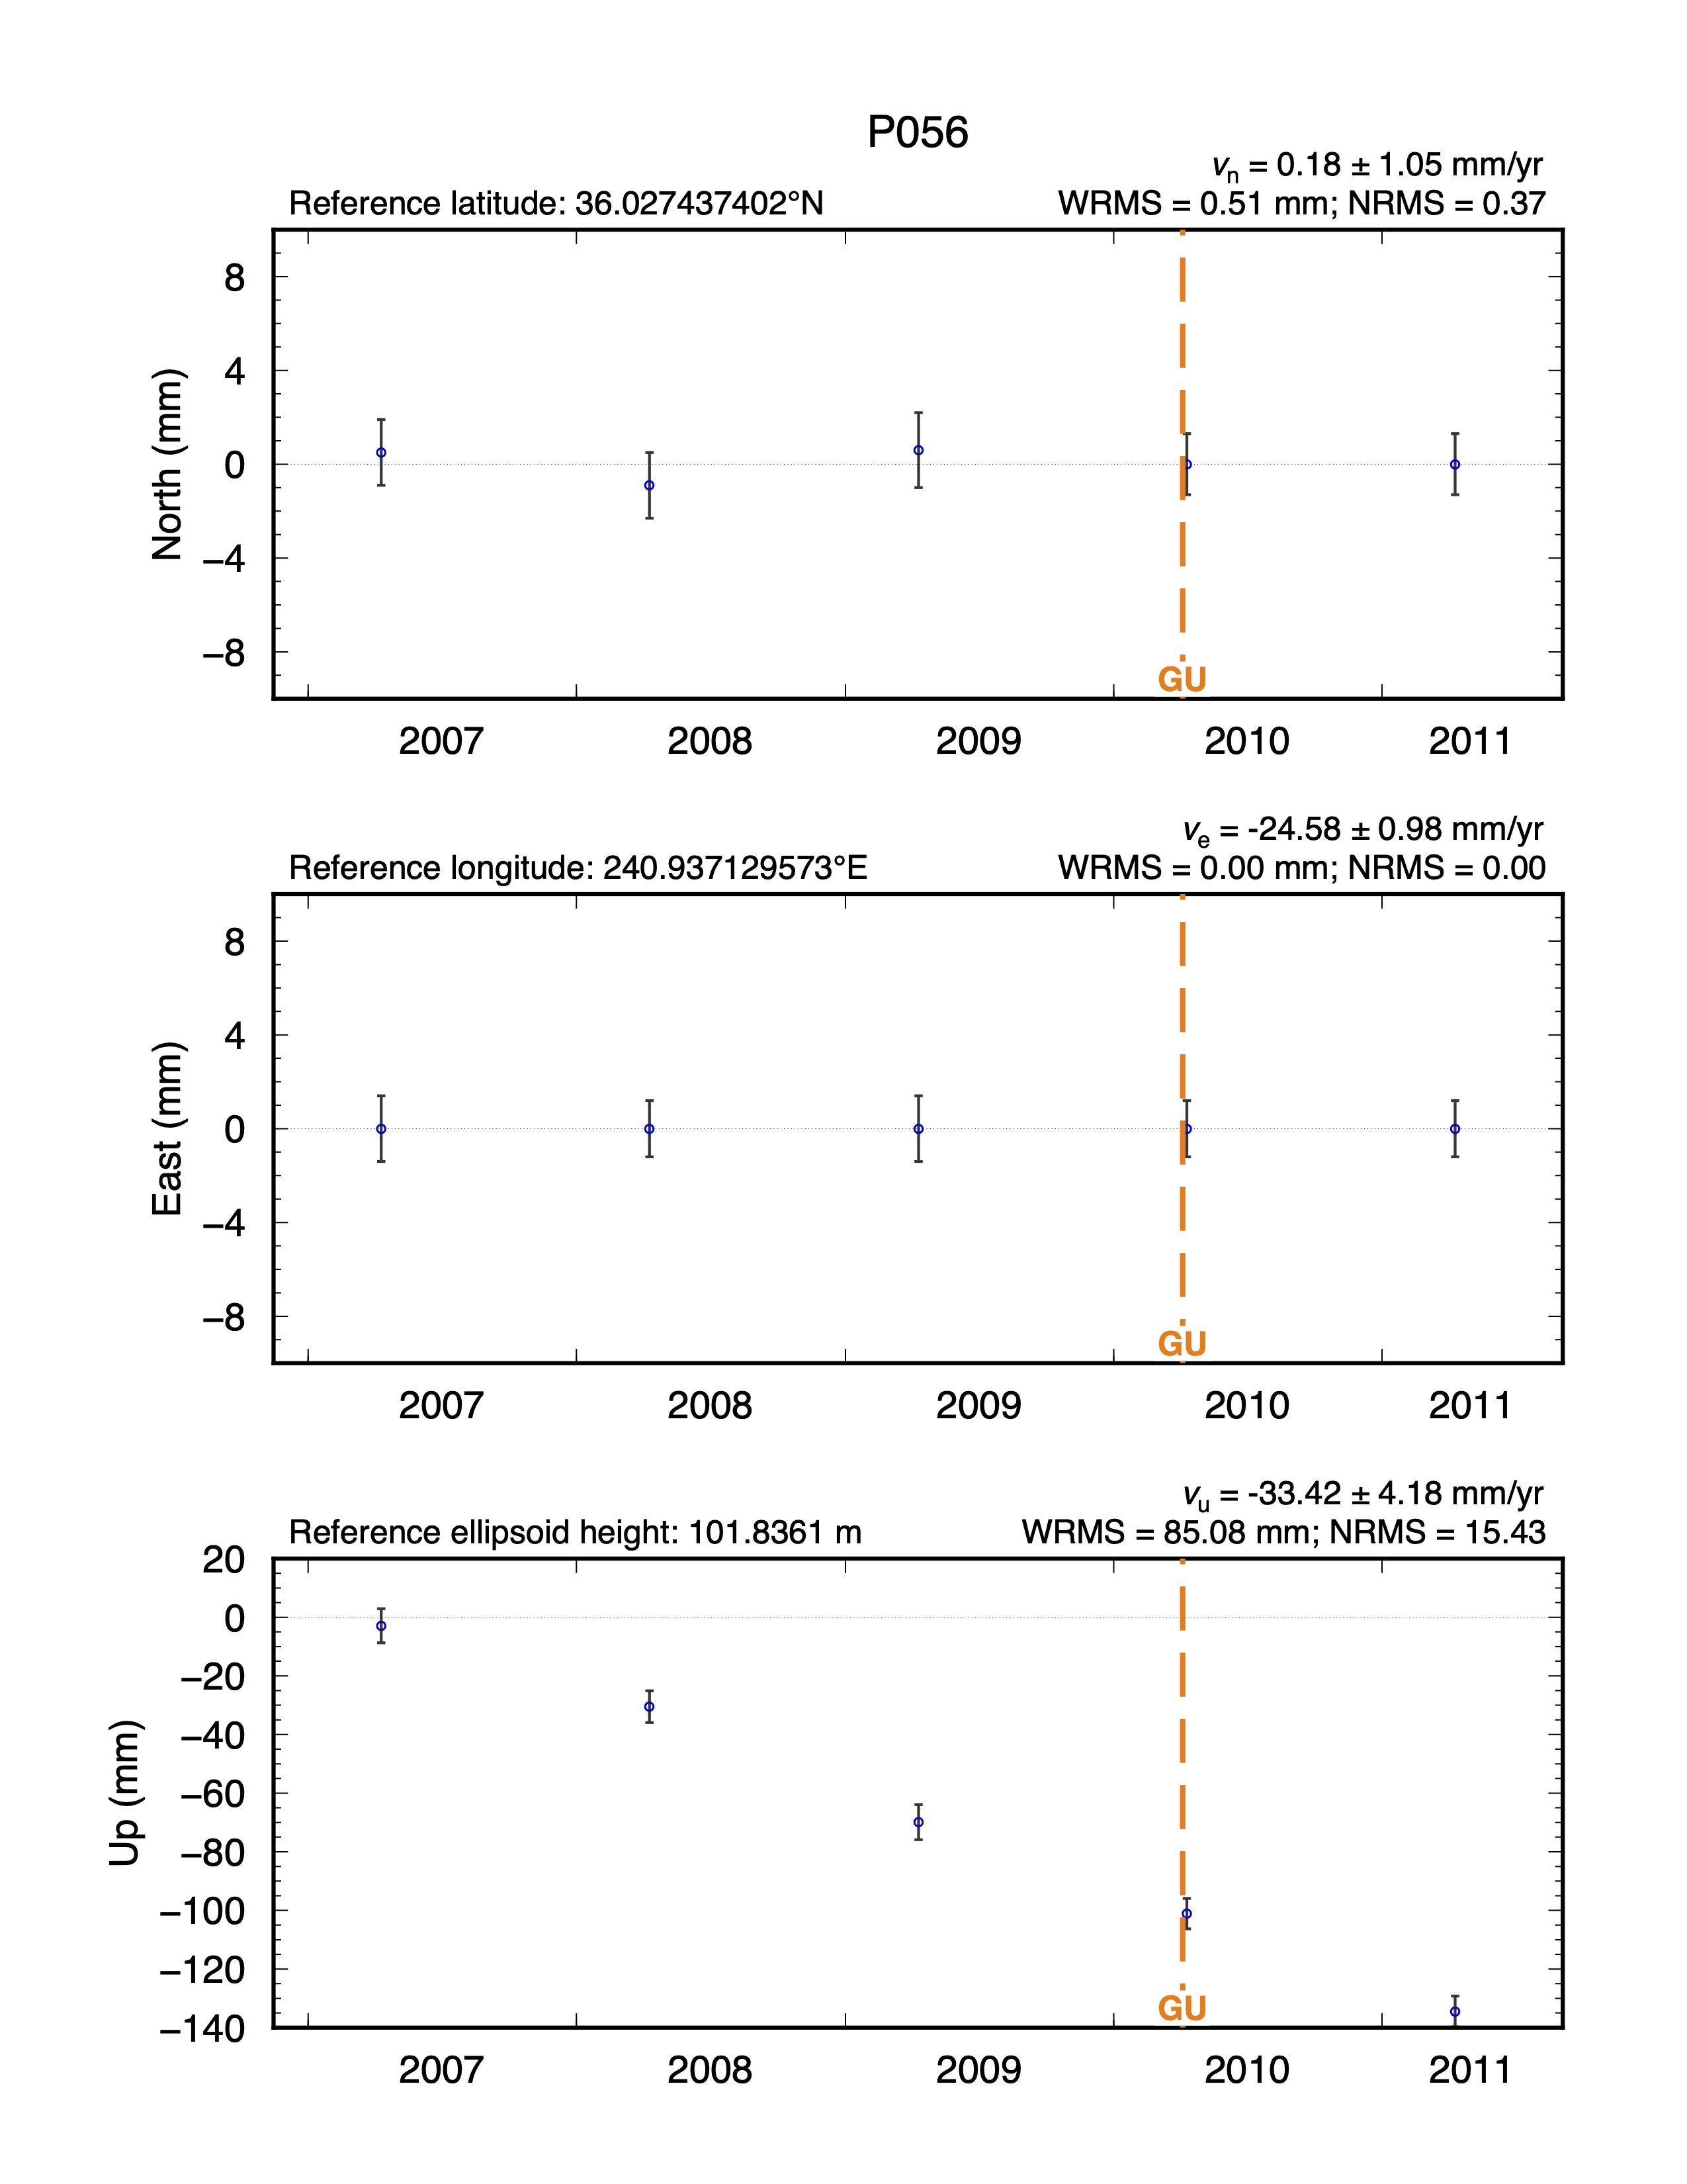
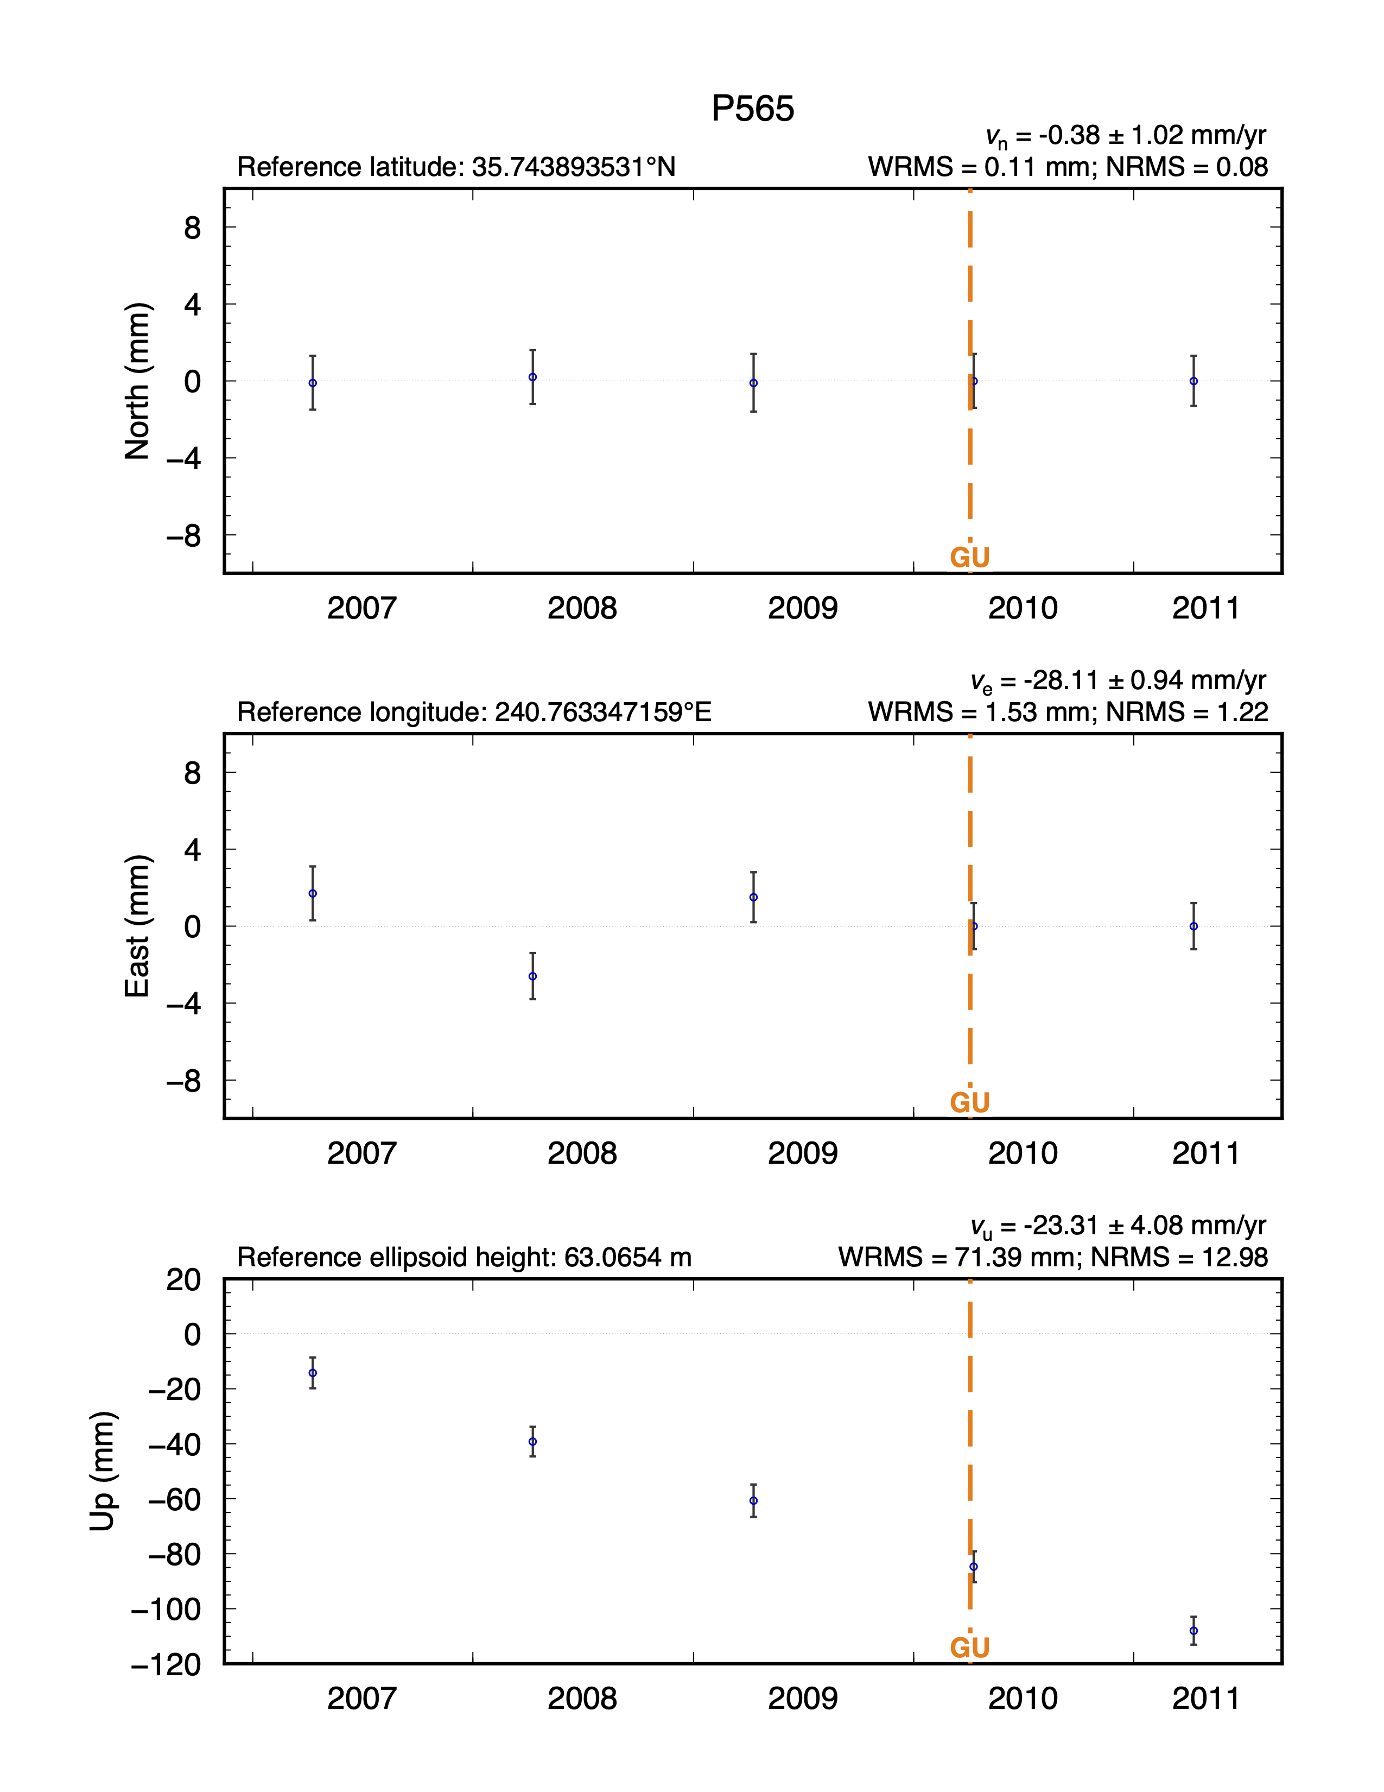
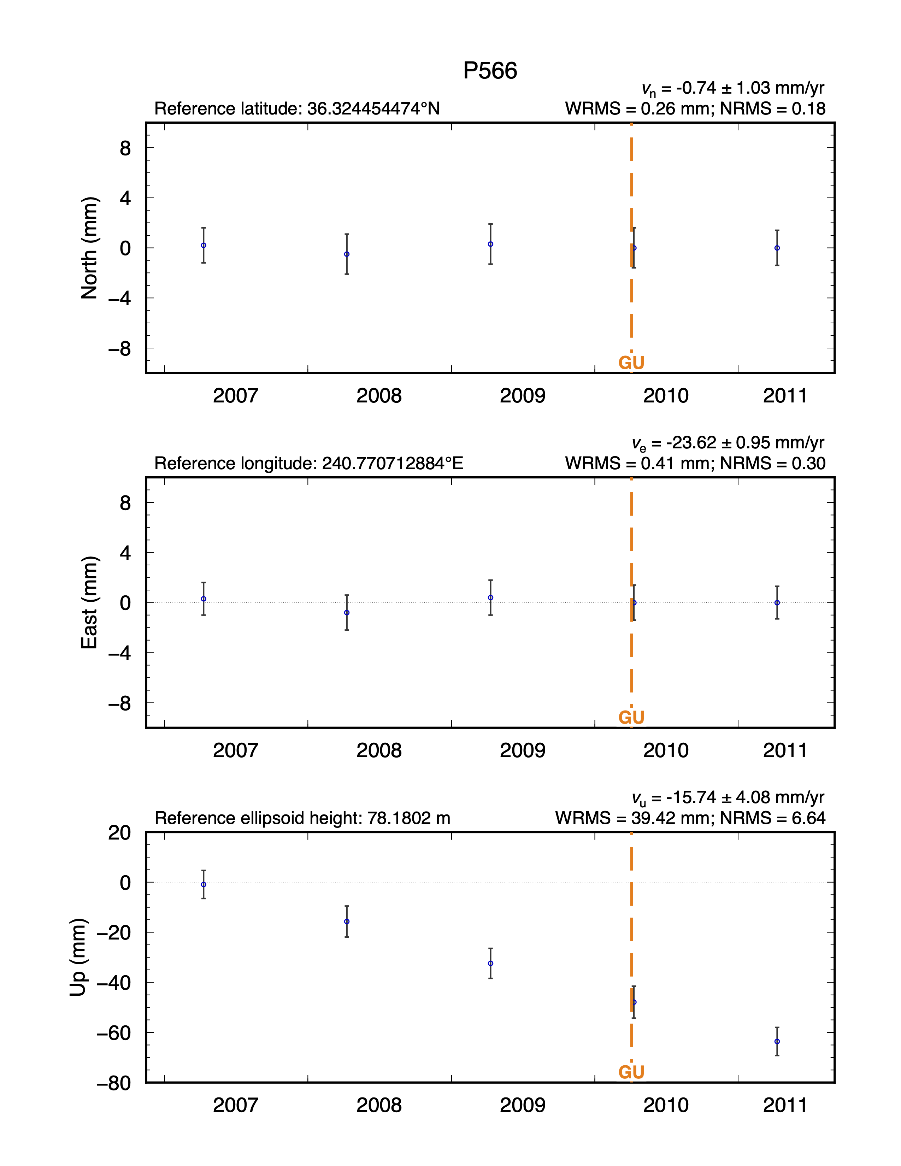
Orange lines represent earthquakes, defined in the “.eq”-files we provided in both globk.cmd and to the sh_plot_pos command, that may be close enough to affect the site; other discontinuities appear in purple
All rates are relative to ITRF2014 because we did not use any keyword at the end of the glred command in slide 15

Slide 18
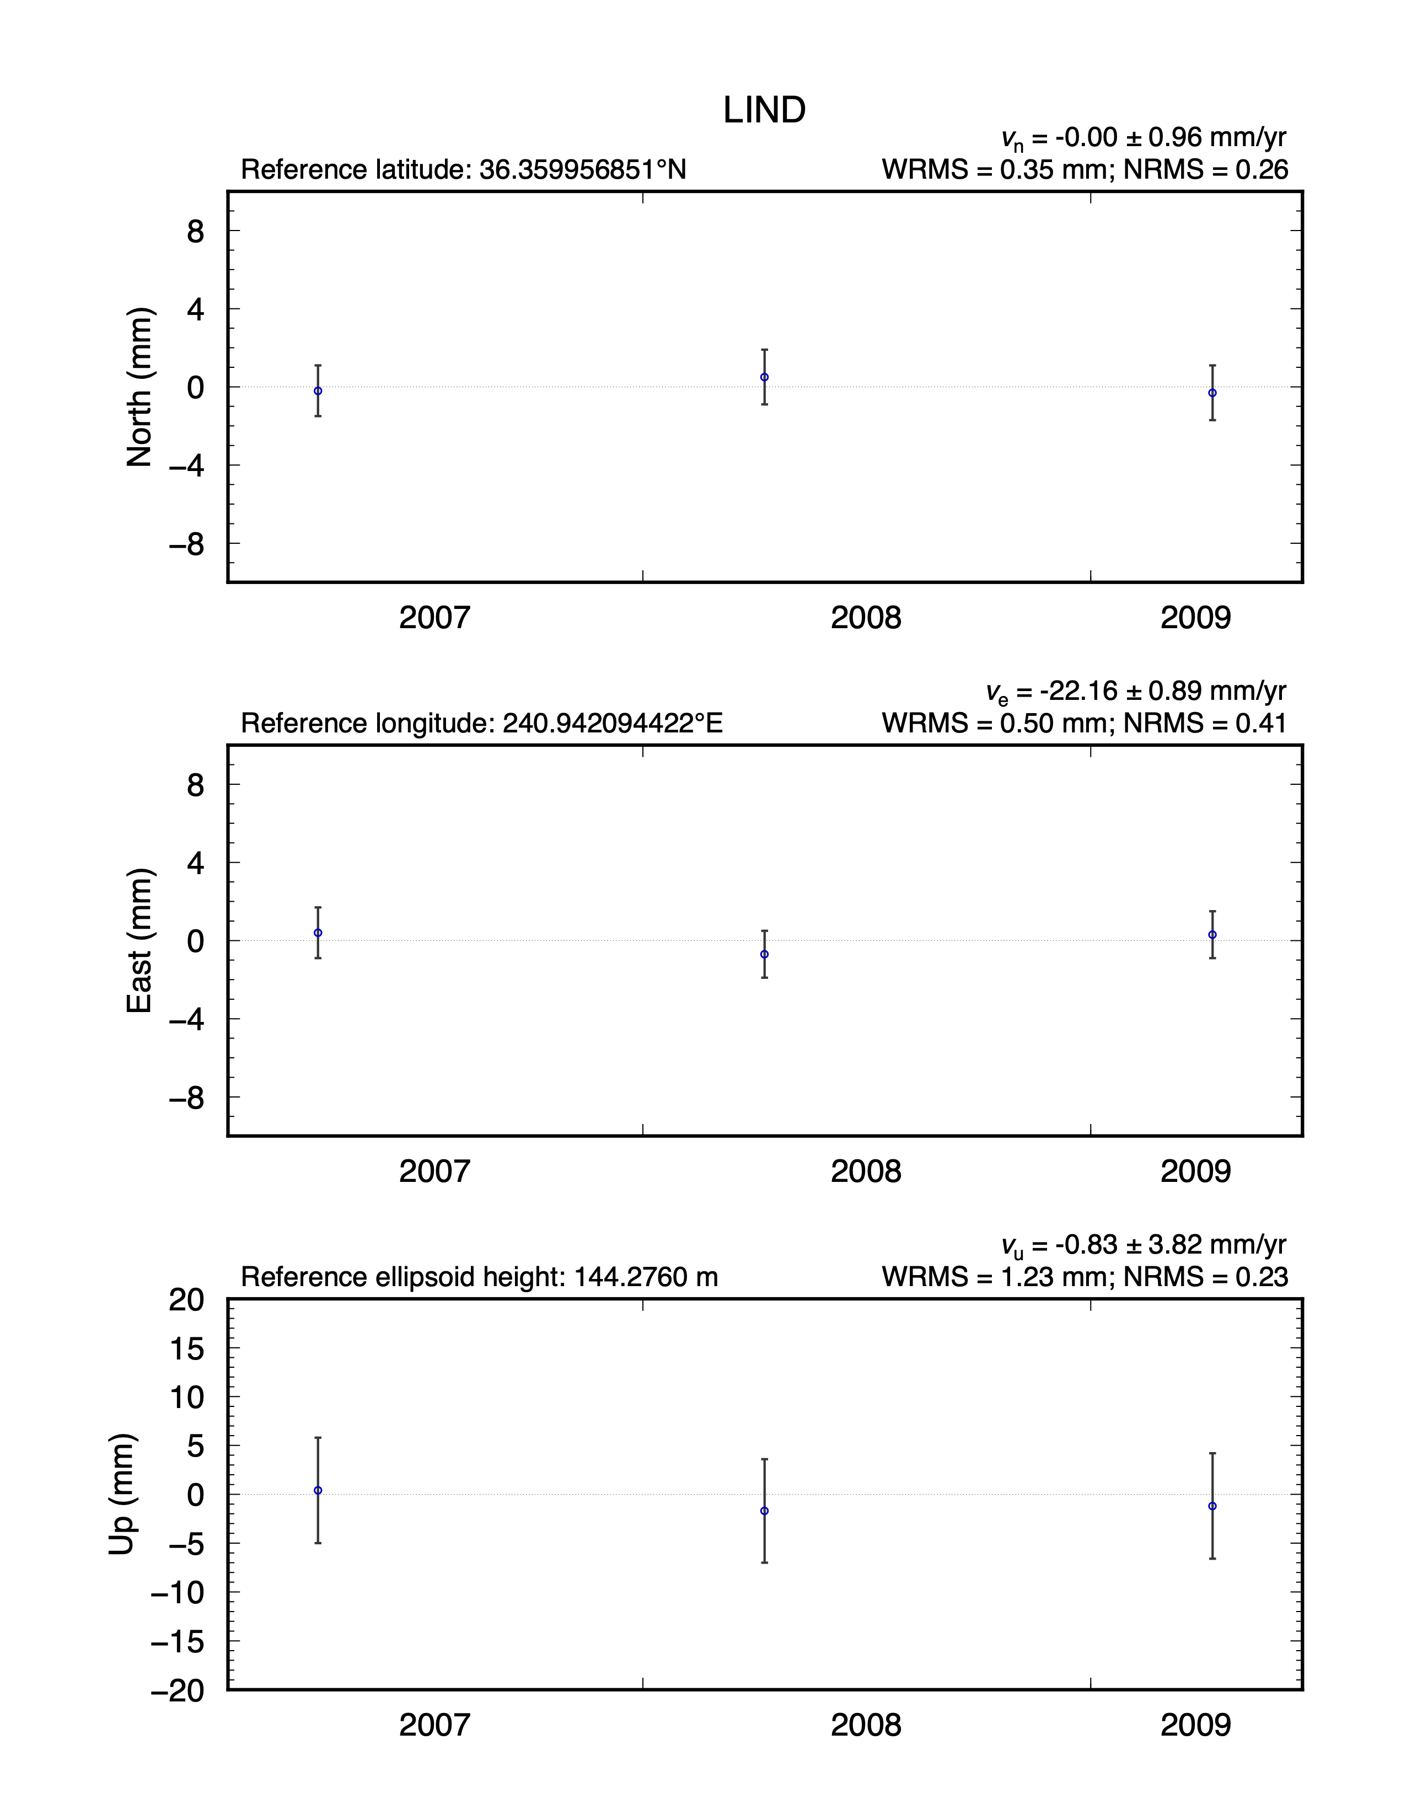
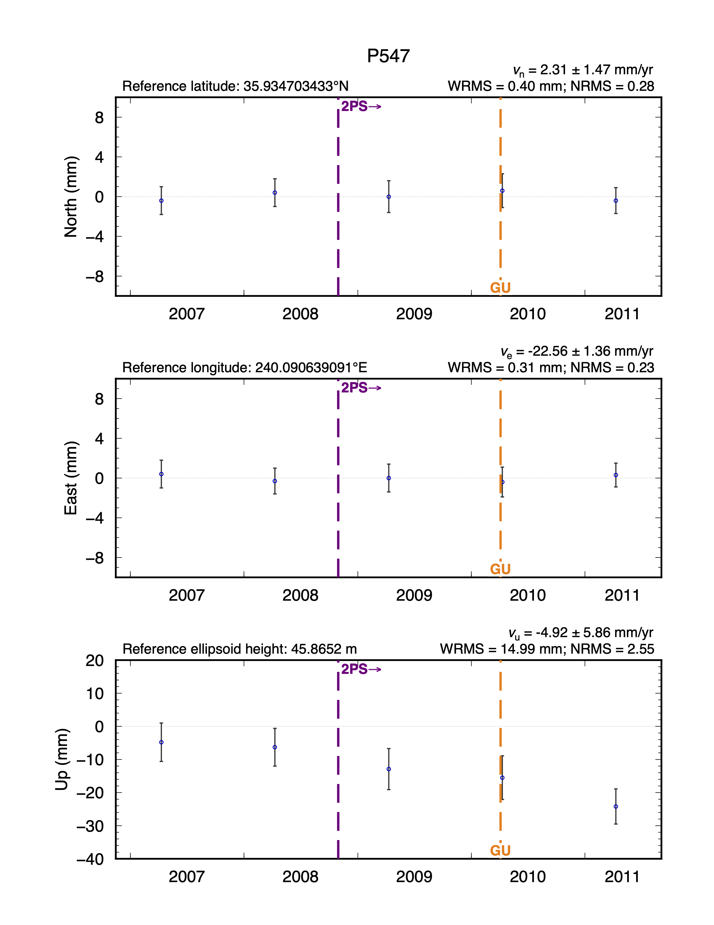

Orange lines represent earthquakes, defined in the “.eq”-files we provided in both globk.cmd and to the sh_plot_pos command, that may be close enough to affect the site; other discontinuities would appear purple
All rates are relative to ITRF2014 because we did not use any keyword at the end of the glred command in slide 15

Slide 19
What was done for you
This example was straightforward because a lot of information was predefined
  Equipment records in the default station.info file
  Coordinates in the default ~/gg/tables/igb14_comb.apr file and a secondary “.apr”-file ~/gg/tables/subs.apr using coordinates from GAGE
  Discontinuities affecting the sites in the default ~/gg/tables/igb14_comb.eq and GAGE’s ~/gg/tables/All_PBO_*.eq files
Normally this takes more work by the user to record, define and iterate the analysis
We did have to deal with the site ID clash of LIND and updating its coordinates accordingly

