Slide 1
GAMIT/GLOBK In A Day*
M. Floyd and T. Herring
Massachusetts Institute of Technology
GAGE/SAGE Science Workshop Pre-Workshop Course 9–10 August 2021
http://geoweb.mit.edu/gg/courses/202108_GAGE-SAGE/
Material from R. W. King, T. A. Herring, M. A. Floyd (MIT) and S. C. McClusky (now at ANU)
*Or two half-days in the world of virtual workshops

Slide 2
GNSS data from receiver to processing input

Slide 3
Basic stages of GAMIT/GLOBK for geoscience
Third-party programs
runpkr00
teqc
etc.
model (model observations)
autcln (cleans data)
solve (solve for parameters)
Data collection and archiving (field)
Raw (RINEX) data processing (GAMIT)
Time series and velocity generation (GLOBK)
RINEX files
ASCII h-files
glred (time series)
globk (velocities)

Slide 4
Raw data formats
GPS antenna
Receiver:
Ashtech
Leica
Septentrio
Trimble
Raw format:
B-file
R-file
.R00
.T00
.T01
.T02
Pre-processing:
.DAT
runpkr00
Translation:
RINEX Converter*
TEQC
ConvertToRINEX*
RINEX file
* Windows only
Notes:
Different manufacturers have proprietary formats of raw data. These formats may even differ from receiver model to receiver model within a manufacturer as technology develops. We require a standardized format with which to exchange GPS data.

Slide 5
Motivation for Receiver INdependent EXchange (RINEX) format
All manufacturers have developed their own proprietary file formats for data storage specific to their receivers and processing software
Problems occur when processing data from another manufacturer’s receiver
RINEX developed by the Astronomical Institute of the University of Berne to allow easy and universal exchange of raw GPS data
Principal driver was the large European GPS campaign EUREF 89 - involved more than 60 GPS receivers of 4 different manufacturers.

Slide 6
RINEX formats
RINEX 2
Short file names (explained in following slides)
RINEX 3
Long file names (explained in following slides)
GAMIT formerly worked with the RINEX 2 format and GPS observations only
Support for RINEX 3 and GNSS (e.g. Galileo, BeiDou, etc.) observations are now available with GAMIT/GLOBK 10.61 and later
But RINEX 3 files need to be renamed, copied or linked with a RINEX 2 file name convention to be used (e.g. sh_rename_rinex3)

Slide 7
RINEX 2 data format
Includes text file formats for:
observation (“o”)
navigation (“n”)
meteorological (“m”)
ionospheric data (“i”)
Latest definition at ftp://igs.org/pub/data/format/rinex211.txt
Each file type consists of a header section and a data section
Header section contains global information for the entire file and is placed at the beginning of the file.
Contains header labels in columns 61–80 for each line contained in the header section
These labels are mandatory and must appear exactly as per format description
RINEX 2 filename convention:
For site “ssss”, on ordinal date (day-of-year) “ddd”, session “t” and year “yy”:
ssssdddt.yyo (RINEX observation file, i.e. the site’s phase and code records)
ssssdddt.yyn (RINEX navigation file, i.e. the broadcast ephemeris)
e.g., hers1270.03o is observation data for Herstmonceux, day 127, session 0, year 2003
All dates and times in GPST
} most important for most users

Slide 8
An example of RINEX 2 observation data
2 OBSERVATION DATA G (GPS) RINEX VERSION / TYPE
CCRINEXO V2.3.1 LH NERC SLRF UK 08-MAY-03 00:05 PGM / RUN BY / DATE
CONCATENATED OBSERVATION FILES COMMENT
ASRINEXO V2.9.10LH NERC SLRF UK 07-MAY-03 01:03 COMMENT
COMMENT
BIT 2 OF LLI (+4) FLAGS DATA COLLECTED UNDER "AS" CONDITION COMMENT
HERS MARKER NAME
13212M007 MARKER NUMBER
SLR HERSTMONCEUX NERC UK OBSERVER / AGENCY
LP03373 ASHTECH Z-XII3 CD00 REC # / TYPE / VERS
CR16688 ASH700936E ANT # / TYPE
4033462.3686 23668.4540 4924295.3147 APPROX POSITION XYZ
0.0096 0.0000 0.0000 ANTENNA: DELTA H/E/N
1 1 WAVELENGTH FACT L1/2
7 C1 L1 L2 P1 P2 S1 S2 # / TYPES OF OBSERV
30 INTERVAL
2003 5 7 0 1 0.000000 TIME OF FIRST OBS
END OF HEADER
03 5 7 0 1 0.0000000 1 9 14 05 26 07 09 23 28 29 18
24932856.904 -1781095.387 7 -1105164.20444 24932855.004 24932862.7814
201.000 130.000
22107202.735 -16063454.741 8 -12490326.44046 22107202.172 22107208.2924
233.000 186.000
22363532.304 -13299541.376 8 -10336679.45446 22363532.099 22363538.2454
231.000 184.000
22661645.377 -12116901.554 8 -9422108.07946 22661644.520 22661651.0584
230.000 182.000
20117144.686 -22534891.328 9 -17538374.49548 20117144.311 20117149.7184
247.000 219.000
:
PRN14
PRN05
PRN26
PRN07
PRN09 :
Notes:
Phase (“L”) records in cycles. Pseudorange (“C”/“P”) records in m. Data records may wrap onto secondary lines, so beware when reading columns. Other common data types are signal-to-noise ratio (“S”) and Doppler shift (“D”) on different frequencies. Nowadays, L5 phase/C5 pseudorange observations becoming more common. L2C and, ultimately, L1C may also be acquired, but may have an impact on simultaneous recording of legacy C/A signal and is currently not recommended (e.g. do not use “+C2” or “-O.obs C2…” teqc options).

Slide 9
RINEX 3 data format
Must be able to accommodate increased number and complexity of observations from multi-GNSS observations (GPS, GLONASS, Galileo, BeiDou, etc.)
Latest definition at ftp://igs.org/pub/data/format/rinex303.pdf
Each file type consists of a header section and a data section
Header section contains global information for the entire file and is placed at the beginning of the file.
Contains header labels in columns 61–80 for each line contained in the header section
These labels are mandatory and must appear exactly as per format description
RINEX 3 filename convention is longer and more complicated than for RINEX 2, e.g.
TG0100USA_R_20153650000_01D_30S_GO.crx.gz
Monument and receiver indices
Data source (R = receiver)
Observation interval and type
4-character site ID (same as RINEX 2)
First epoch (YYYYDDDhhmm)
File length (01D = 1 day)
ISO country code

Slide 10
An example of RINEX 3 observation data
3.02 OBSERVATION DATA GPS(GPS) RINEX VERSION / TYPE
cnvtToRINEX 2.29.0 Michael A Floyd 07-Jan-16 17:28 UTC PGM / RUN BY / DATE
----------------------------------------------------------- COMMENT
TG01 MARKER NAME
GEODETIC MARKER TYPE
M.Floyd / G.Funning MIT / UC Riverside OBSERVER / AGENCY
5049K72210 TRIMBLE NETR9 4.62 REC # / TYPE / VERS
60222738 TRM41249.00 NONE ANT # / TYPE
-2698262.9000 -4182116.4000 3976198.2000 APPROX POSITION XYZ
-0.0160 0.0000 0.0000 ANTENNA: DELTA H/E/N
G 16 C1C C2W C2X C5X D1C D2W D2X D5X L1C L2W L2X L5X S1C SYS / # / OBS TYPES
S2W S2X S5X SYS / # / OBS TYPES
2015 12 31 0 0 0.0000000 GPS TIME OF FIRST OBS
2015 12 31 23 59 30.0000000 GPS TIME OF LAST OBS
0 RCV CLOCK OFFS APPL
G L1C 0.00000 SYS / PHASE SHIFT
G L2X -0.25000 SYS / PHASE SHIFT
G L5X 0.00000 SYS / PHASE SHIFT
17 LEAP SECONDS
31 # OF SATELLITES
END OF HEADER
> 2015 12 31 00 00 0.0000000 0 9
G01 23837864.086 7 23837874.082 4 23837874.383 7 23837870.934 5 125268876.649 7 97612114.300 4 97612120.067 7 93544938.844 5 42.000 24.500 41.600 31.200
L2
L2C
System now listed along with observation types
Observation codes more complicated than RINEX 2 (see Tables 4–10 of current RINEX 3(.03) document)
Notes:
Phase (“L”) records in cycles. Pseudorange (“C”/“P”) records in m. Data records may wrap onto secondary lines, so beware when reading columns. Other common data types are signal-to-noise ratio (“S”) and Doppler shift (“D”) on different frequencies. Nowadays, L5 phase/C5 pseudorange observations becoming more common. L2C and, ultimately, L1C may also be acquired, and RINEX 3 resolves the issue to having multiple signals on the same frequency by introducing more complex observation codes.

Slide 11
Compressing/Uncompressing RINEX
File compression
“*.zip” files
Unzip using “unzip”, “pkzip” or “WinZip”
See http://www.pkware.com/ or http://www.winzip.com/, or http://www.7-zip.org/
“*.??o.Z” (RINEX 2) and “*.rnx.gz” (RINEX 3) files (UNIX compress or gzip)
e.g., hers1270.03o.Z, TG0100USA_R_20153650000_01D_30S_GO.rnx.gz
Uncompress using “uncompress”, “gunzip”, “7zip”, “WinZip” or similar
“*.??d.Z” (RINEX 2) and “*.crx.gz” (RINEX 3) files (Hatanaka compression)
e.g., hers1270.03d.Z, TG0100USA_R_20153650000_01D_30S_GO.crx.gz
Need to uncompress as above to get *.??d and *.crx files
Then need to “unHatanaka” using CRX2RNX from http://terras.gsi.go.jp/ja/crx2rnx.html
Leica Geo Office uncompresses files automatically when using “Internet Download” tool
For manual import you need to uncompress the files manually

Slide 12
runpkr00 (Trimble raw to dat)
Proprietary software from Trimble
Maintained by UNAVCO nowadays
http://facility.unavco.org/kb/questions/744/
Converts raw data from Trimble receiver to teqc-compatible input “dat”-file, e.g. runpkr00 -g -adeimv <raw file> [dat-file root]
Always use “-g” option and separately from other options

Slide 13
Pre-processing data
Some level of data quality control may be performed prior to any data processing
Utilities are available to perform simple but valuable tests
The most common example is TEQC (pronounced “tek”)
Translate, Edit, Quality Check
Translates common binary formats to RINEX format
Header editing, windowing, splicing of RINEX data
Quality check in “lite” mode (no navigation file) or “full” mode (navigation file available)
Download for free from http://www.unavco.org/facility/software/teqc/teqc.html#executables

Slide 14
Using teqc
Be sure to use correct raw format teqc -tr d <Trimble .dat file> teqc -ash d <Ashtech B-file, etc.>
Ability to control observations using “-O.obs” option teqc -O.obs L1L2C1P2 -tr d <Trimble .dat file>
Ability to control header information with other “-O.xxx” options teqc -O.o “M. Floyd” -O.obs L1L2C1P2 -tr d <Trimble .dat file>
May create and use a teqc configuration file for consistent information teqc -config teqc.cfg -tr d <Trimble .dat file>
Use a script or command line loop to create RINEX files in batch

Slide 15
Using teqc
Quality Control (QC)
In “lite” mode, teqc doesn’t know anything about the satellite positions teqc +qc site1891.02o > teqc.log
7 files generated; use the -plots option to prevent all but the summary (‘S’) file being generated
In “full” mode, additional information is available based on the satellite positions teqc +qc –nav site1891.02n site1891.02o > teqc.log
9 files generated (elevation and azimuth of satellites)
Full solution if navigation file matches observation file, e.g. site1891.02o and site1891.02n teqc +qc site1891.02o > teqc.log

Slide 16
RINEX 3 translation
teqc is not designed for RINEX 3
Other programs are often available direct from the manufacturer, e.g. Trimble’s ConvertToRINEX

Slide 17
Site ID clashes
When naming a new site, check against lists of known site IDs to avoid clashing, e.g.
IERS station list (https://itrf.ign.fr/doc_ITRF/iers_sta_list.txt)
UNAVCO Data Archive Interface (https://www.unavco.org/data/dai/)
SOPAC Check Site ID (http://sopac.ucsd.edu/checkSiteID.shtml)
If you have a site that is already named and clashes with a known site that is contained in GAMIT/GLOBK’s default tables, e.g. station.info or igb14_comb.apr, then just be sure that the site information you intend to use is in the copy of the tables in your processing directory (more in later slides)

Slide 18
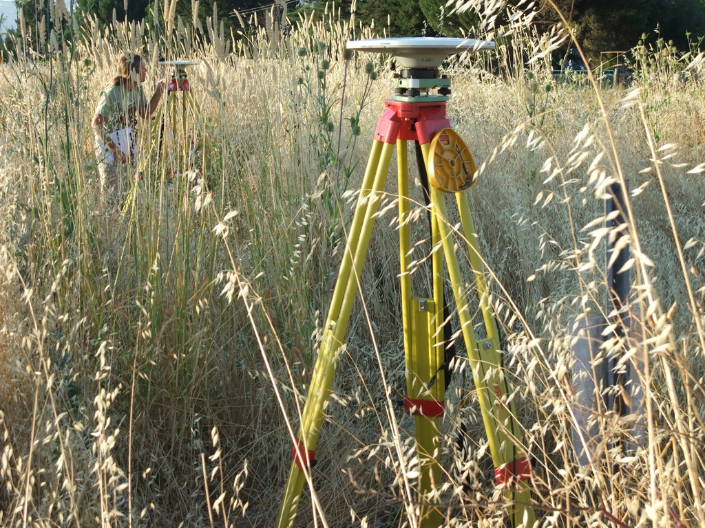
Site identification errors
Photograph by M. Floyd
Photograph by M. Floyd
Photograph by M. Floyd
Notes:
The similarity of the stamp of the central mark at one of its witness marks combined with a lack of photographs or sketches on log sheets from previous occupations meant that the incorrect mark was occupied when measured by a new group. This was made especially difficult by the head-high grass! Once the data from the incorrect mark was processed and identified as such, proceeding occupations measured both marks simultaneously, with better log sheet records!, and the velocities were equated.

Slide 19
Antenna setup errors
Episodic survey setups can mean that measurements are not centered perfectly over a mark or the antenna height not measured accurately
Note any inconsistencies for metadata files or later correction
This can also happen for continuous sites, where incomplete, inaccurate or missing maintenance records
Photograph by M. Floyd

Slide 20
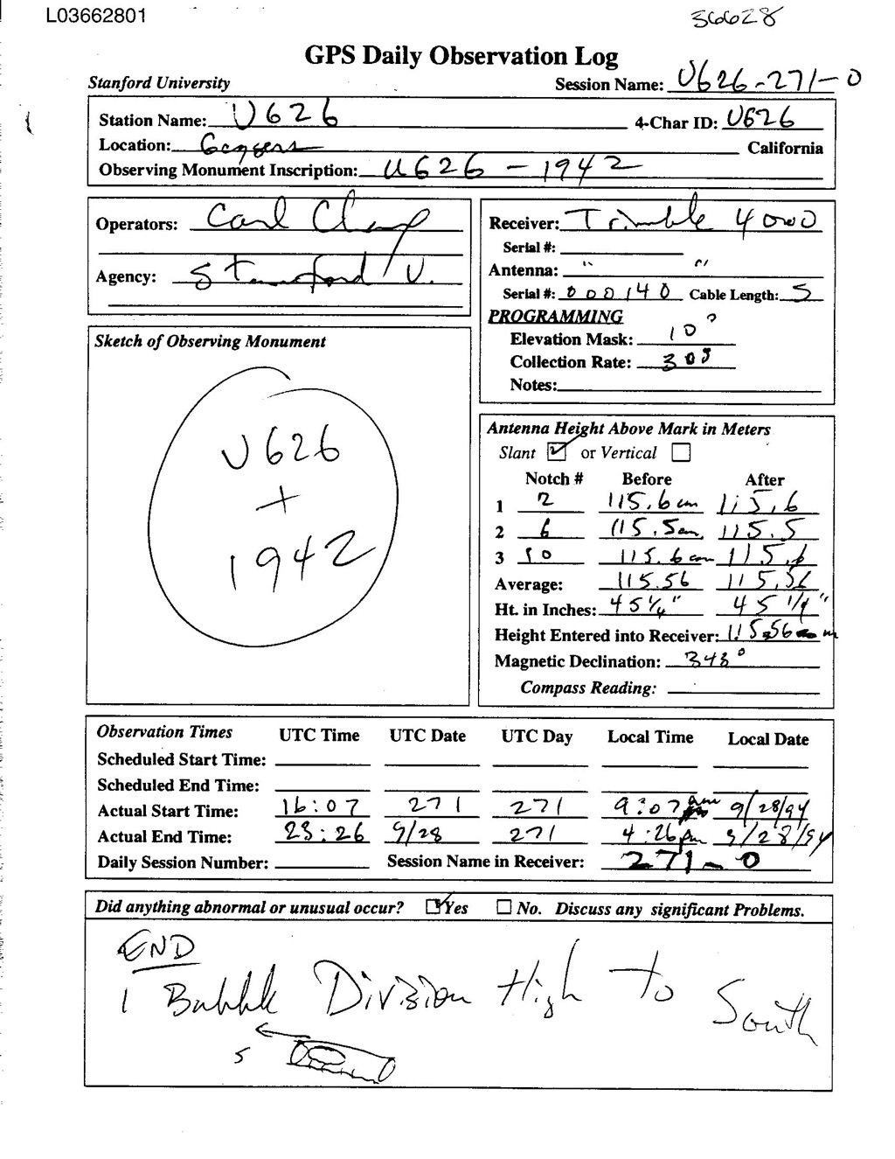
Log (metadata) and archive errors
Critical: antenna type (serial #); height and type; monument ID
2.10 OBSERVATION DATA G (GPS) RINEX VERSION / TYPE
teqc 2006Jul20 UNAVCO Archive Ops 20060725 16:48:29UTCPGM / RUN BY / DATE
Solaris 5.9|UltraSparc IIi|cc -xarch=v9 SC5.5|=+-|*Sparc COMMENT
BIT 2 OF LLI FLAGS DATA COLLECTED UNDER A/S CONDITION COMMENT
U626 MARKER NAME
U626 MARKER NUMBER
UNKNOWN Stanford University OBSERVER / AGENCY
3414A05687 TRIMBLE 4000SSE NP 5.71 / SP 1.26 REC # / TYPE / VERS
3015A00136 TRM14532.00 ANT # / TYPE
-2683218.3014 -4185018.7102 3983204.9361 APPROX POSITION XYZ
1.4755 0.0000 0.0000 ANTENNA: DELTA H/E/N
1 1 WAVELENGTH FACT L1/2
5 L1 L2 C1 P1 P2 # / TYPES OF OBSERV
30.0000 INTERVAL
1994 9 28 16 7 30.0000000 GPS TIME OF FIRST OBS
END OF HEADER
94 9 28 16 7 30.0000000 0 5G 5G 6G17G20G24
2437477.48856 1792564.39355 22428902.4774 22428904.8324
-548226.77657 -402556.82256 20834866.1484 20834867.2274
-567509.56556 -371824.37155 22860949.9614 22860952.7034
1203057.74657 883752.12057 20612879.2734 20612882.3204
793138.12755 501650.82355 22928979.6334 22928982.6914
Notes:
Be very clear in the log what antenna was used (type, serial number), how the height was measured, and what is the inscription on the monument.

Slide 21
Prepare metadata
Many user issues can be traced back to poor quality control of metadata (e.g. site information) or approximate coordinates
Take time to ensure that information from the field or other site installation logs is included and formatted correctly for GAMIT
This mostly concerns two files:
station.info contains information about site ID, antenna, receiver, antenna height, and start and stop times)
An a priori coordinate file, sometimes called the “l-file”, contains the approximate positions, and should be complete and accurate (to within at least a few m) for all sites

Slide 22
station.info
Metadata of sites around the globe for which we know accurate information is listed in ~/gg/tables/station.info
Using the script sh_upd_stnfo, we can:
Truncate this file only to include the sites we intend to process, using the list written to tables/sites.defaults
Add sites from a variety of standard sources, e.g. the RINEX file header, assuming it is accurate, or IGS logs for publicly available global sites
We can also add sites metadata manually, taking care to align columns exactly using whitespace characters (not tabs)

Slide 23
a priori coordinates file
Coordinates of sites around the globe for which we know accurate coordinates are listed in ~/gg/tables/igb14_comb.apr
This will be combined with whatever other file you list with “set aprf =” in tables/process.defaults, which is the file in which you may put your sites’ approximate coordinates
We already saw one way of calculating an approximate position from RINEX data for unknown sites, using teqc
GAMIT/GLOBK also has utilities to help with this
sh_rx2apr
rx2apr
sh_rx2apr reads a RINEX 2 file (RINEX 3 currently not supported) and a broadcast ephemeris (satellite position) file, e.g.
sh_rx2apr -site abdc1000.21o -nav brdc1000.21n
brdc1000.21n can be downloaded with “sh_get_nav -yr 2021 -doy 100”
It can also perform a relative calculation for greater accuracy using a reference site with known coordinates, e.g.
sh_rx2apr -site abdc1000.21o -nav brdc1000.21n -ref monp1000.21o -apr ~/gg/tables/igb14_comb.apr

Slide 24
Additional models and corrections
Other than the information provided by the user and within the default tables in the GAMIT/GLOBK distribution, some additional files must be downloaded separately due to their size
These are generally grid files of ocean tide loading, atmospheric loading and atmospheric delay models
Download the required file(s) from ftp://everest.mit.edu/pub/GRIDS/ to a ~/gg/GRIDS/ directory
Symbolic links in ~/gg/tables/ will then be complete automatically

Slide 25
Links to software
runpkr00 http://kb.unavco.org/kb/article/trimble-runpkr00-v5-40-latest-version-mac-osx-10-7-windows-xp-7-linux-solaris-744.html
RINEX Converter ftp://ftp.ashtech.com/Spectra-precision/Utility%20Software/RINEX%20Converter/
TEQC https://www.unavco.org/software/data-processing/teqc/teqc.html
ConvertToRINEX http://www.trimble.com/support_trl.aspx?Nav=Collection-40773&pt=Trimble RINEX

