Slide 1
GAMIT/GLOBK In A Day*
M. Floyd and T. Herring
Massachusetts Institute of Technology
GAGE/SAGE Science Workshop Pre-Workshop Course 9–10 August 2021
http://geoweb.mit.edu/gg/courses/202108_GAGE-SAGE/
Material from R. W. King, T. A. Herring, M. A. Floyd (MIT) and S. C. McClusky (now at ANU)
*Or two half-days in the world of virtual workshops

Slide 2
Setup and batch processing with sh_gamit

Slide 3
Basic stages of GAMIT/GLOBK for geoscience
Third-party programs
runpkr00
teqc
etc.
model (model observations)
autcln (cleans data)
solve (solve for parameters)
Data collection and archiving (field)
Raw (RINEX) data processing (GAMIT)
Time series and velocity generation (GLOBK)
RINEX files
ASCII h-files
glred (time series)
globk (velocities)

Slide 4
Directory structure
Top level: global tables and survey directories
Within each top-level directory: brdc/ gfiles/ glbf/ gsoln/ igs/ rinex/ tables/ 001/ 002/ … (these directories are created as needed)
Generally 50-60 sites is the largest network processed in GAMIT; networks larger than 99 stations require sub-netting of sites (see netsel, global_sel and sh_network_sel)
Tables are linked from day directories to experiment tables/ and then to ~/gg/tables/
GAMIT processing occurs in the day (<DDD>) directories
GLOBK processing occurs in gsoln/

Slide 5
Processing directory
The processing directory will not have the same structure as the main installation directory
Choose a different location, do not process in your main installation directory
We will, however, be copying or linking to the main installation tables (via symbolic link or “shortcut” ~/gg/tables)

Slide 6
Example continuous GPS structure
SoCal
…
2007
2008
2009
2010
2011
2012
2013
vsoln
001…365
brdc
gfiles
rinex
tables
igs
gsoln
Project level
Year level
Day level
Notes:
A top-level directory defines the general “experiment”. At the first level below this, each year of cGNSS data has its own directory. In each of these directories is the familiar processing structure containing (once processed) 365 or 366 day directories with the processes results as well as the associated data and tables directories.

Slide 7
Example survey GPS structure
NSFBay
…
200808
200907
200909
201007
201010
201102
201306
vsoln
176…185
brdc
gfiles
igs
rinex
tables
gsoln
Project level
Survey level
Day level
Notes:
Similar to the cGNSS structure, a top-level directory defines the general “experiment”. Here, Northern California surveys. At the first level below this, each survey data has its own directory, which I prefer to name by the year and month of the survey, with a descriptive name appending if necessary. In each of these directories is the familiar processing structure containing (once processed) the directories for the days of the survey with the processes results as well as the associated data and tables directories. “gsoln” here will act to combine the survey into one H-file before it is included in the velocity solution in “vsoln” at the same level as the individual surveys.

Slide 8
GAMIT
Run sh_setup
Check all links, especially to grid files (otl.grid, atl.grid, map.grid, met.grid; see sestbl. for what is “switched on”)
Edit sites.defaults to include all publicly available global sites you wish to process and place any other RINEX data to be processed in rinex/ directory
Prepare and verify station.info, e.g. sh_upd_stnfo
Covered in previous lecture
Prepare and verify apr-file, e.g. sh_rx2apr
Covered in previous lecture
Run sh_gamit

Slide 9
sh_gamit
sh_gamit is the top-level script for running GAMIT
The following files are important to verify and/or edit (e.g. after sh_setup)
autcln.cmd (probably unnecessary to edit)
process.defaults (not necessary to edit much, if anything)
sestbl. (controls experiment observations and models; defaults OK but may want to edit)
sites.defaults (list of sites to process in experiment)
sittbl. (controls a priori constraints on sites; probably unnecessary to edit)
station.info (very important file to get right)
.apr-file (very important file to get right)

Slide 10
Phase data processing: GAMIT
Preprocessing
Download (sh_get_orbits) and prepare (sh_sp3fit) orbits
Make clock files (makej)
Download publicly available sites (sh_get_rinex) and convert RINEX files to GAMIT internal format for phase-and-pseudorange observations (makex)
Write batch (“b”) files
Iterative solution (run b-files)
Calculate synthetic observations from a priori parameters and models (model)
Create observables (LC, L1+L2, etc.), clean data (autcln)
Fit calculated to observed by solving for parameter estimates (solve)
Update a priori information if large adjustments
All the above command steps are run for the user by sh_gamit
Although preparation of orbits (sh_get_orbits/sh_sp3fit) and RINEX files (sh_get_rinex) often done manually, depending on resources

Slide 11
Suggestions for multi-GNSS processing strategies
If you wish to combine data from different GNSS, process each system in a separate experiment directory, e.g. /2017G and /2017E for GPS and Galileo
Download the RINEX files in advance to check for availability of GNSS signals
For sh_gamit use the “-gnss” option to specify the GNSS and “-orbit codm” (“-orbit igsf” OK for GPS)
Check the orbit fit rms files in the /igs directory to assess the orbit quality
Combine the resulting h-files in GLOBK to produce a single result (time series or velocities)

Slide 12
Multi-GNSS in GAMIT
Several scripts now have an additional option (“-gnss”) that sets the type of GNSS
Most likely to use directly: sh_gamit, sh_get_orbits, sh_sp3fit
Less likely to use directly: sh_preproc, sh_bcfit, sh_rxscan, sh_get_times, sh_makexp
Valid arguments are (only one of)
G (GPS)
R (GLONASS)
E (Galileo)
C (BeiDou/COMPASS)
J (QZSS)
I (IRNSS)
The default is still “G” (GPS)

Slide 13
Things that will really save you a headache
In our experience, 90% of user issues come down to one of the following:
Not having the latest version or associated updates installed
Incorrect or missing records in station.info
Inaccurate or missing records in the “apr”-file
So, please:
Update your installation on a regular basis (incremental updates are wrapped into a tar-file on the first day of each month)
Take the time verify your setup files and do not rely on sh_gamit or other automated scripts to get everything correct without some manual intervention

Slide 14
Files you need to worry about
RINEX files: local plus list in sites.defaults
Control files
process.defaults : minor edits for each survey
sestbl. : experiment and models setup (unchanged for most processing)
sites.defaults : sites to include or omit and source of metadata
sittbl. : sites constrained for ambiguity resolution
globk.cmd : use_site, apr_neu, apr_svs, apr_wob, apr_ut1, sig_neu and mar_neu commands
glorg.cmd : apr_file, pos_org, stab_site commands
a priori coordinates (.apr-file, l-file)
Metadata (station.info)
Differential code biases (dcb.dat); download current values once per month
Satellite characteristics (svnav.dat); download current with each new launch
Now linked to igs_satellite_metadata.snx, which is maintained by the IGS
Notes:
Templates for these files are in~/gg/tables, and the individual entries are discussed in Chapter 2 of the Introduction to GAMIT/GLOBK and Chapter 3 of the GAMIT Reference Manual. See the doc file Using_global_h-files for suggested strategies for choosing IGS sites to include in your processing.

Slide 15
process.defaults
Controls:
Data and processing directory structure
Some session parameters (e.g. start time, length and data interval, and apr-file name)
Peripheral book-keeping (e.g. files to compress, archive or delete, and email address for summary)
Notes:
You need to understand all of the entries in this file.

Slide 16
sites.defaults
Controls sites to be in included in experiment of given name
Whether or not these sites should be downloaded from a public data server (use “ftprnx” flag)
Whether or not these sites should have their metadata updated from the RINEX file header (not recommended, particularly for continuous sites; use “xstinfo” flag)
May use one sites.defaults file with multiple experiment names and use “-expt” option in sh_gamit to process only certain sites
May use a different experiment setup for different days
sh_gamit will look first for “sites.defaults.YYYYDDD”, then a generic “sites.defaults” file
Notes:
The [expt] token accompanying each entry allows you to use this file to establish sub-netting, as will be described in the lecture on large continuous networks.

Slide 17
autcln.cmd
Controls all parts of the phase cleaning algorithm
Defaults generally work well for all experiments
May occasionally wish to change:
elevation mask
criteria to keep more data from sites with bad a priori co-ordinates

Slide 18
.apr-file
Controls a priori (input) coordinates of sites
Convergence of (non-linear) processing is about 1:1000, i.e. 10 m accuracy for a priori co-ordinate will result in final coordinate accurate to about 10 mm
Important to have good a priori coordinates
Utilities include: sh_rx2apr
.The experiment l-file is initialized each day with the coordinates in the .apr-file specified in process.defaults (while retaining any entries added during prior processing for sites not in the .apr_file

Slide 19
station.info
Controls site occupation metadata
Site name
Start and stop times of occupation
Receiver and antenna information (types, serial numbers, firmware, heights)
Utilities include sh_upd_stnfo which invokes program mstinf
Options for metadata include
Pre-prepared station.info (sh_upd_stnfo, make_stnfo)
Must set “xstinfo” in sites.defaults
RINEX headers (sh_gamit default but may change soon)
Update station.info unless an entry already exists for the day being processed or “stinf_unique” is set to “-u” in process.defaults and entry has not changed
Can be used with non-standard receiver and antenna names specified in guess_rcvant.dat (ideally your RINEX files have the IGS official receiver and antenna names. It is critical that this information is correct
THIS IS A VERY IMPORTANT FILE!
If you do not get this file correct (and verified) before processing, you may lose a lot of time reprocessing phase data at the GAMIT (slowest) stage

Slide 20
sestbl. (“session table”)
Controls processing setup
Observables to use (e.g. LC, L1+L2, etc.)
Experiment (orbits and EOPs) type
“BASELINE” solves for site coordinates only using fixed orbital parameters [default]
“ORBIT” solves for orbital parameters only using fixed site coordinates (from .apr-file)
“RELAX.” solves for both site and orbital parameters
Models used

Slide 21
sittbl. (“sites table”)
Controls:
Site-specific information for processing
Constraint (accuracy) of a priori coordinates in .apr-file
Notes:
Modest contraints (5-10 cm) on one or two sites are sufficient to effect good ambiguity resolution. In many cases you can simply use the template in gg/tables, which includes a large number of IGS sites, some of which are likely to be in your network.

Slide 22
Approximate position and stabilizing network
Accurate a priori coordinates necessary for good GNSS processing
Run teqc to create RINEX observation and (broadcast) navigation files, e.g. teqc +nav abcd3650.14n +obs abcd3650.14o -tr d 12343650.dat
Run teqc in qc-mode on observation file with navigation file to get pseudorange-derived estimate of approximate coordinate, e.g. teqc +qc -nav abcd3650.14n abcd3650.14o
May also be done using GAMIT/GLOBK’s sh_rx2apr
Ultimately we will use the position of known sites to define a reference frame, so we must include those sites in our network to be processed

Slide 23
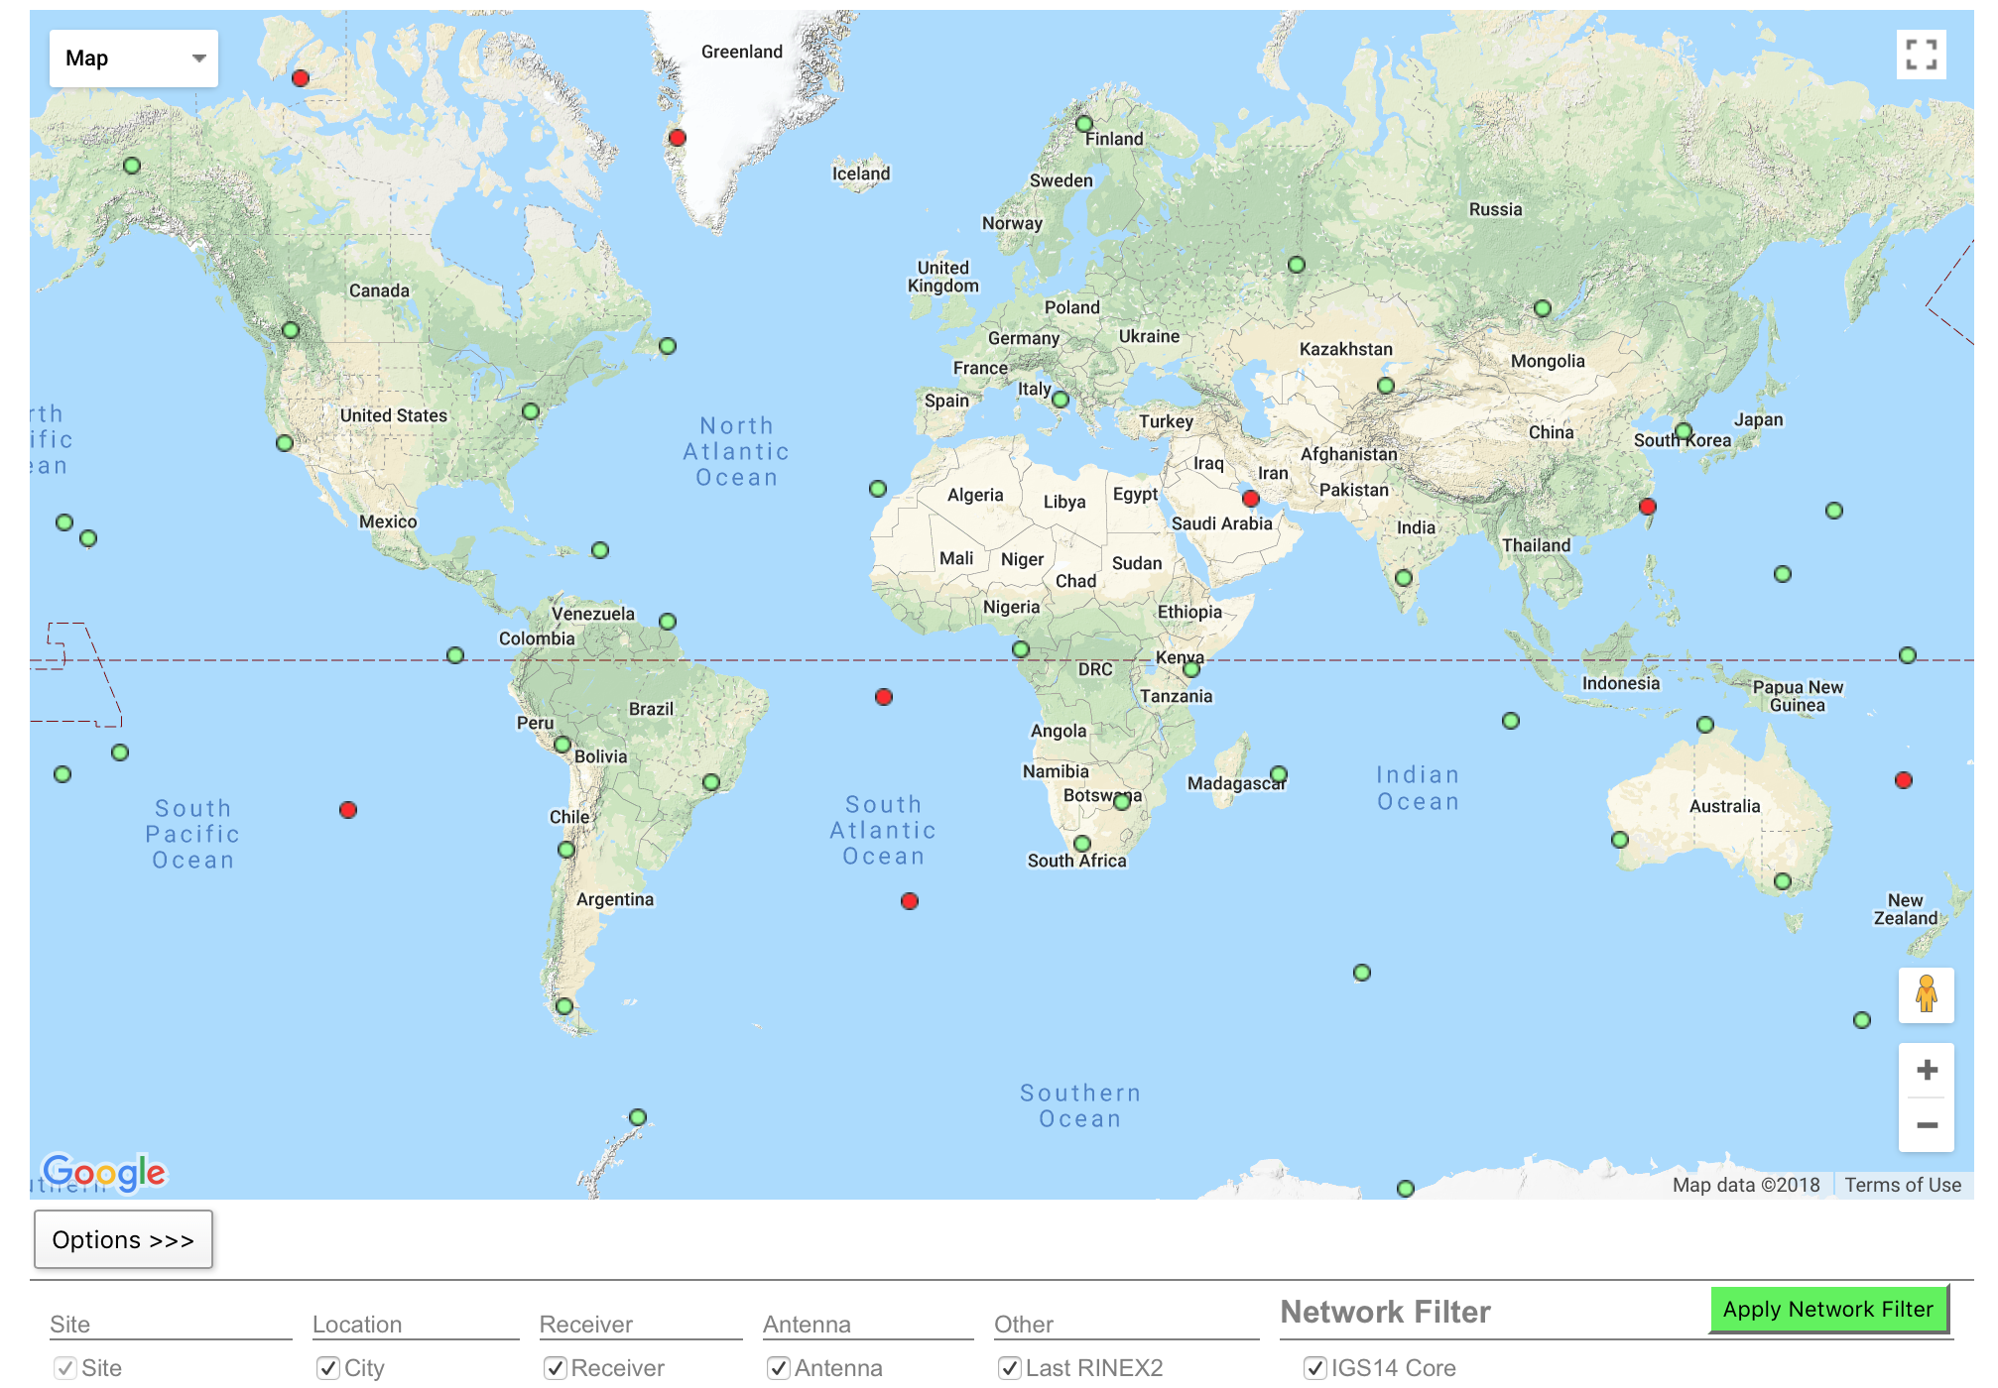
IGS (IGS14) reference frame core network
DRAO
GOLD
GUAT KOKB
MDO1
MKEA
NLIB
PETP
SCH2
SCUB
STJO
USNO
WHIT
http://www.igs.org/network Select IGS14 Core
Notes:
When selecting sites to process with your local data of interest, look first to include sites from the IGS core network.

Slide 24
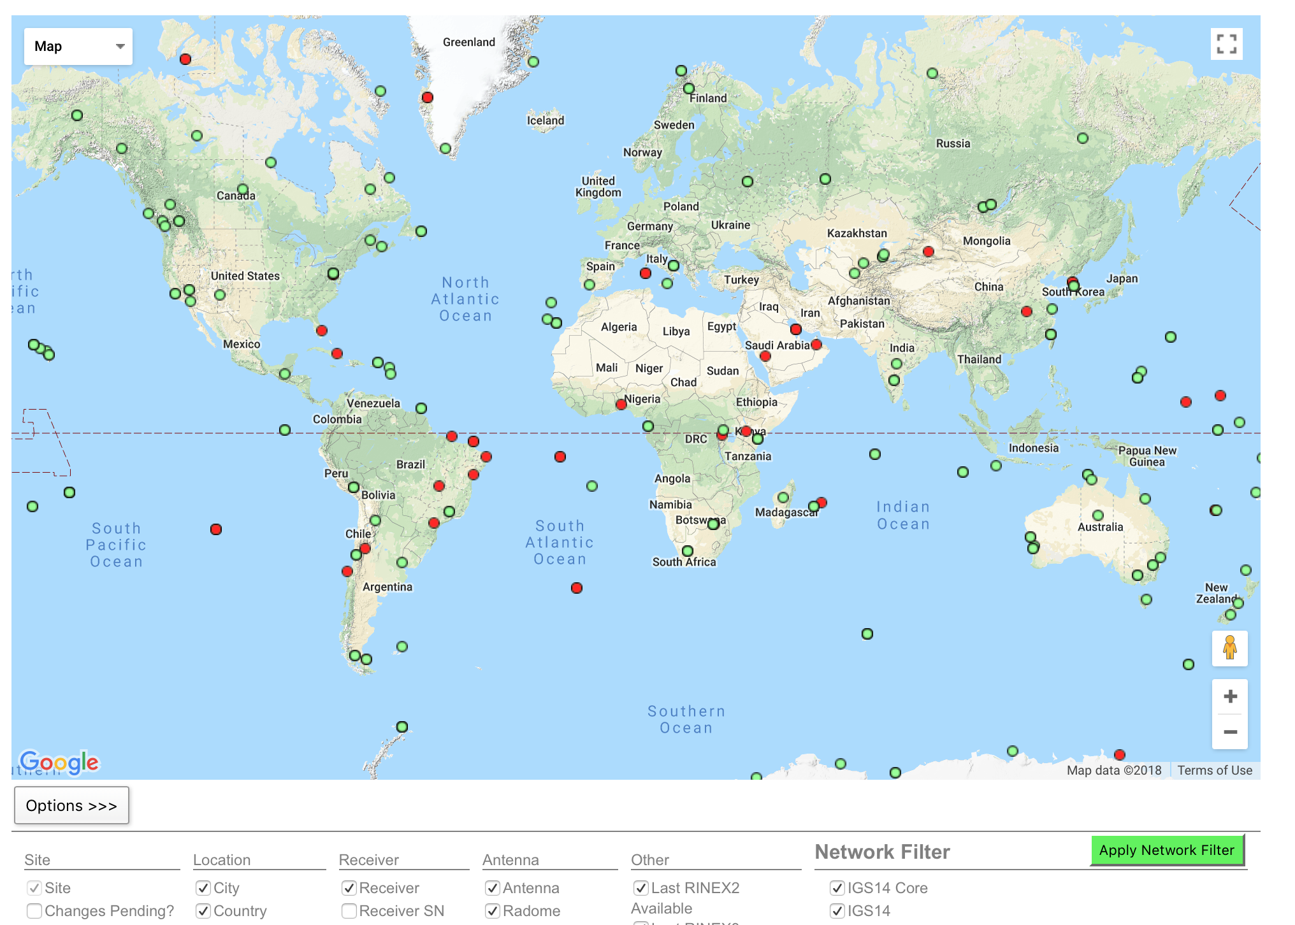
IGS (IGS14) reference frame network
Notes:
If the IGS core network sites are not available, too sparse or do not exist at the epoch of your measurements, try densifying your stabilizing network with all the IGS reference frame sites (the IGS core network is a sub-set of this).

Slide 25
Reference frame implementation
The main point of reference frame definition is to use sites with well known coordinates to stabilize your processed network
If your processed network already contains sites with known accurate coordinates, e.g. in ~/gg/tables/igb14_comb.apr, then there is no need to add additional sites to your processing
Your “stab_site” list in glorg command file should be guided by and closely associated with the contents of an accurate .apr-file, e.g. igb14_comb.apr by default but could be any accurate .apr-file you choose include in globk and glorg command files
~/gg/tables/igb14_hierarchy.stab_site relates to ~/gg/tables/igb14_comb.apr
Decide early in your processing whether or not you will need to include additional, e.g. IGS, sites in your GAMIT processing to use ultimately to realize your preferred reference frame
The first decision you must make (choosing sites to process) is greatly influenced by the ultimate processing step (reference frame realization)!

Slide 26
sh_gamit internal operation
The following programs are run by the script:
makexp and makex prepare the data
fixdrv prepares the batch control files
arc integrates GNSS satellite orbits
model calculates theoretical (modeled) phase and partial derivatives of phase with respect to parameters
autcln repairs cycle slips, removes phase outliers, and resolves the wide-lane ambiguities
solve estimates parameters via least-squares, resolving the narrow-lane ambiguities and creating an h-file for GLOBK (user constraints are removed in the h-file to allow reference frame definition)
Notes:
Once fixdrv is complete, the rest of the run is driven from a batch file, b[expt]][y].bat, which invokes a series of batch files, b[expt][y].nnn, one for each execution of arc, model, cfmrg, and solve. It behooves you to read the documentation for each of these programs so that you can understand problems when they occur.

Slide 27
Steps in the standard GAMIT batch sequence
arc, model, autcln, solve for initial solution
5-minute sampling, no ambiguity resolution (GCR only)
update lfile. for coordinates adjusted > 30 cm
look at: autcln.prefit.sum; q<expt>p.ddd
model, autcln, solve for final solution
2-minute sampling, ambiguity resolution
Look at: autcln.post.sum, q<expt>a.ddd
Final solution repeated if NRMS reduced by > 30% from initial solution, to assure good editing and linear adjustment of parameters (original final solution files overwritten)

Slide 28
What solve produces
Print output is the q-file, which records
in detail
A constrained solution without ambiguities resolved (“GCR”)
A constrained solution with ambiguities resolved (“GCX”)
These are the solutions you should examine, along with the autcln summary files, to assess the quality of the solution
and in summary only
A loose solution without ambiguities resolved (“GLR”)
A loose solution with ambiguities resolved (“GLX”)
Updated l-file for successive iterations or days
Useful output for GLOBK is the h-file (analogous to the IGS standard SINEX file), which contains the parameters estimates and full covariance matrix.
(There is also an o-file, which is just the q-file but in more machine-readable form, and is seldom used; and, if orbits adjusted, an updated g-file)
Notes:
Although when data run smoothly, you will seldom have need to examine the q-file (only the e-mailed summary), you should be familiar with all of the entries in this file in order to understand problems with your data.

Slide 29
What can go wrong?
Site missing (not listed)
No RINEX data within session span: check RINEX file and/or makex.expt.infor
Too few data, x-file too small and not used: check RINEX file size, change “minxf” in process.defaults
Site in solution but no data or adjustment
a priori coordinates > 10 m off: check range rms in autcln.prefit.sum,
run sh_rx2apr differentially for several RINEX files
bad receiver: examine RINEX files or initial c-files with cview
q-file nrms > 0.2
solution over-constrained: check GCX vs GLX nrms, rerun with only one site constrained in the sittbl.
Notes:
Next few slides look at each of these problems.

