Slide 1
Generating time series with glred
M. A. Floyd T. A. Herring Massachusetts Institute of Technology, Cambridge, MA, USA
GNSS Data Processing and Analysis with GAMIT/GLOBK and track UNAVCO Headquarters, Boulder, Colorado, USA 24–28 August 2020
http://geoweb.mit.edu/~floyd/courses/gg/202008_UNAVCO/
Material from R. W. King, T. A. Herring, M. A. Floyd (MIT) and S. C. McClusky (now at ANU)

Slide 2
Post-processing: GLOBK
Convert ASCII h-files to binary h-files (htoglb in glbf/)
Generate and chronological list of binary h-files (glist in gsoln/)
At this point, diverge in approach depending on solution sought
More details about glred, globk and glorg in advanced course lectures
Similarly to sh_gamit, the batch script sh_glred will run all of the above command steps (and more, introduced in next slides)
User may just need to edit globk and/or glorg command files to achieve most desired types of solution

Slide 3
sh_glred
glred is just a way of invoking globk to process one day at a time; sh_glred is a script to invoke glred easily for a sequence of days
Once you’ve run sh_gamit for a sequence of days, you will have on each day an h-file of loosely constrained parameter estimates and covariances. If you have appropriately constructed command files for globk (globk.cmd) and glorg (glorg.cmd) in [expt]/gsoln/, you can obtain time series using, e.g. sh_glred -expt [expt] -s [start yr] [start_doy] [stop yr] [stop doy] -opt H G T which will translate the GAMIT plain text h-files into GLOBK binary h-files (H), run GLOBK (G) and run sh_plot_pos (T)
Self-guided templates will guide you in constructing the command files (~/gg/tables/globk.cmd and ~/gg/tables/glorg.cmd)
Notes:
Running sh_glred to get daily solutions is the standard approach and easy once you’ve got a globk_comb.cmd and glorg_comb.cmd file constructed. The GLOBK lecture will introduce these files, and this lecture along with the Reference Frames and Error Analysis lectures will delve into appropriate strategies for constraining the network and weighting the data.

Slide 4
Manual sequence
htoglb (i.e. sh_glred -opt H)
Converts plain text h-files output from GAMIT to binary h-files (in glbf/) for input to GLOBK
ls
Create list of binary h-files to process (in gsoln/)
glist
Create chronological list of h-files to process and associated information
glred (i.e. sh_glred -opt G)
Create “.org”-file(s) with individual solutions
sh_plot_pos (i.e. sh_glred -opt T)
Create “.pos” (time series) file(s) and time series plots
globk
Create combined (or velocity) solution
glorg
Additional glorg runs for different reference frames

Slide 5
htoglb
Creates binary h-files for input to GLOBK
All metadata etc. carried forward from GAMIT
Not restricted to plain text h-files from GAMIT
May also use SINEX (Software INdependent EXchange format), GIPSY’s “stacov” files, etc.
But beware of constraints implicit in solutions from other software/processing runs!
For example, from glbf/ htoglb . ‘’ ../[0-3][0-9][0-9]/h*a.*
(Use pair of quotes ‘’ if no satellite data is to be saved. This is normal case).

Slide 6
GLOBK checks
List files to be processed by GLOBK, e.g. from gsoln/ ls ../glbf/h*.glx > expt.glx.gdl
Run pre-processing checks using glist glist expt.glx.gdl 201407_NSFBay.sum +1 ~/gg/tables/itrf08_comb.eq:A 201407_NSFBay.gdl
This will also calculate if any overlapping h-files should be combined with glred (e.g. multiple networks on the same day)
Inspect any errors (e.g. site name clashes)

Slide 7
Create time series
glred simply runs the main program, globk, once per interval (e.g. daily) to combine data over that interval into one solution and one effective time series point glred 6 glred_20150811.prt glred_20150811.log 201407_NSFBay.gdl globk.cmd
Assess solution by looking at “POS STATISTICS” lines
Old example (Example 2 on this course’s web page) using sh_glred with “-opt E” creates:
“mb”-files (time series) with multibase
“psbase”-files (PostScript) with sh_baseline
Updated, preferred method is sh_glred with “-opt T”:
tssum to create “.pos”-files (time series) from “.org”-file output from glred
sh_plot_pos to create PostScript plots
“.org”-file may be input to sh_plot_pos, which will run tssum for you, e.g. sh_plot_pos -f glred_YYYYMMDD.org -d _YYYYMMDD ...

Slide 8
Time series solution files
Old scheme
Current scheme
“.org”-file
ensum
“VAL”-file (time series values)
“SUM”-file (statistics)
multibase
“mb”-files
sh_baseline
Time series plots
“.org”-file
tssum
“.pos”-files
tsfit
“.res”-files
sh_plot_pos
Time series plots
sh_plotcrd
sh_plot_pos

Slide 9
Recommended strategy for stabilization
In the template files, globk.cmd and glorg.cmd:
default apr-file is ~/gg/tables/igb14_comb.apr
default eq-file is ~/gg/tables/igb14_comb.eq
default stab-file is ~/gg/tables/igb14_comb.stab_site
igb14_comb.apr is a combined .apr-file, using many publicly available coordinate sources, all aligned to ITRF2014
igb14_comb.eq is the associated .eq-file with defined discontinuities
equipment changes
earthquakes
etc.
igb14_hierarchy.stab_site uses the established IGS core network hierarchy to choose stabilizing sites, e.g.
stab_site DRAO/BREW/NANO/ALBH/HOLB means use DRAO if available in the solution (e.g. h-files), otherwise use BREW if available, otherwise use NANO, etc.
Equivalent files for previous realizations of ITRF2014 (“itrf2014…”, “igs14…”) and ITRF2008 (“itrf08…”, “igb08…”) still available

Slide 10
Inspect consistency of stabilization statistically
It is a good idea to have thought about your reference frame stabilization when setting up your experiment, e.g. sites.defaults, before running sh_gamit
Desire as many well-defined (e.g. IGS) sites as possible for redundancy
Recommended to use some of the sites (preferring the first column) in ~/gg/tables/igb14_hierarchy.stab_site when selecting your processing network, e.g. additional sites listed in your sites.defaults
But remember trade-off with processing time, e.g. processing time scales proportionally to n³
grep ‘^POS S’ glred_20150811.org
POS STATISTICS: For 51 RefSites WRMS ENU 2.15 2.55 6.19 mm NRMS ENU 0.71 0.84 0.63 L0104260000_tg1a.glx
POS STATISTICS: For 54 RefSites WRMS ENU 2.17 2.42 6.03 mm NRMS ENU 0.74 0.80 0.63 L0104270000_tg1a.glx
POS STATISTICS: For 50 RefSites WRMS ENU 2.12 2.25 6.34 mm NRMS ENU 0.71 0.75 0.67 L0104280000_tg1a.glx
POS STATISTICS: For 54 RefSites WRMS ENU 2.19 2.31 5.23 mm NRMS ENU 0.80 0.81 0.58 L0104300000_tg1a.glx
POS STATISTICS: For 54 RefSites WRMS ENU 1.83 2.17 6.34 mm NRMS ENU 0.64 0.75 0.68 L0105010000_tg1a.glx
POS STATISTICS: For 54 RefSites WRMS ENU 2.09 2.63 6.47 mm NRMS ENU 0.80 0.98 0.75 L0105020000_tg1a.glx

Slide 11
“.pos”-files
These contain your time series solution
Long format in various coordinate systems
Geocentric (X, Y, Z)
Geodetic (lon., lat., height)
Local (east, north, up)
Can be input to tsfit (interactive version of GGMatlab tool “tsview”), sh_cats (requires CATS) and sh_hector (requires Hector)
Both “.pos”-files and “.res”-files can be plotted with sh_plot_pos

Slide 12
sh_plot_pos
Uses GMT and has many features including options to:
Read in “.org”-files, “.pos”-files (output of tssum) and “.res”-files (output of tsfit) [-f option]
Run tsfit (GLOBK’s curve-fitting module) on input “.pos”-files [-t option]
Calculate basic statistics (e.g. WRMS, NRMS)
Add vertical lines at epochs specified by renames, earthquakes or user [-b, -e and -l options, respectively]
Specify fixed start and end times of time series [-t1, -t2 options]
etc.

Slide 13
Inspect consistency of time series
Good repeatability
Outlier
Notes:
Large uncertainty will mean outlier will have low weight in inversion/Kalman filter anyway, but

Slide 14
Excluding outliers or segments of data
Create “rename” file records and add to GLOBK command file’s “eq_file” option, e.g.
rename PTRB PTRB_XPS h1407080610_nb4a
rename PTRB PTRB_XPS 2014 07 07 18 00 2014 07 08 18 30
rename ABCD ABCD_XCL 2013 07 08 00 00
“XPS” will not exclude data from glred (so still visible in time series) but will exclude data from globk (combination or velocity solution)
“XCL” will exclude data from all glred and globk runs

Slide 15
Iterating your solution
First time series may only be stabilized by previously well-defined sites, e.g. ITRF sites
Once a high-quality position (and velocity) estimate for a previously unknown or new site is available, we can use all sites to stabilize
This approach may be used with both time series (e.g. glred) and velocity (e.g. globk) solutions

Slide 16
Changes to equipment
Antenna is main concern, although receiver may also affect continuity of calculated position
Even antennas of the same model type may not be manufactured within acceptable geodetic tolerance
stinf_to_rename useful for creating automatic list
Notes:
Site shown in accompanying photograph is SNTR (Santorini) from the COMET cGNSS network. The antenna was replaced by an identical model on the same threaded rod drilled into the top of the lighthouse wall, as shown, and yet an observable discontinuity was still seen in the resulting time series.

Slide 17
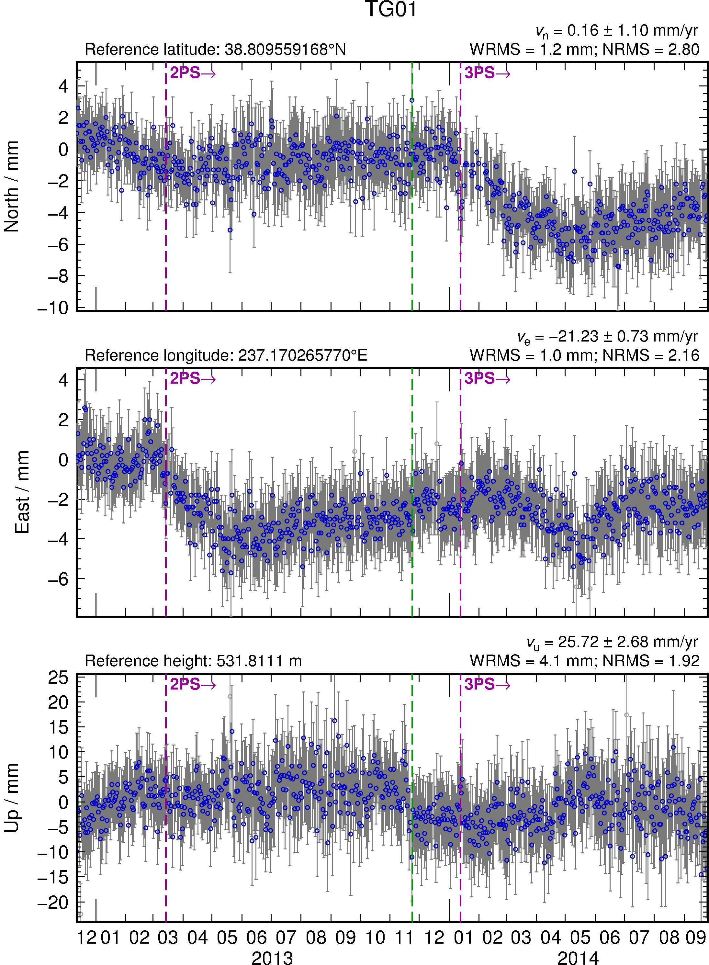
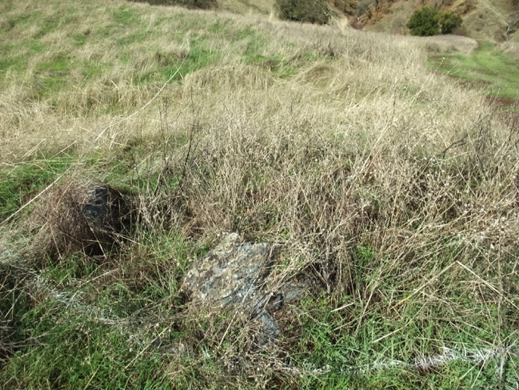
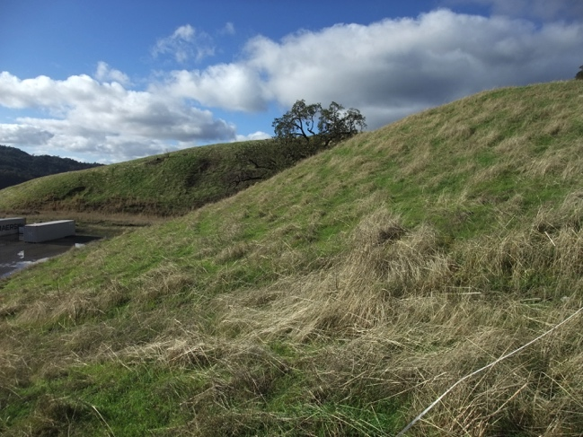
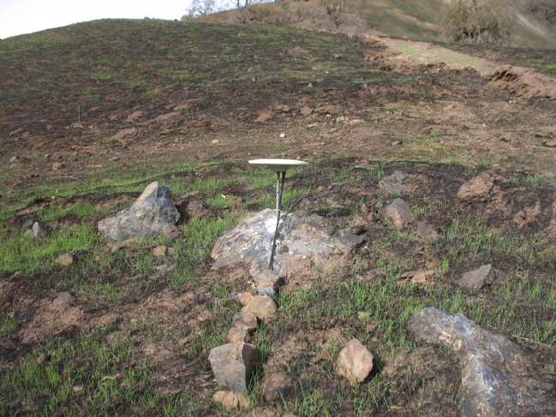
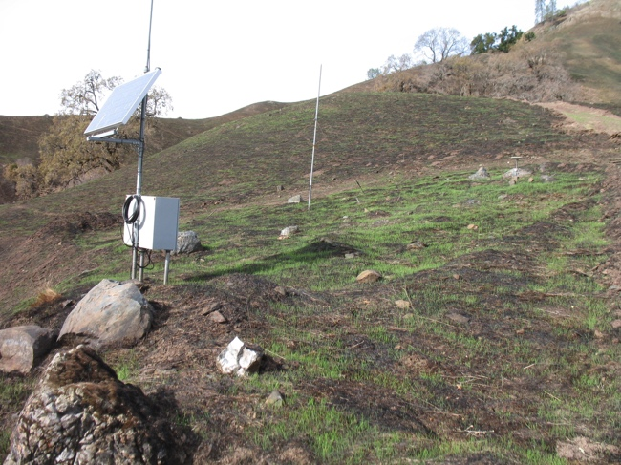
Changes in multipath environment
Photograph by M. Floyd
Photograph by M. Floyd
Photograph by R. Haught
Photograph by R. Haught
Notes:
Photos: Seismometer site SB4 in The Geysers, California, showing effect of November 2013 fire (http://cdfdata.fire.ca.gov/incidents/incidents_details_info?incident_id=932). Site of eventual colocated GPS antenna (TG01) in upper left; seen after installation and November 2013 grass fire in lower left; photos on right side show broader view of site hillside. Right: Time series showing discontinuity (at least in vertical component) at time of fire (green dashed line).

Slide 18
Rename scheme
Rename scheme uses first character of suffix
XXXX_GPS → XXXX_2PS → XXXX_3PS → … etc.
Beyond “9PS”, convert to 10th letter of alphabet (“JPS”) and beyond
… → XXXX_9PS → XXXX_JPS → XXXX_KPS → … etc.
But remember “XPS” is a special case for excluding sites from globk runs
For manual renames (e.g. due to manual inspection rather than known events), use 8 available letters in alphabet before “J”
XXXX_APS, XXXX_BPS, etc.
But remember “GPS” is a special case (the default)

Slide 19
Earthquakes
Earthquakes occur at known times
May exhibit more than just a discontinuity
Take care when earthquake occurs in the middle of processing day
Some data will fall before and some after ground displacement
Time series point on day of earthquake may appear between pre-earthquake and post-earthquake position

Slide 20
Radius of influence
“eq_def” line in eq-file contains earthquake ID (two characters), location, etc.
ID is used to substitute last two characters of 8-character site name, e.g. XXXX_GPS → XXXX_GSN
sh_makeeqdef will search archives (ANSS ComCat or ISC) to generate “eq_def” records

Slide 21
Recommendations
Know your goals
Only fit “nuisance” terms
It is usually best not to try to fit signals that you are interested in, e.g. seasonal terms if you are studying these.
Depending on your goal (e.g. linear tectonic velocities), sometimes you just have to abandon data as it is likely to do more harm than good (rename to xxxx_XPS or xxxx_XCL)
Adding large process noise in globk is one approach but be careful not to make too large
GLOBK “sig_neu” command can be used for small duration “bad” events

Slide 22
Short- vs long-term time series
Exactly the same procedure is used for short (e.g. survey) and long (e.g. years of continuous data) time series
The only difference may be the number and type of input h-files, e.g.
Daily survey h-files (short-term time series)
Combine into one solution (short-term position combination)
Several combined survey files over years (long-term time series)
Several combined survey files over years (long-term velocity combination)

Slide 23
tsfit and tsview
tsfit is the command-line tool for fitting time series and generating statistics
Input “.pos”-files, optionally .eq-files
Fits linear rate and choice of common parameters
Periodic terms
Discontinuities and earthquakes
Post-seismic decays
Outputs
statistics of fit
standard (position and velocity) .apr-files
extended (periodic, logarithmic decay, etc.) .apr-files
Residuals to fit (“.res”-files)
tsview is an alternative that, via a MATLAB interface, allows interaction

Slide 24
Time series characteristics

Slide 25
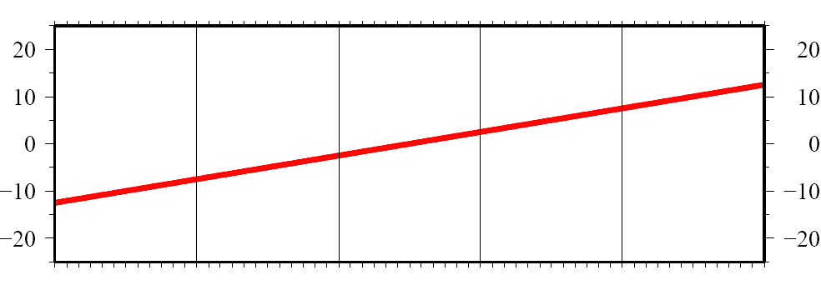
Time series components
observed
position
(linear)
velocity term
initial
position

Slide 26
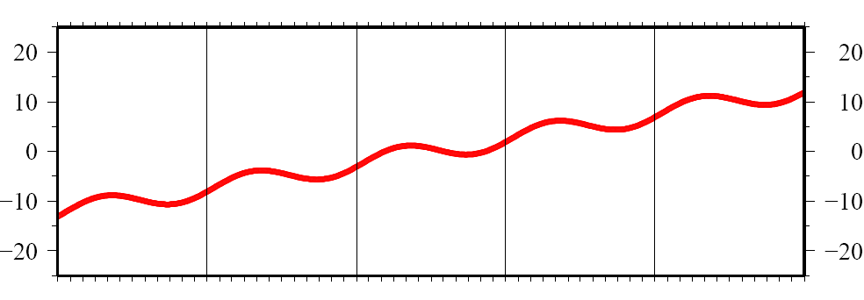
Time series components
observed
position
(linear)
velocity term
initial
position
annual period
sinusoid
Notes:
tau0 = 0.3 yr

Slide 27
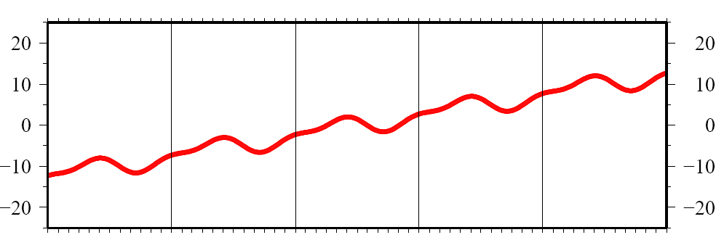
Time series components
observed
position
(linear)
velocity term
initial
position
annual period
sinusoid
semi-annual
period sinusoid
seasonal term

Slide 28
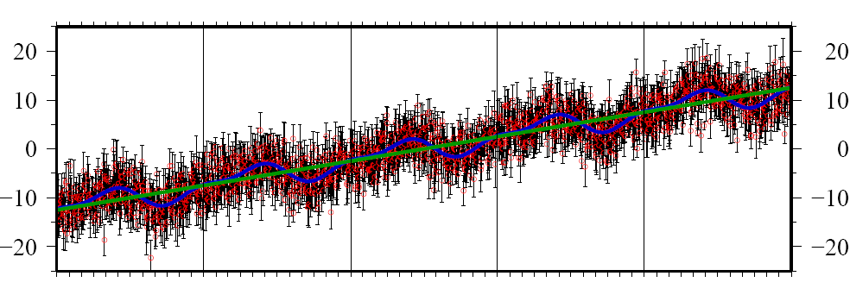
Time series components
observed
position
(linear)
velocity term
initial
position
annual period
sinusoid
semi-annual
period sinusoid
seasonal term
ε = 3 mm white noise

Slide 29
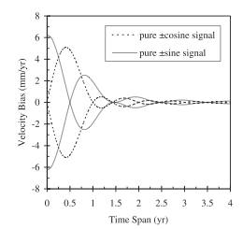
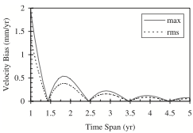
Velocity errors due to seasonal signals in continuous time series
Annual signals from atmospheric and hydrological loading, monument translation and tilt, and antenna temperature sensitivity are common in GPS time series
Theoretical analysis of a continuous time series by Blewitt and Lavallee (2002,2003)
Top: Bias in velocity from a 1mm sinusoidal signal in-phase and with a 90-degree lag with respect to the start of the data span
Bottom: Maximum and rms velocity bias over all phase angles
The minimum bias is NOT obtained with continuous data spanning an even number of years
The bias becomes small after 3.5 years of observation
Notes:
Seasonal, primarily annual. errors due to atmospheric conditions (propagation and loading), changing ground water, and temperature effects on the monuments or antenna elements can be important in GPS measurements. Its pretty obvious that for survey-mode measurements made once a year, the best strategy is to observe at the same time each year, and if the errors are truly annual or semi-annual, they will be nullified. For continuous measurements, however, there is the somewhat non-intuitive result that truncating the time series at an even number of years does not null the veloicity error (sketch a cosine on the back of an envelope to convince yourself of this). Geoff Blewit and David Lavallee did a study of the effect of these errors as a function of span length, and found that the optimal truncation length is on the half-year. Further, as for errors with other shapes, longer time spans reduce the effects. Keep in mind that if seasonal errors are not dominant, extending a time series, e.g. to 4 years instead of truncating it at 3.5 years, would usually produce a smaller bias.

Slide 30
FOGMEx (“realistic sigma”) algorithm for velocity uncertainties
Motivation
Computational efficiency
Handle time series with varying lengths and data gaps
Obtain a model that can be used in globk
Concept
The departure from a white-noise (√N) reduction in noise with averaging provides a measure of correlated noise.
Implementation
Fit the values of χ² versus averaging time to the exponential function expected for a first-order Gauss-Markov (FOGM) process (amplitude, correlation time)
Use the χ² value for infinite averaging time predicted from this model to scale the white noise sigma estimates from the original (least-squares) fit
and/or
Fit the values to a FOGM with infinite averaging time (i.e., random walk) and use these estimates as input to globk (“mar_neu” command)
Notes:
The third approach is the one we’ve taken in GLOBK. It assume that the the noise can be represented by a Gauss-Markov process. Loosely speaking, a Gaussian process is a random process that can be described by its mean and variiance; both the Poisson and normal distributions are Gaussian. A Markov process is one in which the expected value of the next random variable depends on only on its present state and not on its history. Although no single instantaneous source of GPS error is necessarily Gaussian, the central limit theorem allows us to hypothesize, at least, that the ensemble of errors will have a Guassian distribuiton. Viewed another way, our best hope of being to characterize ithe likelihood that the estimated parameter will fall within certain range, e.g. 95% of the time, is to assume that it has a Gaussian distribution, for which the probability distribution can be represented analytically by an exponential equation. We use a first-order Markov process, specifically a random walk, in GLOBK to model stochastic variations because it can be directly implemented in a Kalman fiilter, whereas flicker noise, which is not a Markov process cannot. As we’ll show, these assumptions can be tested by the distribution of velocity residuals from an appropriately modeled GPS solution.

Slide 31
sh_cats/sh_hector
Scripts to aid batch processing of time series with CATS or Hector
Requires CATS and/or Hector to be pre-installed
Outputs
Velocities in “.vel”-file format
Equivalent random walk magnitudes in “mar_neu” commands for sourcing in globk command file
Can take a long time!
Reads GAMIT/GLOBK formats
.pos-file(s) as input
.eq-file(s) to define discontinuities for estimation of offsets
tsfit command file containing “eq_file”, “max_sigma”, “n_sigma” and/or “periodic” options instead of specifying as sh_cats/sh_hector options
Writes files for GLOBK
.apr-file(s), including “EXTENDED” terms where periodic and/or non-linear (logarithmic and/or exponential decay) terms have been estimated
“mar_neu” commands for equivalent random walk process noise

Slide 32
Summary
sh_glred is post-processing equivalent to sh_gamit
.pos-file format now standard GLOBK output for time series
Visual inspection of time series very important for identifying outliers, bad segments of data or other problems like incompatible site IDs
sh_plot_pos (GMT) and tsview (MATLAB)
Populate .eq-file(s) with “rename” commands or use “sig_neu” commands to mitigate impact of poor or incompatible data points during velocity
Be aware that some “outliers” may be stabilization issues if they persist across a large part or all of a network at the same time, so check stabilization using “POS STATISTICS” lines in .org-file(s)
Numbers of stabilizing sites should be consistent and at least as many as the number of parameters estimated in glorg (e.g. three components of rotation and translation)
Numbers for wrms should be consistent from day-to-day and small (< 5 mm)
Batch tools are available for longer, denser, continuous time series where point-by-point visual inspection is unreasonable
tsfit and tsview

