Slide 1



Generating velocity solutions with globk
M. A. Floyd T. A. Herring
Massachusetts Institute of Technology, Cambridge, MA, USA
GNSS Data Processing and Analysis with GAMIT/GLOBK and track
UNAVCO Headquarters, Boulder, Colorado, USA
24–28 August 2020
http://geoweb.mit.edu/~floyd/courses/gg/202008_UNAVCO/
Material from R. W. King, T. A. Herring, M. A. Floyd (MIT) and S. C. McClusky (now at ANU)

Slide 2
Overview
Basics of “velocity” solutions
  Invoked with “apr_neu all xx xx xx <NEU velocity sigmas>”
Strategies for setting up solutions (they can take a long time to run)
Strategies for speeding up solutions
Methods for “cleaning up” potential problems
Different reference frame realizations
Some examples
These solutions involve making decisions about how to treat data and the type of solution to be created – lots of decisions

Slide 3
GLOBK velocity solutions
The aim of these solutions is to combine many years of data to generate position, velocity, offset and postseismic parameter estimates
  Increasingly common to have 10,000 parameters in these solutions if large networks over many years
Input requirements for these solutions:
  a priori coordinate and velocity file
    Used as a check on positions in daily solutions (for editing of bad solutions) and adjustments are a priori values (a priori sigmas are for these values)
  Earthquake file which specifies when earthquakes, discontinuities, and misnamed stations affect solution
    Critical that this file correctly describe data.
  Process noise parameters for each station
    Critical for generating realistic standard deviations for the velocity estimates (e.g. sh_gen_stats).

Slide 4
GLOBK long-term velocities
Combine daily (continuous) or short-term combined h-files (e.g. surveys; see last slide)
Plot long-term time series from short-term combination “.org”-file(s) (sh_plot_pos)
Inspect time series to identify (and remove) outliers
Run globk to form final solution file for all data (another “.org”-file) with velocity estimation, e.g. in globk command file
apr_site all 10 10 10 1 1 1
or
apr_neu all 10 10 10 1 1 1
sh_glred capable of running all these individual commands to produce time series, short-term combinations and long-term velocity solutions

Slide 5
Velocity solution strategies
In general careful setup (i.e. correct a priori coordinates, earthquake file and process noise files) is needed since each run that corrects a problem can take several days. Incorrect solutions may not complete correctly and results may be subtly wrong.
General strategy for iteratively generating velocity solution:
  Define a core-set of sites (usually 20-200 sites) where the solution runs quickly. Test files on this solutions and use the coordinate/velocity estimates to form the reference frame for time series generation.
  Time series using these reference frame sites and then test (RMS scatter, discontinuity tests) to form a more complete earthquake and apriori coordinate/velocity files.
  Steps above are repeated, usually increasing number of stations until solution is complete. As new stations are added missed discontinuities and bad process noise models can cause problems.
Aim here is make sure that when a large solution is run (maybe several days of CPU time) that the run completes successfully.

Slide 6
General methods for increasing speed and to allow for parallel runs
Approaches to increase speed:
Pre-combine daily solutions into weekly to monthly solutions and use these combined solutions in the velocity solutions. There are many advantages to this approach:
  Runs are much faster. Each processing step takes about the same time with the monthly as a daily file but there are 30 fewer files so 30 times faster.
  Numerical rounding errors are much better when monthlies are used
  “MIDP” output option refers the solutions to the middle of the month. (Earlier versions used last day of month as reference time, natural time for a sequential Kalman filter.
  Random walk process noise models correct when velocity NOT estimated in combinations.
  Care needed here when “eq_log” is used for solutions far away in time from the earthquake.
Run decimated solutions (e.g. one day per week). Works fine and changing start day does not have large effect due to correlated noise models. Care needed when different start day results are combined to avoid white noise sigma reduction.
Sub-netting in GLOBK to generate each solution with smaller number of stations. Sub-net velocity solutions are combined with GLOBK. Use netsel with -rw option to make GLOBK “use_site” list (current GAGE approach)

Slide 7
Before velocity runs
Surveys may be combined into one solution per survey
No need to re-run glred again to see long-term time series
Multiple “.org”-files may be read by tssum or sh_plot_pos
  tssum ts_pos mit.final_igb14 -R survey1_comb.org survey2_comb.org ...
    ts_pos is the name of a directory for the .pos files. (“.” can be used)
  sh_plot_pos -f survey1_comb.org survey2_comb.org -k ...

Slide 8
Example: Long-term time series for survey sites
Reasonable repeatability
Outlier in vertical

Slide 9
Excluding outliers or segments of data
Create “rename” file records and add to GLOBK command file’s “eq_file” option, e.g.
  rename PTRB PTRB_XPS h1407080610_nb4a
  rename PTRB PTRB_XPS 2014 07 07 18 00 2014 07 08 18 30
  rename ABCD ABCD_XCL 2013 07 08 00 00
“XPS” will not exclude data from glred (so still visible in time series) but will exclude data from globk (combination or velocity solution)
“XCL” will exclude data from all glred or globk runs

Slide 10
Run globk
Create new “.gdl”-file with combined binary h-files, e.g. from vsoln/, assuming standard directory hierarchy
  ls ../*/gsoln/*.GLX > vsoln.glx.gdl
Optionally run glist to see size of solution
  Recommended to prevent problems during long globk run
  glist can read earthquake file and globk use site type commands (useful if a globk solution seems to be missing or has extra sites)
Run globk
  This may take many hours for very large/long velocity solutions
  Use tsfit with earthquake file to generate a priori site coordinates. Be careful if ~/gg/tables/igb14_*.apr files also used because some site names permutations may have inconsistent coordinates (use unify_apr to be safe)

Slide 11
glorg for different reference frames
No need to re-run globk every time you want
glorg is usually called from globk command file (“org_cmd” option) but glorg may be run separately
  globk 6 globk_vel.prt globk_vel.log globk_vel.gdl globk_vel.cmd
  glorg globk_vel_noam.org ERAS:… glorg_vel.cmd vel.com
Must have saved the “.com”-file!
  e.g. “com_file @.com”
  Do not use “del_scra yes” in globk command file
  “apr_neu” must be loosely constrained (“apr_rot” and “apr_tran” will also need to be used for sestbl. “BASELINE” experiment solutions)

Slide 12
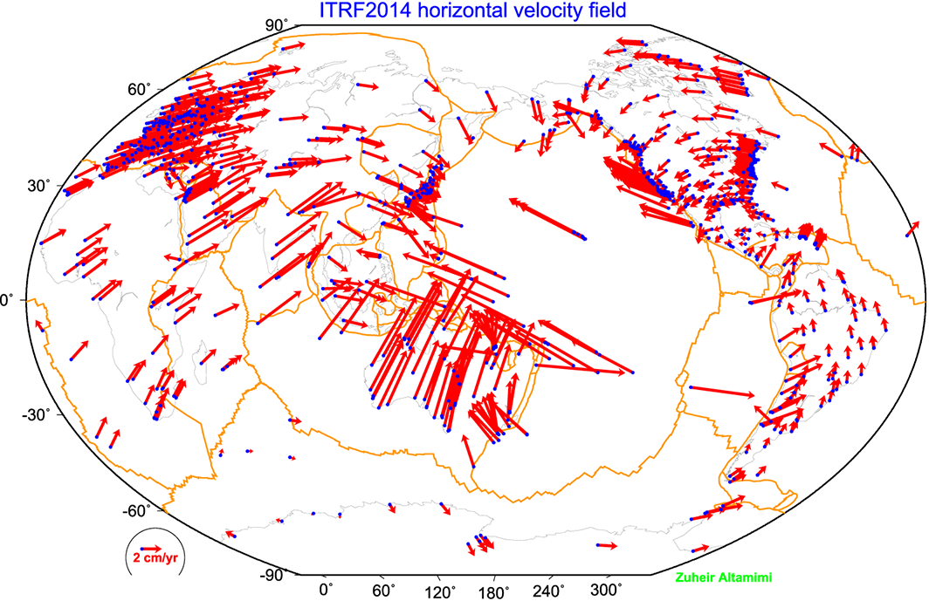
ITRF2014

Slide 13
ITRF2014
What are some general features of plate motion that you can see?
North America rotates around a point in the Pacific off South America
Eurasia and Africa appear to have very similar motions
Antarctica is moving very little
ITRF2014 is a not-net-rotation frame which is a mathematical construction. For some geophysical problems other frames may make more sense (e.g., mantle fixed, hot spot frame, specific plate).
Frames for different plates (based on Euler pole fits) are in ~/gg/tables.

Slide 14
Choices of reference frame
Choose your reference frame based on your geophysical objectives
  Velocities in ITRF are difficult to interpret visually from a geophysical perspective
    Local surroundings of a volcano
    One side of a fault
    Upper plate of a subduction zone
Major plate reference frame
  Major plates are often chosen to conform with conventional perspectives of velocity solutions
  Relative to Eurasia, Nubia, North America, South America, etc.
  But don’t feel restricted by this. Sometimes your geophysical discussion is best visualized relative to any stable boundary of a deforming region
Regional reference frame
  Central Valley of California, non-deforming part of Anatolia, smaller coherent regions, etc.
Local reference frame
  Sites near but outside the influence of a volcano, geothermal field, etc.

Slide 15
Examples
Expressing velocities in ITRF is not very meaningful or useful when we want to look at the deformation at a plate boundary, e.g. the San Andreas Fault system
Better to look at velocities with one side “fixed” so we can see what the other side is doing relative to it
NA
PA
NA
PA

Slide 16
Basic issues in reference frame realization
Concept is to align the estimated site positions and possibly velocity to a set of well defined locations that have physical significance for the analysis being performed (e.g., GAGE aligns to a realization of the North America plate based on ITRF2014)
glorg is the module which does this and computes the covariance matrix of the aligned solution in the reference frame chosen.
Transformation is often called an N-parameter Helmert transformation
  N = 3: translation only (could also be just rotation)
  N = 6: translation and rotation
  N = 7: translation, rotation and scale
In GLOBK analyses, you need to decide
  How many parameters (3/6/7)
  Sites to use to determine the parameters (sh_gen_stats)
  Values of the positions/velocities of the reference frame sites
  Weight to be given to heights in computing the transformation parameters (“cnd_hgtv” command; first two arguments for position and velocity, other arguments are sigma limits)
Notes:
Dong D., T. A. Herring, and R. W. King, Estimating Regional Deformation from a Combination of Space and Terrestrial Geodetic Data, J. Geodesy, 72, 200–214, 1998.

Slide 17
Rules for stabilization of time series
Small-extent network: translation-only in glorg, must constrain EOP in globk
Large-extent network: translation and rotation, must keep EOP loose in globk
If scale estimated in glorg, must estimate scale in globk
First pass for editing:
  Adequate “stab_site” list of stations with accurate a priori coordinates and velocities and available most days
  Keep in mind deficiencies in the list
Final pass for presentation, assessment and statistics
  Robust “stab_site” list of all/most stations in network, with coordinates and velocities determined from the final velocity solution
System is often iterated (velocity field solution, generate time series, editing and statistics of time series; re-generate velocity field)
If you have time series, you can test options using tscon
Notes:
Tscon takes the same commands as glorg but works with time series rather than full covariance matrixes and is therefore very fast.
Here’s a summary guide to maintaining a robust stabilization.

Slide 18
Use of equates
With earthquakes and discontinuities, there can be many site names for the same physically location:
  Equate commands in glorg allow the velocity adjustments at these sites to be made the same (or constrained to be the same within a specified sigma)
  “eq_dist” allows site separate by distance to equated (and constrained in latest glorg)
  “eq_4char” equates sites with same 4-character name (useful to stop equates at sites that share antennas)
  chi-squared increments of equates allows assessment of equates (use “unequate” for large chi-squared values)
  Use “FIXA” option to make a priori the same for equated sites (better to use consistent a priori file)

Slide 19
Uses of sh_gen_stats
Velocity solutions are often iterative:
  Generate time series using some reference frame sites (IGb14 sites initially for example)
  Fit to the time series (tsfit) to:
    Find outliers, nature of earthquakes (log needed?), discontinuities
    Self consistent a priori file.
    Used FOGMEx model (realistic sigma) to get process noise model and list of low-correlated noise reference frame sites). Use “stabrad” option for dense networks
  Run globk velocity solution to refine reference frame site coordinates and velocities
  Re-generate time series and repeat

Slide 20
Some comparisons: Approach
Use sh_exglk -f <soln.org> -vel <soln.vel> -rmdup
to extract velocity estimates (rmdup removes equated sites with the same estimates)
Program velrot allows fields to be compared (change frames and merge fields as well), for example:
velrot solna.vel nam14 solnb.vel IGb14 ‘’ ‘’ ‘’ ‘’ N
compares to solutions directly (use “RT” instead of “N” to allow rotation and translation rates)
  Use “grep ‘^S ‘” to get statistics

Slide 21
Comparisons: Decimation
Decimation: Different days of week (1996-2015 solution, small subset of sites):
Un-aligned fields
compare 1 NMT_vel_150418_day1.vel NMT_vel_150418_day3.vel
S Component North # 75 WMean -0.00 WRMS 0.04 mm/yr, NRMS 0.198
S Component East # 75 WMean -0.02 WRMS 0.04 mm/yr, NRMS 0.203
S Component Up # 75 WMean 0.03 WRMS 0.16 mm/yr, NRMS 0.180
S Component Horz # 75 WMean -0.01 WRMS 0.04 mm/yr, NRMS 0.200
compare 2 NMT_vel_150418_day1.vel NMT_vel_150418_day5.vel
S Component North # 74 WMean -0.01 WRMS 0.04 mm/yr, NRMS 0.207
S Component East # 74 WMean -0.02 WRMS 0.05 mm/yr, NRMS 0.225
S Component Up # 74 WMean 0.04 WRMS 0.19 mm/yr, NRMS 0.212
S Component Horz # 74 WMean -0.01 WRMS 0.04 mm/yr, NRMS 0.217
compare 3 NMT_vel_150418_day3.vel NMT_vel_150418_day5.vel
S Component North # 76 WMean -0.01 WRMS 0.03 mm/yr, NRMS 0.177
S Component East # 76 WMean -0.01 WRMS 0.03 mm/yr, NRMS 0.161
S Component Up # 76 WMean 0.01 WRMS 0.13 mm/yr, NRMS 0.142
S Component Horz # 76 WMean -0.01 WRMS 0.03 mm/yr, NRMS 0.169

Slide 22
Comparison: Time series vs GLOBK
PBO Combined analyses:
Un-aligned fields (no rotation and translation).
compare 1 PBO_vel_150425.vel PBO_vel_150425KF.vel
S Component North # 2105 WMean -0.01 WRMS 0.12 mm/yr, NRMS 0.925
S Component East # 2105 WMean -0.00 WRMS 0.13 mm/yr, NRMS 0.934
S Component Up # 2105 WMean 0.02 WRMS 0.31 mm/yr, NRMS 0.871
S Component Horz # 2105 WMean -0.01 WRMS 0.12 mm/yr, NRMS 0.929
compare 4 PBO_vel_150425.vel PBO_vel_150425_NAM08.vel
S Component North # 1972 WMean 0.03 WRMS 0.13 mm/yr, NRMS 0.965
S Component East # 1972 WMean 0.02 WRMS 0.15 mm/yr, NRMS 1.049
S Component Up # 1972 WMean -0.07 WRMS 0.41 mm/yr, NRMS 0.943
S Component Horz # 1972 WMean 0.02 WRMS 0.14 mm/yr, NRMS 1.008
compare 7 PBO_vel_150425KF.vel PBO_vel_150425_NAM08.vel
S Component North # 1969 WMean 0.04 WRMS 0.16 mm/yr, NRMS 0.952
S Component East # 1969 WMean 0.02 WRMS 0.17 mm/yr, NRMS 0.967
S Component Up # 1969 WMean -0.08 WRMS 0.44 mm/yr, NRMS 0.935
S Component Horz # 1969 WMean 0.03 WRMS 0.16 mm/yr, NRMS 0.959
PBO_vel_150425.vel: tsfit solution to time series
PBO_vel_150425KF.vel: tsfit Kalman filter solution to timeseries
PBO_vel_150425_NAM08.vel: GLOBK combined velocity solution (NMT+CWU), decimated 7 days, 28-subnet combination. Reference frame realization to NAM08 frame sites (~600)
See Herring et al., Reviews of Geophysics, 2016 for more detailed comparisons

Slide 23
Final comments
Practice large solutions with decimated data sets and small networks (run time increased cubically with number of stations)
Make sure your a priori coordinates files are consistent (especially with equates)
  Use the out_aprf command in tsfit to generate an a priori which is consistent with your timeseries estimates

