Slide 1



Fundamentals of GNSS for high-precision geodesy
M. A. Floyd T. A. Herring
Massachusetts Institute of Technology, Cambridge, MA, USA
GNSS Data Processing and Analysis with GAMIT/GLOBK and track
UNAVCO Headquarters, Boulder, Colorado, USA
18–22 July 2022
https://geoweb.mit.edu/gg/courses/202207_UNAVCO/
Material from R. W. King, T. A. Herring, M. A. Floyd (MIT) and S. C. McClusky (now at ANU)

Slide 2
Outline
GNSS Observables:
  GNSS data and the combinations of phase and pseudo-range used
Modeling the observations: Aspects not well modeled
  Multipath and antenna phase center models
  Atmospheric delay propagation
Limits of GNSS accuracy
  Monument types
  Loading (more later)
  Orbit quality
Notes:
This introduction is designed to give us a common language and a framework within which to approach the analysis of high-precision GNSS data. We’ll look at what data are used, how these data are treated in GAMIT and GLOBK, what factors limit their accuracy, and how we go about assessing that accuracy. Each of these aspects will be further developed in subsequent lectures.

Slide 3
Instantaneous positioning with GNSS pseudoranges
Receiver solution, teqc +qc or sh_rx2apr
Point position (svsp3): 5–100 m
Differential (svsp3): 1–10 m
Your location is:
37º 23.323’ N
122º 02.162’ W
Notes:
Since each satellite maintains time very accurately (~1 nanosecond = 30 cm), it can tag its signal with the time of transmission. This information, together with the location of the satellite, also transmitted to the receiver, is sufficient to allow the receiver to calculate the range to each satellite provided that the receiver also knows also knows the time. Equipping receivers with atomic clocks would be very expensive, so the receiver tags the signal with the time of its internal clock to create a “pseudorange” (range plus an unknown clock correction). The software in the receiver then uses the pseudoranges from four satellites to solve for the four unknowns: three coordinates and the receiver clock correction. These solution are good to only the 1 meter level, at best, due to the imprecision of pseudoranges, so we used them in GAMIT only to get initial approximate coordinates for sites, and, when positions are known, to get the receiver clock correction (1 m = 3 ns, and we need only 100 microsecond accuracy to get sub-mm accuracy in differential lpositioning.)

Slide 4
Precise positioning using phase measurements
High-precision positioning uses the phase observations
Long-session static: tracking of change in phase over time carries most of the information
The shorter the span the more important is ambiguity resolution
Each satellite (and station) has a different signature
Notes:
Rather than use the pseudorange, which can be measured only at the cm-to-decimeter level, we do precise positioning with the phase measurements, which can be measured at the mm-level. Since phase is ambiguous, at least initially, we rely on its change over time to reveal the signature of an error in station or satellite position. If there are enough measurements of enough satellites over enough time, these can be inverted to estimate relative positions of all the stations and the atmospheric delay. With a tracking session of ~8 hours, you can get sub-cm estimates even without resolving the two-pi ambiguity in phase. Resolving the ambiguities is more critical for the component of the baseline that is represented by the level rather than the rate-of-change of the phase. For all but high-latitude stations, this weaker component is east-west.

Slide 5
Observables in data processing
Fundamental observations
  L1 phase = f1 × range (λ = 19 cm) L2 phase = f2 × range (λ = 24 cm)
  C1 or P1 pseudorange used separately to get receiver clock offset (time)
To estimate parameters use doubly-differenced observables
  LC = 2.55 L1 − 1.98 L2 “ionosphere-free phase combination” (L1 cycles)
  PC = 2.55 P1 − 1.55 P2 “ionosphere-free range combination” (meters)
Double differencing (DD) cancels clock fluctuations; LC cancels almost all of ionosphere. Both DD and LC amplify noise (use L1 and L2 directly and independently for baselines < 1 km)
Auxiliary combinations for data editing and ambiguity resolution:
“geometry-free combination (LG)” or “extra wide-lane” (EX-WL)
  LG = L2 − f2/f1 L1 (used in GAMIT)
  EX-WL = L1 − f1/f2 L2 (used in track)
  Removes all frequency-independent effects (geometric & atmosphere) but not multipath or ionosphere
Melbourne-Wubbena wide-lane (MW-WL): phase/pseudorange combination that removes geometry and ionosphere; dominated by pseudorange noise
  MW-WL = N1 − N2 = (L1 − L2) − (Df/Sf)(P1 + P2) = (L1 − L2) − 0.12(P1 + P2)
With GNSS processing, other frequencies are available (and changing with time).
Notes:
The measurements are recorded on a receiver’s data file, which we use in the form of the IGS-standard “RINEX” (“Receiver Independent Exchange” format) file, and translate to a GAMIT ‘X-file’ of similar format for processing. The primary entries in the file are the phase and pseudorange at each of the two L-band GNSS frequencies (L1 and L2) at each sampling interval, usually, 30 s.
To cancel the direct effect in the phase of variations in the satellite’s and receiver’s oscillators (not the same as inferring the time of the measurements, to which we are less sensitive), we difference the phases: differencing two satellite cancels the receiver clock; differencing two receivers cancels the satellite clock.
Finally, since the ionospheric delay is frequency-dependent, we combine the doubly differenced L1 and L2 in such a way that the first-order ionospheric delay is removed (2nd and 3rd order are < 1 cm most of the time). This is our primary observable, which we denote LC (linear-combination; Bernese uses the notation L3)
Another useful observable is the difference between L1 and L2 simply scaled by the wavelength (or “gear ratio”), which we call LG (Bernese uses L4). This combination, which you can view with cview, cancels all of the geometry and atmospheric dleay, that is, all effects that are not frequency dependent, leaving only the ionospbere and signal scattering/mutlipath
Finally, we use two combinations of phase and pseudoranges called “wide-lanes” because their effective wave-length is long (86 cm) and can be exploited in resolving ambiguities. An important thing to note here is that the MW-WL, used to resolve the WL (L2-L1) ambiguity needs empirical corrections for the receiver type and is satellite-dependent. These are the Differential Code Biases (DCBs) that must be updated monthly using the dcb.dat file.

Slide 6
Modeling the observations
I. Conceptual/Quantitative
Motion of the satellites
  Earth’s gravity field (flattening effect approx. 10 km; higher harmonics 100 m)
  Attraction of Moon and Sun (100 m )
  Solar radiation pressure (20 m): Different for different GNSS types
Motion of the Earth
  Irregular rotation of the Earth (5 m)
  Luni-solar solid-Earth tides (30 cm)
  Loading due to the oceans, atmosphere, and surface water and ice (10 mm)
Propagation of the signal
  Neutral atmosphere (dry 6 m; wet 1 m)
  Ionosphere (10 m but LC corrects to a few mm most of the time)
  Variations in the phase centers of the ground and satellite antennas (10 cm)
* incompletely modeled
Notes:
These are the effects that need to be modeled in any analysis software. Some of them, like the Earth’s gravity field and the attraction of the Moon and Sun are very large, but can be modeled with negligible error using well-know dynamical equations. The irregular rotation of the Earth is also large but well-known from global observations using satellite-laser ranging (SLR), very-long-baseline interferometry (VLBI), and global GNSS tracking. We’ve shown red the effects that cannot be well modeled and either must be estimated or remain as potential sources of error.

Slide 7
Modeling the observations
II. Software structure
Satellite orbit
  IGS tabulated ephemeris (Earth-fixed SP3 file) [track]
  GAMIT tabulated ephemeris (t-file): numerical integration by arc in inertial space, fit to SP3 file, may be represented by its initial conditions (ICs) and radiation-pressure parameters; requires tabulated positions of Sun and Moon
Motion of the Earth in inertial space [model or track]
  Analytical models for precession and nutation (tabulated); IERS observed values for pole position (wobble), and axial rotation (UT1)
  Analytical model of solid-Earth tides; global grids of ocean and atmospheric tidal loading
Propagation of the signal [model or track]
  Zenith hydrostatic (dry) delay (ZHD) from pressure (met-file, VMF1, or GPT)
  Zenith wet delay (ZWD) [crudely modeled and estimated in solve or track]
  ZHD and ZWD mapped to line-of-sight with mapping functions (VMF1 grid or GMF)
  Variations in the phase centers of the ground and satellite antennas (ANTEX file)
Notes:
This slide shows how the models are incorporated into GAMIT.

Slide 8
Parameter estimation
Phase observations [solve or track]
  Form double difference LC combination of L1 and L2 to cancel clocks & ionosphere
  Apply a priori constraints
  Estimate the coordinates, ZTD, and real-valued ambiguities
  Form M-W WL and/or phase WL with ionospheric constraints to estimate and resolve the WL (N2 − N1) integer ambiguities [autcln (or solve), track]
  Estimate and resolve the narrow-lane (NL) ambiguities [solve, track]
  Estimate the coordinates and ZTD with WL and NL ambiguities fixed
    Estimation can be batch least squares [solve] or sequential (Kalman filter) [track]
Quasi-observations from phase solution (h-file) [globk]
  Sequential (Kalman filter)
  Epoch-by-epoch test of compatibility (χ² increment) but batch output
Notes:
After a model of the observations (“observables”) is constructed, this model is subtracted from the actual observations, yielding a “residual” or “O-C”, which is used together with the partial derivatives of the observations with respect to each parameter to estimate the a correction to the a priori parameter values. We do this in GAMIT with a least-squares estimator, in GLOBK with a Kalman filter, which reduces to sequential least squares if there is no stochastic variation applied.
Because the wide-lane ambiguities are only weakly dependent on the geometry, they are more easily resolved in the data-editing module “autcln” than in the parameter estimator “solve”. The kinematic module “track” does all of this within a single module.

Slide 9
Limits of GNSS accuracy
Signal propagation effects
  Signal scattering ( antenna phase center / multipath )
  Atmospheric delay (mainly water vapor)
  Ionospheric effects
  Receiver noise
Unmodeled motions of the station
  Monument instability
  Loading of the crust by atmosphere, oceans, and surface water
Unmodeled motions of the satellites
Reference frame
Notes:
The four catagories I’ve listed here is a useful way to think about errors in GNSS measurements. For studying global phenomena they are all potentially important, but I’m going to concentrate today on measurements on continental scale. For these intersite distances, we now know the orbits of the satellites well enough that their contribution is usually small. So we’ll look at effects in signal propagation and uninteresting motions of the receiving antenna. In signal propagation, first order ionospheric effects are removed in all high precision work by combining signals at the two GNSS frequencies. And for modern observations, receiver noise is nearly negligible. So we’re left with scattering effects and the atmosphere.

Slide 10
Limits of GNSS accuracy
Signal propagation effects
  Signal scattering (antenna phase center / multipath)
  Atmospheric delay (mainly water vapor)
  Ionospheric effects
  Receiver noise
Unmodeled motions of the station
  Monument instability
  Loading of the crust by atmosphere, oceans, and surface water
Unmodeled motions of the satellites
Reference frame
Notes:
We’ll start with signal propagation, first signal scattering.

Slide 11
Multipath is interference between the direct and a far-field reflected signal (geometric optics apply)
To mitigate the effects:
Avoid reflective surfaces
Use a ground plane antenna
Avoid near-ground mounts
Observe for many hours
Remove with average from many days
Reflected Signal
Direct Signal
Reflected Signal
Notes:
Because the satellite move across the sky, the direct and reflected signal go in and out of phase, with a time interval that is dependent on the distance of the reflector from the antenna. We’ll illustrate this in the next slide.

Slide 12
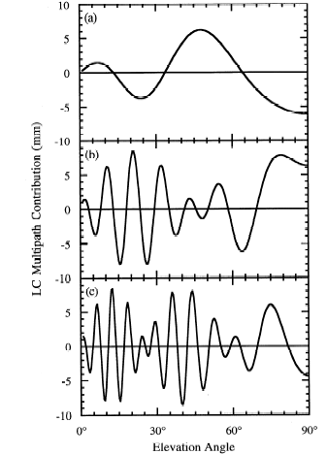
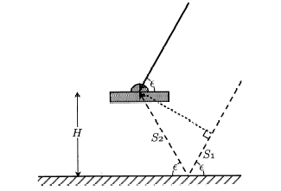
Antenna height
0.15 m
0.6 m
1 m
Simple geometry for incidence of a direct and reflected signal
Multipath contributions to observed phase for three different antenna heights (from Elosegui et al., 1995)
Notes:
RIGHT SIDE is predicted variations for three heights.
The most common and dominant source of high-frequency multipath is reflection from the horizontal surface beneath the antenna. If this surface is far enough away from the antenna (1-2 m) to be outside the fresnel zone (no interaction with the antenna itself), then geometric optics allows us to model the signal well enough to predict the frequency. This slide shows a theoretical model of horizontal reflections as a function of height above the ground. For an antenna mounted 1-2 m above the surface, the variations will be of the order of minutes, and tend to have low (though not always negligible) correlations with the signature of the station’s coordinates and the atmospheric delay, strongly dependent on the length of the tracking sessions. Once you get within a half-meter, though, the longer period variations are a real problem. And this is even without taking into account the interaction with the antenna structure.

Slide 13
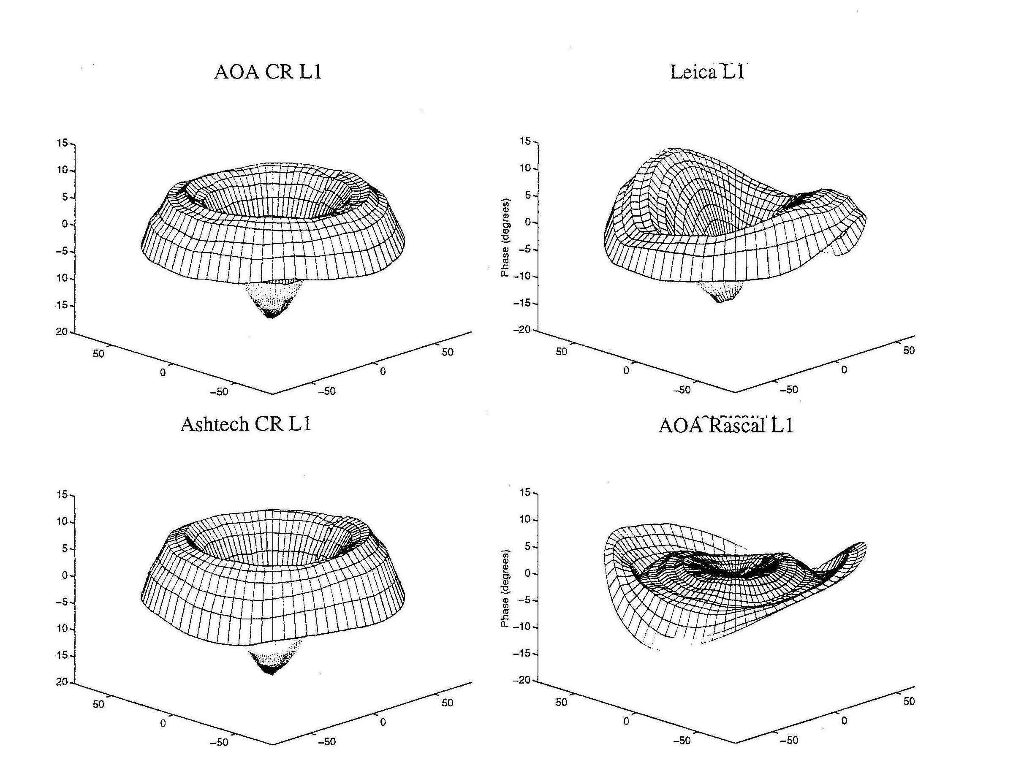
More dangerous are near-field signal interactions that change the effective antenna phase center with the elevation and azimuth of the incoming signal
Antenna phase patterns
Right: Examples of the antenna phase patterns determined in an anechoic chamber…BUT the actual pattern in the field is affected by the antenna mount
To avoid height and ZTD errors of centimeters, we must use at least a nominal model for the phase-center variations (PCVs) for each antenna type
Figures courtesy of UNAVCO
Notes:
The first problem we have is that the phase-response pattern of any physical antenna is not spherical. So the effective phase center ---the point to which you want to refer the location of the ground monument---varies as a function of elevation angle, and hence changes if you use a different minimum cutoff—which can happen when you change receivers or cables because of the change in SNR. Sometimes, the patterns also vary with azimuth, as with the Leica and Rascal antennas here, but most of the antennas used for high precision work have symmetric patterns. L1 phase variations for antennas tested by UNAVCO. Zenith values at the center and values for 10 degrees elevation at the edges. 10 deg L1 phase = 5 mm. The phase center variations (PCVs) and the phase center offsets (PCOs, the constant part of the pattern) are tabulated from external measurements on the ANTEX file distributed by the IGS. The ANTEX file also includes models for the satellite antennas, and hence needs to be updated with each new launch or reassignment of a PRN number to a different satellite.

Slide 14
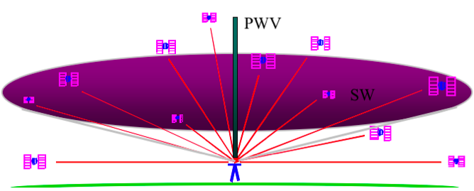
Atmospheric delay
The signal from each GNSS satellite is delayed by an amount dependent on the pressure and humidity and its elevation above the horizon. We invert the measurements to estimate the average delay at the zenith (green bar).
(Figure courtesy of COSMIC Program)
Notes:
This slide illustrates the effect of the atmospheric delay. We handle this in GAMIT by assuming that the delay is azimuthally symmetric or can be represented by a north-south and east-west gradients modeled as an inclined plane. We then estimate as a function of time parameters representing the error in the zenith delay (usually at 2-hr intervals) and the gradients (usually a straight-line over the day).

Slide 15
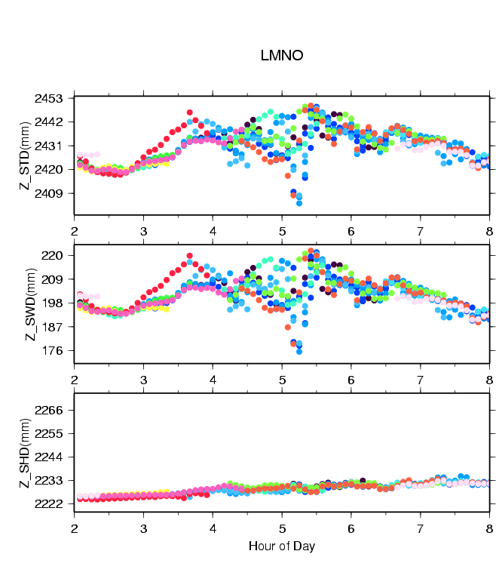
Zenith delay from wet and dry components of the atmosphere
Colors are for different satellites
Total delay is ~2.5 meters
  Variability mostly caused by wet component
Wet delay is ~0.2 meters
  Obtained by subtracting the hydrostatic (dry) delay
Hydrostatic delay is ~2.2 meters
  Little variability between satellites or over time
  Well calibrated by surface pressure
Plot courtesy of J. Braun, UCAR
Notes:
The three figures on the left show time series variations in hydrostatic (“dry”) delay due to (usually smooth) pressure changes (bottom), variations due to the water vapor (“wet”) delay (middle) and the sum of these two (top), in this case from the passing of a squall line. Pressure data from local barometers or, more often, numerical weather models allow us to calibrate well the hydrostatic delay but surface measurements are almost useless for getting the integrated delay from water vapor, so that’s essential what we’re estimating with our zenith-delay parameters.

Slide 16
Multipath and water vapor effects in the observations
One-way (undifferenced) LC phase residuals projected onto the sky in 4-hr snapshots. Spatially repeatable noise is multipath; time-varying noise is water vapor.
Red is satellite track. Yellow (positive) and green (negative) residuals purely for visual effect.
Red bar is scale (10 mm).
Notes:
You’ll see plots like this many times over the next four days, and you will learn to use them in your analysis. They show a projection onto the sky (north to the right, a GMT “feature”) of the phase residuals after removing all known models and estimating coordinates and atmospheric parameters, for the satellites visible in each of three 4-hr windows. The pattern of satellite motion is what you see at northern mid-latitudes, with a “hole” at around the pole. At high latitude, motions would be mainly east-west, as you see near the polar hole; near the equator the motions would be nearly N-S, with little E-W variation. The red bar is a scale, equal 10 mm, and the green and yellow colors are imposed for positive and negative residualls. Almost all of the noise you see is due to multipath (never modeled) and unmodeled short-period variations in water vapor. The very short-period oscillations that are similar over time in a partcular part of the sky (e.g. near an azimuth of 150 degrees) are multipath. The less regular variations that do not repeat over time are water vapor (e.g. near 90 degrees between 20-24 hour).

Slide 17
Limits of GNSS accuracy
Signal propagation effects
  Signal scattering (antenna phase center / multipath)
  Atmospheric delay (mainly water vapor)
  Ionospheric effects
  Receiver noise
Unmodeled motions of the station
  Monument instability
  Loading of the crust by atmosphere, oceans, and surface water
Unmodeled motions of the satellites
Reference frame
Notes:
Next we’ll look at station motion that is non-tectonic. Instability of the monument, by which we mean motions over a scale of cm to meters, are rarely interesting and are to be avoided by choice of site and choice of monument. Loading of the ground by changes in atmospheric pressure, ocean mass, snow cover, and ground water could be “signal” for some investigators but are usually noise for tectonic and meteorological studies.

Slide 18
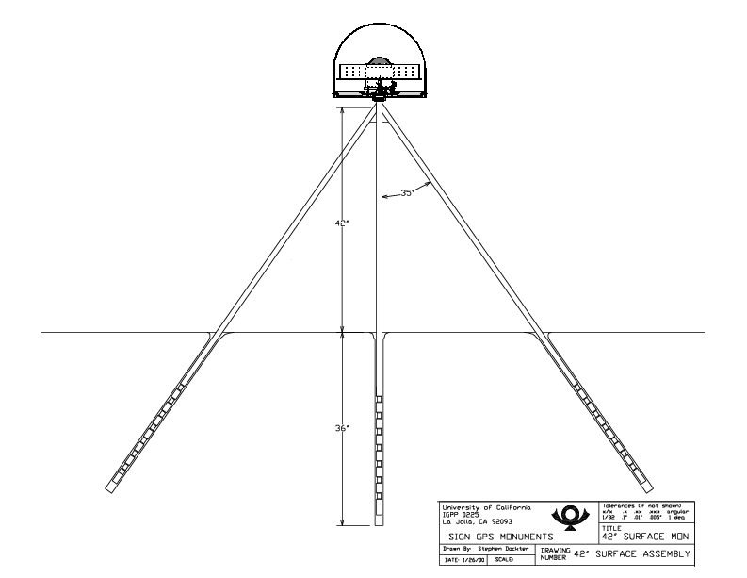
Monuments anchored to bedrock are critical for tectonic studies
(not so much for atmospheric studies)
Good anchoring:
Pin in solid rock
Drill-braced (left) in fractured rock
Low building with deep foundation
Not-so-good anchoring:
Vertical rods
Buildings with shallow foundation
Towers or tall building (thermal effects)
Notes:
The stability of a site cannot be judged with 100% confidence, but there are guidelines you can follow: choose an area in which the soil is as consolidated as possible, stay away from unstable slopes and basins likely to collect moisture, Likewise, there is no perfect monument, but some designs have been shown to be better than others in coupling the mount to the surrounding rock. If you forced to operate in unconsolidated soil, the best monument design is the one shown here, “drill braced”, with the rods penetrating up to 10 m into the ground.

Slide 19
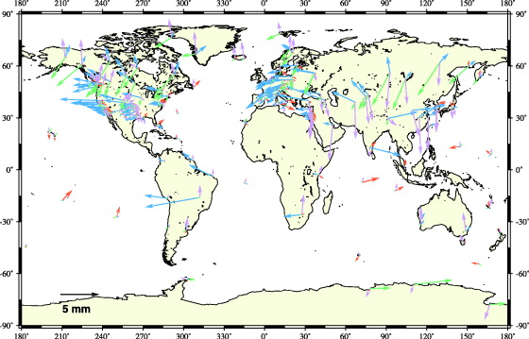
Annual component of vertical loading
Atmosphere (purple)
2-5 mm
Water/snow (blue/green)
2-10 mm
Nontidal ocean (red)
2-3 mm
From Dong et al. J. Geophys. Res., 107, 2075, 2002
Notes:
Loading of the ground due to ocean tides and non-tidal changes in ocean depth, changes in atmospheric pressure, and changes in snow and ground-water affects mainly vertical position, but can be non-negligible in horizontal position. The map here, shows roughly the annual component of vertical displacement due to the atmosphere, hydrology, a non-tidal ocean mass changes, not modeled in our standard processing. Note the large displacements from atmospheric loading in the middle of the continents where there is a large area over which pressure systems can exert their influence., and the large displacements from hydrological loading in regions of high precipitation. Large non-tidal ocean loading is most likely from storm surges in enclosed basins like the North Sea. Not show are ocean tidal effects, which are well-modeled for most regions but poor at high latitudes due to limited coverage by the altimetric satellites used to image the tides. Note that as for atmospheric loading, the size of the effect depends on the total mass of the loading, so high local tides due to an irregular coastline do not mean higher loading.
We model the ocean tidal loading in GAMIT using either a global grid (otl.grid) or site-specific values (otl.list), both provided by Hans-Georg Scherneck of Onsala Space Observatory. We also provide the option of modeling in GAMIT (or soon, GLOBK), the the effects of atmospheric loading using global grids constructed from numerical weather models (atml.grid linked to, e.g. atmfillt.2009). There are not yet good models for hydrological loading (water/snow) or non-tidal ocean lloading, so these remain important sources of error in some regions.

Slide 20
Limits of GNSS accuracy
Signal propagation effects
  Signal scattering (antenna phase center / multipath)
  Atmospheric delay (mainly water vapor)
  Ionospheric effects
  Receiver noise
Unmodeled motions of the station
  Monument instability
  Loading of the crust by atmosphere, oceans, and surface water
Unmodeled motions of the satellites
Reference frame
Notes:
IGS final orbits for most satellites are at the cm level during the 1990s, reducing to 2 cm by by 2002

Slide 21
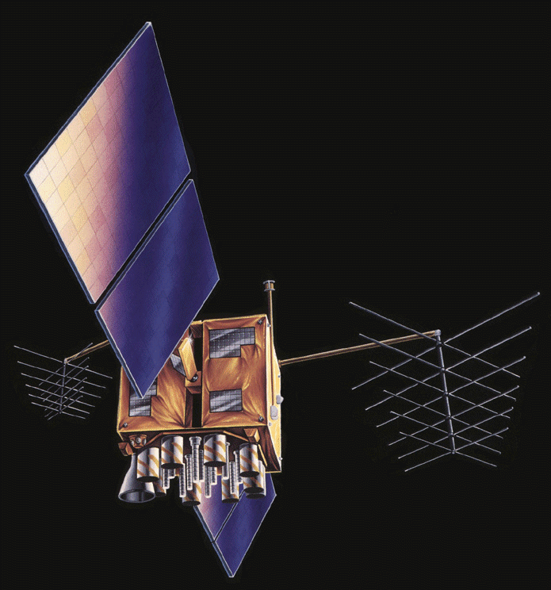
GPS Satellite
Limits to model are non-gravitational accelerations due to solar and Earth radiation, unbalanced thrusts, and outgassing; and non-spherical antenna pattern
Modeling of these effects has improved, but for global analyses remain a problem
Parametric models are used in GAMIT and these evolve with time (and version)
Notes:
In global analyses, we model radiation pressure effects by estimating constant and once-per-revolution variations in the acceleration in a direction perpendicular to the solar panels (direct), a direction along the panel supports (y-axis), and a third direction perpendicular to the first two (B-axis). When we fit the GAMIT (‘arc’) model to an IGS orbit (sp3 file), we adjust these accelerations. The fit of our model to the IGS final orbits is typically 5-10 mm.

Slide 22
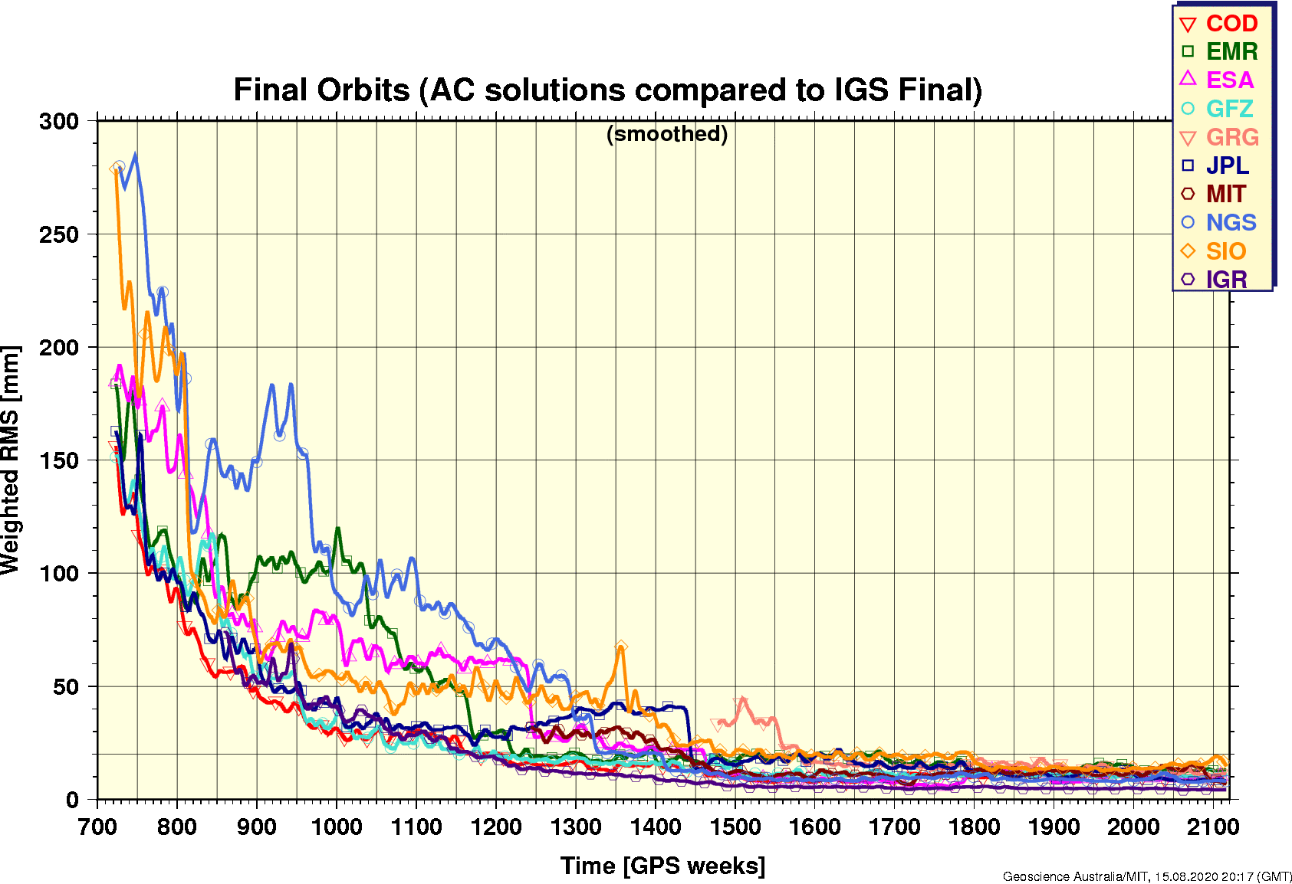
Quality of IGS Final Orbits 1994-2020/08
20 mm = 1 ppb
(http://www.igs.org/analysis/gps-final)
Analysis centers now
< 15 mm RMS difference
2000/1/1 Week 1042
Notes:
This graph shows the improvement in agreement among the orbits generated by 9 IGS Analysis Centers using 6 different software packages from 1994 through mid-2011. By itself, the agreement doesn’t guarantee that the orbits are accurate at this level, but our analysis of station-position repeatability suggests that the 1-2 cm level (0.5-1 parts per billion) seen among the best centers since 2002 is not far off, suggesting that orbital errors are not important for regional networks up to several thousand kilometers.

Slide 23
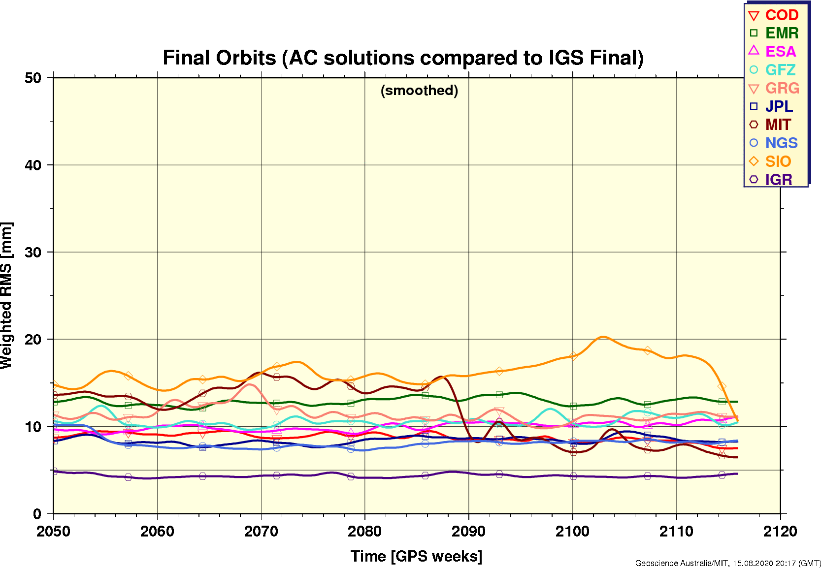
Quality of IGS Final Orbits 2019/08-2020/08
20 mm = 1 ppb
(http://www.igs.org/analysis/gps-final)
Analysis centers now
< 10 mm RMS difference.
Brown line is MIT GAMIT showing impact of SRP model improvements in version 10.71
MIT
Notes:
This graph shows the improvement in agreement among the orbits generated by 9 IGS Analysis Centers using 6 different software packages from 1994 through mid-2011. By itself, the agreement doesn’t guarantee that the orbits are accurate at this level, but our analysis of station-position repeatability suggests that the 1-2 cm level (0.5-1 parts per billion) seen among the best centers since 2002 is not far off, suggesting that orbital errors are not important for regional networks up to several thousand kilometers.

Slide 24
Limits of GNSS accuracy
Signal propagation effects
  Signal scattering (antenna phase center / multipath)
  Atmospheric delay (mainly water vapor)
  Ionospheric effects
  Receiver noise
Unmodeled motions of the station
  Monument instability
  Loading of the crust by atmosphere, oceans, and surface water
Unmodeled motions of the satellites
Reference frame
Notes:
Finally, we need to worry about the reference frame: how we apply constraints on the solution. This is almost always done in GLOBK, with GAMIT constraints approximate (5-10 cm), just enough to allow ambiguities to be resolved.

Slide 25
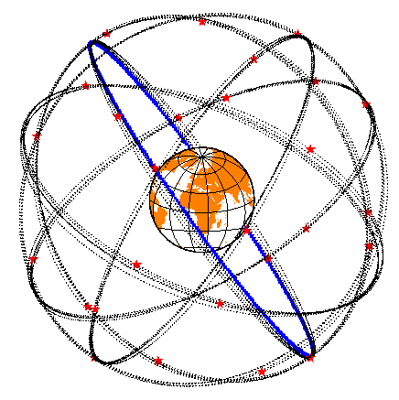
Reference frames
Basic Issue: How well can you relate your position estimates over time to:
  A set of stations whose motion is well modeled?
  A block of crust that allows you to interpret the motions?
Implementation: How to use the available data and the features of GLOBK to realize the frame(s)
Both questions to be addressed in detail in later lectures

Slide 26
Effect of Orbital and Geocentric Position Error (Uncertainty)
High-precision GNSS is essentially relative!
Baseline error (uncertainty) ~ Baseline length × geocentric SV or position error
SV altitude
SV errors reduced by averaging:
  Baseline errors are ~ 0.2 × orbital error/20,000 km
  e.g. 20 mm orbital error = 1 ppb or 1 mm on 1000 km baseline
Network (“absolute”) position errors less important for small networks
  e.g. 5 mm position error ~ 1 ppb or 1 mm on 1000 km baseline
  10 cm position error ~ 20 ppb or 1 mm on 50 km baseline
But SV and position errors are magnified for short sessions
Notes:
In order to understand reference frame issues (mainly in GLOBK) and constraints needed in GAMIT, you need to appreciate that the errors or constraints imposed on the orbits or network as a whole (e.g. on one site or an average of several sites) are reduced in their effects on relative position within a regional network by the ratio of the separation of the regional sites to the separation of the sites or satellites used to define the frame. This means, for example, that for a small network, you do not need to constrain the absolute position very tightly to avoid propagating the uncertainty in the geocentric position into the relative positions within the network. For a 50-km network, a 10 cm constraint may be sufficient. For a 5-km network, 1 meter is enough.

Slide 27

Summary
GNSS observables
  GNSS data and the combinations of phase and pseudo-range used
Modeling the observations: Aspects not well modeled are
  Multipath and antenna phase center models
  Atmospheric delay propagation
Limits of GNSS accuracy
  Monument types
  Loading (more later)
  Orbit quality: Since 2000 less than 40 mm, corresponding to 2 ppb
    Hard to improve on the IGS orbits

Slide 28
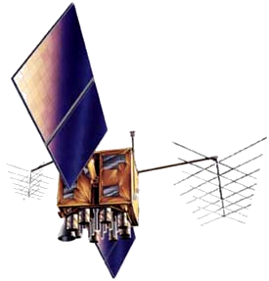
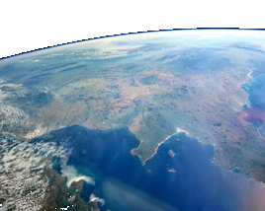
Pseudorange
Receiver-generated
T
t
Satellite-received
T
T+t
~ 20,200 km
T+t
Notes:
Code modulated onto two L-band (approximately microwave) carrier frequencies. Code sent from satellite and generated in receiver at time T. Signal received at time T+t. Difference is travel time, t.

Slide 29
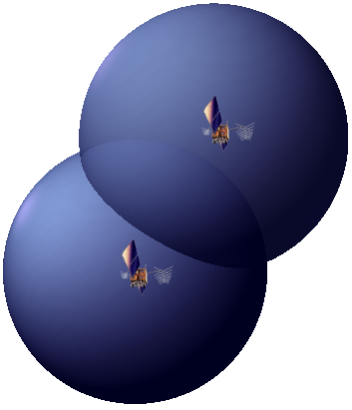
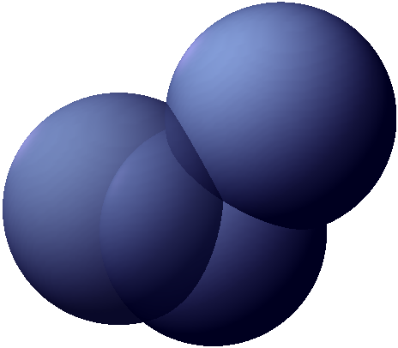
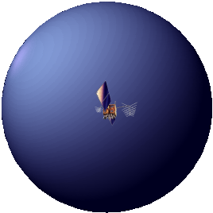
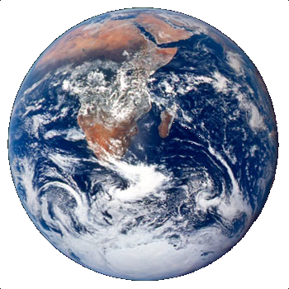
Pseudorange
But…
t is travel time (as measured by clocks in the satellite and receiver), which is subject to error between these clocks.
So…
We need a minimum of four satellites in order to solve for an additional unknown, the clock bias.
R
z (0°E, 90°N)
R
R_{REC}
R_{SAT}
R_{REC}
y (90°E, 0°N)
R = │ R_{sat} – R_{rec} │
R = c[(T+t) – T] = ct
x (0°E, 0°N)
(ct_{sati–rec})² = (x_{sati} – x_{rec})² + (y_{sati} – y_{rec})² + (z_{sati} – z_{rec})²
Notes:
Geocentric (Earth-centred) co-ordinate system. Vector defining satellite position (“known”), vector defining receiver position (unknown), and vector defining signal path (observable). One satellite broadcasting signal allows us to fix receiver position on a sphere, two for on a circle, three for one of two points (one of which will be unrealistic).

