Slide 1



Reference frames
T. A. Herring M. A. Floyd
Massachusetts Institute of Technology, Cambridge, MA, USA
GNSS Data Processing and Analysis with GAMIT/GLOBK and track
UNAVCO Headquarters, Boulder, Colorado, USA
18–22 July 2022
https://geoweb.mit.edu/gg/courses/202207_UNAVCO/
Material from R. W. King, T. A. Herring, M. A. Floyd (MIT) and S. C. McClusky (now at ANU)

Slide 2
Reference frames
Physical realization of reference system
Requires fixed measurement sites which are defined by position and velocity in the reference frame and thus constitute realizing the system
  VLBI
  SLR
  GNSS
Non-linear motions are now also included.

Slide 3
Ultimately, everything is relative
Even “absolute positioning” is relative to some coordinate origin, orientation and scale
So what is “global positioning”?
The center and rotation pole of Earth define our coordinate axes
  But how to we know where the center of the Earth is?
  Do we really care?
    It depends on your goals
No-net-rotation criterion (surface integral of angular velocity is zero) is usually used as the constraint on defining a terrestrial reference frame in the presence of surface motions (plate tectonics)

Slide 4
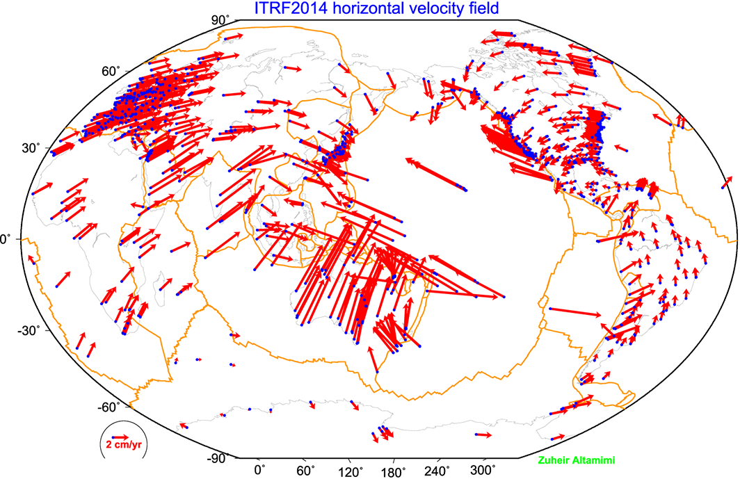
ITRF2014

Slide 5
ITRF2014
What are some general features of plate motion that you can see?
North America rotates around a point in the Pacific off South America
Eurasia and Africa appear to have very similar motions
Antarctica is moving very little
ITRF2014 is a not-net-rotation frame which is a mathematical construction. For some geophysical problems other frames may make more sense (e.g., mantle fixed, hot spot frame, specific plate).
Frames for different plates (based on Euler pole fits) are in ~/gg/tables.

Slide 6
Choices of reference frame
Choose your reference frame based on your geophysical objectives
  Velocities in ITRF are difficult to interpret visually from a geophysical perspective
    Local surroundings of a volcano
    One side of a fault
    Upper plate of a subduction zone
Major plate reference frame
  Major plates are often chosen to conform with conventional perspectives of velocity solutions
  Relative to Eurasia, Nubia, North America, South America, etc.
  But don’t feel restricted by this. Sometimes your geophysical discussion is best visualized relative to any stable boundary of a deforming region
Regional reference frame
  Central Valley of California, non-deforming part of Anatolia, smaller coherent regions, etc.
Local reference frame
  Sites near but outside the influence of a volcano, geothermal field, etc.

Slide 7
Examples
Expressing velocities in ITRF is not very meaningful or useful when we want to look at the deformation at a plate boundary, e.g. the San Andreas Fault system
Better to look at velocities with one side “fixed” so we can see what the other side is doing relative to it
NA
PA
NA
PA

Slide 8
Basic issues in reference frame realization
Concept is to align the estimated site positions and possibly velocity to a set of well defined locations that have physical significance for the analysis being performed (e.g., GAGE aligns to a realization of the North America plate based on ITRF2014)
glorg is the module which does this and computes the covariance matrix of the aligned solution in the reference frame chosen.
Transformation is often called an N-parameter Helmert transformation
  N = 3: translation only (could also be just rotation)
  N = 6: translation and rotation
  N = 7: translation, rotation and scale
In GLOBK analyses, you need to decide
  How many parameters (3/6/7)
  Sites to use to determine the parameters (sh_gen_stats)
  Values of the positions/velocities of the reference frame sites
  Weight to be given to heights in computing the transformation parameters (“cnd_hgtv” command; first two arguments for position and velocity, other arguments are sigma limits)
Notes:
Dong D., T. A. Herring, and R. W. King, Estimating Regional Deformation from a Combination of Space and Terrestrial Geodetic Data, J. Geodesy, 72, 200–214, 1998.

Slide 9
Reference frame implementation
Any vector may be mapped from one coordinate system to another by the application of
  Translation (affects position of co-ordinate origin)
  Rotation (affects orientation of co-ordinate axes)
  Scale (affects length of co-ordinate axes and maps into heights in the network). It is important to note that scale changes are just changes to the average height differences in the network. It is very common to estimate scale changes but be aware that this impacts estimates of height changes.

Slide 10
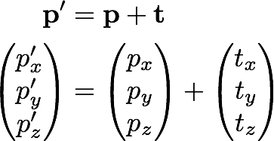
1: Translation

Slide 11
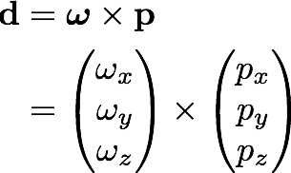
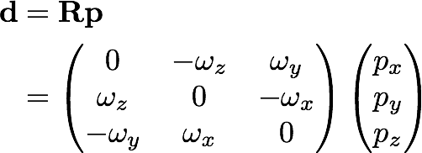
2: Rotation
Rotation vector, ω, is defined as in the direction of the rotation axis with length equal to the magnitude of angular rotation
Displacement (or velocity) vector then makes a right-handed triplet with the rotation vector, ω, and radial vector, p.

Slide 12
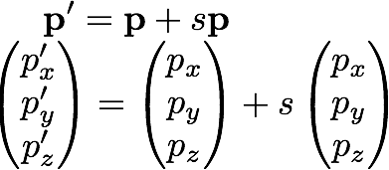
3: Scale
Scale estimation has a direct effect on the average height adjustments in the network so be cautious if your interested in height changes over the region of your reference frame definition.

Slide 13
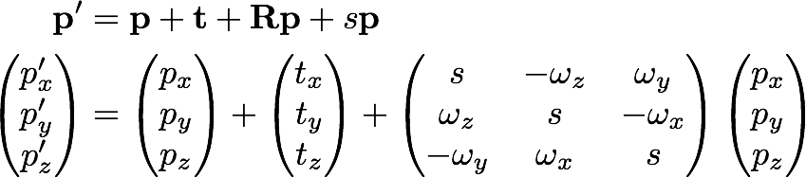
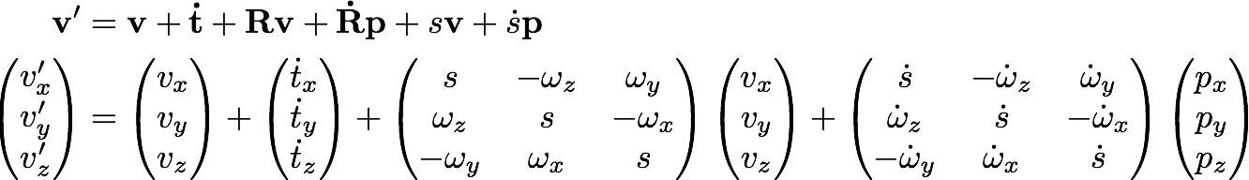
Helmert transformation
Position
Velocity
Usually, the terms Rv and sv are very small and can be neglected (< 10⁻⁶ rad × < 0.1 m/yr and < 0.1 ppb × < 0.1 m/yr, respectively)

Slide 14
Reference frames in geodetic analyses
Output from GAMIT
  Loosely constrained solutions
  Relative position well determined, “absolute” position weakly defined
  Need a procedure to express coordinates in a well defined reference frame
Two aspects
  Theoretical (e.g. rigid block, mantle-fixed, no-net-rotation of plates)
  Realization through a set of coordinates and velocities
    “Finite constraints”: a priori sigmas on site coordinates
    “Generalized constraints”: minimize coordinate residuals while adjusting translation, rotation, and scale parameters
Three considerations in data processing and analysis
  Consistent with GNSS orbits and EOP (NNR)
    not an issue if network small or if orbits and EOP estimated
  Physically meaningful frame in which to visualize site motions
  Robust realization for velocities and/or time series
Notes:
The key point here is that maintaining a consistent frame in your velocity solution but particularly in your time series, is important for getting a geodetic robust result, the manner by which this done and the frame in which it is realized need not be the frame of primary physical interest. The maintenance of a consistent frame is what we accomplish through “stabilization” in glorg. Relating this frame to a plate or block can be done afterward with a different set of sites.

Slide 15
Frame definition with finite constraints
Applied in globk (glorg not called)
We do not recommend this approach since it is sensitive to over-constraints that can distort velocities and positions but some small networks (e.g., volcanoes) this may be easiest approach.
Example:
  apr_file igb14_comb.apr
  apr_neu all 10 10 10 1 1 1
  apr_neu algo .005 .005 .010 .001 .001 .003
  apr_neu pie1 .005 .005 .010 .001 .001 .003
  apr_neu drao .005 .005 .010 .002 .002 .005
  ...
Most useful when only one or two reference sites or very local area
Disadvantage for large networks is that bad a priori coordinates or bad data from a reference site can distort the network

Slide 16
Frame definition with generalized constraints
Applied in glorg: minimize residuals of
reference sites while estimating
translation, rotation, and/or scale (3–7
parameters)
  apr_file igb14_comb.apr
  pos_org xtran ytran ztran xrot yrot zrot
  stab_site algo pie1 drao ...
  cnd_hgtv 10 10 0.8 3.
  stab_it 4 0.5 2.5
All reference coordinates free to adjust (anomalies more apparent), outliers are iteratively removed by glorg
Network can translate and rotate but not distort (no strain except rotational)
Works best with strong redundancy (number and [if rotation] geometry of coordinates exceeds number of parameters)
Notes:
This is the preferred method. Must be careful due to glorg’s iterative removal or poorly fitting sites that the ultimate solution still has enough redundancy and stabilization power. Look through first hundred lines or so of . Can change statistics in cnd_hgtv and stab_it to control .

Slide 17
Defining a reference frame with glorg
Create an .apr-file for use by glorg
  Apply known rotation rate to .apr-file (e.g. igb14_comb.apr → igb14_comb_eura.apr)
  Zero velocity .apr-file records (and iterate using sh_exglk to create updated .apr-file)
Define set of sites (must be included in GAMIT processing or other H-file input to GLOBK) which define stable region
  “plate” in glorg command file can be used to estimate Euler pole of user defined plate.

Slide 18
Stabilization using a global set of sites
Use 40 or more sites with good velocities determined in the ITRF frame
The igb14_comb.apr file, when used together with igb14_comb.eq to account consistently for instrumental changes over time, provides the widest choice of sites, 1992–2020
Combining your solution with the MIT SINEX files (available from CDDIS) which have 350-sites each day.
  You need just 4–6 common sites (more is better), which should be of high quality but need not be well know in ITRF2014 since these “tie” sites do not need to be in your frame-realization list. (Use -a option in htoglb and estimate EOP).
For global ITRF stabilization, you can use the hierarchical list igb14_hierarchy.stab_site in gg/tables
Although a global frame may be a convenient way to do the stabilization, it is usually not necessary for regional studies.
Notes:
The “hierarchy” feature of the stab_site list allows you to specify alternative sites in each geography region, depending on which sites are available.
Use if the SINEX files gives you the MIT final orbit quality.

Slide 19
Use of Global SINEX and GLX files
Advantages
  Access to a large number of sites for frame definition
  Can (should) allow adjustment to EOP (SINEX) and orbits (GLX files)
  Eases computational burden
Disadvantages
  Must use (mostly) the same models as the global processing. Less so with SINEX files.
  For GLX file: Radiation model parameters (loose in GLX files) should be treated carefully.
  Some bad data may be included in global h-files (can remove)
  Greater data storage burden
MIT global GLX available at ftp://everest.mit.edu/pub/MIT_GLL/H<YY>
When using MIT files, add “apr_svant all F F F” to globk command file to fix the satellite antenna offsets
MIT SINEX files: ftp://cddis.gsfc.nasa.gov/gps/products/<week> where <week> is GPS week (program doy for conversions). (SINEX PCO constrained ±1mm.)

Slide 20
Stabilization using regional or local sites
If your area of study has a robust cGNSS network (10 or more well-distributed sites) with accurate a priori velocities, then glorg stabilization is robust and little thought is involved (glorg will automatically discard the one or two sites which may be weak or inconsistent)
If your region is short on cGNSS stations with well-known coordinates, you will need to think carefully about the choice of sites to include in your solution and use the initial stabilization. A stabilization site should have
  High quality data over the full span of your study
  Coordinates well-known in ITRF
  Provide symmetric coverage around your study area (except that if the region is small enough, a translation-only stabilization may be possible and distribution is less important)

Slide 21
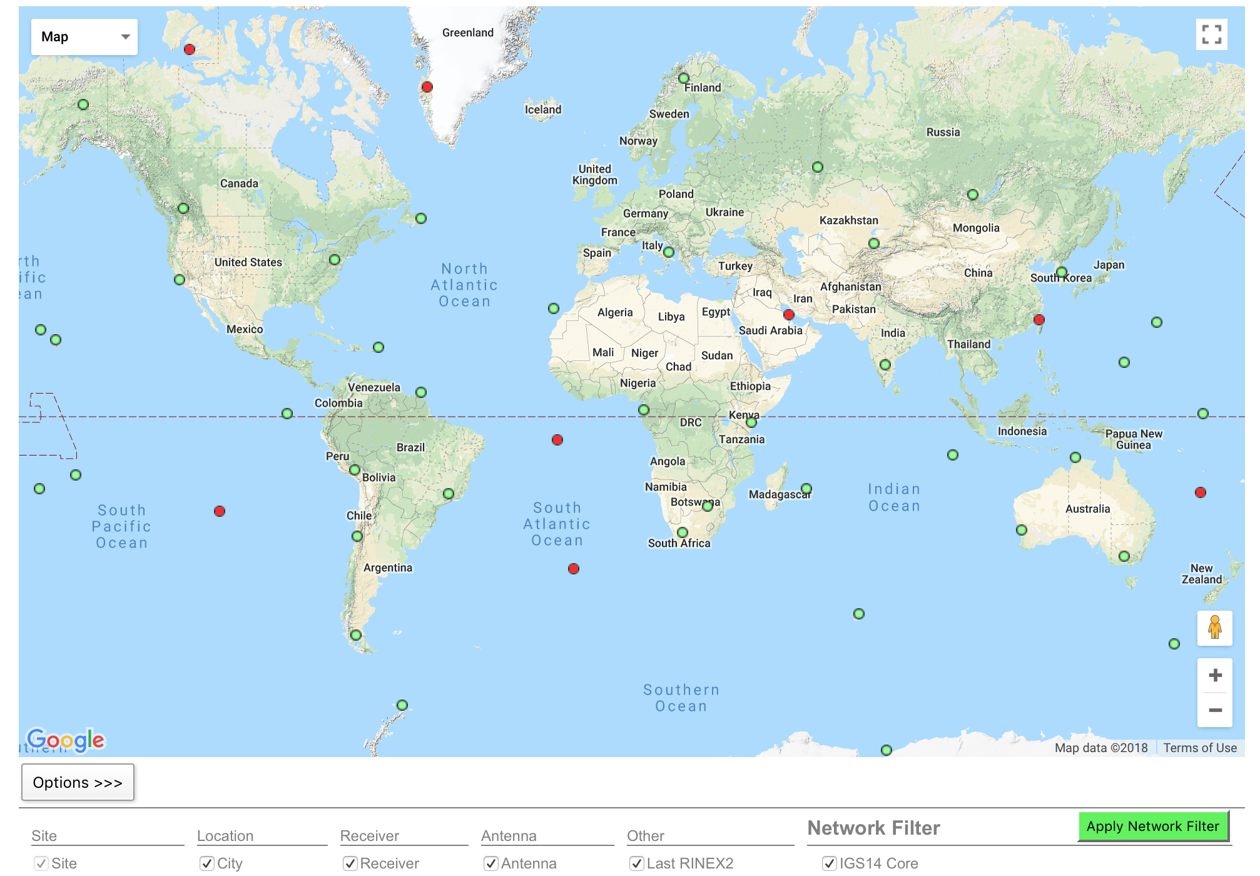
IGS (IGS14) reference frame core network
DRAO
GOLD
GUAT
KOKB
MDO1
MKEA
NLIB
PETP
SCH2
SCUB
STJO
USNO
WHIT
http://www.igs.org/network Select IGS14 Core
Notes:
When selecting sites to process with your local data of interest, look first to include sites from the IGS core network.

Slide 22
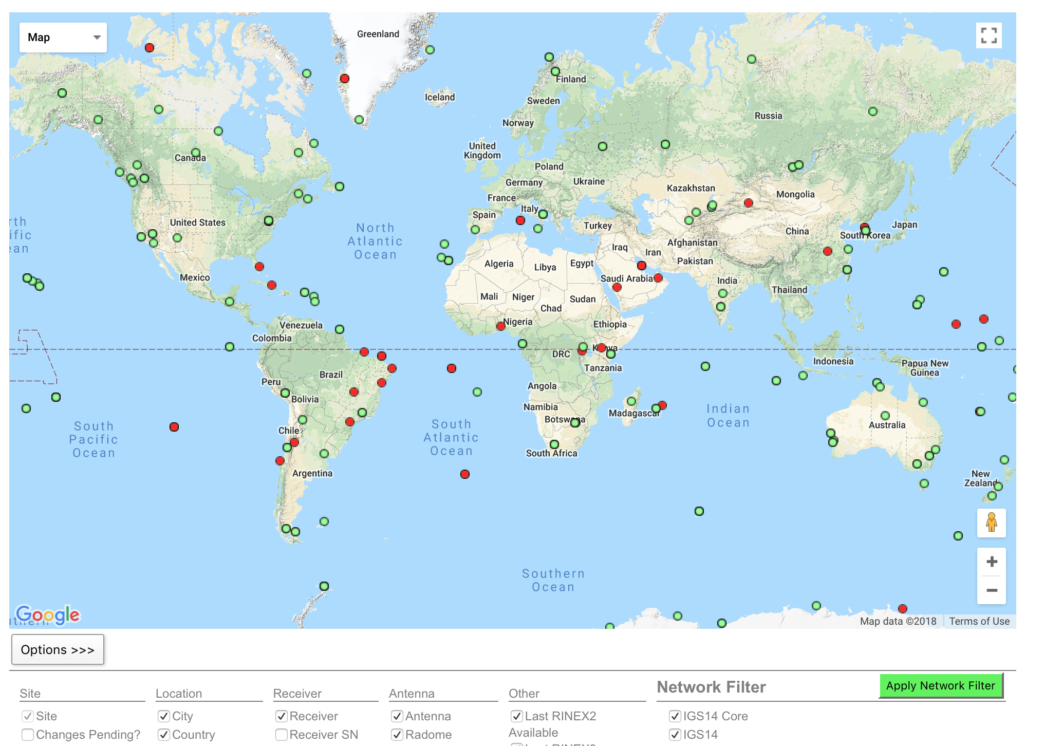
IGS (IGS14) reference frame network
Notes:
If the IGS core network sites are not available, too sparse or do not exist at the epoch of your measurements, try densifying your stabilizing network with all the IGS reference frame sites (the IGS core network is a sub-set of this).

Slide 23
Reference frame implementation
The main point of reference frame definition is to use sites with well known coordinates to stabilize your processed network
  If your processed network already contains sites with known accurate coordinates, e.g. in ~/gg/tables/igb14_comb.apr, then there is no need to add additional sites to your processing
  Your “stab_site” list in glorg command file should be guided by and closely associated with the contents of an accurate .apr-file, e.g. igb14_comb.apr by default but could be any accurate .apr-file you choose include in globk and glorg command files
    ~/gg/tables/igb14_hierarchy.stab_site relates to ~/gg/tables/igb14_comb.apr
Decide early in your processing whether or not you will need to include additional, e.g. IGS, sites in your GAMIT processing to use ultimately to realize your preferred reference frame
  The first decision you must make (choosing sites to process) is greatly influenced by the ultimate processing step (reference frame realization)!

Slide 24
Rules for stabilization of time series
Small-extent network: translation-only in glorg, must constrain EOP in globk
Large-extent network: translation and rotation, must keep EOP loose in globk
If scale estimated in glorg, must estimate scale in globk
First pass for editing:
  Adequate “stab_site” list of stations with accurate a priori coordinates and velocities and available most days
  Keep in mind deficiencies in the list
Final pass for presentation, assessment and statistics
  Robust “stab_site” list of all/most stations in network, with coordinates and velocities determined from the final velocity solution
System is often iterated (velocity field solution, generate time series, editing and statistics of time series; re-generate velocity field)
If you have time series, you can test options using tscon
Notes:
Tscon takes the same commands as glorg but works with time series rather than full covariance matrixes and is therefore very fast.
Here’s a summary guide to maintaining a robust stabilization.

Slide 25
Issues with estimating scale
Many GNSS analyses, automatically include scale when aligning reference frames
  Since the Earth is almost spherical, scale changes are directly proportional to the average height difference between the reference site coordinates and their a priori values
When comparing and analyzing height changes, how scale is treated directly effects the results
  Aspects of this issue are discussed in a white paper that is available from the GAGE analysis documentation at UNAVCO and in Herring et al. (2016)
Scale estimates are related the mean height differences over the reference sites
  Should this be removed or not is an open question

Slide 26
More subtle issues: Important if studying regional and continental height changes
If regional/continental scale networks, there are high correlations between all the sites in the network especially when heights are down weighted in the frame realization (cnd_hgtv).
Adding stations from a global solution can help considerably. Only stations in the regional network that are in the global solution are needed (i.e., no increase in the number of stations processed). The best global solution to use are from SINEX files.
To show the impact, the next slide looks at GNSS solutions using 98 stations from the NOTA network in Alaska and the Western United States. About 3 months of data is processed and the MIT SINEX files from CDDIS are used the global solution.

Slide 27
Impact of scale and of adding global network
Median WRMS scatters of position residuals: G-GPS, E-Galileo, R-Glonass. SNX: 4 sites from MIT IGS SNX file included.
 | No Scale Estimated |  |  |  | Scale Estimated
Solution | N | E | U |  | N | E | U
 | (mm) | (mm) | (mm) |  | (mm) | (mm) | (mm)
MIT_G | 0.74 | 0.79 | 5.11 |  | 0.75 | 0.80 | 3.11
MIT_GE | 0.72 | 0.78 | 4.87 |  | 0.72 | 0.79 | 3.04
MIT_GRE | 0.69 | 0.80 | 4.89 |  | 0.70 | 0.81 | 2.96
SNX_G | 0.72 | 0.78 | 4.54 |  | 0.72 | 0.77 | 3.15
SNX_GRE | 0.69 | 0.78 | 4.54 |  | 0.69 | 0.81 | 2.92
Notes:
Because heights are down weighted in frame realization, estimating scale has little effect on NE scatter. Adding GNSS improves height RMS as does adding SNX covariances.

Slide 28
Velocities and time series
The criteria for stabilization are different for velocity solutions and time series
Velocity solutions:
  Physical reference is important
  Not so sensitive to station dropout (solution holds the frame together)
Time series:
  Physical reference is not important
  Sensitive to station dropout
  Best representation of the statistics of the velocity solution is stabilization using ALL the well-determined sites from the velocity solution, now in a common frame
Notes:
When defining the frame in the velocity solution, the important thing is usually to visualize motion a way most useful for interpretation. Even if there is little or no redundancy in the stabilization site set, you’ve still got a consistent frame because you are estimating only one set of frame parameters. There will be no distortion of internal strain.
When defining the frame for a time series, you have to work to be sure that it’s being done consistently for each epoch.
In the next few slides, we’lll look at examples, first for velocity, then for time series.

Slide 29
Referencing to a horizontal block (“plate”)
Applied in glorg
First stabilize in the usual way with respect to a reference set of coordinates and velocities (e.g. ITRF-NNR), then define one or more “rigid” blocks
  apr_file igb14_comb.apr
  pos_org xtran ytran ztran xrot yrot zrot
  stab_site algo pie1 nlib drao gold sni1 mkea chat
  cnd_hgtv 10 10 0.8 3.
  plate noam algo pie1 nlib
  plate pcfc sni1 mkea chat
After stabilization, glorg will estimate a rotation rate vector (“Euler pole”) for each plate with respect to the frame of the full stabilization set and print the relative poles between each set of plates
Use sh_org2vel to extract the velocities of all sites with respect to each plate
Notes:
Assign_plate assigns sites to plate but they are not used in estimation.

Slide 30
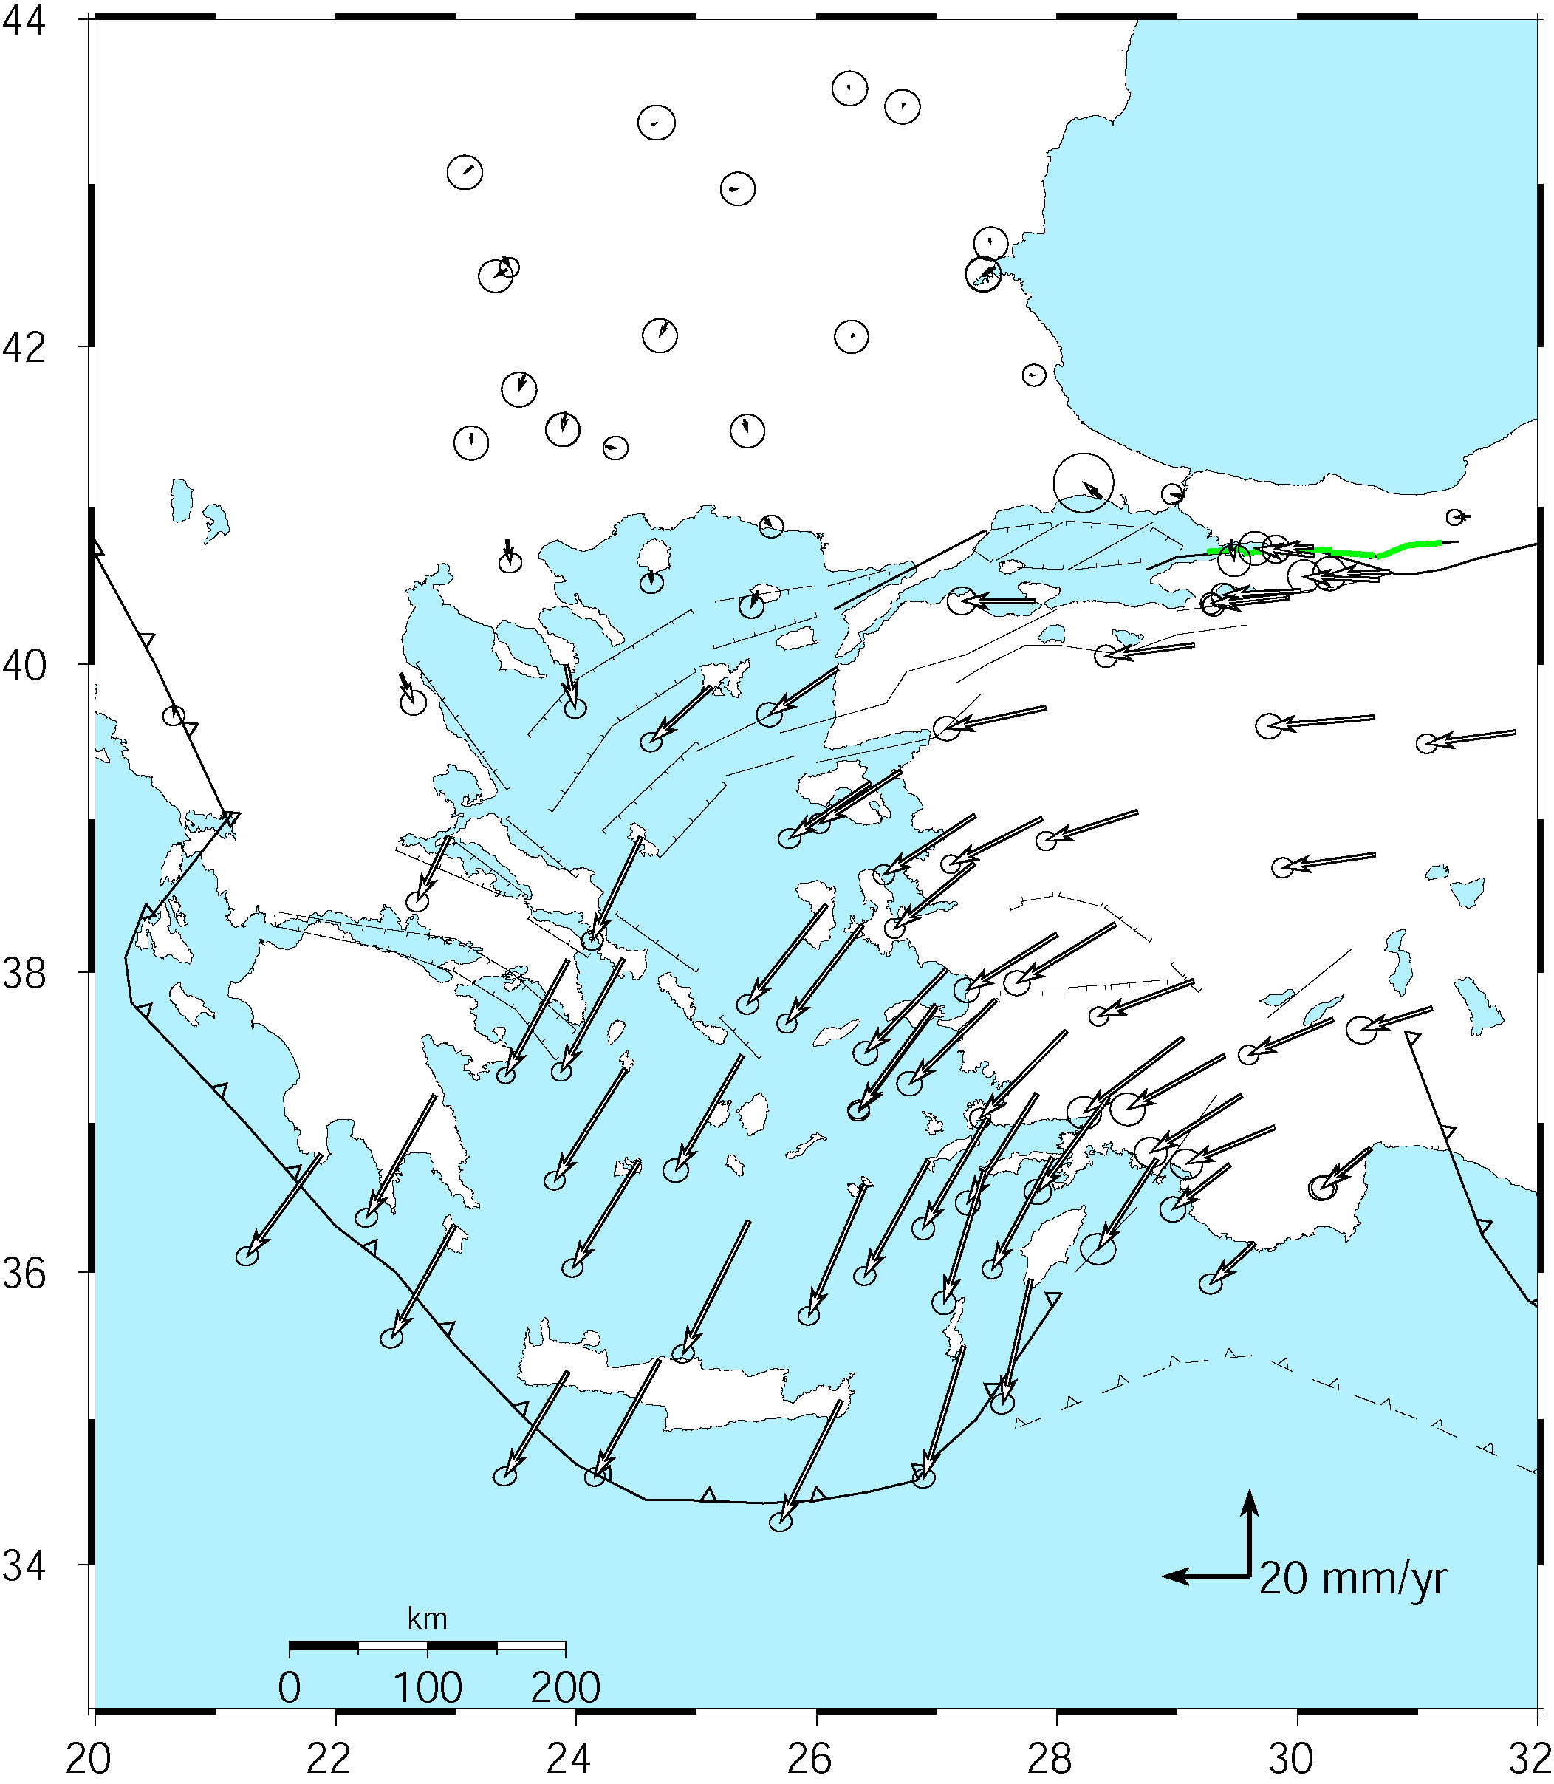
Example:
Velocities of Anatolia and the Aegean in a Eurasia reference frame
Realized by minimizing the velocities of 12 sites over the whole of Eurasia
McClusky et al. (2000)
Notes:
First let’s look at an example of representation of velocity-solution stabilization for visualization and interpretation.

Slide 31
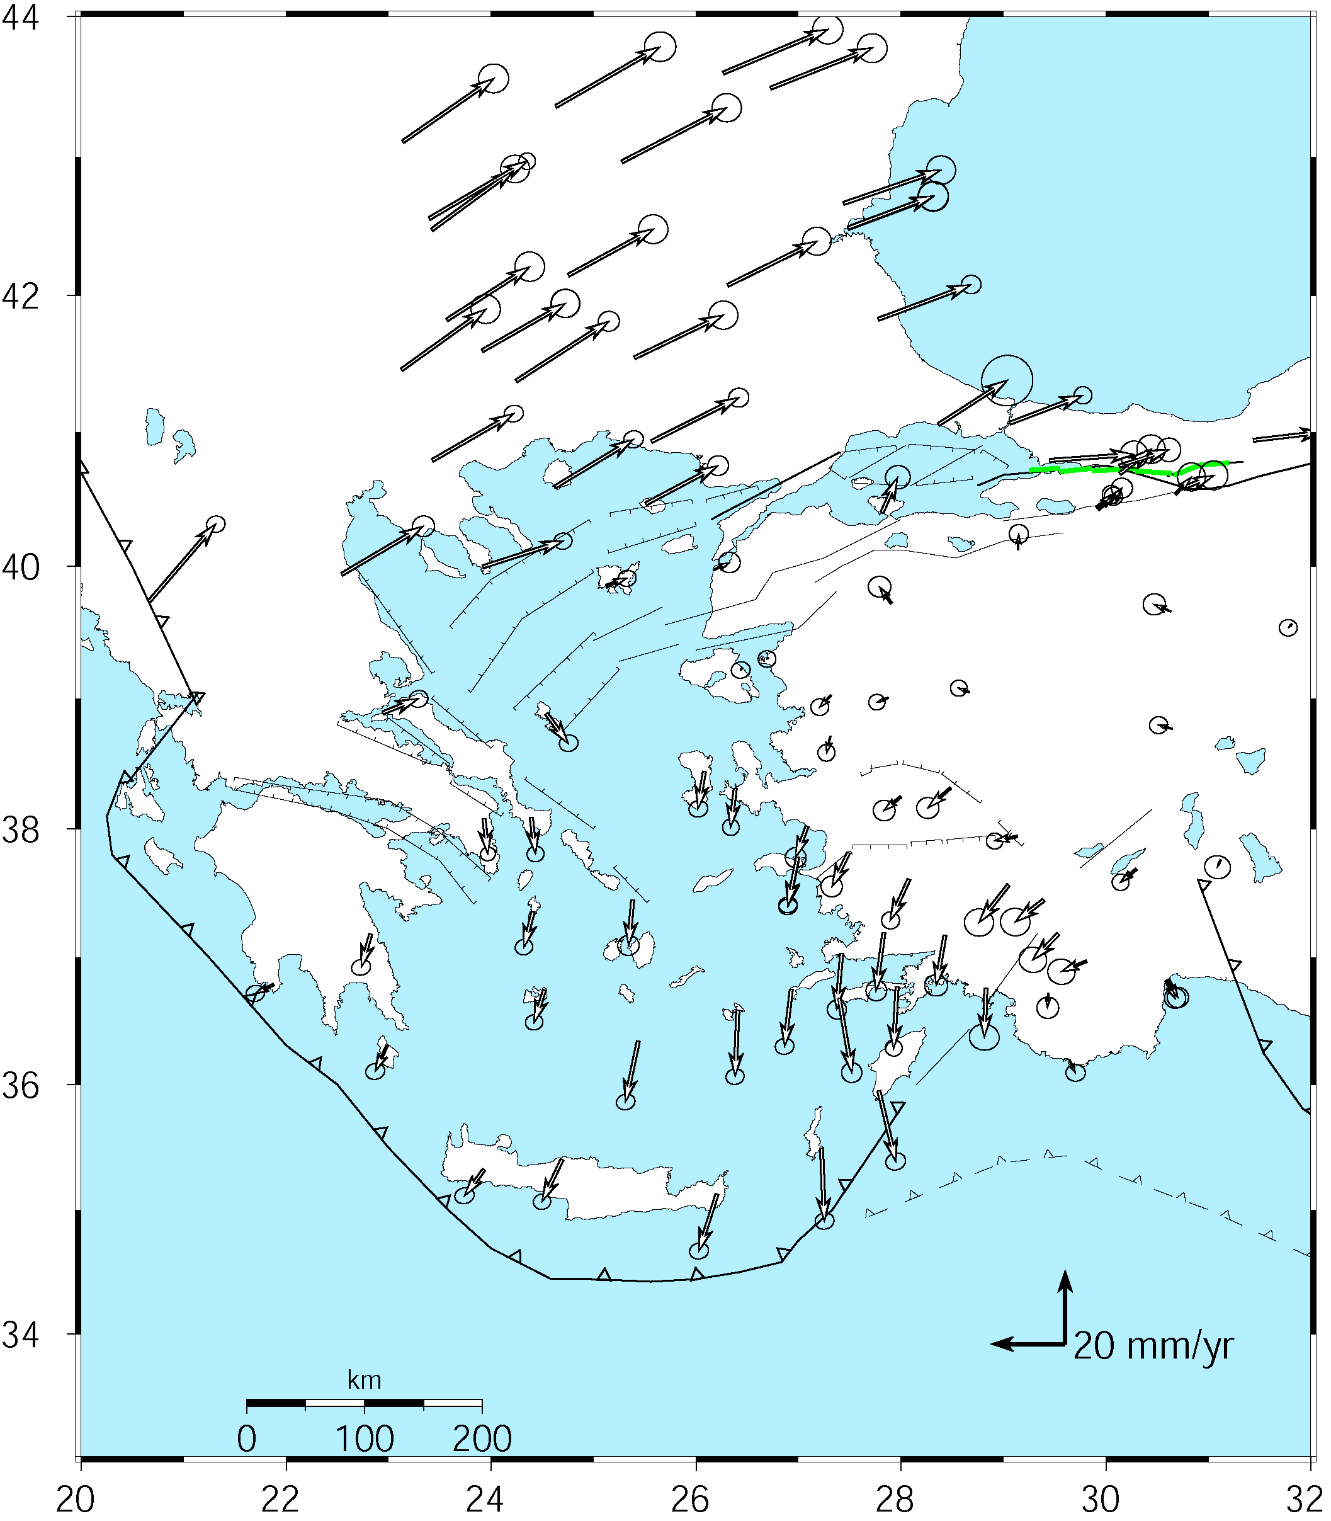
Velocities in an Anatolian reference frame
Better visualization of Anatolian and Aegean deformation
Here stations in Western/Central are used to align the reference frame (a priori velocity set to zero)
McClusky et al. (2000)
Notes:
Note that the major velocity gradients are still present: right-lateral shear across the North Anatolia fault and extension into the Aegean Sea, left-lateral shear and dilation around Rhodes.

Slide 32
Final Thoughts
Reference frames need to be carefully considered when results are to be displayed to best highlight the results you want to convey.
In glorg: The a priori coordinate and velocity file can be changed to generate results in the desired reference frame provide the original globk analysis had loose constraints (e.g., velocity sigma ± 1 m/yr)
Reference frames can be defined with the standard plates (e.g, EURA_I14, program plate lists all plates) or you can define your own plate using the plate command in glorg and sh_org2vel
In many cases for local networks, the reference frame can be defined by zero velocities at a set of local sites
These are the decisions that you need to make. Look in the literature to see how other groups have done this.
Notes:
Re-mention the Aegean case to show you see different things in different frames,

