Slide 1



GAMIT/GLOBK In A Day
M. Floyd and T. Herring
Massachusetts Institute of Technology
GAGE/SAGE 2023 Community Science Workshop
Pre-Workshop Short Course
26 March 2023
http://geoweb.mit.edu/gg/courses/202303_GAGE-SAGE/
Material from R. W. King, T. A. Herring, M. A. Floyd (MIT) and S. C. McClusky (now at ANU)

Slide 2
What is GAMIT/GLOBK?

Slide 3
What is GAMIT/GLOBK?
GAMIT/GLOBK is a suite of software to reduce GNSS phase and pseudorange (raw) data to geophysical quantities such as positions, velocities and other geodetic parameters
  GAMIT is the collection of programs that processes the phase and pseudorange data to generate a network solution vector and associated loosely constrained covariance matrix
  GLOBK is the collection of programs that manipulates and combines phase-and-pseudorange solutions, not just from GAMIT processing, to calculate final positions, velocities and other geophysical parameters
  The two packages of programs are distributed together as “GAMIT/GLOBK”
GAMIT/GLOBK is command-line software that is written mostly in Fortran, with some C, and a lot of shell scripts with which users interact to operate the main programs
  It is not graphical user interface (GUI) software within windows, with clicks and drag-and-drop functionality

Slide 4
Structure
Scripts that control GAMIT and GLOBK, and most programs, have a built-in help page which can be viewed by entering the command name only
  ~/gg/com/ contains all of the scripts used
  ~/gg/gamit/bin/ and ~/gg/kf/bin/ contain the program executables
  (gg is a link in your home directory that points to the directory with the GAMIT/GLOBK software installed and should not be removed)
Once the software is installed, user selects data to be processed over some interval of time and uses sh_gamit for batch processing
GLOBK is used after the daily processing to combine results and set the reference frame

Slide 5
Basic stages of GAMIT/GLOBK for geoscience
Third-party programs
runpkr00
teqc
etc.
model (model observations)
autcln (cleans data)
solve (solve for parameters)
Data collection and archiving (field)
Raw (RINEX) data processing (GAMIT)
Time series and velocity generation (GLOBK)
RINEX
files
ASCII
h-files
glred (time series)
globk (velocities)

Slide 6
Basic inputs and outputs
RINEX data must be prepared or downloaded for input to GAMIT
Output from GAMIT are plain text (ASCII) “h”-files
  Loosely constrained network solutions with a priori parameter information, parameters adjustments and full covariance matrices
Input to GLOBK is binary version of h-files (or equivalent formats)
  Convert from ASCII to binary h-files using htoglb (or “-opt H” option in sh_glred)
Final output of GLOBK is “.org”-file, which contains all information for
  Time series (“.pos”-files)
  and/or
  Velocities (“.vel”-files)

Slide 7
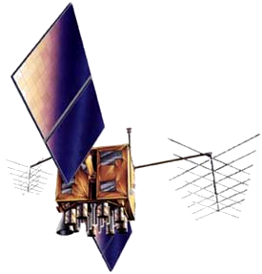
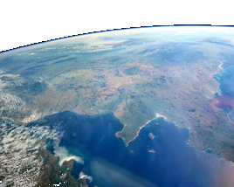
How does GAMIT work?
(not)
Pseudorange (“code”) measurements
for instantaneous positioning
Receiver-generated
T
t
Satellite-received
T
T+t
~ 20,200 km
T+t
Notes:
Code modulated onto two L-band (approximately microwave) carrier frequencies. Code sent from satellite and generated in receiver at time T. Signal received at time T+t. Difference is travel time, t.

Slide 8
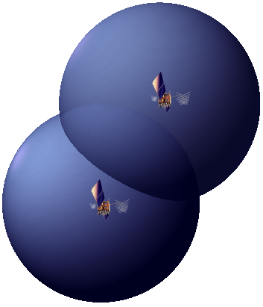
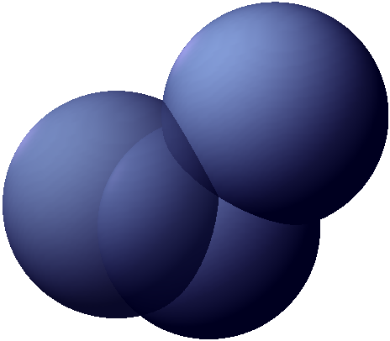
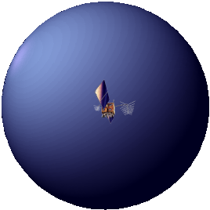
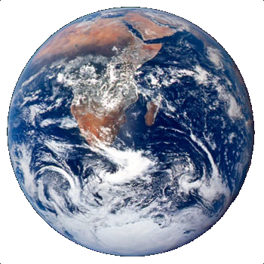
How does GAMIT work?
(not)
But…
t is travel time (as measured by clocks in the satellite and receiver), which is subject to error between these clocks.
So…
We need a minimum of four satellites in order to solve for an additional unknown, the clock bias.
Pseudorange (“code”) measurements
for instantaneous positioning
R
z (0°E, 90°N)
R
R_{REC}
R_{SAT}
R_{REC}
y (90°E, 0°N)
R = │ R_{sat} – R_{rec} │
R = c[(T+t) – T] = ct
x (0°E, 0°N)
(ct_{sati–rec})² = (x_{sati} – x_{rec})² + (y_{sati} – y_{rec})² + (z_{sati} – z_{rec})²
Notes:
Geocentric (Earth-centred) co-ordinate system. Vector defining satellite position (“known”), vector defining receiver position (unknown), and vector defining signal path (observable). One satellite broadcasting signal allows us to fix receiver position on a sphere, two for on a circle, three for one of two points (one of which will be unrealistic).

Slide 9
How does GAMIT (actually) work?
Precise positioning uses tracked carrier phase measurements
High-precision positioning uses the phase observations, not pseudorange (“code”)
  Theoretical phase is modeled to build an “observed-minus-calculated” system of equations to solve ultimately for a single position per session (normally 24-hour days)
Long-session static tracking of change in phase over time carries most of the information
The shorter the span the more important ambiguity resolution is
Each satellite (and station) has a different signature
Notes:
Rather than use the pseudorange, which can be measured only at the cm-to-decimeter level, we do precise positioning with the phase measurements, which can be measured at the mm-level. Since phase is ambiguous, at least initially, we rely on its change over time to reveal the signature of an error in station or satellite position. If there are enough measurements of enough satellites over enough time, these can be inverted to estimate relative positions of all the stations and the atmospheric delay. With a tracking session of ~8 hours, you can get sub-cm estimates even without resolving the two-pi ambiguity in phase. Resolving the ambiguities is more critical for the component of the baseline that is represented by the level rather than the rate-of-change of the phase. For all but high-latitude stations, this weaker component is east-west.

Slide 10
What do we need to know to process data?
Positions of the broadcasting satellites over time
  Provided by various analysis centers and combined by the International GNSS Service (IGS)
Relationship between the satellite orbits above and Earth’s orientation below (i.e. exactly where the pole of rotation is and how fast the Earth is spinning)
  Provided by the International Earth Rotation Service (IERS) and the US Naval Observatory (USNO)
Transient perturbations of the Earth’s surface
  Provided by loading estimates from ocean tides, atmosphere
Characteristics of the broadcast signal delay through the atmosphere
  Provided by “mapping functions”, e.g. Vienna Mapping Function tables
Receiver and antenna used, and signal-tracking behavior of the equipment
  Former provided by the user; latter provided by various calibration centers and combined by the IGS or National Geodetic Survey (NGS)
Approximate positions of the sites
  Provided by previous knowledge (e.g. in GAMIT/GLOBK’s tables) or the user

Slide 11
GNSS available in GAMIT/GLOBK
As of GAMIT/GLOBK release 10.70 (2018-06-13), all Global Navigation Satellite Systems (GNSSs) may be processed:
  GPS (USA), BeiDou (China), Galileo (Europe), IRNSS (India), GLONASS (Russia), QZSS (Japan)
GNSS data must be processed separately for each system in GAMIT, i.e. one cannot process GPS data and Galileo data simultaneously

Slide 12
How does GLOBK work?
Reads network solution vector and associated covariance matrix information from phase-and-pseudorange processing
Combines many such solutions from the same day and/or over time into one using a Kalman filter
Produces time series and/or velocities as well as accompanying parameters such as offsets at discontinuities (e.g. due to equipment changes or geophysical events like earthquakes)

Slide 13
What do we need to know to produce a solution?
Phase-and-pseudorange solutions we want to use
  Provided and defined by the user
Reference frame we want to use for the results
  Provided and defined by the user or standard terrestrial reference frame definitions

Slide 14
GNSS in GLOBK
GLOBK should work in the normal manner with either “BASELINE” (fixed orbits) or “RELAX.” (estimated orbits) mode
  Processing in ”RELAX.” mode allows the orbits to be fixed later in GLOBK, which will generate a solution equivalent to “BASELINE” mode processing
Satellite naming scheme has changed to accommodate GNSS (htoglb lists)
  The default in GLOBK processing is currently to retain the GPS names as PRN_xx (see globk.hlp and USE_PRNN command)
See GLOBK lectures, including those on creating time series using glred and combination or velocity solutions using globk

Slide 15
Summary
GAMIT and GLOBK are partner programs designed around one another’s formats
GAMIT processes the raw phase and pseudorange data broadcast by GNSS satellites and recorded by station receivers
  Precise geodetic-grade solutions are achieved by phase tracking, not instantaneous pseudorange positioning like a satnav or smartphone
GLOBK combines, and, for some parameters, corrects the results of the GAMIT processing to produce geophysically meaningful quantities like position time series, velocities and displacements at discontinuities such as earthquakes
Multi-GNSS solutions are processed separately in GAMIT and combined in GLOBK

