Slide 1



GAMIT/GLOBK In A Day
M. Floyd and T. Herring
Massachusetts Institute of Technology
GAGE/SAGE 2023 Community Science Workshop
Pre-Workshop Short Course
26 March 2023
http://geoweb.mit.edu/gg/courses/202303_GAGE-SAGE/
Material from R. W. King, T. A. Herring, M. A. Floyd (MIT) and S. C. McClusky (now at ANU)

Slide 2
Installation

Slide 3
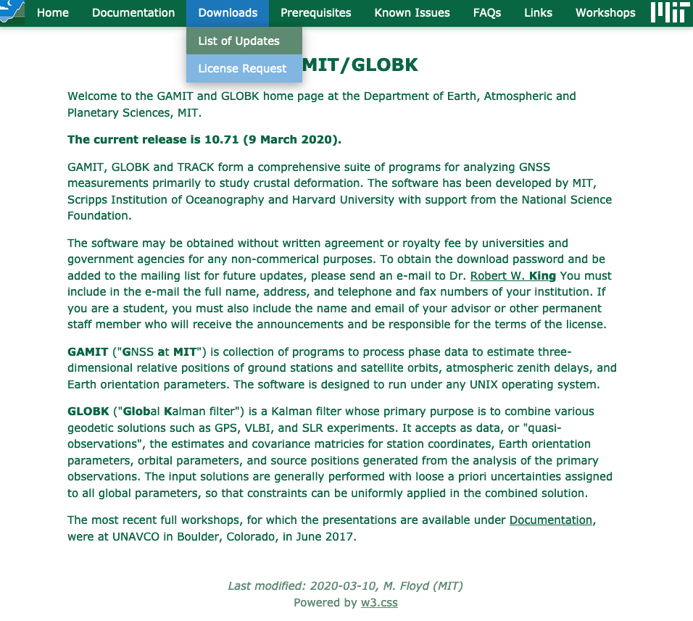
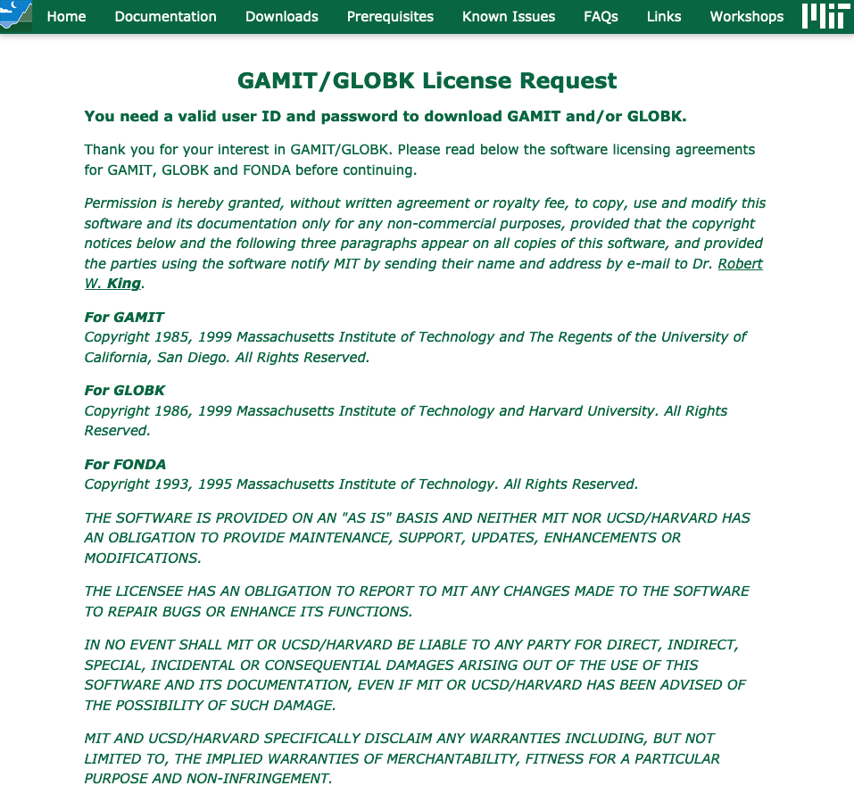
Apply for a license
http://geoweb.mit.edu/gg/
http://geoweb.mit.edu/gg/license.php

Slide 4
License form

Slide 5
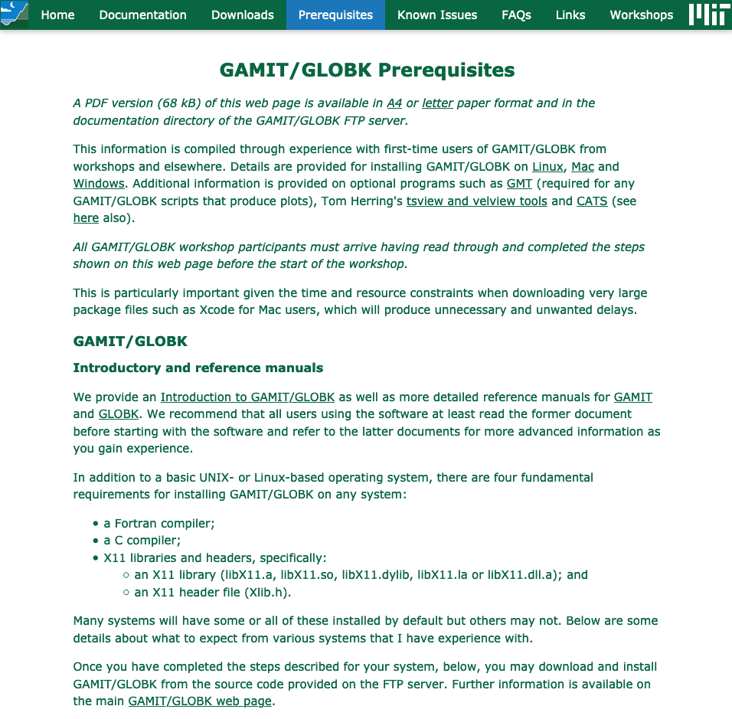
Understand and install the prerequisites
http://geoweb.mit.edu/gg/pre.php
A Fortran compiler (e.g. gfortran)
A C compiler (e.g. gcc or clang)
X11 libraries and header files
Generic Mapping Tools (GMT)
Linux:
Mac:
  Xcode or Command Line Tools for Xcode from the Apple Developer (for C compiler and command line programs in general for Terminal)
    From Terminal: xcode-select --install
  gfortran (e.g. https://gcc.gnu.org/wiki/GFortranBinaries#MacOS)
  XQuartz (https://www.xquartz.org/)
Windows:
  Use Windows Subsystem for Linux (WSL) for Windows 10 and follow instructions for Linux
    Ubuntu 16.04, Ubuntu 18.04, Debian 9, openSUSE 15.1 and openSUSE 43.1 Linux shells available for free
  Use a virtual machine (e.g. https://www.vmware.com/ or https://www.virtualbox.org/), or Cygwin (https://www.cygwin.com/) for other versions of Windows

Slide 6
Read the notes
http://geoweb.mit.edu/gg/docs/GG_Quick_Start_Guide.pdf
A brief guide to installation steps and prerequisites described here
https://chandler.mit.edu/gps/...:
README
  General overview of the GAMIT/GLOBK software, including details of prerequisites and installation
source/relnote.<NN.nn>
  Specific details of the latest release (<NN.nn> is currently 10.71)

Slide 7
Preparation
We recommend you separate tasks into three separate directories:
  Source code directory (to keep a local copy of the source code files; optional)
  Installation directory (to compile and install the source code)
  Processing directory (to process without overwriting files in the installation
  directory)
Make a main installation directory of your choice on the command line
  We highly recommend using a separate directory for each release of GAMIT; do not mix source code from different versions, e.g. (“maf” is the username)
    On Mac, /Users/maf/Applications/gg/10.71/
    On Linux, /home/maf/Programs/gg/10.71/

Slide 8
Source code directory
Users may wish to keep a local copy of source code
  As backup in case of problems during installation
  If unable to reconnect to the source code repository (https://chandler.mit.edu/gps/)
If you wish to do this, keep it separate from where you intend to install GAMIT/GLOBK, e.g.
  ~/src/gg/10.71
  ~/Applications/src/gg/10.71

Slide 9
Download source code
Log in to https://chandler.mit.edu/gps/ using the username and password provided with the license
Download at least these required files
  libraries.10.71.tar.gz (common subroutines)
  gamit.10.71.tar.gz (GAMIT source code)
  kf.10.71.tar.gz (GLOBK source code)
  com.10.71.tar.gz (scripts to run the software from the command line)
  tables.10.71.tar.gz (metadata and other definitions and information)
  help.10.71.tar.gz (program help pages)
  incremental_updates.*.tar.gz (all updates to date for the current release version)
Additional files (optional)
  com_preGMT5.10.71.tar.gz (scripts using syntax prior to GMT 5; no longer supported)
  maps.10.71.tar.gz (used with sh_plotvel and velview; not necessary for most users)
  test_install.10.71.tar.gz (instructions and output files for comparison to test installation)
  relnote.10.71 (release notes for version 10.71)
Copy these files into your main installation directory if downloaded to a source code directory

Slide 10
Compilation
From the main installation directory
  Either extract install_software from com.10.71.tar.gz and run it:
    tar xfzv com.10.71.tar.gz com/install_software
    com/install_software
  Or download install_software from https://chandler.mit.edu/gps/, make it executable and run it:
    chmod +x install_software
    ./install_software

Slide 11
Compilation
Read the output and answer the questions appropriately
install_software will first extract the source code from all the tar-files
You are then quite likely to need to stop the installation process to edit libraries/Makefile.config according to your operating system, e.g.
  X11LIBPATH (path to libX11)
  X11INCPATH (path to Xlib.h)
  MAXSIT (maximum number of sites to process simultaneously; must be < 100)
  MAXSAT (do not change)
  MAXATM (maximum atmospheric estimates per session)
  MAXEPC (maximum epochs per session, e.g. 24 hours at 30 s interval = 2880 measurement epochs)
  OS block (usually no need to change but see next slide)

Slide 12
Compilation: version of gfortran
Run gfortran --version
If your gfortran version is greater than or equal to 10, then you will need to include the --fallow-argument-mismatch option with FFLAGS in libraries/Makefile.config and gamit/solve/Makefile.generic
Unfortunately this option is not even recognized by gfortran version 9 and below, which causes an error if you try to include it, so you must not include this option with FFLAGS in libraries/Makefile.config and gamit/solve/Makefile.generic

Slide 13
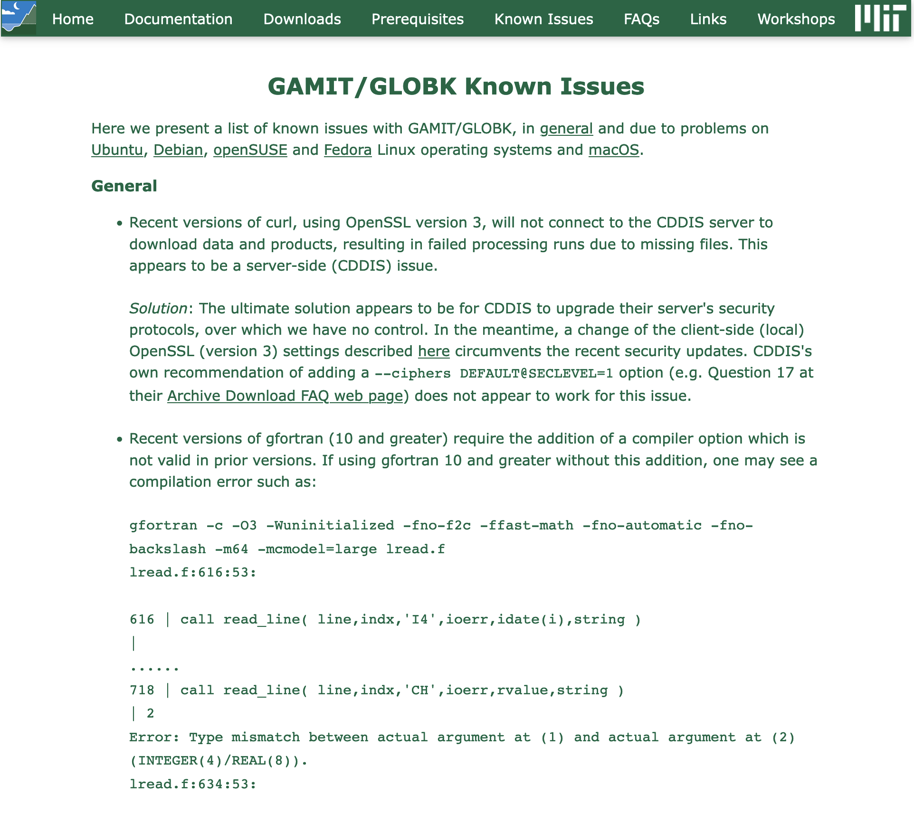
Compilation: version of gfortran

Slide 14
Setting the environment
At the end of the installation you will see instructions such as:
Don't forget to set your : PATH to include /Users/maf/Applications/gg/10.71/com,
/Users/maf/Applications/gg/10.71/gamit/bin and
/Users/maf/Applications/gg/10.71/kf/bin;
: HELP_DIR environment variable in your shell profile; and
: INSTITUTE evnironment variable in your shell profile
For example, if using sh or bash ("echo $SHELL" = /bin/sh or /bin/bash),
add the following lines to ~/.bashrc (or ~/.bash_profile on Mac):
PATH="/Users/maf/Applications/gg/10.71/com:/Users/maf/Applications/gg/10.71/gamit/bin:/Users/maf/Applications/gg/10.71/kf/bin:$PATH"; export PATH
HELP_DIR="/Users/maf/Applications/gg/10.71/help"; export HELP_DIR
Or, if using csh or tcsh ("echo $SHELL" = /bin/csh or /bin/tcsh),
add the following lines to ~/.cshrc:
setenv PATH "/Users/maf/Applications/gg/10.71/com:/Users/maf/Applications/gg/10.71/gamit/bin:/Users/maf/Applications/gg/10.71/kf/bin:$PATH”
setenv HELP_DIR "/Users/maf/Applications/gg/10.71/help"

Slide 15
For sh/bash users
Check your shell type
  echo $SHELL
  returns “/bin/bash”
Edit your ~/.bashrc, ~/.bash_profile or ~/.profile file
  PATH="/Users/maf/Applications/gg/10.71/com:/Users/maf/Applications/gg/10.71/gamit/bin:/Users/maf/Applications/gg/10.71/kf/bin:$PATH"; export PATH
  HELP_DIR="/Users/maf/Applications/gg/10.71/help"; export HELP_DIR

Slide 16
For csh/tcsh users
Check your shell type
  echo $SHELL
  returns “/bin/csh” or “/bin/tcsh”
Edit your environment variables
  setenv PATH "/Users/maf/Applications/gg/10.71/com:/Users/maf/Applications/gg/10.71/gamit/bin:/Users/maf/Applications/gg/10.71/kf/bin:$PATH”
  setenv HELP_DIR "/Users/maf/Applications/gg/10.71/help"

Slide 17
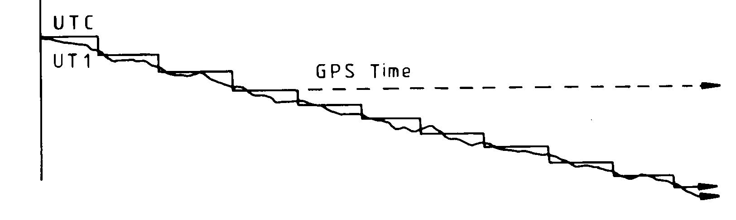
Updates!
Incremental updates are made available on the first day of every month, so please check at least
  Earth orientation parameters (pole.* and ut1.*; or sh_update_eop)
  SVN-PRN translation tables (svnav.dat)
  Differential code biases (dcb.dat)
  Leap seconds (leap.sec)
  Loading grids (ftp://everest.mit.edu/pub/GRIDS/)
Example: 2016-12-31T23:59:60Z leap second

Slide 18
Additional software
Generic Mapping Tools (GMT)
(https://www.generic-mapping-tools.org/)
  Required for plotting scripts to work
  Scripts in com/ use GMT 5+
  Prepend com_preGMT5/ to $PATH if using GMT 4
    These scripts are no longer updated, so switch to GMT 5 or GMT 6!
Tom’s GGMatlab tools
(http://geoweb.mit.edu/~tah/GGMatlab/)
  tsview
  velview

Slide 19
Useful commands

Slide 20
Redirection
The output from one command may be written to a file… (this is useful for us to review if you have a problem or bug to report)
  “>” to overwrite an existing file
  “>>” to append to an existing file
  sort [file] > [sorted file]
…or “piped” to another command, effectively forming the second command’s input
  “|”
  grep ‘^ .* P$’ [file] | sort > [grep’d and sorted file]

Slide 21
Shorthands
Top-level (“root”) directory = “/”, e.g.
  cd /
Your home directory = “~” or “$HOME”, e.g.
  ls ~
“Links” or “shortcuts” may be created, e.g.
  ln -s /home/user/gg/10.71 ~/gg
This creates a link in the user’s home directory called “gg” that points to the directory /home/user/gg/10.71
  Rather than “cd /home/user/gg/10.71”, one can get to the same place simply with “cd ~/gg”
  (This is used in GAMIT/GLOBK scripts and must remain in place!)

Slide 22
Checking processes and disk space
Processing sometimes fails, e.g. due to lack of available disk space, or stalls, e.g. due to a runaway process, which can be checked with the following:
du
  Disk usage: useful if you want to know how much space your (or others’!) directories are taking up
df
  Disk free space: useful if you want to know how much disk space is used and free
top
  Table Of Processes: useful if you want a real-time overview of processes that are running
ps
  List processes: useful if you want to see what processes are running and their process numbers, commands, etc.

Slide 23
What is a script?
Scripts contain a series of commands written in one file and prepended by a “hash-bang”
  #!/bin/sh for original Bourne Shell (usually the same as bash on modern systems)
  #!/bin/bash for Bourne Again Shell
  #!/bin/csh for C Shell (usually the same as tcsh on modern systems)
  #!/bin/tcsh for TENEX C Shell
The script may then be executed to run all of the commands in sequence as written
Most scripts in GAMIT/GLOBK are written in csh or tcsh; many newer scripts are written in bash
  Must have both csh and tcsh installed to run GAMIT/GLOBK scripts
  bash usually installed by default on current Linux distributions

Slide 24
Script example
#!/bin/bash
printf ‘The ISO date is: ’
date +’%Y-%m-%dT%H:%M:%S%Z’
printf ‘The mean of all numbers between 1 and 10 is: ’
printf ‘1 10\n’ | awk ‘BEGIN {sum=0; n=0}; {for (i=$1; i<=$2; i++) {sum=sum+i; n++}}; END {print sum/n}’
printf ‘Goodbye!\n’
(Some lines above are wrapped, and be careful with power point converting – to en-dash and ‘ to a fancy quote)

