Slide 1
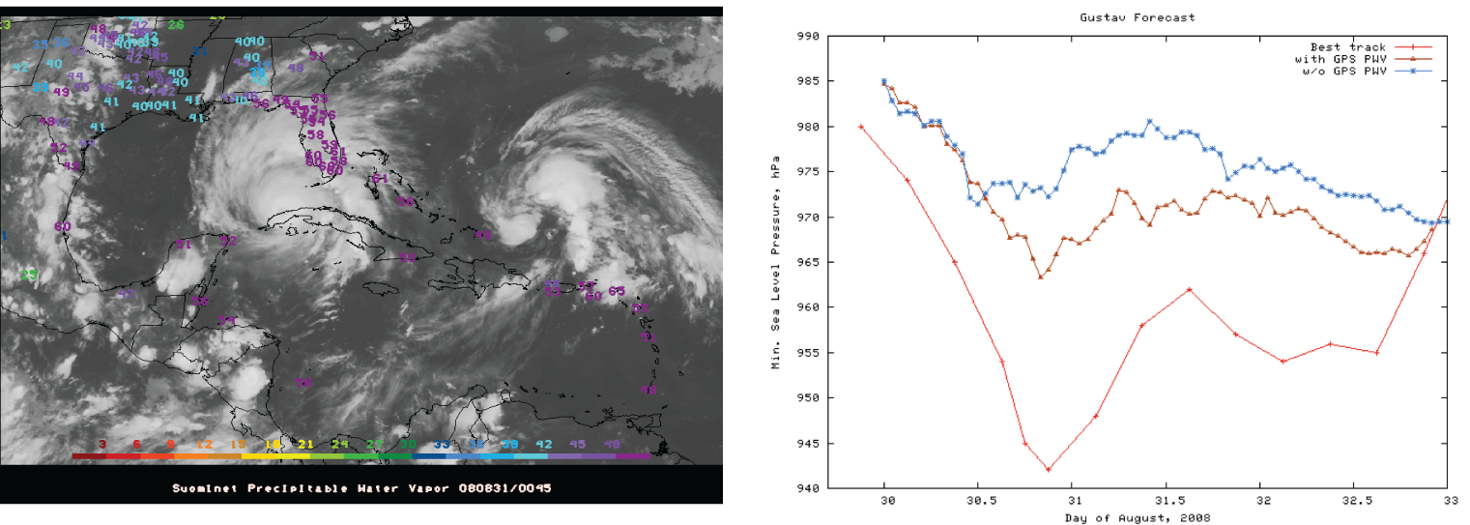
Estimating Atmospheric Water Vapor with Ground-based GPS
Lecture 12

Slide 2
Overview
This lecture covers metrological applications of GPS
Some of the material has already been presented and is shown here for completeness.
There are two major contributions of the atmosphere:
  Neutral atmospheric delay composed of hydrostatic component (N₂, O₂, CO₂, trace gases and part of the water vapor contribution) and water vapor component
  Ionospheric delay component due to free electrons. This component is frequency dependent and can be estimated from dual frequency measurements (L1 and L2 frequencies)

Slide 3
Atmospheric Delays
Ionosphere
Troposphere
  Ionosphere (use dual frequency receivers)
  Troposphere (estimate troposphere)
Notes:
3
Ionosphere is a layer of the atmosphere filled with charged particles that delay the signal from the satellite to the receiver.
With short baselines, less than ten kilometers, the effect are almost equal, and will be canceled out of the solution.

Slide 4
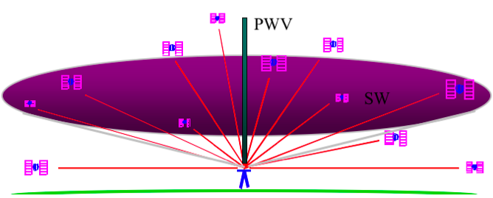
Sensing the Atmosphere with Ground-based GPS
The signal from each GPS satellite is delayed by an amount dependent on the pressure and humidity and its elevation above the horizon. We invert the measurements to estimate the average delay at the zenith (green bar).
( Figure courtesy of COSMIC Program )

Slide 5
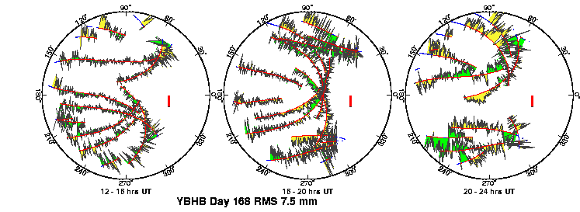
Multipath and Water Vapor Effects in the Observations
One-way (undifferenced) LC phase residuals projected onto the sky in 4-hr snapshots. Spatially repeatable noise is multipath; time-varying noise is water vapor.
Red is satellite track. Yellow and green positive and negative residuals purely for visual effect.
Red bar is scale (10 mm).
Notes:
Now we’ve taken the phase vs time residuals and projected them onto the sky. Same 12-hr period for the same stations on two successive days. North to the right!! This is the pattern you see on the sky at mid-latitudes and shows a mixture of N-S and E-W motion, with N-S dominating. At the equator, all the satellites move nearly N-S on the sky, and at the poles more E-W. The dominant motion determines whether the N-S or E-W component of the station position is better determined. You see again the largest fluctuations at low elevation angles, and much of this noise repeats from day to day—signal multipathing. Where you see differences, as near 90 degrees between 20-24 hours, the likely cause is water vapor.

Slide 6
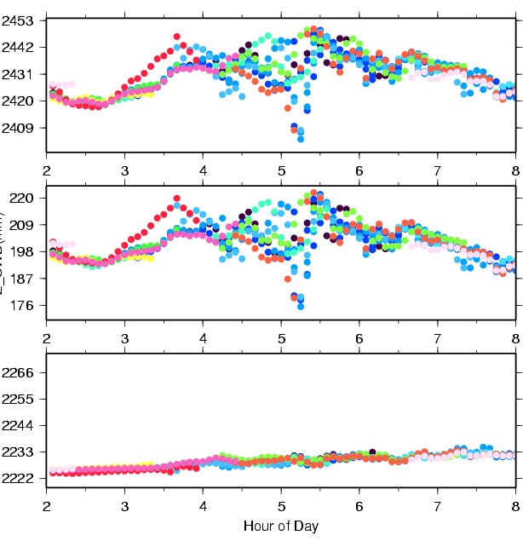
Sensing the Atmosphere with Ground-based GPS
Colors are for different satellites
Total delay is ~2.5 meters
Variability mostly caused by wet component.
Wet delay is ~0.2 meters
Obtained by subtracting the hydrostatic (dry) delay.
Hydrostatic delay is ~2.2 meters; little variability between satellites or over time; well calibrated by surface pressure.
Plot courtesy of J. Braun, UCAR
Notes:
The three figures on the left show time series of ZHD (bottom), ZWD (middle), and ZTD (top) simulated from a MM5 3-km model simulation of a squall line. The

Slide 7
Effect of the Neutral Atmosphere on GPS Measurements
Slant delay = (Zenith Hydrostatic Delay) * (“Dry” Mapping Function) +
(Zenith Wet Delay) * (Wet Mapping Function) +
(Gradient Delay NS) ( Gradient Mapping Function) * Cos/Sin(Azimuth)
  To recover the water vapor (ZWD) for meteorological studies, you must have a very accurate measure of the hydrostatic delay (ZHD) from a barometer at the site.
  For height studies, a less accurate model for the ZHD is acceptable, but still important because the wet and dry mapping functions are different (see next slides)
  The mapping functions used can also be important for low elevation angles
  For both a priori ZHD and mapping functions, you have a choice in GAMIT of using values computed at 6-hr intervals from numerical weather models (VMF1 grids) or an analytical fit to 20-years of VMF1 values, GPT and GMF (defaults)

Slide 8
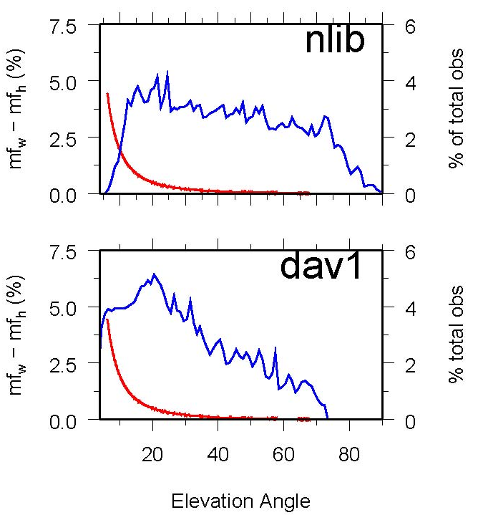
Mapping function effects
Mapping functions differ and this means hydrostatic and wet delays are coupled in the estimation.
Example: Percent difference (red) between hydrostatic and wet mapping functions for a high latitude (dav1) and mid-latitude site (nlib). Blue shows percentage of observations at each elevation angle. From Tregoning and Herring [2006].
Notes:
Problem is that the distribution of satellites on sky for different latitudes creates a bias in height estimates.

Slide 9
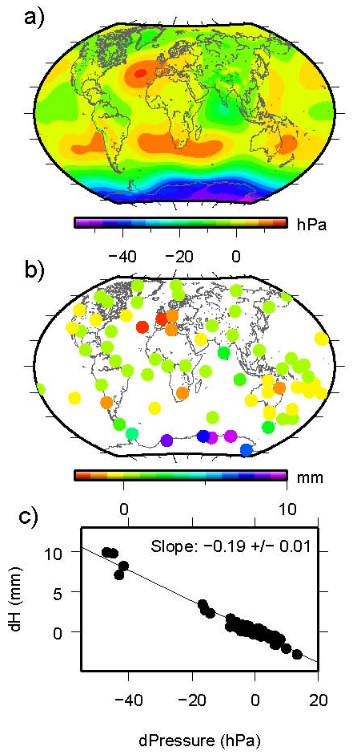
Effect of surface pressure errors
a) surface pressure derived from “standard” sea level pressure and the mean surface pressure derived from the GPT model.
b) station heights using the two sources of a priori pressure.
c) Relation between a priori pressure differences and height differences. Elevation-dependent weighting was used in the GPS analysis with a minimum elevation angle of 7 deg.

Slide 10
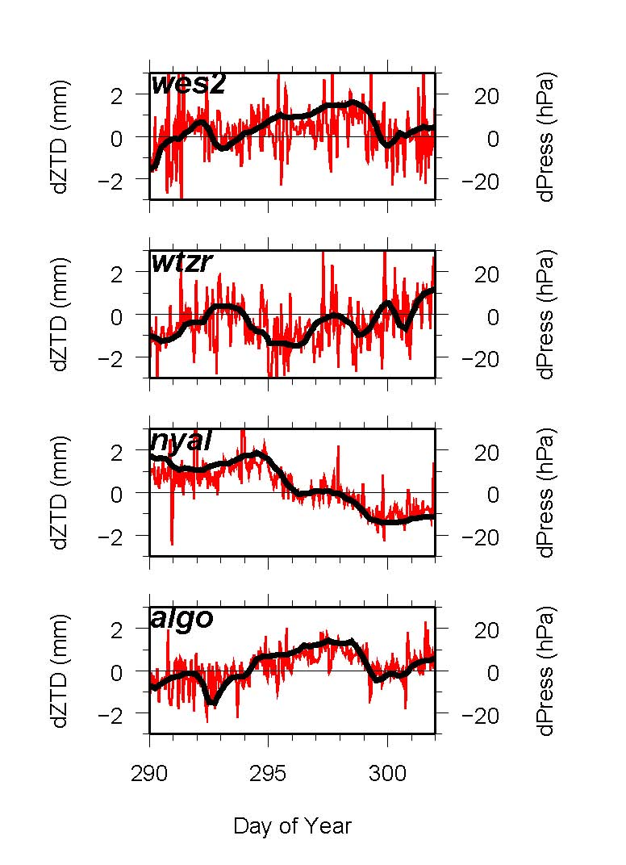
Short-period Variations in Surface Pressure not Modeled by GPT
Differences in GPS estimates of ZTD at Algonquin, Ny Alessund, Wettzell and Westford computed using static or observed surface pressure to derive the a priori. Height differences will be about twice as large. (Elevation-dependent weighting used).
Notes:
10-day span of ZD estimates from GAMIT at 4 stations, showing…
DIFFERENCES in ZTD (red) vs differences (ERROR) in pressure (black)
NOTE high correlation.

Slide 11
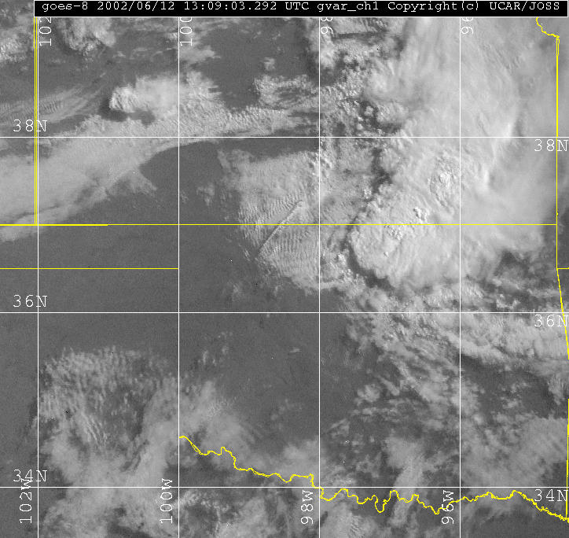
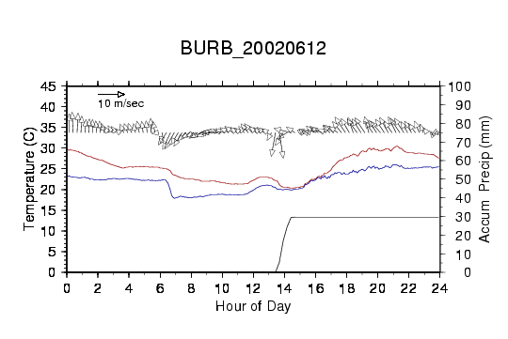
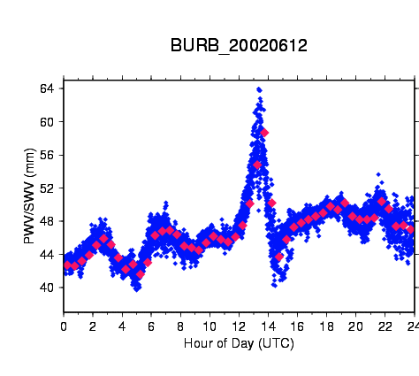
Example of GPS Water Vapor Time Series
GOES IR satellite image of central US on left with location of GPS station shown as red star.
Time series of temperature, dew point, wind speed, and accumulated rain shown in top right. GPS PW is shown in bottom right. Increase in PW of more than 20mm due to convective system shown in satellite image.
Notes:
GOES 8 image at 1309 UTC and GPS PW/SW for station BURB

Slide 12
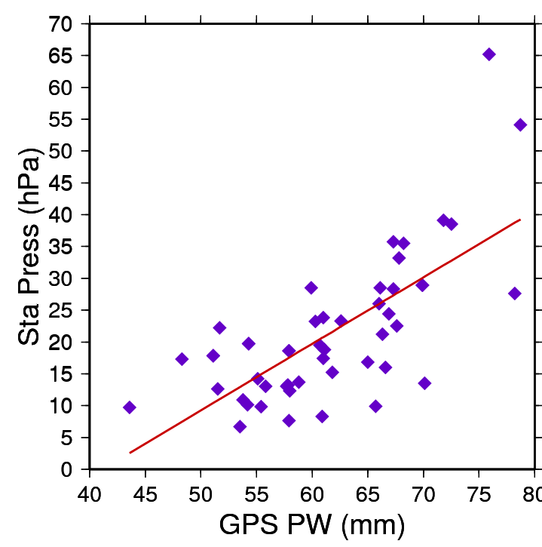
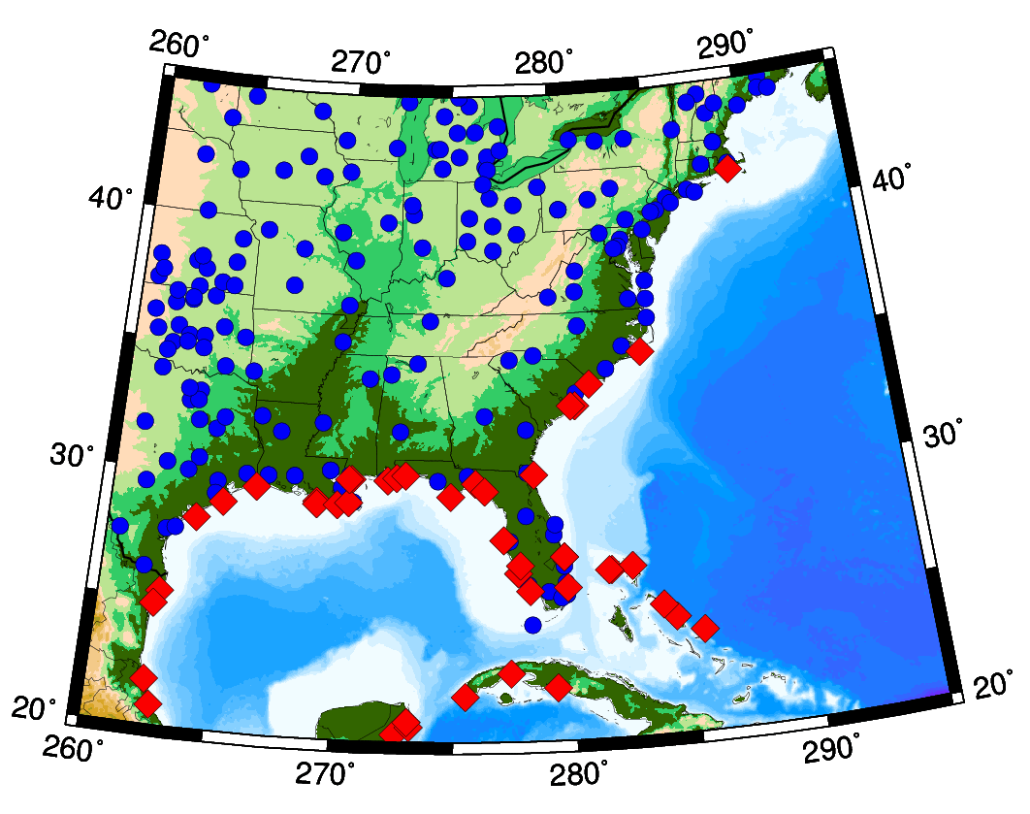
Water Vapor as a Proxy for Pressure in Storm Prediction
GPS stations (blue) and locations of hurricane landfalls
Correlation (75%) between GPS-measured precipitable water and drop in surface pressure for stations within 200 km of landfall.
J.Braun, UCAR
Notes:
12
The map on the lower left shows Suominet GPS stations (in blue), and locations of hurricane landfall from 2003-2005. The scatterplot on the upper right shows the correlation between GPS PW and drop in surface pressure (1013 - Surf_Press) for stations within 200km of hurricane landfall. The correlation between PW and surface pressure is -0.71. This high correlation is a positive sign that GPS PW can be used to improve intensity forecasts.

Slide 13
GAMIT Meteorological Apps.
For gamit meteorological applications the zenith delays and gradient estimates are of most interest.
In general, we find at least two gradient parameters per day (i.e., a linear change over 24-hrs) should be used for good station coordinate estimates.
For atmospheric delay estimates, one strategy is to tightly constrains coordinates in gamit (based on very good coordinates). One potential problem here, is loading effects can change the coordinates and thus possible alias into atmospheric delay estimates.
The sh_metutil is a script that will generate water estimates from gamit o-files is there is a source of pressure data (gamit z-file or rinex met file).

Slide 14
Ionospheric delay estimates
GAMIT uses a dual frequency combination to eliminate the ionospheric delay (to first order) from the data observable.
There are no utilities in gamit to estimate ionospheric delay robustly.
The one-way phase residual files from autcln could be used but the pseudoranges in gamit are not corrected for P1-P2 biases (because these cancel out in double differences). The C1-P1 bias (differential code biases) are accounted for provide dcb.dat is up to date.
http://aiuws.unibe.ch/ionosphere/p1p2_all.dcb provides P1-P2 bias estimates and these need to be applied to one-way range residuals to obtain resonable estimates of the absolute ionospheric delays.

Slide 15
EXTRA SLIDES on STORMS

Slide 16
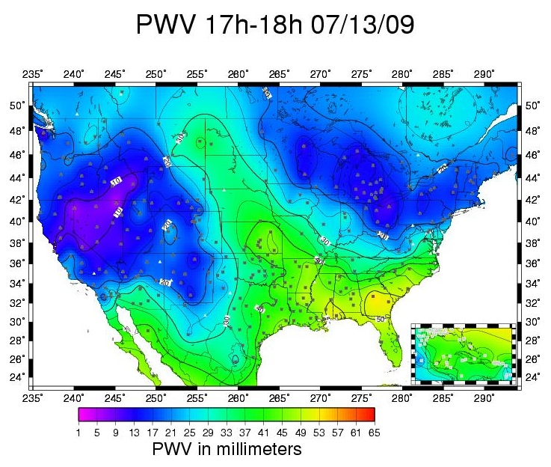
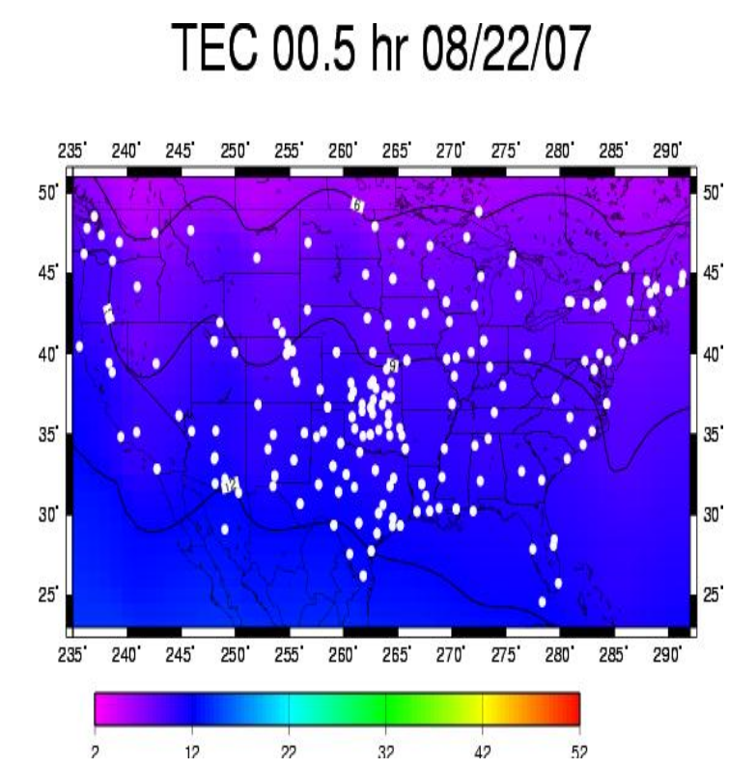
Influence of the Atmosphere
Atmospheric and Ionospheric Effects
Precipitable Water Vapor (PWV) derived from GPS signal delays
Assimilation of PW into weather models improves forecasting for storm intensity
Total electron count (TEC) in Ionosphere
16

Slide 17
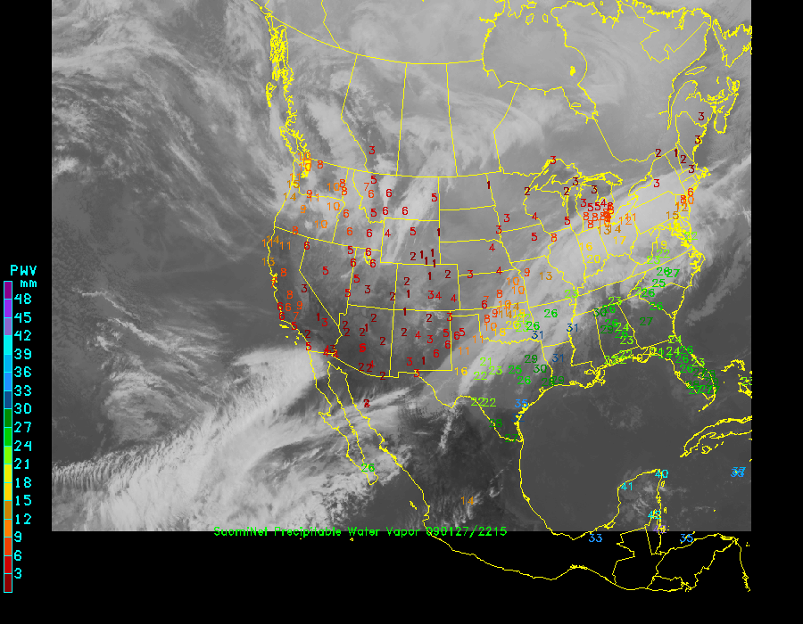
Suominet – PBO Stations
80 Plate Boundary Observatory (PBO) sites now included in analysis.
These sites significantly improve moisture observations in western US.
Should be useful for spring/summer precipitation studies.
Network routine exceeds 300 stations.
Notes:
Beginning in December of 2008, we have started including data from approximately 80 Plate Boundary Observatory (PBO) stations in the western United States. These stations significantly improve the characterization of moisture in the west, and should be useful in the study of summer precipitation events and the development and evolution of the North American Monsoon.

Slide 18
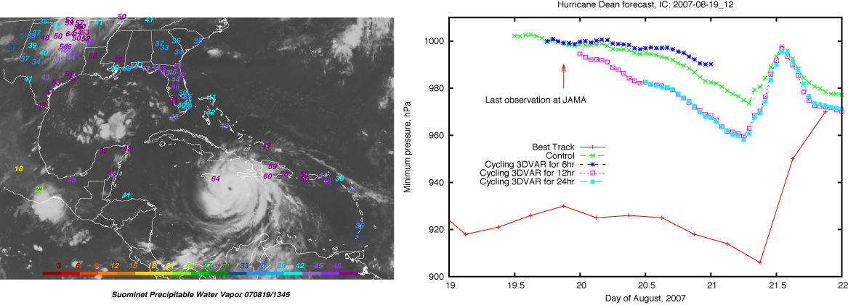
Impact of GPS PW on Hurricane Intensity
Dean - 2007
Gustav - 2008
Notes:
The network of GPS stations in the Caribbean has successfully be used to improve hurricane intensity forecasts.
Assimilation of GPS PW into a WRF forecast of hurricanes Dean (2007) and Gustav (2008) show a positive impact
on the forecast of minimum surface pressure of these two storms. The impact of GPS PW is 10-20 hPa.
Data assimilation done by Dr. Ted Iwabuchi.

